Slide 1
EARLY DETECTION OF BRAIN DAMAGED CHILD
BY: DHWANI CHANPURA
Dr. Dhwani Chanpura

Slide 2
PURPOSE
Every Assessment should end with “diagnosis”.
This diagnosis should be related to the findings of the assessment
Diagnoses should be related to Treatment Recommendations.

Slide 3
Developmental diagnosis can be done in three stages:
1. Antenatal Diagnosis
2.Natal Diagnosis
3.Postnatal Diagnosis

Slide 4
Antenatal diagnosis:
Blood tests
Maternal serum screening
Ultrasound scanning
Chorionic villus sampling
Amniocentesis
Fetoscopy

Slide 5
1. Blood tests
Blood tests are used too detect,
a) Hemoglobin levels
b) Presence of sexually transmitted disese
c) Blood group
d) Blood sugar
e) Hemoglobinopathies

Slide 6
a) Hemoglobin levels:
May be a slight decrease, which is normal during pregnancy, because of increased blood plasma volume
Treatment: Dietary supplements, Folic acid tablets
b) Sexually transmitted disease:
HIV examination should be recommended as part of routine prenatal examination.
The transmission from mother to child can be reduced by –
Effective drug medication during pregnancy,
Delivery by caesarian section
Avoiding breast feeding
VDRL slide is used to test syphili
Pregnant woman should be routinely screened for Hepatitis B

Slide 7
c) Blood glucose:
Increase in blood glucose indicates presence of diabetes.
d) Blood group:
The woman’s blood grouping will be determined as well her Rhesus status.
  Treatment: Rhesus negative state is identified, prophylactic anti –D injections should be given at 28 & 30 weeks gestation.
e) Hemoglobinopathies:
Tests for hemoglobinopathies eg. Sickle cell disease and thalasemia may be carried out.

Slide 8
2) Maternal serum screening
AFP(alpha fetoprotein) level screening is usually performed by 15-18 weeks of pregnancy.
High levels may indicate – Down syndrome
-- Neural tube defects: spina bifida anencephaly
Multiple pregnancies may also produce high levels.

Slide 9
3) Ultrasound scanning
It is used to measure the nuchal translucency – an area of subcutaneous fluid at the nape of fetal neck. Increased thickness may suggests—
Down syndrome
other chromosomal anomalies
Structural anomalies
It is usually performed between 11 and 14 weeks of pregnancy
It is used to visualize fetal position and fetal movements.

Slide 10
4) Chorionic villus biopsy:
Chorionic villi are fluid like tissue placed near placenta.
It is a technique which is carried out transabdominally.
Fragments of chorionic villi are removed under ultrasound guidance and inspected for genetic fetal abnormality such as down’s syndrome.
It can be detected within 8 weeks of conception.

Slide 11
5) Amniocentesis
It is performed after 15 weeks of gestation
In this test small amount of fluid is withdrawn transabdominally.
Culture of the cells shed by fetus within the fluid is used to give indication of genetic anomaly such as Down’s syndrome.
Fetal sex can also be determined and is useful where there is familial history sex- linked disorders such as →Haemophillia
→DMD

Slide 12
6) Fetoscopy
It is direct visualisation of fetus.
It is done in mid trimester through a small puncture in abdomen.
A fiber optic system is introduced into the uterine cavity to view fetal parts
To detect structural anomalies.

Slide 13
Natal Diagnosis
APGAR score

Slide 14
APGAR score is a quantitative assessment of the neonate’s medical status that is usually performed at 1 and 5 minutes of age and, occasionally, at 10 and 15 minutes of age as well.
A score of eight or more at 1 minute of age means that the baby will not require extensive resuscitation.
A score of zero to two indicates severe asphyxia and may indicate the need for intubation and cardiac massage.
Score of five to seven may indicate a need for less intense resuscitation.

Slide 15
Postnatal Diagnosis
Blood examination
EMG
NCV
Muscle biopsy
ECG
Genetic testing
Lumbar puncture

Slide 16
DIAGNOSTIC PROBLEM
Neurological problems
Orthopaedic problems
Cardiac problems

Slide 17
NEUROLOGICAL PROBLEM
Attention-Deficit Hyperactivity Disorder
Cerebral palsy
Hydrocephalus
Meningitis
Seizure
Spina Bifida

Slide 18
ATTENTION-DEFICIT HYPERACTIVITY DISORDER
Disorder | Diagnosis
Attention-deficit hyperactivity disorder | Hand eye coordination Auditory and visual perception Comprehension, memory, IQ

Slide 19
CEREBRAL PALSY
Disorder | Sign | Diagnosis
Cerebral palsy | Abnormal posturing, Perceptual problems, Language deficits, Intellectual impairment | Primitive reflexes continue Physical signs include poor head control after 3 months of age Feeding difficulties and floppy or limp body posture

Slide 20
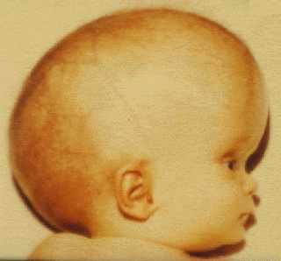
HYDROCEPHALUS
Disorder | Diagnosis
Hydrocephalus | Primary diagnostic tools: CT & MRI Infancy –serial head measurements

Slide 21
MENINGITIS
Disorder | Diagnosis
Meningitis | Blood Cultures Cloudy CSF (Bacterial), high protein, low glucose

Slide 22
SEIZURE
Disorder | Diagnosis
Seizure | Video recording and EEG Complete physical and Neurological exam Lab tests (Metabolic causes) CT & MRI (trauma, tumor, congenital)

Slide 23
SPINA BIFIDA
Disorder | Diagnosis
Spina Bifida | Fetal Ultrasound CT and Myelography after birth

Slide 24
CARDIAC PROBLEMS
PROBLEM | DIAGNOSIS
Atrial septal defect | Right bundle branch block
Ventricular septal defect | Digital chest x – ray , ECG
Coaractation of the aorta | 8 shape figure
Patent Ductus Arteriosus | Digital chest x – ray , ECG
Tetralogy of Fallot | Boot shape heart & Fine nodular formation
Ref : - worldheartfederation.org

Slide 25
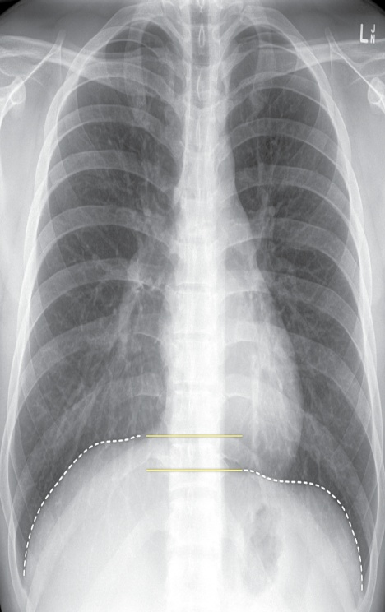
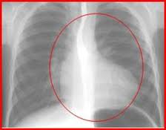
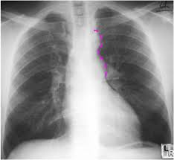

Slide 26
ORTHOPAEDIC PROBLEMS
Area | Problem
Foot | Club Foot
Leg | Genu Varum Genu Varus
Hip | Congenital dislocation of Hip
Spine | Kyphosis Scoliosis

Slide 27
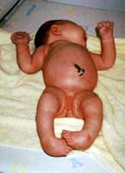
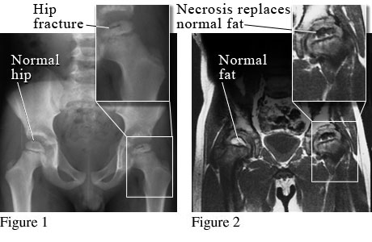

Slide 28
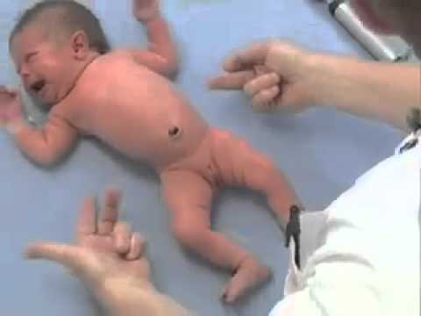
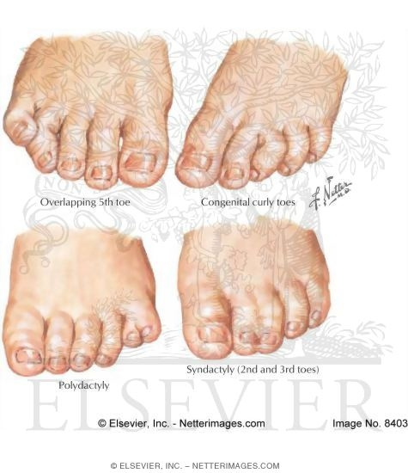

Slide 29
Area | Problem
Neck | Torticollis
Shoulder | Sprengel's deformity
Wrist | Ganglion
Hand and fingers | Polydactyly and syndactyly

