Slide 1
THEORY OF “DEMAND”
Ms. Mital Thakkar
Assistant Professor
Department of Management
SVDU

Slide 2
INTRODUCTION
Demand for a particular commodity refers to the commodity which an individual consumer or household is willing to purchase per unit of time at a particular price.
Demand for a particular commodity implies:
- Desire of the customer to buy the product;
- The customers willingness to buy the product;
- Sufficient purchasing power in the customers possession to buy the product.
The demand for a particular commodity by an individual consumer or household is known as Individual demand for the commodity and Summation of the individual demand is known as the Market demand.
Notes:
Rishabh

Slide 3
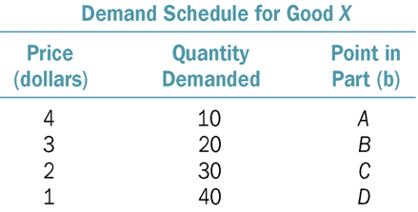
DEMAND SCHEDULE
It shows the price and output relationship.
Tabular representation of price and demand.
Notes:
mintu

Slide 4
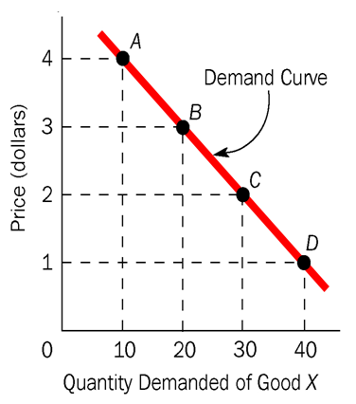
DEMAND CURVE
The geometrical representation of demand schedule is called the demand curve.
Notes:
mintu

Slide 5
LAW OF DEMAND
As the price of a good rises, quantity demanded of that good falls.
As the price of a good falls, quantity demanded of that good rises.
Notes:
Mintu

Slide 6
DEMAND FUNCTION
When we express the relationship between demand and its determinant mathematically, the relationship is known as demand function.
The demand for product X can be written in functional form as-
Dx= f (Px, Y, Po, T, A, Ef, N )
Notes:
Mintu

Slide 7
P= The own price of the product itself
Po (Ps or Pc)= The price of the substitute and complementary goods
Yd= The level of disposable income with the buyers (i.e., income left after direct taxes)
T= Change in buyers’ tastes and preferences
A= The advertisement effect measured through the level of advertising expenditure
N= Changes in population number or the number if the buyers
[Here we assumed commodity X; hence, Dx represents the amount of demanded for the commodity X and Px refers to the price of X. Further, u is incorporated to recognise ‘other’ unspecified/unknown determinants of the demand for commodity X.]

Slide 8
INDIVIDUAL DEMAND
&
MARKET DEMAND
[Schedule]

Slide 9
“Demand curve refers to the graph of a demand schedule, measuring price on the Y-axis and quantity demand on the X-axis. Usually , a demand curve has a downward slope, representing an inverse relationship between price and demand.”

Slide 10
Determinants of Demand
Factors Influencing Individual Demand
  Price
  Income
  Tastes, habits & preferences
  People with different taste and habits have different preferences for different goods
  Relative prices of other goods – substitute and complementary products
  Consumer’s expectation
  Advertisement effect

Slide 11
B. Factors Influencing Market Demand
  Price of the product
  Distribution of income and wealth in the community
  Community’s common habits and scale of preferences
  General standards of living and spending habits of the people
  Number of buyers in the market and the growth of population
  Age structure and sex ratio of the population
  Future expectations
  Level of taxation & tax structure
  Fashions
  Climate & weather conditions
  Customs

Slide 12
Law of Demand
“The higher the price of a commodity, the smaller is the quantity demanded and lower the price, larger the quantity demanded.”
Briefly stated, the law of demand stresses that, other things remaining unchanged, demand varies inversely with price.
The law of demand can be illustrated with the help of a market demand schedule, i.e., as the price of a commodity decreases the corresponding quantity demanded for that commodity increases and vice versa.

Slide 13
Assumptions
No change in consumer’s income
No change in consumer’s preferences
No change in the fashion
No change in the price of related goods
No expectation of future price changes or shortages
No change in size, age composition and sex ratio of the population
No change in the rage of goods available to the consumers
No change in the distribution of income and wealth of the community
No change in government policy
No change in weather conditions

Slide 14
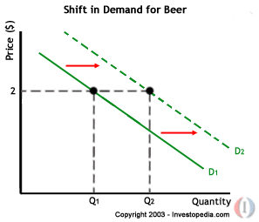
CHANGE IN DEMAND VS. CHANGE IN QUANTITY DEMANDED
A shift of the entire demand curve to a new position is called change in demand.
Changes in non-price determinants of demand.
Notes:
Rishabh

Slide 15
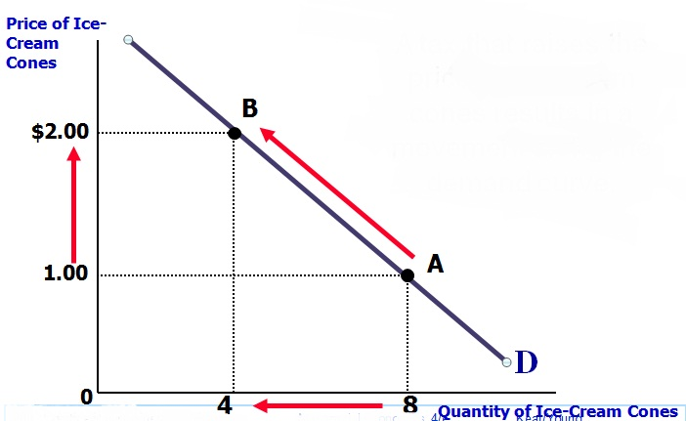
QUANTITY DEMANDED
Fluctuations in price, another determinant of demand, cause movement along the demand curve.
Notes:
Rishabh

Slide 16
“An increase in demand signifies either that more will be demanded at a given price or same will be demanded at a higher price. An increase in demand really means that more is now demanded that before at each and every price.”
“Likewise, a decrease in demand signifies either that less will be demanded at a given price or the same quantity will be demanded at the lower price. Decrease in demand really means that less is now demanded that before at each and every rise in price.”
Shifting the demand curves shows the increase and decrease in demand.

Slide 17
Reasons for change in Demand
Change in income
Change in taste, habits and preferences
Change in fashions and customs
Change in the distribution of wealth
Change in substitutes
Change in demand position of complementary goods
Change in population
Advertisement and publicity persuasion
Change in the level of taxation
Expectation of future change in prices

Slide 18
Why the demand curve slope downwards?
Law of diminishing marginal utility.
Income effect.
Substitution effect.
New consumers.
Multiple use of commodity.
Notes:
rishabh

Slide 19
Types of Demand
Demand for consumer goods and producers goods
Demand for perishable goods and durable goods
Autonomous demand and company demand
Industry demand and long run demand
Short-run demand and Company demand
Joint demand and composite demand
Price demand, Income demand and cross demand

Slide 20
DETERMINANTS OF DEMAND
Price of Product
Income of Consumer
Price of Related Good
Tastes and Preferences
Advertising
Consumer’s expectation of future Income and Price
Growth of Economy
Seasonal conditions
Population
Notes:
anupam

Slide 21
Exceptions to the Law of Demand (Upward sloping Demand Curve)
Giffen goods
Articles of Snob appeal
Speculation
Consumer’s psychological bias or Illusion.

Slide 22
ELASTICITY OF DEMAND
Elasticity of demand is defined as the responsiveness of the quantity of a good to changes in one of the variables on which demand depends-
Price of the commodity
Income of the Consumer
Various other factor
DEFINATION-’’The elasticity of demand measures the response of the demand for the commodity to change in price”.
Notes:
shahbaz

Slide 23
PRICE ELASTICITY OF DEMAND
The price elasticity of demand is the percentage change in quantity demanded divided by the percentage change in price.
Notes:
baba

Slide 24
PRICE ELASTICITY OF DEMAND
Point Definition
Arc Definition
Notes:
baba

Slide 25
Perfectly Elastic Demand: Elasticity Equals Infinity
Price
1. At any price
above $4, quantity
demanded is zero.
$4
Demand
2. At exactly $4,
consumers will
buy any quantity.
0
Quantity
3. At a price below $4,
quantity demanded is infinite.

Slide 26
Perfectly Inelastic Demand: Elasticity Equals 0 city of Demand
Price
Demand
$5
4
1. An
increase
in price . . .
0
100
Quantity
2. . . . leaves the quantity demanded unchanged.
Copyright©2003 Southwestern/Thomson Learning

Slide 27
Elastic Demand: Elasticity Is Greater Than 1
Price
$5
4
Demand
1. A 22%
increase
in price . . .
0
50
100
Quantity
2. . . . leads to a 67% decrease in quantity demanded.

Slide 28
Inelastic Demand: Elasticity Is Less Than 1
Price
$5
4
1. A 22%
Demand
increase
in price . . .
0
90
100
Quantity
2. . . . leads to an 11% decrease in quantity demanded.

Slide 29
Unit Elastic Demand: Elasticity Equals 1
Price
$5
4
1. A 22%
Demand
increase
in price . . .
0
80
100
Quantity
2. . . . leads to a 22% decrease in quantity demanded.
Copyright©2003 Southwestern/Thomson Learning

Slide 30

INCOME ELASTICITY
The degree of responsiveness of the demand for the commodity to a change in the income of the consumer.
It is defined as Ratio of percentage change in the quantity demanded of a commodity to the percentage change in the income of consumer
Notes:
shahbaz

Slide 31
INCOME ELASTICITY
Negative ( inferior commodities )
Zero ( neutral commodities )
Greater than zero but less than 1( normal commodities )
Greater than unity ( Luxurious commodity )

Slide 32
INCOME ELASTICITY
Point Definition
Arc Definition

Slide 33
Cross Elasticity of Demand (CED)
Cross price elasticity (CED) measures the responsiveness of demand for good X following a change in the price of good Y (a related good)
CED = % change in quantity demanded of product A
% change in price of product B
With cross price elasticity we make an important distinction between substitute products and complementary goods and services.
Notes:
deepak

Slide 34
Substitutes
+
Price of Good S
Two Weak Substitutes
Demand
Goods S and T are weak substitutes
A rise in the price of Good S leads to a small rise in the demand for good T
P2
P1
tea and coffee
Quantity demanded of Good T
Notes:
deepak

Slide 35
Complements
-
Price of Good X
Two Close Complements
Demand
Goods X and Y are close complements
A fall in the price of good X leads to a large rise in the demand for good Y
P1
P2
Petrol and petrol car
Quantity demanded of Good Y

Slide 36
Goods with zero cross-price elasticity of demand . INDEPENDENT
Price of Good A
Demand
Goods A and B have no relationship.
A fall in the price of good A leads to no change in the demand for good B
Therefore the cross-price elasticity of demand is zero
P1
P2
P3
salt!
Quantity demanded of Good B

Slide 37


