Slide 1

RADIATION MODALITIES
Dr. Kavita Gupta
Dept. Of Prosthodontics
K.M shah Dental college

Slide 2
Objective
End of lesson you will be able to know the basics about radiation modalities

Slide 3
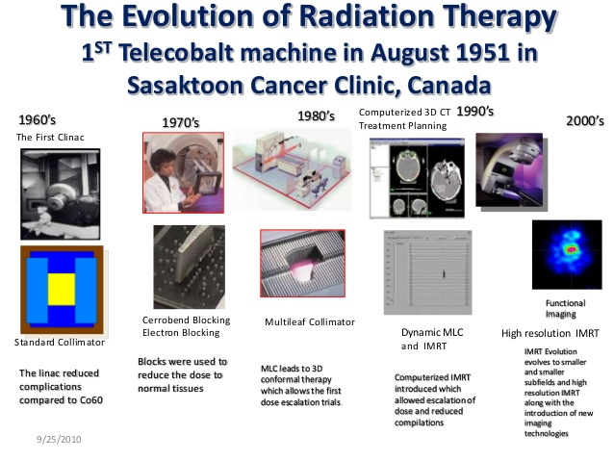
CONFORMAL RADIO THERAPY
Pt is seated with the shield and on the area of interest a wire is kept and x-ray is done.
This xray will tell that the area is completely covered or not
If yes then the same area is marked with pen on patients skin
The rectangular high dose volume of radiation is converted into desired size and shape with the help of acrylic block which is converted into metal (cerrobond) later
This metal block is kept at the head of the machine, this will block the extra radiations

Slide 4
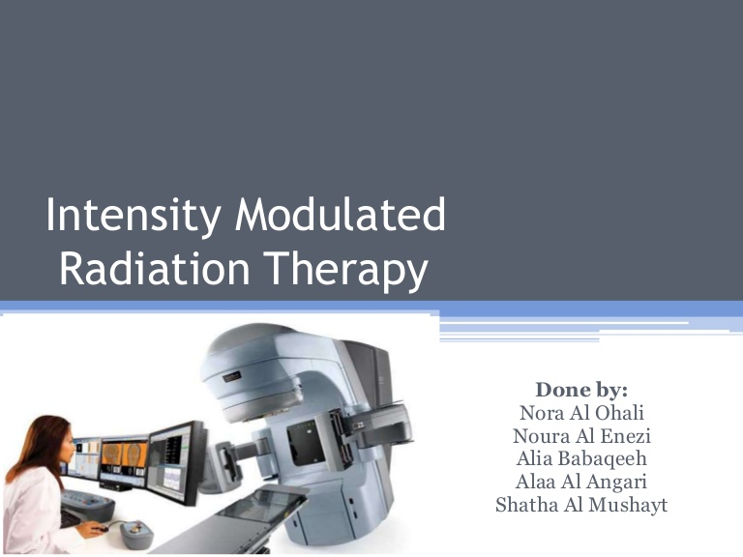
INTENSITY MODULATED RADIATION THERAPY
IMRT aims to deliver radiation more precisely to the tumor and while relatively limiting dose to surrounding normal tissues
IMRT produces highly conformal dose distributions in the target
In IMRT the doses are delivered in volume.
These volumes are drawn on CT image, and are called as planning target volume
PTV

Slide 5
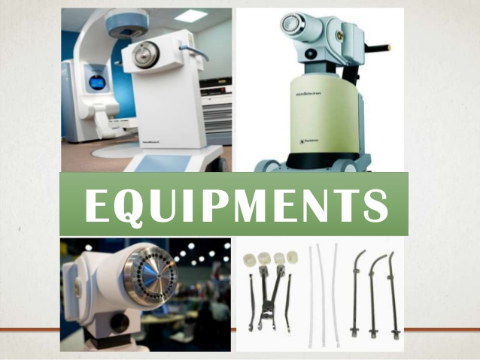
BRACHYTHERAPY
It is the method of radiation treatment in which sealed radioactive sources are used to deliver the dose
Most commonly used isotope is iridium 192
Generally multiple sources are used.
Major drawback is inhomogeneity of dose throughout the implanted volume.

Slide 6
IMAGE GUIDED RADIATION THERAPY (IGRT)
Is used to treat tumors in the area of body that are prone to movement. Eg lungs
It is equipped with special imaging technology that allows the physician to image the tumor immediately before and even during the time radiation is delivered.

Slide 7
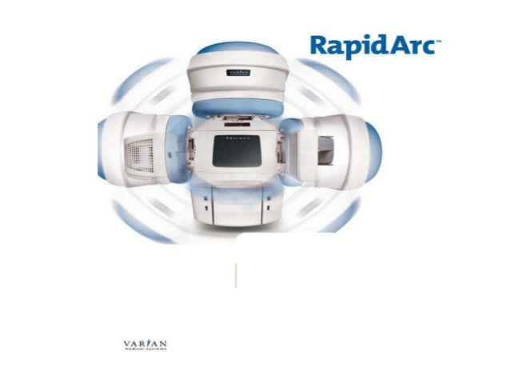
RAPID ARC
A extremely fast ad precise form of image guided intesity modulated radiation therapy.
Rapid arc deliver radiation with a single 360 degree rotation
It takes less then 2 min

Slide 8
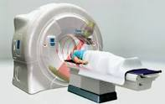
TOMOTHERAPY
Patient is scanned across a modulated strip beam so that only one slice of the target is exposed at one time
Does several rotation of the slice beam when the patient goes around the scanner

Slide 9
Thank you

