Slide 1
RNA
Dr Anup Nilawar

Slide 2
RNA (RIBONUCLEIC ACID)
A polymer of purine and pyrimidine ribonucleotides linked by 3’,5’-phosphodiester bridges analogous to those in DNA, bearing specific differences:-
Sugar to which bases and phosphates are attached is Ribose.
Contains the ribonucleotide of Uracil, does not contain Thymine.
Found in nucleolus, cytoplasm, mitochondria, ribosomes.

Slide 3
Types of RNA :-
Three major types:-
Messenger RNA (mRNA)
Ribosomal RNA (rRNA)
Transfer RNA (tRNA)
Each differ from the others by size, function and general stability.
Other types:- hnRNA
snRNA

Slide 4
Messenger Rna(mRNA) :-
comprises only about 5% of the RNA in the cell.
Carries genetic information from the nuclear DNA to the cytosol, where it is used as a template for protein synthesis.
May be monocistronic (carrying information from only one gene, characteristic of prokaryotes) or polycistronic (carrying information from more than one gene, characteristic of eukaryotes)

Slide 5
carries untranslated regions at both the ends. In eukaryotes, a long sequence of adenine nucleotides (poly-A tail) at the 3’-end and a molecule of 7-methylguanosine
(cap) at the 5’-end.
Function of poly-A tail is not understood.
5’ cap is involved in the recognition of the protein biosynthetic machinery (Protein synthesis begins at at the 5’-end of the cap) & also protects the m-RNA from attack by 5’- exonucleases.

Slide 6
Transfer Rna(tRNA) :-
smallest of all the three types of RNA.
there is at least one specific type of t-RNA for each of the 20 amino acids commonly found in proteins.
t-RNA constitute about 15% of the total RNA present in the cell.
contains unusual bases. Eg., Dihydrouracil.
Carries specific amino acid covalently attached at its 3’-end to the site of protein synthesis.
It recognises the codon on the m-RNA, which specifies the addition of its amino acid to the growing peptide chain.

Slide 7
Structure of t-RNA:-
Primary structure consists of a polymer of approximately 75 nucleotides.
Secondary structure consists of a single stranded t-RNA folded to form a clover leaf-like structure. The folds are stabilised by intrachain H-bonds between complementary bases.
Four arms or loops are formed viz., Acceptor arm, Anticodon arm, D-arm, T ψ C arm.

Slide 8
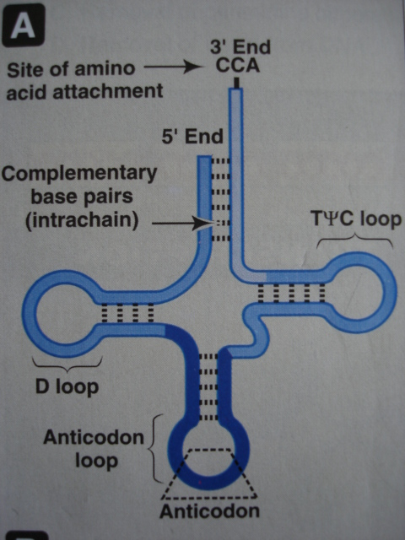
SECONDARY STRUCTURE OF t-RNA (CLOVER LEAF STRUCTURE)

Slide 9
No. of base pairs in t-RNA:-
Arm/ Loop | No. of base pairs
TψC loop | 7
T- arm | 5
D loop | 7-11
D arm | 4
Anticodon loop | 7
Anticodon arm | 5
Acceptor loop | 4
Acceptor arm | 7
Variable Arm | 4-21

Slide 10
Tertiary structure of t-RNA is formed by further folding of the cloverleaf due to H-bonds between T and D arms.
The amino acid acceptor end and the anti-codon end are located at the two extreme ends of the column.

Slide 11
m-RNA | t-RNA
1.High mol.wt. | Low mol.wt.
2.Most heterogenous. | Less heterogenous. Only 20 different types.
3.Acts as template for protein synthesis | Acts as carrier of amino acid.
4.Carries codons. | Carries anticodons.
5.Shape & size vary. | Shape & size constant (cloverleaf).
6.Cap found at the 5’ end. | No such structure.
7.Poly-A tail at 3’ end. | CCA sequence at 3’end which binds to the specific amino acid.
8.Precursor is hn RNA or pre m-RNA. | No such precursor.
9.Unusual bases not found. | Unusual bases found. Eg., pseudouridine.
10.No stem & loop structure found. | Stem & loop structure constant.

Slide 12
Ribosome- a cytoplasmic nucleoprotein structure.
It is the site for protein synthesis.
m-RNA acts as the template.
m-RNA & t-RNA interact to translate the information transcribed from the gene into the specific protein molecule.
Formed of 2 subunits- 40S & 60S (eukaryotes), 30S & 50S (prokaryotes).

Slide 13
Ribosomal RNA(r-RNA) :-
Make upto 80% of the total RNA in the cell.
Occur in association with proteins as components of the ribosomes- the complex structures that are the sites for protein synthesis.
Some rRNA act as catalyst in protein synthesis (ribozyme).

Slide 14
hn RNA(heteronuclear RNA)
It is the mRNA in its immature form.
Also known as the primary transcript.
Requires extensive editing, eg., poly-A tailing, 5’-capping, methylation, removal of introns, connecting of exons(splicing) etc.

Slide 15
Author/year | Study design | Level | Conceptualization | Conclusion
MicroRNA function: Multiple mechanisms for a tiny RNA? RAMESH S. PILLAI | Review Article | Low | MicroRNAs are sequence-specific regulators of post-transcriptional gene expression in many eukaryotes. They are believed to control the expression of thousands of target mRNAs, with each mRNA believed to be targeted by multiple microRNAs. Recent studies have uncovered various mechanisms by which microRNAs down-regulate their target mRNAs and have linked a well-known subcellular structure, the cytoplasmic processing bodies (PBs) to the microRNA pathway. | The finding that microRNAs are misexpressed in cancers has reinforced the idea that their regulatory roles are very important.

Slide 16
snRNA(small nuclear RNAs)
small in size(90-300 nucleotides in length).
Located in the nucleus.
Complex with proteins to form small nuclear ribonucleoproteins (SnRNPs).
They are rich in Uracil content. Hence, named as U₁,U₂,U₄, U₅ etc.
Takes part in the process of splicing.

Slide 17
DIFFERENTIATION OF DNA & RNA :-
Similarities:-
Both have Adenine, Guanine, Cytosine.
Nucleotides are linked together by phosphodiester bonds.

Slide 18
Differences:-
RNA | DNA
1. Mainly seen in cytoplasm. | Mostly inside nucleus.
2. Usually 100-5000 bases. | Millions of base pairs.
3. Generally single stranded. | Double stranded.
4. Sugar is Ribose | Sugar is deoxyribose.
5. Purines: Adenine, Guanine. Pyrimidines: Uracil, Cytosine. | Purines: Adenine, Guanine. Pyrimidines: Thymine, Cytosine.
6. Purines & pyrimidines are unequal. | Purines always equal to pyrimidines.
7. Alkali labile. | Alkali resistant.

Slide 19
