Slide 1
HIGH RISK INFANT
Dr. Dhwani Chanpura

Slide 2
HIGH RISK INFANT
Gestational age & Birth weight: Major risk factors
WHO – infant less than 37 weeks gestation
AGE - <37 – Premature
      <32 – Very premature
      <28 – Extremely Premature
Birth weight - < 2500gms LBW
        < 1500gms VLBW
        < 1000gms ELBW

Slide 3
Biological risk
Birth weight of 1500g or less
Gestational age of 32 wks or less
Prenatal exposure to drugs or alcohol
Ventilator requirement for 36 hr or more
Muscle tone abnormality
Recurrent neonatal seizures
Feeding dysfunction
Symptomatic TORCH infection
Meningitis
Asphyxia with apgar < 4 at 5 minutes
Multiple birth

Slide 4
Birth asphyxia
Respiratory distress syndrome
Meconium aspiration
Hyperbilirubinaemia
Erb palsy
Brachial plexus injury
CDH
CTEV

Slide 5
Motor signs
Three general high risk profiles are observed
1)movement abnormalities
2)related temperament/behavioral characteristics
3)interactional styles associated with motor status

Slide 6
hypertonic infant
Predominant extensor posture and movement
tremulous or disorganized movement with poor midline orientation
Limited antigravity movement into flexion
Visual tracking and feeding may be difficult
Increased tone with related decreased mobility in oral musculature

Slide 7
Poor self quieting abilities
Express discomfort when given quick change in body position And when placed in any position for prolonged time

Slide 8
Hypotonic/ lethargic infant
excessively accommodates to the stimulation of the nursery environment
The cry is characteristically weak ,low volume, short duration and decreased respiratory capacity
To compensate for low muscle tone when in the supine position, some preterm infants appears to push into extension against the surface of the mattress in search of stability

Slide 9
These infants are exceedingly comfortable in any position and when held they easily mold themselves to the arm of the caregiver
Drowsy behavior limits spontaneous approach to the environment
Feeding behavior is commonly marked by fatigue, difficulty remaining awake, weak sucking and need for supplementation of caloric intake by gavage
The risk for sensory deprivation and failure to thrive is high for hypotonic

Slide 10
Infant with fluctuating tone
Easily over stimulated with routine handling but remains passive when left alone
When calm, these infants frequently demonstrate high quality social interaction and efficient feeding with coordinated suck swallow sequence
When distracted and overstimulated, however these infants appear hypertonic and irritables

Slide 11
ATTENSION/ INTERACTION SIGN
Inability to integrate multi sensory process with Attention and Interaction ( can’t look and face, listen to talking and suck a bottle at the same time)
infant’s ability to assume and maintain an alert state, respond appropriately to environmental input including social, cognitive and emotional input

Slide 12
INDICATORS OF STABILITY
  Smooth respiration
  Pink colour
  Cooing, smiling
  Hand to mouth, smooth body movements, regulated tone
  Brightened eyes

Slide 13
INDICATORS OF STRESS
Color changes – cyanosis
Changes of Vital signs –HR,RR,BP
Visceral responses – vomiting, gagging, hiccups
Sneezing
Yawning
coughing

Slide 14
MOTOR INDICATORES OF STRESS
Sudden change in muscle tone
Flaccidity
Opisthotonus
Facial gramacing
Alterations in quality of movement
Disorganized movement
jitteriness

Slide 15
EVALUATION OF INFANT
Neurobehavioral state - Physiologic, Motor, State, Interaction/attention
Musculoskeletal status - anomalies and or contractures
Neurological status - Level of motor ability, tone & Reflexes
Oral motor abilities

Slide 16
Neurological Assessment
Active mobility
Posture
Muscle tone
Responses to stimulus of Noise, Touch etc
Reflexes

Slide 17
Musculoskeletal Examination
Range of Motion
Congenital Anomalies

Slide 18
Physical examination
General appearance
Global flexion or abnormal posture
State of consciousness
Obvious skeletal abnormalities
Skin color and response with touch

Slide 19
Oral Motor Examination
Oral structure examination (lips, tongue, jaw, hard & soft palate, breathing & oral movement)
Positioning
Mode of feeding
Pace of feeding

Slide 20
GOALS
Modify Sensory stimulation to promote behavioral organization and physiological stability
Reduce active reinforcements of abnormal movement patterns and positions
Facilitate normal patterns of movement
promote appropriate feeding behaviors

Slide 21
GOALS
Minimize contractures and deformities
Foster attachment to primary caregivers/parents
Support parental engagement and competency during critical course
Promote developmental progression
Follow up services

Slide 22
INTERVENTION
Body positioning
Graded sensorymotor intervention/ neurobehavioral activities
Oral motor activities/feeding, facilitation of sucking (pacifier)
Range of motion exercises with caution
Extremity splints

Slide 23
INTERVENTION
Containment
Kangaroo care & alignment
Education of parents/ caregivers

Slide 24
POSITIONING
Potential components of this high risk postural profile follows:
Hyperextended neck
Elevated shoulders with adducted scapula
Depressed midline arm movement (hand to mouth)
Excessively extended trunk
Immobile pelvis (anterior tilt)
Infrequent antigravity movement of legs

Slide 25
ET tube placement contributes to the neck hyperextension posture who require mechanical ventilator
In some high risk infants, excessive postural stabilizing into neck hyperextension may contribute to sequential blocking of mobility in shoulder, pelvis and hip region

Slide 26
POSITIONING
SUPINE, PRONE & SIDE LYING
Swaddling, nesting- boundaries
Stress reduction, state organization
Enhances flexor patterns, increase midline orientation, promote state organization
Proper weight shifts
Increase hand to mouth awareness
Inhibit jittery or disorganized movement
Prevention of skin degradation

Slide 27
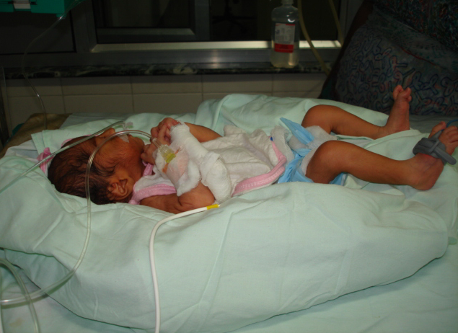
SUPINE POSITIONING

Slide 28
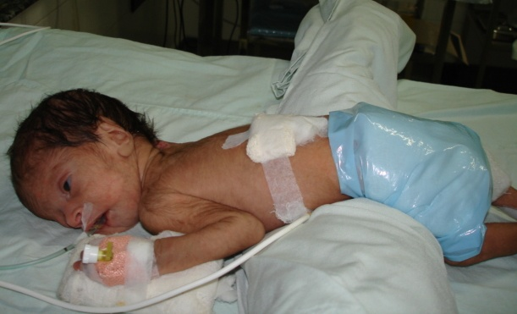
PRONE POSITIONING

Slide 29
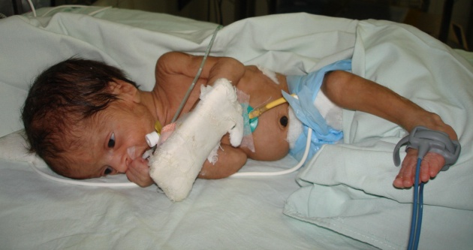
SIDE LYING POSITION

Slide 30
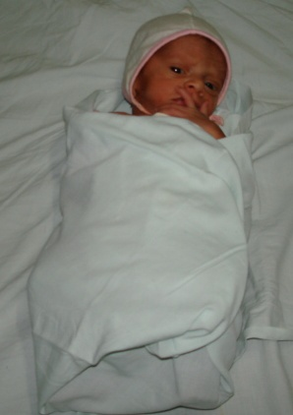
SWADDLING POSTURE

Slide 31
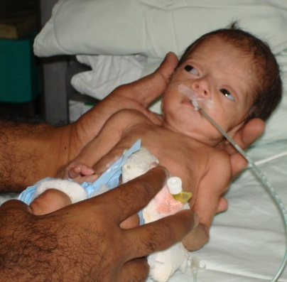
CONTAINMENT
It provides comfort and sense
of security.
Sustained even touch is readily accepted by fragile infants
Helps during handling, medical procedures & nursing care.

Slide 32
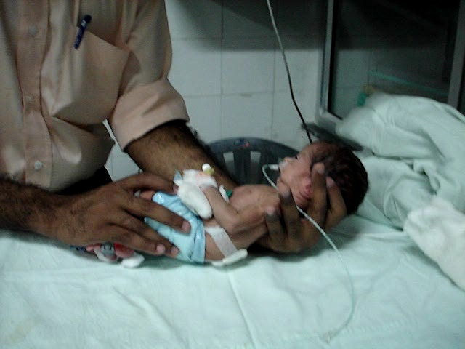
CONTAINMENT

Slide 33
HAMMOCK HANDLING
Activate trunk muscles
Facilitate head righting
Facilitate alertness
Facilitate vestibular system
Provide the perception of various positions

Slide 34
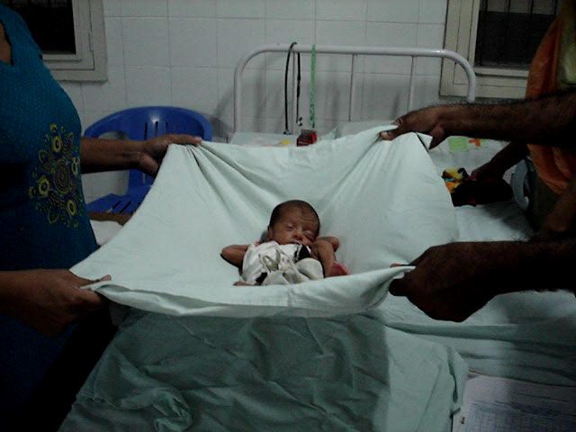
HAMMOCK HANDLING

Slide 35
Feeding difficulty
Feeding difficulties are common among LBW due to:
Neurological immaturity
depressed oral reflexes
prolonged use of an ET tube for mechanical ventilation or
insufficient postural tone

Slide 36
Other variables influencing feeding may include:
Decreased tongue mobility
Tongue thrusting
Depressed lip seal on nipple
Nasal regurgitation
Tactile hypersensitivity in the mouth
Inefficient and uncoordinated respiratory pattren
Hypertonic posturing of the neck and trunk in extension

