Slide 1
Government Schemes
Shabana Khan
Asst. Professor
Subject: Hospital Interaction
Dept. Of management

Slide 2
Mukhyamantri Amrutam & Mukhyamantri Amrutam Vatsalya Yojana
What is Yojana?
"MA” & MA Vatsalya Yojana is a tertiary care scheme for Selected population of Gujarat. All beneficiaries can avail cashless quality medical and surgical treatment for catastrophic illnesses related to: Cardiovascular diseases, Renal diseases, Neurological diseases, Burns, Poly-Trauma, Knee & Hip Replacement - Joint Replacement.

Slide 3
Who is eligible under “MA Vatsalya” Yojana
  Families are having an annual income up to Rs.4.00 lakh.
  All urban & rural ASHAs (Accredited Social Health Activist),
  Accredited Reporters
  Fix pay employees of class-3 & 4 appointed by state government
  U-win Card holders.
  Senior citizens of those families with annual income up to Rs. 6 lakh

Slide 4
How much medical coverage is provided under “MA” & “MA Vatsalya” Yojana?
“MA” & “MA Vatsalya” Yojana provides tertiary medical coverage up to Rs. 5,00,000/- for a family on a floater basis.
Kidney Transplant, Liver Transplant, Kidney + Pancrease Transplant procedures are covered with benefit up to Rs. 5,00,000/- under scheme.
Knee and Hip replacement procedures are covered.
Rs. 300/- is paid to the beneficiary as transportation charges for every instance of availing treatment from the empanelled hospital.

Slide 5
Our Hospital is empanelled under the scheme for Following Clusters.
  Cluster: 1 - Burns & plastic Surgery
  Cluster: 2 - Cardiology
  Cluster: 3 - Cardiac Thoracic Surgery
  Cluster: 4 - Cardio Vascular Surgery
  Cluster: 5 - Genito Urinary Surgery(Renal)/ Dialysis
  Cluster: 6- Neurosurgery/Neurology
  Interventional Neuroradiology
  Cluster: 7 - Pediatric Surgery
  Cluster: 8 - Poly-Trauma
  Cluster: 14 - Knee & Hip - Joint Replacement
  Cluster: 16 - Ortorinolaryngology (ENT)
  Cluster: 17 - Obstetrics & Gynecology
  Cluster: 18 - Ophthalmology
  Cluster: 19 - General Surgery
  Cluster: 20 - Oral and Maxillo-Facial Surgery
  Cluster: 26 - Orthopedics

Slide 6
Mandatory Documents Under the MA scheme
For Registration:-
MA Card
Patient
Patient’s Aadhaar Card
If Patient finger print do not come then Patient relative
IPD file with MA cluster number and surgery name with singe and stamp of treating consultant
For Preauth Approval:-
Detail Clinical Note with Surgeon sign and stamp
Pre-op Investigations (Printed with Consultant Sing & Stamp)
Clinical Photo (where applicable)
Treatment Plan with singe and stamp of treating consultant

Slide 7
Continue:-
For Discharge:-
Detail OT Note with Consultant sign and stamp/Detail Daily Note, Nursing Chart, Vital Chart, Drugs Chart
Scar Photo (where Applicable)
Anaesthesia Note
Consent for surgery (Hospital Form)
Implant Sticker (where Applicable)
Post Op Reports Printed with radiologist sign and stamp
Complete Discharge Summary
Patient

Slide 8
Ayushman Bharat Pradhan Mantri Jan Arogya Yojana (AB-PMJAY)
This scheme is applicable across India.
Annual Benefit Cover of INR 5,00,000/- Per Family Per Year for Secondary and Tertiary Treatment on Cashless and Paperless basis
No Limit on Family Size
Convergence with Central as well as State Health Insurance Schemes
Individual Member is being issued Ayushman Bharat Card from eligible Family.

Slide 9
Mandatory Documents Under the AB-PMJAY scheme
For Preauth Approval:-
Detailed History (Individual and Family).
Clinical finding with signature & stamp of treating Consultant.
Pre-operative lab investigation reports as per the requirement of
package in printed format with signature & stamp of Consultant.
Pre-operative Radiology Report as mentioned in package in Printed
Format with signature & stamp of Consultant.
Cluster No. selected with signature & stamp of treating Consultant.
Patient on bed photo at the time of admission.
Detailed treatment Plan.

Slide 10
Mandatory Documents Under the AB-PMJAY scheme
For Discharge:-
Detailed OT Note with signature & stamp of surgeon.
Detailed Clinical Notes ( Daily Basis)
Medicine Chart. ( Daily Basis)
Scar Photo in case of surgery.
Lab reports as per the requirement of package in printed format with signature & stamp of Consultant.
Radiology Report as mentioned in package in Printed Format with signature & stamp of Consultant.
Patient photo at the time of discharge.
TPR Charts (in Case of HDU/ICU, Prolonged Stay).
HEP reports in identified cases.

Slide 11
Mandatory Documents Under the AB-PMJAY scheme
Detailed Discharge Summery with sign and stamp.
In case of any change in package or cancellation justification from treating Consultant on hospital letterhead with sign and stamp.

Slide 12
Exclusions Policy under AB-PMJAY Scheme
Conditions that do not require hospitalization.
Congenital external diseases.
Fertility related procedures.
Drugs and Alcohol Induced illness.
Vaccination.
Suicide

Slide 13
The Process under MA/ AB-PMJAY
Beneficiary Identification & Registration
  The Beneficiary will contact the AB-PMJAY Help Desk on Arrival to Hospital
  The Arogya Mirta will identify the beneficiary and prepare Card, if not available with beneficiary.
  The beneficiary will be registered by Hospital Coordinator as OPD.
Diagnosis and Package Selection
  The beneficiary will go for consultation.
  Based on the history and present clinical symptoms the consultant will write his tentative diagnosis.
  Based on the results required diagnosis the beneficiary will be registered as IP and as suggested by the Consultant package selection will be done.

Slide 14
The Process under MA/ AB-PMJAY
Pre-Authorization
  Hospital Coordinator will start the process of preauthorization.
  He will up load the clinical notes, diagnosis reports and beneficiary photo on bed etc. for approval
  Based on the document submitted Preauthorization doctor will either approves, reject or may ask for additional information for approval.
  In case of any additional information required the hospital has to submit the information within 24 hrs of raises the query, otherwise the preauthorization gets rejected.
Surgery/Medical management
  Based on the package approved the hospital will provide free of cost services, which will be well documented.

Slide 15
The Process under MA/ AB-PMJAY
Discharge
Once the treatment is complete the patients file will be sent to hospital coordinator for Discharge & claim processing.
Hospital coordinator will discharge the patient in TMS and will up load the mandatory documents in TMS.
Once the process of discharge is complete, the hospital will forward the case for claim.
It is mandatory to upload all claim documents max. within 24 hours of patient discharge
Upon discharge, patient will receive feedback call from call centre about services etc. during hospitalization period.

Slide 16
Gujarat government launched “VAHAN AKSMAT SARVAR SAHAY” scheme

Slide 17
Key Features of the Scheme
Under the scheme emergency aid up to Rs. 50,000 per victim per episode during the first 48 hours of road accident is provided.
All govt., trust & private hospitals of the state provide treatment.
Any individual who meets road accident within the territory of Gujarat irrespective to its financial status, state and nationality is eligible for this scheme benefits.
Total Cashless treatment for road accident up to Rs. 50,000 per episode per victim.
No cash Incentive to beneficiaries for treatment.
One hospital can refer the victim to other hospital for further treatment, If the said treatment is not available with that Hospital.

Slide 18
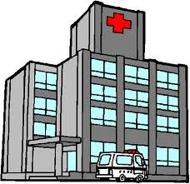
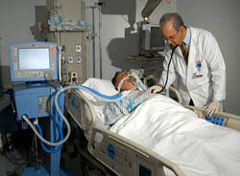

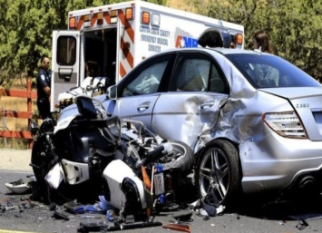

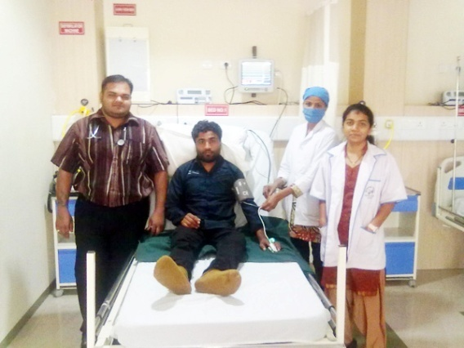

TREATMENT FLOW OF ROAD ACCIDENT VICTIM
Road Accident Victim approaches to any Government/Private / trust hospital
Patient transferred to Emergency ward of the hospital
Doctor Consultation
Discharge
Continue Admission
Referred to other hospital
48 Hours Free hospitalization
& Stabilization
Police Complain & Verification (Generate MLC No.)

Slide 19
The Scheme
The Scheme is applicable for first 48 hours only, If the victim is required to stay for longer time the victim will have to pay the expenses as per the rules of treating hospital.
If the expenses goes above Rs.50,000 per victim within 48 hours, the excess amount will be paid by the victim or his relative as per the rules of the treating hospital.
If the beneficiary is having MA or MA Vastalya card then he can use the facility under this scheme for additional treatment.

Slide 20
Mandatory Documents under The Scheme
Scanned Copy of MLC Register showing details of injury and police intimation copy with acknowledgement from police.
Two Photos ( along with treating Doctor)
  Clearly showing Wounds before treatment and Face of the Patient. (Wound+Doctor+Patient’s face)
  After treatment clearly showing treated area of wounds and Face of Patient. (Wound+Doctor+Patient’s face)
OP Records/Case Sheet showing treatment given( including OT note) with investigation reports are required for claim process.
Detailed Hospital Bill
Other documents over and above as per the details given in Government Resolution.

Slide 21
Bal-sakha- 3
Enrolment criteria for facilities:
Facilities having Level 2 or Level 3 NICU
Facilities with full time functioning Human resources (Paediatrician/SN)
Inclusion criteria for New born (up to 28 days):
All babies with birth weight <1500 grams (Very Low Birth Weight)
All premature babies (Gestational age <37 weeks)
Babies with birth weight >1500 grams with any one of the following:
  Birth asphyxia
  Meconium aspiration syndrome
  Respiratory distress syndrome
  Sepsis/meningitis confirmed by lab diagnosis
  Metabolic complications like hypoglycaemia, hypocalcaemia, hypernatremia etc.
  Babies requiring surgical intervention with congenital anomalies

Slide 22
Treatment:
All services to be provided free of cost
lab test/Diagnostic services.
Drugs
Procedures required for treatment.
In case where Ventilator support.
Any surgery
Vaccination of newborn, if not done.
Treatment Cost:
For every new born it is estimated to be Rs.7000 per day and such treatment may be required for approximately for 7 days, hence cost of treatment for single new born is estimated to be maximum of Rs.49,000.

Slide 23
Responsibility of Hospital:
During the period of MoU, if the newborn dies due to any mistake or irresponsible behaviour of staff of hospital, it will the responsibility of hospital
Documents for payments:
Following documents are required:
Register is to be maintained by Hospital for Balsakha-3 as per the sample of GoG.
All records of treatment
Records required for processing the bills
  Application form
  Certificate of Parents of New born regarding free treatment.
  Letter of Hospital regarding payment of bills

Slide 24
Public Private Partnership For New-born and infant care
Beneficiary
    Any newborn or infant visiting hospital irrespective of her socio-economic status of his/her parents.
Type of services
    Any inborn or out born newborns or infants examined, investigated, treated for any abnormality etc.
    Identified High Risk newborns/ infants admitted in NICU/ PICU and treated.
    newborns / infants given tertiary level care such as ventilator care, pediatric surgery, prolonged admission for surgical intervention or newborn weight less than 1200 gms at the time of birth etc.

Slide 25
Public Private Partnership For Maternal Health services
Beneficiary
    Any Pregnant or postpartum mother or Women in reproductive age group visiting hospital irrespective of her socio-economic status.
Type of services
    Pregnant and Post-Partum Mothers examined, investigated, suffering from Thallasamia, Sickle Cell Anemic, Cardiac Diseases, Metabolic Diseases etc. who requires special attention.
    Identified High Risk beneficiary in NAC/PNC and intra-partum period as per Govt. Criteria.
    High Risk Mothers given tertiary level care such as ventilator care, Obst/Gynac surgery, prolonged admission for Systemic Diseases, treatment or surgery for Obst/Gynac Complications, Post-Partum Diseases etc. and who require prolonged admission.

Slide 26
Treatment
    All beneficiary falling under criteria-1 in both PPP are to be
    treated in OPD basis.
    All beneficiary falling under criteria-2 in both PPP are to be
    admitted and treated through medical management on IPD basis.
    All beneficiary falling under criteria-3 on in both PPP are to Be admitted and treated either medical management or surgical intervention on IPD basis.
    Under all 3 criteria treatment is to on FoC basis.

Slide 27
Nutrition Rehabilitation Center
Nutrition Rehabilitation Center as "Bal Sanjeevani
Kendra" at Medical College
Beneficiaries:
Severe acute Malnourished children who requires significant medical care identified by ASHAs, Government Health Staff, PHC or in regular OPD.
Benefit:
Under this program malnourished children are enrolled under the scheme and are provided treatment and nutritional care for 10-14 working days at center residentially, were they are provided 6-8 times supervised diet + micronutrient supplementation and medicines.

Slide 28
Employees State Insurance Corporation-MoU for
Super Specialty Treatment
&
Super Specialty Investigations

Slide 29
Clusters -Super Specialty Treatment
Cardiology
Cardiothoracic Vascular Surgery
Neurology & Neurosurgery
Pediatric Surgery
Oncology & Onco surgery
Urology
Nephrology
Endocrinology & Endocrine Surgery
Burns and Plastic Surgery
Reconstruction Surgery

