Slide 1
Albinism
Trushna Shah

Slide 2
What is Albinism?
Albinism is a genetic disorder that affects your melanin production so your skin and hair lack color.
Tyrosinase enzyme is deficient
Some symptoms you can look for include:
-Lack of color in hair, skin and eyes
-Patchy skin color
-Light sensitivity
-Crossed eyes
-Rapid eye movements

Slide 3
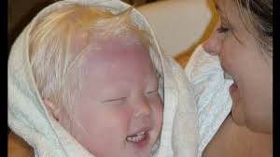
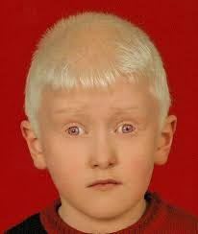
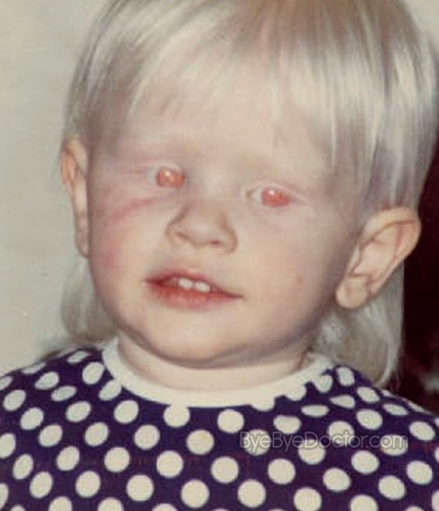
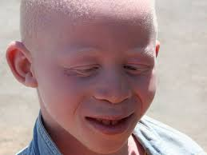

Slide 4
Evidence 1
Skin cancers in albinos in a teaching Hospital in eastern Nigeria - presentation and challenges of care
Kingsley O Opara*, Bernard C Jiburum

Slide 5
Author/year | Study design | Level | Results | Outcome
Skin cancers in albinos in a teaching Hospital in eastern Nigeria - presentation and challenges of care Opara and Jiburum World Journal of Surgical Oncology 2010, 8:73 Kingsley O Opara*, Bernard C Jiburum | Case control | Level IV | albinos accounted for 67% of patients managed for primary skin cancers. There were twenty patients with thirty eight (38) lesions. Sixty one percent of the patients were below 40 years. Average duration of symptoms at presentation was 26 months. The commonest reason for late presentation was the lack of funds. Squamous cell carcinoma was the commonest histologic variant. Most patients were unable to complete treatment due to lack of funds. | Albinism appears to be the most important risk factor in the development of skin cancers in our environment. Late presentation and poor rate of completion of treatment due to poverty are major challenges.

Slide 6
Treatments for Albinism
Albinism is a genetic disorder, so not much can really be done to treat it.
Surgery may be done to improve your vision.
Some home remedies include using vision aids such as magnifiers, using sunscreen, wearing protective clothing, and protecting your eyes.

Slide 7
Does Albinism Spread?
Albinism is spread through the parents to the child.
However, it does not spread from person to person or does not spread inside the body.

Slide 8
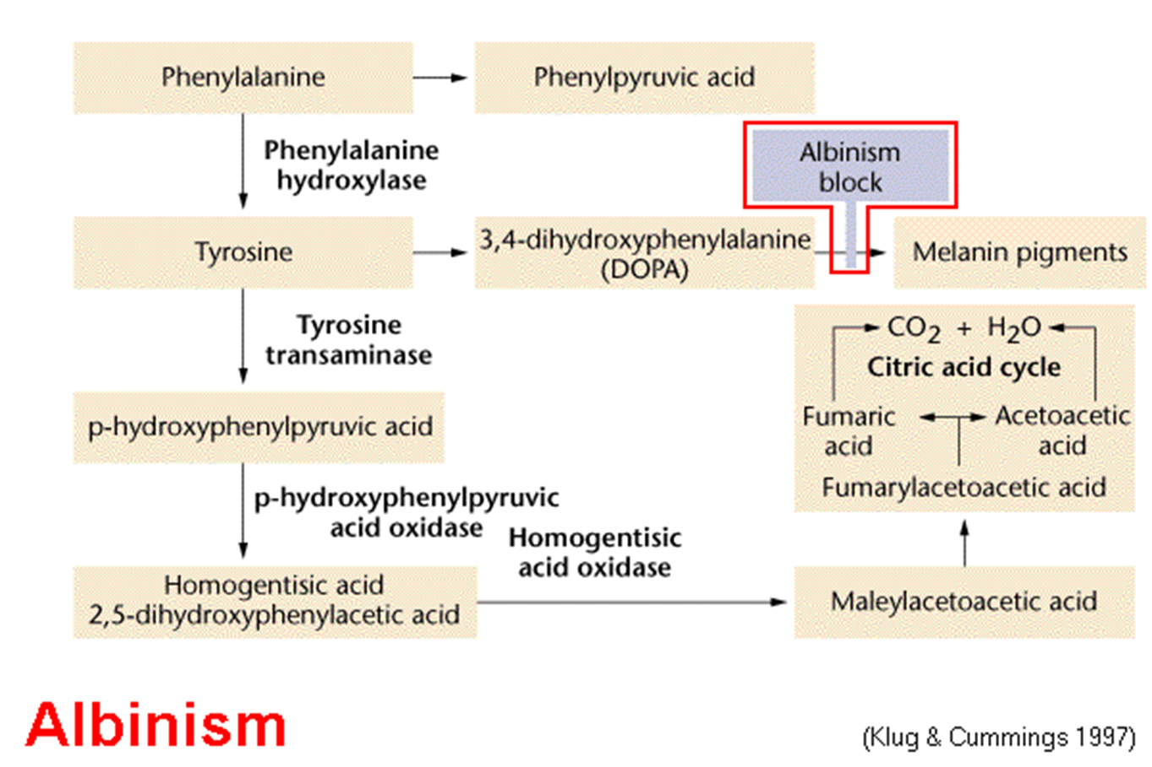
Albinism

Slide 9
AMINO ACID DISORDER (CONT.)
Homocystinuria:
METHIONINE Cystathionine
Cysathionine
Synthatase

Slide 10
DIAGNOSIS:
HIGH METHIONINE AND HOMOCYSTINE.
TREATMENT:
High dose of B6 and Folic Acid.
Low methionine and high cystine diet,
Betain (trimethylglycine)

