Slide 1
Business Strategy (An Introduction To Market Driven Strategy)
Dr. Subhasish Chatterjee

Slide 2
Definition
Business strategy can be understood as the course of action or set of decisions which assist the entrepreneurs in achieving specific business objectives.

Slide 3
It is nothing but a master plan that the management of a company implements to secure a competitive position in the market, carry on its operations, please customers and achieve the desired ends of the business.
In business, it is the long-range sketch of the desired image, direction and destination of the organization. It is a scheme of corporate intent and action, which is carefully planned and flexibly designed with the purpose of:

Slide 4
Achieving effectiveness.
Perceiving and utilizing opportunities.
Mobilizing resources.
Securing an advantageous position.
Meeting challenges and threats.
Directing efforts and behavior and
Gaining command over the situation.

Slide 5
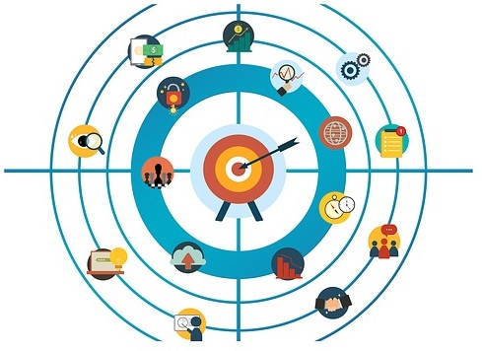
A business strategy is a set of competitive moves and actions that a business uses to attract customers, compete successfully, strengthening performance, and achieve organizational goals. It outlines how business should be carried out to reach the desired ends.

Slide 6
Business strategy equips the top management with an integrated framework, to discover, analyze and exploit beneficial opportunities, to sense and meet potential threats, to make optimum use of resources and strengths, to counterbalance weakness.

Slide 7
Levels of Business Strategy
Corporate level
Business level
Functional level

Slide 8
Corporate level strategy
Corporate level strategy is long-range, action-oriented, integrated and comprehensive plan formulated by the top management. It is used to ascertain business lines, expansion and growth, takeovers and mergers, diversification, integration, new areas for investment and divestment and so forth.

Slide 9
Business level strategy
The strategies that relate to a particular business are known as business level strategies. It is developed by the general managers, who convert mission and vision into concrete strategies. It is like a blueprint of the entire business.

Slide 10
Functional level strategy
Developed by the first line managers or supervisors, functional level strategy involves decision making at the operational level concerning particular functional areas like marketing, production, human resource, research and development, finance and so on.

Slide 11
In business, there is always a need for multiple strategies at various levels as a single strategy is not only inadequate but improper too. Therefore, a typical business structure always possesses three levels.

Slide 12
Nature of Business Strategy
A business strategy is a combination of proactive actions on the part of management, for the purpose of enhancing the company’s market position and overall performance and reactions to unexpected developments and new market conditions.

Slide 13
The maximum part of the company’s present strategy is a result of formerly initiated actions and business approaches, but when market conditions take an unanticipated turn, the company requires a strategic reaction to cope with contingencies. Hence, for unforeseen development, a part of the business strategy is formulated as a reasoned response.

Slide 14
What is Market-Driven strategy?
Market-Driven strategy is the long term planning of a business to provide the maximum value or advantages to the customers. The main target of the market driven strategy is to provide maximum value to the customers

Slide 15
According to David W. Cravens & Nigel F. Piercy:
“Marketing-driven strategy provides a companywide perspective which mandates more effective integration of a activities and processes that impact customer value.”
“Market-driven strategy consists of activities and processes that create and provide superior customer value.”

Slide 16
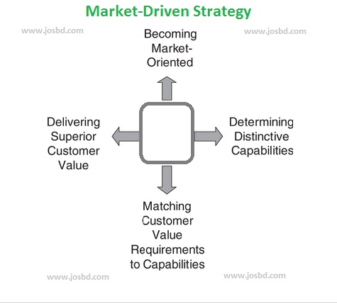

Slide 17
Characteristics of MDS:
The fundamental logic of this strategy is that the market and the customers that form the market should be the starting point in business strategy formulation; which therefore an understanding of the market and the customers that form the market is essential (Cravens & Piercy, 2006).

Slide 18
According to Cravens & Piercy (2006), the characteristics of market driven strategies include:
1.Becoming market oriented.
2.Determining distinctive capabilities.
3. Finding a match between customer value and organizational capabilities.
4. Obtaining superior performance by providing superior customer value.

Slide 19
Although it is a highly promising strategy, yet it is argued that a long-term commitment is crucial in order to develop these strategies.

Slide 20
Becoming Market Oriented
A market orientation is a business perspective that placed the customer as the center of a company’s total operations (Cravens & Piercy, 2006). This concepts is basically holds the same idea as the “marketing concept” that is being discussed before in “what is marketing”. Moreover, Slater & Narver, (1994) argues that a business is market-oriented when “its culture is systematically and entirely committed to the continuous creation of superior customer value”.

Slide 21
However, for a business to achieve market orientation, it involves the use of superior organizational skills in understanding and satisfying customers (Day, 1990).
A market-oriented organization always gathers information about its customers, competitors, and the markets; analyze it from a total business perspective, decides how to deliver superior customer value, and finally takes actions to provide value to customers (Slater & Narver, 1994).

Slide 22
Moreover, Cravens & Piercy, (2006) suggest the requirements for the organizations to become market-oriented:
Customer focus (understand the customer needs, wants, and responses towards the products delivered).
Competitor intelligence (Understand the competitor just like the customer).
Cross-functional cooperation and involvement (abilities to get all business functions to work together in providing superior customer value).

Slide 23
Distinctive Capabilities
Identifying an organization’s distinctive capabilities is a crucial part of market-driven strategy. Capabilities can be defined as “complex bundles of skills and accumulated knowledge, exercised through organizational processes, that enable firms to coordinate activities and make use of their assets” (Day, 1994).

Slide 24
According to Cravens & Piercy, (2006), The Major components of distinctive capabilities are:
Organizational Processes.
Skills and Accumulated Knowledge.
Coordination of Activities.
Assets.

Slide 25
For example: Zara’s new-product development process, which illustrates the retailer’s distinctive capabilities, where the new-product development applies the skills of their design team and benefits from the team’s accumulated knowledge; the coordination of activities across business functions during new-product development is facilitated by information and technology (the product designs take into account the manufacturing requirements as well as offering high fashion products). The asset is the strong brand image possessed by Zara which helps the launching of the new product.

Slide 26
Creating Value for Customers
Customer Value is “the outcome of a process that begins with a business strategy anchored in a deep understanding of customer needs” (Troy, 1996). The creation of customer value is an important challenge for the managers, since it is an ongoing competitive challenge in maintaining successful market-driven strategies (Cravens & Piercy, 2006). Being able to overcome these challenge, the organization is believed to be able to successfully deliver the customer value; hence fulfilled their goals.

Slide 27
Superior customer value occurs when the buyer has a very positive use experience compared to his/her expectations as well as the value offerings of competitors (Cravens & Piercy, 2006).
Furthermore, Cravens & Piercy (2006) also stated that the values could be product differentiation, lower prices than competing brands, or a combination of lower cost and differentiation.

Slide 28
Through the deep understanding of this concept, ability to implement and manage all the elements, as well as the constant management and updates of the strategy, it is believed that the organization will able to achieve its goals.

Slide 29
THANK YOU

