Slide 1
Soft tissue injury:
Anterior Cruciate Ligament (ACL)
Dr. Niketa Patel

Slide 2
Objectives
After completing this lecture, you will be able to:
Retrieve anatomy and biomechanics of ACL
Explain mechanism of injury and clinical features
Explain principles of assessment for ACL injured knee joint
Demonstrate special tests for ACL injury
Implement functional test for ACL injury
Apply Evidence based Learning

Slide 3
Introduction
Ligament injuries occur most frequently in individuals between 20 to 40 yrs of age as a result of sport injuries but can occur in individuals of all ages.
The ACL is most commonly injured ligament.
Often more than 1 ligament is damaged as the result of a single injury.

Slide 4
Anatomy
The cruciate ligaments cross each other and are the primary rotary stabilizers of the knee.
These strong ligaments are named according to their attachment to the tibia and are intracapsular but extrasynovial.
Each ligament has an anteromedial and a posterolateral portion.
The ACL has in addition an intermediate portion.

Slide 5
Anatomy (contd…)
ACL extends superiorly, posteriorly and laterally, twisting on itself as it extends from tibia to the femur.
Its main function are to prevent anterior translation of tibia on femur. Also to check lateral rotation of tibia in flexion.
To lesser extent it helps to check extension and hyperextension at the knee.

Slide 6
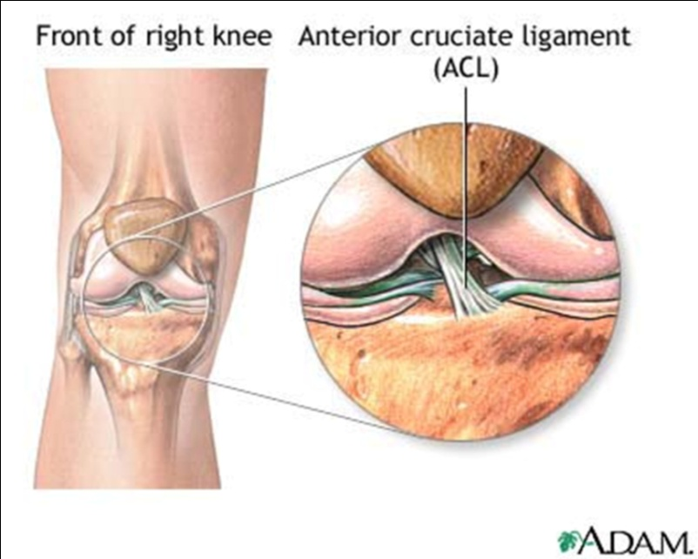
Anatomy (contd…)
It also helps to control the normal gliding and rolling movement of the knee.

Slide 7
Biomechanics
At 0⁰ of knee flexion the AMB is at its shortest length (lax) while the PLB is at it longest length (taut).
So at 0⁰ the lax AMB would be able to offer least restraint and the taut PLB would be able to offer the most restraint.
At 30⁰ of knee flexion the AMB has lengthened so that it is longer than PLB.

Slide 8
Biomechanics (contd…)
Under valgus loading the length of both bands of the ACL increases as knee flexion increases.
Anterior loading alone or combined with valgus loading causes an increase in length of all portions of the ACL with increase in knee flexion.
In flexion, AMB is taut, (maximally tensed at 70⁰ of flexion) and PLB is lax.

Slide 9
Biomechanics (contd…)
Forces producing anterior translation of the tibia will result in maximal excursion of the tibia at about 30⁰ of flexion when neither of the ACL bands are particularly tensed.
Passive extension of the knee generated forces in the ACL only during the last 10⁰ of extension.

Slide 10
Biomechanics (contd…)
The PLB checks and tends to be injured with excessive hyperextension of knee whereas AMB tends to get injured in flexed knee trauma.
As ACL contributes less in preventing valgus and varus stresses. But if MCL is damaged then ACL plays major role in restraining the varus and valgus stresses.

Slide 11
Biomechanics (contd…)
Torn ACL leads to a loss of normal proprioception at the knee.

Slide 12
Mechanism of Injury
Usually a history of non-contact injury.
But ACL injury can occur from both contact and non-contact mechanism.
The most common contact mechanism is a blow to the lateral side of the knee resulting in the valgus force to the knee.

Slide 13
Mechanism of Injury (contd…)
Frequently valgus force is accompained by injury to the posteromedial capsule, medial meniscus and ACL. (terrible triad)
The most common mode of injury in non contact mechanism is external rotation with abduction of the flexed knee or hyperextension of knee in internal rotation, deceleration.

Slide 14
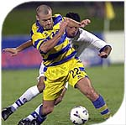

Slide 15
Mechanism of Injury (contd…)
Hyperextension leads to ACL injuries often associated with meniscus tears.

Slide 16
Clinical features
This is a disabling injury and the knee may immediately collapse and is painful.
Following trauma, the joint usually does not swell for several hours. If blood vessels are torn, swelling is usually immediate.
If there is a complete tear, instability is detected when the torn ligament is tested.

Slide 17
Clinical features (contd…)
When swollen, motion is restricted, the joint assumes a position of minimum stress (usually flexed 25), and inhibition (shut down) of the quadriceps muscle occurs.
When acute, the knee cannot bear weight, and the person cannot ambulate without an assistive device.

Slide 18
Clinical features (contd…)
With a complete tear, there is instability, and the knee may give way during weight bearing.

Slide 19
Principles of Physiotherapy Assessment

Slide 20
History
A detailed history and description of the MOI are vitals components to initial evaluation.
MOI questions can guide to what structures can be injured.
Popping sensation felt or heard at the time of injury indicates ACL tear.

Slide 21
History (contd…)
Deceleration injuries also affects cruciate ligaments.
Constant speed with cutting may involve ACL.
Does the knee “gives way”? This finding usually indicates instability in the knee.

Slide 22
On examination
Swelling : Does the joint is swollen?
Has swelling occurred immediately after injury or after several hours of injury?
Fluid accumulation within 2hrs of injury indicates the possibility of a hemarthrosis, which could result from an ACL tear.
Swelling with activities can occur due to instability.

Slide 23
On examination (contd…)
Pain parameters: the existence of pain, onset of pain and whether the patient can walk without pain are good indicators of the extent of injury.
Generalized pain in the area of the knee is usually characteristics of partial tears of muscles or ligaments.

Slide 24
On examination (contd…)
Instability: Instability rather than pain is major presenting factor in complex ligament disruptions.

Slide 25
Active ROM
The examination is performed initially with patient in sitting position and then with patient in lying position.
While patient performing active ROM, examiner must observe following:
The ROM is available

Slide 26
Active ROM (contd…)
Normal knee ROM:
Knee flexion 0⁰ to 135⁰
Knee extension 0⁰

Slide 27
Passive ROM
If active ROM is full then gentle overpressure should be applied to check the end feel of various movements of the tibiofemoral joint.
Normal End-feels:
Knee flexion is tissue approximation
Knee extension is tissue stretch

Slide 28
Passive ROM (contd…)
Whether pain occurs during the movement. And if so where?
What appears to be the limiting the movement?
The active movement can be done in sitting or supine position and the most painful movement must be checked at last.

Slide 29
Resisted Isometrics
For a proper test of the muscles, resisted isometric movements must be performed.
The patient should be in supine position.
Ideally this resisted isometric movements are performed in its resting position.

Slide 30
Special tests for ACL injury
It may be necessary to carry out specific tests of the injury to differentiate it from other injury with similar clinical features.

Slide 31
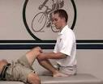
Tests for ACL
Anterior Drawer Test:
Patient position is supine
Then flex the patient hip to 45⁰ and knee flexion to 80⁰ or 90⁰ with the foot flat on the table.

Slide 32
Tests for ACL (contd…)
The examiner sits on the table positioning his/her buttocks on the patient’s dorsum of the foot to fix it firmly.
The examiner’s hand are placed about the upper part of the tibia .
The examiner provides a gentle pull repeated in an anterior direction.

Slide 33
Tests for ACL (contd…)
Lachman test: It is the best indicator to ACL injury, especially with posterolateral band.
It is the test for 0ne-plane instability.
The patient lies supine.
Examiner passively flexes the patient’s knee 30⁰ of flexion.
This position is functional position of the knee in which ACL plays an major role.

Slide 34


Tests for ACL (contd…)
The patient’s femur is stabilized with one of the examiner while the proximal aspect of the tibia is moved forward with the other hand.
A positive sign is indicated by a soft end feel when the tibia is moved forward on the femur.

Slide 35
Functional assessment
Instability produced on examination table are easily produced functionally.
Especially in athletes who participates in activities such as vigorous cutting, jumping or rapid deceleration which produces high physiological joint loads.

Slide 36
Functional assessment (contd…)
If active, passive and resisted isometrics are performed with little difficulty, the examiner can test the patient functionally by applying functional tests to see whether this sequential activities produces pain or other symptoms.
This test may be scored by the time taken to do the test or by the distance or height attained when doing the test.

Slide 37
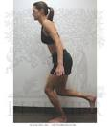
Functional assessment (contd…)
Single-leg hop test: With this test, the patient is assessed for the time taken to hop 6 meters on one leg.
The good leg is test first followed by the injured leg.

Slide 38
Evidence Based Learning
A PROSPECTIVE ANALYSIS OF INCIDENCE AND SEVERITY OF QUADRICEPS INHIBITION IN A CONSECUTIVE SAMPLE OF 100 PATIENTS WITH COMPLETE ACUTE ACL RUPTURE

Slide 39
JOURNAL & NAME OF AUTHORS | STUDY DESIGN & LEVEL OF INCIDENCE | AIMS | METHODOLOGY | CONCLUSION
Journal of orthopedic Research Terese L., Scott Stackhouse, Michael J., Lynn Snyder. | Prospective study design Level of evidence – 2 | The purpose of the study was to systematically examine the incidence and severity of Q’ceps voluntary activation failure in both L.E. after ACL injury. | 100 consecutive patients with acute ACL rupture were tested when ROM was restored and effusion resolved, an average of 6 wks after injury. A burst superimposition technique was used to assess Q’ceps muscle activation and strength in all patients. | The inhibition of voluntary Q’ceps activation on involved side was 3 times that of uninjured acute young subjects but magnitude was not large. The incidence of Q’ceps inhibition on the uninjured side was similar to the injured side.

Slide 40
MCQs
1. ACL main function is to prevent ________ translation of tibia on femur.
a. posterior
b. anterior

Slide 41
MCQs (contd…)
2. In Lachman’s test, patient knee is flexed to how many degrees?
30⁰
45⁰
50⁰
None of the above

Slide 42
MCQs (contd…)
3. ________ is major presenting factor in complex ligament disruptions.
Pain
Instability
swelling

Slide 43
MCQs (contd…)
4. In anterior drawer test, the examiner ____________
a. Push the tibia posteriorly
b. Pulls the tibia anteriorly

Slide 44
MCQs (contd…)
5. Hyperextension leads to ______ injuries often associated with meniscus tears
PCL
LCL
ACL
Both a and b

