Slide 1
Cholesterol
Dr.Anup Nilawar

Slide 2
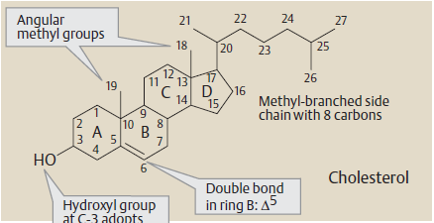
Chemistry
Highly decorated small molecule in biology
Most Important sterol in human, also known as animal sterol
First isolated from gall stones
Name originates from Greek word
Mol. Formula – C₂₇H₄₅OH
Properties

Slide 3
It has one hydroxy group at C3 and double bond between C5 and C6.
An 8 carbon aliphatic side chain is attached to C17.
Cholesterol contains total of 5 methyl groups.
Cholesterol is amphipathic.

Slide 4
PROPERTIES AND REACTIONS
Cholesterol is an yellowish crystalline solid.
The crystals, under the microscope, show a notched appearance.
Cholestrol is insoluble in water and soluble in organic solvents chloroform,benzene,ether etc.
Several reactions given by cholesterol are useful for its qualitative identification and quantitative estimation .
These include Salkowaski’S test ,Libermann burched reactionand zak’

Slide 5
FUNCTIONS OF CHOLESTEROL
The Structural component of the cell membrane.
Cholesterol increases the fluidity of
plasma membranes.
It is required to establish proper membrane permeability, it reduces the permeability of plasma membrane to H+.

Slide 6
Author/year | Study design | Level | Conceptualization | Conclusion
Cholesterol metabolism in the brain Dietschy, John M.; Turley, Stephen D | Review Article | Low | The central nervous system accounts for only 2% of the whole body mass but contains almost a quarter of the unesterified cholesterol present in the whole individual. This sterol is largely present in two pools comprised of the cholesterol in the plasma membranes of glial cells and neurons and the cholesterol present in the specialized membranes of myelin. From 0.02% (human) to 0.4% (mouse) of the cholesterol in these pools turns over each day so that the absolute flux of sterol across the brain is only approximately 0.9% as rapid as the turnover of cholesterol in the whole body of these respective species. The input of cholesterol into the central nervous system comes almost entirely from in situ synthesis | This cholesterol turnover across the brain is increased in neurodegenerative disorders such as Alzheimer's disease and Niemann-Pick type C disease. Changes in cholesterol balance across the whole body may, in some way, cause alterations in sterol recycling and apolipoprotein E expression within the central nervous system, which, in turn, may affect neuron and myelin integrity.

Slide 7
Functions of Cholesterol (contd)
2.Precursor of steroid hormones like; Corticosteroids, mineralocorticoids, sex hormones.
3. Synthesis of vit D.
4. Synthesis of bile acids.
5. Component of lipoproteins, LDL;HDL;VLDL.

Slide 8
Chemistry
Sources :
Principle dietary source is animal food
Plant sterols are poorly absorbed
Forms :
Un esterified (Free)
Esterified (Bound)
  In tissues :
  Acyl CoA + Cholesterol
  In Plasma :
  Lecithin + Cholesterol
ACAT
Cholesterol ester + CoASH
LCAT
Cholesterol ester + Lysolecithin

Slide 9
Biosynthesis of Cholesterol
Liver is major site
Enzyme present in microsomes & cytosol
Active acetate or Acetyl CoA is precursor
NADPH provides reducing equivalents & ATP provides energy
Steps of Biosynthesis :
    Formation of HMG- CoA
    Formation of Mevalonate (6C)
    Production of Isoprenoid units(5C)
    Synthesis of squalene (30C)
    Conversion of squalene to cholesterol (27C)

Slide 10
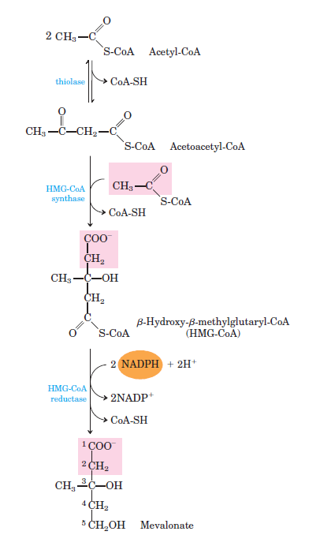
Formation of HMG – CoA & Mevalonate
CH3 – C – S - CoA
2 Acetyl CoA
Acetoacetyl CoA
HMG CoA
Mevalonate

Slide 11
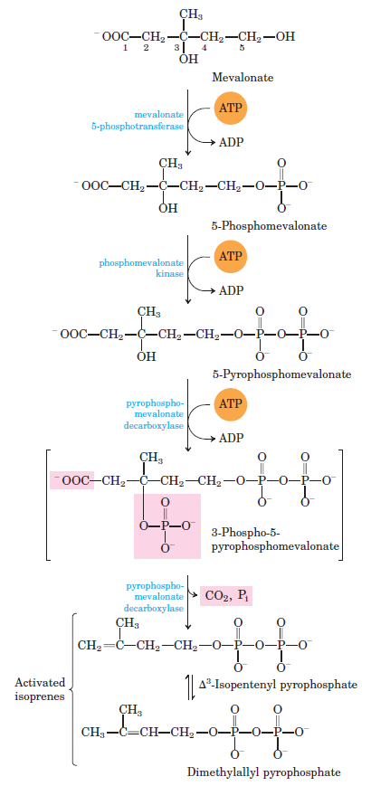
Formation of Isoprenoid Units
Mevalonate
5 – P Mevalonate
5 – PP Mevalonate
3 P 5 PP Mevalonate
IPP
DPP

Slide 12
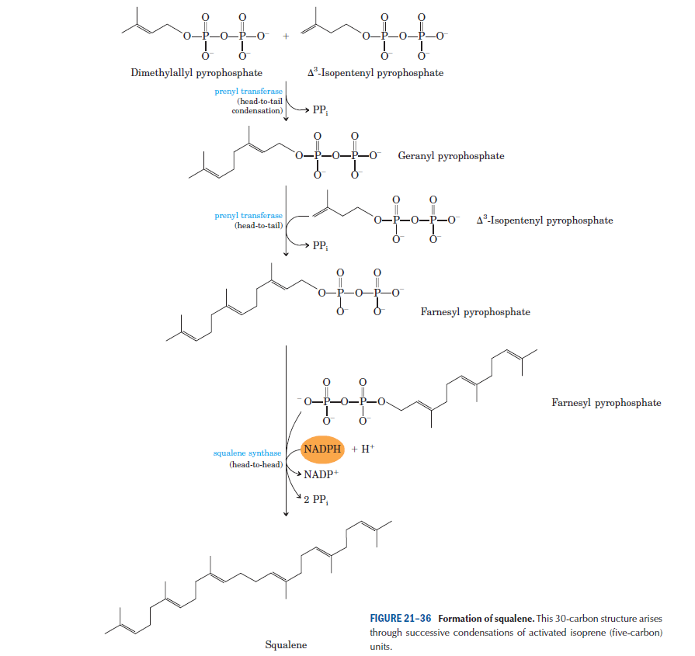
Formation of Squalene

Slide 13
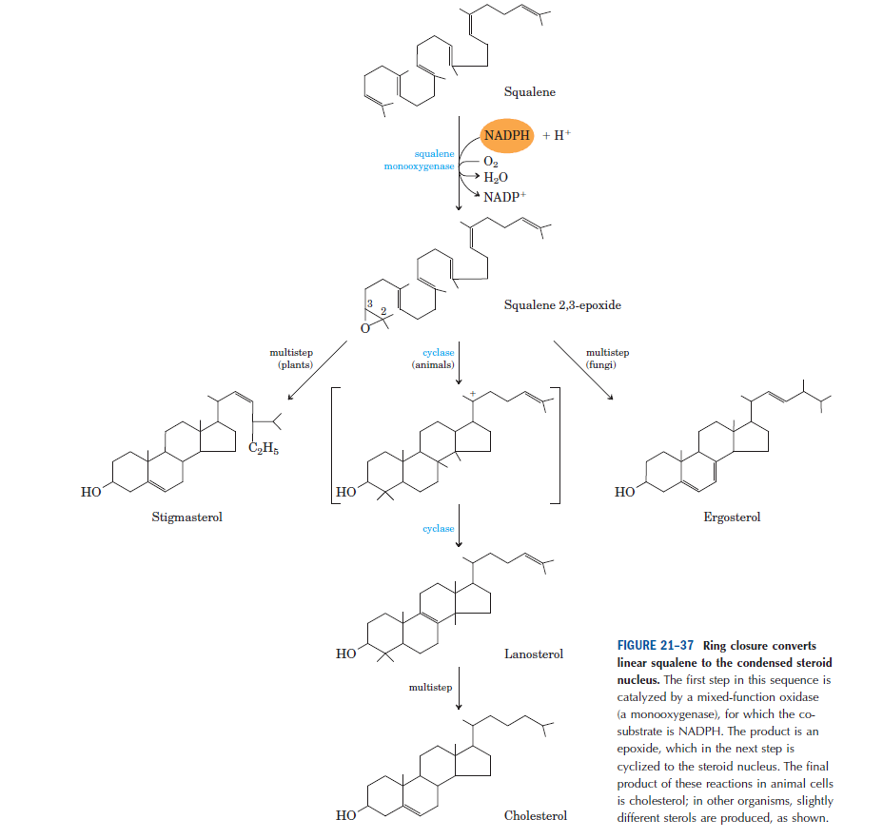
Conversion of Squalene to Cholesterol

Slide 14
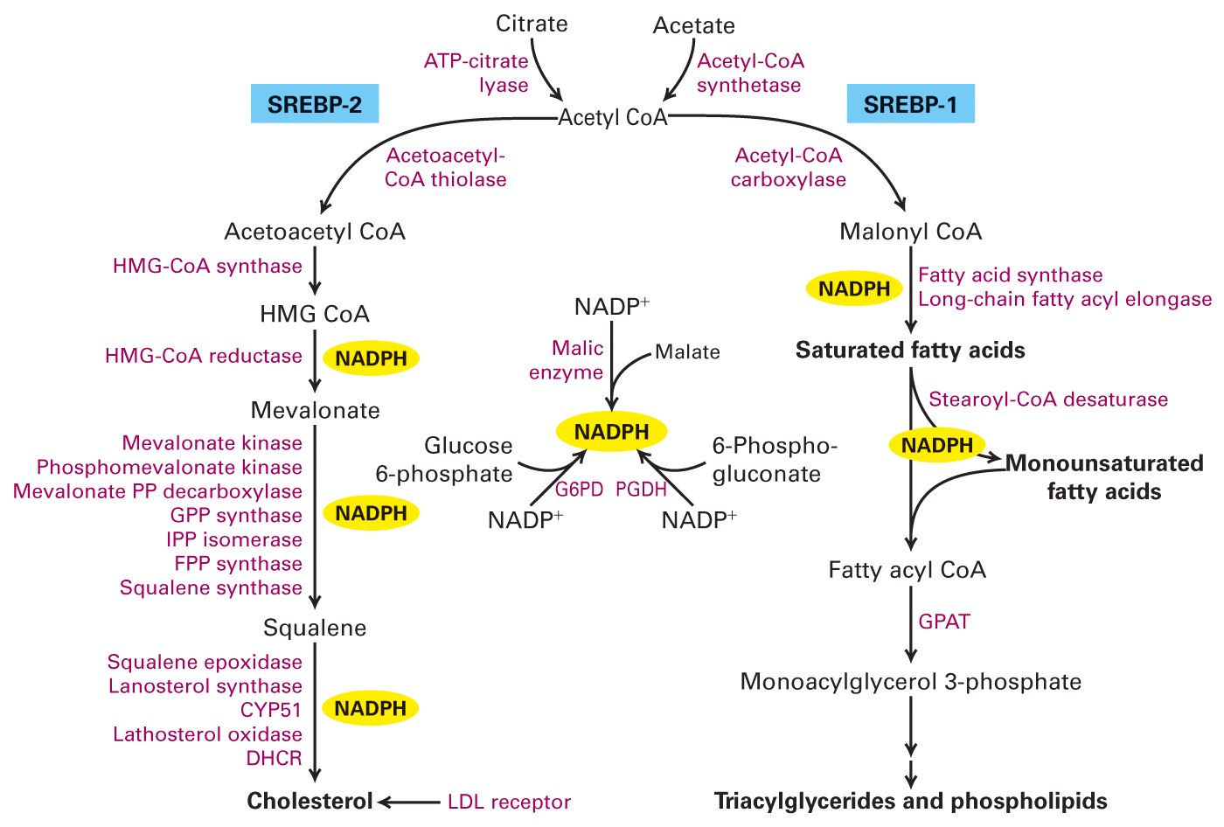

Slide 15
Regulation of synthesis
1. Feedback control: Cholesterol Inhibits HMG-CoA reductase.
2. Hormonal Regulation: Insulin, Glucagon, Steroids, Thyroxine.
3. Inhibition by Drugs: ‘Statin’ class of drugs.
4. Regulation by Bile Acids:

Slide 16
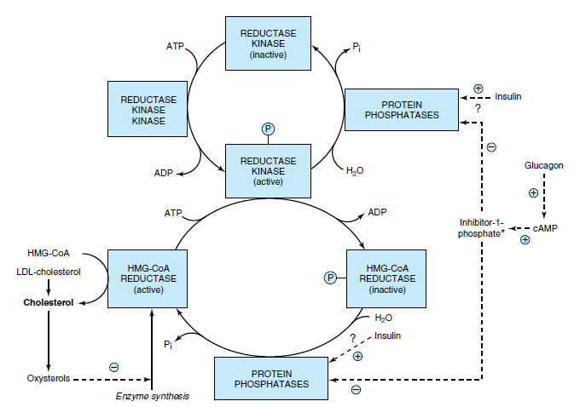
Regulation of Biosynthesis

Slide 17
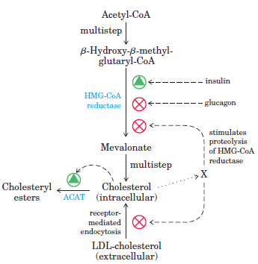
Regulation of Biosynthesis
Hormonal Regulation
Insulin
Thyroxin
Glucagon
Glucocorticoids

Slide 18
Fate of Cholesterol & IPP
Steroid Hormones
Bile Acids
Vitamin D
Cholesterol
Vitamin A
Rubber
Vitamin E
Isopentenyl Pyrophosphate (IPP)
Phytols
Vitamin K
Dolichols
Carotene
Ubiquinone

Slide 19
Biosynthesis of Bile Acids
Cholesterol
NADPH + H⁺
O₂
7 α Hydroxylase
NADPH
7 α Hydroxycholesterol
O₂
NADPH + H⁺
12 α Hydroxylase
CoA SH
Cholyl CoA
Chenodeoxycholyl CoA
Cholic Acid
ChenodeoxyCholic Acid
Primary Bile A.
Glycine
Taurine
Glycine
Taurine
Glycocholic Acid
Taurocholic Acid
Glycochenodeoxy CA
Taurochenodeoxy CA
Conjugated Bile A
Bacteria
Bacteria
Deoxycholic Acid
Lithocholic Acid
Secondary Bile A

Slide 20
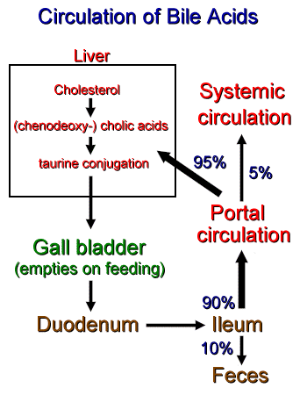
Regulation
Amount lost is resynthesised in liver
7 α hydroxylase is rate limiting enzyme
Activity of enzyme under feed back control by Farnesoid X Receptor
Enterohepatic Circulation :

Slide 21
Functions of Bile Salts
Lowers surface tension
Micelle formation
Absorption of vitamins
Stimulates intestinal activity
Keeps cholesterol in solution
Clinical significance:
Cholelithiasis: Formation of gall bladder stones

Slide 22
Synthesis of Steroid Hormones
Cholesterol is precursor of synthesis of all steriod hormones
    Glucocorticoides
    Mineralocorticoides
    Progestines
    Androgens
    Estrogen
    Various Hydroxylases are
    Required.
Cholesterol (27C)
Pregenenolone (21C)
Progesterone (21C)
Cortisol (21C)
Aldosterone (21C)
Estradiol (18C)

Slide 23
Hypercholesterolemia
Increased plasma cholesterol concentration (>200 mg/ dl) is hypercholesterolemia
Causes:
      DM
      Hypothyroidism
      Obstructive jaundice
      Nephrotic syndrome
According to lipid hypothesis abnormal cholesterol level is increased LDL & decreased HDL
Especially higher LDL particle concentration & smaller LDL particle size is important
Higher concentration of HDL is protective

Slide 24
Synthesis of Vitamin D
7- dehydrocholesterol is intermediate in the synthesis of cholesterol.
UV rays, convert it into cholecalciferol

Slide 25
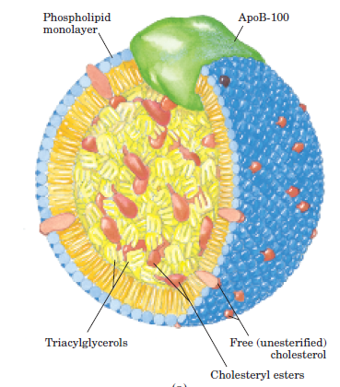
Transport of Cholesterol
As cholesterol is insoluble in water, transported in blood with Lipoproteins (LP)
LP have shell of phospholipid, chol. & apo-protein
Core composed of Triacyl glycerol & Cholesterol esters
Apo-protein acts as signal & targets LP to specific tissues & activate enzyme that act on LP
Each LP has specific function
    Chylomicron
    VLDL
    IDL
    LDL
    HDL

