Slide 1
MANAGING BASIC REMUNERATION
Dr. Subhasish Chatterjee

Slide 2
What is Remuneration?
Remuneration is any type of compensation or payment that an individual or employee receives as payment for their services or the work that they do for an organization or Company It includes whatever base salary an employee receives.

Slide 3
COMPONENTS
To be Specific , Typical Remuneration of an Employee Comparies Wages And Salary Incentives , Fringe Benefits, Perquisites And Non-monetary Benefits.
Wage and salary
Wages represent hourly rates of pay ,and salary refers to the monthly rate of pay, irrespective of the number of hours put in by an employee.

Slide 4
INCENTIVES
Also called as payments by results.
Incentives are paid in addition to wages and salaries incentives depend upon productivity, sales, profit or cost reduction efforts.
There are individual incentive schemes which are applicable to specific employee performance.
Group incentives are the incentives paid to the group as a whole.

Slide 5
ALLOWANCES
House rent allowance, conveyance allowance and leave travel allowance also form part of compensation.

Slide 6
GRATUITY
This is a statutory national component appearing in the salary breakup, but is paid only at the time of employees exit after serving more than five years
it is governed by the Payment of Gratuity Act, 1922.

Slide 7
CLAIMS
A part of monthly salary may be made up by build claims they include telephone or mobile allowance internet allowance and medical allowance.

Slide 8
TAXES
These , Like Death , are unavoidable.It is the duty of the employee to deduct taxes from an employee salary to The tax department.

Slide 9
FRINGE BENEFITS
These includes such benefits as provident fund, health and group insurance , canteen, uniform.

Slide 10
THEORIES
In order to understand which componnets of remuneration are more effective , we need to understand the conceptual framework or theories of the employee remuneration.
1) Reinforcement and expectancy theory
2) Equity theory
3) Agency theory

Slide 11
REINFORCEMENT AND EXPECTANCY THEORIES
This theory suggests that a behaviour which has a rewarding experience is likely to be repeated. The implication for remuneration is that high employees performance followed by a monetary reward will make future employee performance more likely.

Slide 12
EQUITY THEORY
Adams equity theory posits that an employee who perceives in equity in his or her awards seeks to restore equity.
This theory emphasizes equity in pay structure of employees remuneration. The remuneration system needs to meet 3 types of equity :
internal
external
individual

Slide 13
Internal equity
it involves the percent fairness of pay differential among different jobs within an organisation employee should feel that at the paid financials among jobs as fair, given the corresponding differences in job responsibilities.
External equity involves employees perception of the fairness of the remuneration relative to those outside the organisation
Individual equity considers employee perception of pay differential among individuals who hold identical jobs in the same organisation.
A professor in a University with more number of years of service behind him or her tends to receive higher salary than his or her junior who has become professor just now.

Slide 14
AGENCY THEORY
This theory focuses on the different interest and goals of the organisation stakeholders .
employers and employees are the two stakeholders of a business unit, the former assuming the role of principles and the latter the role of agents.
the remuneration payable to employees is the agency cost.

Slide 15
IMPORTANCE
Talks on job satisfaction, loyalty, organisation before self, altruism, and the like, may be alright for boardroom discussions and for delivering lectures in classrooms .
The talk may also be relevant in a country like Japan where people are inspired by a fanatical devotion to work.
But in our country, and average work cares only for money such being the reality remuneration must fulfill the Expectations and aspirations of employees and exploit their energies for the benefit of organisation.
Attractive compensation enables an organisation to attract, retain and motivate competent people ,retaining competent individuals for long is more difficult than attracting fresh ones.

Slide 16
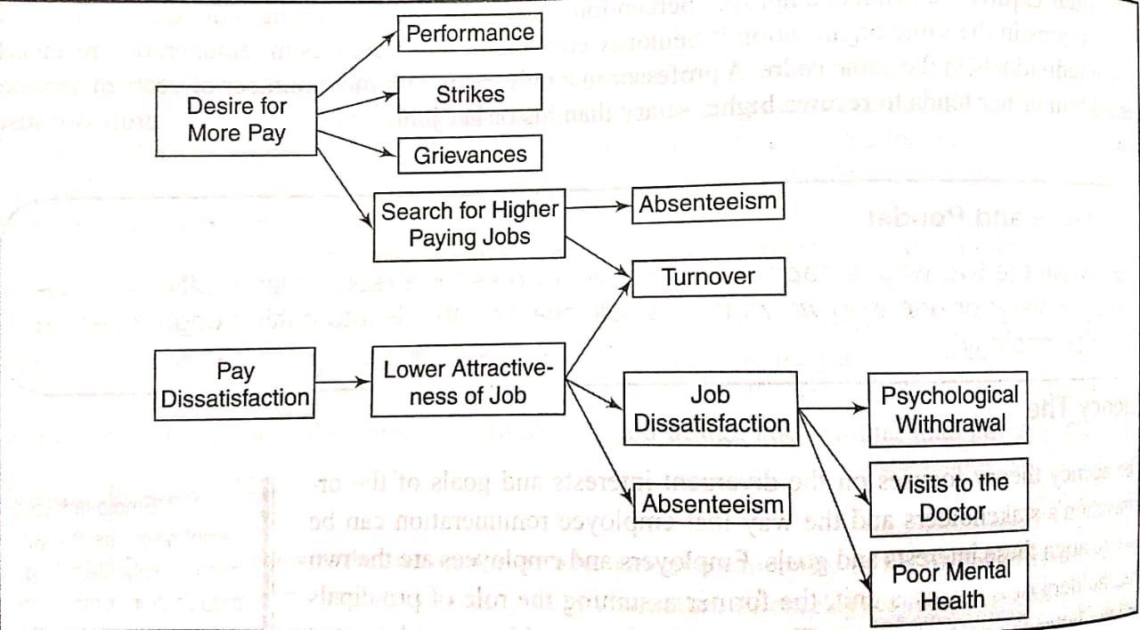
CONSEQUENCES OF PAY DISSATISFACTION

Slide 17
PAUSE AND PONDER
Attractive compensation enables an organization to attract ,retain and motivate competent people
Fresh MBA and brilliant engineers flocks around WIPRO , Infosys , Google , Reliance because of their attractive remuneration packages.
Employees get motivated to perform better when their past performance is rewarded. Employees achieving the desired level of performance expect a certain level of compensation.

Slide 18
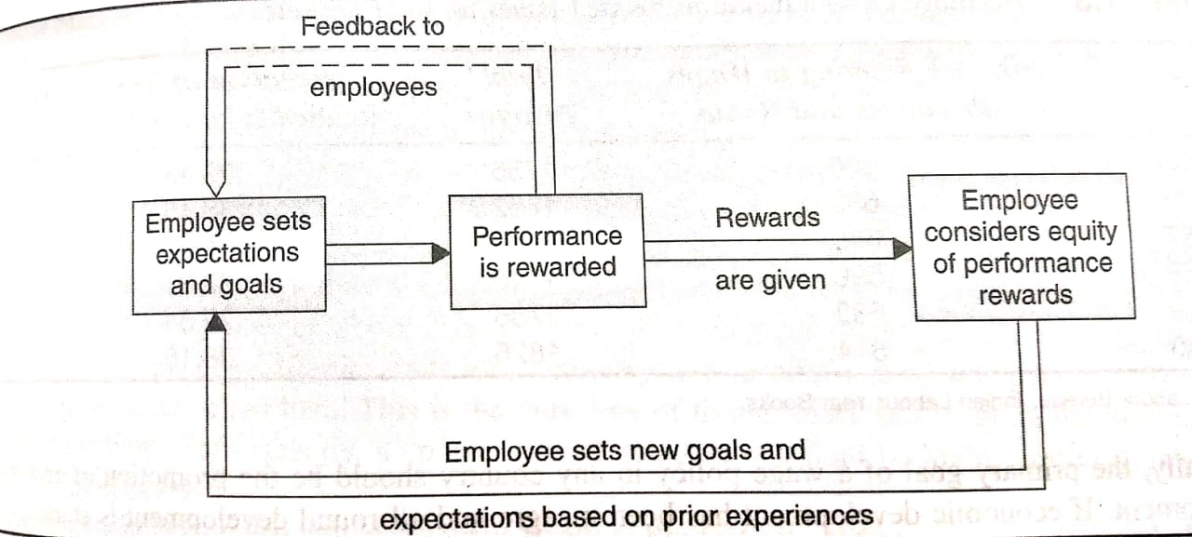
Motivation and performance Model

Slide 19
FACTORS INFLUENCING EMPLOYEE COMPENSATION
Influence the compensation payable to employees such as external and internal factors
External factors
External factors include labour market, cost-of-living, labour unions, government legislations, the society, and the economy
Labour market
Demand for and supply of labour influence Wage and salary fixation.
A low wage may be fixed when the supply of labour exceeds the demand for it higher wage will have to be paid when the demand exceeds supply, as in the case of skilled labour.

Slide 20
Going rate of pay is another labour related factor influencing employee compensation going rates are those that are paid by different units of an industry in a locality and biocompatible units of the same industry located elsewhere.
Productivity of labour also influences wage fixation productivity can arise due to increased effort of the worker, or as a result of the factors beyond the control of the workers such as improved Technology, sophisticated machines and equipment, better management, and the like.
Productivity arising from advanced technology and more efficient methods of production will influence wage fixation
Cost of living this Criterion matters during periods of rising prices, and is forgotten and prices stable or falling.
Arise in the cost of living is sought to be compensated by payment of dearness allowance, basic pay to remain undisturbed.

Slide 21
Labour unions
The presence or absence of labour organisations often determine the quantum of wages paid to employees.
Employers in in non unionized factories enjoy the freedom to fix wages and salaries as they please .
The employees of strongly unionized companies too, have no freedom in Wage and salary fixation.
Labour laws some of the central laws which have a bearing on employee remuneration are The the payment of wages act, 1936, the minimum wages act, 1948 ; The payment of of Bonus Act , 1965 equal remuneration act, 1976; the Payment of Gratuity Act, 1972
These acts seek to protect workers against irregularities in payment of wages and unauthorised deduction by the employers.

Slide 22
Society
Compensation paid to employees is reflected in the prices fixed by an organisation for its goods and services for this reason, the consuming public is interested in remuneration decisions.
The economy
The last external factor that has its impact on Wage and salary fixation is the state of the economy
For example a depressed economy will probably increase the labour supply this inturn should serve to lower the going wage rate.

Slide 23
Internal factors
The internal factors which have an impact on pay structure are the company’s strategy, job evaluation, performance appraisal, and the work himself or herself
Business strategy
The overall strategy which company pursues should determine the compensation to its employees.
Where the strategy of the enterprise is to achieve Rapid growth, remuneration should be higher than what competitors pay.

Slide 24
Job evaluation and performance appraisal
Job evaluation helps establish satisfactory wage differential among jobs .
several employee related factors interact to determine his or her compensation these include performance, seniority, experience, potential, and Even sheer luck.
Performance is always rewarded with a pay increase.
Rewarding performance motives the employee to do better managements and employees prefer performance to effect pay increases but unions view seniority as the most objective Criterion for pay increases.

Slide 25
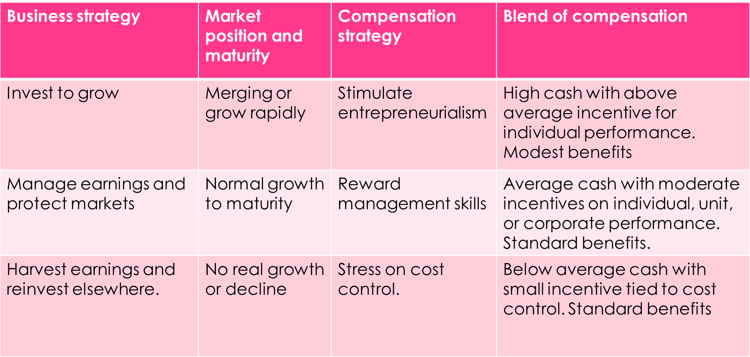
COMPENSATION PLAN AND BUSINESS STATERGY

Slide 26
JOB DESCRIPTION
JOB EVALUATION
JOB HIERARCHY
PAY SURVEY
PRICING JOBS
Devising a Compensation plan

Slide 27
JOB DESCRIPTIONS are crucial in designing pay systems, for, they help to identify important job characteristics.
JOB EVALUATION this is an important step in pay fixation and to establish relative worth of jobs by employing job evaluation.
JOB HIERARCHY the points assigned to all compensable factors are aggregated.
The total points scored will help establish the hierarchy of job work, starting from the highest point total to the lowest point total.

Slide 28
JOB DESCRIPTIONS are crucial in designing pay systems, for, they help to identify important job characteristics.
JOB EVALUATION this is an important step in pay fixation and to establish relative worth of jobs by employing job evaluation.

Slide 29
Challenges of compensation
Employee participation
Pay secrecy
Skill based pay
compensation
Elitisms or Egalitarianism
Salary reviews
Comparable worth
Monetary and non monetary rewards
Below and above market rates

Slide 30
SKILL BASE PAY
In the traditional job based pay, employees are paid on the bases of the job they do.
But in the skill based system , worker are paid on the basis of number of jobs they are capable of doing, or depth of their knowledge.

Slide 31
SKILL BASED PAY AND JOB BASED PAY COMPARISON
FACTORS | SKILL BASED | JOB BASED
Pay structure | Based on job performance | Based on the ability
Employer’s focus | Job carries wages | Employee carries wages
Employee focus | Job promotion to earn | Skill acquisition to earn
Advantages | Pay based on value of work performance | Flexibility
Disadvantages | Potential personnel bureaucracy: inflexibility | Potential personnel bureaucracy: cost controls

Slide 32
WAGES POLICY IN INDIA
The objectives of wage policy are
To obtain for the workers a just share of the fruits of economic development
To set minimum wages for workers whose bargaining position is weak
To bring about a more efficient allocation and utilisation of human resources through Wage and salary differentials.
To abolish malpractices and abuses in Wage and salary payments
The first step towards the evolution of wage Policy was the enactment of the payment of wages act, 1936.

Slide 33
Concept of wages
While evolving wage policy, three concepts of wages namely minimum wages, fair wages, living wages are generally considered.
MINIMUM WAGE is the one which provides not nearly for bare sustenance of life, but also for the preservation of the efficiency of the worker.

Slide 34
FAIR WAGE is understood in two ways in a narrow sense, which is fair if it is equal to the rate prevailing in the same trade and in the neighbourhood for similar work.
LIVING WAGE is a step higher than fair wage living wage may be described as one which would enable the wage earner to provide for himself or herself and his or her family not only the bare essentials of life like food clothing shelter but a measure of frugal comfort including education for children, protection against ill health, requirements of essential social needs, and or measure of insurance against the more important misfortunes including old age.

Slide 35
INCENTIVES
Incentive payments are based on efficiency of employees, efficiency itself being determined by comparing actual performance with standard performance.

Slide 36
TYPES OF INCENTIVE SCHEMES
International labour organisation (ILO) classifies all the schemes of payment by results into 4 categories:
Incentive schemes
Earnings differ at the different levels of output.
Taylor’s differential piece rate
Merrick piece rate
Gantt task system
Emerson’s efficiency plan
Earnings vary in the more proportion than the output
High piece rate
High standard hour
Earnings vary in the less proportion than the output
Halsey plan
Rowan plan
Barth scheme
Bedaux plan
Earnings vary in the same proportion as the output
Straight piece work
Standard hour

Slide 37
IMPORTANCE OF INCENTIVES
The primary advantage of incentives is the inducement and motivation of workers for higher efficiency and greater output.
Earnings of the employees would be enhanced due to incentives.
Production capacity is also likely to increase. The Bangalore-based rail wheel factory, for example has now a production capacity of 77,000 wheels and 48,000 axles as against the initial capacity of 56,800 wheels and 23000 axles.
The higher capacity has been achieved as a result of implementation of the recommendations for the adoption of a group incentive scheme carried out by the Rail India technical and economic services.

Slide 38
DISADVANTAGES
There is a tendency for the quality of products to deteriorate unless steps are taken to ensure maintenance of quality through checking and inspection.
Difficulty may arise over the introduction of new machines or methods.
Workers may oppose such introduction of new ways and methods.

Slide 39
THANK YOU

