Slide 1
Physiotherapy after Hip dislocation
Dr. Purvi Patel

Slide 2
Objectives
At the end of the session, students should be able to
Enumerate types of hip dislocation
Explain mechanism of injury of hip dislocation
Explain the physiotherapy management after surgery for hip dislocation

Slide 3
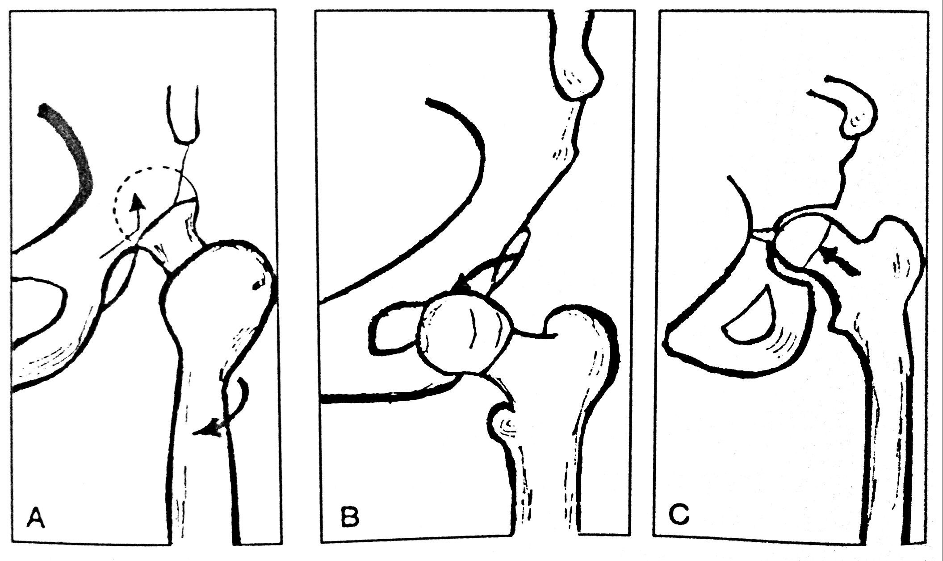

Slide 4
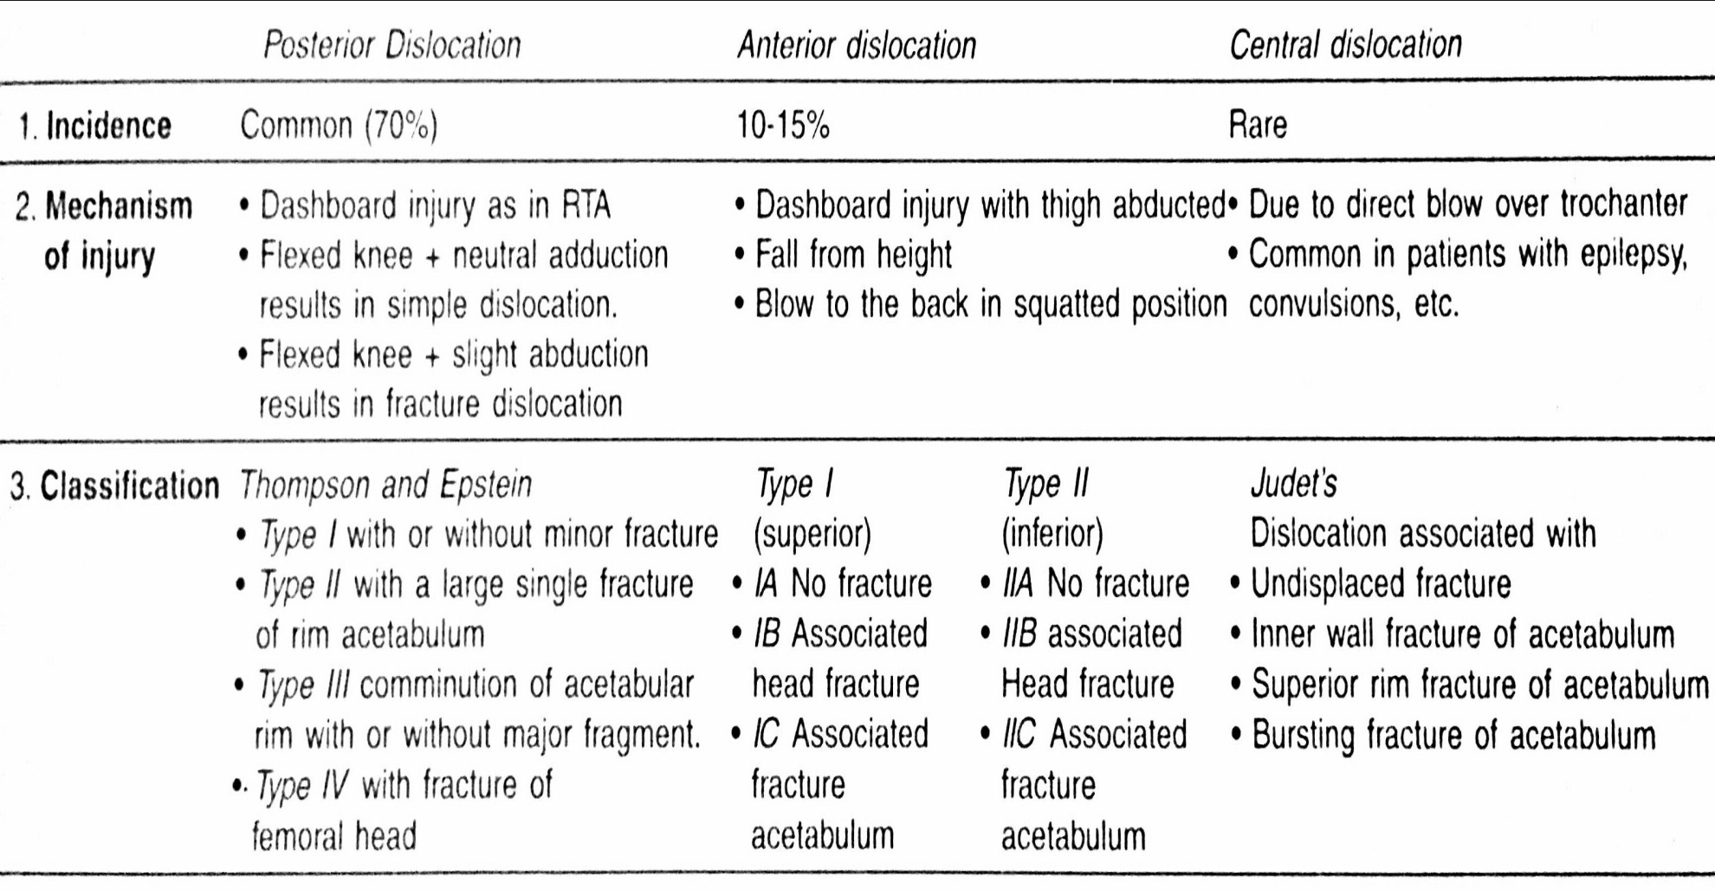
Comparative features of dislocation of hip

Slide 5
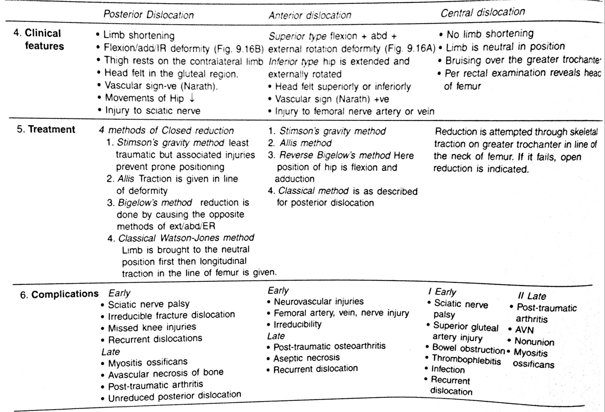

Slide 6
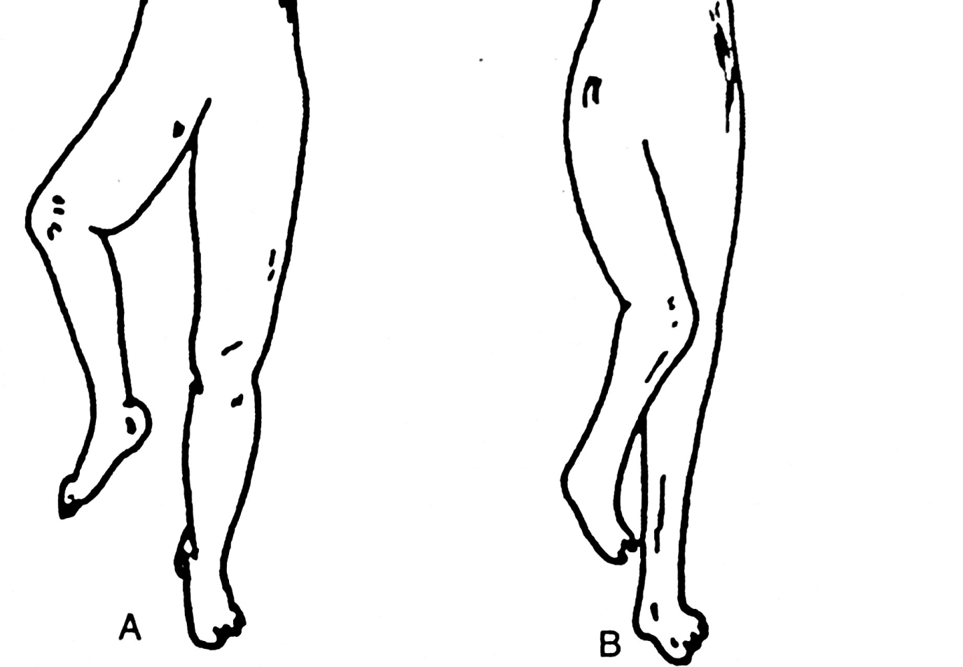

Slide 8
Physiotherapy management after surgery
During the 1st week:
Precautions:
Wound inspection
No passive range
Prevent secondary complications:
Prevent pulmonary and DVT complications
Derotation bar
Isotonic exercises at ankle

Slide 9
Maintain strength of the muscles:
Isometric exercises for hip abductors, gluteus and quadriceps muscles
Maintain range of hip and knee joint:
Active exercise of flexion-extension of hip & knee gradually

Slide 10
Weight bearing with crutch or walker
ADL’s: use of raised toilet seat and chair, wearing trousers from affected side first and removing it from non-affected side first, rolling on unaffected side

Slide 11
During 2-4 weeks:
No passive movement
Ankle isotonic continued
Improve range of hip and knee joint:
Active and active-assisted exercises for hip, knee and ankle

Slide 12
Maintain strength of muscles:
Isometric of hip and knee
Weight bearing: walking with walker or crutch

Slide 13
During 4-8 weeks
More or less same
Improve range of hip joint
Flex hip upto 90⁰
Self assisted heel drag
Improve strength of the muscles of hip and knee:
High sitting
Assisted and self resisted exercises of hip and knee muscle

Slide 14
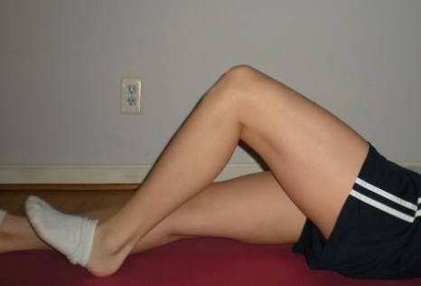

Slide 15
After 8 weeks:
Can give slight passive force
improve strength of the muscles:
Isotonic and isokinetic exercises
PRE
Normalize the gait and ADL’s:
Four point gait
ADL’s allowed normally to perform

Slide 16
After 12-16 weeks full weight bearing is allowed

