Slide 1
TOTAL Knee ARTHROPLASTY
By: Dr Purvi Patel

Slide 2
Objectives
The student at the end of the session will be able to
Enumerate the indications, contraindications of knee arthroplasty
List the principles of assessment and management of THR

Slide 3
Indications
Severe joint pain with weight bearing or motion that compromises functional abilities
Extensive destruction of articular cartilage of the knee secondary to advanced arthritis
Marked deformity of the knee such as genu varum or valgum
Gross instability or limitation of motion
Failure of nonoperative management or a previous surgical procedure

Slide 4
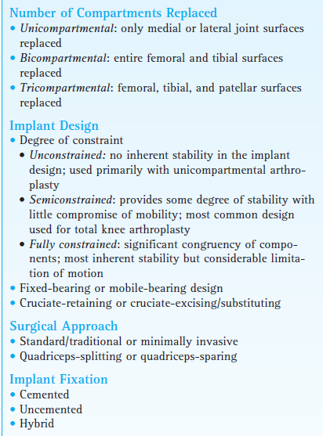
Types of knee arthroplasty

Slide 5
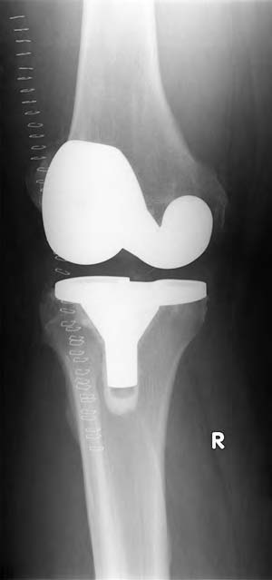

Slide 6
Surgical approach
Anteromedial parapatellar vertical or curved incision from the distal aspect of the femoral shaft, running medial of the patella to just medial of the tibial tubercle, ranging from 8 to 12 cm or 13 to 15 cm in length

Slide 7
Fixation
cemented, uncemented, or “hybrid”
Hybrid” TKA combines cemented fixation of the tibial component and cementless fixation of the femoral component.
Depends on: patient’s age, bone quality, expected activity level, and the tightness of fit of the femoral component

Slide 8
Operative Overview
quadriceps-splitting or a quadriceps-sparing approach is used. The knee is flexed; and osteophytes, menisci, and the ACL are resected. The lateral retinaculum may be released to improve patellar Tracking.
The wound is closed with the knee extended and with a small suction drain in place. A sterile dressing is placed over the incision, and the area is covered from foot to thigh with a compression wrap.

Slide 9
Complications
Intraoperative
intercondylar fracture or damage to a peripheral nerve (e.g., the peroneal nerve), is uncommon
Fracture or malpositioning of an implant
Early and late postoperative
infection
joint instability
polyethylene wear
mechanical loosening-the tibial component

Slide 10
limited knee flexion
joint instability leading to subluxation
patellar instability or tracking problems leading to impaired function of the extensor mechanism (most often an extensor lag).

Slide 11
Postoperative Management

Slide 12
A patient is advanced from one phase of rehabilitation to the next based on an evaluation of their signs and symptoms and responses to selected interventions rather than at designated time periods.

Slide 13
Immobilization and Early Motion
the knee is immobilized in a bulky compression dressing for a day, or sometimes continuous passive motion (CPM) is initiated within a day after surgery.
The position of immobilization is extension.
During the initial postoperative period, patient advised to wear a posterior extension splint during ambulation until quadriceps control is re-established.

Slide 14
Although the addition of CPM increased the rate of return of knee flexion during the early postoperative period it provided no significant long-term benefits as to gains in ROM and functional mobility.
The literature currently reflects that it is either no longer recommended after primary TKA or, if used, is recommended as an adjunct to, not a replacement for, a postoperative exercise program.

Slide 15
Weight-Bearing Considerations
depends on the type of prosthesis implant, the type of fixation used, the patient’s age, size, and bone quality, and whether a knee immobilizer is worn during ambulation or transfers.
With cemented fixation, weight bearing typically is permitted as tolerated immediately after surgery using crutches or a walker.
During the first few days after surgery, use of a knee immobilizer may be required.
The patient progresses to full weight bearing over 6 weeks.

Slide 16
With biological/cementless fixation, recommendations vary from touch-down weight bearing for 4 to 8 weeks to weight bearing as tolerated within a few days after surgery.
Cane use is indicated as a patient progresses from partial to full weight bearing. Ambulation without an assistive device, is not advisable until the patient has attained full or nearly full active knee extension and adequate strength of the quadriceps and hip musculature.

Slide 17
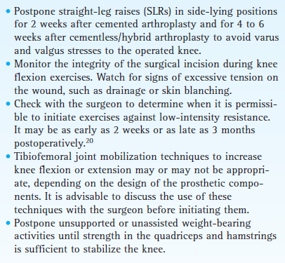
Exercise precautions following TKA

Slide 18
Exercise: Maximum Protection Phase (0-4 weeks)
to control pain and swelling (with cold and compression),
achieve independent ambulation and transfers
prevent early postoperative medical complications, such as pneumonia and deep vein thrombosis, and
minimize the adverse effects of postoperative immobilization.
The goal is to attain 90 of knee flexion and full knee extension
In addition to early postoperative exercise, neuromuscular electrical stimulation or biofeedback is recommended.

Slide 19
Prevent vascular and pulmonary complications.
■ Ankle pumping exercises with the leg elevated immediately after surgery to prevent venous stasis and reduce the risk of a DVT or pulmonary embolism
■ Deep breathing exercises
Control pain and swelling.
■ Cold, compression, and elevation
Minimize reflex inhibition or loss of strength of knee and hip musculature.
■ Muscle-setting exercises of the quadriceps

Slide 20
Active-assisted and active straight leg raise (SLR) exercises in supine
Active-assisted ROM (A-AROM) progressing to active ROM (AROM) of the knee while seated and standing for antigravity knee extension and flexion, respectively.
As weight bearing on the operated lower extremity permits, terminal knee extension in standing, wall slides in a standing position, minisquats, and partial lunges to develop control of the knee extensors and reduce the risk of an extensor lag

Slide 21
Maintain or improve strength of the contralateral lower extremity.
■ PRE of nonoperated lower extremity, particularly the quadriceps and hip extensors and abductors312
Regain knee ROM.
■ Heel-slides in a supine position or while seated with the foot on the floor to increase knee flexion
Gravity-assisted knee flexion by having the patient sit and dangle the lower leg over the side of a bed
■ Gravity-assisted or self-assisted knee extension in the supine or long-sitting position
Gentle inferior and superior patellar gliding techniques to prevent restricted mobility

Slide 22
PRECAUTION: Avoid placing a pillow under the knee while
lying supine or while seated with the operated leg elevated to reduce the risk of developing a knee flexion contracture.
Improve trunk stability and balance.
■ Trunk stabilization exercises
■ Balance activities in sitting and weight shifting in bilateral stance while adhering to weight-bearing restrictions
Reestablish functional mobility.
■ Gait training adhering to weight-bearing restrictions with use of appropriate assistive device
■ Functional training (bed mobility, sit-to stand transfers, basic ADL)
Criteria to progress.
The criteria to progress to the intermediate phase of rehabilitation include the following.
■ Minimal swelling and pain
■ Well-healed incision with no signs of infection
■ Independent basic ADL and ambulation with appropriate assistive device
■ AROM approaching full or nearly full, active knee extension and 90° knee flexion

Slide 23
Exercise: Moderate Protection Phase (4-8 to 12 weeks)
achieve approximately 110 knee flexion and active knee extension to 0
to regain lower extremity strength, muscular endurance, and balance.
By 4 to 6 weeks postoperatively if nearly full knee extension has been achieved and the strength of the quadriceps is sufficient, most patients transition to using a cane during ambulation activities. This makes it possible to focus on improving the patient’s gait pattern and the speed and duration of walking.

Slide 24
Increase strength and endurance of knee and hip musculature.
■ Multiple-angle isometrics and low-intensity dynamic resistance exercises of the quadriceps, hamstrings, and hip musculature (extensors, abductors, external rotators) against a light grade of elastic resistance or a cuff weight around the ankle
■ Resisted SLRs in various positions to increase the strength of hip and knee musculature

Slide 25
As weight bearing allows, continue or begin closed-chain exercises including resisted terminal knee extension in standing, standing wall slides, minisquats, partial lunges
Add forward and backward, progressing to lateral stepups and step-downs
Stationary cycling with the seat positioned as high as possible to emphasize knee extension
Include strengthening exercises for the nonoperated lower extremity
Continue to increase knee ROM.
Low-intensity self-stretching using a prolonged stretch or hold-relax technique to increase knee flexion and extension if limitation persists.

Slide 26
Grade III inferior or superior patellar mobilization techniques to increase knee flexion
Improve standing balance and trunk stability.
■ Trunk stabilization exercises
■ Proprioceptive and balance training progressing from bilateral to unilateral stance on stable surface, then to balance activities on an unstable surface
■ Functional reaching activities while standing or stooping
■ Tandem walking, grapevine walking initially in parallel bars for safety
PRECAUTION:
A progression of balance activities for patients with TKA is typically safe to begin about 8 weeks postoperatively but must be based on the ability to control the knee during stance, weight-bearing restrictions, and the absence of pain.225
■ Continue to improve functional mobility.

Slide 27
Improve cardiopulmonary endurance.
■ Aerobic conditioning on a stationary cycle or upper body ergometer, emphasizing increased duration
Criteria to progress. The following criteria typically must
be met to progress to the final phase of rehabilitation following TKA.
AROM: full knee extension (no extensor lag), 110° knee flexion
Quadriceps/hamstring and hip muscle strength: at least 70% (or 4/5 muscle testing grade) compared to uninvolved leg
Minimal to no pain during exercises and ambulation with or without a cane

Slide 28
Exercise: Minimum Protection and Return to Function Phases (8th week onwards)
task-specific strengthening exercises, proprioceptive training, and cardiopulmonary conditioning so the patient develops the strength, balance, and endurance needed to return to a full level of functional activities.

Slide 29
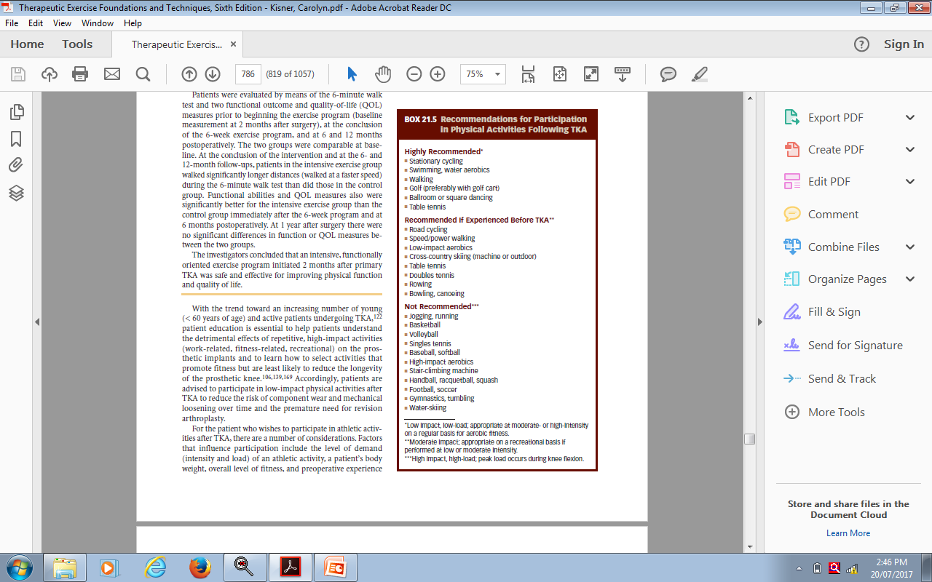

Slide 30
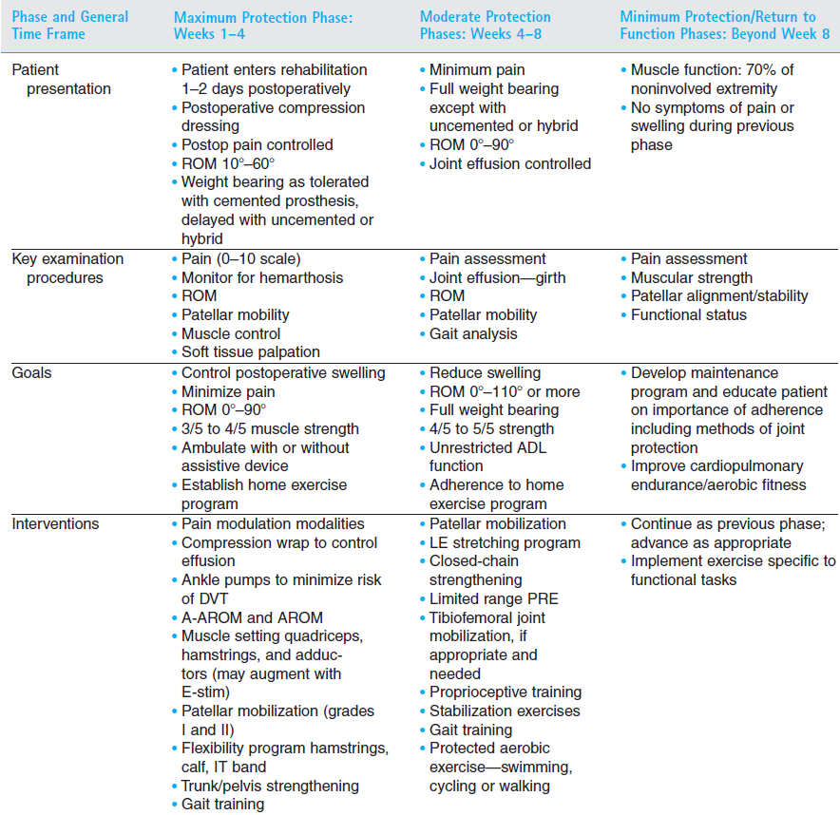

Slide 31
EVIDENCES….
P: patients operated with THR or TKR
I: typical exercises & balance exercises
C: only typical exercises
O: (1) the Berg Balance Scale, (2) the Timed Up and Go test, (3) the Western Ontario McMaster Universities Osteoarthritis Index, and (4) the Activities-specific Balance Confidence Scale.

Slide 32
Effectiveness of balance exercises in the acute post-operative phase following total hip and knee arthroplasty: A randomized clinical trial
Authors: Pankaj Jogi, Tom J Overend, Sandi J Spaulding, Aleksandra Zecevic and John F Kramer
Published: SAGE Open Medicine 2015

Slide 33
Methods: Patients who had total hip arthroplasty (n = 30) or total knee arthroplasty (n = 33) were seen in their residence 1–2 times per week for 5 weeks. At the first post-operative home visit, patients were randomly assigned to either typical (TE, n = 33) or typical plus balance (TE + B, n = 30) exercise groups. The TE group completed seven typical surgery-specific joint range-of-motion and muscle strengthening exercises, while the TE + B group completed the typical exercises plus three balance exercises. Patients were assessed before and 5 weeks after administering the rehabilitation program using four outcome measures: (1) the Berg Balance Scale, (2) the Timed Up and Go test, (3) the Western Ontario McMaster Universities Osteoarthritis Index, and (4) the Activities-specific Balance Confidence Scale.
Conclusion: Balance exercises added to a typical rehabilitation program resulted in significantly greater improvements in balance and functional mobility compared to typical exercises alone.

