Slide 1
Health care system in India
By- Rahul Sharma

Slide 2
Concept of health care
“health care” implies more than “Medical care” not just the synonyms
Influence by adequate food, housing, basic sanitation, lifestyles, protection against diseases,
Health has been declared as fundamental human right.
State is responsible for the health of people

Slide 3
Major health problems
• Nearly one-eighth of equivalent life years continue to be lost due to various diseases.
• Double burden of communicable and non communicable diseases.
• Nutritional problem among mothers and children.

Slide 4
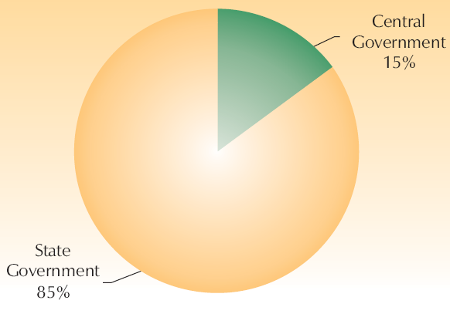
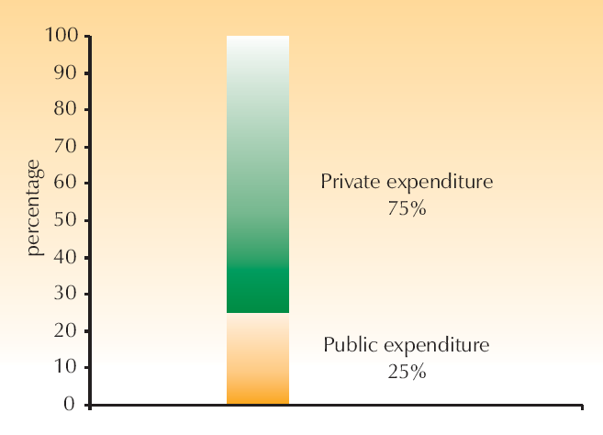
Health expenditure

Slide 5
Health care systems
Public health sector
Private health sector
Indigenous system of medicine
Voluntary health agencies
National health programme

Slide 6
Public health sector
Primary health centres and community health centres
Rural hospitals and District hospitals
Specialist hospitals and teaching hospitals
Health insurance schemes
Defense and railway

Slide 7
Private health sector
Private hospitals
Polyclinics and nursing homes
Private practitioners and general practitioners
Multispecialty hospitals

Slide 8
Indigenous systems of medicine
Ayurveda
Unani
Siddha
Homeopathy
Tibbi
Naturopathy
Unregistered practitioners

Slide 9
Voluntary health agencies
Supplement government activities
Advocacy, guarding and promotion of health programme
  Indian red cross society
  Rockefeller foundation
  CARE
  Malinda and gates foundation
  WHO
  World bank
  UNFPA
  UNICEF

Slide 10
National health program
Various health programmes for the children and reproductive womens
National health programme for communicable diseases like TB, Malaria, AIDS, etc
Integrated disease surveillance project
National health programme for prevention and control of Non communicable diseases like diabetes, hypertension, cancers
Programme for improvement of environment and sanitation

Slide 11
Organization of the health system
extends from the national level to village level.
healthcare system at national- Health, Family Welfare, and Indian System of Medicine and Homeopathy,
At state – Minister and with a Secretariat under the charge of Secretary/Commissioner (Health and Family Welfare)

Slide 12
Organization of the health system
At Regional - covers three to five districts and acts under authority delegated by the State Directorate of Health Services.
District – Chief district health officer (CDHO)
Taluka level- Assistant District Health and Family Welfare Officer (ADHO)

Slide 13
Organization of the health system
Community (CHC) –for every 80,000 to 1, 20,000 population with services in general medicine, pediatrics, surgery, obstetrics and gynecology.
PHC - covering about 30,000 (20,000 in hilly, desert and difficult terrains) with Medical officer and supportive staff
sub-centre levels - for about 5,000 populations (3,000 in hilly and desert areas) with male and female health workers

Slide 14
Levels of health care
Primary health care
Secondary health care
Tertiary health care

Slide 15
Criticism of existing health care
Predominately Urban oriented
Mostly curative in nature
Accessible to small part of general population
Poor acceptable level of many services
Many institutions are not functional due to staff shortage and non-availability of drugs and consumables and essential equipment
Increase burden over family in many situation

