Slide 1
PLANTER FASCITIS
Dr .Maitri Shukla

Slide 2
Plantar fasciitis is most common causes of heel pain. It involves pain and inflammation of thick band of tissue, called plantar fascia.
It is caused by repeated stress of weight bearing during walking, running, climbing and its leads microtrauma to planter fascia.
Have flat feet or high arch
Tight TA tendon
Wear high heel
Patient complains of pain early in the morning during first step in the sole or heel, during weight bearing and is relieved once it is discontinued.
Some time heel spur may develop at the site of irritation on calcaneus.
It also seen in gout and RA.

Slide 3
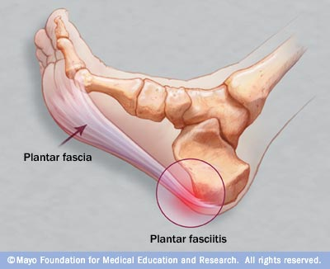
Planter fasciitis

Slide 4
Assessment
On Observation:
Swelling may be present around heel
On examination:
Pain examination: pain increasing in weight bearing activity, early in the morning
Tenderness over the medial side on the calcaneum
ROM of affected joint
TA tightness

Slide 5
Conservative treatment:
consists of NSAIDs and local steroids.
Surgical treatment:
Surgery is indicated when no relief is seen with conservative treatment.
Osteotomy of the calcaneus.
Decompressing operation with multiple drill holes in the calcaneus.

Slide 6
Physiotherapy treatment:
Pain relieve modalities :ultra sound,
hot pack

Slide 7
Exercises to the intrinsic muscle in warm water in the morning before initiating weight bearing are useful in lessening the morning pain.

Slide 8
Exercise of toe curling and holding it for some time.
Walking on the outer border of the foot with the toes curled up either bare foot or within the shoes during walking, standing.
Apply deep massage and stretching exercise to the planter fascia.

Slide 9
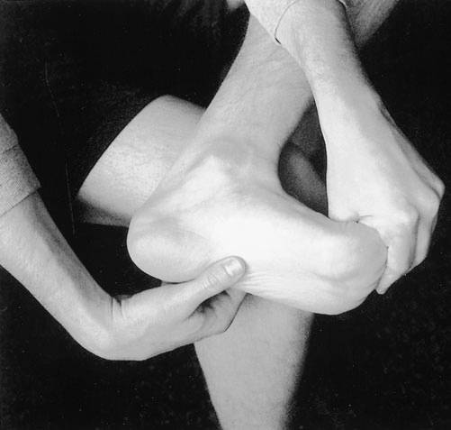
Plantar fascia-stretching exercise. The patient crossed the affected leg over the contralateral leg. While placing the fingers across the base of the toes, the patient pulled the toes back toward the shin until he or she felt a stretch in the arch or plantar fascia. The patient confirmed that the stretch was correct by palpating tension in the plantar fascia. Holding the stretch
for a count of ten.

Slide 10
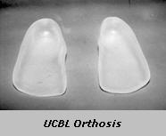
Shoe modification
UCBL shoe insert to increase the angle between the hindfoot and forefoot is inserted. This relaxes the plantar fascia and relieves stress on it. It is effective in reducing the pain.

Slide 11
Plantar Fascia-Specific Stretching Exercise Improves Outcomes in Patients with Chronic Plantar Fasciitis.

Slide 12
pport | BENEDICT F. DIGIOVANNI et al THE JOURNAL OF BONE & JOINT SURGERY VOLUME 88-A · AUGUST 2006 | The aim of this study was to evaluate the long-term outcomes of the plantar fascia-stretching protocol in patients with chronic plantar fasciitis. | The two-year follow-up results showed marked improvement for all patients after implementation of the plantar fascia-stretching exercises, with an especially high rate of improvement for those in the original group treated with the Achilles tendon-stretching program. | This study support plantar fascia-stretching protocol as the key component of treatment for chronic plantar fasciitis. Long-term benefits of the stretch include a marked decrease in pain and functional limitations and a high rate of satisfaction.

Slide 13
CONTINUOUS ULTRASOUND FOR CHRONIC PLANTAR FASCIITIS TREATMENT

Slide 14
Level of Evidence | JOURNAL | AIM OF THE STUDY | RESULT | CONCLUSIONS
Level II. | Renata Graciele Zanon et al ACTA ORTOP BRAS 14(3) - 2006 | The aim of this study is see the use of high-power continuous US is a potential indication for chronic PF treatment | group 1 (stretching + ultrasound turned off) and group 2 (stretching + 2 w/cm² ultrasound). After 15 treatment sessions a functional improvement was seen for both groups, with no difference between them. | The high-power continuous ultrasound did not add value for function and pain; additionally, only specific stretching exercises were efficient in reducing more than 50% of the pain in chronic plantar fasciitis.

