Slide 1
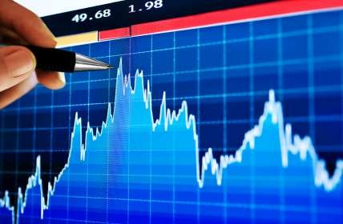
Market equilibrium
Ms. Mital Thakkar
Assistant Professor
Department of Management
SVDU

Slide 2
Supply and Demand Together
Equilibrium Price
The price that balances supply and demand. On a graph, it is the price at which the supply and demand curves intersect.
Equilibrium Quantity
The quantity that balances supply and demand. On a graph it is the quantity at which the supply and demand curves intersect.
Demand Schedule
Supply Schedule
 | Price | Quantity
 | $0.00 | 19
 | 0.50 | 16
 | 1.00 | 13
 | 1.50 | 10
 | 2.00 | 7
 | 2.50 | 4
 | 3.00 | 1
Price | Quantity
$0.00 | 0
0.50 | 0
1.00 | 1
1.50 | 4
2.00 | 7
2.50 | 10
3.00 | 13
At $2.00, the quantity demanded is equal to the quantity supplied!

Slide 3
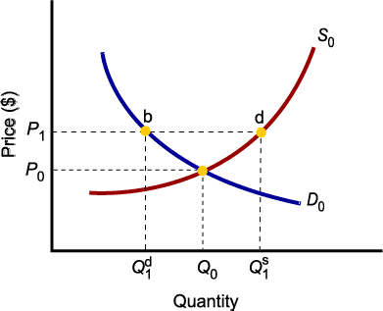
Market Equilibrium
A market brings together those who are willing and able to supply the good and those who are willing and able to purchase the good.
In a competitive market, where there are many buyers and sellers, the price of the good serves as a rationing mechanism.
Since the demand curve shows the quantity demanded at each price and the supply curve shows the quantity supplied, the point at which the supply curve and demand curve intersect is the point at where the quantity supplied equals the quantity demanded. This is call the market equilibrium.
  Only in equilibrium is quantity supplied equal to quantity demanded.
  At any price level other than P0, the wishes of buyers and sellers do not coincide.

Slide 4
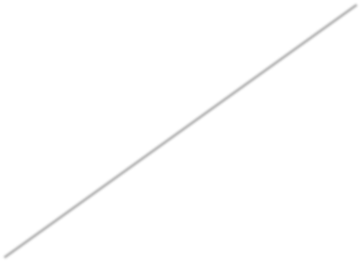
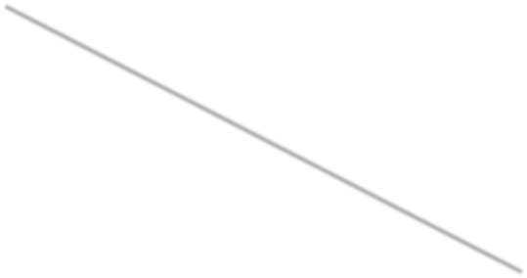


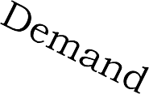
Consumer Surplus
Only the marginal consumer is willing to pay just the market price in a typical supply and demand equilibrium.
The consumers would be willing to pay more than the market price are what makes the demand curve slope downward.
The amount that these consumers would be willing to pay, but do not have to pay is known as the consumer surplus.
Consumer Surplus:
Prices
Equilibrium Point
Consumer Surplus
The difference between the
demand curve (marginal benefit) and price (marginal cost)
Quantity

Slide 5



Producer Surplus
The marginal cost of producing a good is represented by the supply curve.
The price received by the sale of the good would be the marginal benefit to the producer, so the difference between the price and the supply curve is the producer surplus.
Producer surplus:-The difference between the price (marginal benefit) and the supply curve
Prices
Equilibrium Point
(marginal cost).
Producer surplus
Quantity

Slide 6
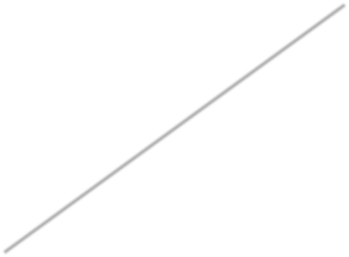
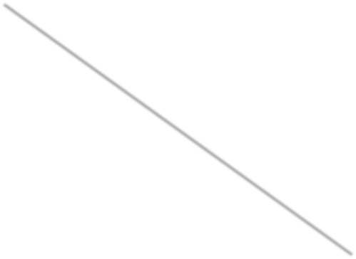

Market Disequilibria
Price
Excess demand, or shortage, is the condition that exists when quantity demanded exceeds quantity supplied at the current price.
  When quantity demanded exceeds quantity supplied, price tends to rise until
equilibrium is restored.
Shortage
Quantity

Slide 7
Market Disequilibria
Price
Excess supply, or surplus, is the condition that exists when quantity supplied exceeds quantity demanded at the current price.
Surplus
When quantity supplied exceeds quantity demanded, price tends to fall until equilibrium is restored.
Quantity

Slide 8
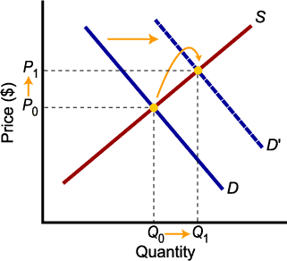
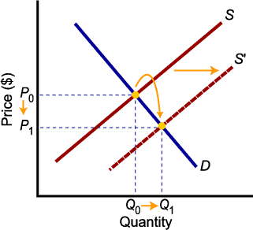
Increases in Demand and Supply
Higher demand leads to higher equilibrium price and higher equilibrium quantity.
Higher supply leads to lower equilibrium price and higher equilibrium quantity.

Slide 9
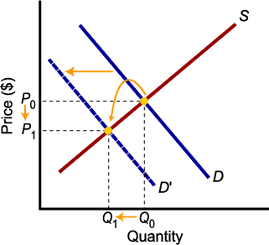
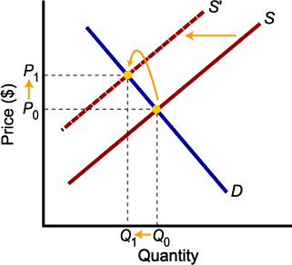
Decreases in Demand and Supply
Lower demand leads to lower price and lower quantity exchanged.
Lower supply leads to higher price and lower quantity exchanged.

