Slide 1
Physiotherapy in Abdominal Surgeries
By- Parth P. Devmurari

Slide 2
Objectives
Brief overview of abdominal organs
Different types of abdominal Incisions indicated for surgeries
Pre and Post operative physiotherapy management after abdominal surgery

Slide 3
BRIEF OVERVIEW OF ORGANS

Slide 4
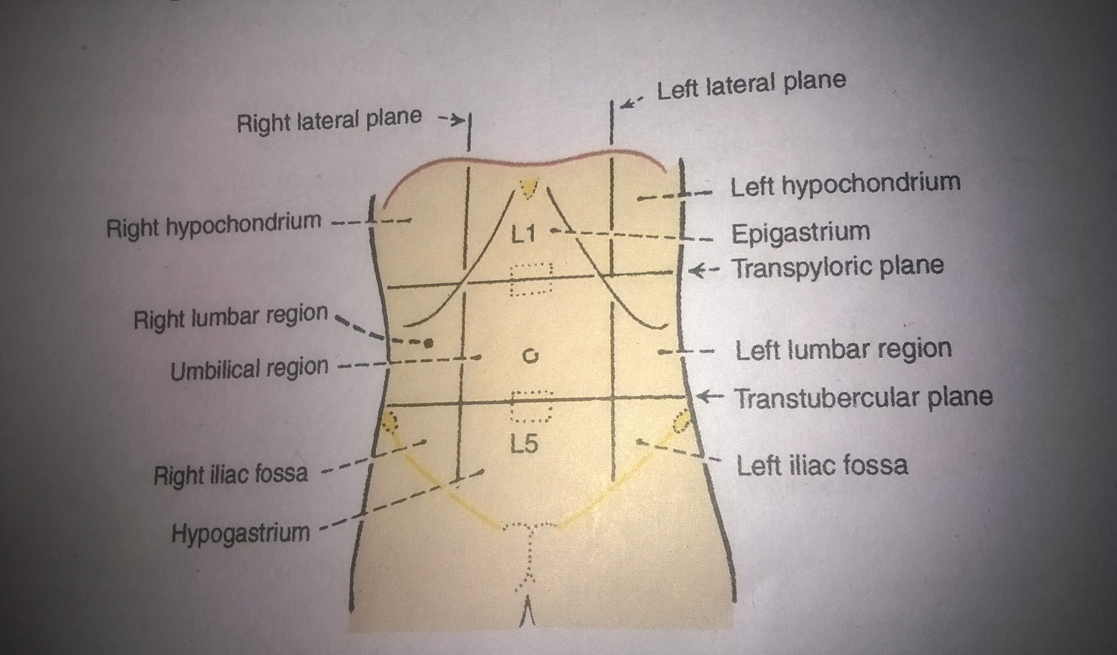
Nine regions of abdominal wall

Slide 5
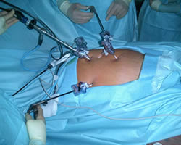
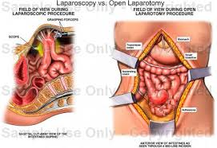
In simple terms: Laparoscopy (incisions in the form of holes), laparotomy: opening of abdominal cavity where viscera will be exposed.
Laparoscopy
Laparotomy

Slide 6
STOMACH
The stomach is a muscular, hollow, dilated part of the digestive system
The stomach lies between the esophagus and the duodenum (the first part of the small intestine).
Bolus (masticated food) enters the stomach through the oesophagus, stomach releases protease (protein-digesting enzymes such as pepsin) and hydrochloric acid, which kills or inhibits bacteria and provides the acidic pH for the proteases to work. Food is churned by the stomach through muscular contractions of the wall called peristalsis
Absorption of vitamin B12 and water (when body is dehydrated)

Slide 7
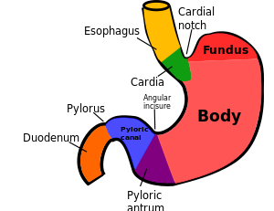
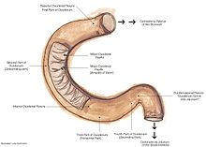

Slide 8
DUODENUM
The duodenum is the first section of the small intestine
The duodenum precedes the jejunum and ileum and is the shortest part of the small intestine, where most chemical digestion takes place.
The duodenum is largely responsible for the breakdown of food in the small intestine, using enzymes
The duodenum also regulates the rate of emptying of the stomach via hormonal pathways

Slide 9
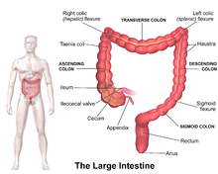
COLON OR LARGE INTESTINE
The colon is the last part of the digestive system
The large intestine takes about 16 hours to finish the digestion of the food. It removes water and any remaining absorbable nutrients from the food before sending the indigestible matter to the rectum.
The colon absorbs vitamins that are created by the colonic bacteria - such as vitamin K, vitamin B12, thiamine and riboflavin.
It also compacts feces, and stores fecal matter in the rectum until it can be discharged via the anus in defication.

Slide 10
GALL BLADDER
The gallbladder is a hollow organ that sits just beneath the right lobe of the liver.
The gallbladder is part of the biliary system and serves as a reservoir for bile, which is produced by the liver.
When food containing fat enters the digestive tract, it stimulates the secretion of cholecystokinin (CCK) from duodenum and jejunum. In response to cholecystokinin, the gallbladder rhythmically contracts and releases its contents into the common bile duct, eventually draining into the duodenum.
The bile, originally produced in the liver, emulsifies fats in partly digested food, thereby assisting their absorption. Bile consists primarily of water and bile salts, and also acts as a means of eliminating bilirubin, a product of hemoglobin metabolism, from the body

Slide 11
PANCREASE
The pancreas is an endocrine organ that lies in the abdomen.
Endocrine function to secret glucagon and insulin
Exocrine function helps out the digestive system.
It secretes pancreatic fluid that contains digestive enzymes that pass to the small intestine. These enzymes help to further break down the carbohydrates, proteins and lipids (fats) in the chyme.

Slide 12
Incision
Definition
A cut produced surgically by a sharp instrument that creates an opening into an organ or space in the body.
When choosing an incision these three should be achieved
Accessibility
Extensibility
Security

Slide 13
Classification of abdominal incision
The incisions used for exploring the abdominal cavity can be classified as
(A) Vertical incision : These may be
(i) Midline incision
(ii) Paramedian incisions
(B) Transverse and oblique incisions :
(i) Kocher's subcostal Incision
(a) Chevron (Roof top Modification)
(b) Mercedes Benz Modification
(ii) Mc Burney’s Grid iron or muscle spliting incision
(iii) Oblique Muscle cutting incision
(iv) Pfannenstiel incision
(v) Maylard Transverse Muscle cutting Incision
(C) Abdominothoracic incisions

Slide 14
Cholecystectomy
Cholecystectomy is the surgical removal of the gall bladder.
Preferably laproscopy surgery chosen for cholecystectomy.
Indications
Indications for cholecystectomy include inflammation of the gall bladder (cholecystitis), bilary colic, risk factors for gall bladder cancer
The most serious complication of cholecystectomy is damage to the common bile duct. This occurs in about 0.25% of cases. Damage to the duct that causes leakage typically manifests as fever, jaundice, and abdominal pain several days following cholecystectomy

Slide 15
Partial colectomy
Bowel resection , also called partial colectomy, removes a diseased or damaged part of the colon or rectum.
Indication
colorectal cancer, diverticulitis, or Crohn's disease
The goal of bowel resection is to take out the part of the colon or rectum where the problem is.

Slide 16
Appendectomy
An appendectomy (sometimes called appendisectomy or appendicectomy) is the surgical removal of the vermiform appendix.
This procedure is normally performed as an emergency procedure, when the patient is suffering from acute appendicitis. However, a 12-hour delay had no effect on outcomes, in a large retrospective study
The following incisions are placed for appendectomy: 1) McBurney's incision also known as Grid iron incision 2) Lanz Incision 3) Rutherford morrision 4) Para-median incision

Slide 17
Ileostomy
Surgical Opening in abdominal wall during surgery.
"ileostomy" -- "ileum" and "stoma." ileum is the lowest part of small intestine. "Stoma" means "opening." means ileum will pass through a stoma after surgery.
An ileostomy is used to move waste out of the body when the colon or rectum is not working properly.
Intestinal waste passes out of the ileostomy and is collected in an artificial external pouching system

Slide 18
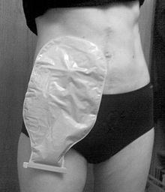
Ileostomies are necessary where injury or a surgical response to disease has rendered the large intestine incapable of safely processing intestinal waste, typically because the colon and rectum have been partially or wholly removed.
Common indications:
Inflammatory bowel disease
Colorectal cancer

Slide 19
Hernia
Protrusion of an organ or the fascia of an organ through the wall of the cavity that normally contains it.
Usually, there is no clear cause of a hernia. Sometimes, hernias occur with heavy lifting, straining while using the toilet, or any activity that raises the pressure inside the belly.

Slide 20
Types of hernia
Femoral hernia is a bulge in the upper thigh, just below the groin. This type is more common in women than men.
Hiatal herniaoccurs in the upper part of the stomach. Part of the upper stomach pushes into the chest.
Incisional hernia can occur through a scar/incision if abdominal surgery in the past.
Umbilical hernia protrusion of intra-abdominal contents through a weakness at the site of passage of the umbilical cord through the abdominal wall. Umbilical hernias in adults are largely acquired, and are more frequent in obese or pregnant women.
Inguinal hernia is a bulge in the groin. An incisional hernia occurs when the defect is the result of an incompletely healed surgical wound. Most common type and It is more common in men. It may go all the way down into the scrotum.

Slide 21
Hernia repair
Herniorraphy:
Traditionally hernia has been repaired by sewing the edges of healthy muscle tissue together.
This is appropriate for smaller hernias that have been present since birth (indirect hernias) and for healthy tissues, where it is possible to use stitches without adding stress on the tissue.
But the surgical approach varies depending on the area of muscle wall to be repaired and the surgeon's preference

Slide 22
Hernioplasty
Mesh patches of synthetic material are now being widely used to repair hernias known as hernioplasty.
This is especially used for large hernias and for hernias that reoccur.
Patches are sewn over the weakened area in the abdominal wall after the hernia is pushed back into place.
The patch decreases the tension on the weakened belly wall, reducing the risk that a hernia will recur.

Slide 23
Revision of upper GIT, small & large intestine surgeries
  Endoscopy
  Endoscopic ultrasonography
  Small bowel enteroscopy
  Laparoscopic surgery of the upper GI tract
  Gastrectomy
  Oesophagectomy
  Pancreaticoduodenectomy (Whipple procedure)
  Hepatectomy
  Cholecystectomy
  Partial colectomy
  Appendisectomy
  Ileostomy
  Hernia
  Herniorraphy
  Hernioplasty

Slide 24
Pre- Operative Physiotherapy Management
Benefits of Pre-operative physiotherapy management
Examination and evaluation of a patient’s preoperative impairments and functional status to establish a baseline for documenting postoperative improvement
Opportunity to identify and prioritize a patient’s needs and understand a patient’s goals and functional expectations after surgery
A basis for establishing rapport for enhanced continuity of care after surgery
A mechanism for patient education about the scheduled surgery and the components of postoperative rehabilitation

Slide 25
Components of Preoperative Patient Education
Overview of the plan of care.
Explain the general physiotherapy plan of care the patient can expect during the postoperative period.
Postoperative precautions.
Advise the patient of any precautions or contraindications to positioning, movement, or weight bearing that must be followed postoperatively.
Bed mobility and transfers.
Teach the patient how to move in bed or perform wheelchair transfers safely, incorporating necessary postoperative precautions.
Wound care.
Explain or reinforce postoperative care of the incision for optimal wound healing.
Initial postoperative exercises.
Teach the patient any exercises that will be started during the very early post- operative period.
  Example:
  Breathing exercise
  Splinted coughing
  Incentive spirometer etc

Slide 26
Post-operative physiotherapy management
To minimize / prevent post operative pulmonary complications
A well-planned physiotherapy program, composed of a carefully progressed sequence of therapeutic exercise and functional training and ongoing patient education, is fundamental to the patient’s postoperative care.
Appropriate physiotherapeutic management takes many factors into consideration, any of which may affect the components and progression of a patient’s postoperative program.
To design a safe, effective, efficient rehabilitation program for a patient,

Slide 27
A Physiotherapist must……
Understand the indications and rationale for a particular surgical procedure,
Become familiar with the procedure itself,
Be aware of special precautions related to the surgery, and
Communicate effectively with the patient and surgeon.

Slide 28
Cont..
Every individually designed postoperative rehabilitation program must be based on initial and ongoing examinations of a patient. In addition to the components of a pre-operative examination noted previously in this section, an assessment of integumentary integrity is important after surgery.
The incision should be inspected before and after each exercise session to identify any evidence of wound infection or delayed healing.

Slide 29
Inspection of the Surgical Incision
Check for signs of redness or tissue necrosis along the incision(s) and around sutures.
Palpate along the incision and note signs of tenderness and edema.
Palpate to determine evidence of increased heat.
Check for signs of drainage; Note color and amount of drainage on the dressing.
Note the integrity of an incision across a joint during and after exercise.
As the incision heals, check the mobility of the scar

Slide 30
Aims of post-operative physiotherapy management
S To minimize / prevent post operative pulmonary complications
To reduce incision pain
To minimize or prevent post operative circulatory complications
To maintain functional mobility while protecting the operative site.
Incision or wound care
To prevent development of pressure sore
To restore exercise tolerance

Slide 31
Breathing exercises:
Diaphragmatic breathing
Segmental expansion (Focus on Lateral costal breathing, posterior basal breathing.
Thoracic mobility
Note: Refer above mentioned breathing exercises in detail From Kisner & Colby, 5th Edition

Slide 32
Incentive Spirometer
Incentive Spirometer enhances lung expansion via spontaneous and sustained decrease in pleural pressure. The basic maneuver of incentive spirometry is sustained maximal inspiration. Sustained maximal inspiration is a slow, deep inhalation from Functional Residual Capacity up to Total Lung Capacity followed by 5 to 10 second of breath hold (breath hold to improve collateral circulation).

Slide 33
Early Mobilization
Frequent re-positioning and Early Mobilization also has important role in preventing post-operative pulmonary complications.

Slide 34
If Patient has Secretion retention
To Remove Secretion
ACBT (Active Cycle of Breathing Technique)
Splinted Coughing
Postural drainage (with all precautions)

Slide 35
To reduce incision pain
Trans Electrical Nerve Stimulation (TENS):
High frequency TENS at least for 20 minutes has beneficial effects in pain reduction.
Note: Dosage and method of application needs to be mentioned as given for high TENS

Slide 36
Relaxed positions
Patient educations regarding any precautions or contraindications to positioning, movement, or weight bearing or splinted coughing that must be followed postoperatively.

Slide 37
To minimize or prevent post-operative circulatory complications
Ankle - Toe movement
Early or bed side mobilizations
Compressive stockings / elevations etc. for edema.

Slide 38
To maintain functional mobility while protecting the operative site
Passive / Active assisted or Active ROM exercises according to patient condition
To prevent development of pressure sore
Frequent change in positions
Bed side mobilization
To restore exercise tolerance
Early mobilization
Aerobic exercises according patient condition
Establish a mobile scar
Gentle massage across and around the maturing scar
Abdominal Muscle Strengthening
Can begin as soon as incision is healed as in long term management and can be assessed for the same during follow-ups.

Slide 39
Home advice
Educational counselling
Importance of exercise & to be continued at home also
Mobility and posture maintenance
Energy conservation during ADL’s (if indicated)
Ergonomic Advice
NOTE: Physiotherapy management may differ according to patient conditions.

Slide 40
Thank you

