Slide 1

INSTRUCTIONAL OBJECTIVES
AND LESSON PLANNING
Presented By:
Shabana Khan
Asst. Professor
Subject: Human Resource Development & Organizational Training (HRDOT)
Dept. of Management

Slide 2
CONTENTS
OBJECTIVES
INSTRUCTIONAL OBJECTIVES
NEED INSTRUCTIONAL OBJECTIVE
NEED OF LESSON PLAN
COMPONENTS OF LESSON PLANNING

Slide 3

WHAT IS AN OBJECTIVE?
Objectives are tools
used to meet the goals.
These are specific,
measurable and observable
behaviours the employees
will perform to reach the goal.

Slide 4
INSTRUCTIONAL OBJECTIVES:-
It is defined as a statement that will describe what the learner will be able to do after completing the instructions.
Instructional objectives are specific, measurable, short-term, observable behaviours.
They indicate knowledge, skills or attitudes to be gained.

Slide 5

HOW TO WRITE INSTRUCTIONAL OBJECTIVES?

Slide 6
Instructional Objectives should specify four main things:-
Audience- Who? Who is aimed at?
Behaviour- What? What do you expect them to be able to do?
Condition- How? Under what circumstances will the learning occur?
Degree- How much? Must a specific set of criteria be met?

Slide 7
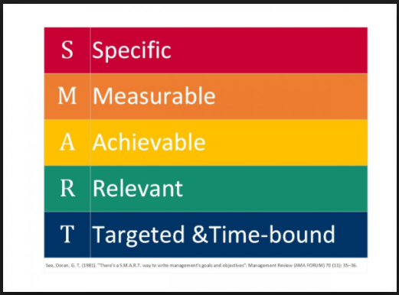
INSTRUCTIONAL OBJECTIVE SHOULD BE SMART:-

Slide 8
Specific- Use the ABCD to create a clear and concise objective.
Measurable- write the objective so that anyone can observe the learner perform desired action and objectively assess the performance.
Achievable- Make sure the learner can do what is required.

Slide 9
Relevant- Demonstrate value to the learner. Don’t teach materials which are not required.
Timely and Time bound- Ensure the performance will be used soon, not a year from now. Also, include any necessary time constraints, such as completing a task in 10 minutes or less.

Slide 10
WHY DO WE NEED TO PREPARE A LESSON PLAN?
Lesson planning is a vital component of the training-learning process. Proper planning will keep instructors organized, thus allowing them to give systematic training, helps employs reach objectives more easily and - helps the instructor to plan lessons according to the requirements.

Slide 11
WHY PLAN?
Lesson planning for training:
Provides a coherent framework for smooth efficient teaching.
Helps the instructor to be more organized.
Gives a sense of direction in relation to the syllabus.
Helps the instructor to be more confident when delivering the lesson.

Slide 12
Helps the instructor to be more confident when delivering the lesson.
Provides a useful basis for future planning.
Helps the instructor to plan lessons which cater for different students.
Is a proof that the instructor has taken a considerable amount of effort in his/her training.

Slide 13
7 COMPONENTS FOR LESSON PLANNING:-
Materials
Objective
Set the stage
Direct instruction
Guided practice
Closure
Demonstration of learning

