Slide 1
Plasma Proteins- Chemistry, Functions and Clinical Significance
Dr Anup Nilawar

Slide 2
Plasma proteins- Introduction
Plasma consists of water, electrolytes, metabolites, nutrients, proteins, and hormones.
The concentration of total protein in human plasma is approximately 6.0–8.0 g/dL and comprises the major part of the solids of the plasma.
The proteins of the plasma are a complex mixture that includes not only simple proteins but also conjugated proteins such as glycoproteins and various types of lipoproteins.

Slide 3
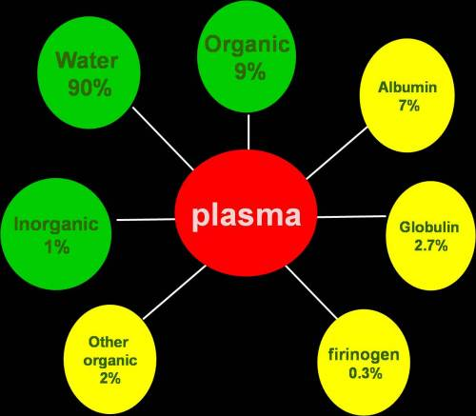
Components of Plasma

Slide 4
Separation of Plasma proteins
Salting-out methods-three major groups—fibrinogen, albumin, and globulins—by the use of varying concentrations of sodium or ammonium sulfate.
Electrophoresis- five major fractions
Albumin
α1 and α2 globulins
β globulins
γ globulins

Slide 5
Patterns in serum electrophoresis
normal
alb
α1
α2
β
γ

Slide 6
Author/year | Study design | Level | Result | Conclusion
Kyle RA Mayo Clinic Proceedings [1975, 50(1):29-40] | Review Article | High | Serum protein electrophoresis showed a spike in 76%, hypogammaglobulinemia in 9%, and minor or no abnormalities in 15%, and a globulin spike was seen 75% of the urinary electrophoretic patterns. Immunoelectrophoresis of the serum revealed a monoclonal heavy chain in 83% and a monoclonal light chain in the serum, in 8% (Bence Jones proteinemia). Three patients had no monoclonal protein in the serum or the urine ("nonsecretory"). | There is a lot variation in serum electrophoresis pattern in Multiple Myeloma.

Slide 7
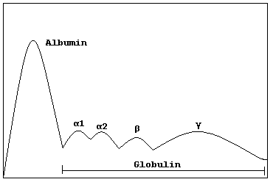
Separation of Plasma proteins by Electrophoresis

Slide 8
Albumin
Albumin (69 kDa) is the major protein of human plasma (3.4–4.7 g/dL)
Makes up approximately 60% of the total plasma protein.
Half life of albumin is about 20 days.
Migrates fastest in electrophoresis at alkaline pH and precipitates last in salting out methods

Slide 9
Synthesis of Albumin
The liver produces about 12 g of albumin per day, representing about 25% of total hepatic protein synthesis and half its secreted protein.
Albumin is initially synthesized as a preproprotein
Its signal peptide is removed as it passes into the cisternae of the rough endoplasmic reticulum, and a hexapeptide at the resulting amino terminal is subsequently cleaved off farther along the secretory pathway.

Slide 10
Structure of Albumin
Mature human albumin consists of one polypeptide chain of 585 amino acids and contains 17 disulfide bonds
It has an ellipsoidal shape, which means that it does not increase the viscosity of the plasma as much as an elongated molecule such as fibrinogen does.
Has a relatively low molecular mass about 69 kDa
Has an iso-electric pH of 4.7

Slide 11
Functions of Albumin
Colloidal osmotic Pressure-albumin is responsible for 75–80% of the osmotic pressure of human plasma due to its low molecular weight and large concentration
It plays a predominant role in maintaining blood volume and body fluid distribution.
Hypoalbuminemia leads to retention of fluid in the tissue spaces(Edema)

Slide 12
Functions of Albumin
Transport function-albumin has an ability to bind various ligands, thus acts as a transporter for various molecules. These include-
free fatty acids (FFA),
calcium,
certain steroid hormones,
bilirubin,
copper
A variety of drugs, including sulfonamides, penicillin G, dicoumarol, phenytoin and aspirin, are also bound to albumin

Slide 13
Functions of Albumin
Nutritive Function
Albumin serves as a source of amino acids for tissue protein synthesis to a limited extent, particularly in nutritional deprivation of amino acids.
Buffering Function-Among the plasma proteins, albumin has the maximum buffering capacity due to its high concentration and the presence of large number of histidine residues, which contribute maximally towards maintenance of acid base balance.
Viscosity- Exerts low viscosity

Slide 14
Clinical significance of Albumin
Blood brain barrier- Albumin- free fatty acid complex can not cross the blood brain barrier, hence fatty acids can not be utilized by the brain.
Loosely bound bilirubin to albumin can be easily replaced by drugs like aspirin
In new born if such drugs are given, the released bilirubin gets deposited in brain causing Kernicterus.

Slide 15
Clinical significance of Albumin
Protein bound calcium
Calcium level is lowered in conditions of Hypo- Albuminemia
Serum total calcium may be decreased
Ionic calcium remains same
Tetany does not occur
Calcium is lowered by 0.8 mg/dl for a fall of 1g/dl of albumin

Slide 16
Clinical significance of Albumin
Drug interactions—
Two drugs having same affinity for albumin when administered together, can compete for available binding sites with consequent displacement of other drug, resulting in clinically significant drug interactions.
Example-Phenytoin, dicoumarol interactions

Slide 17
Clinical significance of Albumin
Edema- Hypoalbuminemia results in fluid retention in the tissue spaces
Normal level- 3.5-5 G/dl
Hypoalbuminemia- lowered level is seen in the following conditions-
Cirrhosis of liver
Malnutrition
Nephrotic syndrome
Burns
Malabsorption
Analbuminemia- congenital disorder
Hyperalbuminemia- In conditions of fluid depletion(Haemoconcentration)

Slide 18
Globulins
Globulins are separated by half saturation with ammonium sulphate
Molecular weight ranges from 90,000 to 13,00,000
By electrophoresis globulins can be separated in to –
α₁-globulins
α₂-globulins
β-globulins
Y-globulins

Slide 19
Synthesis of Globulins
α and β globulins are synthesized in the liver.
Y globulins are synthesized in plasma cells and B-cells of lymphoid tissues (Reticulo- endothelial system)
Synthesis of Y globulins is increased in chronic infections, chronic liver diseases, auto immune diseases, leukemias, lymphomas and various other malignancies.

Slide 21
α- Globulins
They are glycoproteins
Based on electrophoretic mobility , they are sub classified in to α₁ and α₂ globulins
α₁ globulins
Examples-
α₁antitrypsin
Orosomucoid (α₁ acid glycoprotein)
α₁-fetoprotein (AFP)

Slide 22
α1 globulins
α₁-antitrypsin
Also called α₁₋antiprotease
It is a single-chain protein of 394 amino acids, contains three oligosaccharide chains
It is the major component (> 90%) of the α ₁ fraction of human plasma.
It is synthesized by hepatocytes and macrophages and is the principal serine protease inhibitor of human plasma.
It inhibits trypsin, elastase, and certain other proteases by forming complexes with them.

Slide 23
Polymorphic forms of α₁-antitrypsin
At least 75 polymorphic forms occur, many of which can be separated by electrophoresis
The major genotype is MM, and its phenotypic product is PiM
A deficiency of this protein has a role in certain cases (approximately 5%) of emphysema.
This occurs mainly in subjects with the ZZ genotype, who synthesize PiZ, and also in PiSZ heterozygotes, both of whom secrete considerably less protein than PiMM individuals.

Slide 24
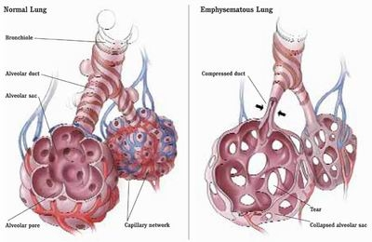
Clinical consequences of α₁-antitrypsin deficiency
Emphysema- Normally antitrypsin protects the lung tissue from proteases(active elastase) released from macrophages
Forms a complex with protease and inactivates it.
In its deficiency, the active elastase destroys the lung tissue by proteolysis.

Slide 25
Clinical consequences of α₁-antitrypsin deficiency
Smoking and Emphysema-A methionine (residue 358) of α₁-antitrypsin is involved in its binding to proteases.
Smoking oxidizes this methionine to methionine sulfoxide and thus inactivates it.
Affected molecules of α₁-antitrypsin no longer neutralize proteases.
This is particularly devastating in patients (eg, PiZZ phenotype) who already have low levels of α₁-antitrypsin.
The further diminution in α ₁-antitrypsin brought about by smoking results in increased proteolytic destruction of lung tissue, accelerating the development of emphysema.

Slide 26
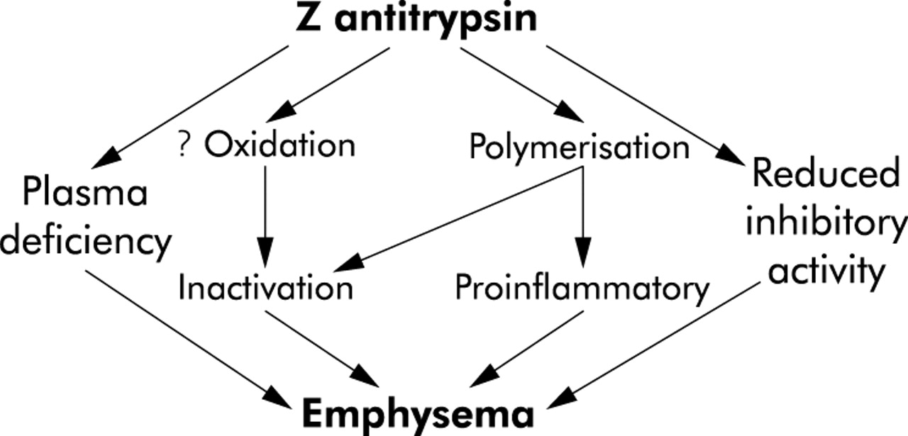
Clinical consequences of α₁-antitrypsin deficiency

Slide 27
Clinical consequences of α₁-antitrypsin deficiency
Cirrhosis of Liver- In this condition, molecules of the ZZ phenotype accumulate and aggregate in the cisternae of the endoplasmic reticulum of hepatocytes.
Aggregation is due to formation of polymers of mutant α ₁-antitrypsin, the polymers forming via a strong interaction between a specific loop in one molecule and a prominent -pleated sheet in another (loop-sheet polymerization).
By mechanisms that are not understood, hepatitis results with consequent cirrhosis (accumulation of massive amounts of collagen, resulting in fibrosis).

Slide 28
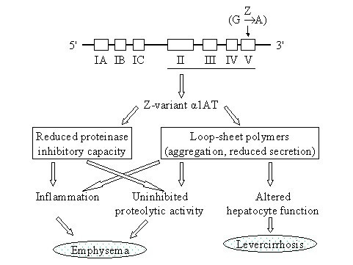
Clinical consequences of α₁-antitrypsin deficiency

Slide 29
Orosomucoid /α₁-acid glycoprotein
Concentration in plasma- 0.6 to 1.4 G/dl
Carbohydrate content 41%
Marker of acute inflammation
Acts as a transporter of progesterone
Transports carbohydrates to the site of tissue injury
Concentration increases in inflammatory diseases, cirrhosis of liver and in malignant conditions
Concentration decreases in liver diseases, malnutrition and in nephrotic syndrome

Slide 30
α₁-fetoprotein (AFP)
Present in high concentration in fetal blood during mid pregnancy
Normal concentration in healthy adult-
< 1µg/100ml
Level increases during pregnancy
Clinically considered a tumor marker for the diagnosis of hepatocellular carcinoma or teratoblastomas.

Slide 31
α₂-globulins
Clinically important α₂-globulins are-
Haptoglobin
Ceruloplasmin
α₂- macroglobulins

Slide 32
Haptoglobin-(Hp)
It is a plasma glycoprotein that binds extracorpuscular hemoglobin (Hb) in a tight noncovalent complex (Hb-Hp).
The amount of Haptoglobin in human plasma ranges from 40 mg to 180 mg of hemoglobin-binding capacity per deciliter.
The function of Hp is to prevent loss of free hemoglobin into the kidney. This conserves the valuable iron present in hemoglobin, which would otherwise be lost to the body.

Slide 33
Haptoglobin (Contd.)-
The molecular mass of hemoglobin is approximately 65 kDa
Hb-Hp complex has a molecular mass of approximately 155 kDa.
Free hemoglobin passes through the glomerulus of the kidney, enters the tubules, and tends to precipitate therein (as can happen after a massive incompatible blood transfusion, when the capacity of haptoglobin to bind hemoglobin is grossly exceeded).
However, the Hb-Hp complex is too large to pass through the glomerulus.
Thus Hp helps to conserve iron.

Slide 34
Clinical Significance of Haptoglobin
Concentration rises in inflammatory conditions
Concentration decreases hemolytic anemias
Half-life of haptoglobin is approximately 5 days, the half-life of the Hb-Hp complex is about 90 minutes, the complex being rapidly removed from plasma by hepatocytes.
Thus, when haptoglobin is bound to hemoglobin, it is cleared from the plasma about 80 times faster than normally.
The level of haptoglobin falls rapidly in hemolytic anemias.
Free Hp level or Hp binding capacity depicts the degree of intravascular hemolysis.

Slide 35
Ceruloplasmin
Copper containing α₂-globulin
Glycoprotein with enzyme activities
It has a blue color because of its high copper content
Carries 90% of the copper present in plasma.
Each molecule of ceruloplasmin binds six atoms of copper very tightly, so that the copper is not readily exchangeable.

Slide 36
Ceruloplasmin
Normal plasma concentration approximately 30mg/dL
Enzyme activities are Ferroxidase, copper oxidase and Histaminase.
Synthesized in liver in the form of apo ceruloplasmin, when copper atoms get attached it becomes Ceruloplasmin.
Although carries 90% of the copper present in plasma. but it binds copper very tightly, so that the copper is not readily exchangeable.
Albumin carries the other 10% of the plasma copper but binds the metal less tightly than does ceruloplasmin.
Albumin thus donates its copper to tissues more readily than ceruloplasmin and appears to be more important than ceruloplasmin in copper transport in the human body.

Slide 37
Clinical Significance of Ceruloplasmin
Normal level- 25-50 mg/dl
Low levels of ceruloplasmin are found in Wilson disease (hepatolenticular degeneration), a disease due to abnormal metabolism of copper.
The amount of ceruloplasmin in plasma is also decreased in liver diseases, mal nutrition and nephrotic syndrome.

Slide 38
α₂- Macroglobulin (AMG)
Major component of α₂ proteins
Comprises 8–10% of the total plasma protein in humans.
Tetrameric protein with molecular weight of 725,000.
Synthesized by hepatocytes and macrophages
Inactivates all the proteases and thus is an important in vivo anticoagulant.
Carrier of many growth factors
Normal serum level-130-300 mg/dl
Concentration is markedly increased in nephrotic syndrome, since other proteins are lost through urine in this condition.

Slide 39
β Globulins
β Globulins of clinical importance are –
Transferrin
C-reactive protein
Haemopexin
Complement C1q
β Lipoprotein(LDL)

Slide 40
Transferrin
Transferrin (Tf) is a β ₁-globulin with a molecular mass of approximately 76 kDa.
It is a glycoprotein and is synthesized in the liver.
About 20 polymorphic forms of transferrin have been found.
It plays a central role in the body's metabolism of iron because it transports iron (2 mol of Fe³⁺ per mole of Tf) in the circulation to sites where iron is required, eg, from the gut to the bone marrow and other organs.
Approximately 200 billion red blood cells (about 20 mL) are catabolized per day, releasing about 25 mg of iron into the body—most of which is transported by transferrin.

Slide 41
Transferrin Receptors
There are receptors (TfR1 and TfR2) on the surfaces of many cells for transferrin.
It binds to these receptors and is internalized by receptor-mediated endocytosis.
The acid pH inside the lysosome causes the iron to dissociate from the protein.
The dissociated iron leaves the endosome via DMT1 to enter the cytoplasm.
ApoTf is not degraded within the lysosome. Instead, it remains associated with its receptor, returns to the plasma membrane, dissociates from its receptor, reenters the plasma, picks up more iron, and again delivers the iron to needy cells.
Normally, the iron bound to Tf turns over 10–20 times a day.

Slide 42
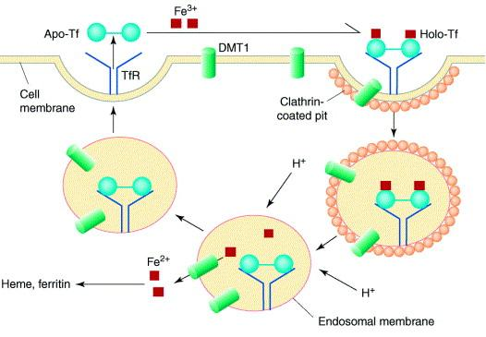
Transferrin Receptors

Slide 43
Clinical Significance of Transferrin
The concentration of transferrin in plasma is approximately 300 mg/dL.
This amount of transferrin can bind 300 g of iron per deciliter, so that this represents the total iron-binding capacity of plasma.
However, the protein is normally only one-third saturated with iron.
In iron deficiency anemia, the protein is even less saturated with iron, whereas in conditions of storage of excess iron in the body (eg, hemochromatosis) the saturation with iron is much greater than one-third.

Slide 44
Clinical Significance of Transferrin
Increased levels are seen in iron deficiency anemia and in last months of pregnancy
Decreased levels are seen in-
Protein energy malnutrition
Cirrhosis of liver
Nephrotic syndrome
Trauma
Acute myocardial infarction
Malignancies
Wasting diseases

Slide 45
C- reactive protein(β Globulin)
So named because it reacts with C- polysaccharide of capsule of pneumococci
Molecular weight of 115-140 kD
Synthesized in liver
Can stimulate complement activity and macrophages
Acute phase protein- Concentration rises in inflammatory conditions
Clinically important marker to predict the risk of coronary heart disease

Slide 46
Haemopexin(β Globulin)
Molecular weight 57,000-80,000
Normal level in adults-0.5 to 1.0 gm/L
Low level at birth, reaches adult value within first year of life
Synthesized in liver
Function is to bind haem formed from breakdown of Hb and other haemoproteins
Low level- found in hemolytic disorders, at birth and drug induced
High level- pregnancy, diabetes mellitus, malignancies and Duchenne muscular dystrophy

Slide 47
Complement C1q (β Globulin)
First complement factor to bind antibody
Binding takes place at the Fc region of IgG or Ig M
Binding triggers the classical complement pathway
Thermo labile, destroyed by heating
Normal level – 0.15 gm/L
Molecular weight-400,000
Can bind heparin and bivalent ions
Decreased level is used as an indicator of circulating Ag –Ab complex.
High levels are found in chronic infections

Slide 48
Gamma Globulins
They are immunoglobulins with antibody activity
They occupy the gamma region on electrophoresis
Immunoglobulins play a key role in the defense mechanisms of the body
There are five types of immunoglobulins IgG, IgA, IgM, IgD, and IgE.

Slide 49
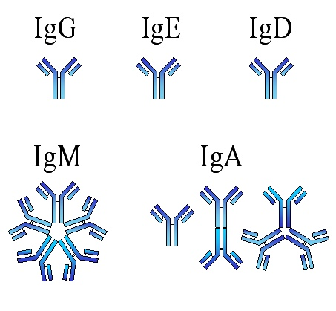
Different Classes of Immunoglobulins

Slide 50
Major functions of immunoglobulins
Immunoglobulin | Major Functions
IgG | Main antibody in the secondary response. Opsonizes bacteria, Fixes complement, neutralizes bacterial toxins and viruses and crosses the placenta.
IgA | Secretory IgA prevents attachment of bacteria and viruses to mucous membranes. Does not fix complement.
IgM | Produced in the primary response to an antigen. Fixes complement. Does not cross the placenta. Antigen receptor on the surface of B cells.
IgD | Uncertain. Found on the surface of many B cells as well as in serum.
IgE | Mediates immediate hypersensitivity Defends against worm infections. Does not fix complement.

Slide 51
Fibrinogen
Also called clotting factor1
Constitutes 4-6% of total protein
Precipitated with 1/5 th saturation with ammonium sulphate
Large asymmetric molecule
Highly elongated with axial ratio of 20:1
Imparts maximum viscosity to blood
Synthesized in liver
Made up of 6 polypeptide chains
Chains are linked together by S-S linkages
Amino terminal end is highly negative due to the presence of glutamic acid
Negative charge contributes to its solubility in plasma and prevents aggregation due to electrostatic repulsions between the fibrinogen molecules.

Slide 52
Transport proteins
Name | Compounds transported
Albumin | Fatty acids, bilirubin, hormones, calcium, heavy metals, drugs etc.
Prealbumin-(Transthyretin) | Steroid hormones thyroxin, Retinol
Retinol binding protein | Retinol (Vitamin A)
Thyroxin binding protein(TBG) | Thyroxin
Transcortin(Cortisol binding protein) | Cortisol and corticosteroids
Haptoglobin | Hemoglobin
Hemopexin | Free haem
Transferrin | Iron
HDL(High density lipoprotein) | Cholesterol (Tissues to liver)
LDL(Low density lipoprotein) | Cholesterol(Liver to tissues)

Slide 53
Acute phase proteins
The levels of certain proteins may increase in blood in response inflammatory and neoplastic conditions, these are called Acute phase proteins.
Examples-
C- reactive proteins
Ceruloplasmin
Alpha -1 antitrypsin
Alpha 2 macroglobulins
Alpha-1 acid glycoprotein

Slide 54
Negative acute phase protein
The levels of certain proteins are decreased in blood in response to certain inflammatory processes.
Examples-
Albumin
Transthyretin
Retinol binding protein
Transferrin

Slide 55
Abnormal Proteins
1) Bence – Jone’s proteins
Abnormal proteins- monoclonal light chains
Present in the urine of a patient suffering from multiple myeloma (50% of patients)
Molecular weight 45,000
Identified by heat coagulation test
Best detected by zone electrophoresis and immunoelectrophoresis
2)Cryoglobulins
These proteins coagulate when serum is cooled to very low temperature
Commonly monoclonal IgG or IgM or both
Increased in rheumatoid arthritis, multiple myeloma, lymphocytic leukemia, lymphosarcoma and systemic lupus erythematosus

Slide 56
Functions of plasma proteins
Nutritive
Fluid exchange
Buffering
Binding and transport
Enzymes
Hormones
Blood coagulation
Viscosity
Defense
Reserve proteins
Tumor markers
Antiproteases

Slide 57
Clinical Significance of Plasma proteins
Hyperproteinemia- Levels higher than 8.0gm/dl
Causes-
Hemoconcentration- due to dehydration, albumin and globulin both are increased Albumin to Globulin ratio remains same.
Causes- Excessive vomiting
Diarrhea
Diabetes Insipidus
Pyloric stenosis or obstruction
Diuresis
Intestinal obstruction

Slide 58
Hypergammaglobulinemia
1)Polyclonal-
Chronic infections
Chronic liver diseases
Sarcoidosis
Auto immune diseases
2) Monoclonal
Multiple myeloma
Macroglobulinaemia
Lymphosarcoma
Leukemia
Hodgkin’s disease

Slide 59
Hypoproteinemia
Decease in total protein concentration
Hemodilution- Both Albumin and globulins are decreased, A:G ratio remains same, as in water intoxication
Hypoalbuminemia- low level of Albumin in plasma
Causes-
Nephrotic syndrome
Protein losing enteropathy
Severe liver diseases
Mal nutrition or malabsorption
Extensive skin burns
Pregnancy
Malignancy

Slide 60
Hypogammaglobulinemia
Losses from body- same as albumin- through urine, GIT or skin
Decreased synthesis
Transient neonatal
Primary genetic deficiency
Secondary – drug induced (Corticosteroid therapy), uremia, hematological disorders
AIDS(Acquired Immuno deficiency syndrome)

Slide 61
Patterns in serum electrophoresis
normal
alb
α1
α2
β
γ
Nephrotic Syndrome
alb
α1
α2
β
γ
Multiple Myeloma
alb
α1
α2
β
γ

