Slide 1
Physiotherapy during antenatal & postnatal period

Slide 2
Objectives
At the end of the lecture the students will be able to:
Enumerate different pregnancy induced pathology
Describe in brief about physiotherapy during antenatal period, labour and post natal period.

Slide 3
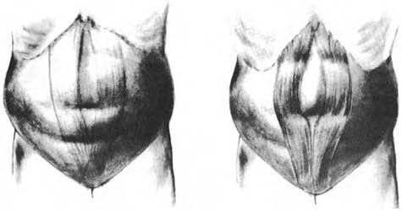
PREGNANCY-INDUCED PATHOLOGY
Diastasis Recti
Diastasis recti is separation of the rectus abdominis muscle in the midline at the linea alba.

Slide 4
Diastasis recti may occur in pregnancy as a result of hormonal effects on the connective tissue and the biomechanical changes of pregnancy.
It may also develop during labor, especially with excessive breath-holding during the second stage.
It can occur above, below, or at the level of the umbilicus but appears to be less common below the umbilicus.

Slide 5
Significance
low back pain
inability to perform independent supine to sitting transitions
Decreased fetal protection
Potential for herniation

Slide 6
Examination
A self-test on or after the third postpartum day for optimal accuracy.
Until 3 days after delivery, the abdominal musculature has inadequate tone for valid test results.

Slide 7
Patient position and procedure:
Hook-lying.
Have the patient slowly raise her head and shoulders off the floor reaching her hands toward the knees, until the spines of the scapulae leave the floor.
Place the fingers of one hand horizontally across the midline of the abdomen at the umbilicus.
If a separation exists, the fingers will sink into the gap between the rectus muscles.

Slide 8
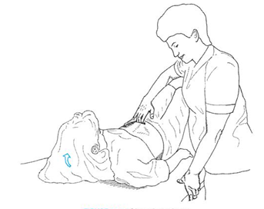
The number of fingers that can be placed between the muscle bellies is then documented.

Slide 9
Postural Back Pain
Back pain commonly occurs because of the postural changes of pregnancy, increased ligamentous laxity, and decreased abdominal muscle function.
The symptoms of low back pain usually worsen with muscle fatigue from static postures or as the day progresses; symptoms are usually relieved with rest or change of position.
Women who are physically fit generally have less back pain during pregnancy.

Slide 10
Low back pain symptoms can be treated effectively with many traditional low back exercises, proper body mechanics, posture instructions, improvement in work techniques, along with superficial modality application.
The use of deep-heating agents, electrical stimulation, and traction is generally contraindicated during pregnancy.

Slide 11
Sacroiliac/Pelvic Girdle Pain
Sacroiliac pain is localized to the posterior pelvis and is described as stabbing deep into the buttocks distal and lateral to L5/S1.
Symptoms
Pain with prolonged sitting, standing or walking, climbing stairs, turning in bed, unilateral standing, or torsion activities.
Symptoms may not be relieved by rest and frequently worsen with activity.

Slide 12
Varicose veins
It is aggravated in pregnancy by the increased uterine weight, venous stasis in the legs and increased venous distensibility.
Exercise modification
External support

Slide 13
Joint Laxity
All joint structures are at increased risk of injury during pregnancy and during the immediate postpartum period.

Slide 14
Nerve compression syndromes
Postural changes in neck and upper quarter
Fluid retention
Hormonal changes
Circulatory compromise
Postural correction exercises
Ergonomics assessment
Modalities
splints

Slide 15
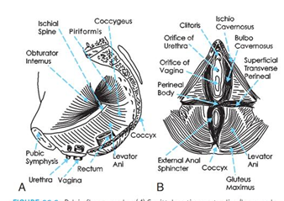
Pelvic floor dysfunction

Slide 16
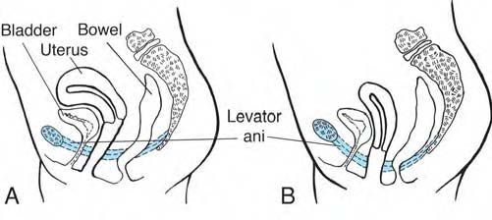
A prolapse is a supportive impairment. It refers to the descent of any of the pelvic viscera out of their normal alignment because of muscular, fascial, and/or ligamentous deficits, and increased abdominal pressure

Slide 17
Involuntary loss of bladder or bowel contents, often a result of both neuromuscular and musculoskeletal impairments, often occurs in combination with prolapse.

Slide 18
Potential Impairments and Functional Limitations
Stress, pain, and muscle imbalances from faulty postures
Poor body mechanics; related to lack of knowledge, changing body size and caring for growing child
Lower extremity edema and discomfort from altered circulation, varicose veins

Slide 19
Pelvic floor dysfunction
• Urinary or fecal incontinence
• Organ prolapse
• Hypertonus
• Poor episiotomy healing
• Poor proprioceptive awareness and disuse atrophy
Abdominal muscle stretch, trauma, and diastasis recti
Potential decrease in cardiovascular fitness

Slide 20
Lack of knowledge of body changes and safe exercises to use during and after pregnancy
Changing body image
Lack of physical preparation (strength, endurance, relaxation) necessary for labor and delivery
Lack of knowledge of appropriate positioning for optimal comfort in labor and delivery
Lack of adequate postpartum rehabilitation

Slide 21
Physiotherapy during Antenatal period

Slide 22
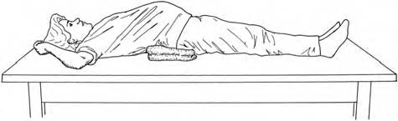
Education
Do not exceed 5 minutes of supine positioning at any one time after the first trimester of pregnancy to avoid vena cava compression by the uterus.
To prevent inferior vena cava compression when the patient is
lying supine, a folded towel can be placed under the right side of the pelvis so the patient is tipped slightly to the left.

Slide 23
To avoid the effects of orthostatic hypotension, instruct the woman to always rise slowly when moving from lying down or sitting to standing positions.
Discourage breath-holding and avoid activities that tend to elicit the Valsalva maneuver because this may lead to undesirable downward forces on the uterus and pelvic floor.

Slide 24
Encourage complete bladder emptying before exercise.

Slide 25
Aerobic Exercises
It consist of an activity which involves large muscle group in a continues rhythmic manner, like walking, cycling, dancing etc.
Activities which may be harmful in pregnancy are:
Scuba diving and exertion in supine.
When doing skiing and jogging should be done with caution.

Slide 26
Intensity of exercise:
60-90% of Maximal heart rate.
Lower end of this range should be considered appropriate.
RPE : 12-14 on 6-20 scales

Slide 27
Duration:
If prescribing prolonged exercise (more than 45 minutes) take following into consideration:
Thermoregulation
Proper hydration
Give short sessions with proper break in between.

Slide 28
Frequency:
30 minutes a day in absence of any other contraindication.

Slide 29
Absolute Contraindications for exercise
Incompetent cervix: early dilation of the cervix before
the pregnancy is full term
Vaginal bleeding, especially second or third trimester
Placenta previa: placenta is located on the uterus in
a position where it may detach before the baby is
delivered.
Multiple gestation with risk of premature labor.

Slide 30
Pre-eclampsia: pregnancy-induced hypertension
Rupture of membranes: loss of amniotic fluid before the onset of labor.
Premature labor: labor beginning before the 37th week of pregnancy
Maternal heart disease, thyroid disease or serious respiratory muscle disorder
Maternal type 1 diabetes
Intrauterine growth retardation

Slide 31
Precautions
Exercises may require modification.
Gestational diabetes
Severe anemia
Systemic infection
Extreme fatigue
Musculoskeletal complaints and/or pain
Overheating
Extreme obesity or extreme underweight/eating disorder
Diastasis recti

Slide 32
Posture Exercises
The growing fetus places added stress on postural muscles as the center of gravity shifts forward and upward and the spine shifts to compensate and maintain stability.
In addition, after delivery, activities involving holding and caring for the baby stress postural muscles.

Slide 33
Some stretching exercise
Upper neck extensors and scalenes
Scapular protractors, shoulder internal rotators, and
levator scapulae
Low back extensors
Hip flexors, adductors, and hamstrings
Ankle plantarflexors
Caution: women with pelvic instabilities should not overstretch.

Slide 34
Some strengthening exercise
Upper neck flexors, lower neck and upper thoracic extensors
Scapular retractors and depressors
Shoulder external rotators
Trunk flexors (abdominals), particularly lower abdominals

Slide 35
Hip extensors
Knee extensors
Ankle dorsiflexors

Slide 36
Corrective Exercises for Diastasis Recti
A check for diastasis recti must always be performed before initiating abdominal exercise.
Only the corrective exercises (head lift or head lift with pelvic tilt) should be used until the separation is corrected to 2 cm (two finger widths) or less

Slide 37
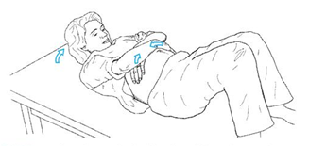
Head lift
Patient position and procedure: Hook-lying

Slide 38
With her hands Crossed over midline at the level of the diastasis for support.
Have the woman exhale and lift only her head off the floor or until the point just before a bulge appears.
At the same time, her hands should gently approximate the rectus muscles toward midline

Slide 39
Head Lift with Pelvic Tilt
Patient position and procedure: Hook-lying.
The arms are crossed over the diastasis for support as above.
Have the patient slowly lift her head off the floor while approximating the rectus muscles and performing a posterior pelvic tilt, then slowly lower her head and relax.
All abdominal contractions should be performed with an exhalation so that intra-abdominal pressure is minimized.

Slide 40
Stabilization exercises
Exercise for activating the abdominal and low back muscles and developing control of their stabilizing function in the lumbar spine and pelvis.

Slide 41
Dynamic trunk exercise
Pelvic motion training
These exercises are helpful in cases of posture related back pain, they are beneficial for improving proprioceptive awareness as well as lumbar, pelvic and hip mobility.

Slide 42
Pelvic tilting exercise
Begin in quadruped. Instruct the patient to perform posterior pelvic tilt., have her lower abdominals contracted isometrically and hold.
Pelvic clock: hook lying: ask her to visualize a face of clock on her lower abdomen. Ask her to slowly move back and forth. Then ask her to move back and forth between 3 and 9 o’clock.
Trunk curls: curl ups and down can be given in very initial stage.

Slide 43
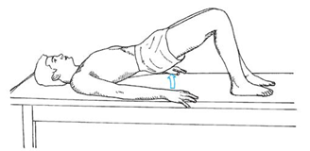
Modified Upper and Lower Extremity Strengthening
Supine Bridging

Slide 44
Patient position and procedure: Supine in the hook-lying position.
Have the patient perform a posterior pelvic tilt and then lift her pelvis off the floor.
She can do repetitive bridges, or hold the bridge position and alternately flex and extend her upper extremities to emphasize the stabilization function of the hip extensors and trunk musculature.

Slide 45
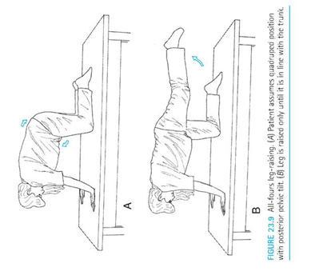
Quadruped Leg Raising

Slide 46
Patient position and procedure: On hands and knees (hands may be in fists or palms open and flat).
Instruct the woman to first perform a posterior pelvic tilt, and then slowly lift one leg, extending the hip to a level no higher than the pelvis while maintaining the posterior pelvic tilt
She then slowly lowers the leg and repeats with the opposite side. The knee may remain flexed or can be straightened throughout the exercise.

Slide 47
Standing Push-Ups
Patient position and procedure:
Standing, facing a wall, feet pointing straight forward, shoulder-width apart, and approximately an arm-length away from the wall. The palms are placed on the wall at shoulder height.
Have the woman slowly bend the elbows, bringing her upper body close to the wall, maintaining a stable pelvic tilt, and keeping the heels on the floor.
Her elbows should be shoulder height. She then slowly pushes with her arms, bringing the body back to the original position.

Slide 48
Perineum and Adductor Flexibility
These exercises prepare the legs and pelvis for childbirth.
Self-Stretching
Patient position and procedure: Supine or side-lying.
Instruct the patient to abduct the hips and pull the knees toward the sides of her chest and hold the position for as long as is comfortable (at least to the count of 10).

Slide 49
Patient position and procedure: Sitting on a short stool with the hips abducted as far as possible and feet flat on the floor.
Have her flex forward slightly at the hips (keeping the back straight), or have her gently press her knees outward with her hands for an additional stretch.

Slide 50
Pelvic Floor Awareness, Training, and Strengthening
Begin pelvic floor exercise training with an empty
bladder.
Gravity-assisted positioning (hips higher than the
heart, such as supported bridge or elbows/knees position) may be indicated initially for some women with extreme weakness and proprioceptive deficits.

Slide 51
Positional changes are introduced as strength and awareness improve (supine side-lying, quadruped, sitting, standing).

Slide 52
Contract–Relax
Instruct the woman to tighten the pelvic floor as if attempting to stop urine flow or hold back gas.
Hold for 3 to 5 seconds and relax for at least the same length of time.
Repeat up to 10 times (if performed with proper technique).

Slide 53
With significant coordination dysfunction or
fatigue, substitution with the gluteals, abdominals, or hip adductors may occur.
To maximize proprioception and motor learning, it is important to emphasize isolation of the pelvic floor and avoid the substitute muscle actions.

Slide 54
Quick Contractions
Have the woman perform quick, repeated contractions of the pelvic floor muscles while maintaining a normal breathing rate and keeping accessory muscles relaxed.
Try for 15 to 20 repetitions per set.

Slide 55
Pelvic Floor Relaxation
Instruct the woman to contract the pelvic floor as in the strengthening exercise, then allow total voluntary release and relaxation of the pelvic floor.

Slide 56
Unsafe Postures and Exercises During Pregnancy
Knee–chest position with buttocks elevated above heart level.
An air embolism, although rare, can occur when the buttocks are elevated and the uterus moves superiorly.
The pressure change causes air to be introduced into the vagina and uterus, where it can enter the circulatory system through the open placental site.

Slide 57
A pregnant woman is at risk only if bleeding or other symptoms of early placental detachment are present.
The pregnant woman should be instructed not to assume this position for 6 weeks postpartum.

Slide 58
Bilateral straight-leg raising.
This exercise typically places more stress on the abdominal muscles and low back than they can tolerate.
It can cause back injury or diastasis recti, and therefore should not be attempted.

Slide 59
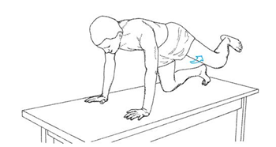
All-fours (quadruped) hip extension.
It becomes unsafe and can cause low back pain when the leg is elevated beyond the physiologic range of hip extension, causing the pelvis to tilt anteriorly and the lumbar spine to hyperextend.

Slide 60
Unilateral weight-bearing activities
Weight bearing on one leg (which includes slouched standing with the majority of weight shifted to one leg and the pelvis tilted down on the opposite side) during pregnancy can cause sacroiliac joint irritation and should be avoided by women with preexisting sacroiliac joint symptoms.

Slide 61
MCQs
Mention true or false.
In SI joint dysfunction, asymmetrical activities should be discouraged.
True
False

Slide 62
2. Mention true or false :
Gestational diabetes is a contra indication for exercise.
True
False

Slide 63
3. If you want to start pelvic floor muscle exercise, which of the following position you will chose?
Standing
Sitting
On elbows and kness
Knealing

Slide 64
4. Which of the following activities is to be done with caution during pregnancy
Walking
Stationary cycling
Skiing
All of above

Slide 65
5. While giving aerobic exercise, intensity range should be…
0-9 on 20 RPE
B. 9-15 on RPE
12-15 on RPE
None of above

Slide 66
Physiotherapy during labor

Slide 67
Relaxation and Breathing During Labor
First Stage
As labor progresses, the contractions of the uterus become stronger, longer, and closer together. Relaxation during the contractions becomes more difficult.
Provide the woman with suggested techniques to assist in relaxation.
Ensure the woman has emotional support from the father, family member, or special friend to provide encouragement and assist with overall comfort.

Slide 68
Breathe slowly with each contraction;
Some women find it helpful to focus their attention on a specific visual object. Other suggestions include talking, or moaning during each contraction to prevent breath holding and encourage slow breathing.

Slide 69
Massage or apply pressure to any areas that hurt such as the low back. Using the hands may help distract the focus from the contractions.
Apply heat or cold for local symptoms; wipe the face with a wet wash cloth.

Slide 70
Second Stage
Once dilation of the cervix has occurred, the woman may become active in the birth process by assisting the uterus during a contraction in pushing the baby down the birth canal.
Teach her the following techniques: While bearing down, take in a breath, contract the abdominal wall, and slowly breathe out. This will cause increased pressure within the abdomen along with relaxation of the pelvic floor.

Slide 71
Tell the woman that if she holds her breath, there will be increased tension and resistance in the pelvic floor. In addition, exertion with a closed glottis, known as the Valsalva maneuver, has adverse effects on the cardiovascular system.

Slide 72
For maximum efficiency, maintain relaxation in the extremities, especially the legs and perineum. Keeping the face and jaw relaxed assists with this.
Between contractions, perform total body relaxation. As the baby is delivered, just “let go” and breathe with light pants or groans to relax the pelvic floor as it stretches.

Slide 73
Exercise Critical to the Postpartum Period
After an uncomplicated vaginal delivery, exercise can be started as soon as the woman feels able to exercise, and has been cleared by her physician or midwife.
Pelvic floor strengthening.
Exercises should be resumed as soon after the birth as possible. These exercises may increase circulation and aid healing of lacerations or episiotomy.
Combining pelvic floor contractions with feeding or changing the baby may help them become integrated into the daily routine.

Slide 74
Diastasis recti correction.
. The mother should be taught to test and encouraged to perform it on the third postpartum day. Corrective exercises should continue until the separation is two fingerwidths or less.
At that time, more vigorous abdominal exercise can be resumed.
Aerobic and strengthening exercises.
As soon as the woman feels able, cardiopulmonary exercise can be resumed with gradual increasing intensity. A physical examination is suggested before the onset of vigorous exercise or sport-specific training.

Slide 75
P R E C A U T I O N S
If bleeding increases or turns bright red, exercise should be postponed. Tell her to rest more and allow a longer recovery time.
Joint laxity may be present for some time after delivery, especially if breastfeeding. Precautions should be taken to protect the joints as described previously.
Adequate warm-up and cool-down time is important.
Avoid the prone knee–chest position for at least 6 weeks postpartum because of the risk of air embolism.

Slide 76
Physiotherapy after cesarean childbirth

Slide 77
A cesarean section is the delivery of a baby through an incision in the abdominal wall and uterus rather than through pelvis and vagina.

Slide 78
Potential structural and functional impairment
Risk of pulmonary, gastrointestinal or vascular complications
Postsurgical pain and discomfort
Development of adhesions at incision site
Faulty posture
Pelvic floor dysfunction
Abdominal weakness, diastasis recti
General functional restriction

Slide 79
Pelvic floor rehabilitation: many women experience prolong labor specially second stage. Also pregnancy itself creates significant strain on the pelvic floor musculature.
Postsurgical rehabilitation: general postsurgical rehabilitation and postpartum intervention.
Emotional support: woman with an unplanned C-section frequently feels as if her body failed her, causing her to have more conflicting emotions than woman with vaginal delivery.

Slide 80
Exercises
Begin preventive exercises as soon as possible
Ankle pumping, active lower extremity ROM, walking
Pelvic floor exercises
Deep breathing, coughing, huffing
Progress abdominal exercise slowly
Teach postural correction
Reinforce diaphragmatic breathing techniques
Instruct woman to wait at least 6 to 8 weeks to start vigorous exercise.

Slide 81
Coughing and huffing
Coughing is difficult after C-section so give huffing. Instruct the patient to support the incision with pillow or hands.
Interventions to relieve intestinal gas pains
Abdominal massage or kneading: have the patient lie supine or on left side. it is done with either long or circular strokes. Begin on the right side at ascending colon, stroking upwards then stroke across transverse colon from right to left and down the descending colon.

Slide 82
Pelvic tilting and/or bridging: can be done along with massage
Scar mobilization: cross friction massage as soon as sufficient healing has occurred. This will minimize adhesions.

Slide 83
Query :
Pelvic floor muscle exercise is important in preventing urinary incontinence during pregnancy???
P : Urinary incontinence during pregnancy
I : Pelvic floor exercises
C : No exercise of pelvic floor
O : Urinary control

Slide 84
Pelvic floor muscle training during pregnancy to prevent urinary incontinance : A single blind randomized controlled trial
Obstetrics and Gynecology, Feb 2013

Slide 85
Methods :
Nulliparous women, at 18 weeks of pregnancy
Recruited from Oct 1998 to May 2000, followed until April 2001.
Sample Size : 301
Randomized into – Pelvic floor ms group
Control Group

Slide 86
Training group : Trained 60 minutes once a week for 12 weeks
Control group : Received customary information given by midwife or general practitioners
Assessment : 20 nd 30 weeks of gestation and 3 months after childbirth

Slide 87
Outcome measure : Self report of urinary incontinance
Conclusion : Intense pelvic floor muscle training during pregnancy prevents urinary incontinence during prenancy and after child birth.

Slide 88
Effect of an exercise program on diastasis recti abdominis in pregnant women.
J of women’s health physical therapy 2005. Vol 29, issue 1.

Slide 89
Purpose : To determine effect of abdominal strengthening exercise program on presence and size of diastastic recti in pregnant women.
P – Pregnant women with diastasis recti
I – Abdominal Strengthening program
C – No strengthening
O – Size of diastasis recti

Slide 90
Method :
2 groups
In one group – 8 pregnant women participating in abdominal exercise program
Another group – 10 non exercsing pregnant women.
Outcome : Distance between two rectus abdominis muscles

Slide 91
Result:
90% of non exercise women exhibited diastastic recti while only 12.5% of exercise women had condition.
So diastastic recti can be prevented by giving abdominal muscle exercise.

Slide 92
MCQs
If bleeding occurs in a post natal women, exercise should be stopped..
True or False
True
False

Slide 93
2. Knee to chest position is to be avoided for at least..
4 weeks
5 weeks
6 weeks
7 weeks

Slide 94
3. Vigorous exercise should be avoided till
1-2 weeks
6-8 weeks
8-12 weeks
1 month

Slide 95
4. Following of which is given extra to C-section woman compared to normal delivery
Pelvic floor strengthening
Abdominal exercises
Emotional support
None of above

Slide 96
5. True of false
Valsalva maneuver should be avoided during labor
True
false

