Slide 1
Acupuncture

Slide 2
Objectives
At the end of the lecture the students will be able to
Define Acupucture
Know about Principles of Acupuncture
Enumerate about the techniques of Acupuncture

Slide 3
Acupuncture
Acu (Latin)=Needle, Punctura (English)= to pierce
Acupuncture, therefore, refers to the insertion of needles through the skin into underlying tissues at different depths and at strategic points on the body to produce a desired therapeutic effect.
NIH Consensus Development Conference on Acupuncture

Slide 4
History of Acupuncture
Acupuncture is one of the principle components of a 2000 year old system known as Traditional Chinese Medicine (TCM).
Originally Chinese medicine was practiced as a folk tradition
These Chinese doctors made their way to the West to fuel growing interest in TCM in Europe and North America
YIN-YANG AND CHI IN ACUPUNCTURE, Tiffany Pui Lin Chiu, December 2006

Slide 5
Concept of CHI (QI) or Life Energy
Chinese Philosophy- Every thing in the universe comprises energy which is called “chi” or “Qi” in Chinese language
The primary function of qi can be seen in all movements either involuntary or voluntary
“Qi” is universal & present at all the time in different form.
It is an Invisible force responsible for all the movement of life.
It has two components Ying and Yang
Alternative Therapies, Swati Bhagat, First Edition, 2004

Slide 6
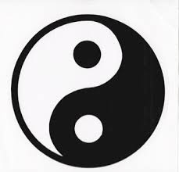
Yin and Yang
Yin signifies
Female
Passive
Dark
Cold
Moist
Moon
Earth
Dirty
Peace
Harmony
Endurance
Weakness
All i.e. Negative
Yang signifies
Male
Light
Active
Warm
Dry
Sun
Heaven
Up
Strength
All i.e. Positive

Slide 7
Yin and Yang
They are dynamically opposite yet harmonising energies.
This brings about a balanced state of the universe
Good health is the state of energy balance
Bad health signifies imbalance between both energies
Alternative Therapies, Swati Bhagat, First Edition, 2004

Slide 8
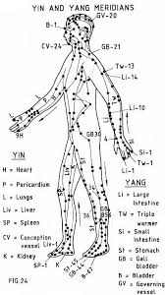
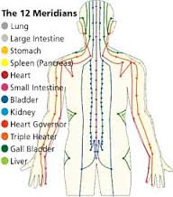
Meridians

Slide 9
Meridians
The Chinese have discovered 12 meridians and eight extraordinary vessels, each of which are related to chi. The pathways of chi flow through the meridians, which then connect to a specific location in the body, and is a key component in acupuncture.
The meridians are very much like streams and rivers, where the essential energy flows through a pathway and replenishes the areas of the body that is the closest

Slide 10
Meridian
The word meridian as used in East Asian medicine came from the term jing-luo. Jing means “to go through” or “a thread of fabric”; luo means “something that connects or attaches,” or “a net”
The meridians goes vertically from below upwards or above downwards are termed as “Jing”, are the main meridians
YIN-YANG AND CHI IN ACUPUNCTURE, Tiffany Pui Lin Chiu, December 2006

Slide 11
Meridians
The 12 paired meridians originate from the internal viscera of the body.
The viscera are divided into
Zang or solid organs like heart, lung, spleen, liver stores the “Qi” & are Yin (-ve)in nature
Fu or hollow organs like stomach, intestine, bladder & discharges the “Qi” & are Yang (+ve) in polarity
Alternative Therapies, Swati Bhagat, First Edition, 2004

Slide 12
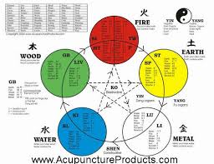
Five Element Theory

Slide 13
Five Element Theory Contd.
Traditional Chinese Philosophy divides the whole Universe into five elements Fire, Metal, Wood, Earth & Water
They are related to the Destructive Cycle ‘KO’ & Generative cycle ‘Sheng’
This five elements are constantly tranformed into one another
Alternative Therapies, Swati Bhagat, First Edition, 2004

Slide 14
Importance of Acupuncture
The World Health Organization endorsed more than 40 disorders that can beneﬁt from acupuncture treatment

Slide 15
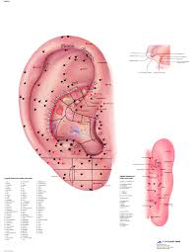
Auriculotherapy

Slide 16
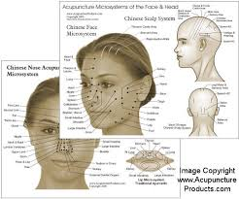
Nose, Scalp & Face Acupuncture

Slide 17
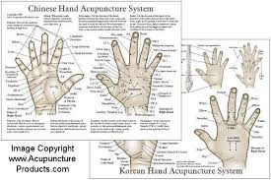
Hand Acupuncture

Slide 18
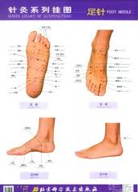
Foot Acupuncture

Slide 19
ElectroAcupuncture
It is deﬁned as the electrical stimulation of acupuncture points (acupoints) through needles.
Electroacupuncture: An introduction and its use for peripheral facial paralysis, David F Mayor,2007

Slide 20
Electroacupuncture is also referred to as Acupuncture Analgesia
Electroacupuncture according to Voll, W John Diamond

Slide 21
Thank You

