Slide 1
NATURE AND SCOPE OF
HUMAN RESOURCE MANAGEMENT
Dr. Subhasish Chatterjee

Slide 2
CONTENTS:
Nature
Functions
Personnel Policies
HRM Models
Evolution of HRM
Human Capital Management

Slide 3
Nature:
HRM consists of people related functions such as hiring, training and development, performance review, compensation, safety etc.
HRM necessitates alignment of HR policies and practices with the organisation’s strategies.
HRM involves application of management principles and functions to people management.
HR activities are not the sole responsibility of the HR specialists.
HR functions are not confined to business establishments only.

Slide 4
Functions:
Planning
Staffing
Developing
Monitoring
Managing relationships
Managing change
Evaluating

Slide 5
Personnel Policies:
A policy is a plan of action. It is a statement of intention committing the management to a general course of action.
WHY ADOPT POLICIES????
Helps management give deep thought to the basic needs of the employees as well as organisation.
Established policies ensure consistent treatment of all personnel.
Policies serve as standard of performance.
Sound policies help resolve conflicts and builds employee motivation and loyalty.

Slide 6
A few specific personnel policies are:
Policy of hiring people with due respect to factors like reservation, marital status etc.
Policy on terms and conditions of employment like compensation, hours of work, overtime etc.
Policy with regard to medical assistance like sick leave, company medical benefits etc.
Policy regarding transport, housing, allowances etc.
Policy regarding training and development like need and frequency for training.
Policy regarding industrial relations like trade union recognition, grievance procedure etc.

Slide 7
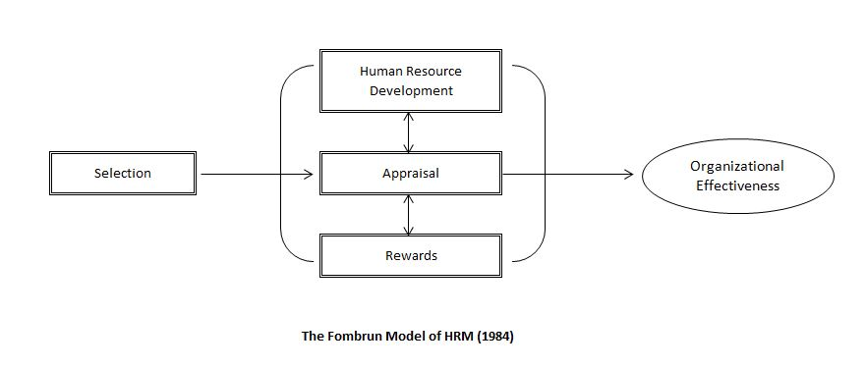
HRM Models:
The Fombrun, Tichy and Devanna Model:

Slide 8
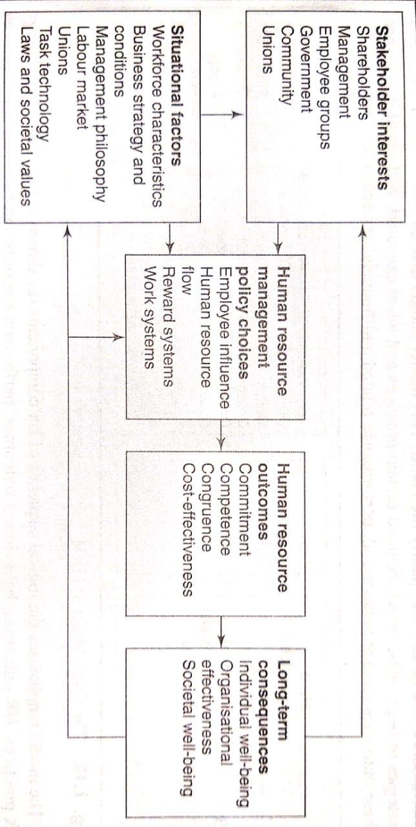
The Harvard Model:

Slide 9
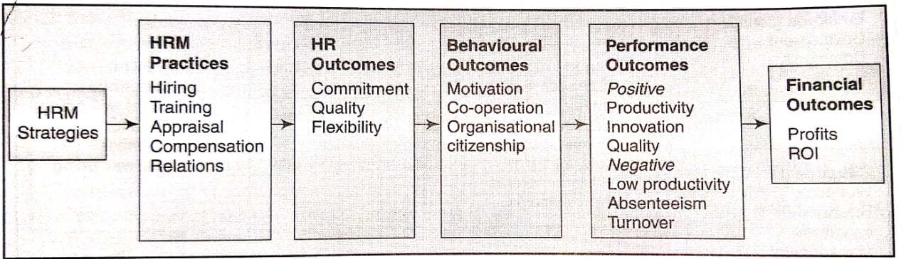
The Guest Model:

Slide 10
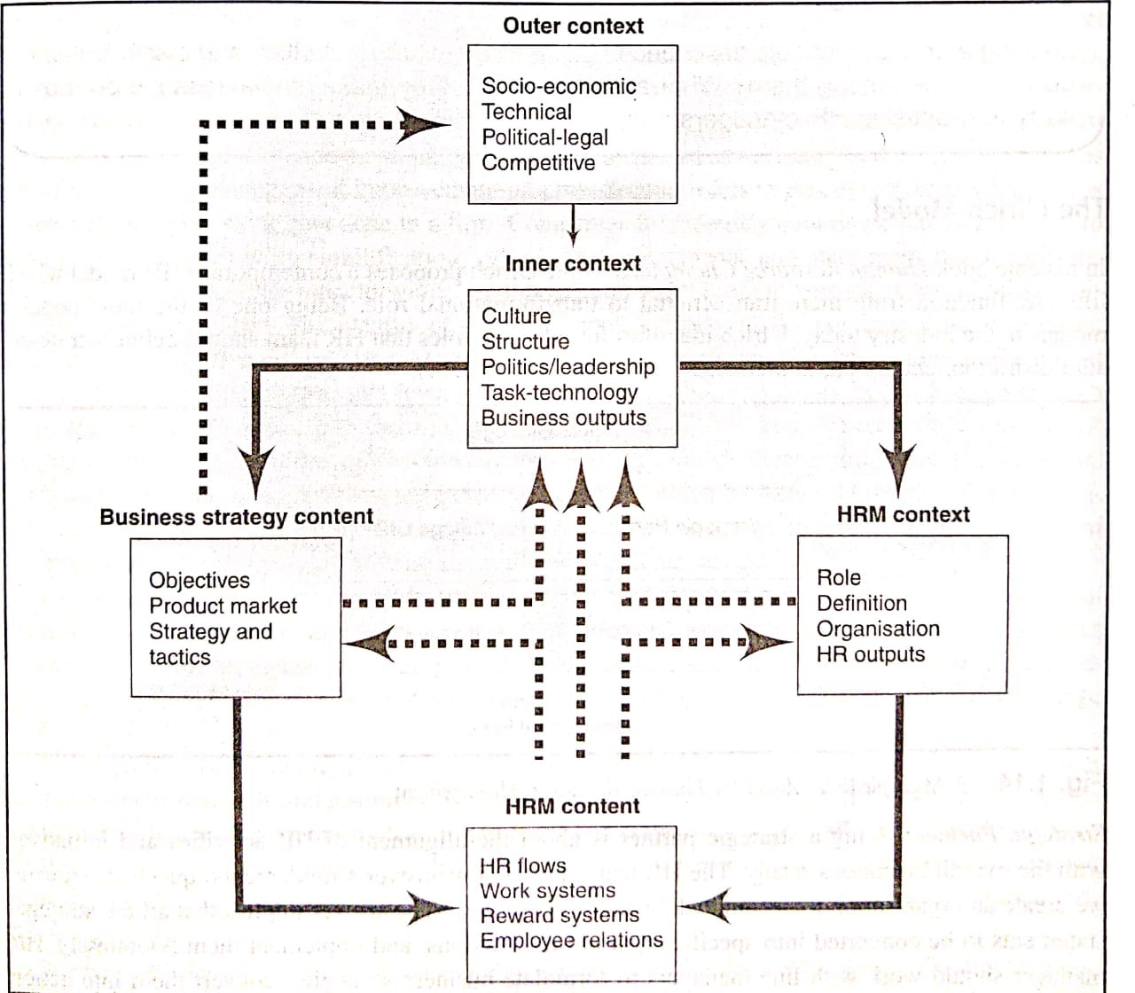
The Warwick Model:

Slide 11
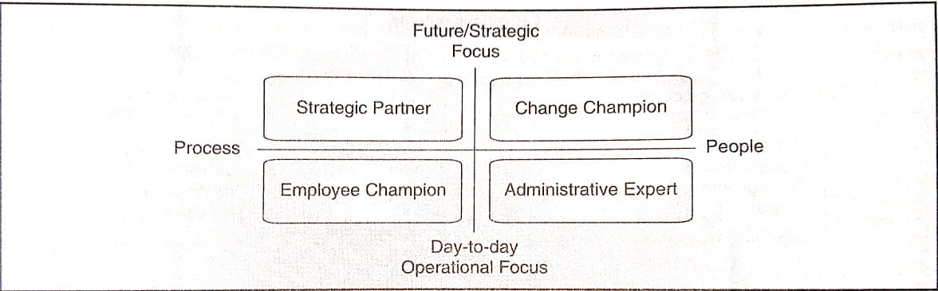
The Ulrich Model:

Slide 12
Evolution of HRM:
PERIOD | DEVELOPMENT STATUS | OUTLOOK | EMPHASIS | STATUS
1920S-1930S | Beginning | Pragmatism of capitalists | Statutory, Welfare, paternalism | Clerical
1940s-1960s | Struggling for recognition | Technical, legalistic | Introduction of techniques | Administrative
1970s-1980s | Achieving sophistication | Professional, legalistic, impersonal | Regulatory, confirming, imposition of standards on other functions | Managerial
1990s-Present | Promising | Philosophical | Human values, productivity through people | Executive

Slide 13
Human Capital Management:
Human capital management is also known as talent management.
HRM treats people as an organisational resource. HCM recognises that people are investors of their personal human capital and this provides the main source of value for an organisation.
Organisations do not own capital but can rent it from their employees. As a result, human capital is highly precarious and is in constant danger of being lost when an employee exits the organisation.

Slide 14
THANK YOU…!!!!!!!

