Slide 1
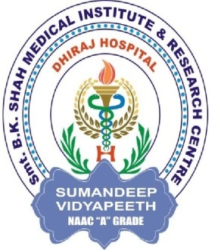
ENDOCRINOLOGY
COMPETENCY CODE: PY8.2 (contd…)
BY
DR J M HARSODA
PROFESSOR AND HEAD

Slide 2
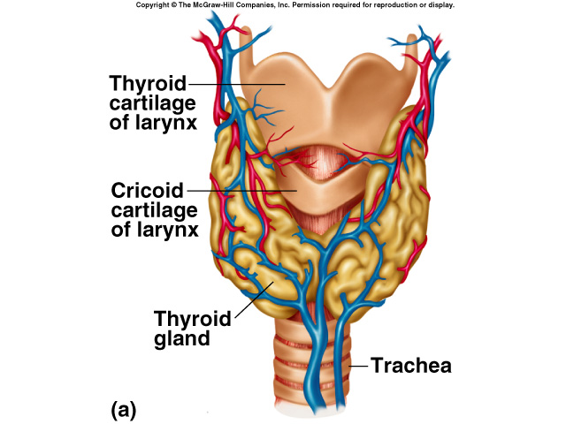
THYROID GLAND

Slide 3
FUNCTIONAL ANATOMY OF THYROID GLAND
Thyroid gland is located on eitther side of trachea just below the larynx.
It consists of two lobes joined together by a narrow
Isthmus.
Thyroid gland is the largest gland in the body (weighing about 15-25 gm).
Rate of blood flow ( highly vascular gland ): 400-600 ml/100gm/minute.
Blood supply: Superior and inferior thyroid arteries.
Nerve supply: Parasympathetic via larngeal recurrent branch of vagus. Sympathetic postganglionic neurones via superior cervical sympathetic ganglion.

Slide 4
GROSS ANATOMY OF THYROID GLAND

Slide 5
FUNCTIONAL HISTLOGY OF THYROID GLAND
The thyroid gland is made up of multiple acini ( follicles). Each spherical follicle is surrounded by a single layer of cuboidal cells and filled with pink-staining proteinaceous material called colloid. The major constituent of colloid is the large glycoprotein thyroglobulin.
Follicular cells secrete T3 and T4
Parafollicular cells secrete Thyrocalcitonin

Slide 6
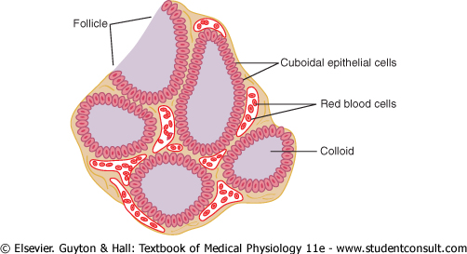
HISTOLOGY OF THYROID GLAND

Slide 7
IODINE METABOLISM
500 μg I- IN DIET
120 μg I-
THYROID
40 μg I-
Extracellular 80 μg T3, T4
fluid LIVER &
OTHER
60 μg I- TISSUES
Bile
480 μg I- in urine 20 μg I- in stool

Slide 8
SYNTHESIS AND SECRETION OF THYROID HORMONE (T3,T4)
Iodide Pump (Iodide Trapping) or Na+/ I- Symporter.
Formation and Secretion of Thyroglobulin by the Thyroid Cells.
Oxidation of the Iodide Ion.
“Organification” of Thyroglobulin - Iodination of Tyrosine and Formation of the Thyroid Hormones
Storage of iodinated Thyroglobulin.
Secretion of T3 and T4 in blood from thyroid gland

Slide 9
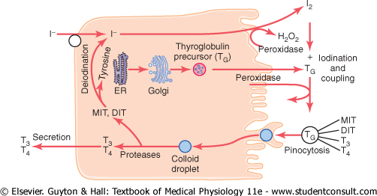
SYNTHESIS AND SECRETION OF THYROID HORMONE (T3,T4)

Slide 10
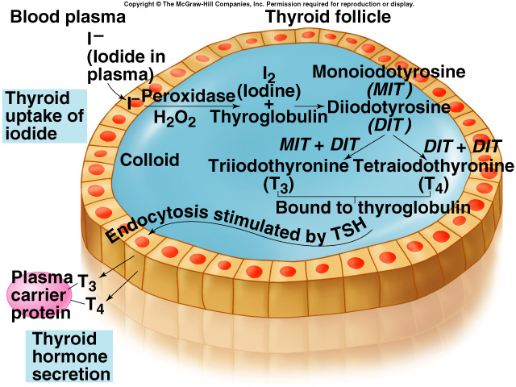
SYNTHESIS AND SECRETION OF THYROID HORMONE (T3,T4)

Slide 11
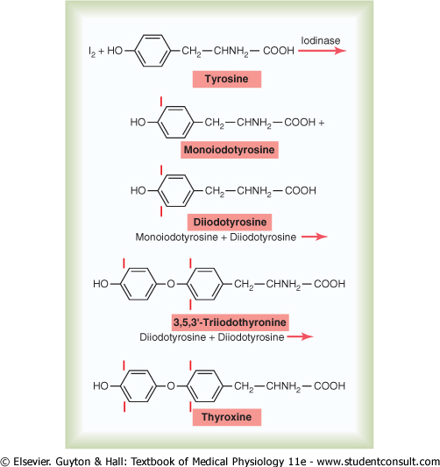
STEPS INVOLVED IN THE SYNTHESIS OF THYROID HORMONES (T3, T4)

Slide 12
DISTRIBUTION OE IODINATED COMPUND IN THYROID
Normal plasma I- level is about 0.3 µg/dl.
Monoiodotyrosine (MIT) - 23 %
Diiodotyrosine (DIT) - 33 %
Triiodothyronine (T3) - 37 %
Tetraiodothyronine (T4) - 07 %
RT3 - Only traces

Slide 13
THYROID HORMONES SECRETION PER DAY
T4 - 80 µg ( 103 nMol ) / day
T3 - 04 µg ( 07 nMol ) / day
RT3 - 02µg ( 3.5 nMol ) / day
RT3 is a biologically inactive thyronine formed by peripheral conversion catalyzed by 5- deiodinase

Slide 14
TRANSPORT OF THYROID HORMONES
PROTEIN BINDING
Normal plasma level jn adults:
T4 - 08 µg / dl (103 nMol/L)
T3 - 0.15 µg / dl (2.3 nMol/L)
The plasm proteins that bind thyroid hormones
are prealbumin and globulin.
- Thyroxine binding prealbumin (TBPA)
now called transthyretin.
- Thyroxine binding globulin (TBG).
Free thyroxine index:
- FT4 I - Free tetraiodo thyronine index
- FT3 I - Free triiodo thyronine index

Slide 15
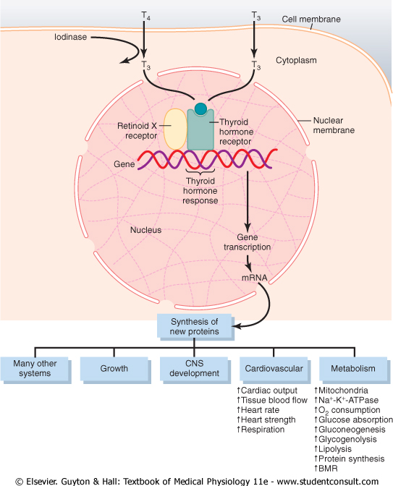
MECHANISM OF ACTION OE T3 AND T4

Slide 16
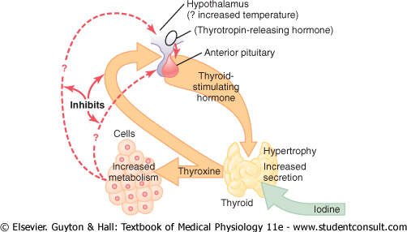
REGULATION OF THYROID HORMONES SECRETION

Slide 17
PHYSIOLOGIC EFFECTS OF THYROID HORMONES (T3, T4)
THERMOGENIC EFFECT
EFFECT ON BONE GROWTH AND MATURATION
EFFECT ON GIT
EFFECT ON SKELETAL MUSCLE
EFFECT ON CVS
EFFECT ON REPRODUCTIVE SYSTEM
EFFECT ON CNS
METABOLIC EFFECTS:
- ON CARBOHYDRATE METABOLISM
- ON FAT METABOLISM
- ON PROTEIN METABOLISM
- ON VITAMIN METABOLISM

Slide 18
Cretinism
Children who are hypothyroid from birth or before are called cretins.
They are dwarfed and mentally retarded and have potbellies and enlarged, protruding tongues Worldwide, congenital hypothyroidism is one of the most common causes of preventable mental retardation.
They include not only maternal iodine deficiency and various congenital abnormalities of the fetal hypothalamo-pituitary-thyroid axis but also maternal antithyroid antibodies that cross the placenta and damage the fetal thyroid.
T₄ crosses the placenta, and unless the mother is hypothyroid, growth and development are normal until birth.

Slide 19
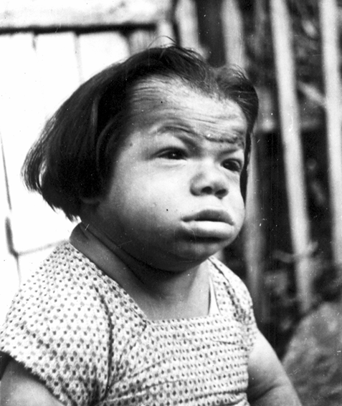
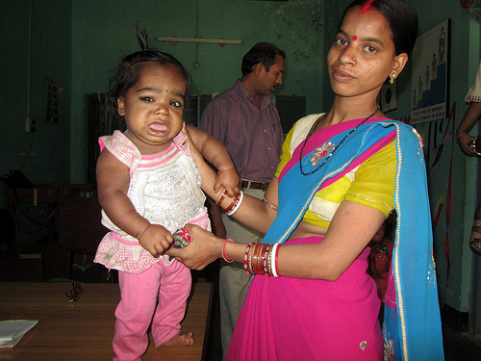
CLINICAL FEATURES OF CRETINISM

Slide 20
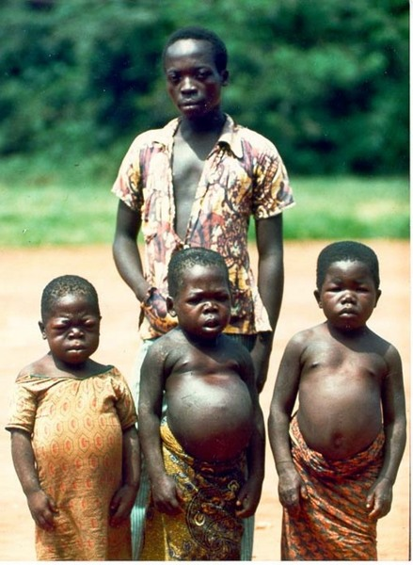
CLINICAL FEATURES OF CRETINISM

Slide 21
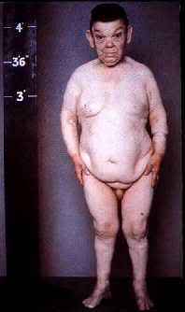
CLINICAL FEATURES OF CRETINISM

Slide 22
Myxedema
The syndrome of adult hypothyroidism is generally called myxedema, although this term is also used to refer specifically to the skin changes in this syndrome.
Hypothyroidism may be the end result of a number of diseases of the thyroid gland, or it may be secondary to pituitary failure (pituitary hypothyroidism) or hypothalamic failure (hypothalamic hypothyroidism).
In the latter two conditions, unlike the first, the thyroid responds to a test dose of TSH, and at least in theory, hypothalamic hypothyroidism can be distinguished from pituitary hypothyroidism by the presence in the former of a rise in plasma TSH following a test dose of TRH.
The TSH response to TRH is usually normal in hypothalamic hypothyroidism, while it is increased in hypothyroidism caused by thyroid disease and decreased in hyperthyroidism because of the feedback of thyroid hormones on the pituitary gland.

Slide 23
Myxedema
In completely athyreotic humans, the BMR falls to about 40.
The hair is coarse and sparse, the skin is dry and yellowish (carotenemia), and cold is poorly tolerated.
The voice is husky and slow, the basis of the aphorism that "myxedema is the one disease that can be diagnosed over the telephone.
Mentation is slow, memory is poor, and in some patients there are severe mental symptoms ("myxedema madness").
Plasma cholesterol is elevated.

Slide 24
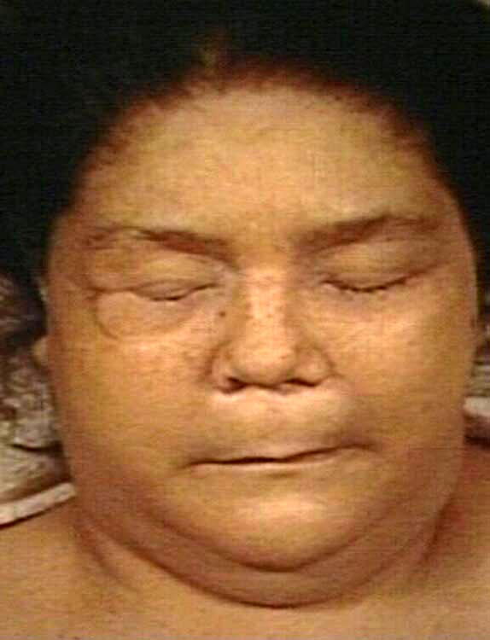
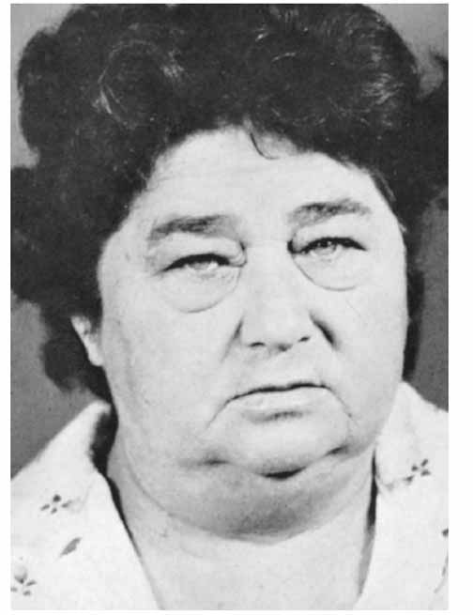
CLINICAL FEATURES OF MYXODEMA

Slide 25
Graves' disease
Hyperthyroidism is characterized by nervousness; weight loss; hyperphagia; heat intolerance; increased pulse pressure; a fine tremor of the outstretched fingers; a warm, soft skin; sweating; and a BMR from +10 to as high as +100.
However, the most common cause is Graves' disease (Graves' hyperthyroidism), which accounts for 60-80% of the cases.
The condition—which for unknown reasons is much more common in women—is an autoimmune disease in which antibodies to the TSH receptor stimulate the receptor.
This produces marked T₄ and T₃ secretion and enlargement of the thyroid gland (goiter).
However, due to the feedback effects of T₄ and T₃, plasma TSH is low, not high.

Slide 26
Graves' disease
Another hallmark of Graves' disease is the occurrence of swelling of tissues in the orbits, producing protrusion of the eyeballs (exophthalmos).
This occurs in 50% of patients and often precedes the development of obvious hyperthyroidism.
A subpopulation of fibroblasts in the orbits ultimately develop into adipocytes, and these preadipocyte fibroblasts contain TSH receptor protein.
The current theory of the development of exophthalmos is that when stimulated by the TSH receptor-stimulating antibodies in the circulation, these cells release cytokines that promote inflammation and edema.

Slide 27
Graves' disease
Other antithyroid antibodies are present in Graves' disease, including antibodies to thyroglobulin and thyroid peroxidase. In Hashimoto's thyroiditis, autoimmune antibodies destroy the thyroid with little if any stimulation, producing hypothyroidism.

Slide 28
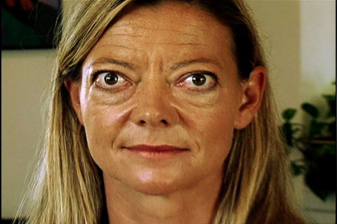
CLINICAL FEATURES OF EXOTHALAMIC GOITER

Slide 29
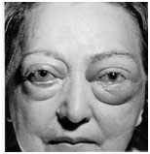
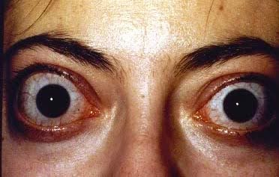
CLINICAL FEATURES OF EXOTHALAMIC GOITER

Slide 30
SIMPLE GOITER
When the dietary iodine intake falls below 50 ug/d, thyroid hormone synthesis is inadequate and secretion declines.
As a result of increased TSH secretion, the thyroid hypertrophies, producing an iodine deficiency goiter that may become very large.
Such "endemic goiters" have been known since ancient times.
Before the practice of adding iodide to table salt became widespread.
They were very common in Central Europe and the area around the Great Lakes in the United States, the inland "goiter belts" where iodine has been leached out of the soil by rain so that food grown in the soil is iodine-deficient.

Slide 31
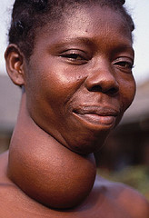
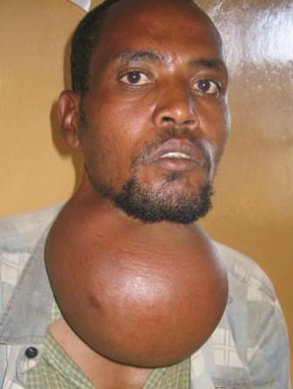
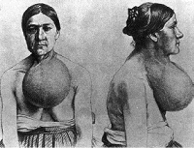
CLINICAL FEATURES OF SIMPLE GOITER

Slide 32
Wolff-Chaikoff effect
In normal individuals, large doses of iodides act directly on the thyroid to produce a mild and transient inhibition of organic binding of iodide and hence of hormone synthesis. This inhibition is known as the Wolff-Chaikoff effect.
The Wolff-Chaikoff effect is greater and more prolonged when iodide transport is increased, and this is why patients with hyperthyroidism are more responsive to iodide than normal individuals.
There are at least two additional mechanisms by which excess I⁻ inhibits thyroid function.
It reduces the effect of TSH on the gland by reducing the cAMP response to this hormone, and it inhibits proteolysis of thyroglobulin.

Slide 33
MCQ TEST AFTER END OF LECTURE
1 One of the following hormone secreted from Thyroid gland:
A PTH
B ICSH
C ADH
D T3
2 Thyrocalcitonin is secreted from :
A Parathyroid gland
B Thyroid gland
C Kidney
D None of above

Slide 34
MCQ TEST AFTER END OF LECTURE
One disease that can be diagnosed over the
telephone:
A Acromegaly
B Cushing’s syndrome
C Grave’s disease
D Myxedema
4 Hyperthyroidism is characterized by :
A carotenemia
B myxedema madness
C Hashimoto's thyroiditis,
D None of above

Slide 35
MCQ TEST AFTER END OF LECTURE
5 In normal individuals, large doses of iodides act directly on the thyroid to produce a mild and transient inhibition of hormone synthesis. This inhibition is known as :
A Cretinism
B Exophthalmic goiter
C Wolff-Chaikoff effect
D Endemic goiter

Slide 36

THANK YOU

