Slide 1

ENDOCRINOLOGY
COMPETENCY CODE: PY8.2 (contd…)
BY
DR J M HARSODA
PROFESSOR AND HEAD

Slide 2
POSTERIOR PITUITARY GLAND

Slide 3
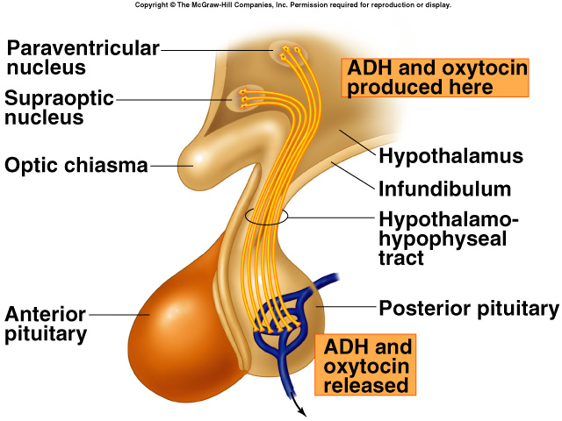
HORMONES RELEASED FROM POSTERIOR PITUITARY

Slide 4
ANTIDIURETIC HORMONE (ADH)
SITE OF FORMATION: Hypothalamic hormone synthesized in the cells of the supraoptic nucleus .
Bound to neurophysin II & stored in posterior pituitary.
Relesead by nerve impulses arriving along the hypothaloma-hypophysial tract.
Hypothalamic nuclei that represent the main source of ADH are the supraoptic nuclei.
ADH stored (not synthesized) in parse nervosa.

Slide 5
CONTD…. ADH
CHEMISTRY : ADH (vasopressin) is polypeptide, containing nine amino acids with a Mol. Wt. 1000.
SITE OF ACTION: Kidney and blood vessels.
MECHENISM OF ACTION : Acts via three types of receptors (V1A,V1B, V2) all are coupled to G-proteins.
PHYSIOLOGICAL ACTIONS:
Regulation of water balance by increases water reabsorption and decreases urine volume through renal nephron.
Vasoconstrictor effect: ADH ( high dose) Via V1A receptors, it produces; peripheral vasoconstriction increases blood pressure, because of this reason is also called vasopressin.

Slide 6
CONTD…. ADH
Action on anterior pituitary: Via V1B receptors stimulates the release of ACTH from anterior pituitary thereby control aldosterone secretion.
Via V1A receptors causes glycogenolysis in the liver.
REGULATION OF ADH:
Effective plasma osmotic pressure or plasma osmolality.
Change in blood volume.
Other factors affecting ADH secretion.
Stress of pain, chronic emotional stress,
and surgical trauma.

Slide 7
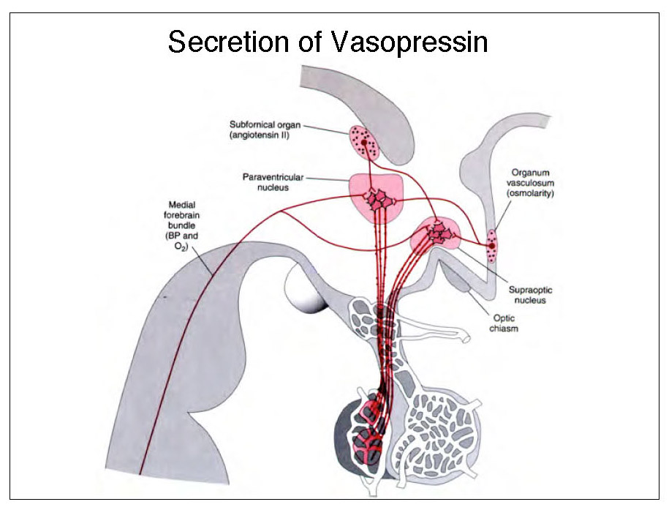

Slide 8
ENDOCRINOPATHIES
Abnormalities of ADH secretion include:
Syndrome of inappropriate hyper secretion of ADH
(SIADH).
Diabetes insipidus.
SIADH:
SIADH refers to a conditon in which ADH secretion is increased despite the presence of hypo-osmolality.
Exessive ADH secretion leads to water intoxication (overhydration), and because of this SIADH is also called dilution syndrome.

Slide 9
CONTD….. ENDOCRINOPATHIES
Characteristic features of SIADH:
Water retention.
Hypernatriuria.
Hyponatraemia.
Oedema.
Treatment:
SIADH can be treated with drugs like demeclocycline, that block the effect of ADH on kidneys.

Slide 10
CONTD….. ENDOCRINOPATHIES
Diabetes insipidus:
Diabetes insipidus refers to a clinical condition of polyuria that occurs either due to deficiency of ADH release or failure of renal response to ADH.
Characteristic features of Diabetes insipidus:
Polyuria.
Polydipsia.
Dehydration.

Slide 11
OXYTOCIN
SITE OF FORMATION: Oxytocin is synthesized mainly in the paraventricular nuclei of the hypothalamus and stored in the pars nervosa.
CHEMISTRY : Oxytocin is polypeptide, containing nine amino acids with a Mol. Wt. 1000.
SITE OF ACTION: Smooth muscles of uterus and mammary glands.
MECHENISM OF ACTION : Mediated through Phospholipase C Second Messenger System.

Slide 12
CONTD….. OXYTOCIN
PHYSIOLOGICAL ACTIONS:
Oxytocin stimulates contraction of smooth muscle of uterus (myometrium) at the end of gestation.
Oxytocin plays a role in labor and has been shown to be a useful theraputic agent in the induction of labor.
Milk let-down or milk ejection reflex:
Stimulation of the tactile receptors in the areolar region of the female breast during suckling activates somesthetic neural pathways, which transmit this signal to the hypothalamus. This leads to the reflex secretion of oxytocin into blood stream and to milk release following a latent period of 30-60 seconds.

Slide 13
CONTD….. OXYTOCIN
Oxytocin secretion can be conditioned so that the physical stimulation of the nipple no longer is required. Thus, lactating women can experience milk release in response to the sight and sound of a baby.
Oxytocin is produced in man and also is released during genital tract stimulation. The role of this hormone in men is unknown.

Slide 14
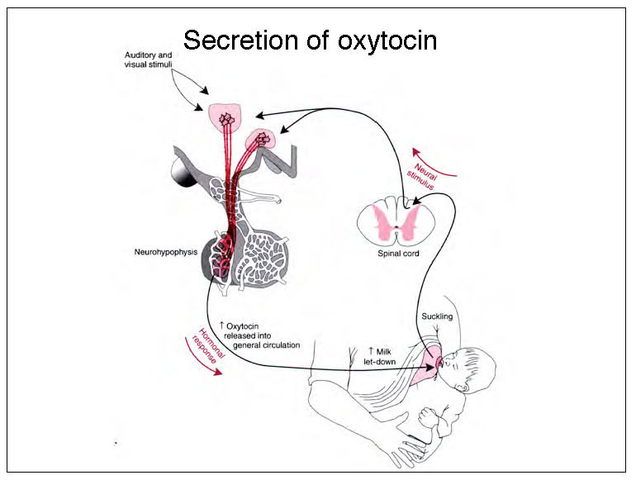

Slide 15
MCQ TEST AFTER END OF LECTURE
1 Oxytocin is synthesized mainly in hypothalamus by
A supraoptic nuclei
B Tubercinerum nuclei
C Paraventricular nuclei
D None of above
2 Milk let-down or milk ejection reflex is initiated by:
A Prolactin
B Oxytocin
C Vasopressin
D LH

Slide 16
MCQ TEST AFTER END OF LECTURE
3 Exessive ADH secretion leads to :
A Diabetes insipidus
B SIADH
C Diabetes mellitus
D Hyponatriuria.
4 One of following is symptom of Diabetes insipidus :
A Metabolic ketoacidosis
B Dehydration
C Overhydration
D None of above

Slide 17
MCQ TEST AFTER END OF LECTURE
5 Retention of sodium and excretion of potassium by kidney is action of :
A Cortisol
B Androgen
C Aldosterone
D Hydrocortisone

Slide 18


