Slide 1

ENDOCRINOLOGY
COMPETENCY CODE: PY8.2 (contd…)
BY
DR J M HARSODA
PROFESSOR AND HEAD

Slide 2
HYPOPHYSIS
(PITUITARY GLAND)

Slide 3
HYPOPHYSIS (PITUITARY GLAND)
GROSS ANATOMY
The pituitary gland lies in a bony walled cavity, the sella turcica, in the sphenoid bone at the base of the skull.
Anterior pituitary (Adenohypophysis)
Pars distalis
Pars intermedia
Pars tuberalis
Posterior pituitary (Neurohypophysis)
Median eminence
Infundibular stem (Pituitary stalk)
Pars nervosa

Slide 4
EMBRYOLOGICAL DEVELOPMENT OF PITUITARY GLAND
ADENOHYPOPHYSIS is derived from the primitive gut an upward extension(Rathke’ s pouch) of the epithelium of the primitive mouth cavity (stomodeum). The adenohypophysis is a derivative of buccal ectoderm.
NEUROHYPOPHYSIS is develops as a downward evagination of the neural tube at the base of the hypothalamus (infundibulum) and, therefore, represents a true extension of brain. The neurohypophysis is a derivative of neural ectoderm.

Slide 5
HISTOLOGY OF ADENOHYPOPHYSIS
CELLS
CHROMOPHILS CHROMOPHOBES
ACIDOPHILS BASOPHILS
SOMATOTROPHS LACTOTROPHS
GONADOTROPHS THYROTROPHS CORTICOTROPHS

Slide 6
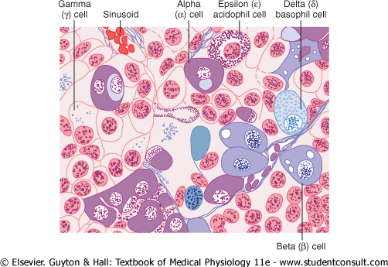
HISTOLOGY OF ANTERIOR PITUITARY

Slide 7
PHYSIOLOGIC ANATOMY OF PITUITORY
3rd VENTRICAL OF HYPOTHALAMUS
MAMMILARY BODY OPTIC CHIASMA
INFUNDIBULUM MEDIANEMINENCE
POSTERIOR PITUITORY ANERIOR PITUITORY
(NEUROHYPOPHYSIS ) (ADENOHYPOPHYSIS)
SELLA TURCICA PARS INTERMEDIA
SPHENOID BONE
J M Harsoda (2011) EBES DOCUMENT, ENDOCRINOLOGY;SV.

Slide 8
HYPOPHYSIAL PORTAL SYSTEM
THE BLOOD SUPPLY OF THE ANTERIOR LOBE is derived from branches of the internal carotid arteries (mainly the superior hypophysial artery).
The primary capillary plexus, which emanates from the superior hypophysial artery from a set of long portal veins that carry blood downward into the anterior lobe.
The anterior lobe receives its remaining blood from the short portal veins, which originate in the capillary plexus of inferior hypophysial artery at the base of the infundibular stem.

Slide 9
HYPOPHYSIAL PORTAL SYSTEM
3rd Ventrical of hypothalamus
Magnocellular Parvicellular neurones neurones
Int. Carotid
Infundibular stem Sup. Hypophyseal artery
portal veins
(long and Short)
POSTERIOR LOBE ANTERIOR LOBE
Int. Carotid
Inf. Hypophyseal artery
J M Harsoda (2011) EBES DOCUMENT, ENDOCRINOLOGY;SV.

Slide 10
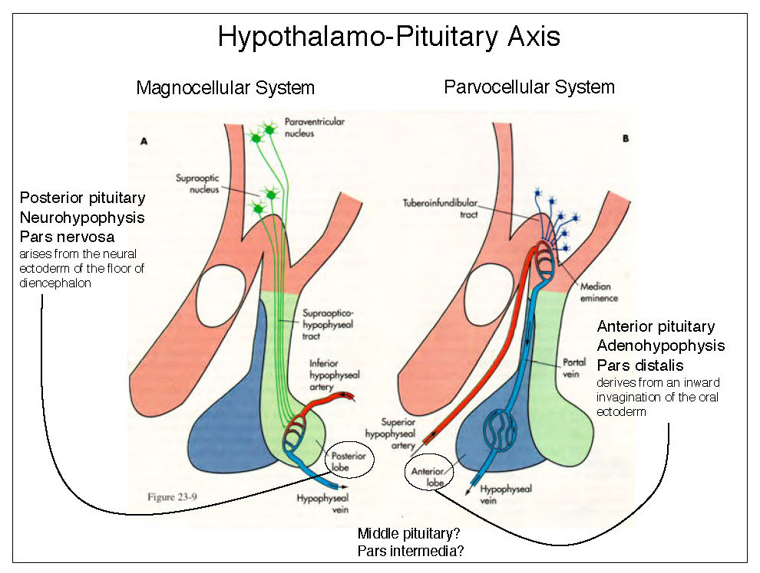

Slide 11
HORMONES OF THE ANTERIOR PITUITARY
GROWTH HORMONE (GH) SOMATOTROPHIN (STH)
THYROID STIMULATING HORMONE (TSH)
ADRENOCORTICOTROPHIC HORMONE (ACTH)
GONADOTROPHIC HORMONES (GTH)
FOLLICLE STIMULATING HORMONE (FSH)
LUTEINIZING HORMONE/INTERSTITIAL CELL STIMULATING HORMONE( LH/ICSH)
PROLACTIN/LACTOTROPHIC HORMONE(LTH)
PROOPIOMELANOCORTIN (POMC)
B- LPH, α-MSH AND B- ENDORPHIN

Slide 12
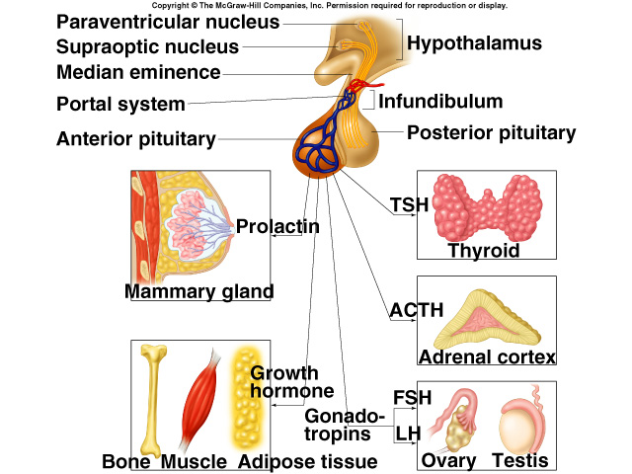
HORMONES OF THE ANTERIOR PITUITARY

Slide 13
GROWTH HORMONE (GH)
SITE OF FORMATION
CHEMISTRY
MECHANISM OF ACTION
SITE OF ACTION
PHYSIOLOGICAL EFFECTS
STIMULATION OF GROWTH OF BONE, CARTILAGE AND CONNECTIVE TISSUE
ACTION ON CARBOHYDRATE METABOLISM
ACTION ON FAT METABOLISM
ACTION ON PROTEIN METABOLISM
ACTION ON MINERAL METABOLISM
CONTROL OF SECRETION
ENDOCRINOPATHIES
DISORDERS ASSOCIATED WITH INCREASED GH SECRETION
IN CHILDREN (BEFORE EPIPHYSIAL FUSION) : GIANTISM
IN ADULT (AFTER EPIPHYSIAL FUSION) : ACROMEGALY
DISORDERS ASSOCIATED WITH DECREASED GH SECRETION
IN CHILDREN (BEFORE EPIPHYSIAL FUSION) : DWARFISM
IN ADULT (AFTER EPIPHYSIAL FUSION) : PROGERIA
MISCELLANEOUS
KWASHIORKOR, AFRICAN PYGMIES, TURNER’ S SYNDROME, ACHONDROPLASIA AND KASPAR HAUSER SYNDROME

Slide 14
GIANTISM OR GIGANTISM
DISORDERS ASSOCIATED WITH INCREASED GH SECRETION
IN CHILDREN (BEFORE EPIPHYSIAL FUSION)
Excessive growth of long bones.
Excessive tallness as much as 2.5 mt or 8 ft.
Bilateral gynaecomastia-(Enlargement of breast in male may be associated)
Large hands & feet.
Coarse facial features.
Loss of libido/impotence
Hyperglycaemia

Slide 15
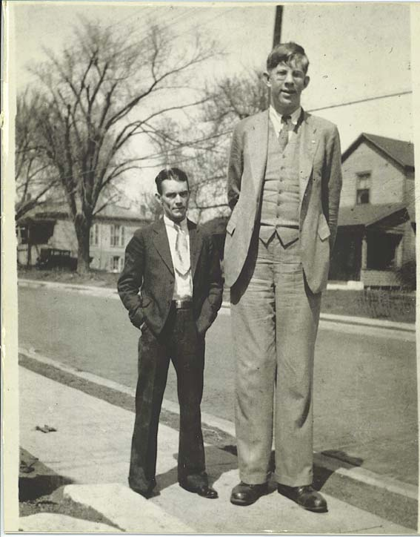
GIANTISM OR GIGANTISM

Slide 16
ACROMEGALY
Due to acidophilic cell tumor of anterior pituitary
produces excessive secretion of GH during adulthood
Headache, bitemporal hemianopia
Prognathism:Elongation & widening of the mandible .
Enlargement of the frontal, mastoid, ethmoid & maxillary sinuses, causing a prominent eye brow.
Thickning of the skin and coarsening of the facial features.
Hypertrophy of the body soft tissues such as heart (cardiomegaly), liver (hepatomegaly), kidney (renomegaly), instestine, spleen (splenomegaly), tongue & muscles.
Kyphosis and hirsutism.

Slide 17
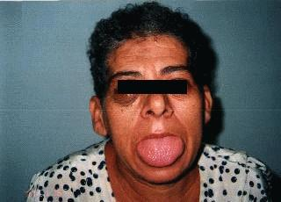
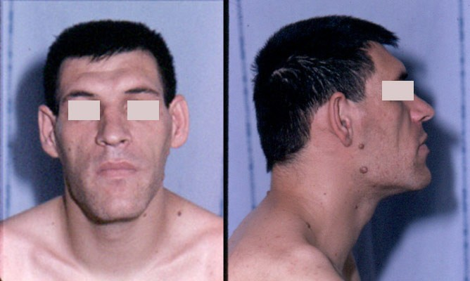

ACROMEGALY

Slide 18
DWARFISM
DISORDERS ASSOCIATED WITH DECREASED GH SECRETION
IN CHILDREN (BEFORE EPIPHYSIAL FUSION).
Shortness of stature (height 3 to 4 feet ).
Normal mental activity.
Plumpness (fatness).
Immature faces.
Delicate extremities.
Sexual maturity does not occur when associated
with gonadotrophin deficiency.
Impaired hair growth and a tendency toward
fasting hyperglycemia.

Slide 19
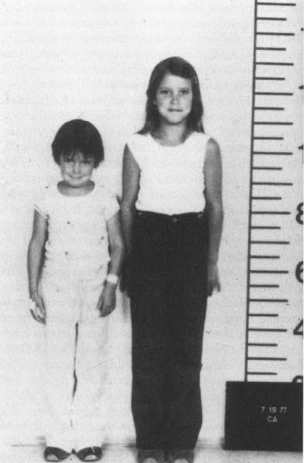

CLINICAL FEATURES OF DWARFISM

Slide 20
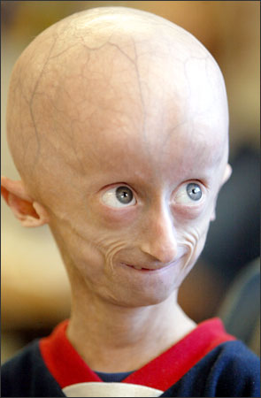
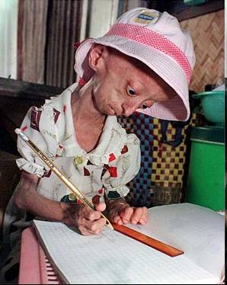
PROGERIA

Slide 21
PROLACTIN
Prolactin is also called lactogenic or mammotrophic or galactopoetic hormone.
SITE OF FORMATION: Anterior pituitary acidophil cells.
CHEMISTRY : It is a single peptide chain containing 199 amino acids Mol. Wt.23,000 to 25000.
SITE OF ACTION : Mammary glands.
MECHENISM OF ACTION : Through cyclic AMP mediated hormone activity

Slide 22
CONTD..... PROLACTIN
Normal serum levels in adults:
Females : 8 ng/ml plasma
Males : 5 ng/ml plasma.
PHYSIOLOGICAL ACTIONS : During pregnancy, the mammary ducts give rise to lobules of alveoli which are secretory structures of this tissue. This differentiation require prolactin, oestrogen and progesterone.

Slide 23
CONTD..... PROLACTIN
Once lobuloalveolar system is developed, the role of prolactin and corticosteroids in milk production.
GH & thyroid hormone enhance milk secretion.
Immediately following pregnancy, prolactin stimulates galactosyltransferase activity, leading to the synthesis of lactose.
In women, high rerum level of prolactin are associated with supressed LH secretion and anovulation.

Slide 24
CONTROL OF PROLACTIN SECRETION
Stimuli that increase prolactin secretion:
- Act via stimulating prolactin releasing factor (PRF).
- Secretion increases 2-3 hrs after the onset of sleep
and continues throughout the sleep time.
- Exercise & various stresses such as surgical operation and
myocardial infarction etc.
- Pregnancy- plasma prolactin levels begin to increases
by 8thweek of pregnancy
- Nursing & breast stimulation raises the prolactin levels to
250 ng/ml.

Slide 25
CONTD…. CONTROL OF PROLACTIN SECRETION
Stimuli that inhibit prolactin secretion:
- Through an inhibitory peptide, prolactin inhibiting factor
(PIF), which is released by the hypothalamus into
hypothalamo- hypophysial portal vessels.
- PIF inhibit prolactin secretion by an action on the prolactin
secreting cells of the anterior pituitary.
- Dopamine may be the main PIF, therefore serotonin
antagonists and dopamine agonists block the secretion of
prolactin.

Slide 26
ENDOCRINOPATHIES
Hyperprolactinemia:-
DISORDERS ASSOCIATED WITH INCREASED PROLACTIN SECRETION
- In women, elevated serum prolactin manifests
infertility and menstrual abnormalities.
- In men, hyperprolactenemia is cause of
decreased libido and impotence.
Treatment of prolactin hypersecretion includes administration of bromocriptine, a dopamine-agonist that lowers prolactin levels.

Slide 27
MCQ TEST AFTER END OF LECTURE
1 The pituitary gland lies in a bony walled cavity :
A Median eminence
B Sella turcica
C Infundibulum
D 3rd Ventrical of hypothalamus
2 One of the following is Protein and polypeptide type hormone :
A Cortisol
B Testosterone
C PTH
D Thyroxine

Slide 28
MCQ TEST AFTER END OF LECTURE
3 One of the following hormone secreted from ant pituitory:
A PTH
B ICSH
C ADH
D T3
4 Milk Secretion is initiated in female mammary glands by:
A LTH
B Oxytocin
C ADH
D ACTH

Slide 29
MCQ TEST AFTER END OF LECTURE
5 Headache, bitemporal hemianopia is one of the clinical feature of:
A Progeria
B Acromegaly
C Dwarfism
D Gigantism

Slide 30

THANK YOU

