Slide 1

ENDOCRINOLOGY
COMPETENCY CODE: PY8.2 (contd…)
BY
DR J M HARSODA
PROFESSOR AND HEAD

Slide 2
PARATHYROID GLANDS

Slide 3
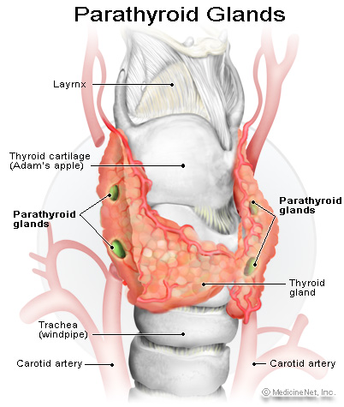
FUNCTIONAL ANATOMY

Slide 4
FUNCTIONAL ANATOMY OF PARATHYROID GLANDS
Normally there are four parathyroid glands in humans. (weighing about 120-140 mg).
They are located immediately behind the thyroid gland—one behind each of the upper and each of the lower poles of the thyroid.
Each parathyroid gland is about 6 millimeters long, 3 millimeters wide, and 2 millimeters thick and has a macroscopic appearance of dark brown fat.

Slide 5
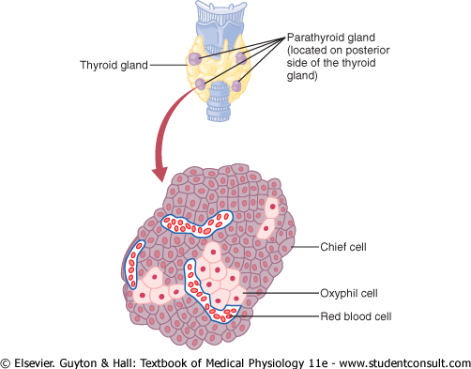
FUNCTIONAL HISTOLOGY OF PARATHYROID

Slide 6
FUNCTIONAL HISTOLOGY OF PARATHYROID
Each parathyroid gland is a richly vascularized disk, about 3 × 6 × 2 mm, containing two distinct types of cells.
The abundant chief cells, which contain a prominent Golgi apparatus plus endoplasmic reticulum and secretory granules , synthesize and secrete parathyroid hormone (PTH).
The less abundant and larger oxyphil cells contain oxyphil granules and large numbers of mitochondria in their cytoplasm.
In humans, few are seen before puberty, and thereafter they increase in number with age.
Their function is unknown, although some have argued that they are degenerated chief cells.

Slide 7
PARATHYROID HORMONE (PTH)
Human PTH is a linear polypeptide with a molecular weight of 9500 that contains 84 amino acid residues . Its structure is very similar to that of bovine and porcine PTH.
It is synthesized as part of a larger molecule containing 115 amino acid residues (preproPTH).
Upon entry of preproPTH into the endoplasmic reticulum, a leader sequence is removed from the amino terminal to form the 90-amino-acid polypeptide proPTH.
Six additional amino acid residues are removed from the amino terminal of proPTH in the Golgi apparatus, and the 84-amino-acid polypeptide PTH is packaged in secretory granules and released as the main secretory product of the chief cells.
The normal plasma level of intact PTH is 10-55 pg/mL. The half-life of PTH is approximately 10 minutes.

Slide 8
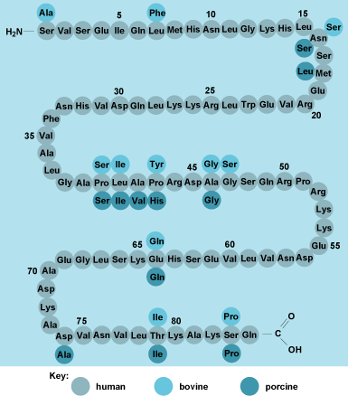
STRUCTURE OF PTH

Slide 9
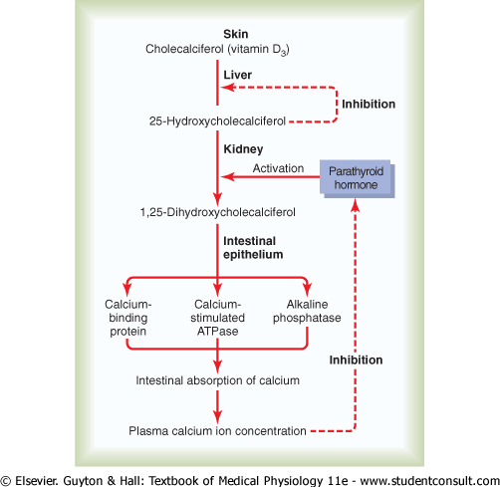
FORMATION OF 1,25 DIHYDROXYCHOLECALCIFEROL

Slide 10
CLINICAL FEATURE OF TETANY
PTH is essential for life. After parathyroidectomy, there is a steady decline in the plasma Ca²⁺ level. Signs of neuromuscular hyperexcitability appear, followed by full-blown hypocalcemic tetany .
Plasma phosphate levels usually rise as the plasma calcium level falls after parathyroidectomy, but the rise does not always occur.
In humans, tetany is most often due to inadvertent parathyroidectomy during thyroid surgery.
Symptoms usually develop 2-3 days postoperatively but may not appear for several weeks or more.
In rats on a low- calcium diet, tetany develops much more rapidly, and death occurs 6-10 hours after parathyroidectomy.
Injections of PTH correct the chemical abnormalities, and the symptoms disappear.
Injections of Ca²⁺ salts give temporary relief.

Slide 11
CLINICAL FEATURE OF TETANY
The signs of tetany in humans include Chvostek's sign, a quick contraction of the ipsilateral facial muscles elicited by tapping over the facial nerve at the angle of the jaw.
Trousseau's sign, a spasm of the muscles of the upper extremity that causes flexion of the wrist and thumb with extension of the fingers .
In individuals with mild tetany in whom spasm is not evident, Trousseau's sign can sometimes be produced by occluding the circulation for a few minutes with a blood pressure cuff.

Slide 12
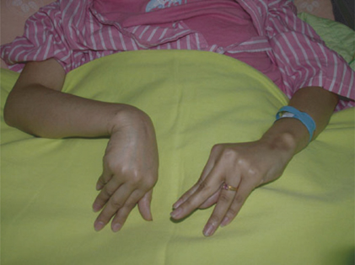
CLINICAL FEATURE OF TETANY

Slide 13
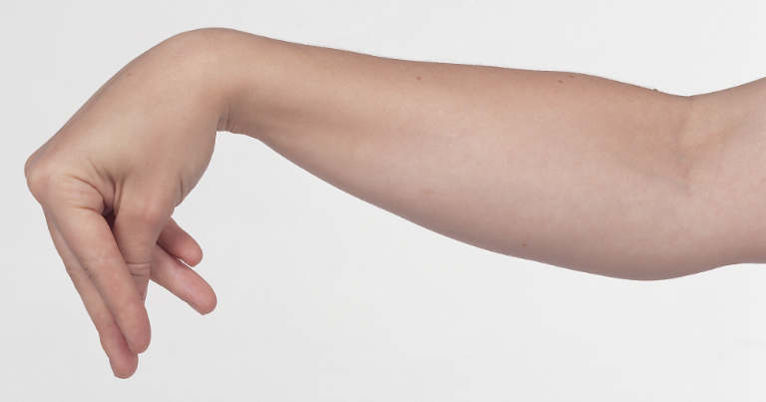
CARPOPEDAL SPASM

Slide 14
Pseudohypoparathyroidism
In the disease called pseudohypoparathyroidism, the signs and symptoms of hypoparathyroidism develop but the circulating level of PTH is normal or elevated.
Since the tissues fail to respond to the hormone, this is a receptor disease. There are two forms.
In the more common form, there is a congenital 50% reduction of the activity of G_{s}, and PTH fails to produce a normal increase in cAMP concentration.
In a different, less common form, the cAMP response is normal but the phosphaturic action of the hormone is defective.

Slide 15
Hyperparathyroidism
Hyperparathyroidism due to injections of parathyroid extract in animals or hypersecretion of a functioning parathyroid tumor in humans is characterized by hypercalcemia and hypophosphatemia.
Humans with PTH-secreting adenomas are usually asymptomatic, with the condition detected when plasma Ca²⁺ is measured in conjunction with a routine physical examination.
However, there may be minor changes in personality, and calcium-containing kidney stones occasionally form.

Slide 16
Secondary Hyperparathyroidism
In conditions such as chronic renal disease and rickets, in which the plasma Ca²⁺ level is chronically low, stimulation of the parathyroid glands causes compensatory parathyroid hypertrophy and secondary hyperparathyroidism.
The plasma Ca²⁺ level is low in chronic renal disease primarily because the diseased kid- neys lose the ability to form 1,25-dihydroxychole- calciferol.

Slide 17

RICKETS

Slide 18
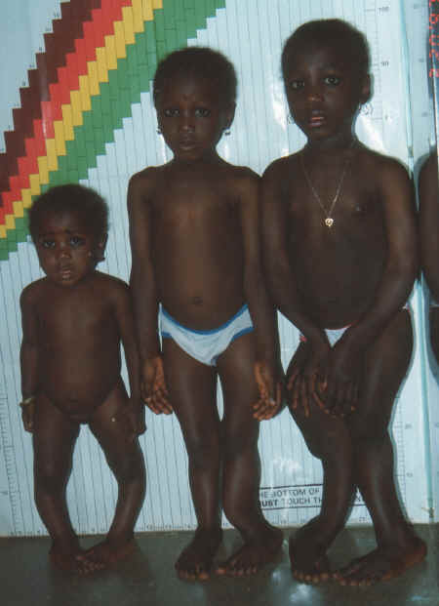
RICKETS

Slide 19
MCQ TEST AFTER END OF LECTURE
1 PTH is secreted from:
A Thyroid gland
B Parathyroid glands
C Pituitory gland
D Adrenal glands
2 Normally there are four parathyroid glands in humans,weighing about :
A 20-25 mg
B 120-140 gram
C 120-140 mg
D 5 - 6 gram

Slide 20
MCQ TEST AFTER END OF LECTURE
3 Human PTH is a linear polypeptide that contains :
A 191 amino acid residues
B 199 amino acid residues
C 51 amino acid residues
D 84 amino acid residues
4 The sign of tetany in humans include :
A Wolff-Chaikoff effect.
B Exophthalmos
C Trousseau's sign
D Kyphosis

Slide 21
MCQ TEST AFTER END OF LECTURE
5 PTH increase absorption of ca++ by villi of small intestine in presence of:
A 25-Hydroxychole- calciferol.
B 1,25-dihydroxychole- calciferol.
C Chole calciferol.
D Ergosterol

Slide 22
MCQ TEST AFTER END OF LECTURE
5 Retention of sodium and excretion of potassium by kidney is action of :
A Cortisol
B Androgen
C Aldosterone
D Hydrocortisone

Slide 23

THANK YOU

