Slide 1

ENDOCRINOLOGY
COMPETENCY CODE: PY8.2
BY
DR J M HARSODA
PROFESSOR AND HEAD

Slide 2
GENERAL PRINCIPLES OF ENDOCRINOLOGY
INTRODUCTION
DEFINITION AND HORMONE INFORMATION TRANSFER
CHEMISTRY OF HORMONES
HORMONE ASSAYS
MECHANISMS OF HORMONES ACTION
REGULATION OF SECRETION OF HORMONES
ENDOCRINOPATHIES

Slide 3
INTRODUCTION
NEUROAL CONTROL
ENDOCINE CONTORL
PRINCIPAL ENDOCIRNE ORGANS AND HORMONES
HORMONE SECRETING TISSUES

Slide 4
PRINCIPAL ENDOCIRNE ORGANS AND HORMONES
PITUITARY GLAND
Tropic hormones (e.g., STH/GH, TSH , GTH and LTH/Prolactin )
HYPOTHALAMUS
Hypophysiotropic Hormones (e,g., Releasing hormones/Releasing factors ) and ADH ,Oxytocin.
THYROID GLAND Thyroxine, Triiodothyronine and Thyrocalcitonin
ADRENAL GLANDS
Glucocorticoids, Mineralocorticoids, Sex steroids and catecholamines
PARATHYROID GLANDS Parathyroid hormone (PTH)
GONADS Testosterone, Estradiol, Progesterone
PANCREATIC ISLETS Insulin, Glucagon, Somatostatin

Slide 5
HORMONE SECRETING TISSUES
HEART Atrial natriuretic peptide (ANP)
KIDNEY 1,25 –Dihydroxycholecalciferol (calcitriol)
Erythropoetin, renin
LIVER 25- Hydroxycholecalciferol (calcidiol),
Somatomedin, IGF-I and II
PINEAL GLAND Melatonin
SKIN Calciferol (Vitamin D3 )
GI TRACT Gastrin, Cholecystokinin (CCK), Secretin,
Vasoactive intestinal peptide

Slide 6
DEFINITION AND HORMONE INFORMATION TRANSFER
HORMONE :- Hormones are secretory products of the ductless glands, which are released into the bloodstream and transported to specific target cells (or organs), where they elicit physiologic, morphologic, and biochemical responses.
METHODS OF HORMONE INFORMATION TRANSFER
Endocrine signaling
Paracrine signaling
Autocrine signaling

Slide 7
CHEMISTRY OF HORMONES
PROTEIN AND POLYPEPTIDES
Generally are water soluble and circulate unbound in plasma.The peptide and protein hormones very greatly in size. For example, TRH is a tripeptide, HCG consists of 243 amino acid residues.
Protein and polypeptide type hormones:-
Hormnes of anterior and posterior pituitary, insulin and PTH.

Slide 8
CONTD…… CHEMISTRY OF HORMONES
AMINO ACID DERIVATIVES
Catecholamines, which are water soluble, and thyroid hormones, which are lipid soluble, circulate in the plasma bound mainly to binding globulins.
Catecholamines are derived from the amino acid phenylalanine/tyrosine.
Thyroid hormones (T3,T4 ) are derived from two iodinated tyrosine residues.
STEROIDS
Steroid hormones are lipid soluble and circulate in the plasma bounds to carrier proteins called steroid binding globulins.
Steroids are synthesized and secreted by endocrine organs derived from mesoderm(adrenal cortex, testis, ovary).

Slide 9
MECHANISMS OF HORMONES ACTION
Cyclic AMP mediated hormone activity:-
The first messenger is the hormone that bind to the membrane receptor and leads to activation membrane bound adenyl cyclase. This enzyme converts ATP to cyclic AMP in the presence of Mg ++ .
Cyclic AMP exerts physiologic activity via the phosphorylation of cyclic AMP dependent protein kinase A .

Slide 10
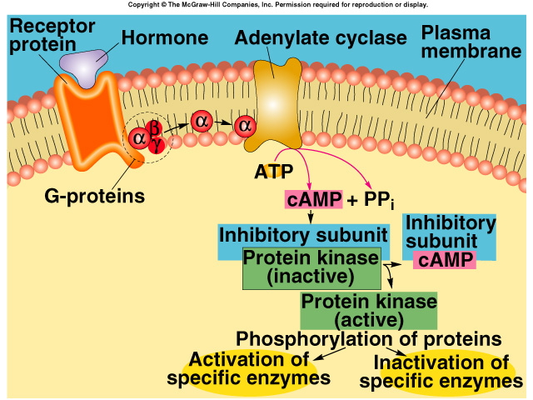
Cyclic AMP mediated hormone activity

Slide 11
MECHANISMS OF HORMONES ACTION CONTD ……..
Transcription and translation effects:-
Steroid hormones modulate transcription in specific area of the chromatin by interacting with DNA.
As result of the interaction of steroid hormones with the chromatin, transcription is stimulated and specific messenger RNA (mRNA) synthesis increases.
The specific mRNAs enter the cytoplasm and reach at ribosome, where they direct the synthesis (translation) of specific proteins and exert physiologic activity.

Slide 12
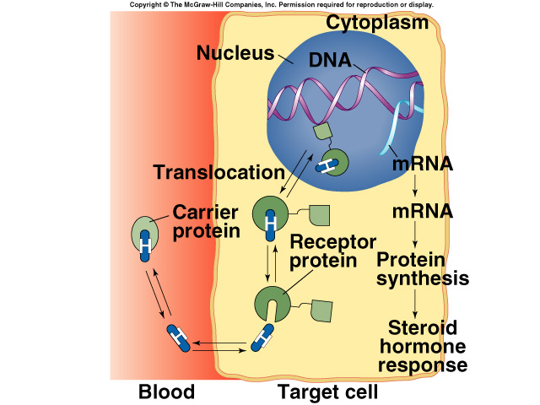

Transcription and translation effects

Slide 13
PHOSPHOLIPASE C SECOND MESSENGER SYSTEM
Some hormones activate transmembrane receptors
that activate the enzyme phospholipase -C attached to the inside projections of the receptors.
This enzyme catalyzes the breakdown of some phospholipids in the cell membrane, especially phosphatidylinositol biphosphate (PIP2), into two different second messenger products: inositol triphosphate (IP3) and diacylglycerol (DAG). The IP3 mobilizes calcium ions from mitochondria and the endoplasmic.
Examples: (GnRH , GHRH and oxytocin ).

Slide 14
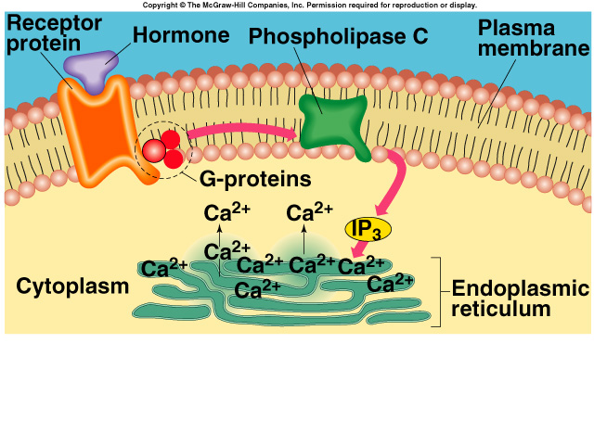
PHOSPHOLIPASE C SECOND MESSENGER SYSTEM

Slide 15
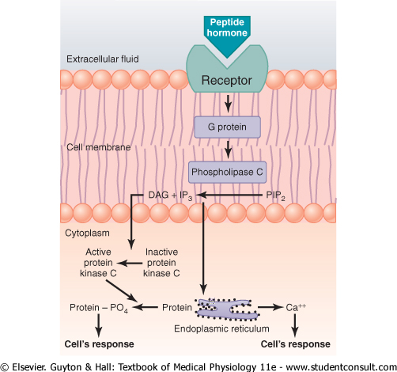
PHOSPHOLIPASE C SECOND MESSENGER SYSTEM

Slide 16
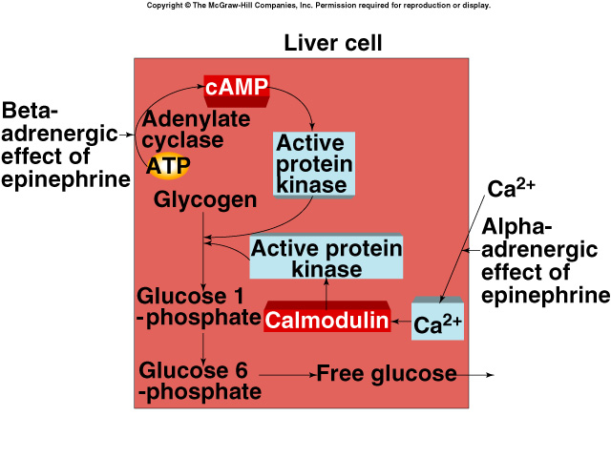
Epinephrine Can Act Through Two 2nd Messenger Systems

Slide 17
REGULATION OF SECRETION OF HORMONES
FEEDBACK CONTROL
1 HYPOTHALAMIC –PITUITORY-TARGET GLAND MODEL
2 NEGATIVE FEEDBACK CONTROL :-
LONG-LOOP FEEDBACK
SHORT-LOOP FEEDBACK
ULTRASHORT- LOOP FEEDBACK

Slide 18
FEEDBACK MECHANISMS FOR CONTROLLING HORMONE SECRETION
HYPOTHALAMUS
_ _ ULTRA-LOOP FEEDBACK
SHORT- LOOP FEEDBACK _
RH LONG-LOOP FEEDBACK
+ ANT. PITUITORY
_
PITUITORY TROPIC TARGET GLAND
HORMONE + HORMONE
TARGET GLAND
J M Harsoda (2011) EBES DOCUMENT, ENDOCRINOLOGY;SV.

Slide 19
MCQ TEST AFTER END OF LECTURE
1 Catecholamines are derived from the amino acid :
A Phenylalanine.
B Glutamic acid.
C Leucine
D Asparatic acid
2 Steroids are synthesized and secreted by endocrine organs derived from :
A Ectoderm
B Endoderm
C Mesoderm
D None of above

Slide 20
MCQ TEST AFTER END OF LECTURE
3 Mechanism of acton of steroid hormones mediated through :
A Cyclic AMP mediated hormone activity
B Transcription and translation effects
C Phospholipase c second messenger system
D Two 2nd Messenger Systems
4 Atrial natriuretic peptide (ANP) secreted by:
A Liver
B Heart
C Kidney
D Skin

Slide 21
MCQ TEST AFTER END OF LECTURE
5 The peptide and protein hormone very greatly in size. (For example in human being):
A STH/GH
B LTH/Prolactin
C HCG
D ADH

Slide 22


Slide 23
HARSODA FAMILY WISHES YOU AND YOUR FAMILY GOOD HEALTH AGAINST COVID-19
H = HANDWASH FREQUENTLY
A = AVOID GATHERING
R = REMAIN LOCKED
S = SANITIZE PROPERLY
O = OBEY THE COMMANDS BY GOVERNMENT.
D = DON’T SPREAD RUMORS.
A = APPRECIATE THOSE WHO ARE WORKING FOR US.

