Slide 1

INDIAN HEALTHCARE INDUSTRY
Dr. Medha Wadhwa

Slide 2
SUMMARY
The Indian healthcare industry: US$65billion in 2012, is highly fragmented and dominated by private players
Tremendous entrepreneurial activity over the last few decades
A global survey on healthcare costs suggests that India spends only 4.2% of its GDP on healthcare, compared to an average of 8.5% globally, and lower than other emerging countries such as Brazil (9.0%), China (4.6%), and Russia (5.4%)
In general government-run facilities have inadequate equipment and poor quality, and as a result private players can capitalize on this opportunity.
The private sector is expected to contribute 80% - 85% of the US$86billion investments required in healthcare till 2025

Slide 3
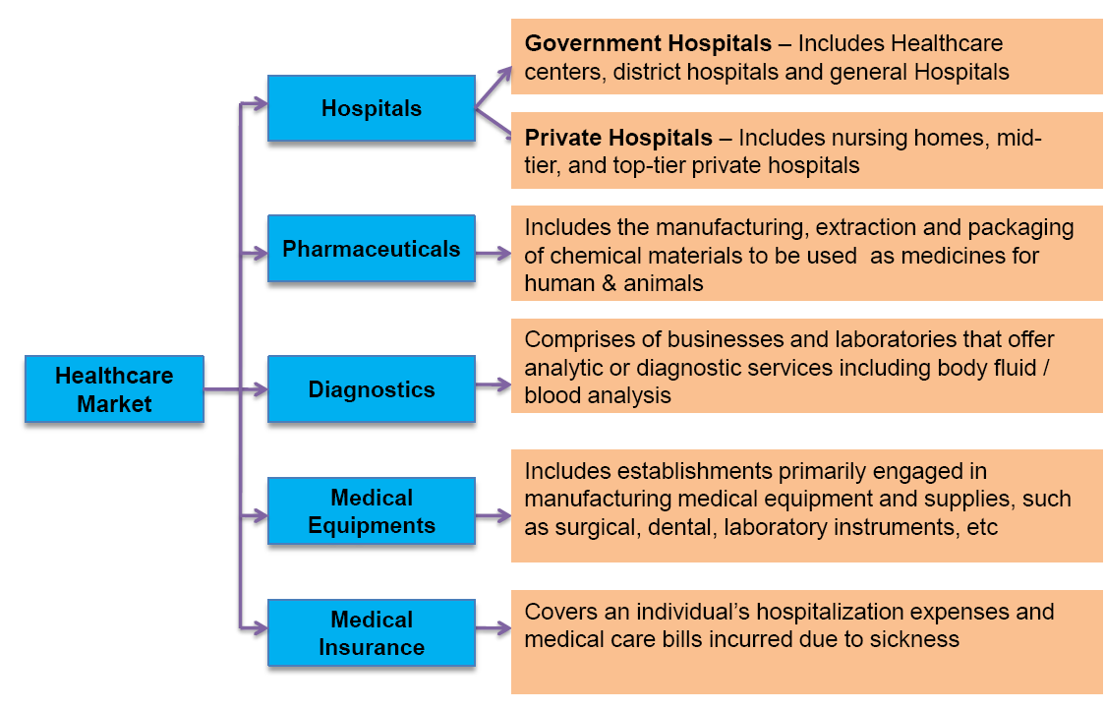

Slide 4
Indian Hospital Industry
Industry Overview
The hospital segment holds a major share of the healthcare industry and is outpacing the overall industry growth
Realizing the continuous growing demand, many investors worldwide have expressed their keenness towards investing in the Indian hospital service market.
The country is making strides in the right direction as evident from the 100% allowance of FDI in the hospital segment under the automatic route, since January 2000

Slide 5
According to “Indian Hospital Services Market Outlook” by RNCOS Industry Research Solutions, the country needs to cover the cumulative deficit of around 3 million hospital beds to match up with the global average of 3 beds per 1000 population

Slide 6
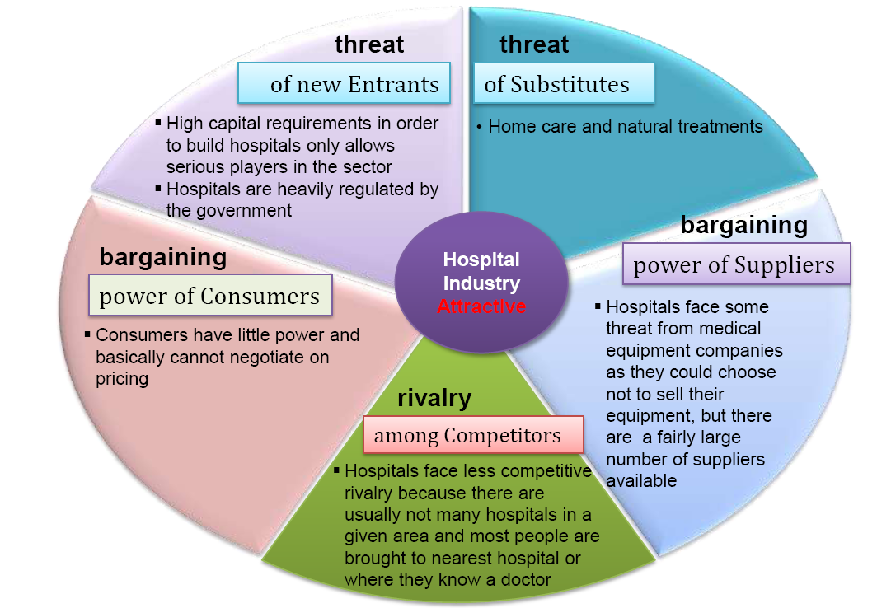
Porter’s Five Forces Analysis

Slide 7
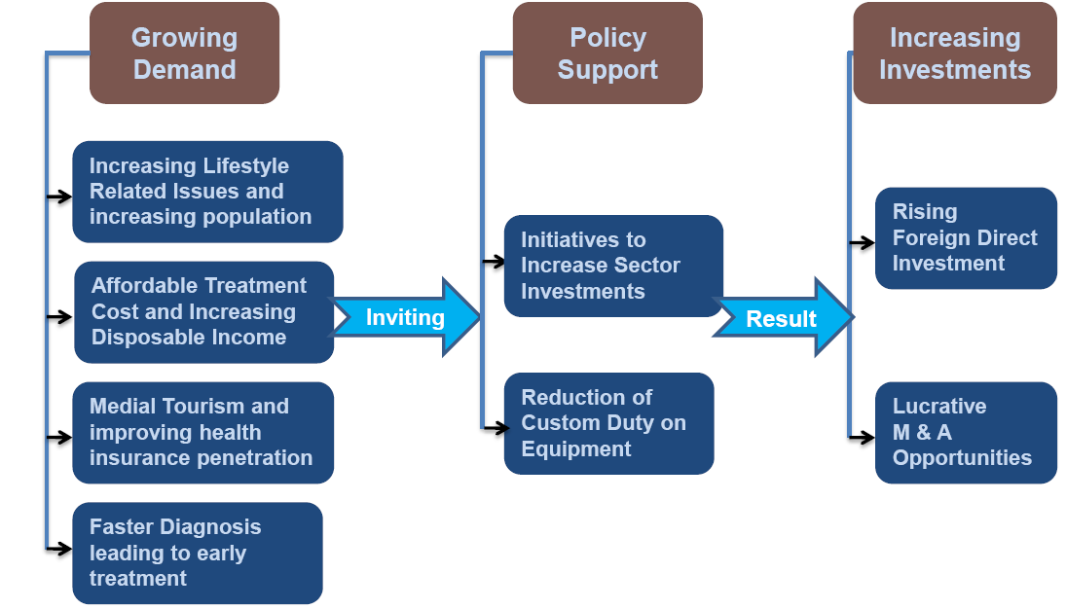
Growth Drivers

Slide 8
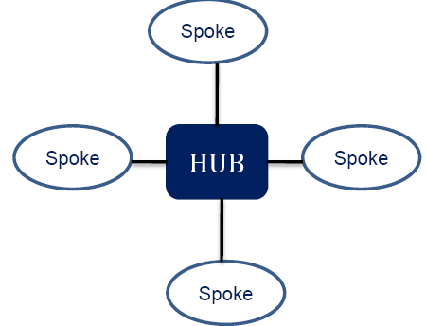
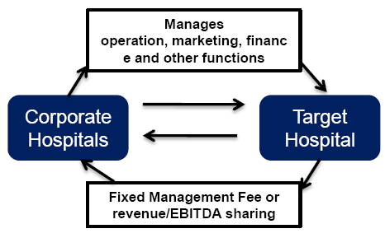
Operating Business Models
Hub & Spoke Model
Operating Maintenance Contracts

Slide 9
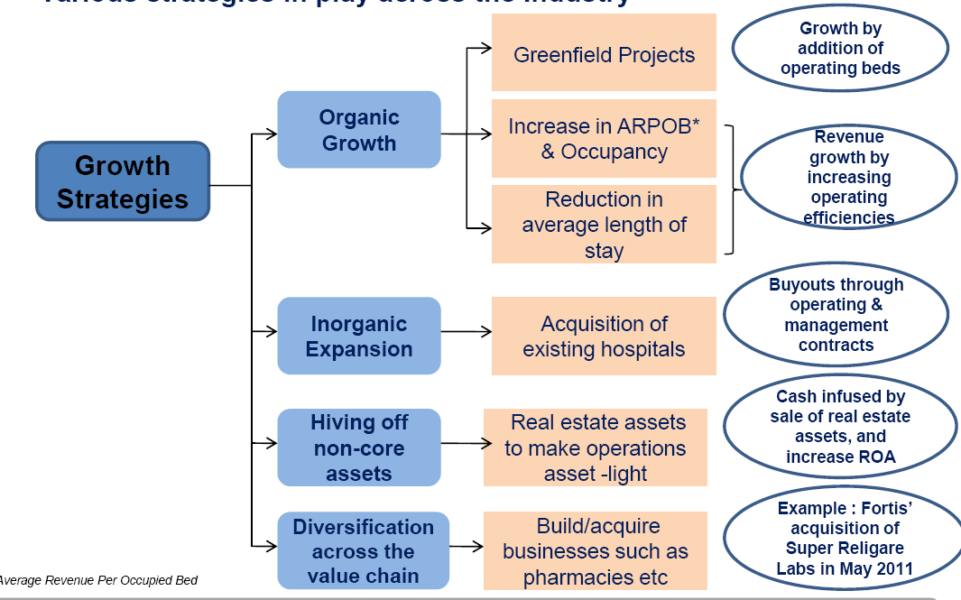
Growth Strategies in the Industry

Slide 10
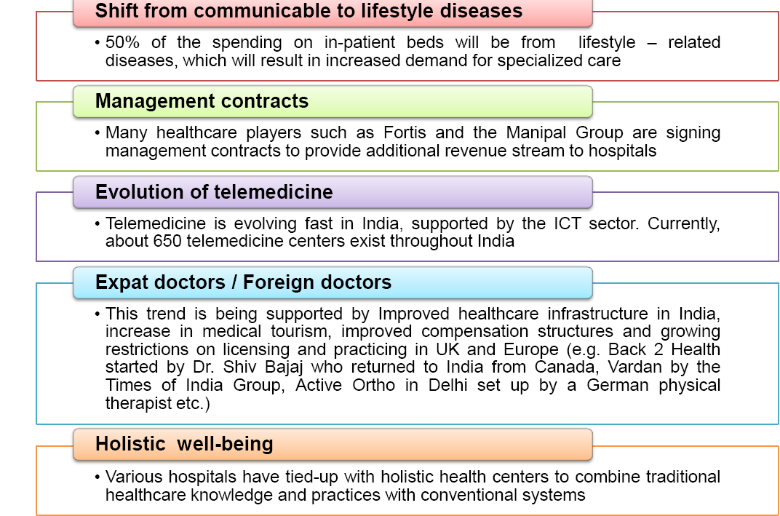
Key Trends in the Industry

Slide 11
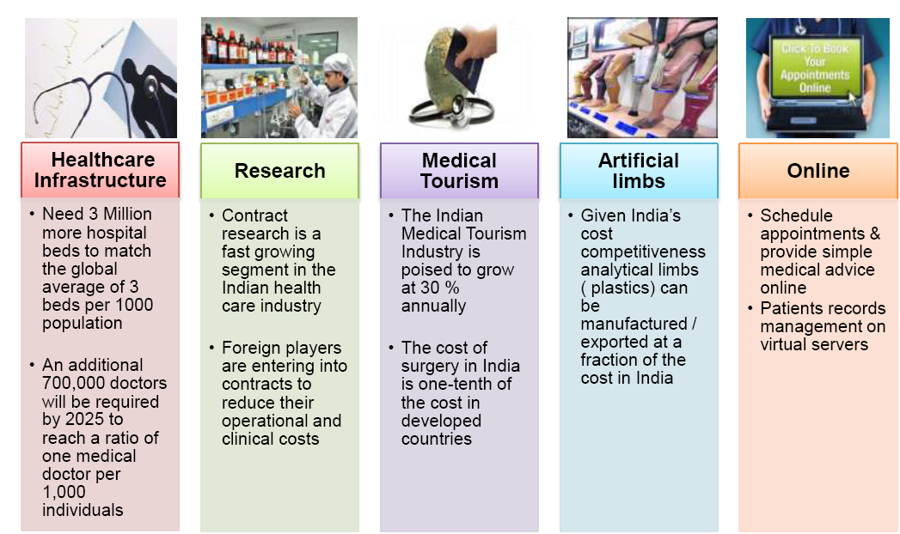
Opportunities in the Industry

Slide 12
Challenges in the Industry
Hospitals will always have a community / charitable angle to them…constant government regulation and scrutiny and thus super-profits…raise eyebrows
Many hospitals and healthcare providers are struggling with outdated information technology in India today
to retain the healthcare workforce but also to develop an environment, which would attract those abroad to return (reverse brain drain)
The growing demand for quality healthcare and the absence of matching delivery mechanism

Slide 13
There is an acute shortage of faculty of medical teachers all over the country.
To find good talent in India to provide the ancillary healthcare services, especially the voice based ones which require not only good English communication skills but also very good analytical skills

Slide 14
Government Initiatives
The government plans to build 6 super specialty tertiary care hospitals with research and education centers across the country. These would cater to the economically challenged sections and make high-end clinical care available to the masses (but a lot more needs to be done)
The government has also undertaken initiatives through its flagship programs such as the Rashtriya Swastha Bima Yojana (RSBY) and State level Insurance schemes like the Arogyashri and Chiranjeevi
The Central government is setting up the first specialized device center “National Center for Medical Devices” in Gujarat to promote indigenous R&D efforts

Slide 15
Customs duty on life-saving equipment has been reduced to 5% from 25%, and is exempted from countervailing duty. Import duty on medical equipment has been reduced to 7.5% in the current budget
The government take on the current compulsory rural stint for medical professionals is that it should be continued; however it needs to be augmented with better facilities and support systems

Slide 16
Risk Factors of the Hospital Industry
Long gestation periods
Lack of qualified staff
Rising real estate prices
Lack of capital
Increasing operating cost

Slide 17
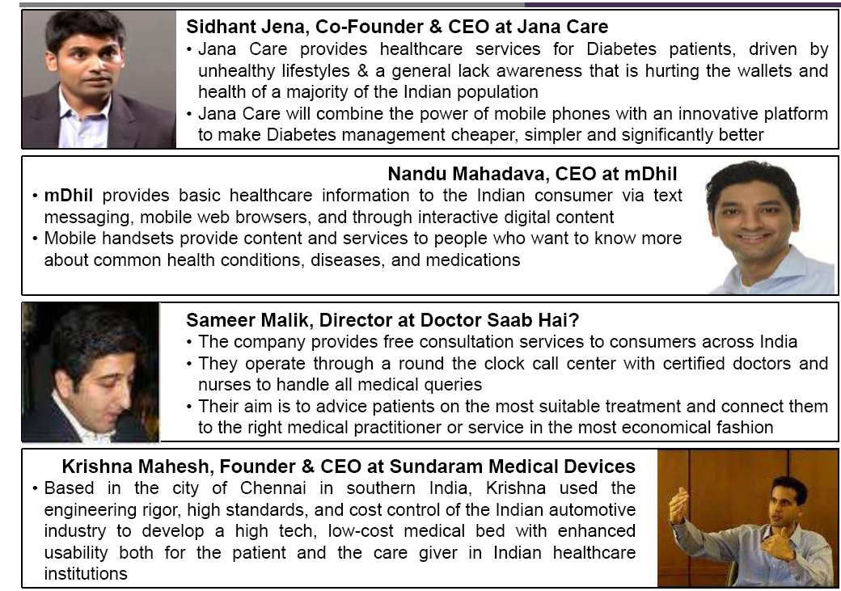
New - Age Healthcare Solutions

Slide 18
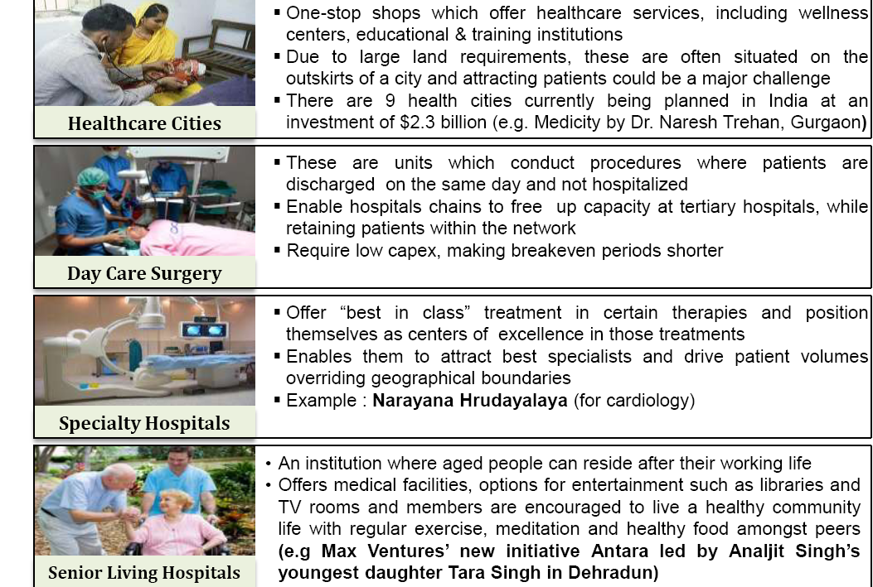
Innovative Delivery Formats

Slide 19
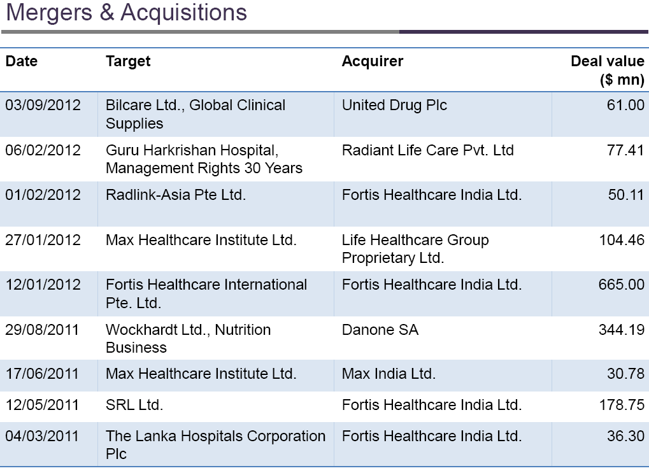
Deals in the Hospital Industry in India

Slide 20
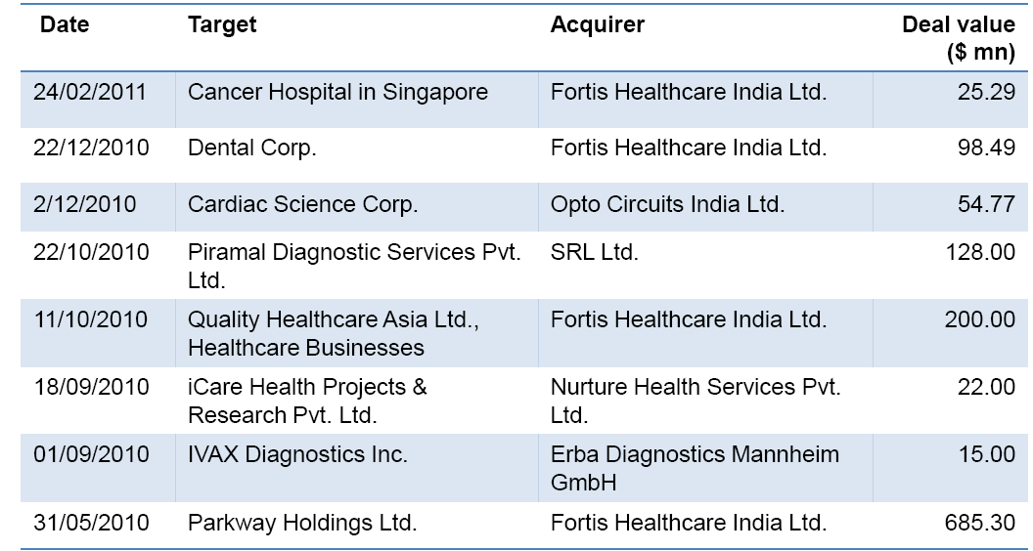

Slide 21
Type of study | Citation | Aim | Results | Conclusion | Level of evidence
Descriptive | Naresh Vashist, Puneet Jain (2013), FOREIGN DIRECT INVESTMENT IN HOSPITAL INDUSTRY-A REVIEW IJTBM, Vol. No. 2, Issue No. 4, Apr-Jun |  | There is growing interest among foreign players to enter India’s healthcare sector through capital investments, technology tie-ups, and collaborative ventures across various segments, including diagnostics, medical equipment, hospitals, and education and training. | The results of this study provide the current status of FDI in Hospitals and diagnostic centers in healthcare sector | Level 6

Slide 22
Type of study | Citation | Aim | Results | Conclusion | Level of evidence
Descriptive | P. H. RAO, (2012), The Private Health Sector in India: A Framework for Improving the Quality of Care Journal of Management 41 (2): 14–39 |  | Hospitals and nursing homes need to be set up in such a way that their location is not concentrated in urban areas. Tools like geographical information system (GIS) can be useful in this regard. Ramani (2006) found that Ahmedabad has successfully used GIS for arriving at decisions regarding the appropriate location of new health facilities in the city so as to improve accessibility | The private health sector in India is fairly large. Its contribution to achieving national health objectives to a large extent is dependent on the quality of care it offers. The private sector has improved access to medical and health care. The quality of care offered by the private health care delivery system needs immediate attention. Improving the quality of medical and para-medical education, capacity building, improving access to standards and guidelines, and encouraging accreditation are some of the measures that can improve QoC. | Level 6

Slide 23
MCQs
1.Which of the following events did not contribute to the development of the hospital as the center of acute medical care?
  public health quarantine policy
  growth of technology
  development of germ theory
  government reimbursement policy
2. Which of the following functions is typically performed by a hospital medical staff?
  determination of surgery privileges
  marketing
  financial management
  hotel services

Slide 24
3. Management of an acute spinal sprain by a physical therapist in a direct access, outpatient environment is an example of:
  secondary care.
  primary care.
  tertiary care.
  quarternary care
4. Which of the following events is a catalyst for the development of an integrated health care system?
  government action
  public petition
  provider choice
  managed care dominance
5. The merger of a hospital and large primary care provider practice is an example of:
  horizontal integration.
  inclusion.
  mainstreaming.
  vertical integration.

Slide 25


Slide 26
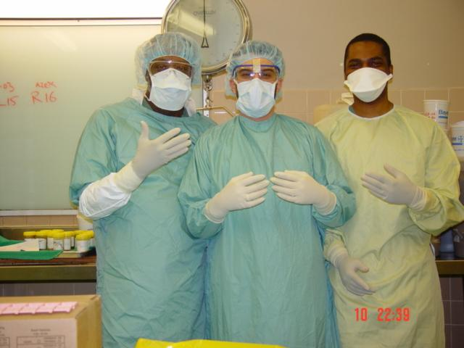
UNIVERSAL PRECAUTIONS
Approach to infection control to treat all human blood and certain human body fluids as if they were known to be infectious for HIV, HBV and other bloodborne pathogens.
Use gloves, masks, and gowns if blood or OPIM exposure is anticipated.

Slide 27
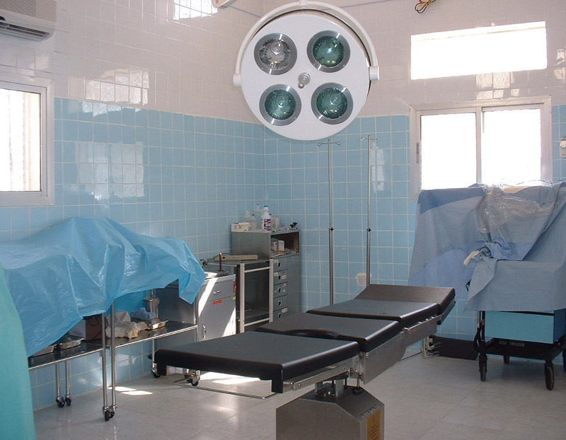
OPERATION THEATER
operating theatre, operating room (OR) or operating suite
facility within a hospital where surgical operations are carried out in a sterile environment.

Slide 28
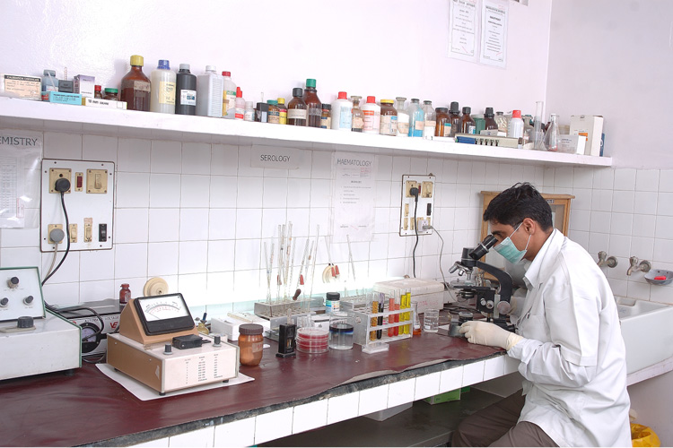
LABORATORY
A laboratory (informally, lab) is a facility that provides controlled conditions in which scientific research, experiments, and measurement may be performed.

Slide 29
RADIOLOGY
Branch or specialty of medicine that deals with the study and application of imaging technology like x-ray and radiation to diagnosing and treating disease.
An array of imaging technologies (such as ultrasound, computed tomography (CT), nuclear medicine, positron emission tomography (PET) and magnetic resonance imaging (MRI)) to diagnose or treat disease: DIAGNOSTIC RADIOLOGY
INTERVENTIONAL RADIOLOGY : performance of (usually minimally invasive) medical procedures with the guidance of imaging technologies.

Slide 30
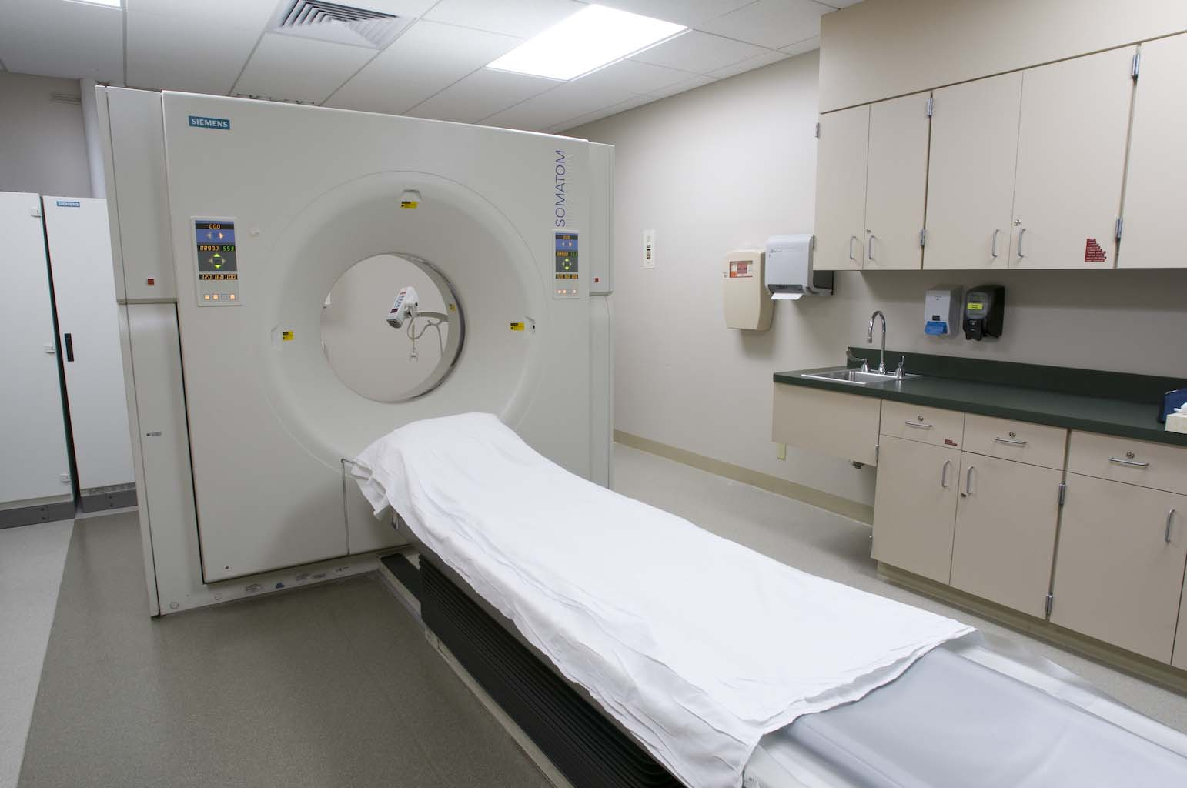

Slide 31
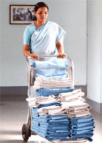
HOUSEKEEPING SERVICES
Clean aesthetic and hygienic environment
Sanitation
Odor Control
Pest Control
Hospital waste disposal
Linen Supply
Hospital equipment maintainence
Management task

Slide 32
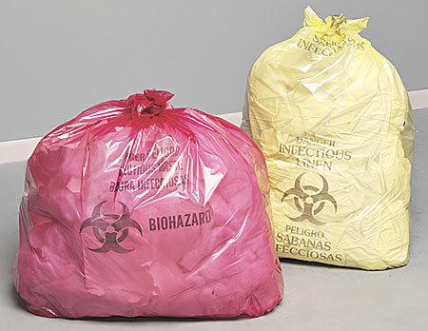
BIOMEDICAL WASTE
Bio-medical waste’: any solid and/or liquid waste including its container and any intermediate product, which is generated during the diagnosis, treatment or immunisation of human beings or animals or in research pertaining thereto or in the production or testing thereof.

Slide 33
COMPONENTS OF BIO-MEDICAL WASTE
(i) human anatomical waste (tissues, organs, body parts etc.),
(ii) animal waste (as above, generated during research/experimentation, from veterinary hospitals etc.),
(iii) microbiology and biotechnology waste, such as, laboratory cultures, micro-organisms,human and animal cell cultures, toxins etc.,
(iv) waste sharps, such as, hypodermic needles, syringes, scalpels, broken glass etc.,
(v) discarded medicines and cyto-toxic drugs
(vi) soiled waste, such as dressing, bandages, plaster casts, material contaminated with blood etc.,
(vii) solid waste (disposable items like tubes, catheters etc. excluding sharps),
(viii) liquid waste generated from any of the infected areas,
(ix) incineration ash,
(x) chemical waste.

