Slide 1
ANEURYSM
DR.KUNTAL PATEL
PATHOLOGY

Slide 2
AT THE END OF LECTURE STUDENT SHOULD BE ABLE TO ANSWER THE FOLLOWING ….
DEFINITION
CLASSIFICATION
PATHOGENESIS
TYPES
MORPHOLOGY
TREATMENT

Slide 3
An aneurysm is a localized abnormal dilation of a blood vessel or the heart.
It can be congenital or acquired.
When an aneurysm involves an intact attenuated arterial wall or thinned ventricular wall of the heart, it is called a true aneurysm. Example: Atherosclerotic, syphilitic, and congenital vascular aneurysms, and ventricular aneurysms that follow transmural myocardial infarctions

Slide 4
false aneurysm (also called pseudo-aneurysm) is a defect in the vascular wall leading to an extravascular hematoma that freely communicates with the intravascular space (“pulsating hematoma”).
Examples: ventricular rupture after myocardial infarction that is contained by a pericardial adhesion, or a leak at the sutured junction of a vascular graft with a natural artery.
An arterial dissection arises when blood enters the arterial wall itself, as a hematoma dissecting between its layers.
Dissections are often but not always aneurysmal .

Slide 5
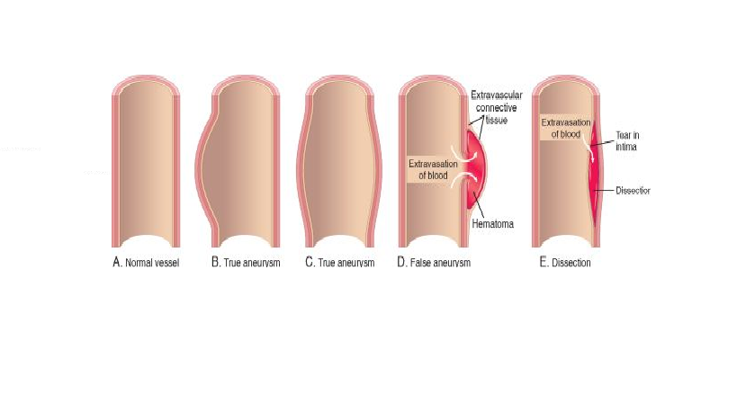
Aneurysms. A, Normal vessel. B, True aneurysm, saccular type. The wall focally bulges outward and may be attenuated but is otherwise intact. C, True aneurysm, fusiform type. There is circumferential dilation of the vessel, without rupture. D, False aneurysm. The wall is ruptured, and there is a collection of blood (hematoma) that is bounded externally by adherent extravascular tissues. E, Dissection. Blood has entered (dissected) the wall of the vessel and separated the layers. Although this is shown as occurring through a tear in the lumen, dissections can also occur by rupture of the vessels of the vaso vasorum within the media.

Slide 6
Aneurysms are generally classified by shape and size.
Saccular aneurysms are spherical outpouchings (involving only a portion of the vessel wall); they vary from 5 to 20 cm in diameter and often contain thrombus.
Fusiform aneurysms involve diffuse, circumferential dilation of a long vascular segment; they vary in diameter (up to 20 cm) and in length, and can involve extensive portions of the aortic arch, abdominal aorta, or even the iliac arteries.

Slide 7
Pathogenesis of Aneurysms.
Arteries are dynamically remodeling tissues that maintain their integrity by constantly synthesizing, degrading, and repairing damage to their ECM constituents.
Aneurysms can occur when the structure or function of the connective tissue within the vascular wall is compromised.
examples of inherited defects in connective tissues, weakening of vessel walls is important in the common, sporadic forms of aneurysms.

Slide 8
The intrinsic quality of the vascular wall connective tissue is poor.
In Marfan syndrome, defective synthesis of the scaffolding protein fibrillin leads to aberrant TGF-β activity and progressive weakening of elastic tissue.
Loeys-Dietz syndrome is another recently recognized cause of aneurysms; in this disorder, mutations in TGF-β receptors lead to abnormalities in elastin and collagen I and III.
Weak vessel walls due to defective type III collagen synthesis are also a hallmark of the vascular forms of Ehlers-Danlos syndrome .
altered collagen cross-linking associated with vitamin C deficiency is an example of a nutritional basis for aneurysm formation.

Slide 9
The balance of collagen degradation and synthesis is altered by local inflammatory infiltrates and the destructive proteolytic enzymes they produce.
Increased MMP production, especially by macrophages in atherosclerotic plaque or in vasculitis, probably contributes to aneurysm development; these enzymes have the capacity to degrade virtually all components of the ECM in the arterial wall (collagens, elastin, proteoglycans, ldecreased aminin, fibronectin).
Tissue inhibitor of metalloproteinase (TIMP) expression can also contribute to the overall ECM degradation.
Genetic predisposition to aneurysm formation in the setting of inflammatory lesions (such as atherosclerosis) may be related to polymorphisms of MMP and/or TIMP genes, or to the nature of the local inflammatory response that results in increased production of MMP.

Slide 10
The vascular wall is weakened through loss of smooth muscle cells or the inappropriate synthesis of noncollagenous or nonelastic ECM.
Ischemia of the inner media occurs when there is atherosclerotic thickening of the intima.
Systemic hypertension can also cause significant narrowing of arterioles of the vasa vasorum (e.g., in the aorta), which can cause outer medial ischemia. Ischemia is reflected in “degenerative changes” of the aorta, whereby smooth muscle cell loss—or change in synthetic phenotype—leads to scarring (and loss of elastic fibers), inadequate ECM synthesis, and production of increasing amounts of amorphous ground substance (glycosaminoglycan).
Histologically these changes are collectively called cystic medial degeneration.

Slide 11
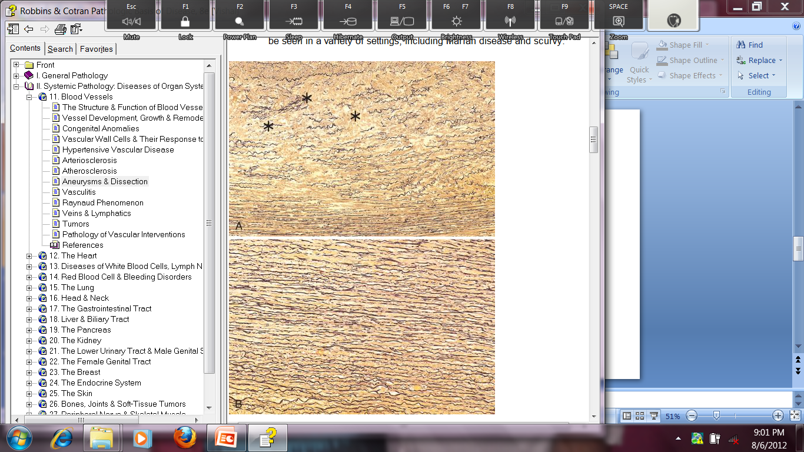

Slide 12
The two most important disorders that predispose to aortic aneurysms are atherosclerosis and hypertension;
Other conditions that weaken vessel walls and lead to aneurysms include trauma, vasculitis congenital defects e.g., berry aneurysms typically in the circle of Willis; and infections (mycotic aneurysms).
Mycotic aneurysms can originate (1) from embolization of a septic embolus, usually as a complication of infective endocarditis; (2) as an extension of an adjacent suppurative process; or (3) by circulating organisms directly infecting the arterial wall.
Tertiary syphilis is now a rare cause of aorticaneurysms. The obliterative endarteritis characteristic of late-stage syphilis shows a predilection for small vessels, including those of the vasa vasorum of the thoracic aorta.

Slide 13
ABDOMINAL AORTIC ANEURYSM (AAA)
Aneurysms associated with atherosclerosis most commonly in the abdominal aorta.
Atherosclerotic plaque in the intima compresses the underlying media and compromises nutrient and waste diffusion from the vascular lumen into the arterial wall.
The media therefore undergoes degeneration and necrosis that results in arterial wall weakness and consequent thinning.
Abdominal aortic aneurysms occur more frequently in men and in smokers, and rarely develop before age 50.

Slide 14
Morphology
usually positioned below the renal arteries and above the bifurcation of the aorta.
AAAs can be saccular or fusiform, up to 15 cm in diameter, and up to 25 cm in length.
Typically the intimal surface of the aneurysm shows severe complicated atherosclerosis with destruction and thinning of the underlying aortic media.

Slide 15
Inflammatory AAAs are characterized by dense periaortic fibrosis containing abundant lymphoplasmacytic inflammation with many macrophages and often giant cells.
Mycotic AAAs are lesions that have become infected by the lodging of circulating microorganisms in the wall, particularly in bacteremia from a primary Salmonella gastroenteritis.

Slide 16
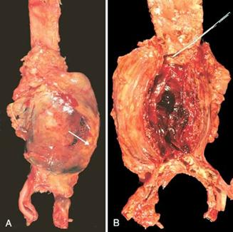
Most abdominal aortic aneurysms (AAA) occur between the renal arteries and the bifurcation of the aorta

Slide 17
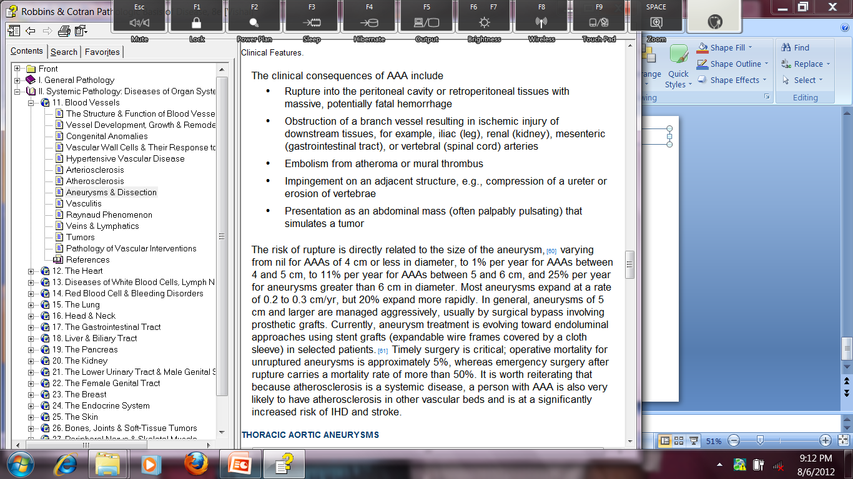

Slide 18
Treatment
In general, aneurysms of 5 cm and larger are managed aggressively, usually by surgical bypass involving prosthetic grafts.
Currently, aneurysm treatment is evolving toward endoluminal approaches using stent grafts (expandable wire frames covered by a cloth sleeve) in selected patients. Timely surgery is critical.
Atherosclerosis is a systemic disease, a person with AAA is also very likely to have atherosclerosis in other vascular beds and is at a significantly increased risk of IHD and stroke.

Slide 19
THORACIC AORTIC ANEURYSMS
Thoracic aortic aneurysms are most commonly associated with hypertension.
other causes such as Marfan and Loeys-Dietz syndromes are increasingly recognized.
Regardless of etiology, these give rise to signs and symptoms referable to
(1) encroachment on mediastinal structures,
(2) respiratory difficulties due to encroachment on the lungs and airways,
(3) difficulty in swallowing due to compression of the esophagus,
(4) persistent cough due to irritation of or pressure on the recurrent laryngeal nerves,
(5) pain caused by erosion of bone (i.e., ribs and vertebral bodies),
(6) cardiac disease as the aortic aneurysm leads to aortic valve dilation with valvular insufficiency or narrowing of the coronary ostia causing myocardial ischemia, and
(7) rupture.
Most patients with syphilitic aneurysms die of heart failure induced by aortic valvular incompetence.

Slide 20
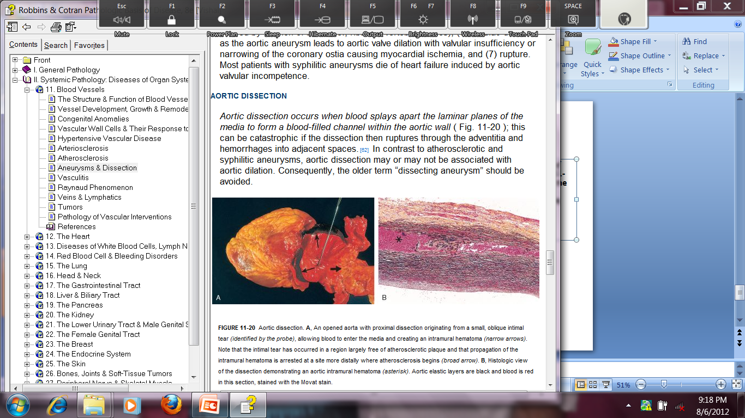
AORTIC DISSECTION
Aortic dissection occurs when blood splays apart the laminar planes of the media to form a blood-filled channel within the aortic wall . this can be catastrophic if the dissection then ruptures through the adventitia and hemorrhages into adjacent spaces. term “dissecting aneurysm” should be avoided.

Slide 21
Aortic dissection occurs principally in two groups:
(1) men aged 40 to 60, with antecedent hypertension (more than 90% of cases of dissection);
(2) younger patients with systemic or localized abnormalities of connective tissue affecting the aorta (e.g., Marfan syndrome).
Dissections can also be iatrogenic (e.g., complicating arterial cannulations during diagnostic catheterization or cardiopulmonary bypass).

Slide 22
Pathogenesis
Hypertension is the major risk factor in aortic dissection.
Aortas of hypertensive patients have medial hypertrophy of the vasa vasorum associated with degenerative changes in the aortic media and variable loss of medial smooth muscle cells.
Inherited or acquired connective tissue disorders causing abnormal vascular ECM (e.g., Marfan syndrome, Ehlers-Danlos syndrome, vitamin C deficiency, copper metabolic defects).
once the tear has occurred, blood flow under systemic pressure dissects through the media, fostering progression of the medial hematoma.

Slide 23
Morphology
The most frequent preexisting histologically detectable lesion is cystic medial degeneration ; inflammation is characteristically absent.
An aortic dissection usually initiates with an intimal tear, the tear is found in the ascending aorta, usually within 10 cm of the aortic valve.
Such tears are typically transverse or oblique and 1 to 5 cm in length, with sharp, jagged edges.
The dissection can extend along the aorta retrograde toward the heart as well as distally, sometimes into the iliac and femoral arteries.
It often ruptures out through the adventitia causing massive hemorrhage (e.g., in the thoracic or abdominal cavities) or cardiac tamponade (hemorrhage into the pericardial sac).
In some (lucky) instances, the dissecting hematoma reenters the lumen of the aorta through a second distal intimal tear, creating a new vascular channel and forming a “double-barreled aorta” with a false channel.
sometimes false channels may be endothelialized and become chronic dissections.

Slide 24
Clinical Features
The most serious complications occur with dissections that involve the aorta from the aortic valve to the arch.
Aortic dissections are generally classified into two types
They are named after Dr. Michael DeBakey, a pioneer in vascular surgery.
More common (and dangerous) proximal lesions (called type A dissections), involving either both the ascending and descending aorta or just the ascending aorta (types I and II of the DeBakey classification)
Distal lesions not involving the ascending part and usually beginning distal to the subclavian artery (called type B dissections or DeBakey type III)

Slide 25
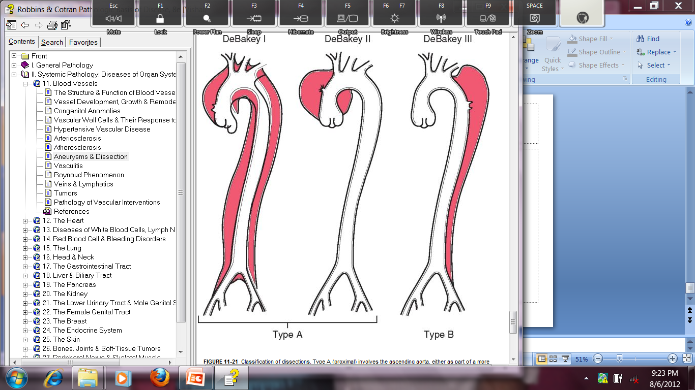

Slide 26
The classic clinical symptoms of aortic dissection are the sudden onset of excruciating pain, usually beginning in the anterior chest, radiating to the back between the scapulae, and moving downward as the dissection progresses;
Pain can be confused with that of myocardial infarction.

Slide 27
The most common cause of death is rupture of the dissection outward into the pericardial, pleural, or peritoneal cavities.
common clinical manifestations include cardiac tamponade, aortic insufficiency, and myocardial infarction or extension of the dissection into the great arteries of the neck or into the coronary, renal, mesenteric, or iliac arteries.
compression of spinal arteries may cause transverse myelitis.

Slide 28
Prognosis has markedly improved.
Rapid diagnosis and institution of intensive antihypertensive therapy, coupled with surgical procedures involving plication of the aortic wall, permit 65% to 75% of stricken individuals to be saved.

Slide 29
Jeffrey E Everett and Harold M Burkhart
Journal of Cardio thoracic Surgery 2008, 3 :1 doi:10.1186/1749-8090-3-1
Name of author | TITLE OF STUDY & DESIGN | AIM | OBJECTIVE | conclusion
Jeffrey Everett and Harold M Burkhart | Coronary artery aneurysm: case report LEVEL 4 | Coronary artery aneurysm: case report Aneurysms of the left main coronary artery are rare with an incidence of 0.1% in large angiographic series. The majority are atherosclerotic in origin. Other causes include connective tissue disorders, trauma, vasculitis, congenital, mycotic and idiopathic. The primary complication is myocardial ischemia or infarction, with rupture being rare. Treatment options include anticoagulation, custom made covered stents, reconstruction, resection, and exclusion with bypass. | Cardiopulmonary bypass with hyperkalemic cardioplegic arrest was utilized. The aneurysm was exposed in the atrioventricular groove. The aneurysm was resected and oversewn. Calcification precluded patch angioplasty. The patient then underwent coronary bypass grafting . | Left main coronary artery aneurysms in adult patients are predominantly atherosclerotic in origin. The clinical presentation is that of myocardial ischemia, likely from associated embolism. Rupture is rare. Operative treatment is exclusion and revascularization.

Slide 30
MCQ-1
Most common site of involvement of atherosclerotic aneurysm is-
a) Arch of aorta
b) Thoracic aorta
c) Suprarenal abdominal aorta
d) Infrarenal abdominal aorta

Slide 31
MCQ-2
Most common cause of dissecting haematoma-
a) Cystic medial necrosis of erdheim
b) Trauma during cardiac catheterization
c) Systemic hypertension
d) Marfan’s syndrome

Slide 32
MCQ-3
Dissecting hematoma causes separation of aortic wall as under-
a) Btv intima and media
b)Btv inner third of media and outer two thirds of media
c) Btv inner two thirds of media and outer third
d) Btv media and adventitia

Slide 33
MCQ-4
Medial calcific sclerosis is a type of -
a) Dystrophic calcification
b) Metastatic calcification
c) Both of above
d) None of above

Slide 34
MCQ-5
Dabaky and stanford classification is used ofr catagerization of –
a) Arteritis
b) Vascular tumors
c) Dissecting aneurysm
d) Atherosclerosis

