Slide 1
ARTERIOVENOUS MALFORMATION OF SPINAL CORD
DR Bhagwati Salgotra

Slide 2
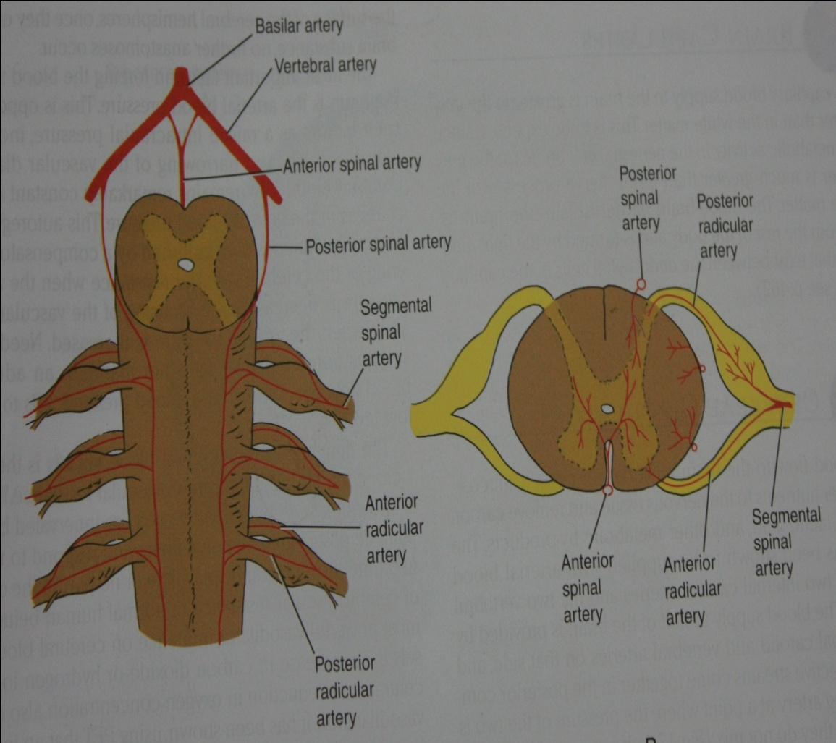
Vascular anatomy of spinal cord
Arterial anatomy-
Anterior arterial plexus
Posterior arteial plexus
Medullary arterial system-
Artery of Adamkiewicz

Slide 3
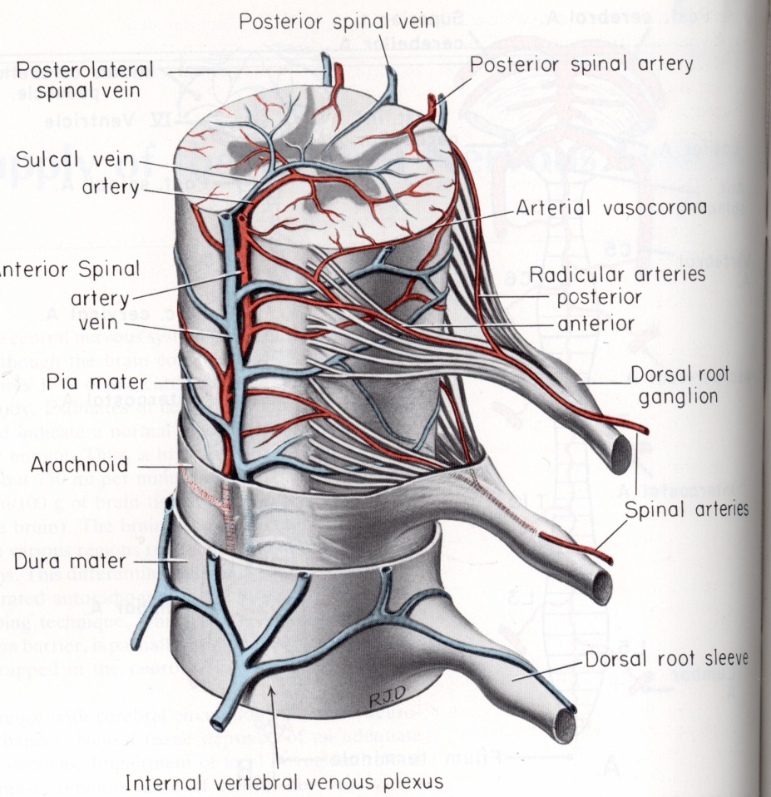
Vascular anatomy of spinal cord
Venous anatomy
sucal veins& radial veins
Coronal venous plexus
Medullary vein
Epidural venous plexus
(batson’s plexus)

Slide 4
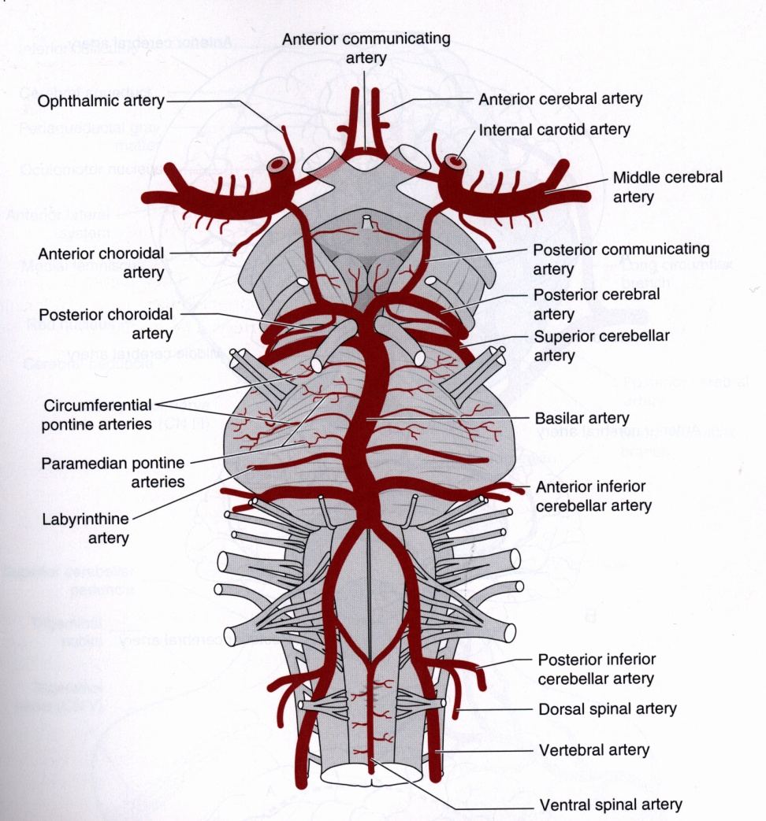
Vascular anatomy
Paired anterior spinal arteries unite to form a single descending vessel (ie, anterior spinal artery) which enters the anterior median fissure of the spinal cord and supplies the anterior two thirds of the cord. Like the basilar artery, it has smaller penetrating and circumferential branches
Distribution:
a. supplies the ventral 2/3 of the spinal cord which include corticospinal tract,anterior horn cells & spinothalamic tract.

Slide 5
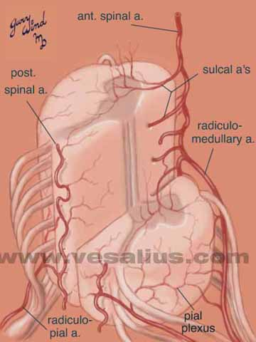
The longitudinal anterior spinal artery and its transverse radiculomedullary feeders are the dominant blood supply to the cord.. Sulcal branches of the anterior spinal artery penetrate the cord in the depth of the sulcus and each artery goes to one side only.
The pial network surrounds the cord, and sends fine radial branches into the white matter of the spinal cord tracts.

Slide 6
Vascular anatomy
Posterior Spinal Arteries (2), originate from each vertebral artery or Posterior Inferior Cerebellar on each side of the Medulla. They receive varied contribution from the posterior radicular arteries and form two longitudinal plexiform channels near the dorsal root entry zone.
Descends along the dorsolateral sulcus.
Notice that these vessels also taper until resupplied by radicular arteries.

Slide 7
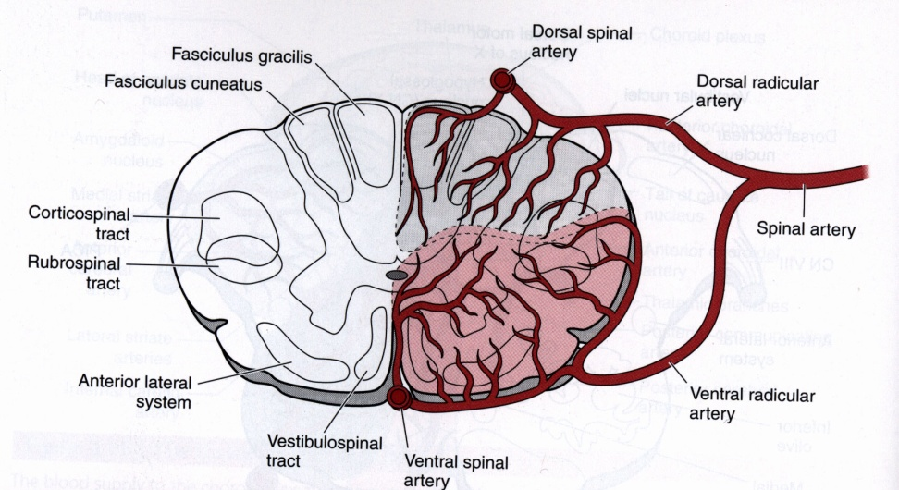
Vascular antomy
Anterior Spinal Artery, provides sulcal branches which penetrate the ventral median fissure and supply the ventral 2/3 of the spinal cord.
Posteroir spinal arteries supply the posterior columns, substantia gelatinosa, dorsal root entry zone, and a variable portion of the lateral corticospinal tract.

Slide 8
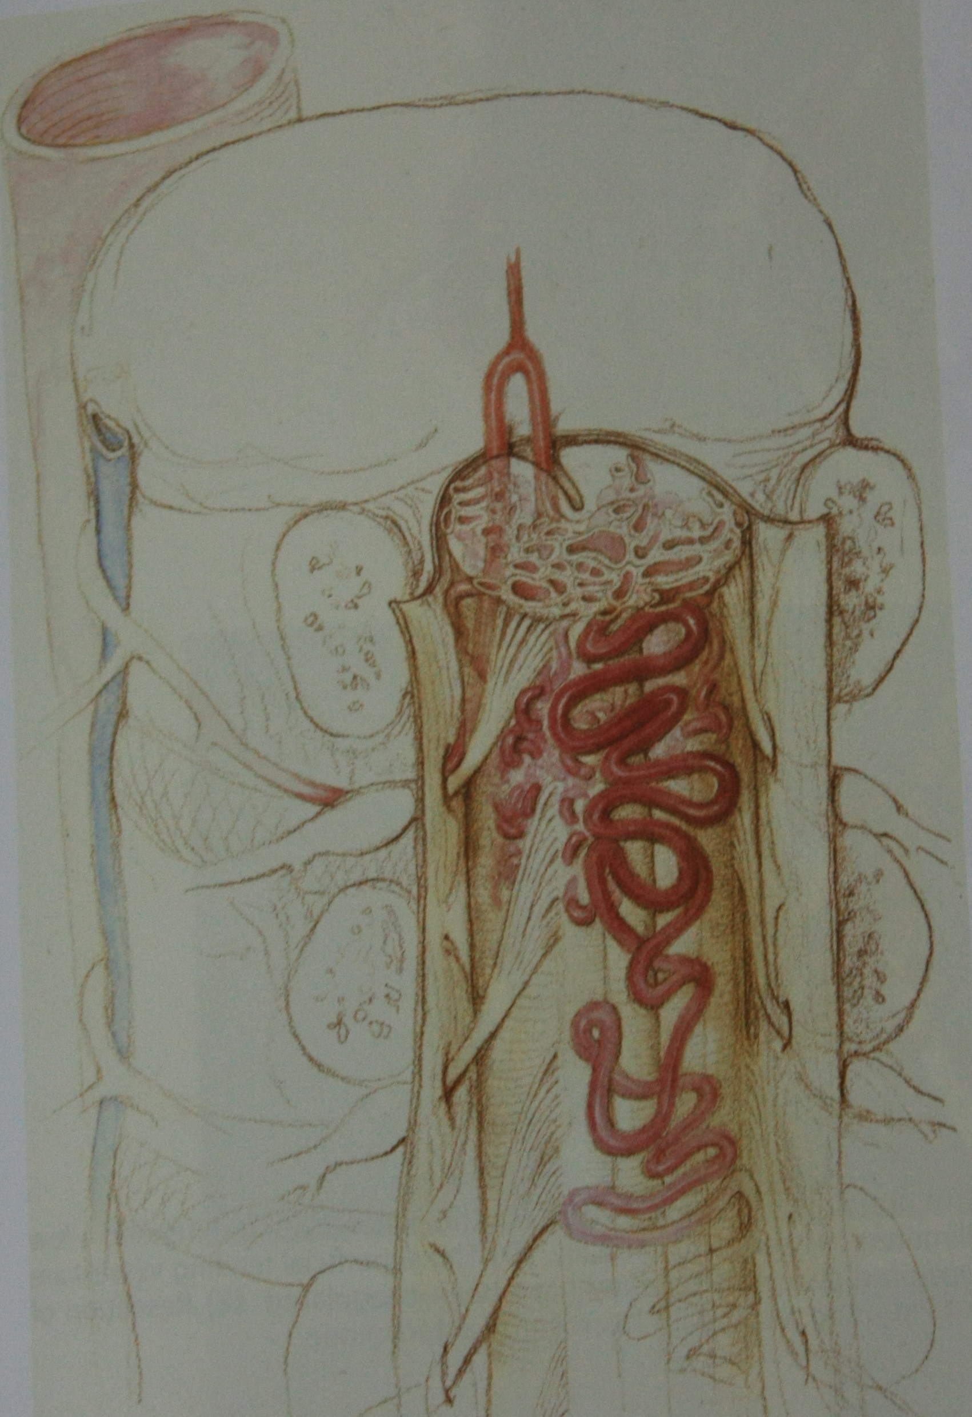
ARTERIOVENOUS MALFORMATIONS OF SPINAL CORD

Slide 9
History and classifications
Elsberg performed the first succcesful operation for a spinal AVM in 1914

Slide 10
WYBURN MASON 1943
Histological classifications
1. Arteriovenous angiomas
2.Purely venous angioma- angioma racemosum venosum

Slide 11
Dopman and djindjian 1960
Radiological classification
Type I- Single coiled type- 80-85%
Type II- glomous
Type III-juvenile

Slide 12
Kendal and Louge 1977
AVF in dural sleeve of spinal nerve root

Slide 13
Djindjian 1977
AVF in the pia – perimedullary AVF
Cavernous angioma

Slide 14
classification
Dural AVFs
Intradural AVMs
Spinal cord AVMs
Juvenile AVMs
Glomus AVMs
Perimedullary AVFs
Cavernous angiomas

Slide 15
AVM
Vascular anatomy
Cause
Pathophysiology
Clinical presentations
Natural history

Slide 16
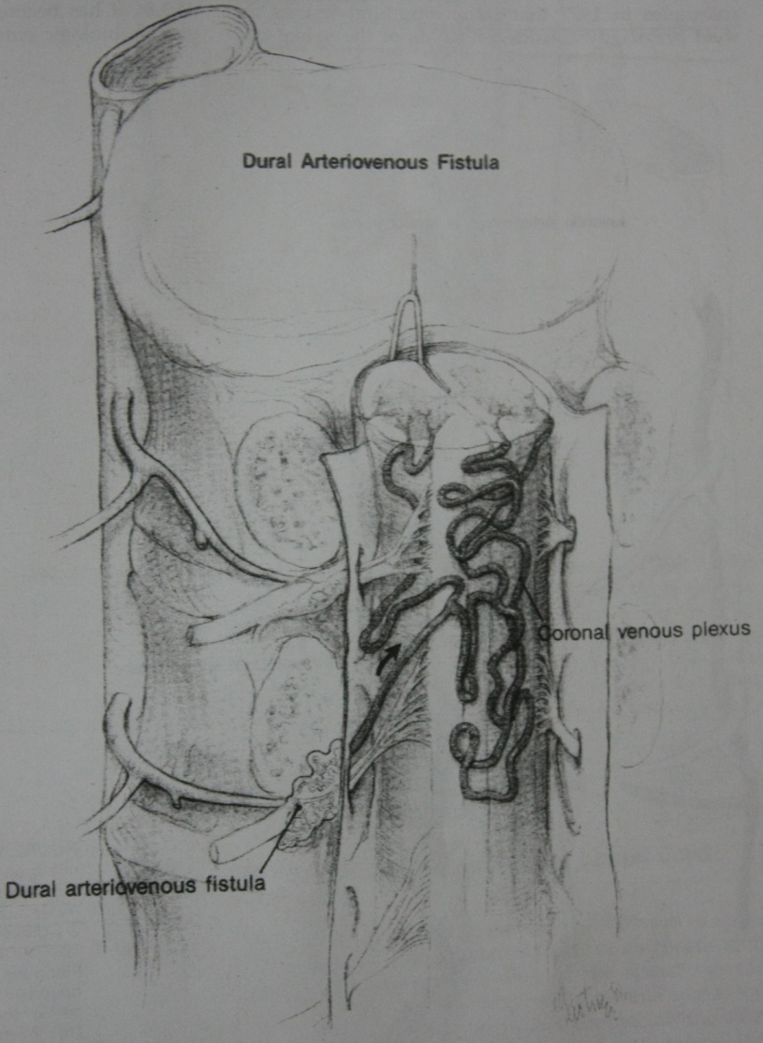
Dural arteriovenous fistula
Dural sleeve of spinal root
A-Dural branch of intrvertebral a.
V-Medullary v.
Low flow shunt

Slide 17
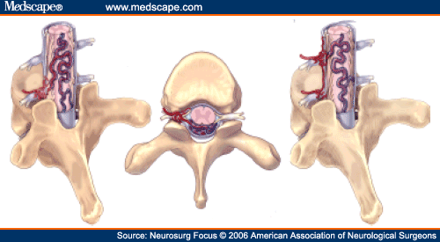
Dural AVF

Slide 18
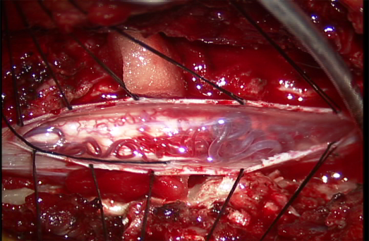
Dural AVF

Slide 19
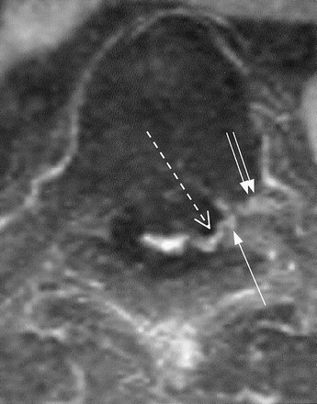
Dural AVF

Slide 20
Cause
Male-80%
>40yrs-80%
Associated with trauma and post op cases
Acquired lesion

Slide 21
Pathophysiology
Venous congestion

Slide 22
Clinical features
Slowly progressive myelopathy- 85-95%
Acute myelopathic exaggaration- 5-15%
Foix alajouanine syndrome

Slide 23
Natural history
Aminoff and louge 1974 – retrospective analysis
49 0f 60 patients - more than 41 years
55 of 60 patients - thoracic and lumbar spinal segments
20% - required crutches and nonambulatory by 6 months
50% confined to wheel chair or bed ridden within 3 years
91% had restricted activity by 3 years

Slide 24
Tobin and Layton
“there seems to be a distinct natural history for patients who have angiographic Type I AV malformations. These usually have a slowly progressive course , evolving over 2-3 years, leading to nearly complete paraplegia and bowel and bladder incompetence. Few of these patients seem to have other modes of presentation.”

Slide 25
Intrdural AV malformations
Nidus of the lesion is within the spinal cord
Types- juvenile type
Glomus type

Slide 26
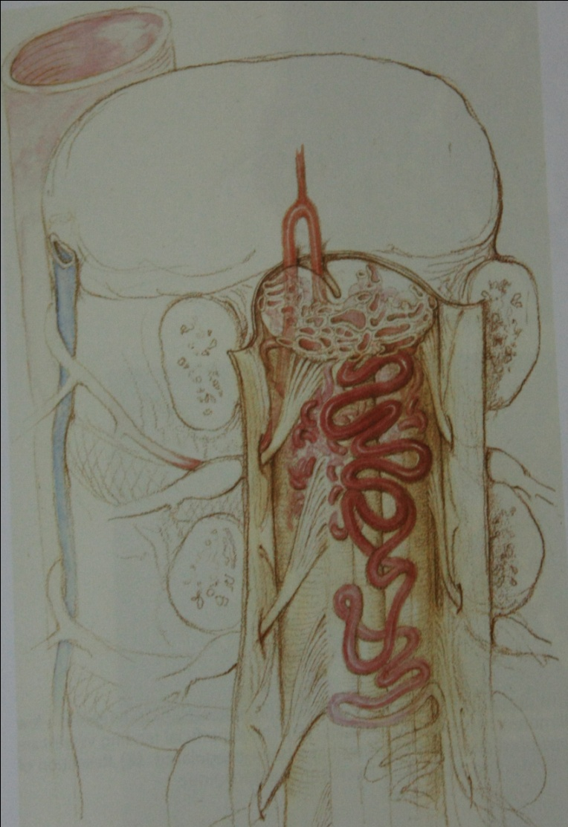
Juvenile AVM

Slide 27
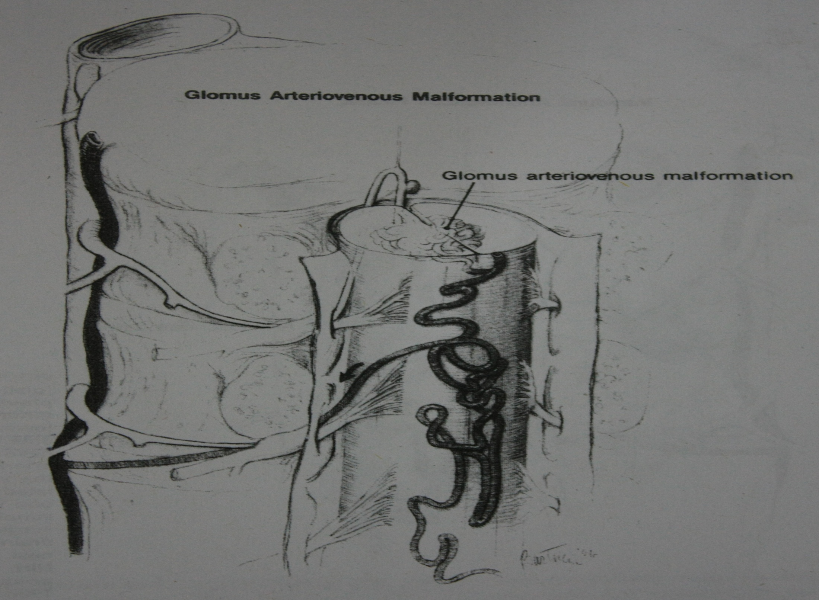

Slide 28
Intrdural AV malformations
Male:female- equal
Child and young adults
Associations with other vascular anomalies
Errors of vascular embryogenesis

Slide 29
Pathology
Hemorrhage
Venous congestion
Vascular steel phenomenon
Mechanical compression by aneurysm

Slide 30
Clinical features
Acute onset 50%
Chronic 50%

Slide 31
Natural history
Hurth and associates – 69% had acute episodes of step wise neurological progression
39% of patients with previous hemorrhage had atleast one additional hemorrhage
Aminoff and Louge – 50 % of patients whose presentation was acute, there was no subsequent neurological progression

Slide 32
Conclusion
Thus although the neurological prognosis is guarded for untreated adults with intradural AVM’s , it may not be as dismal as it is for patients with dural AVF. This must be considered when undertaking treatment of intradural AVM’s, because in some cases , attempts to permanently eliminate the AVM are associated with significant risk.

Slide 33
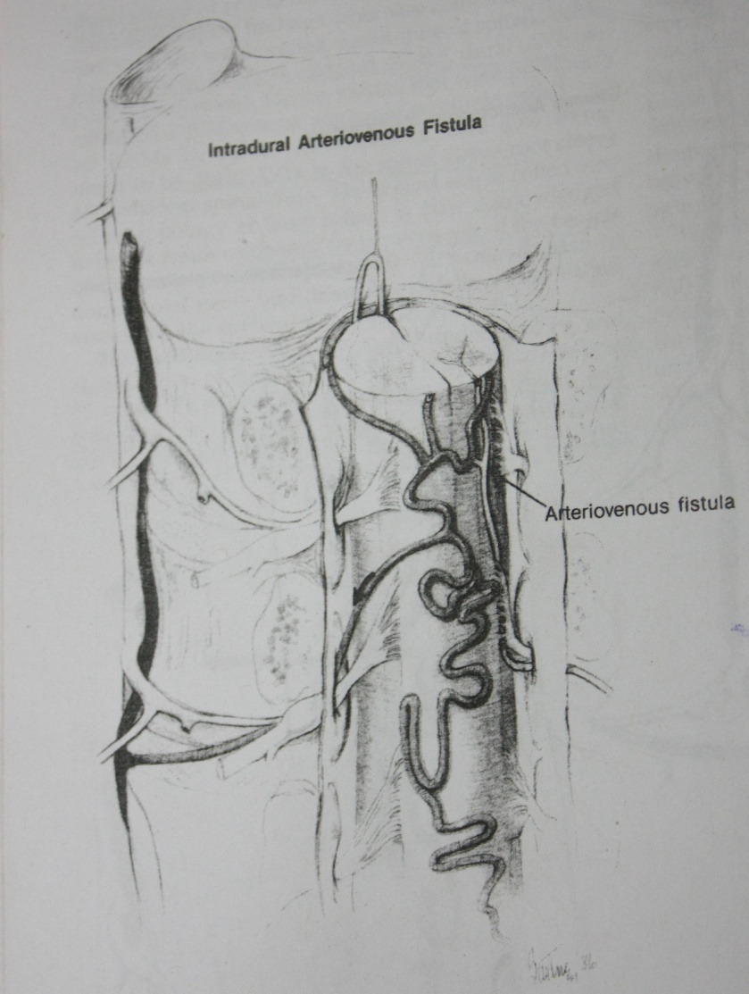
Intradural AVFs

Slide 34
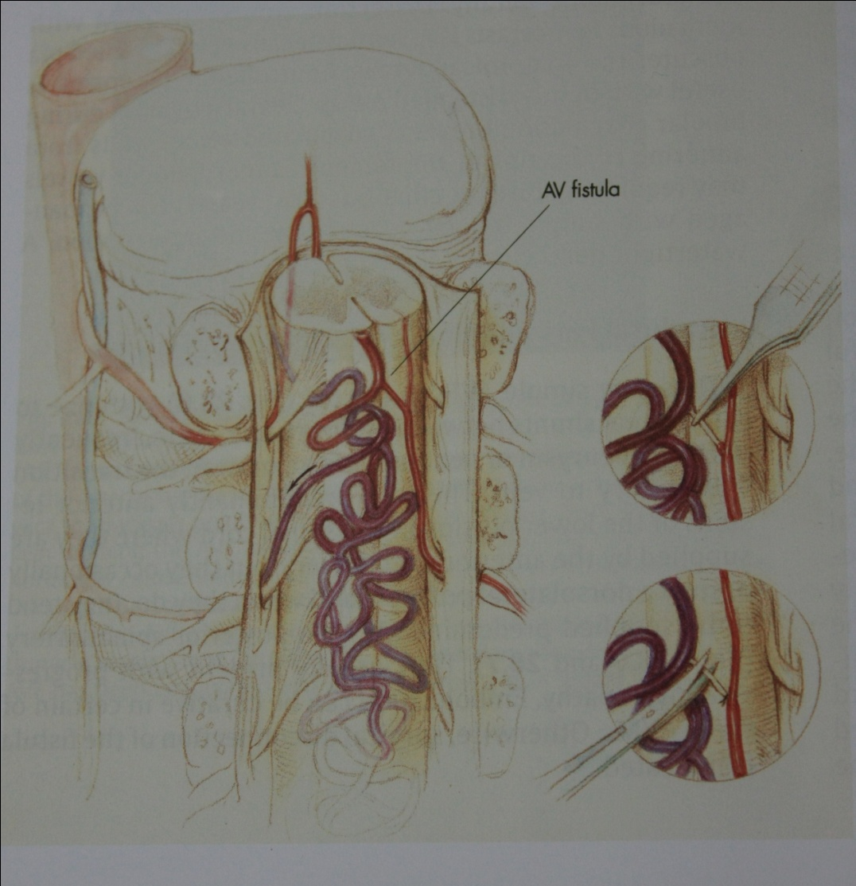
Perimedullary AVFs

Slide 35
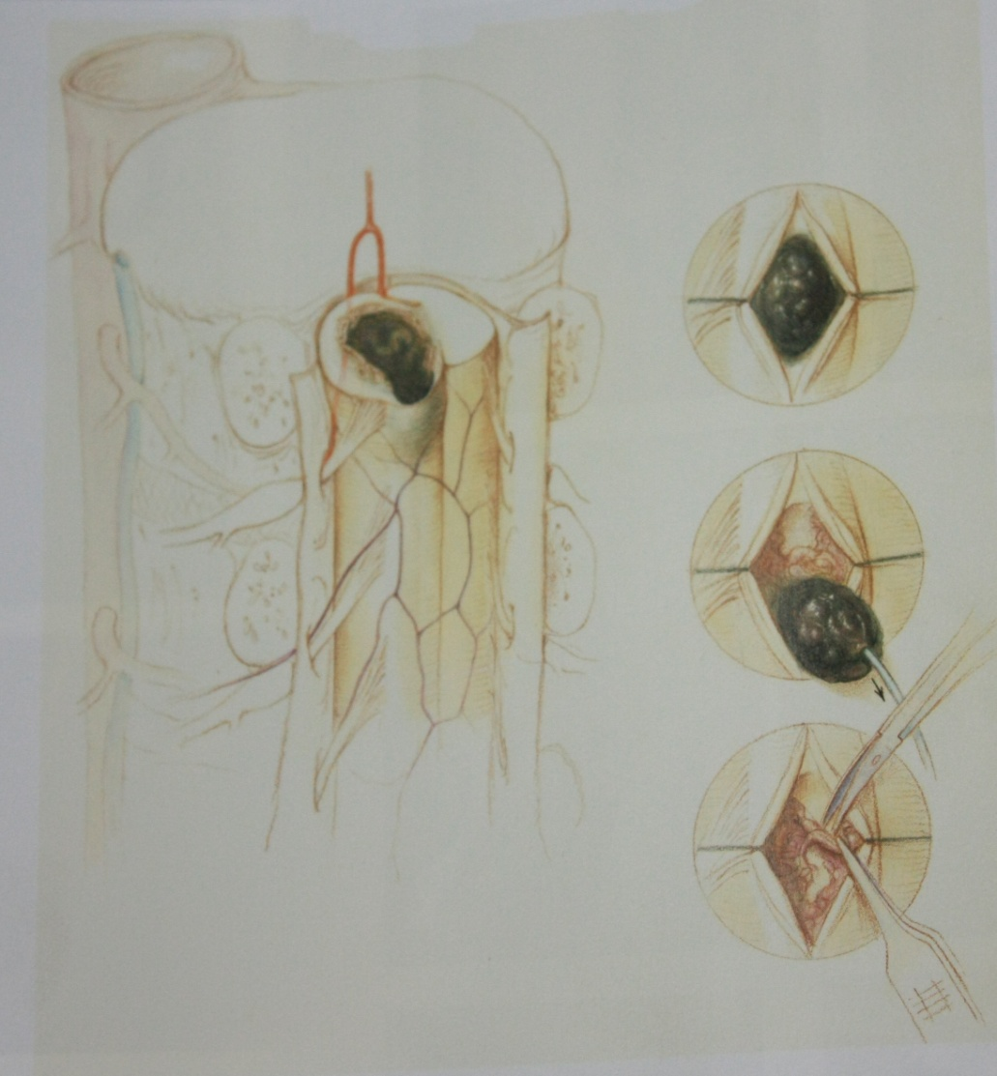
Cavernous angioma

Slide 36
Differential diagnosis
Cervical spondylosis
Intervertebral disc diseases
Neoplasia
Amyotrophic Lateral Sclerosis
Multiple Sclerosis
Infections

Slide 37
Diagnostic studies
Screaning studies
X-ray- incresed interpedicular distance at the level of AVM
Myelography-Sensitive investigation
MRI- Intial diagnostic procedure in patient with myelopathy-1.5 tesla using a spinal coil

Slide 38
Confirmative invesigation
Selective spinal arteriography-
1. type of AVM
2. exact location and anatomical configeration of the nidus
3. Identification of feeding vessel
4. Regional vascular anatomy of spinal cord

Slide 39
Dural AVF
T1-T2 Area of focal cord expansion most commanly affecting the conus
Study conducted by Gilbert-increased T2 signal in the cord was the most comman finding
I.V. gadolium- enhancement of vessels at the coronal venous plexes
Peripheral hypointensity on T2 images-specific

Slide 40
Intrdural AVM & AVF
T1 images-srepentine pattern of signal flow void in a area of local expansion of spinal cord

Slide 41
Cavernous angiomas
Arteriography and myelography- normal
MRI- Low signal spherical or oblong lesions with scattered heterogenous areas of increased signals (target configeration)

Slide 42
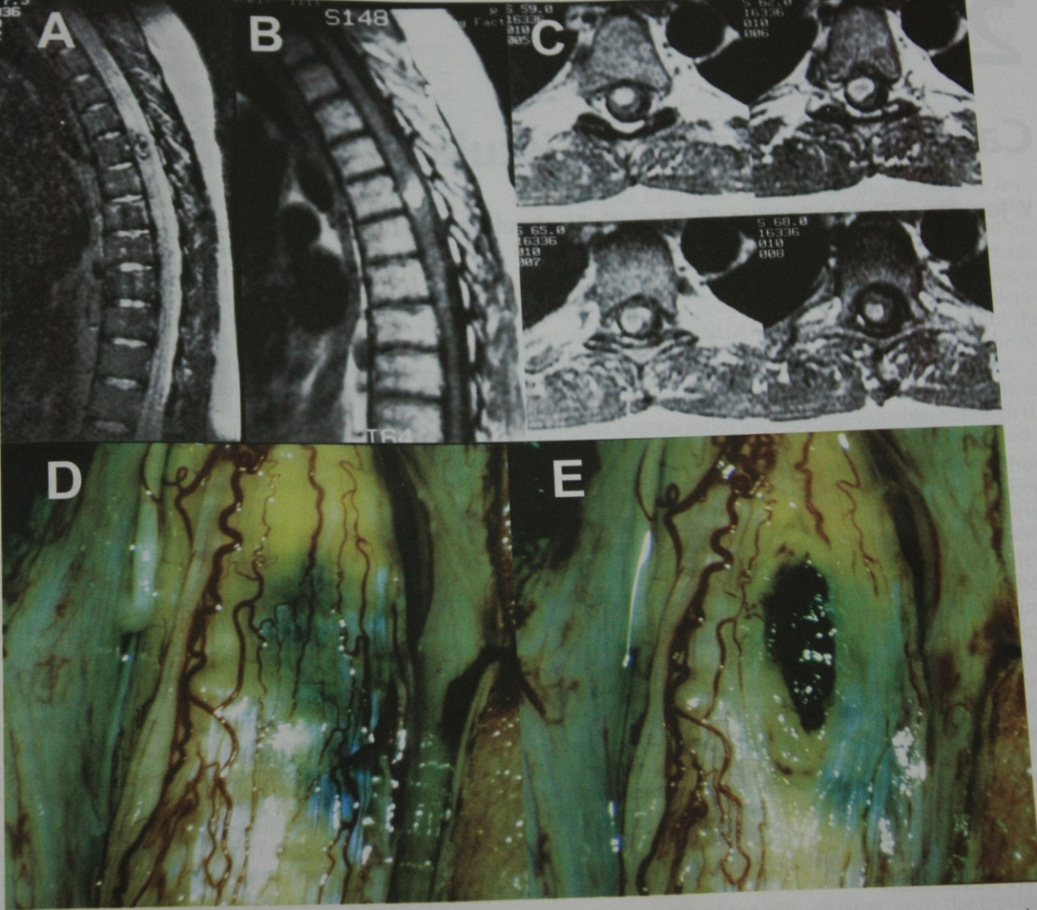
Cavernous angioma

Slide 43
Selective spinal angiography
Type of AVM
Exact location and anatomical configuration of nidus of AVM
Identification of feedind vesselsto AVM
Regional vascular anatomy of spinal cord

Slide 44
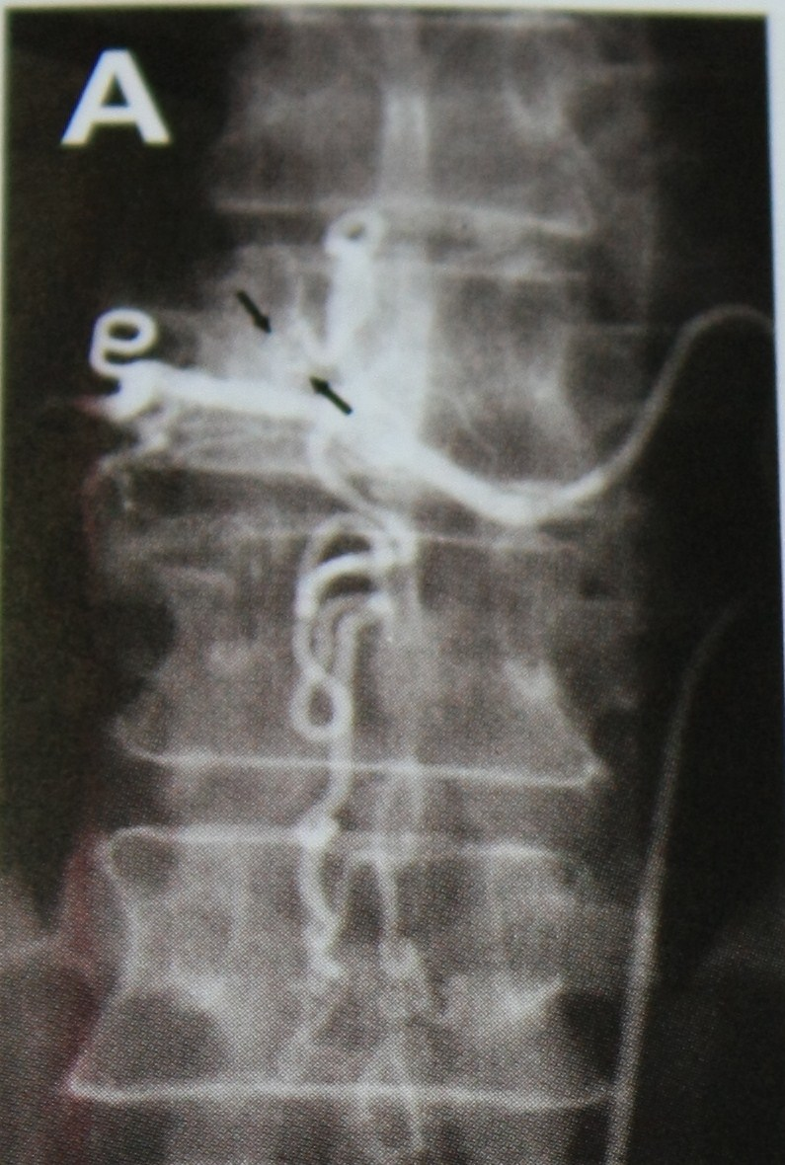
Selective spinal angiography of dural AVF

Slide 45
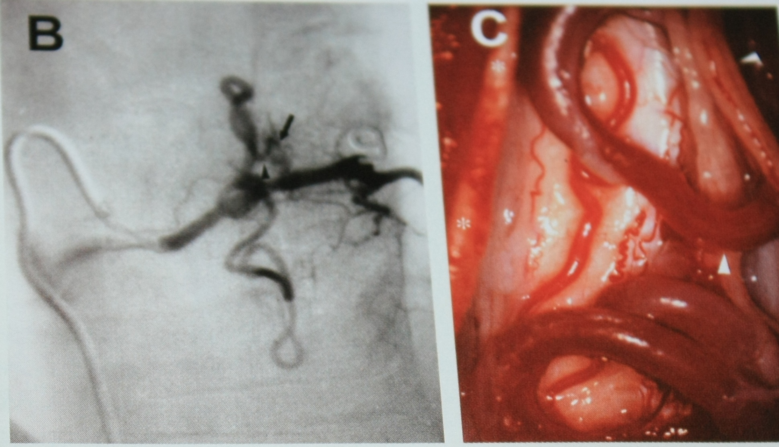
Dural AVF

Slide 46
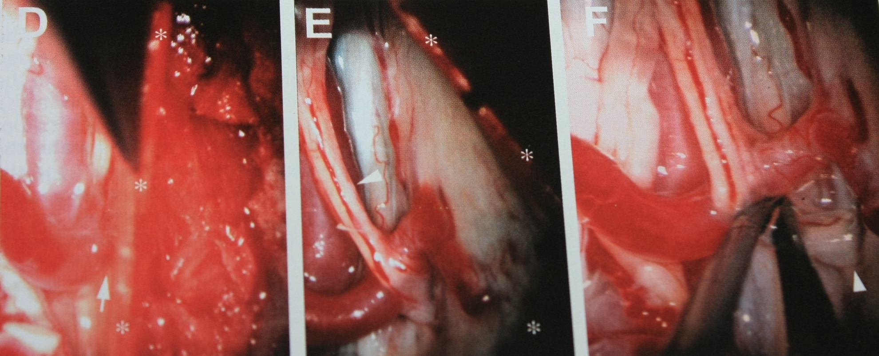
Dural AVF

Slide 47
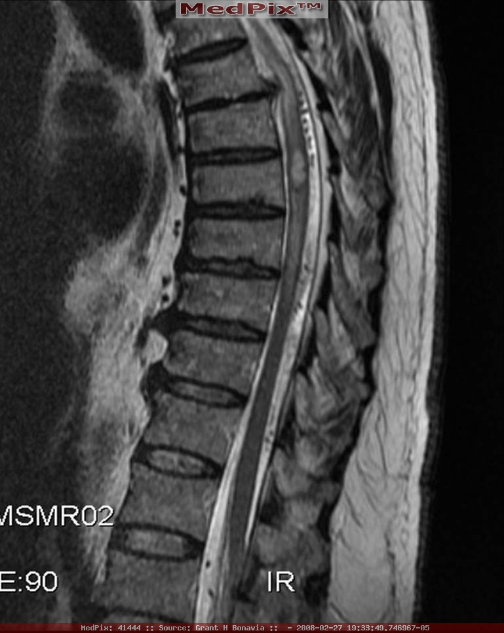
Intradural AVM

Slide 48
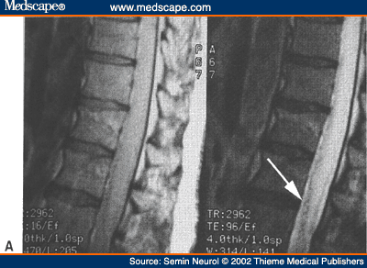
Intrdural AVM

Slide 49
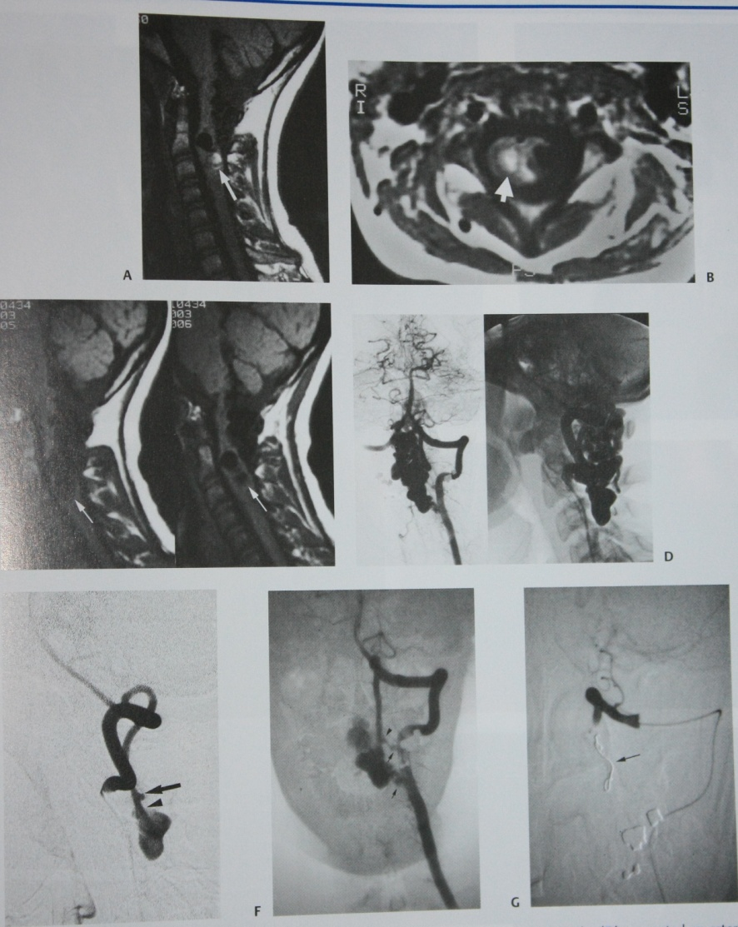
Intrdural AVF

Slide 50
Treatment and outcome
Dural AVF
Surgery
Embolisation
Surgery: treatment of choice
NIH- 37 of 49 severly disabled-improved gait
26 of 27 disability but unaided motion-retained independent ambulation
7o of 76- stabilised or improved

Slide 51
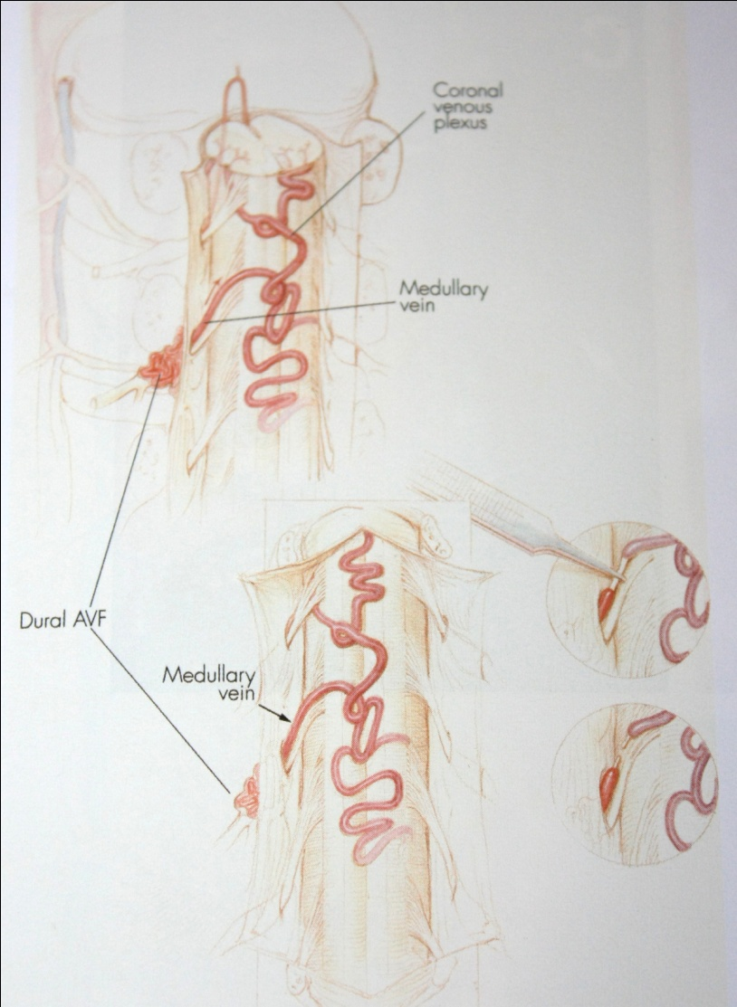
Surgery of dural AVF

Slide 52
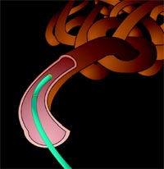
Embolisation: IBC (isobutyl-2-cynoacrylate)
Disadvantages:
1. Durability of occlusoin is less
2. Cannot be saftely used in patients with comman arterial supply
3. Hemorrage and delayed paraplegia
PRESENT ROLE: Foix alajouanine syndrome

Slide 53
Intradural avm
Surgery: type, location & size
Embolisation: PVA sponge microparticles

Slide 54
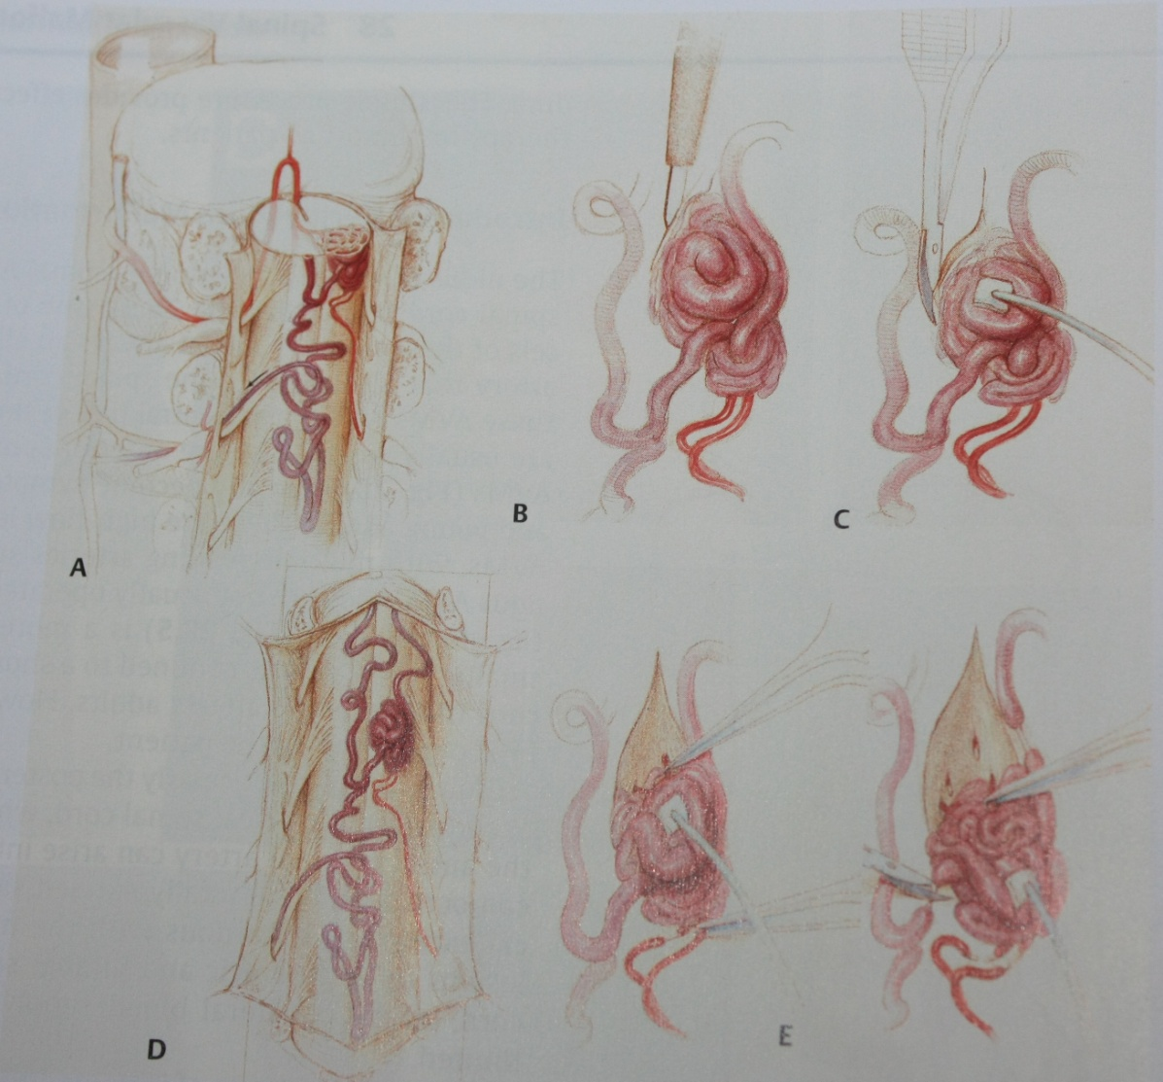
Glomus angioma surgery

Slide 55
Perimedullary AVF
Type I- Surgery
Type II- Surgery
Type III- Embolic occlusion with latex balloon, surgery or embolisation

Slide 56

Cavenous angioma
Surgery is the treatment of choice
Linear myelotomy over the most supe

Slide 57
Thank you

