Slide 1
ANATOMY OF VISUAL PATHWAY AND OPTIC CHIASMA
DR. Bhagwati salgotra

Slide 2
VISUAL PATHWAY
Retina
Optic disc
Optic nerve
Optic chiasma
Optic tract
Lateral geniculate body
Optic radiation
Visual cortex
Visual association cortex

Slide 3
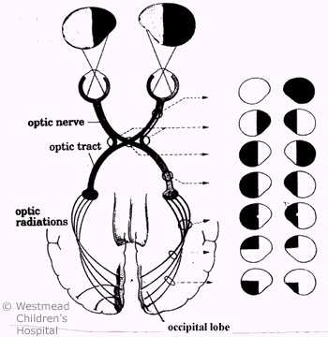
.

Slide 4
.
Four neuron conduct visual impulse
a. rod and cones
b. bipolar neurons
c. ganglion cells
d. neurons of lateral geniculate body.

Slide 5
VISUAL PATHWAY
Retina
Optic disc
Otic nerve
Optic chiasma
Optic tract
Lateral geniculate body
Optic radiation
Visual cortex
Visual association cortex

Slide 6
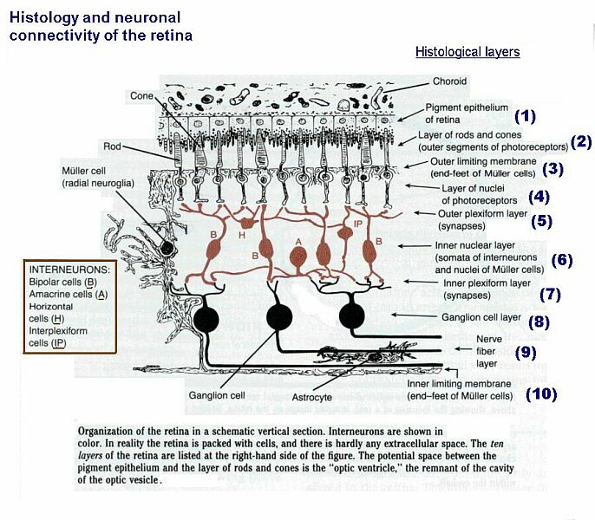
RETINA

Slide 7
Retina..
Extends – Ora serrata to optic disc
4 Quadrants
10 layers
Axons of ganglion cell- fibers of optic nerve
Fibers converge on optic disc
Consist of photoreceptor cells (rod & cones) , bipolar cells, ganglion cell.
First neural elements in the visual system

Slide 8
.
Rods – 100 million
- light wavelength 400 – 800nm
- more in the fundus
- absent at optic disc & macula
- night vision, peripheral vision, perception of movements
Cones – 7 million
- 100,000 at macular region
- light wavelength – L - 564-580nm
M- 534- 545nm
S - 420- 440nm
Having opsins a protien molecule.
Conscious vision: rod opsins and cone opsins.
A third type, melanopsin in some of the retinal ganglion cells ,part of the body clock mechanism

Slide 9
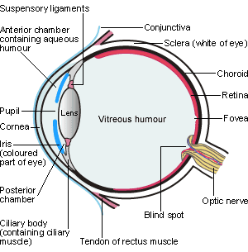
.

Slide 10
VISUAL PATHWAY
Retina
Optic disc
Optic nerve
Optic chiasma
Optic tract
Lateral geniculate body
Optic radiation
Visual cortex
Visual association cortex

Slide 11
.
The optic disc -where ganglion cell axons exit the eye to form the optic nerve.
Light insensitive .
Called the blind spot or "physiological blind spot".
Carries 1 to 1.2 million neuron from the eye.
3 to 4 mm nasal to fovea.
It is a vertical oval,
Dimension 1.76mm horizontally by 1.92mm vertically.
a central depression - optic cup.

Slide 12
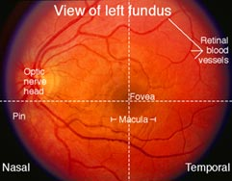
Optic disc cont…
Normal yellowish white
Nasal margin slightly blurred then temporal
Flat with retina
Paler temporally

Slide 13
Clinical importance of optic disc
Papilledema –
  a/k choked disc
  c/b axoplasmic stasis
  elevated ICP lead to obliteration of retinal vein
  Where retinal vein pass through the subarachnoid space (1 cm post to globe)
  Elevated ICP – b/l papilledema
  Takes 24 - 48 hr to develop
  Does not cause visual problem till very severe.

Slide 14
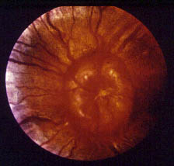
Clinical importance of optic disc
Disc edema-
-optic neuritis
-ant ischemic optic neuropathy
-compression
-central retinal vein occlusion
-optic nerve infiltration
-etc

Slide 15
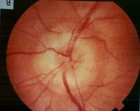
Clinical importance of optic disc..
Optic atrophy –
-paler then normal
-more demarcated
-punched-out appearance
-Cup prominent

Slide 16
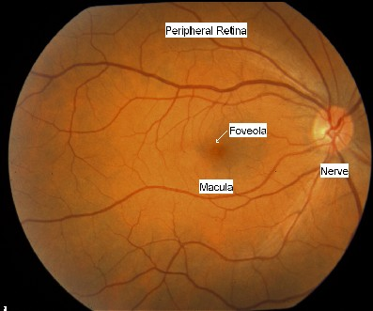
Macula lutea
Latin macula, "spot" + lutea, "yellow")
Oval-shaped
Center of the retina.
Diameter ≈ 5 mm
Histologically ≥2 layers of ganglion cells.
Optic nerve, 90% nerve fibers arise from macula.
Fovea, a small pit - largest concentration of cone cells, responsible for central vision.

Slide 17
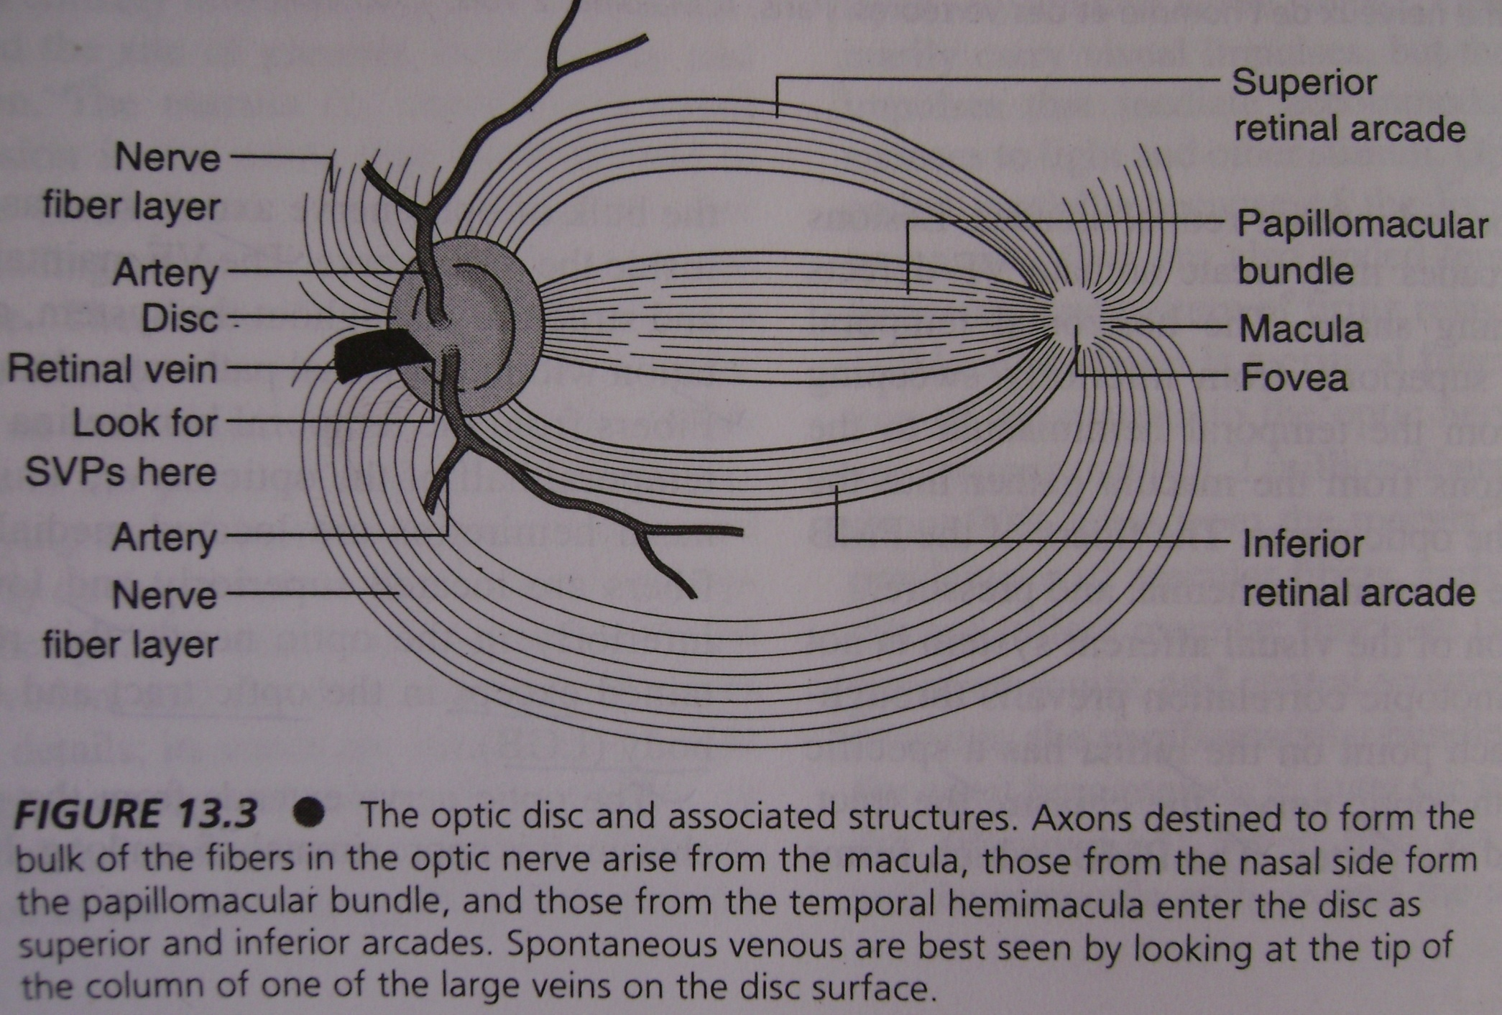
Optic disc & associated structures

Slide 18
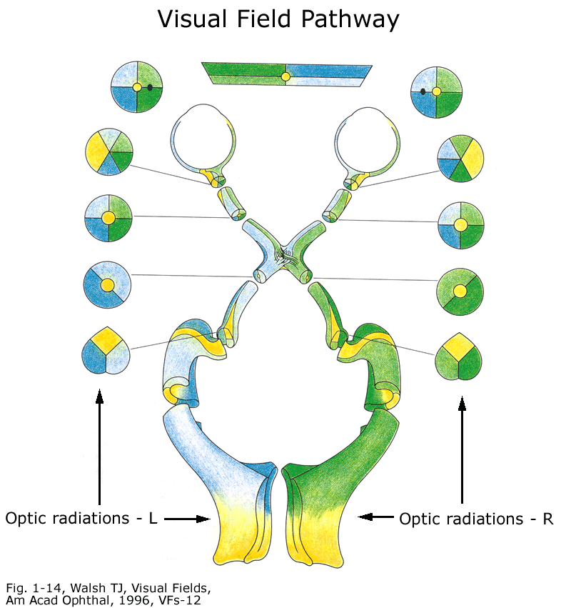
Organization of fibers in visual pathway
At disc macular- temporal
Shift to centre
Medial fibers decussate to other side- at chiasma
Rotation of fibers inward in optic tract ,
Upper fib – medial , Lower – lateral
In post tract fib- fans out in six layers of LGB
Crossed fib- layer 1,4,6
Uncrossed- layer 2,3,5
Macular fib-central wedge in LGB

Slide 19
Organization of fibers in visual pathway
Ultimately lower field represented medially(LGB)
Upper field - laterally(LGB)
The resultant fibers sweep out into the hemisphere in two fan shaped projection
Lower fib makes Meyer’s loop(ant. temp. lobe)
Upper fibers direct to parietal lobe
Macular fib-at extreme tip : upper field - lower half
lower field – upper half

Slide 20
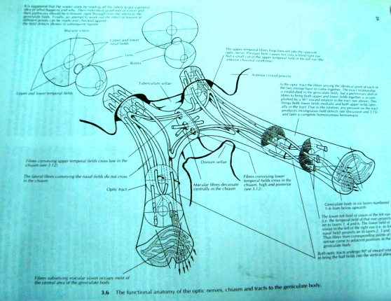
.

Slide 21
VISUAL PATHWAY
Retina
Optic disc 3-4 mm nasal to the center.
Optic nerve
Optic chiasma
Optic tract
Lateral geniculate body
Optic radiation
Visual cortex
Visual association cortex

Slide 22
OPTIC NERVE
Optic nerve fibers – axons of ganglion cells
Converge on optic disc
myelination by oligodendrocytes
Leaves the orbital cavity through optic canal
Optic nerve extends from retina to optic chiasma

Slide 23
Optic nerve
5 cm long
Divided into 4 portions:
intraocular-1mm
intraorbital-25-30mm
intracanalicular- 10mm
intracranial- 10mm
Meninges extend forward along the optic nerves forming Vaginal sheath.
Through this sheath, subarachnoid space continues along the nerves & transmits increased ICP, causing Papilledema.

Slide 24
VISUAL PATHWAY
Retina
Optic disc 3-4 mm nasal to the center.
Optic nerve
Optic chiasma
Optic tract
Lateral geniculate body
Optic radiation
Visual cortex
Visual association cortex

Slide 25
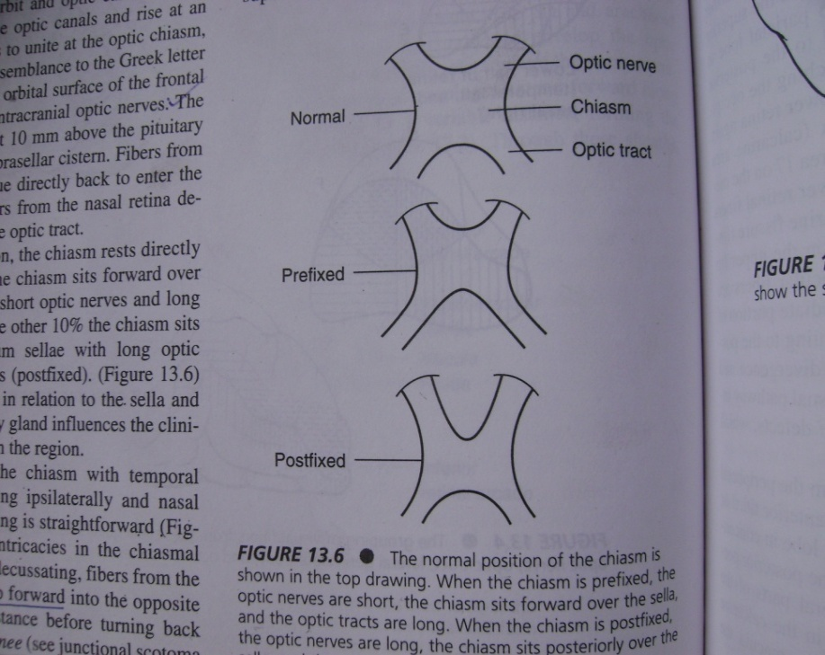
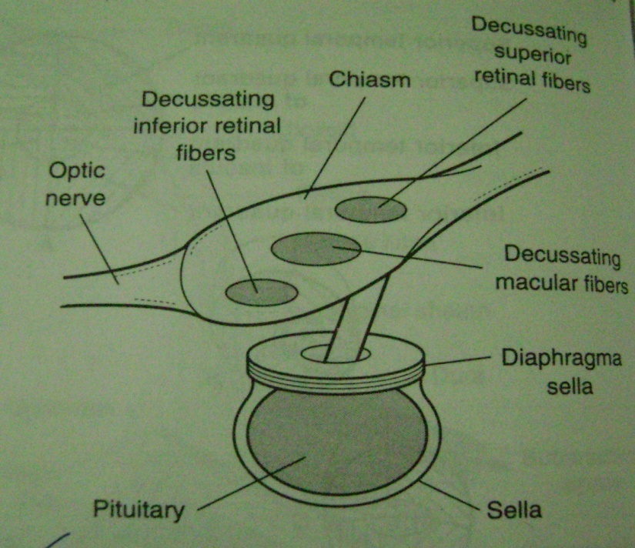
Optic Chiasma
Two optic nerves rise at an angle of 45 degrees to unite at the optic chiasma.
Chiasma – Greek, chi X
Normal – above sella : 80%
Prefixed – 10%
Postfixed – 10%
Macular fiber decussate as a separate compact bundle, inferior retinal (superior visual field) fibers cross inferiorly & superior retinal (inferior visual field) fibers superiorly.

Slide 26
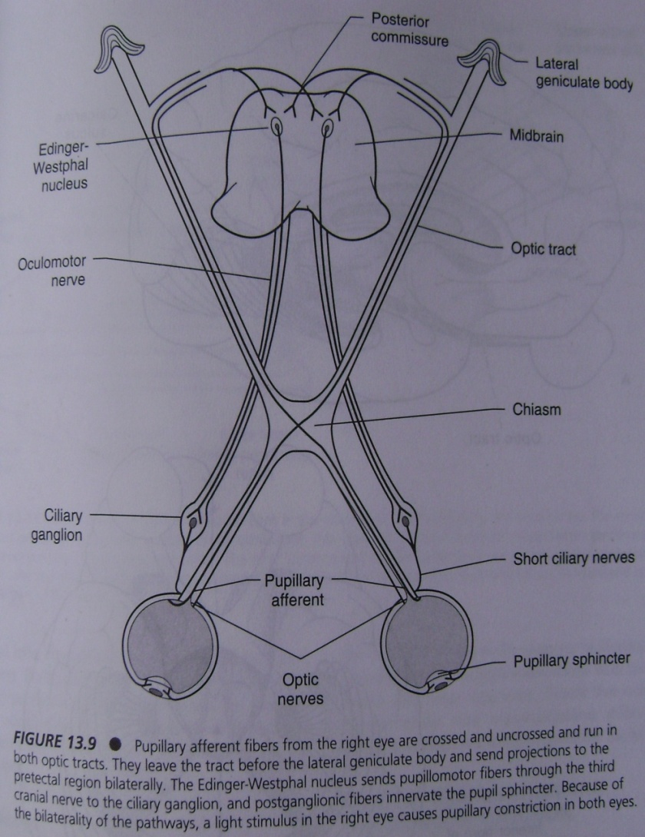
Optic tracts
Posterior to optic chiasm,
the uncrossed fibers from the ipsilateral temporal hemiretina & the crossed fibers from the contralateral nasal hemiretina form the optic tract.
55% axons from cotralateral, & 45% from the ipsilateral hemiretina.
80% visual afferents & 20% pupilary afferents.
Afferent fibers from pupil leave the tract just anterior to geniculate to enter the pretectal area of midbrain.

Slide 27
VISUAL PATHWAY
Retina
Optic disc 3-4 mm nasal to the center.
Optic nerve
Optic chiasma
Optic tract
Lateral geniculate body
Optic radiation
Visual cortex
Visual association cortex

Slide 28
VISUAL PATHWAY
Retina
Optic disc 3-4 mm nasal to the center.
Optic nerve
Optic chiasma
Optic tract
Lateral geniculate body
Optic radiation
Visual cortex
Visual association cortex

Slide 29
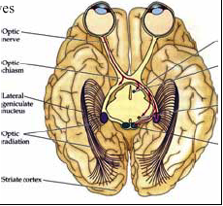
Lateral geniculate body
Small oval swelling
Projecting from pulvinar of thalamus
Input from both the eyes
Relay these message to primary visual cortex through optic radiation
.

Slide 30
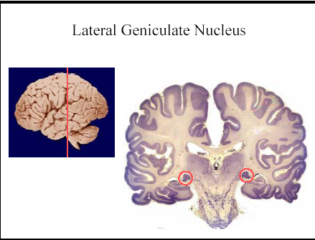

Slide 31
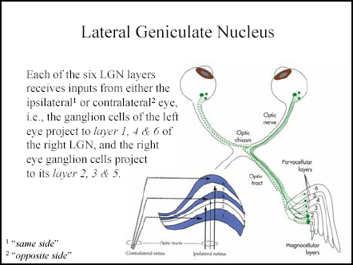
.
6 layers- 1,2,3,4,5,6
Crossed fib- layer 1,4,6
Uncrossed- layer 2,3,5

Slide 32
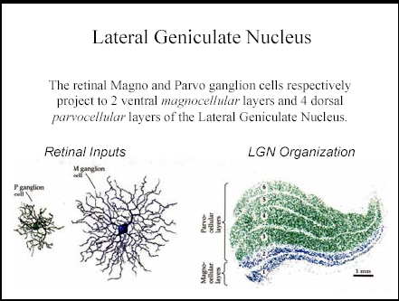
LGB….
Retinal magno and parvo ganglion cell project to- 6 layers of LGB-
2 ventral magnocellular layer
4 dorsal parvocellular layer
.

Slide 33
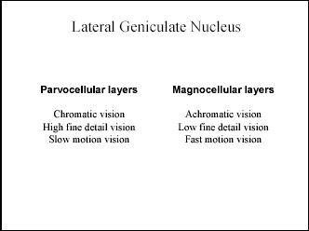

Slide 34
VISUAL PATHWAY
Retina
Optic disc 3-4 mm nasal to the center.
Optic nerve
Optic chiasma
Optic tract
Lateral geniculate body
Optic radiation
Visual cortex
Visual association cortex

Slide 35
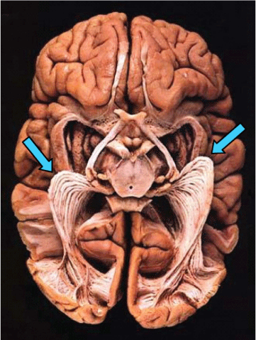
Optic radiation
optic radiation = geniculo-calcarine tract = geniculostriate pathway).
axons from relay neurons in the LGB carrying visual information to the visual cortex (also called striate cortex) along the calcarine fissure.

Slide 36
Optic radiation
Fibers in optic radiations split into two parts on each side:
Fibers from the inferior retina (also called "Meyer's loop" or "Archambault's loop")
Pass through the temporal lobe by looping around the inferior horn of the lateral ventricle.
Carry information from the superior part of the visual field. A lesion in the temporal lobe that results in damage to Meyer's loop causes a characteristic loss of vision in a superior quadrant (quadrantanopia.) pie in sky
Fibers from the superior retina (also called "Baum's loop")
Travel straight back through the parietal lobe to the occipital lobe in the retrolenticular limb of the internal capsule to the visual cortex.
Carry information from the inferior part of the visual field. Taking the shorter path, less susceptible to damage.

Slide 37
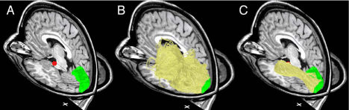
NEUROSURGICAL IMPORTANCE OF MEYER’S LOOP
Meyer's loop (Meyer,1907), carries signals that represent the entire contralateral upper visual field.
Clinical significance, because of the large number of temporal lobe resections.
Anterior tip of Meyer's loop is 28 ± 3 mm posterior to the temporal pole.
Diffusion tensor imaging and fiber tractography (DTI-FT).
Identification of OR with ConTrack

Slide 38
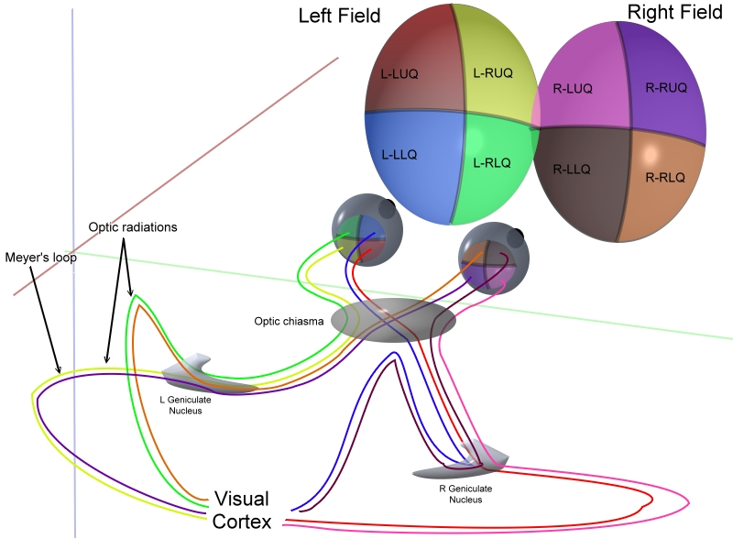
.

Slide 39
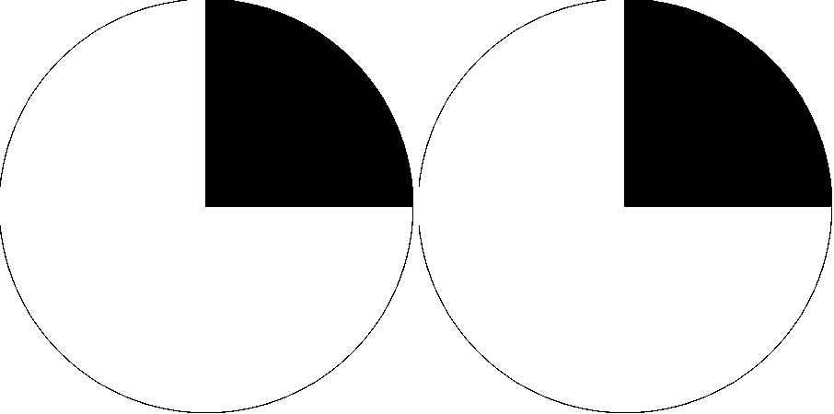
Right superior quadrantanopia. characteristic of damage toMeyer's loop on the left side of the brain.

Slide 40
VISUAL PATHWAY
Retina
Optic disc 3-4 mm nasal to the center.
Optic nerve
Optic chiasma
Optic tract
Lateral geniculate body
Optic radiation
Visual cortex &Visual association cortex
Blood supply of visual pathway.

Slide 41
Visual cortex & Visual association cortex
The term visual cortex refers to the primary visual cortex (also known as striate cortex or V1).
The primary visual cortex is anatomically equivalent to Brodmann area 17.
The extrastriate cortical areas consist of Brodmann area 18 and Brodmann area 19.

Slide 42
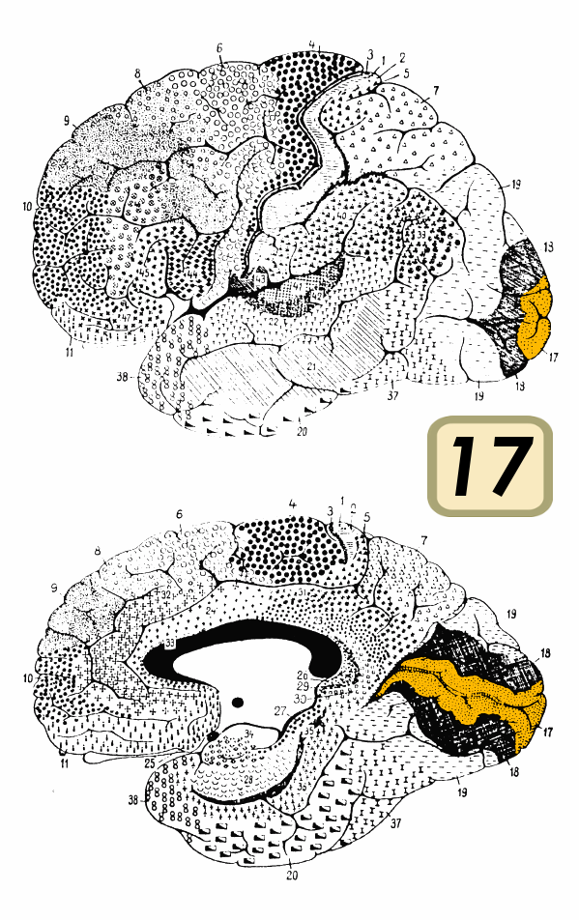
.

Slide 43
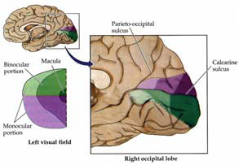
Visual cortex

Slide 44
Visual cortex cont…
The primary visual cortex, V1, is the koniocortex (sensory type)
located in and around the calcrine fissure in the occipital lobe.
Each hemisphere’s V1 receives information directly from its ipsilateral lateral geniculate nucleus.
Each V1 transmits information to two primary pathways, - dorsal stream &ventral stream:-

Slide 45
Cont…
Dorsal stream - begins with V1, through V2, then to the dorsomedial area and v5 (MT) to the posterior parietal cortex.
Sometimes called the "Where Pathway" or "How Pathway",
Associated with motion,
locations, control of the eyes and arms, especially when visual information is used to guide .
Ventral stream- begins with V1, through V2, then through V4, and to the inferior temporal cortex.
Called the "What Pathway", is associated with form recognition ,storage of long term memories

Slide 46
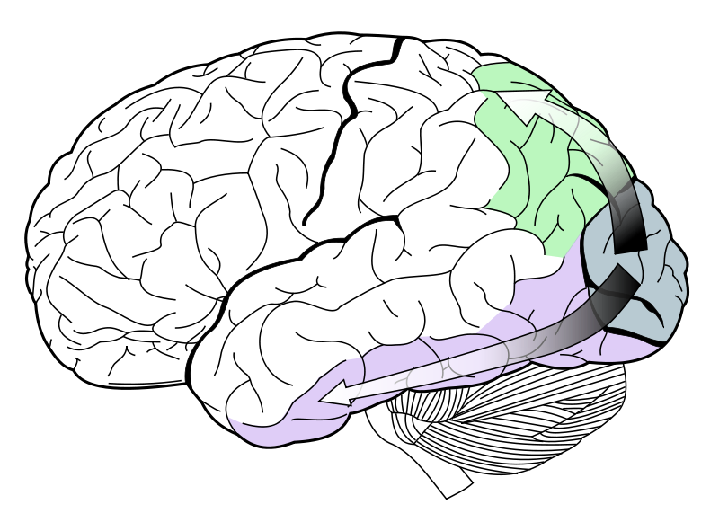
Image showing ventral stream (purple) and dorsal stream (green) in the human brain visual system.

Slide 47
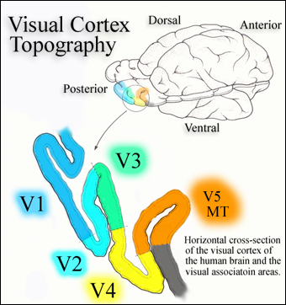
visual association areas
Visual area V2, k/a prestriate cortex, second major area in the visual cortex, first region in the visual association area. It receives strong feed forward connections from V1
Sends strong connections to V3, V4, and V5.
Sends strong feedback connections to V1.
Third visual complex(V3) refers to the region of cortex located immediately in front of V2,
Visual area V4 is extrastriate visual cortex. located anterior to V2 and posterior to posterior inferotemporal area (PIT).
Visual area V5, also known as visual area MT (middle temporal), is a region of extrastriate visual cortex that play role in the perception of motion.

Slide 48
VISUAL PATHWAY
Retina
Optic disc 3-4 mm nasal to the center.
Optic nerve
Optic chiasma
Optic tract
Lateral geniculate body
Optic radiation
Visual cortex &Visual association cortex
Blood supply of visual pathway.

Slide 49
Vascular supply of the visual pathways
Retina – Ophthalmic artery
* Central retinal artery
* Dural branches
Falcine artery
Recurrent meningial A
* Posterior ciliary artery
Optic nerve – Branches of ophthalmic A
- Carotid A
- Ant. Cerebral A
Chiasma & Optic tract – Ant. Com art.
- Post. Com art.
- Post. Cerebral art.
LGB – Ant choroidal art.
- Lateral Post choroidal art.
Optic radiation – Middle cerebral art.
- Post cerebral art.
Primary visual cortex – calcarine branch of Post cerebral art.

Slide 50
Localization of lesions in the optic pathways
Visual acuity
Colour vision
Visual fields

Slide 51
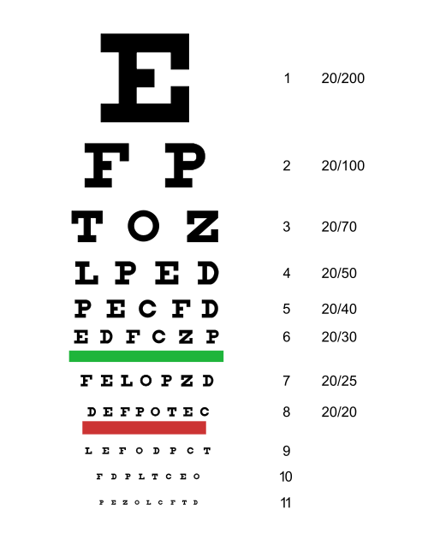
Visual acuity
Quantitative measure of the ability to identify black symbols on a white background at a standardized distance.
In the term "20/20 vision" the numerator refers to the distance in feet from which a person can reliably distinguish a pair of objects. The denominator is the distance from which an 'average' person would be able to distinguish —the distance at which their separation angle is 1 arc minute.
The metric equivalent is 6/6 vision where the distance is 6 meters.
20/20 = 6/6
20/200 = 6/60

Slide 52
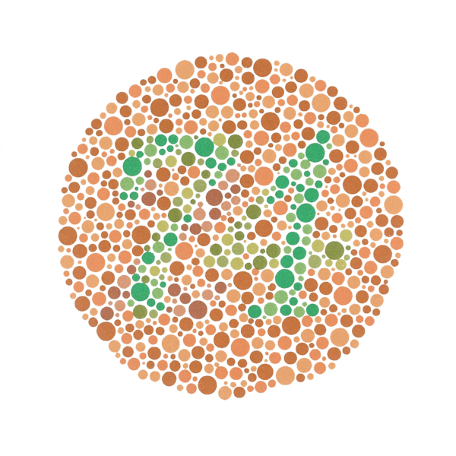
Colour vision
The Ishihara Color Test- test for red-green color deficiencies.
By ishihara plates
contain a circle of dots
a number visible to those with normal color vision
and invisible, or difficult to see, for those with a red-green color vision defect.
The full test consists of 38 plates.

Slide 53
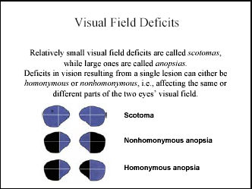
Visual field deficits
Small visual field deficit-
scotomas
Large deficits- anopsias
Affecting same part- homonymous
Affecting different part- nonhomonymous
.

Slide 54
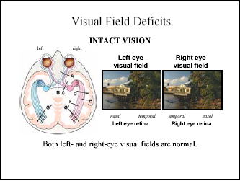

Slide 55
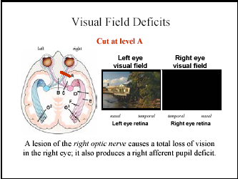

Slide 56
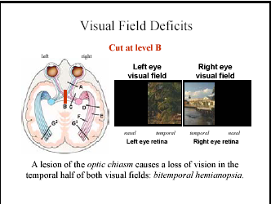

Slide 57
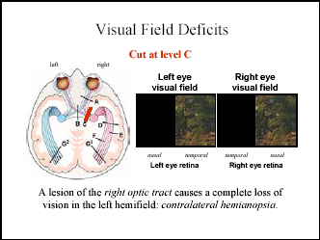

Slide 58
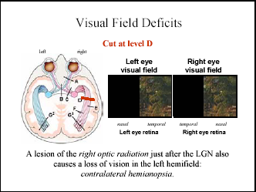

Slide 59
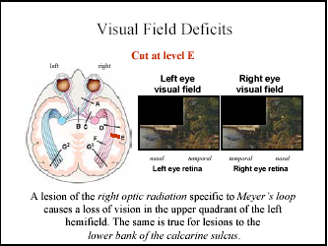

Slide 60
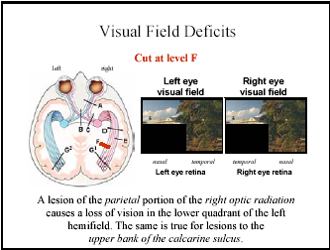

Slide 61
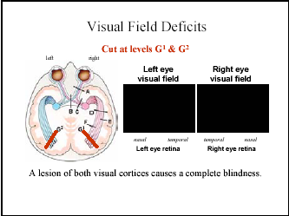

Slide 62
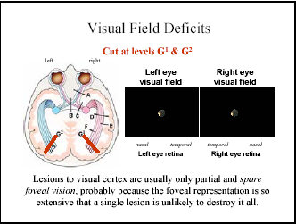

Slide 63
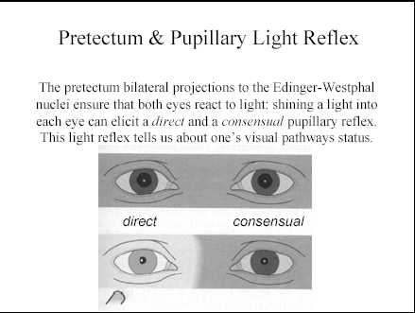

Slide 64
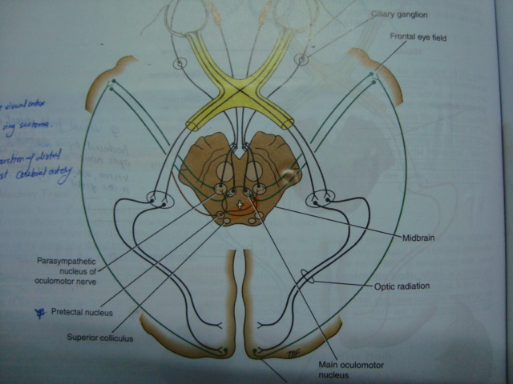
Optic pathway and visual reflexes

Slide 65
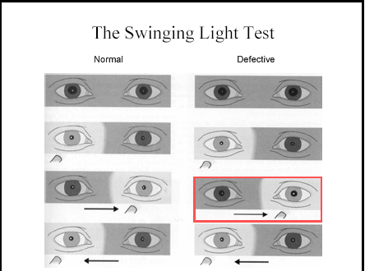

Slide 66
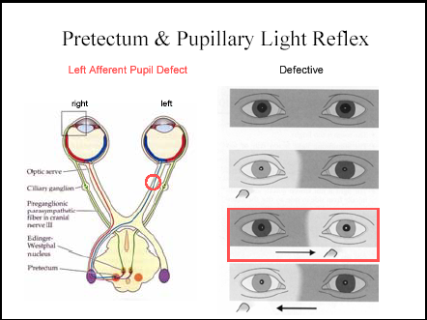

Slide 67
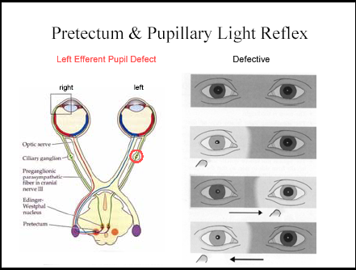

Slide 68
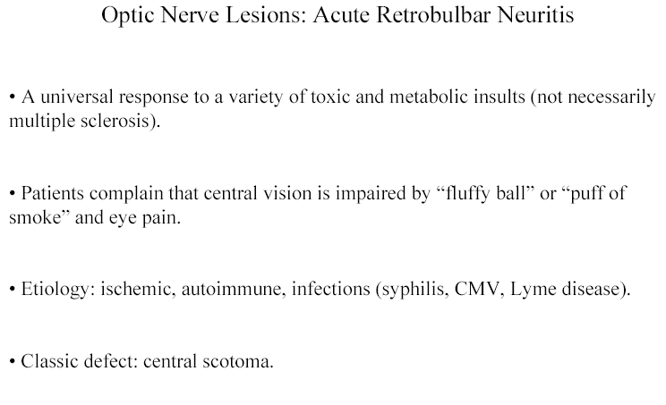

Slide 69
Chiasmatic compression

Slide 70
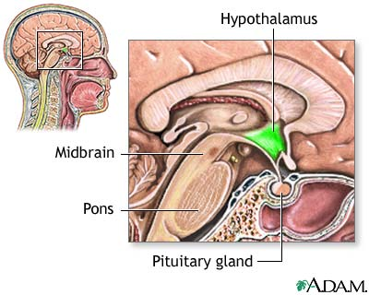

Slide 71
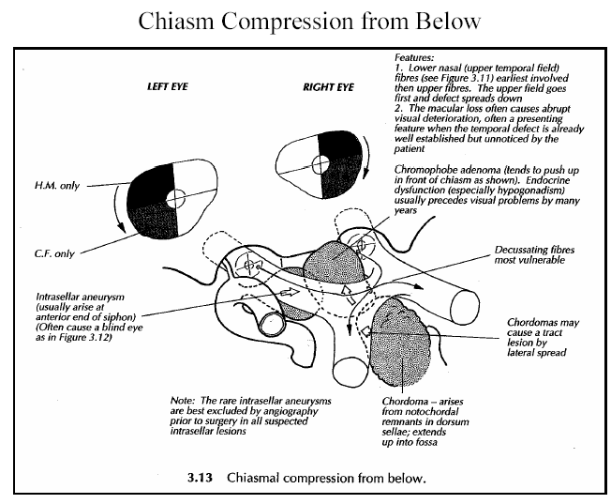

Slide 72
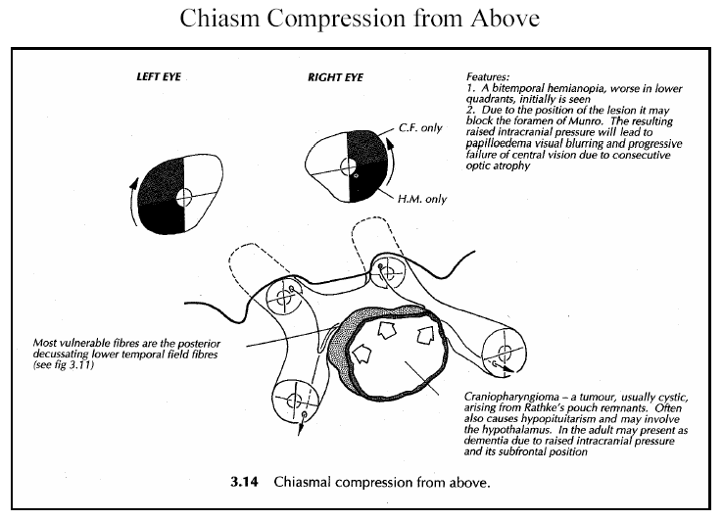

Slide 73
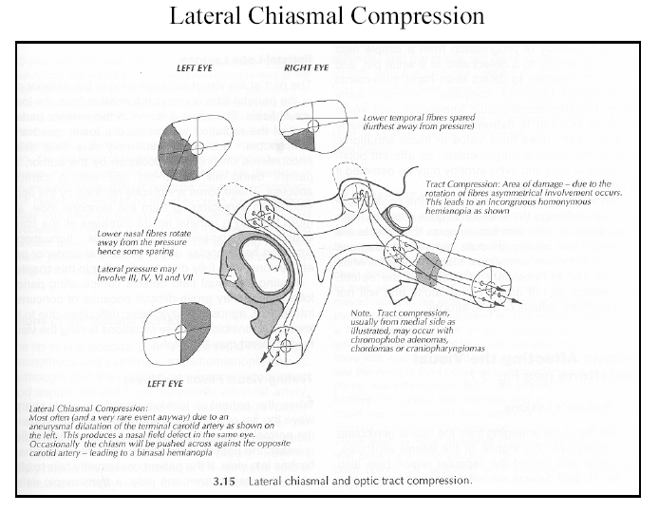

Slide 74

Thank you
Thank you

