Slide 1
PATHOGENESIS Of ATHEROSCLEROTIC PLAQUE FORMATION AND DESTABILISATION
Faculty : Dr. Sanjay Prakash

Slide 2
History
Cellular components of atherosclerosis and plaque formation
Further progression of the atherosclerotic plaque
The vulnerable carotid artery plaque
Imaging markers of plaque vulnerability

Slide 3
Atherosclerosis has been a companion of mankind since antiquity. Mummies from Egypt,North America and China dating from around 3000 B.C. to 400 A.D. showed extensive macroscopic and microscopic evidence of atherosclerosis.

Slide 4
It was probably Leonardo da Vinci (1452–1519) who first recognized the macroscopic changes of atherosclerosis. When he illustrated the arterial lesions in an elderly man at autopsy, he suggested that the thickening of the vessel wall was due to ‘excessive nourishment’ from the blood
(Keele 1952; Quiney andWatts 1989).

Slide 5
Around 1860, Felix J. Marchand (1846–1928) coined the term ‘atherosclerosis’ to emphasize the pathological findings of atheroma (Greek,gruel) and sclerosis (Greek, hard) seen in the intimal layer of the arteries

Slide 6
Fromthe very start, the theories concerning the pathogenesis of atherosclerosis could be divided into two broad schools, the cellular and the humoral.

Slide 7
The cellular school proposes that the atherosclerotic lesion mainly has its origin in changes within the artery itself. This is most commonly expressed as the response-to-injury hypothesis, originally proposed in 1856 by the father of cellular pathology Rudolf Virchow (1821–1902)

Slide 8
The humoral school, by contrast, emphasizes that atherosclerosis is due to changes in the milieu within which the artery finds itself

Slide 9
Today, it is clear that aspects of both the cellular and humoral schools of atherogenesis are correct, in the sense that processes both outside and within the arterial wall have a profound influence on the initiation and progression of the atherosclerotic lesion.

Slide 10
Atherosclerosis mainly affects large and medium-sized arteries, including the aorta, the carotid arteries, the coronary arteries and the arteries of the lower extremities.
The earliest lesion of atherosclerosis is called the fatty streak,which is common even in infants and young children (Napoli et al. 1997).

Slide 11
The fatty streak is a pure inflammatory lesion, consisting only of monocyte derived macrophages and T lymphocytes

Slide 12
CELLULAR COMPONENTS OF A ATHEROSCLEROSIS

Slide 13
Endothelial cells
In lesion-prone areas, atherosclerotic lesions begin to develop under an intact but leaky, activated and dysfunctional endothelium

Slide 14
Depending on size and concentration, plasma molecules and lipoprotein particles extravasate through the leaky and defective endothelium into the subendothelial space

Slide 15
Here potentially atherogenic lipoproteins are retained and modified (e.g., oxidized) and become cytotoxic, proinflammatory, chemotaxic,
and proatherogenic
N Engl J Med 2005;352:1685–95.

Slide 16
Nitric oxide is a potent oxidant produced by both endothelial cells and macrophages that appears to exert both protective and atherogenic effects, depending on its source of production.

Slide 17
Nitric oxide produced by endothelial NOS has vasodilator function and is potentially atheroprotective.
In contrast nitric oxide produced by the macrophages, serving antimicrobial functions based on its potent oxidative properties, is potentially proatherogenic

Slide 18
The endothelium becomes activated by atherogenic and proinflammatory stimuli, and the expression of adhesion molecules, primarily vascular cell adhesion molecule-1
(VCAM-1).

Slide 19
Besides VCAM-1, other adhesion molecules,
such as intercellular adhesion molecule-1, E selectin, and P selectins contribute to the recruitment of bloodborne cells to the atherosclerotic lesion
Nature 2002;420:868 –74.

Slide 20
Macrophages
One of the principal characteristics of the atherosclerotic plaque is the presence of macrophages and macrophage derived foam cells.

Slide 21
Monocyte chemotactic protein-1 is a powerful
chemokine and its receptor on monocyte and
macrophages (CCR2) is up-regulated enormously during plaque development

Slide 22
Monocyte chemotactic protein-1 attracts potently both monocytes and T cells (but not neutrophils and B cells) and most likely plays a fundamental role in the recruitment of these cells

Slide 23
Endothelial cells, smooth muscle cells, and macrophages all contribute to overexpression of MCP-1 in atherosclerosis. Thus, once within the intima, monocyte-derived macrophages may recruit themselves by secreting MCP-1.

Slide 24
Within intima, the monocytes differentiate into macrophages and internalize the atherogenic lipoproteins via so called scavenger receptors, of which SR-A and CD36 have been demonstrated to play quantitatively significant roles in experimental atherosclerosis
Atherosclerosis. Cell 2001;104:503–16.

Slide 25
The development of lipid-loaded macrophages containing massive amounts of cholesteryl esters (foam cells) is a hallmark of both early and late atherosclerotic lesions. With continuing supply of atherogenic lipoproteins, the macrophages eat until they die

Slide 26
The death of macrophages by apoptosis and necrosis contributes to the formation of a soft and destabilizing lipid-rich core within the
plaque.

Slide 27
Aside from their scavenger function, macrophages also possess destabilizing and thrombogenic properties by expressing matrix-degrading proteolytic enzymes (e.g., matrix metalloproteinases) and tissue factor.
Nature 2002;420:868 –74.

Slide 28
SmoothMuscle Cells
Only endothelial cells, macrophages, and a few T cells participate in the development of the early and asymptomatic foam-cell lesion, the fatty streak

Slide 29
In disease progression, the immuno inflammatory response is joined by a Fibro proliferative response mediated by intimal smooth muscle cells.
These cells are responsible for healing and repair after arterial injury.

Slide 30
If the atherogenic stimuli persist over the course of years, as they often do, the reparative response may become so voluminous and dominating that lumen is lost, blood flow is reduced, and ischemia sets in

Slide 31
Nevertheless, smooth muscle cells and the collagen-rich matrix they produce do confer stability to plaques, protecting them against much more ominous consequences; plaque
rupture and thrombosis
Curr Atheroscler Rep 2000;2:422–9..

Slide 32
Leukocytes
One of the earliest cellular responses in atherogenesis is the focal recruitment of circulating monocytes and, to a lesser extent, T lymphocytes.
The persistence of this cellular response underlies disease progression. B lymphocytes and plasma cells are rare in the intimal plaque.
J Pathol 2001;193:263–9.

Slide 33
Neutrophils are rare in uncomplicated atherosclerosis but have been described in thrombosed plaques, probably recruited as a response to plaque rupture
Circulation 2002;106:2894 –900.

Slide 34
Mast cells
Mast cells participate in the pathogenesis of atherosclerosis. Indeed, there is increasing evidence that mast cells play a role in
a recruitment of inflammatory cells
b foam cell formation
c destabilization of atherosclerotic plaques (Kelley et al. 2000).

Slide 35
The Role of the Extracellular Matrix
Large sections of the sub-intima consist of tissue that is rich in collagen but poor in cells. This exaggerated matrix deposition contributes significantly to narrowing of the arterial lumen.

Slide 36
Weakening of extracellular matrix in certain areas of the plaque plays a central role in plaque rupture, the most dangerous complication of atherosclerosis.

Slide 37
The Role of Infection in Atherogenesis
The suggestion that infectious agents might be involved in the causation of atherosclerosis was first proposed by Sir William Osler
Interest has focused on four organisms:
Chlamydia pneumoniae
cytomegalovirus (CMV)
HSV types 1 and 2
Helicobacter pylori

Slide 38
By means of a closed, highly sensitive, and specific real-time PCR, C. pneumoniae was not detected in cerebrovascular atherosclerosis.
(Stroke. 2004;35:2024-2028.)

Slide 39
FURTHER PROGRESSION OF ATHEOSCLEROSIS

Slide 40
The Role of Thrombus Formation
Thrombus formation at the site of atherosclerotic lesion is the commonest cause of myocardial infarction and stroke; the thrombus may occlude the artery at the site of formation or may detach and block the blood vessel downstream.
.

Slide 41
In most cases, the thrombus does not occlude the artery but is organized and incorporated into the vessel wall, thus contributing to the growth of the atherosclerotic plaque

Slide 42
Rupture of the plaque surface is followed by variable amounts of hemorrhage into the plaque and luminal thrombosis, causing sudden and rapid but often clinically silent progression of the lesion.
It is probably the most important mechanism underlying the episodic vascular events

Slide 43
Intraplaque hemorrhage
Haemorrhagic events occur frequently in advanced atherosclerotic lesions either by infiltration of blood from the lumen through fissures or by rupture or by degradation of vasa vasora which frequently grow at the plaque base.

Slide 44
Due to the high thrombogenicity of the plaque base, intra-plaque haemorrhages are usually subject to clotting and undergo essentially the same
fate as luminal thrombi

Slide 45
Inflammation and Atherosclerosis
Inflammation plays an important role in the progression of atherosclerosis and ICA plaque destabilization converting a chronic process into an acute disorder with ensuing thromboembolism

Slide 46
Two major autoantigens, oxidized LDL
(oxLDL) and heat shock proteins (HSP), have
been implicated in the pathogenesis of atherosclerosis.
J Immunol. 2005;174:6509–6517.

Slide 47
Autoreactive T cells recognize oxLDL, HSP as microbial antigens by molecular mimicry and locally release proinflammatory
cytokines.
Arterioscler Thromb Vasc
Biol. 2002;22:1892–1898.

Slide 48
Cytokines released from locally activated T cells
further stimulate macrophages, the main
effector cells in atherosclerosis

Slide 49
Macrophages on stimulation by T-cell– derived
cytokines and transformation into foam cells
after uptake of oxLDL secrete MMP
Predisposing the plaques to subsequent
rupture.

Slide 50
Vaccination against modified LDL and HSP can slow development of atherosclerotic plaques.
Current therapeutics effective in preventing atherosclerosis and stroke such as statins and renin-angiotensin system inhibitors may exert part of their effects by modulating inflammatory responses in the vessel wall.
Atherosclerosis. 2004;176:27–35.

Slide 51
Aggressive lipid-lowering therapy over a 3-month period is associated with significant reduction in USPIO-defined inflammation of the plaque .

Slide 52
Ultrasmall superparamagnetic iron oxide (USPIO)-
A significant reduction from baseline in USPIO defined inflammation was observed in the 80-mg group at both 6 weeks (SI 0.13; p 0.0003) and at 12 weeks (SI 0.20; p 0.0001). No difference was observed with the low-dose regimen.
ATHEROMA (J Am Coll Cardiol 2009;53:2039–50)

Slide 53
The Vulnerable Carotid Artery Plaque

Slide 54
Ischemic strokes and transient ischemic attacks (TIAs) are frequently caused by cerebral embolism from an atherothrombotic plaque or thrombosis at the site of plaque rupture.

Slide 55
Although the degree of lumen obstruction is a relevant marker of the risk of stroke the recognition of the role of the vulnerable plaque has opened new avenues in the field of atherothrombotic stroke.
N Engl J Med. 1998;12;339:1415–1425.

Slide 56
All types of atherosclerotic plaques with a high likelihood of thrombotic complications and rapid progression should be considered as vulnerable plaques which is the underlying
cause of most clinical events.

Slide 57
Several interrelated processes may account for the development of vulnerable atherosclerotic plaques
Circulation. 2003;108:1664 –1672.

Slide 58
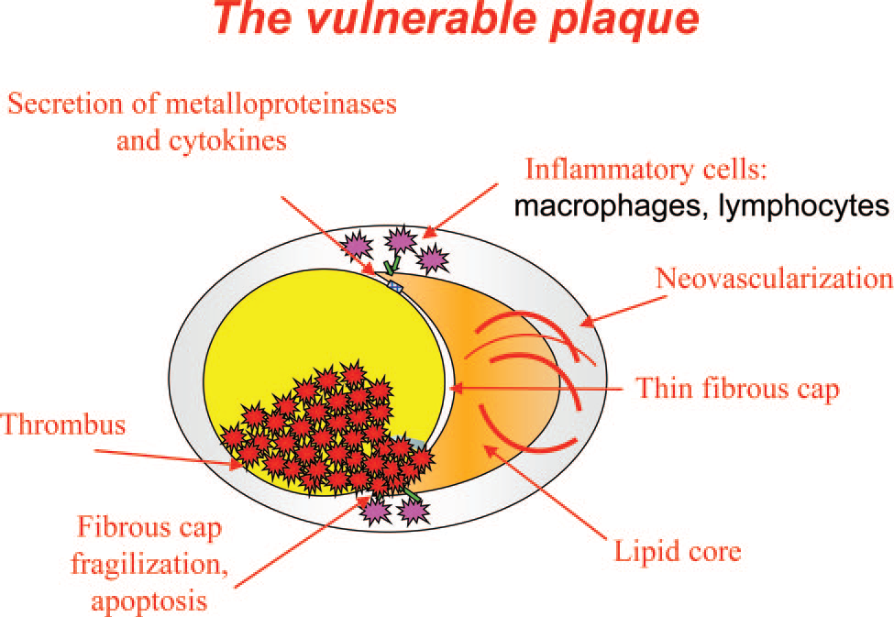

Slide 59
Conventional Pathologic markers of Plaque vulnerability
Carotid artery intima/media thickness (IMT)
Erosion
Ulceration
Thrombus
Intraplaque hemorrhage

Slide 60
Calcification
Status of fibrous cap
Status of lipidic core
Degree of plaque inflammation
Microembolic signals on transcranial Doppler

Slide 61
Carotid Artery Intima/Media Thickness
In the Rotterdam Study, intima/media thickness (IMT) and aortic calcifications were related most strongly to the risk of carotid vascular events
Stroke. 2003;34: 2367–2373.

Slide 62
The odds ratio for stroke per standard deviation increase (0.163 mm) was 1.41.
For myocardial infarction, an odds ratio of 1.43 (95% CI, 1.16 to 1.78) was found.

Slide 63
Plaque Erosion
In some cases, a deep plaque injury cannot be identified despite a careful search. The thrombus appears to be Superimposed on a de-endothelialized but otherwise intact plaque. This type of superficial plaque injury is called erosion.

Slide 64
Such erosions may lead to immediate vessel occlusion and hemodynamic compromise, even without rupture of the fibrous plaque cap
Circulation. 1996;1;93:1354 –1363.

Slide 65
Extracranial carotid artery calcified plaques are significantly less likely to be symptomatic and, thus, may be more stable than noncalcified plaques.

Slide 66
In a study calcified plaque volume was significantly inversely associated with the occurrence of symptoms (P0.012; odds ratio, 0.047).
There was a notable overlap in the calcified plaque volume/total plaque volume ratio between 0% and 45% for symptomatic and asymptomatic plaques. However, calcification > 45% of the total plaque was very specific: 97.1% (34/35) for absence of symptoms
Stroke. 2007;38:935-940.

Slide 67
An inverse relationship between the degree of plaque calcification was found in critical carotid stenoses.
J Vasc Surg. 2004;40:262–269

Slide 68
Fibrous cap and lipid core:The carotid artery plaque considered responsible for acute ischemic events usually had a thin fibrous cap, a large lipid pool, and macrophage-dense inflammation on or beneath its surface.
Circulation 2004 1;109:2617–2625.

Slide 69
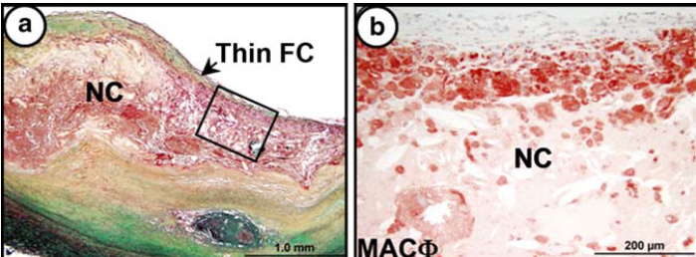

Slide 70
Plaque inflammation
Differences in the inflammatory infiltrate have been explored in patients with ipsilateral major stroke, TIAs, and those who
were asymptomatic.

Slide 71
A thrombotically active carotid plaque
associated with a high-inflammatory infiltrate was observed in 71 of 96 patients (74%) with ipsilateral major stroke compared with 32 of 91 (35.2%) patients with TIA. 12 of 82 patients (14.6%) who were asymptomatic
JAMA. 2004;20:292:1845–1852.

Slide 72
A large, prospective population-based study has analyzed the relationship between monocyte activity and the risk for atherosclerosis in 2610 subjects, 25 to 82 years of age, who had no plaque in their right carotid artery.

Slide 73
After 7 years of follow-up, a new ultrasound screening was performed, and the number of novel plaques was classified as none, 1 plaque, and 2 plaques.

Slide 74
For 1 SD (0.17109) increase in the monocyte activity, the risk of being in a higher plaque category increased by 18% [odds ratio
(OR), 1.18; 95% CI, 1.08 to 1.29].
Stroke. 2005;36:715–719.3

Slide 75
MMPs in Carotid Atheroma
MMP-1 levels were nearly 8 fold higher in thin-cap carotid plaques than in thick-cap plaques, and MMP-12 transcript levels were significantly increased in ruptured plaques compared with plaques without cap disruption.
Atherosclerosis. 2003;169:199.

Slide 76
The relationship between fibrinogen and the risk of ischemic stroke has been studied in patients with recent TIA or minor ischemic stroke.
Fibrinogen predicted subsequent ischemic stroke, with a p value 0f 0.001
Circulation. 2000;22;101:744 –750.

Slide 77
The role of C-reactive protein (CRP) as a risk marker for carotid atherosclerosis is conflicting. A recent study showed that the high sensibility-CRP level is associated with a higher risk score for coronary heart disease but not for carotid atherosclerosis.
Circ J. 2004;68: 297–303.

Slide 78
Proinflammatory genetic profiles are significantly more common in subjects with a history of stroke

Slide 79
The polymorphisms of CRP, interleukin 6, macrophage migration inhibitory factors, monocyte chemoattractant protein 1 and MMP-3 genes were studied.
The odds of stroke increased with the number of high-risk genotypes

Slide 80
Carrying 1 proinflammatory gene variant conferred a risk of 3.3 (1.6 to 6.9), whereas individuals who carried 2 and 3 gene variants had adjusted odds ratios of 21.0(7.6 to 57.5) and 50.3 (10.2 to 248.1), respectively
Jerrard-Dunne P et al, Inflammatory gene load
and early carotid atherosclerosis.
Stroke. 2004;35:2438 –2443.

Slide 81
Imaging Markers of Plaque Vulnerability
High-resolution MRI identification of a ruptured fibrous cap and size of lipidic-necrotic core, calcification, thrombus, intraplaque hemorrhage, and neovascularization
MR molecular imaging of macrophage, myeloperoxydase activity, thrombus
components, angiogenesis, and cytokines

Slide 82
Plaque composition can be determined in vivo using a combination of pulse sequences.
Several plaque components have a characteristic appearance and can be assessed qualitatively
according to established high-resolution MRI
Circulation. 2002;10;106: 1368–1373.

Slide 83
Several pathological reviews suggest that a large, lipid-rich necrotic core and a thin overlying fibrous cap as well as inflammatory activity are features of plaque vulnerability.
Stroke. 2004;35:2300 –2305

Slide 84
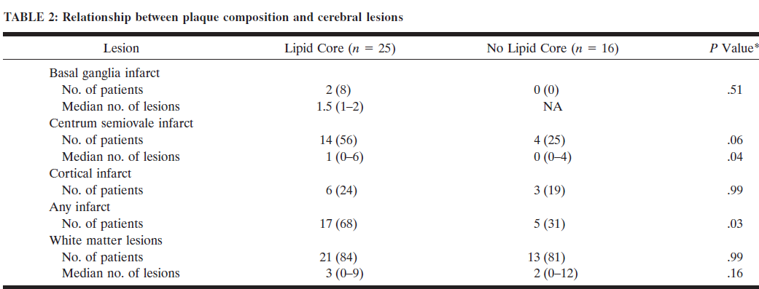

Slide 85
Infarcts were more frequent in patients with a
lipid core in the atherosclerotic plaque than in patients without a lipid core (P .03)
The presence of a lipid core was significantly associated with any cerebral infarction on MR imaging.

Slide 86
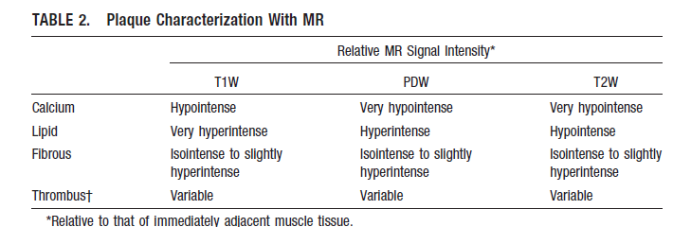

Slide 87
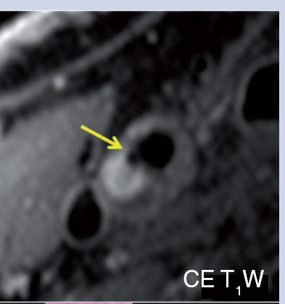
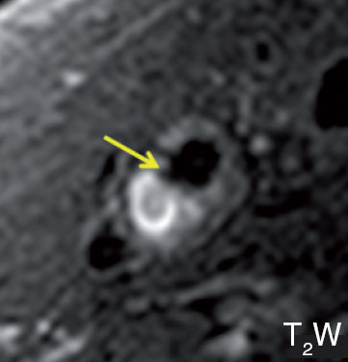

Slide 88
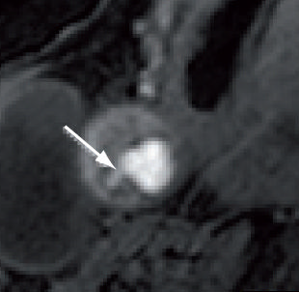

Slide 89
The fibrous tissues were demonstrated to show iso- and slightly high signal intensity on both the proton density and T2-weighted images whereas the lipid cores show low signal intensity on T2-weighted images
STROKE AHA.106.479139

Slide 90
Contrast-enhanced T1-weighted images can differentiate lipid-rich necrotic cores from fibrous tissues, as the former does not show significant enhancement but the latter does
Int Angiol 12:299–311

Slide 91
MRI with a 3D TOF was capable of distinguishing an intact thick fibrous cap from
an intact thin and/or ruptured fibrous cap
Radiology 221(2):285–299.

Slide 92
Inflammation
Inflammatory activity within the plaque, which can be assessed by use of contrast media, is a recognized risk factor for the vulnerable atherosclerotic plaque.
Gadolinium-based contrast agent has been shown to preferentially enhance inflamed fibrous areas
J Neurol Neurosurg Psychiatry 78(12):1337–1343

Slide 93
MR Molecular Imaging

Slide 94
Imaging of Myeloperoxydase (MPO) Activity
Activatable paramagnetic MRI agents can be used to directly image MPO activity in humans.
Weissleder et al have demonstrated the MPO activity in a model tissue-like system.

Slide 95
Winter et al have recently shown that MPO activity may be predictive of myocardial infarction in patients with chest pain.
Circ Res. 2004;94:433– 445

Slide 96
Molecular Imaging of Thrombus
Molecular imaging of microthrombus within the fissures of vulnerable atherosclerotic plaques has been demonstrated with fibrin-targeted nanoparticles.
This molecular imaging approach might assess the responsiveness of individual patients to antithrombotic therapies. Circulation. 2003;4:
108:2270 –2274.

Slide 97
The oxidized low-density lipoprotein receptor (LDLR) LOX-1 plays a crucial role in atherosclerosis
LOX-1 can be used as a target for molecular imaging of atherosclerotic plaque in vivo. Furthermore, the LOX-1 imaging signal is associated with markers of rupture-prone atherosclerotic plaque.
Circ Cardiovasc Imaging. 2010 Jul;3(4):464-72. Epub 2010 May 4.

Slide 98
molecular imaging of fibrin-targeted paramagnetic nanoparticles can provide sensitive detection and localization of fibrin and may allow early, direct identification of vulnerable plaques, leading to early therapeutic decisions.

Slide 99
Which of the following is not seen in fatty streak
A T lymphocytes
B Monocytes
C Macrophages
D Smooth muscle cells

Slide 100
Macrophages are derived from
A B Lymphocytes
B T Lymphocytes
C Monocytes
D Mast cells

Slide 101
Which among the following is likely to be associated with vulnerable carotid plaque
A Thick fibrous cap
B Calcification
C Low activity of MMP
D Large lipid core

Slide 102
Thank you

