Slide 1

PRODUCTION ANALYSIS
Ms. Mital Thakkar
Assistant Professor
Department of Management
SVDU

Slide 2

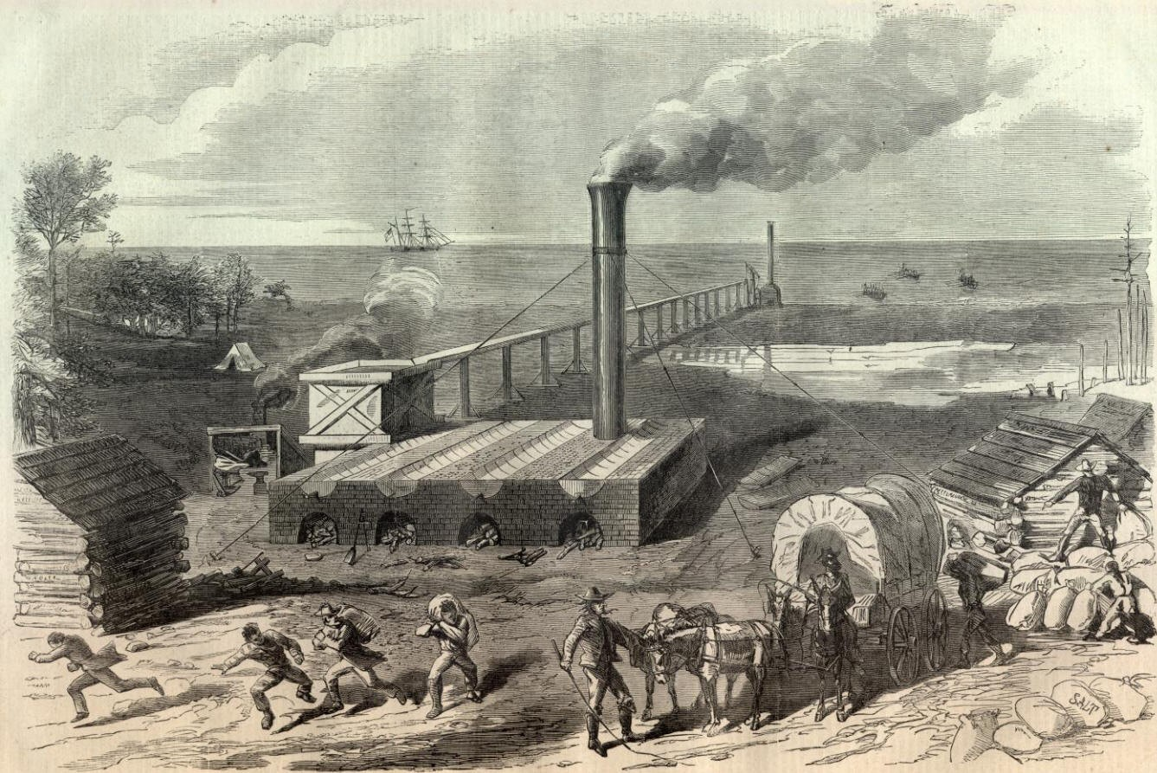
It’s an activity that transforms input into output.

Slide 3



Technology Inputs
•
•
•
•
•
•
Labor Capital Machinery Land
Raw material Power
Time period

Slide 4


Production Function
A production function can be an equation, table or graph presenting the maximum amount of a commodity that a firm can produce from a given set of inputs during a period of time.

Slide 5
Output
Inputs
Process
Land
Product or service generated
Labour
Capital

Slide 6

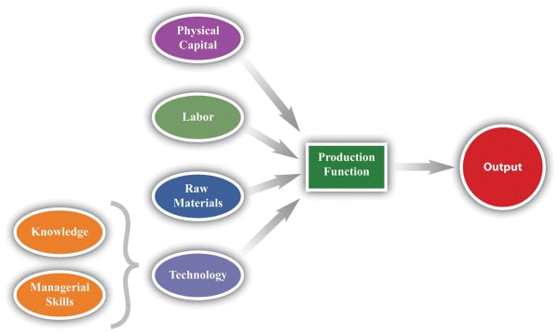

Slide 7

The production function can be mathematically written as
Q = f(X₁, X₂, …, X_{k})
where
Q = output
X₁, …, X_{k} = inputs
For our current analysis, let’s reduce the inputs to two, capital
(K) and labor (L):
Q = f(L, K)

Slide 8

How to obtain Maximum output
Helps the producers to determine whether employing variable inputs /costs are profitable
Highly useful in longrun decisions
Least cost combination of inputs and to produce an output

Slide 9


•
FIXED INPUTS :
Fixed inputs are those factors the quantity of which remains constant irrespective of the level of output produced by a firm. For
example, land, buildings, machines, tools, equipments, superior types of
labour, top management etc.
•
VARIABLE INPUTS :
Variable inputs are those factors the quantity of which varies with variations in the levels of output produced by a firm.For example, raw materials, power fuel, water, transport, labour and communication etc.

Slide 10

Total Product or Output (TP):
It refers to the total volume of goods produced during a specified period of time.
Total product (TP)can be raised only by increasing the quantity of variable factors employed in production.

Slide 11
Average Product (AP):
The AP of an input is the TP divided by the amount of input used to produce this amount of output. Thus AP is the output-input ratio for each level of variable input usage.
AP_{L} = Q/L
Where:
Q = Total Product
L = Number of workers

Slide 12
Marginal Product (MP):
The MP of an input is the addition to TP resulting from the addition of one unit of input, when the
amounts of other inputs are constant.
MP_{L} = W Q/WL
Where:
W means ‘the change in’

Slide 13

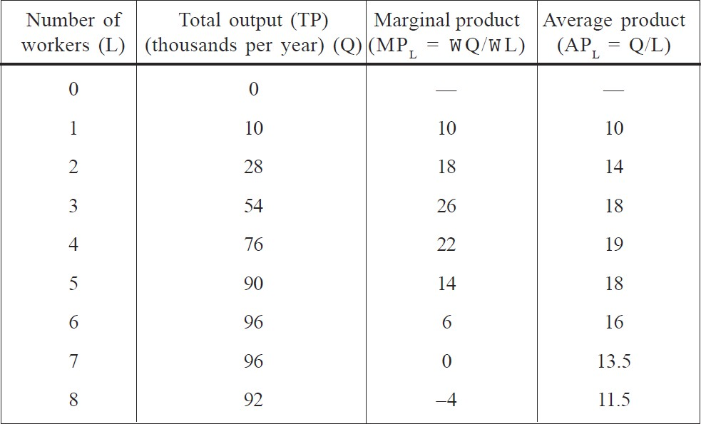

Slide 14

Holding all factors constant except one, the law of diminishing returns says that:
As additional units of a variable input are combined
with a fixed input, at some point, the additional
output (i.e., marginal product) starts to diminish.
e.g. trying to increase labor input without also increasing capital will bring diminishing returns

Slide 15

The fixed proportion production function.
The variable proportion production function.

Slide 16

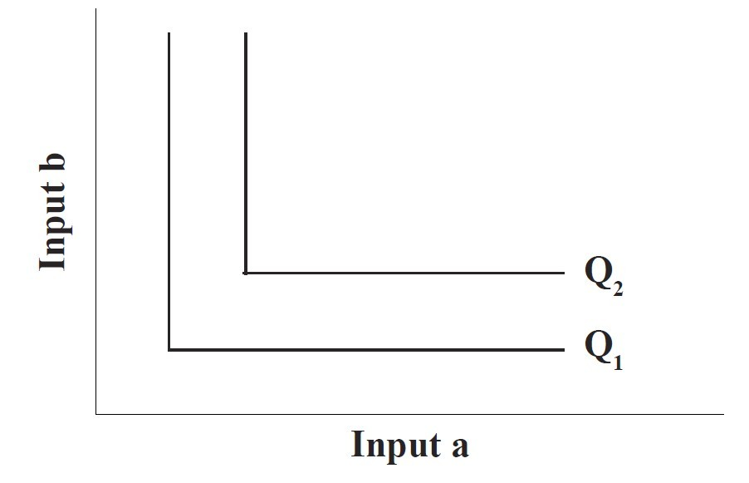
There is only one way in which the factors may be combined to produce a given level of output efficiently.
•
•
It requires a fixed combination of inputs to produce a given level of output.
•
There is no possibility of substitution between the factors of production.

Slide 17

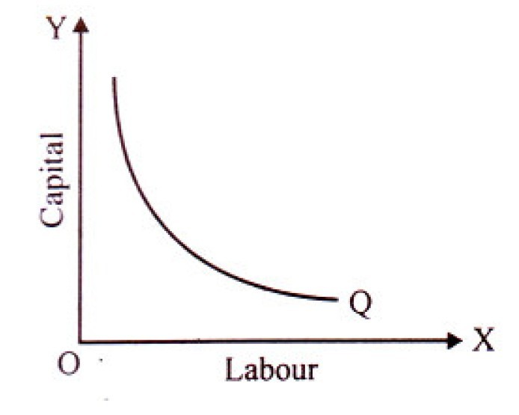
Acc. to it, a given level of output can be produced by several alternative combinations of factors of production, say capital and labour.
•
•
It is assumed that the factors can combined in infinite number of ways.
be
•
The common level of output obtained from alternative combinations of capital and labour is given by an isoquant Q in Fig.

Slide 18

In the short run at least one factor be fixed in supply but all other factors are capable of being changed.
•
Reflects ways in which firms respond to changes in output (demand).
Can increase or decrease output using more or less of some factors.
Increase in total capacity only possible in the long run.
•
•
•

Slide 19
In times of rising sales (demand) firms can increase labour and capital but only up to a certain level – they will be limited by the amount of space. In this example, land is the fixed factor which cannot be altered in the short run.

Slide 20
If demand slows down, the firm can reduce its variable factors – in this example it reduces its labour and capital but again, land is the factor which stays fixed.

Slide 21
If demand slows down, the firm can reduce its variable factors – in this example, it reduces its labour and capital but again, land is the factor which stays fixed.

Slide 22
Units of K Employed
Output Quantity (Q)
8 | 37 | 60 | 83 | 96 107 117 127 | 128
7 | 42 | 64 | 78 | 90 101 110 119 | 120
6
5
4
3
2
1
37 52 64 73 82 90 97 104
31 47 58 67 75 82 89 95
24 39 52 60 67 73 79 85
17 29 41 52 58 64 69 73
8 18 29 39 47 52 56 52
4 8 14 20 27 24 21 17
1 2 3 4 5 6 7 8
Units of L Employed
How much does the quantity of Q change, when the quantity of L is increased?
Tanu Kathuria 22

Slide 23

The long run is defined as the period of time taken to vary all factors of production
•
By doing this, the firm is able to increase its total capacity
– not just short term capacity
Associated with a change in the scale of production
The period of time varies according to the firm and the industry.

Slide 24
In the long run, the firm can change all its factors of production thus increasing its total capacity. In this example it has doubled its capacity.

Slide 25
Units of K Employed
Output Quantity (Q)
8 | 37 | 60 |  | 83 |  | 96 107 117 127 |  |  |  |  |  | 128
7 | 42 | 64 |  | 78 |  | 90 101 110 119 |  |  |  |  |  | 120
6 | 37 |  | 52 |  | 64 |  | 73 |  | 82 | 90 | 97 | 104
5 | 31 |  | 47 |  | 58 |  | 67 |  | 75 | 82 | 89 | 95
4 | 24 |  | 39 |  | 52 |  | 60 |  | 67 | 73 | 79 | 85
3 | 17 |  | 29 |  | 41 |  | 52 |  | 58 | 64 | 69 | 73
2 | 8 |  | 18 |  | 29 |  | 39 |  | 47 | 52 | 56 | 52
1 | 4 |  | 8 |  | 14 |  | 20 |  | 27 | 24 | 21 | 17
 | 1 |  | 2 |  | 3 |  | 4 |  | 5 | 6 | 7 | 8
Units of L Employed
How much does the quantity of Q change, when the quantity of both L and K is increased?

Slide 26
Thank You

