Slide 1
GENETIC CAUSES OF
SPASTIC-ATAXIAS
Faculty : Dr. Sanjay Prakash

Slide 2
Scheme of presentation
Introduction
Common causes of spastic ataxia
Rare spastic ataxias
Practical approach to diagnosis
Summary

Slide 3
Spastic- ataxias
Combined presence of cerebellar ataxia and spasticity as the predominant clinical syndrome
Not any condition where both co-exist
Once identified as the core feature – diagnostic considerations are limited
Additional symptoms and signs point to a specific diagnosis

Slide 4
Etiology
Genetic spastic-ataxias
Acquired spastic-ataxias

Slide 5
GENETIC CAUSES OF SPASTIC -ATAXIAS

Slide 6
Genetic causes
Genetically and clinically heterogeneous conditions
Rare diseases
Is it hereditary ataxia with spasticity or hereditary spastic paraplegia with cerebellar features?

Slide 7
A mixed disorder
Genetic ataxias
(AD and AR)
Hereditary spastic paraplegia
Spastic ataxias

Slide 8
Commoner causes of spastic-ataxia
1. Autosomal recessive ataxia of Charlevoix-Saguenay
2. Late-onset Friedreich ataxia
3. Hereditary spastic paraplegia type 7
4. Adult-onset Alexander disease
5. Spinocerebellar ataxia type 3
6. Cerebrotendinous xanthomatosis
7. Fatty acid hydroxylase-associated neurodegeneration

Slide 9
GENETIC ATAXIAS
Autosomal recessive
Autosomal dominant
Friedreich’s ataxia-like
Friedreich’s ataxia-like with cerebellar atrophy
Early onset ataxia with cerebellar atrophy
Spinocerebellar ataxia 1 – 31
DRPLA
Episodic ataxia 1 – 6

Slide 10
AUTOSOMAL RECESSIVE ATAXIA OF CHARLEVOIX-SAGUENAY (ARSACS)
First described in the Charlevoix-Saguenay region of Northeastern Que´bec in Canada in 1978
Commonest condition to present as spastic ataxia
Once early onset FA is excluded , frequency of SACS mutations has been reported to be as high as 37% in patients with early onset ataxia

Slide 11


Slide 12
Clinical features
Onset in early childhood – 12 – 18 mths (before age 13)
Slowly progressive ataxia
Severe lower limb spasticity
Sensorimotor axonal neuropathy

Slide 13
Additional features
Distal amyotrophy, pes cavus
Dysphagia
Urinary urgency
Subtle dystonic features
Generalized epilepsy in 7%

Slide 14
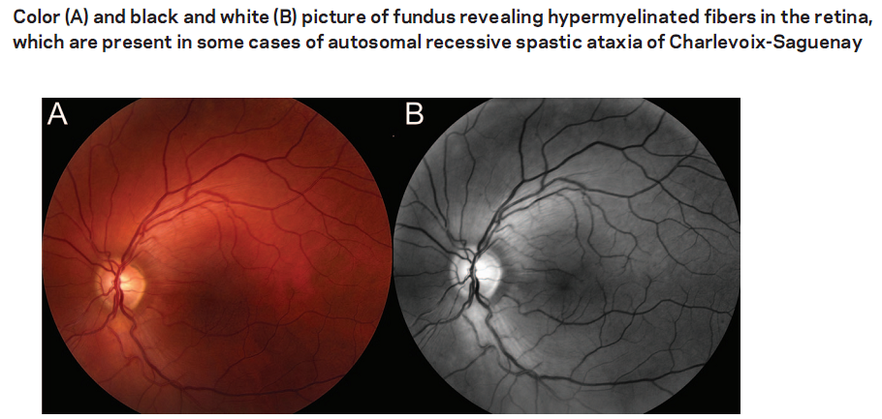
Ocular findings – typical
Saccadic intrusions of ocular pursuit
Myelinated fibers radiating from the optic disc - early abnormal process in myelination

Slide 15
Genetics
SACS gene (encoding the protein sacsin) – identified in 2000 (Engert et al)
Gene localized on chromosome 13q
Gene product involved in protein folding - may integrate the ubiquitin proteasome system (UPS) and Hsp70 function to a speciﬁc chaperon activity
The SACS gene is highly expressed in the brain, with the highest levels in the Purkinje cells

Slide 16
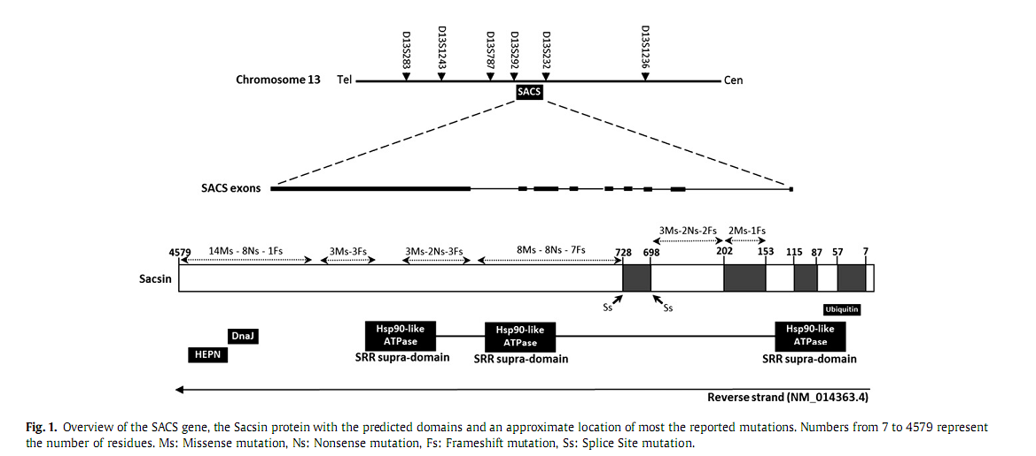

Slide 17
MRI brain
Vermian cerebellar atrophy
Marked cervical spinal cord atrophy
Linear hypointensities in the pons and middle cerebellar peduncles on T2 sequences

Slide 18
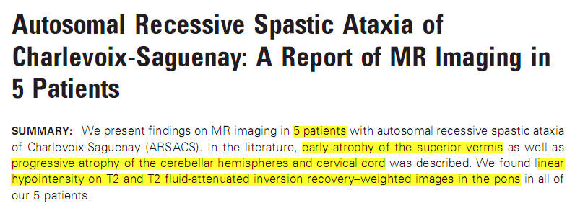
Ellar fi
Correlates with the site of pontocerebellar fibres and may be the pontine nuclei (appear comma shaped rather than rounded)
Martin et al. AJNR Sept 2007

Slide 19
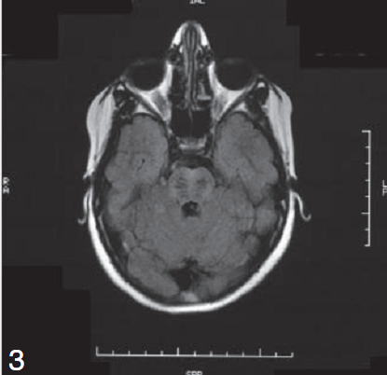
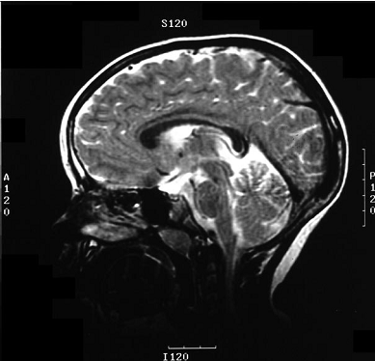
Superior vermis atrophy
Linear hypodensities in pons

Slide 20
Autopsy study
Single case of a young man - reported in 1991
Focal rarefaction of the Purkinje cells
Demyelination along the corticospinal tracts in the medulla and spinal cord
? Storage disease
    Swollen thalamic and cerebellar cortical neurons
    Cells had dense, lipofuscin-like granules within their lysosomes
Bouchard J-P, 1991

Slide 21
FRIEDREICH’S ATAXIA
Commonest form of hereditary ataxia
Age of onset before age 25 years
Estimated prevalence about 1:30,000 to1:50, 000
The incidence of FRDA in Asians low
Sites of pathology – dorsal root ganglia, posterior columns, corticospinal tracts, and dentate nuclei

Slide 22
Diagnostic criteria for FA
Criteria | Geoffroy et al, 1976 | Harding, 1981
Primary | Onset before the end of puberty (never after the age of 20 years) Progressive ataxia of gait, Dysarthria, Loss of JPS or vibration sense, Absent tendon reﬂexes in the legs, Muscle weakness | Age of onset of symptoms before the age of 25 years, Progressive unremitting ataxia of limbs and of gait, Absence of knee and ankle jerks
Secondary | Extensor plantar responses, Pes cavus, Scoliosis, Cardiomyopathy | Dysarthria, Extensor plantar responses
Additional |  | (1) An affected sib fulﬁlling primary and secondary criteria, (2) Median motor nerve conduction velocities of greater than 40 m/s

Slide 23
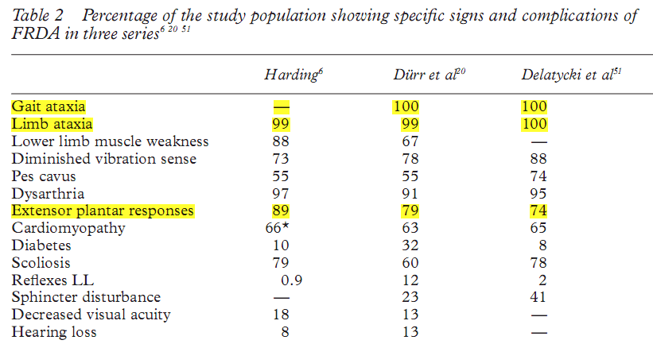

Slide 24
Genetics
Pathogenic mutation is a homozygous GAA trinucleotide repeat expansion on chromosome 9q13
Causes a transcriptional defect of the frataxin gene
Results in deficiency of frataxin, a small mitochondrial protein
Long expansions lead to early onset, severe clinical illness, and death in young adult life

Slide 25
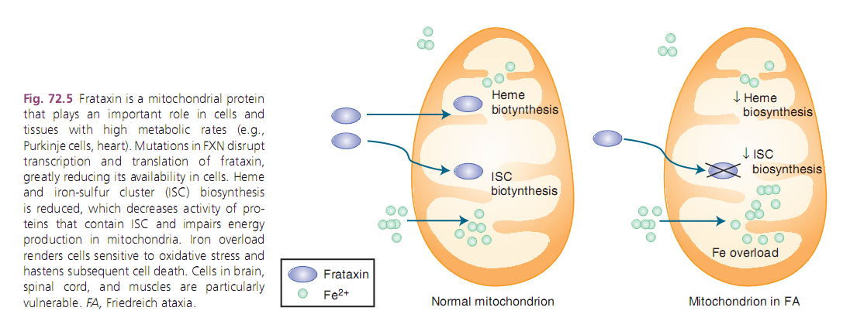

Slide 26
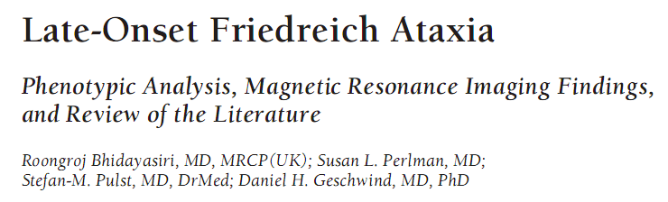
Late onset Friedreich ataxia was defined as onset after 25 years of age
Arch Neurol . 2005;62:1865-1869, UCLA Medical Centre, LA

Slide 27
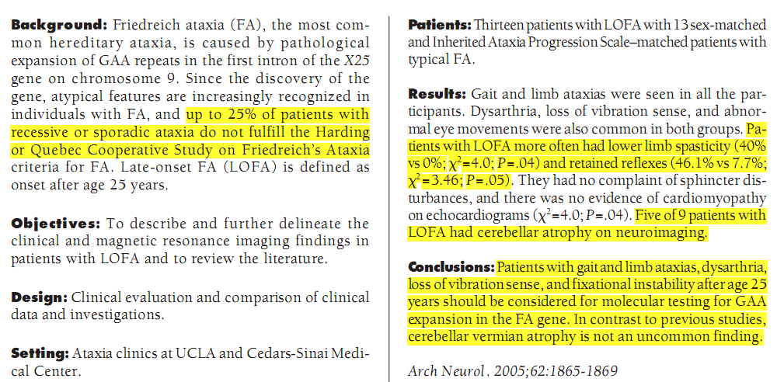

Slide 28
LATE ONSET FRIEDREICH’S ATAXIA
Caused by smaller GAA repeat expansions
Milder and more slowly evolving disease
Patients more often have lower limb spasticity and retained reflexes.
Fewer skeletal abnormalities (scoliosis) and sphincter disturbances
Less frequent cardiomyopathy

Slide 29
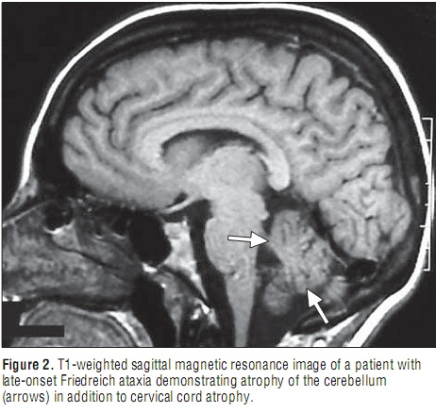
MRI brain
MRI brain in classical – cervical cord atrophy
Cerebellar atrophy found in 5 out of 9 patients with LOFA

Slide 30
SPINOCEREBELLAR ATAXIAS
Autosomal dominant
Pyramidal features seen in
  SCA3
  SCA 1
  SCA 5
  SCA 7
  SCA 8

Slide 31
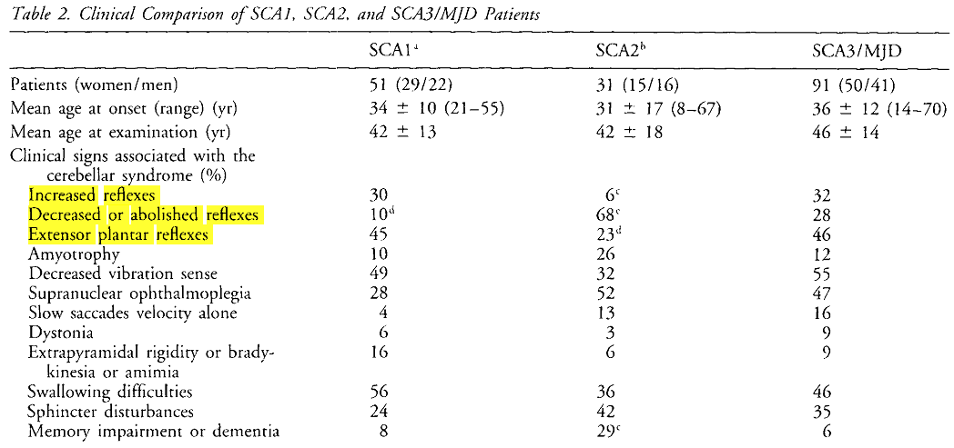
Durr et al, Ann Neurol 1996;39:490-499

Slide 32
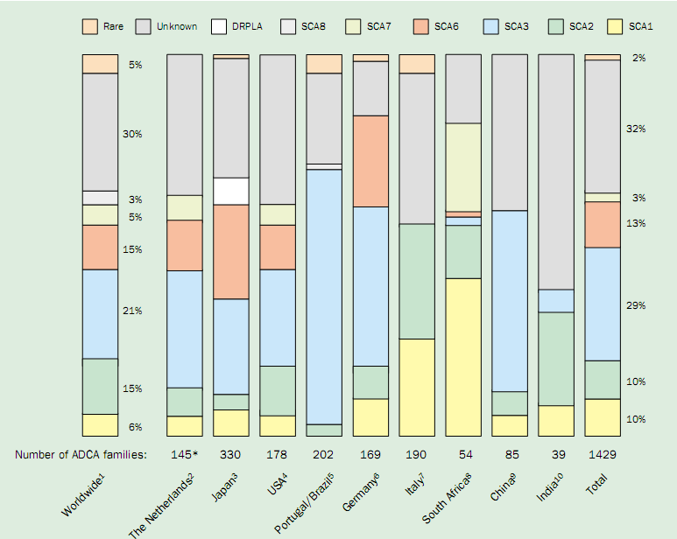
Schols et al, Lancet Neurol 2004; 3: 291–304

Slide 33
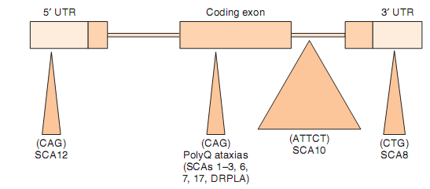
Genetics

Slide 34
Pathology
Purkinje cell layer and dentate nucleus show neuronal loss
Additional structures – basal ganglia, oculomotor nuclei, spinal cord tracts
May show mismatch with the clinical features – morphologically normal pyramidal tracts and prominent spasticity in SCA1, SCA3, and SCA7
Neuroimaging shows pontocerebellar atrophy

Slide 35
SPINOCEREBELLAR ATAXIA TYPE 3 (SCA3)
CAG repeat expansion in the MJD1(ATXN3) gene in chromosome 14
Most frequent SCA subtype in many populations, usually accounting for 20% – 25%
Age of onset is usually in adulthood (second to fifth decade)

Slide 36
Clinical features
Highly variable phenotype
Primary symptoms are cerebellar ataxia and pyramidal signs
Other associations
  Extrapyramidal signs
  Peripheral neuropathy/amyotrophy
  Bulging eyes/ eyelid retraction
  Ophthalmoparesis with upgaze restriction
  Peri-oral fasciculations
As disease progresses - ataxia will dominate

Slide 37
Clinical features of other SCAs
SCA 1
Ataxia, dysarthria, nystagmus, slow saccades, ophthalmoplegia, spasticity, PNP, executive dysfunction
SCA 7
Ataxia, dysarthria, visual loss owing to pigmentary retinopathy, slow saccades, pyramidal signs
SCA 8
Ataxia, dysarthria, nystagmus, tremor, mild spasticity
SCA 5
Ataxia, dysarthria, normal life expectancy; early onset bulbar signs, mild spasticity

Slide 38
HEREDITARY SPASTIC PARAPLEGIA
Characterised by the presence of lower limb spasticity and pyramidal weakness
Retrograde degeneration of the longest nerve fibres in the corticospinal tracts and posterior columns
Heterogenous clinical presentation
  Uncomplicated
  ‘Complicated’

Slide 39
Complex genetics
HSP
AR
X linked
AD

Slide 40
Genetic defects
30 different genetic loci (SPG1–30) and 11 responsible genes have been identified
Proteins lead to defects in
  intracellular signaling pathways
  corticospinal tract myelination by oligodendrocytes
  mitochondrial metabolism
  molecular trafficking and transport

Slide 41
HSPs with cerebellar features
SPG 7
SPG11
SPG15
SPG 20
SPG 21
Adolescent onset, pigmented retinopathy, mental retardation
Variable onset, optic atrophy, neuropathy
Childhood to early adult onset, thin corpus callosum, cognitive impairment, neuropathy
Childhood onset, amyotrophy, developmental delay
Early adult onset, thin corpus callosum, cognitive decline, extrapyramidal features

Slide 42
HEREDITARY SPASTIC PARAPLEGIA TYPE 7
Spastic paraplegia type 7 (SPG7) – first AR identified
Accounts for 5% to 12% of autosomal recessive HSPs
Prevalence is estimated at 2–6/ 100,000
Onset in adulthood (third or fourth decade)

Slide 43
Clinical features
Presents in a spectrum between pure spastic paraplegia and a predominantly spastic-ataxic phenotype
Mild dysarthria, oculomotor signs including nystagmus
Other features
  Dysphagia, subtle cognitive impairment, pale optic discs, ptosis, strabismus, supranuclear oculomotor palsy, decreased hearing, scoliosis, sensorimotor neuropathy, and amyotrophy

Slide 44
Genetics
SPG7 gene – chromosome 16q24.3
Encodes the protein paraplegin, which is a mitochondrial metalloprotease
Forms a complex on the inner mitochondrial membrane that controls protein quality and regulates ribosomal assembly
Deficiency leads to increased susceptibility to oxidative stress

Slide 45
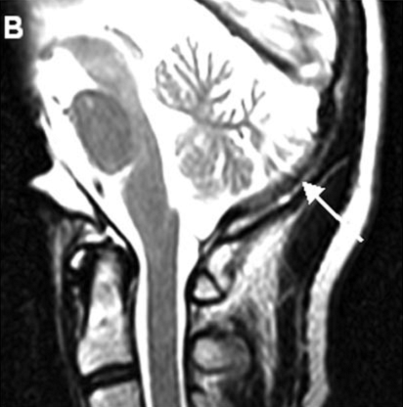
Imaging
Cerebellar atrophy seen in spastic ataxic types

Slide 46
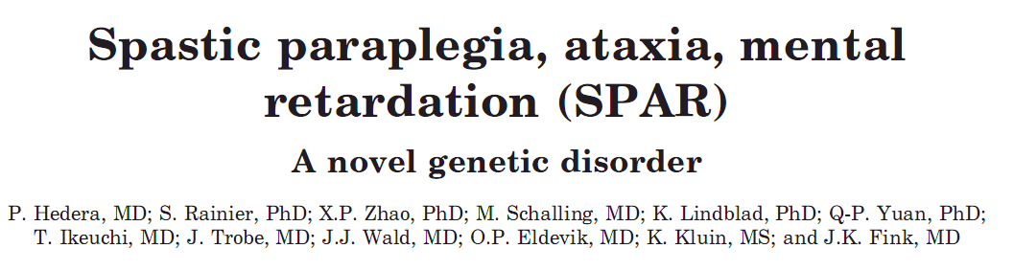
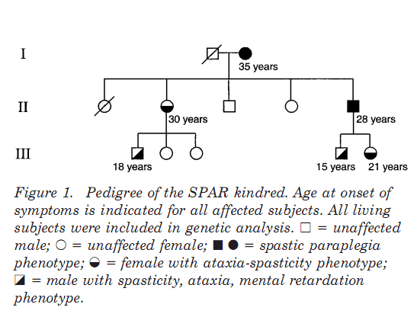

Slide 47
ALEXANDER DISEASE
Typical form – infantile lethal leukodystrophy
Mutations in the GFAP gene
Sporadic or autosomal dominant
Classic form - predominantly affects infants and children
  Progressive psychomotor retardation, megalencephaly, seizures
  Severe white matter abnormalities on brain MRI
  Usually results in death within the first decade

Slide 48
GFAP gene
Mutation in glial fibrillary protein gene responsible
Gain of function mutation
Rosenthal fibres, eosinophilic inclusions localized in astrocyte cytoplasm, are the pathologic hallmark

Slide 49
ADULT-ONSET ALEXANDER DISEASE
Onset in adolescence or adulthood (range 12–71 years)
Responsible for 25% cases
Different clinical and neuroradiological presentation
Abnormalities are mainly concentrated in the brainstem-spinal cord junction

Slide 50
Clinical features
Pyramidal signs with cerebellar ataxia
Bulbar signs - dysarthria, dysphonia, and dysphagia
Additional autonomic dysfunctions like urinary disturbances, ocular abnormalities, and sleep disorders
Palatal tremor – highly suggestive

Slide 51
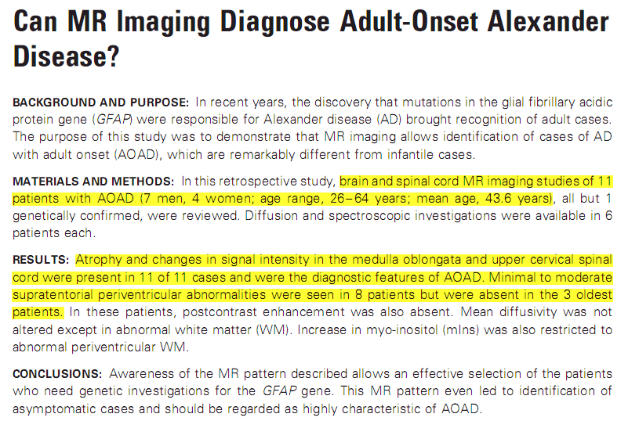
Farina et al, AJNR 2008

Slide 52
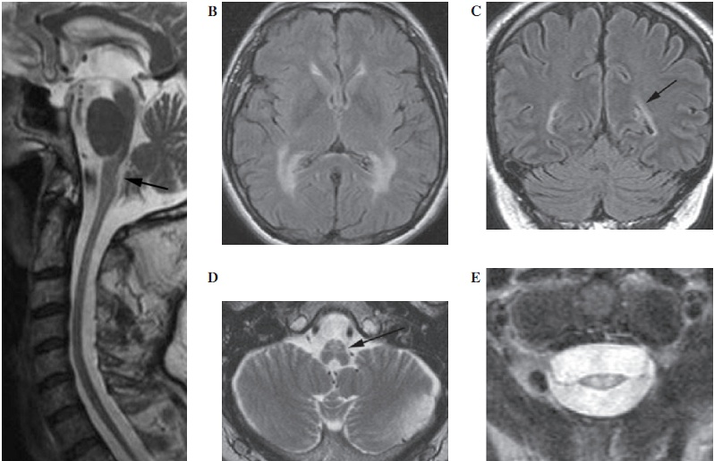

Slide 53
CEREBROTENDINOUS XANTHOMATOSIS
Autosomal recessive inborn error of bile acid metabolism
Accumulation of cholestanol and cholesterol, predominantly in the brain, spinal cord, peripheral nerves, tendons, lungs, liver and kidneys.
About 300 cases described worldwide
Onset in first decade

Slide 54
Clinical presentation
Non-neurological
  Diarrhea in infancy
  Cataract in child hood
  Tendon xanthomas in young adulthood
Neurological
  Progressive neuropsychiatric deterioration – in young adulthood
  Pyramidal or cerebellar signs – always present before age 30
  Dementia in more than 50%
  Seizures

Slide 55
Genetics
Defect of hepatic mitochondrial steroid 26 hydroxylase
Mutations occur in the CYP27A1 gene
Codes for the hepatic oxidation of the side chain of the cholesterol molecule in bile acid biosynthesis.
Deficiency decreases bile acid synthesis → reduces feedback inhibition on cholesterol 7-alpha hydroxylase, resulting in synthesis and accumulation of more cholestanol.

Slide 56
Metabolic abnormality
Increased levels of serum cholestanol and urine bile alcohols
Treatment - chenodeoxycholic acid that may arrest and possibly reverse the progression of CTX when started early.

Slide 57
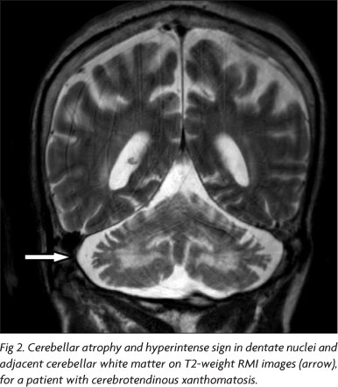
MRI brain

Slide 58
FATTY ACID HYDROXYLASE-ASSOCIATED NEURODEGENERATION
Autosomal recessive neurodegenerative disease with brain iron accumulation
Mutations in the FA2H gene
Metabolic pathway of FA2H involves the lipid and ceramides (Bras et al. 2008) where it is important for myelin metabolism
Described in less than 30 individuals

Slide 59
Clinical features
First- or second-decade onset
Spasticity with ataxia or dystonia
Nystagmus, strabismus, or optic atrophy can occur early
Later, intellectual impairment and seizures develop

Slide 60
MRI brain
Typical iron deposition in the globus pallidus
Periventricular white matter changes
Thinning of the corpus callosum
Profound pontocerebellar atrophy
Mild cerebral atrophy

Slide 61
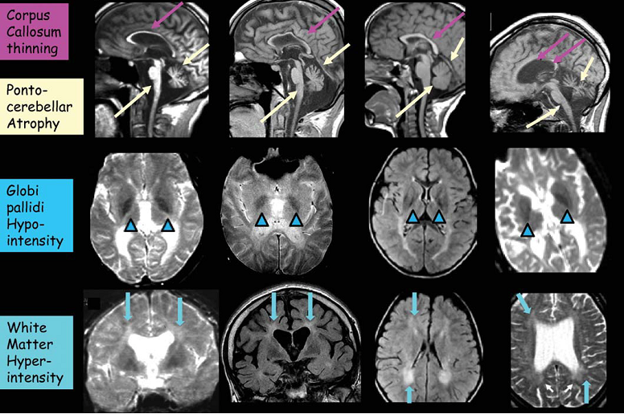

Slide 62
Rare spastic-ataxias
Spastic ataxia 1
Spastic ataxia 2
Spastic ataxia 3
Spastic ataxia 4
Spastic ataxia 5
AD
AR
AR
AR
AR

Slide 63
Spastic-ataxia type | Gene | Features
SPAX 1 | Chr 12p13 | Spastic ataxia before age 20 yrs
SPAX 2 | Chr 17p13 | Ataxia, dysarthria Mild spasticity, amyotrophy and fasciculations
SPAX 3 | MARS2 gene | Spastic ataxia with leukoencephalopathy and cerebellar atrophy
SPAX 4 | MTPAP gene (Chr 10) | Gene for mitochondrial polymerase Childhood- onset spastic paraparesis, cerebellar ataxia, dysarthria, optic atrophy, loss of reflexes
SPAX 5 | AFG3L2 gene | Early-onset (10 years) spastic-ataxia Neuropathy, cerebellar atrophy, oculomotor apraxia, dystonia, and mitochondrial features like ptosis and progressive myoclonic epilepsy

Slide 64
Rare genetic and metabolic causes of spastic-ataxias
Rare genetic and metabolic diseases
To be considered when
  More regular causes have been excluded
  Brain MRI points to a specific diagnosis.

Slide 65
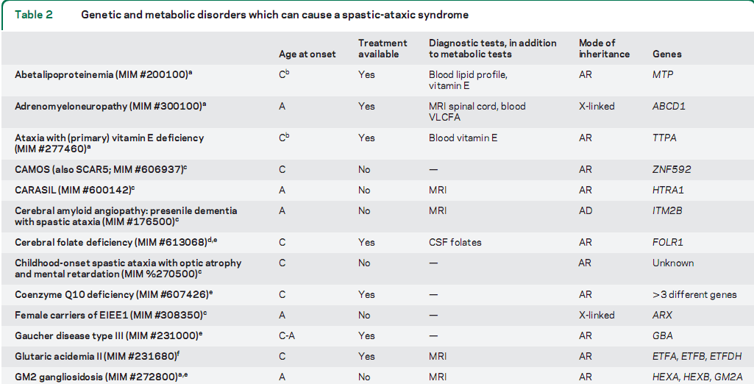

Slide 66
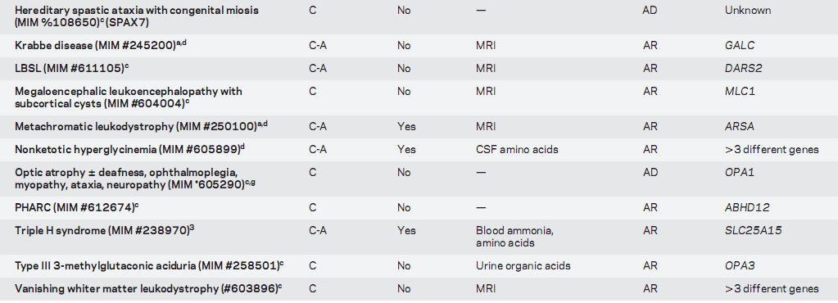

Slide 67
SPASTIC ATAXIAS IN INDIA
No data on the prevalence in India
Studies available for prevalence of SCAs
CTX reported as case reports or series
ARSACS, FA2H not reported

Slide 68
PRACTICAL APPROACH
TO DIAGNOSIS

Slide 69
First step
Rule out acquired and treatable causes

Slide 70
Acquired causes
Sporadic occurrence
Later age of onset
Acute or subacute onset
Rapidly progressive course

Slide 71
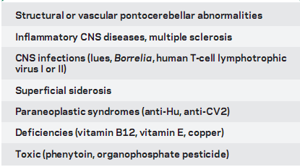
Acquired causes
Lyme’s disease

Slide 72
Suspect genetic cause
Very early age of onset, chronic course
Symmetrical
Selective neuraxis involvement
Family history

Slide 73
Pin-point the diagnosis based on
Age at onset
Suspected mode of inheritance
Additional symptoms and signs
Neuroimaging
Molecular studies

Slide 74
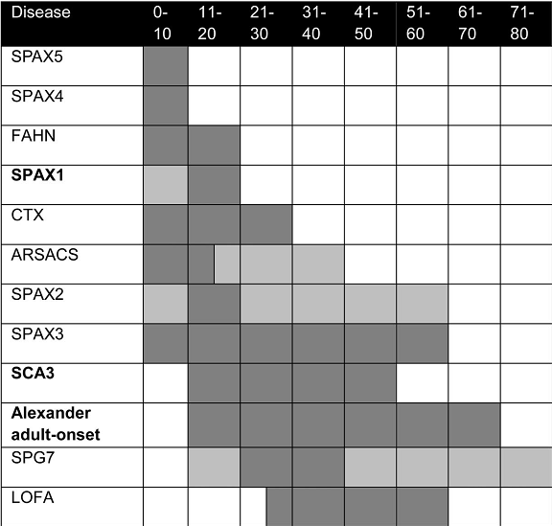

Slide 75
Inheritance pattern
AD
SCA 3
AR
ARSACS
SPAX 1
AOAD
LOFA
SPG 7
SPAX 2,3

Slide 76
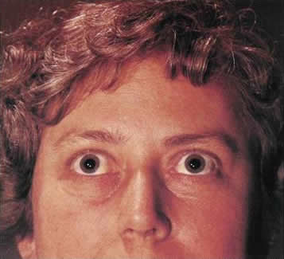
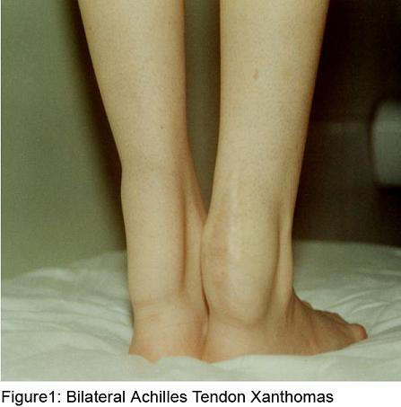
Clinical features

Slide 77
Other signs
Peripheral neuropathy
ARSACS, LOFA, SPG 7
Extrapyramidal signs
SCA 1,3, FAHN
Hearing impairment
Lower brainstem signs
AOAD
LOFA, SPG 7, SPAX 3

Slide 78
Ocular abnormalities
Cataract in cerebrotendinous xanthomatosis
Optic atrophy in SPG7, LOFA, FAHN, SPAX3, or SPAX4
Retinopathy in ARSACS

Slide 79
Neuroimaging
Non diagnostic
Cerebellar atrophy
Periventricular white matter changes
Adult-onset Alexander disease,
Iron deposits in GP
FAHN
Cervical spinal cord atrophy
SPAX3
Rarer metabolic diseases

Slide 80
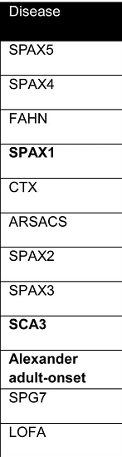
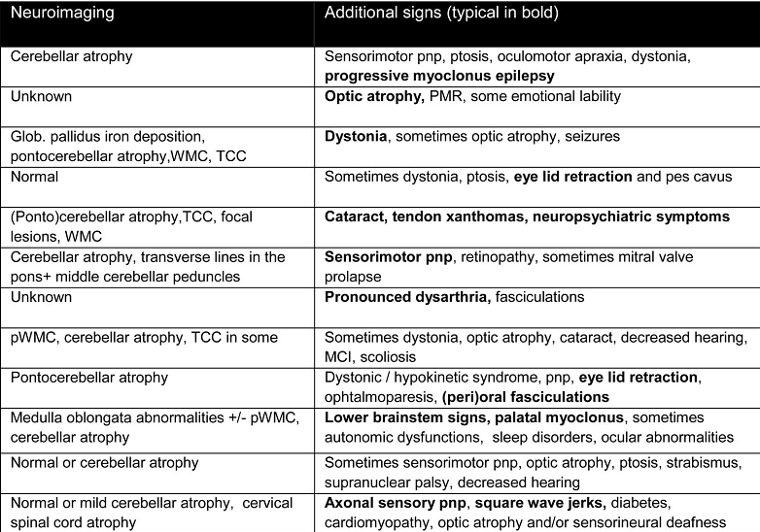

Slide 81
GENETIC TESTING

Slide 82
Testable genes
Disease | Gene
ARSACS | SACS - mutation
LOFA | FXN – GAA repeat expansion
AOAD | GFAP - mutation
SPG 7 | SPG 7 - mutation
SCA 3 | MJD 1 - CAG repeat expansion

Slide 83
Genetic testing
Onset <15 yrs
ARSACS
Onset > 25 yrs
LOFA
SCA 3
AOAD
SPG 7

Slide 84
If a diagnosis cannot be made by means of this more targeted approach, then metabolic screening should be requested.
It is of great importance to prove or rule out treatable disorders
  Cerebrotendinous xanthomatosis
  Ataxia with (primary) vitamin E deficiency
  Coenzyme Q10 deficiency

Slide 85
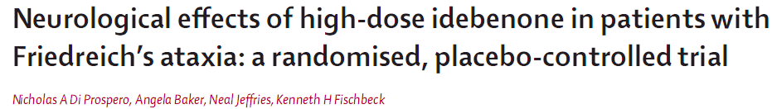
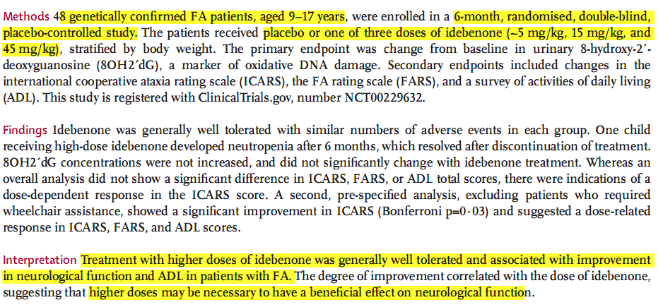

Slide 86
Summary
Spastic-ataxia is a clinical presentation with a limited genetic etiology
Step wise and targeted approach help in pin-pointing the diagnosis
Molecular tests to be used judiciously

Slide 87
THANK YOU

Slide 88
References
Susanne T. de Bot et al. Reviewing the genetic causes of spastic-ataxias. Neurology 2012;79:1507–1514
Yosr Bouhlal et al. Autosomal recessive spastic ataxia of CharlevoixeSaguenay: An overview. Parkinsonism and Related Disorders 17 (2011) 418 – 422
Bhidayasiri et al. Late-Onset Friedreich Ataxia. Arch Neurol . 2005;62:1865-1869
Pareyson et al. Adult-onset Alexander disease: a series of eleven unrelated cases with review of the literature. Brain (2008), 131,2321- 2331

