Slide 1
BRANDING IN HEALTHCARE
Presented by:
Khan Shabana Parveen
Asst. Professor
Subject: Healthcare Communication & Delivery System
Department of Management

Slide 2
What is Branding?
A Brand is a recognizable identity that has a personality, values, and traits.
It is an active business asset that provides differentiation, shareholder value, and longevity.
Branding is not only marketing, advertising or making public relations, but these are also the ways of communicating your healthcare brand.
To communicate your healthcare brand, first, you must build your brand.
Good healthcare brands are relatable, likable, memorable and captivating.
The brand logo and slogan make your brand instantly recognizable. With a strong brand, you can build a future for your healthcare business.

Slide 3
Hospitals, healthcare institutions, doctors and other medical labs want to differentiate themselves from others in the minds of the people.
• Increase brand awareness
• Show your brand’s value
• Build trustable relationships with doctors, patients, providers, and payers
• Render a unique experience to your patients
• Instill trust and assurance
• Drive higher returns and growth

Slide 4
Importance:
The importance of building a brand in the healthcare business is,
  Brand builds trust:-
    Trust the most vital element when it comes to business, especially healthcare. The healthcare brand which builds a strong trust between the people is the one who is less risky and has a better value.
  Brand sharpens your competitive edge:-
    The more powerful your brand is, easier for the customers to pick your healthcare service from all others. You promise your customers, with your brand reputation.
  Brand communicates:-
    The only way to build trust and confidence for your Healthcare service among the people in this content-driven modern world is the way you stand out from others and strong brand’s position.

Slide 5
Brand enhances revenue:-
  The strong brand image and reputation significantly increase your healthcare brand among the people, accelerate the income. This could satisfy your employees, stakeholders, investors, and patients with minimum efforts and maximum ease.
Brand mitigates risk:-
  With a strong brand and its benefits, healthcare institutions are self-protecting, remain independent from all other unwanted takeovers. A strong brand boosts its own power in its own sector.

Slide 6
Vital times: The changing role of brand in healthcare
We believe brands have the power not only to change individual lives, but to change the world. We also believe that brands are the most underleveraged business asset within the health and life sciences industry. This can no longer be the case.
A brand is more than just a symbol, slogan or trade name. It transcends logos and visual identities. Brands are living business assets that come to life across all touch points when created and managed properly. They establish identity, provide differentiation and, most importantly, drive economic value.

Slide 7
Why are brands particularly important to the health & life sciences industry?
First, brands possess the unique ability to transform attitudes. The role that brands play within the health & life sciences industry is not to simply identify a particular product or service, but rather to transform patients’ attitudes towards the treatment or solution being offered. In effect, brands need to create a positive association, and, in some cases, a sense of hope.
Second, brands are capable of engaging consumers and healthcare professionals by providing them with a much-needed sense of clarity – highlighting both rational and irrational points of differentiation among other products and services. By leveraging brands properly, manufacturers will be able to give patients a reason to use products and services that go well beyond “my doctor said so.”

Slide 8
Finally, brands are able to connect emotionally with their respective audiences. A well-managed brand finds the connective tissue between the functional and emotional responses of the patient—linking the head and the heart. Purchasing products and services requires patients to make intimate and, in some cases, life-changing decisions. Brands can play an instrumental role in guiding them through what can sometimes be a difficult and emotional decision-making process.
Conclusion out of all is a brand can no longer be viewed as strictly a promotional/communications tool. It must be recognized as a core business driver – one that directly influences a manufacturer’s business strategy from the very beginning. It must be seen as a way to emotionally connect with customers, drive long-term loyalty and generate revenue.

Slide 9
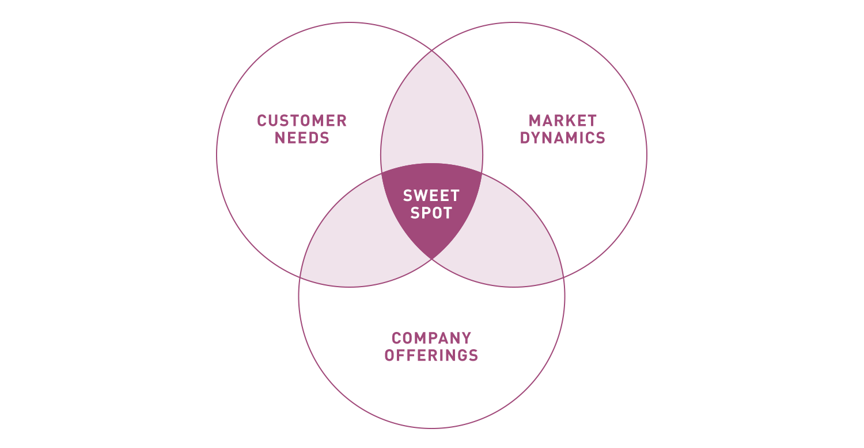
Healthcare Branding: 5 ways to make your company stand out
1. Positioning
  Positioning your healthcare brand is the most fundamental strategic effort you can make in healthcare branding. Strict regulations, mega-mergers, and tightening of budgets mean there’s little leeway for most healthcare companies to rebrand themselves. the goal of positioning is to create a unique impression in your customer’s mind that sets your brand apart. Of course, to accomplish this, first you have to define what makes your brand unique. This requires consensus among key stakeholders on things like your brand category, target customer, competitive advantage, and brand promise. Authentic answers to each of these questions lead to genuine differentiation.

Slide 10

2. Identity
  A visual audit of the healthcare industry reveals that most brands have seriously lackluster identities. Some are holdovers of previous eras; others were designed with little inspiration. Color palettes are very similar and font choices are humdrum at best. Your visual identity tells your customers why you are different from your competition. To ensure this message is compelling and effective, your identity should be built to stand the test of time. An enduring logo represents an enduring brand. Finally, your identity should be deployed with the utmost consistency so as to instill trust in the minds of your customers.

Slide 11
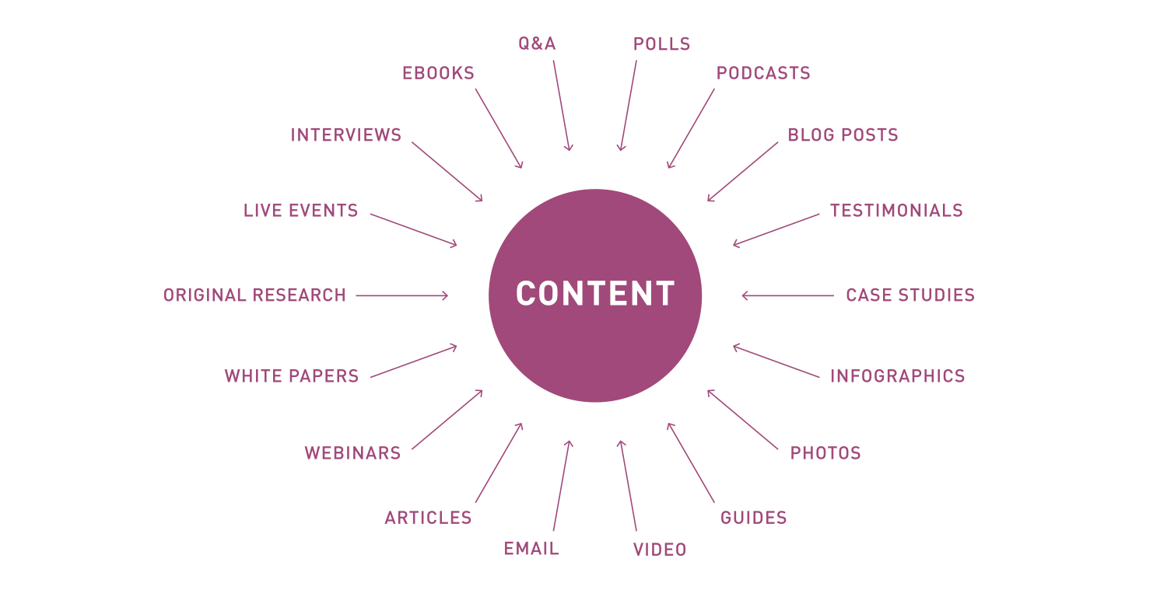
3. Content
  When it comes to healthcare branding, content is king. Not just any content, though. Compelling, engaging, and, most of all, useful content.
  Luckily for healthcare brands, there will never be a dearth of inspiring and educational content. Heartrending stories of patients whose lives have been changed by your brand are a powerful way to connect with customers on a deeply human level. And while it’s wise to be aware of the ever-changing legal and ethical regulations surrounding healthcare branding, there are many acceptable ways to inform consumers on vital health topics.
  This type of educational content is both relevant and useful to a broad spectrum of audiences.

Slide 12
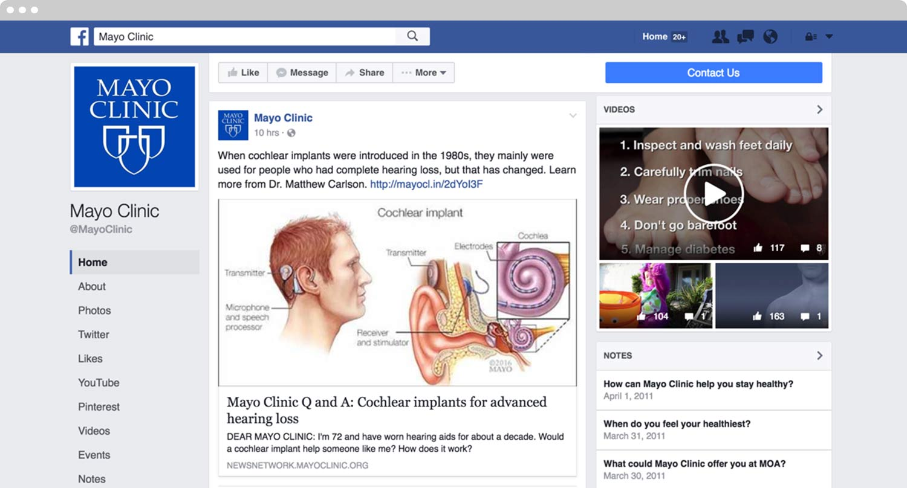
4. Digital Marketing
  Digital marketing, then, is one of the most valuable ways a healthcare brand can engage with its audience and improve patient engagement. It starts with a clean, modern website that’s a dynamic embodiment of your brand. Not only should your website be user-friendly, it should offer an engaging experience regardless of which type of device your customers are using. Mobile traffic has surpassed desktop traffic, so it’s safe to assume that the majority of your customers are accessing your site on the go. Mobile-first design is the mark of a competent brand that has its customer’s front of mind.
  Advertising platforms such as Facebook and LinkedIn allow you to reach highly targeted audiences with relevant information.

Slide 13
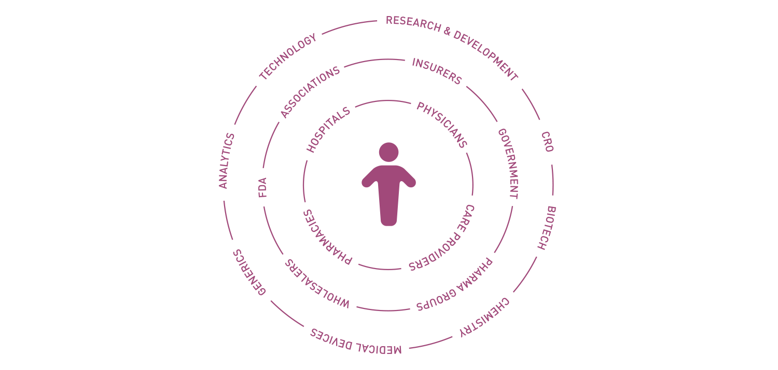
5. Customer Experience
  The emerging healthcare industry centers on customer experience. Patient satisfaction and value-based metrics mean that the ultimate judges of your brand’s success will be those you serve. With this in mind, it’s important to ensure your brand is aligned with your customers’ needs and expectations. Consistency translates into reliability in the mind of your customer. Your brand personality should extend from the smiles on your employees’ faces to the user-friendliness of your website’s interface. Your brand’s positioning should be intimately familiar to every stakeholder within your organization. An authentic and inspiring culture drives employees to serve as brand ambassadors, and better equips them to handle customer concerns and complaints.

Slide 14
The Conclusion-
Healthcare brands are faced with a unique opportunity to redefine themselves in order to address fundamental industry changes brought about by legislation, technology, and consumer demand. Fortunately, there is no shortage of ways to meaningfully differentiate your brand.
Positioning, identity, content, digital marketing, and customer experience each represent a powerful area where healthcare brands can better align themselves with the needs of their customers and stand out from the competition.

Slide 15
Thank You !

