Slide 1
HISTORY OF COMPUTERS
Presented by:
Khan Shabana Parveen
Asst. Professor
Subject: Healthcare & Hospital Information System
Dept. Of Management

Slide 2
STEP TOWARDS MODERN COMPUTING
The most basic idea of computing: the notion of representing data in a physical object of some kind, and getting a result by manipulating the object in some way—is very old.

Slide 3
First Step: Calculators
During the sixteenth and seventeenth centuries, European mathematicians developed a series of calculators that used clockwork mechanisms and cranks
A calculator is a machine that can perform arithmetic functions with numbers, including addition, subtraction, multiplication, and division.

Slide 4
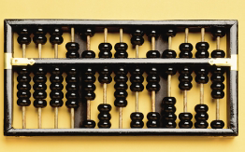
Abacus (4000 years ago to 1975)
Used by merchants throughout the ancient world. Beads represent figures (data); by moving the beads according to rules, the user can add, subtract, multiply, or divide. The abacus remained in use until a worldwide deluge of cheap pocket calculators put the abacus out of work, after being used for thousands of years.

Slide 5
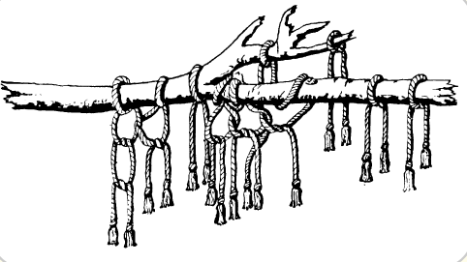
Quipa (15th and 16th centuries) At the height of their empire, the Incas used complex chains of knotted twine to represent a variety of data, including tribute payments, lists of arms and troops, and notable dates in the kingdom’s chronicles.

Slide 6
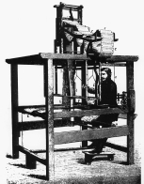
Jacquard's loom (1804) French weaver Joseph-Marie Jacquard creates an automatic, programmable weaving machine that creates fabrics with richly detailed patterns. It is
controlled by means of punched cards.

Slide 7
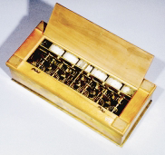
Pascal’s calculator (1642) French mathematician and philosopher Blaise Pascal, the son of an accountant, invents an adding machine to relieve the tedium of adding up long columns of tax figures.

Slide 8
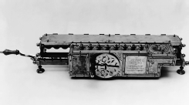
Leibniz’s calculator (1674) German philosopher Gottfried Leibniz invents the first mechanical calculator capable of multiplication.

Slide 9
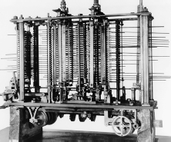
Babbage’s difference engine (1822) English mathematician and scientist Charles Babbage designs a complex, clockwork calculator capable of solving equations and printing the results. Despite repeated attempts, Babbage was never able to get the device to work.

Slide 10
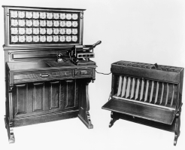
Hollerith’s tabulating machine (1890) Created to tally the results of the U.S. Census, this machine uses punched cards as a data input mechanism. The successor to Hollerith’s company is International Business Machines (IBM).

Slide 11
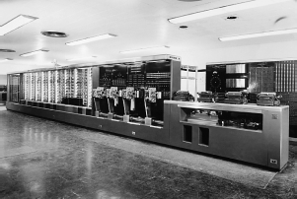
Mark I (1943) In a partnership with Harvard University, IBM creates a huge, programmable electronic calculator that used electromechanical relays as switching devices.

Slide 12
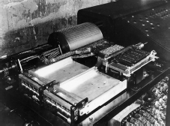
Zuse’s Z1 (1938) German inventor Konrad Zuse creates a programmable electronic calculator. An improved version, the Z3 of 1941, was the world’s first calculator capable of automatic operation.

Slide 13
Putting It All Together: The ENIAC
In World War II, the American military needed a faster method to calculate shell missile trajectories.
The military asked Dr. John Mauchly…worked with a graduate student, J. Presper Eckert : to build the device.
Although it was used mainly to solve challenging math problems, ENIAC was a true programmable digital computer rather than an electronic calculator.
1000times faster than any existing calculator, the ENIAC
newspaper reports described it as an “Electronic Brain.”
The ENIAC took only 30 seconds to compute trajectories that would have required 40 hours of hand calculations.

Slide 14
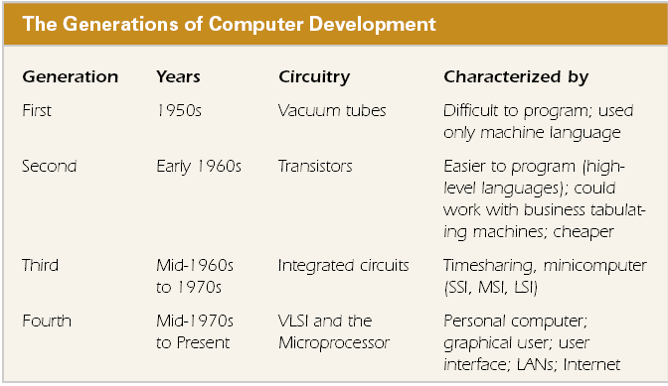
THE COMPUTER’S FAMILY TREE

Slide 15
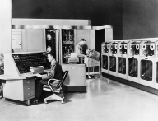
The First Generation (1950s)
Eckert and Mauchly resigned to form their own company, the Eckert-Mauchly Computer Company, and landed a government grant to develop their machine.
With Rand’s financial assistance, Eckert and Mauchly delivered the first UNIVAC to the U.S. Census Bureau in 1951

Slide 16
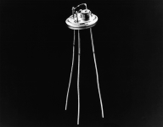
THE SECOND GENERATION (EARLY 1960S)
First-generation computers were notoriously unreliable, largely because the vacuum tubes kept burning out.
1947 Bell Laboratories invention, the transistor…small electronic device that, like vacuum tubes, can be used to control the flow of electricity in an electronic circuit, but at a tiny fraction of the weight, power consumption, and heat output of vacuum tubes.
Because second-generation computers were created with transistors instead of vacuum tubes, these computers were faster, smaller, and more reliable
than first-generation computers

Slide 17
The two programming languages introduced during the second generation, Common Business-Oriented Language (COBOL) and Formula Translator (FORTRAN), COBOL is preferred by businesses, and FORTRAN is used by scientists and engineers.
A leading second-generation computer was IBM’s fully transistorized 1401,

Slide 18
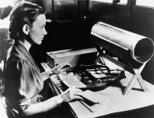
In business computing, an important 1959 development was General Electric Corporation’s Electronic Recording Machine Accounting (ERMA), the first technology that could read special characters. Banks needed this system to handle the growing deluge of checks….it has helped to lay the foundation for electronic commerce (e-commerce).
In 1963: American Standard Code for Information Interchange (ASCII), a character set enables computers to exchange information
In 1964, IBM announced a new line of computers called System/360 that changed the way people thought about computers.
An entire line of compatible computers (computers that could use the same programs and peripherals),
System/360 eliminated the distinction between computers designed primarily for business and those designed primarily for science.

Slide 19
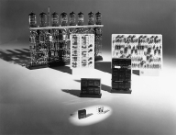
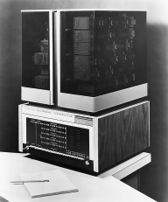
The Third Generation
(Mid-1960s to Mid-1970s)
the key technological event was the development of computers based on the integrated circuit (IC), which incorporated many transistors and electronic circuits on a single wafer or chip of silicon
Digital Electronic Corporation (DEC), which launched the minicomputer industry. (smaller than a mainframe and is designed to meet the computing needs of a small- to mid-sized organization or a department within a larger organization.)

Slide 20
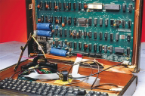
The Fourth Generation (1975 to the Present)
very-large-scale integration (VLSI) technology, they could place the equivalent of more than 5,000 transistors on a single chip—enough for a processing unit.
Intel 4004, the world’s first microprocessor (A microprocessor chip holds the entire control unit and arithmetic-logic unit of a computer.
The 4004 followed by the 8080, and the first microcomputers:microcomputer, called the Altair, used Intel’s 8080 chip.

Slide 21
A FIFTH GENERATION?
artificial intelligence (AI),
LAN and WAN levels.
U.S. Advanced Research Projects Agency (ARPA) had supported a project to develop a wide area network (WAN), a computer network capable of spanning continents.
Headed by Vincent Cerf, this project created a test network, called the ARPANET, that connected several universities that had Defense Department research contracts.
In 1973, ARPANET fully implemented the Internet protocols (also called TCP/IP), the standards that enable the Internet to work.

Slide 22
THE INTERNET REVOLUTION
a packet-switching network works by dividing messages up into small-sized units called packets. Each packet contains a unit of data as well as information about its origin, its destination, and the procedure to be followed to reassemble the message.
The first e-mail program was created in 1972, and was quickly followed by a set of topically-focused mailing lists.
Because the ARPANET was fast becoming indispensable for university researchers, the U.S. National Science Foundation (NSF) created a civilian version of ARPANET, called CSNET, in 1981. In 1984, this network was renamed NSFNET.

Slide 23
In the early 1990s, the term Internet was increasingly used to describe the growing network that relied on the NSFNET backbone—and increasingly, regional extensions of the network were being constructed by for-profit firms.
In 1995, NSF announced that it would withdraw support for the Internet’s backbone network.
Commercial providers stepped in to take up the slack, and the restrictions on the Internet’s commercial use were finally withdrawn completely.

Slide 24
Growing numbers of people use the Internet to telecommute to work. In telecommuting, employees work at home, and stay in touch by means of computer-based communications.
The Internet is proving indispensable in every conceivable professional field.
The growing role of electronic commerce, or e-commerce, is even changing the way we shop.

Slide 25
Moore’s Law: Computers double in power roughly every two years, but cost only half as much.
Metcalfe’s Law: A network’s social and economic value increases steeply as more people connect to it.
These two laws explain why we’re witnessing the distribution throughout society of incredibly inexpensive but powerful computing devices, and why the Internet is growing at such an impressive rate. At the same time that computers are rapidly becoming more powerful and less expensive, the rise of global networking is making them more valuable. The combination of these two forces is driving major changes in every facet of our lives

Slide 26


