Slide 1
Need Assessment
Presented By:
Khan Shabana Parveen,
Asst. Professor
Dept. Of Management

Slide 2
Need Assessment
Definition & Purpose of Needs
  Levels of Need Analysis
    Strategic/Organizational
      Analysis
      Task Analysis
      Person Analysis
      Prioritizing HRD Needs

Slide 3
Definition & Purpose of Needs
“Need” refers to the gap or discrepancy between a present state (what is) and a desired state (what should be). The need is neither the present nor the future state; it is the gap between them.
A “needs assessment/analysis” is a systematic set of procedures that are used to determine needs, examine their nature and causes, and set priorities for future action.
Desired Results (What should be) - Current results (What is) = Need.
Needs assessments are initially conducted to determine the needs of the people (i.e., service receivers) for whom the organization or system exists.
However, a “comprehensive” needs assessment often takes into account needs identified in other parts of a system.

Slide 4
What is Need Analysis?
A “Needs Analysis/Assessment” is a systematic approach that progresses through a defined series of phases.
Needs Assessment focuses on the ends (i.e., outcomes) to be attained, rather than the means (i.e., process). For example, reading achievement is an outcome whereas reading instruction is a means toward that end.
It gathers data by means of established procedures and methods designed for specific purposes. The kinds and scope of methods are selected to fit the purposes and context of the needs assessment.

Slide 5
What is Need Assessment?
It is a process by which an organization’s HRD needs are identified and articulated.
Needs assessment sets priorities and determines criteria for solutions so that planners and managers can make sound decisions.
It also sets criteria for determining how best to allocate available money, people, facilities, and other resources.
Needs assessment leads to action that will improve programs, services, organizational structure and operations, or a combination of these elements.

Slide 6
Needs Analysis can identify:
Organization’s goals and its effectiveness in reaching these goals
Gaps between employees’ skills and the skills required for effective current job performance
Gaps between current skills and skills needed to perform the job successfully in the future
The conditions under which the HRD activity will occur

Slide 7
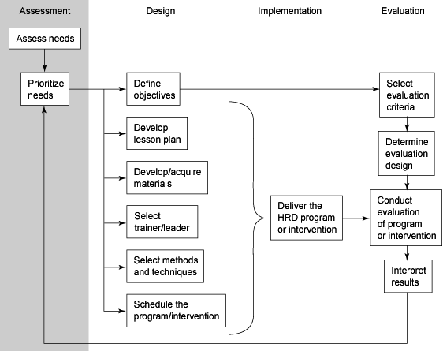
The HRD Process: A DIME

Slide 8
Different types of Assessment
Organization
  Where is training needed and under what conditions?
Task
  What must be done to perform the job effectively?
Person
  Who should be trained and how?

Slide 9
Levels of Need Analysis
A Three-Phase Model of Needs Analysis:
…a systematic approach that progresses through a defined series of phases.
Phase 1: Gather information: Any analysis involves gathering information to help make appropriate decisions. Gathering information can be the process of collecting existing information or developing new information. The process can be formal or informal and involves one or more of the six types of needs analysis.
Phase 2: Analyze information: After gathering information, analyze it, interpret it, and draw conclusions from the information. It is rarely appropriate or helpful if the trainer who gathers needs analysis information independently analyzes and interprets information and suggests conclusions.
Phase 3: Create a training plan: After analyzing and interpreting information and offering conclusions, the information becomes the basis for a training plan which proposes how to resolve the performance deficiency.

Slide 10
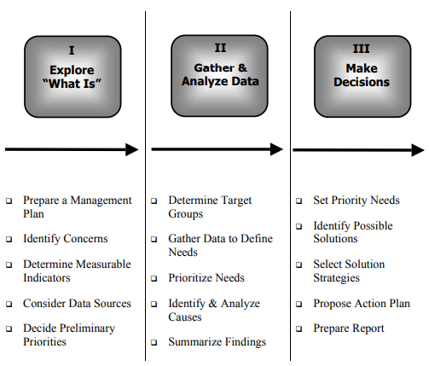
3 Levels of Need Analysis

Slide 11
I
Explore
“What Is”
II
Gather &
Analyse Data
III
Make Decision
Prepare Management Plan
Identify Major Concerns
The purpose of Phase 1 is to investigate what is already known about the needs of the target group; to determine the focus & scope of the need analysis; & to gain commitment for all stages of the assessment; including the use of the findings for program planning & implementation.
Determine Need Indicators
Consider Data Sources
Decide Preliminary Priorities

Slide 12
Phase 1: Explore “What Is”
Phase I: Explore “What Is”  Two major objectives of the exploration phase are gaining: 1) a sense of commitment to the needs assessment at all levels in the organization; and 2) an assurance that decision makers will follow-up (i.e., use) the findings with appropriate and timely action.
STEP 1: Prepare Management Plan.
Successful projects have leadership. A key person in planning and managing a needs assessment is the project manager.
Form a Needs Assessment Committee. The members of a Needs Assessment Committee should represent those organizations and individuals that are critical to ensuring commitment and follow-up.
Determine a reporting schedule. Timely reports to top management and other important stakeholders, with opportunities for interaction on major issues, also are critical.

Slide 13
Phase 1: Explore “What Is”
STEP 2: Identify Major Concerns.
Reach consensus on the goals (desired outcomes) of greatest importance to the target group.
Refine the list of goals to the top 3 – 5 goals.
Brainstorm a list of concerns/factors for each of the goals.
Decide on the major concerns for each goal.
STEP 3: Determine Need Indicators.
Identify indicators that could verify that the concern/issue exist. [An indicator is data that can verify that a concern exists.]
STEP 4: Consider Data Sources
Determine what kinds of information would be helpful to more clearly define the need and where to get the data.
STEP 5: Decide on Preliminary Priorities. Set the priorities of each concern as a focus in the gathering of data.

Slide 14
I
Explore
“What Is”
II
Analyze Data
III
Make Decision
Determine Target Groups
Gather Data to Define Needs
The task of the Phase 11 is to document the status, the “what is” of the concerns/issues, to compare the status with the vision of “what should be”, & to determine the magnitude of the needs & their causes. The major output from this phase is a set of needs statements in tentative order of priority, based on the criticality of the need, and its causes.
Prioritize Needs
Identify & Analyse Causes
Summarize Findings

Slide 15
Phase 2: Data Gathering & Analysis
STEP 1: Determine Target Groups.
Determine the scope of the needs assessment—e.g., all districts with eligible migrant children.
Determine target groups—e.g., migrant students, parents, teachers, etc.
STEP 2: Gather Data to Define Needs.
Specify a desired outcome based on the program’s goals.
Collect data to determine the current state of the target group in relation to the desired outcome.
Formulate need statements based on discrepancies between current and desired outcomes.
STEP 3: Prioritize Needs—Based on Data.
List concerns (need areas) in rank order of importance (e.g., School affliation, English Language, Course Completion).
Within each area of concern, separately rank the identified needs (e.g., Within School affliation—Counselor-student contact, peer network, extra curricula activities).

Slide 16
Phase 2: Data Gathering & Analysis
STEP 4: Identify & Analyze Causes.
Determine general and specific causes of high priority needs. In general, try to answer question “Why does this need persist?”
Identify the factors that are amenable to intervention with control of your program.
STEP 5: Summarize Findings.
Summarize and document findings by need with an explanation of the major causes.
Share the results with the Needs Assessment Committee, managers, and other key stakeholders.

Slide 17
I
Explore
“What Is”
II
Analyze Data
III
Make Decision
Set Priority of Needs
It cannot be emphasized too strongly- that a needs assessment is not complete unless plans are made to use the way information in a practical way. Phase 3 is the bridge from the analysis to action- to use needs assessment findings. It answers important questions: What needs are the most critical? What are some possible solutions? Which solutions are best?
Identify Possible Solutions
Select Solutions
Propose Action Plan
Prepare Report

Slide 18
Phase 3: Decision-making
STEP 1: Set Priority of Needs Criteria for assigning priorities among needs are based on several factors:
The magnitude of discrepancies between current and target states;
Causes and contributing factors to the needs;
The degree of difficulty in addressing the needs;
Risk assessment—the consequences of ignoring the needs;
The effect on other parts of the system or other needs if a specific need is or is not met;
The cost of implementing solutions; and
Other factors that might affect efforts to solve the need.
Set priorities in two stages: (a) broad areas, such as goals, concerns (needs) or target groups; and (b) critical needs within each area.

Slide 19
Phase 3: Decision-making
STEP 2: Identify Possible Solutions.
Set criteria (or standards) for judging the merits of alternative solution strategies.
At a minimum, proposed solutions should meet the criteria of effect on causes, acceptability, and feasibility (includes resources).
Generate and examine potential solutions. In examining possible solutions—review and document research and evaluation data that supports the merits of each alternative.

Slide 20
Phase 3: Decision-making
STEP 3: Select Solutions.
Evaluate and rate each solution separately against the evaluation criteria.
Consider whether each of the high-ranking solutions will drive toward the contemplated change or whether they will push in the opposite direction, preventing change.
On the basis of all the information, select one or more solutions for each need area.
STEP 4: Propose Action Plan.
The plan should include descriptions of the solutions, rationale, proposed timelines, and resource requirements.

Slide 21
Phase 3: Decision-making
STEP 5: Prepare Report.
At the end of this phase, a written report should be prepared to communicate the methods and results of the needs assessment to decision-makers, policymakers, and key stakeholders.
The report should include: Description of the needs assessment process;
Major outcomes (identified needs);
Priority Needs (and criteria used to determine such priorities);
Action Plan (with the data and criteria used to arrive at the solution strategies); and
Recommendations for future needs assessments.

Slide 22
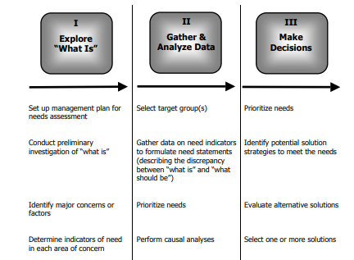
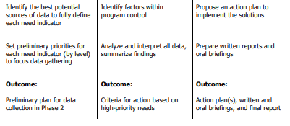

Slide 23
Task Analysis
The collection of data about a specific job or group of jobs
What employee needs to know to perform a job or jobs

Slide 24
How to Collect Information For a Task Analysis
Job descriptions
Task analysis
Performance standards
Perform job
Observe job
Ask questions
Analysis of problems

Slide 25
Steps in conducting a task analysis
Develop job description
Identify job tasks
  What should be done
  What is actually done
Describe KSAOs needed
Identify potential training areas
Prioritize potential training areas

Slide 26
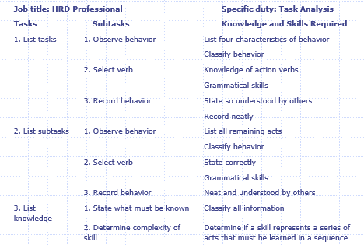
Task Analysis for HRD Position

Slide 27
Person Analysis
Determines training needs for specific individuals
Based on many sources of data
Summary Analysis
  Determine overall success of the individual
Diagnostic Analysis
  Discover reasons for performance

Slide 28
Prioritizing HRD Needs
There are never enough resources available
Must prioritize efforts
Need full organizational involvement in this process
Involve an HRD Advisory Committee.

Slide 29
Thank you ☺

