Slide 1
Autosomal Recessive Cerebellar Ataxia
Faculty : Dr. Sanjay Prakash

Slide 2
SCHEMA OF PRESENTATION
Introduction
Pathogenesis
Classification
Individual disorders
Congenital ataxias
Summary

Slide 3
INTRODUCTION
Hereditary ataxias can be divided into autosomal
dominant, autosomal recessive, X-linked and
mitochondrial on the basis of mode of inheritance

Slide 4
Autosomal Recessive Cerebellar Ataxias
The key feature in all these disorders is spinocerebellar
Ataxia involving the cerebellum, brainstem or
spinocerebellar long tracts
  autosomal recessive inheritance
  In most early onset ( before 20 years)

Slide 5
Autosomal recessive ataxias are generally associated with
peripheral sensorimotor neuropathy, most notably with
Loss of proprioception and vibration sense as seen in the
prototypical disorder FA
In contrast to the autosomal dominant ataxias autosomal
recessive ataxias tend to have involvement outside the
nervous system

Slide 6
PATHOGENESIS

Slide 7
Molecular pathogenesis of autosomal recessive ataxias

Slide 8
CLASSIFICATION

Slide 9
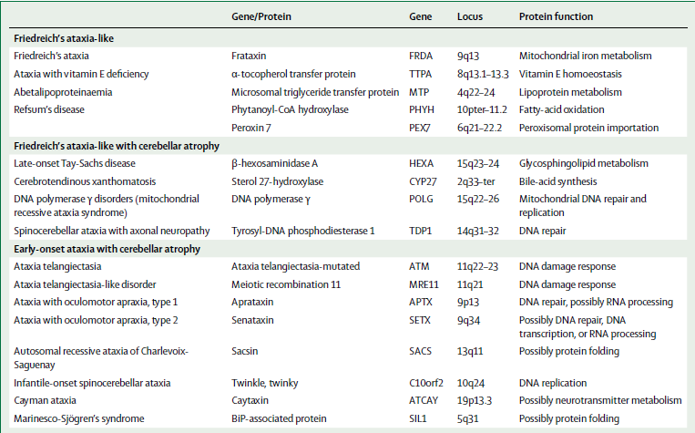

Slide 10
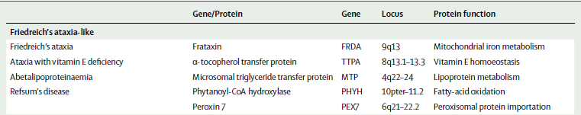

Slide 11
Friedreich’s ataxia
Friedreich’s ataxia is the most common of the autosomal
recessive ataxias and the most common hereditary ataxia

Slide 12
Age at onset is typically age 5–25 years
Clinical features
  Cerebellar ataxia
  sensory loss, areflexia
  Extensor plantar
  scoliosis, foot deformity
  cardiac symptoms,diabetes
  optic atrophy, deafness

Slide 13
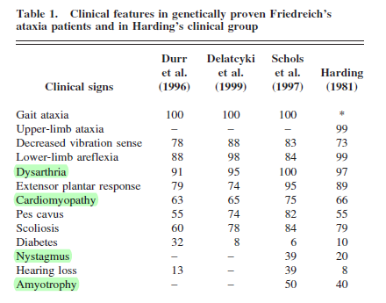

Slide 14
Large sensory neurons in the dorsal root ganglia are lost
initially, with subsequent deterioration of the
spinocerebellar tract,pyramidal tract and dorsal columns
Patients with Friedreich’s ataxia generally lose
Independent locomotion after they have had the disease
for 10 to 15 years.
Dysarthria and dysphagia both contribute to severe
disability

Slide 15
MRI shows no obvious cerebellar atrophy but instead
shows cervical spinal cord atrophy

Slide 16
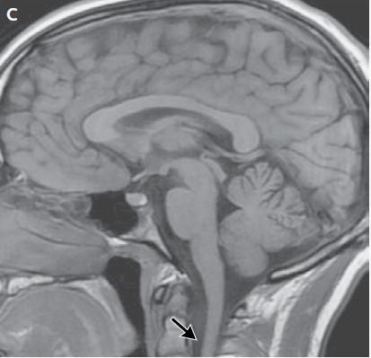
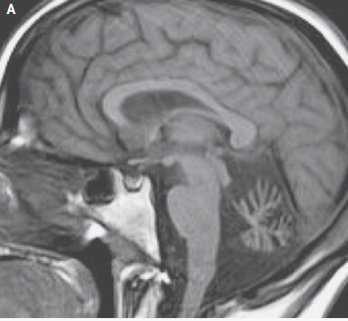
AT
FA

Slide 17
In about 98% of patients, the disease is caused by a triplet
GAA expansion within the first intron of the frataxin gene
found on chromosome 9q
Point mutations accounts for about 2–4% of patients

Slide 18
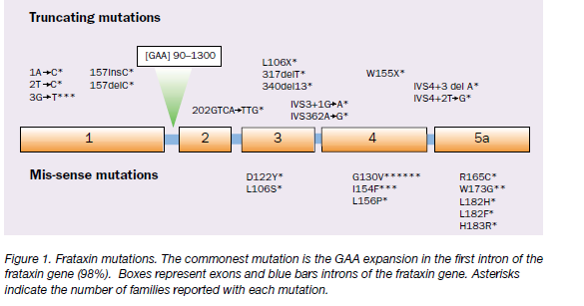

Slide 19
Frataxin is a mitochondrial protein. Loss of frataxin
Impairs mitochondrial iron handling, respiratory chain
function and contributes to increased oxidative stress and
cellular damage

Slide 20
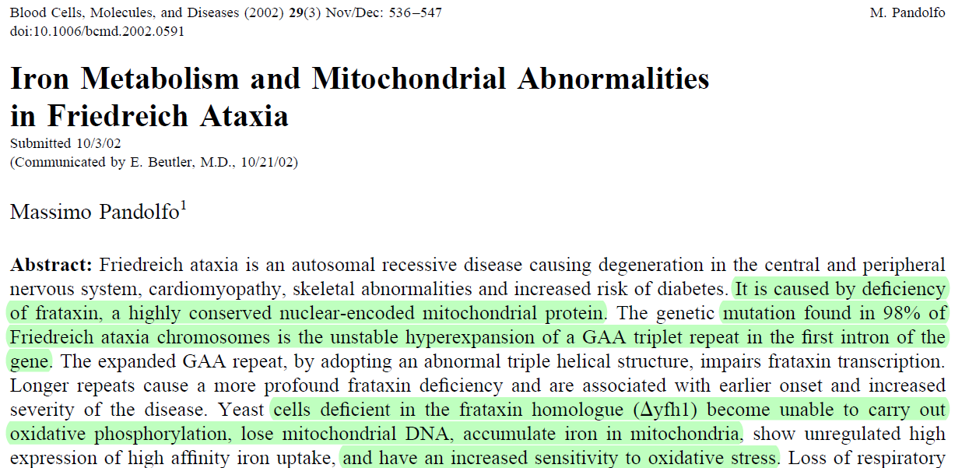

Slide 21
Different phenotypes
  Late onset Friedreich ataxia (LOFA) onset after 25 years
  FA with retained reflexes (FARR)
  Acadian form of FA - no cardiomyopathy or diabetes.

Slide 22
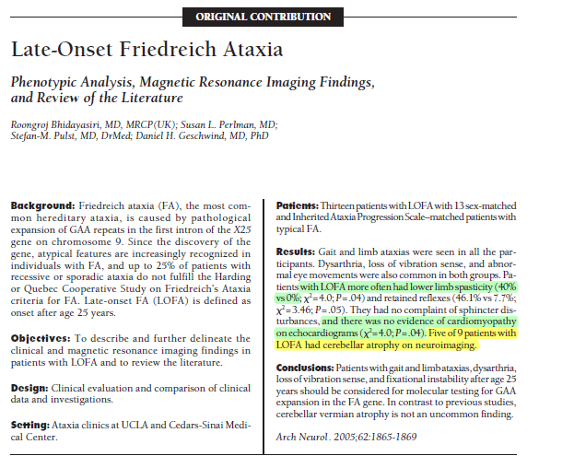

Slide 23
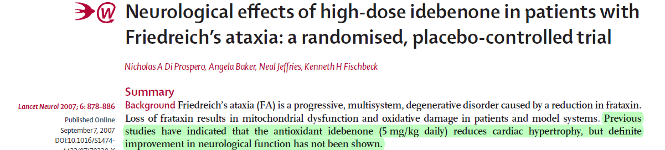
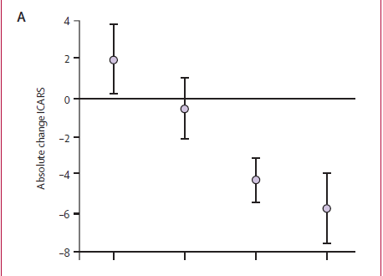
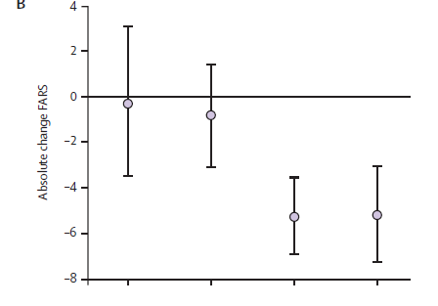
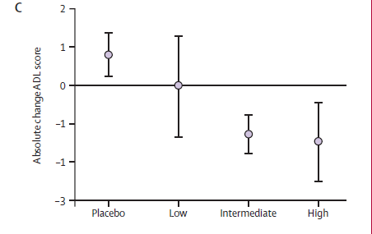

Slide 24
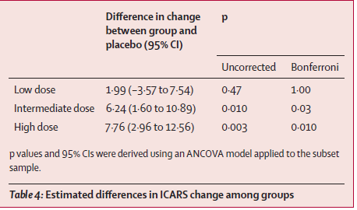
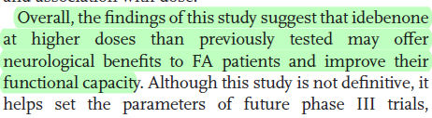

Slide 25
Ataxia with vitamin E deficiency
This disorder presents with FA phentype but serum
concentrations of vitamin E are low
Retinitis pigmentosa
Less Cardiomyopathy
Slower course

Slide 26
The disease is caused by mutation of the α tocopherol
Transfer protein on chromosome 8 q13
The α-tocopherol transfer protein mediates the
Incorporation of vitamin E into circulating lipoproteins
The mutations reduce the delivery of vitamin E to the CNS
increasing oxidative stress

Slide 27
Low serum vitamin E values (< 2.5 mg/L; normal value 6–15
mg/L)
Lipid profile and RBC morphology – Normal
Axonal sensory neuropathy
Treatment
1500 mg of alpha-tocopherol in two daily doses maximal
efficacy in presymptomatic patients and patients with very
mild signs

Slide 28
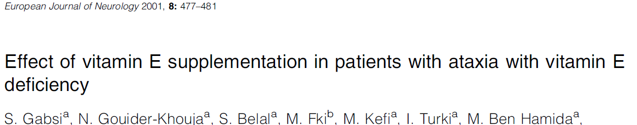
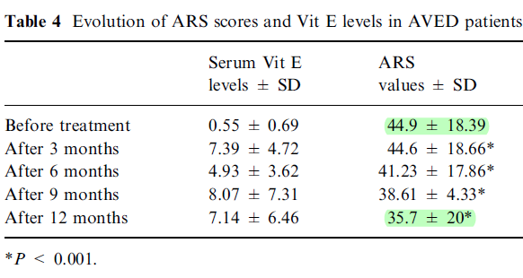
Conclusion Vitamin E supplementation in AVED patients seems to stop disease
progression and may lead to improvement of the cerebellar syndrome. It should be prescribed as soon as the diagnosis is made, with better results with supplementation in earlier stages of the disease.

Slide 29
Abetalipoproteinaemia
Bassen-Kornzweig syndrome
Inborn error of lipoprotein metabolism
Abnormality in the microsomal trygliceride transfer
protein (MTP)
Gene maps to chromosome 4q22-24
Assembly and secretion of plasma lipoproteins that
contain apolipoprotein B defective

Slide 30
Clinical features
Malabsorption syndrome
Pigmentary degeneration of the retina
Progressive ataxic neuropathy
Investigations
Red cells - "thorny" - acanthocytosis.
Total cholesterol is low (<70 mg/dL) & triglycerides
almost undetectable.
Lipoprotein profile - absent low-density lipoproteins (LDL) and VLDL.

Slide 31
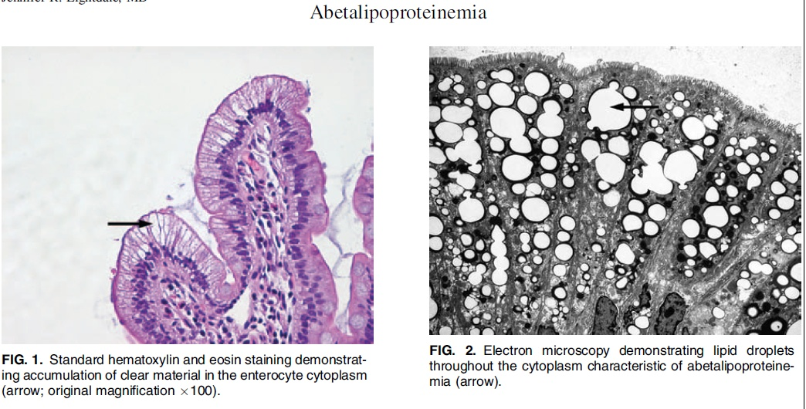

Slide 32
RP IN ABL

Slide 34
Treatment
Administration of a low fat diet
High doses of vitamins A and E
Prevent progression if treatment begun early

Slide 35
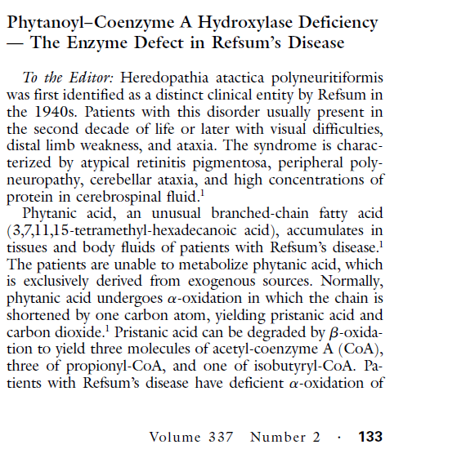
Refsum disease
Defective peroxisomal alpha oxidation of the branched
Chain fatty acids like phytanic acid
The defective enzyme is phytanoyl coenzyme A
hydroxylase

Slide 36
PHYH gene - chromosome 10p 11.2 is responsible in most

Slide 37
Clinical features
Age of onset varies, most patients < 20 years.
Neurological
  cerebellar ataxia.
  retinitis pigmentosa (usualy the first manifestation)
  chronic polyneuropathy
  Anosmia
  deafness
Non neurological
cardiac arrhythmias
bony and skin abnormalities

Slide 38
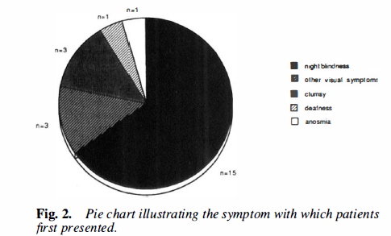
Typically patients with Refsum disease first present before the
age of 20 years with nyctalopia. diagnosis is frequently delayed
for at least a decade till the development of neurological
symptoms

Slide 39
Diagnostic tetrad of RD
Retinitis pigmentosa
Cerebellar ataxia
Peripheral polyneuropathy
High CSF protein without pleocytosis

Slide 40
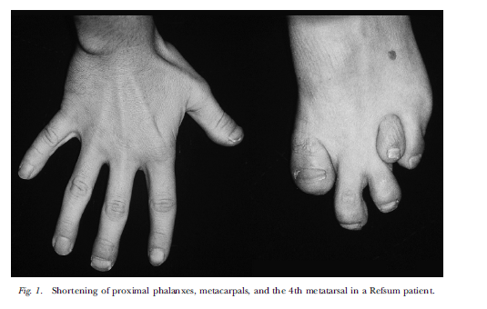

Slide 41
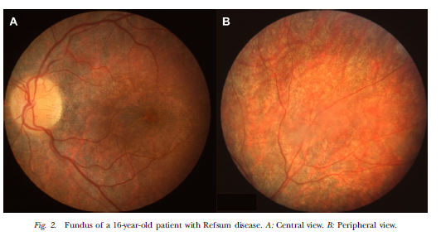

Slide 42
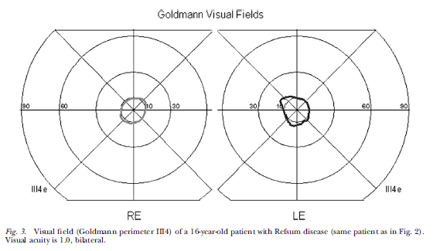

Slide 43
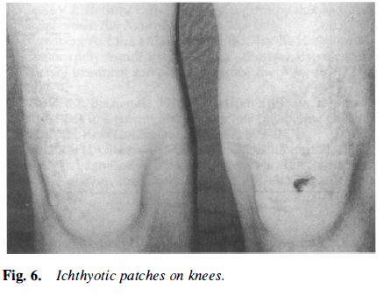

Slide 44
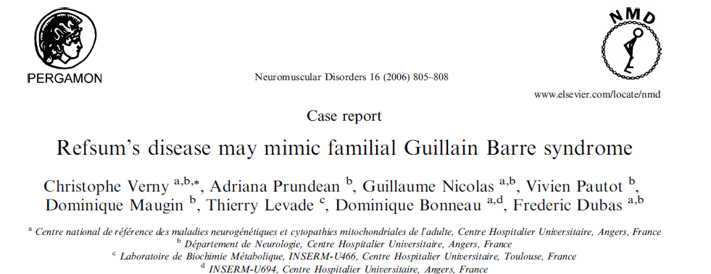
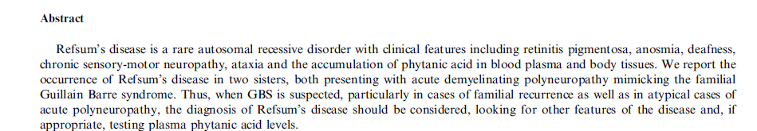

Slide 45
Investigations
Elevated serum phytanic acid levels
NCS Demyelinating neuropathy
CSF Protein usually elevated
Enzyme activity in cultured fibroblasts
PAHX Gene study

Slide 46
Treatment
Restriction of food containing high phytanic acid level
Fish
Meat
Dairy products
Acute cases- plasma exchange - used to reduce plasma
phytanic acid
Enzyme replacement therapy under evaluation

Slide 47
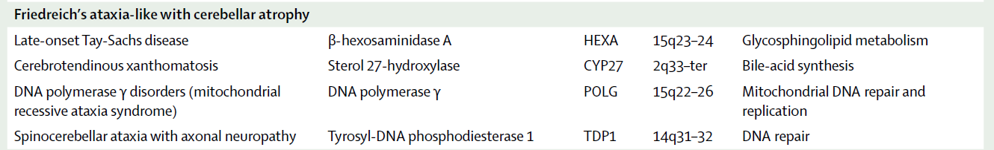

Slide 48
Late-onset Tay-Sachs disease
GM2-gangliosidosis - deficiency of the enzyme β hexosaminidase A
HEXA-chromosome 15q23–24.
Late-onset phenotype presents as
  childhood or adult-onset disease
  cerebellar dysfunction
  areflexia
  proximal muscle weakness, muscle atrophy and
  Fasciculations and spasticity
  psychiatric or behavioural problems

Slide 49
Infantile Tay–Sachs disease is characterized by progressive
Psychomotor retardation,megalencephaly, a retinal cherry
red spot,blindness and death by age 3 to 5 years.
The juvenile-onset form can also include Spasticity
Seizures dementia.
LOTS is a chronic progressive illness, with onset usually in
early to Mid adulthood unlike the infantile form, the eyes
in LOTS show no cherry red spot.
MRI shows cerebellar atrophy, even in patients without
clinical cerebellar involvement

Slide 50
These differences occur due to phenotype – genotypic
Variations.
severe infantile form two inactive alleles
late onset forms - one inactive allele

Slide 51
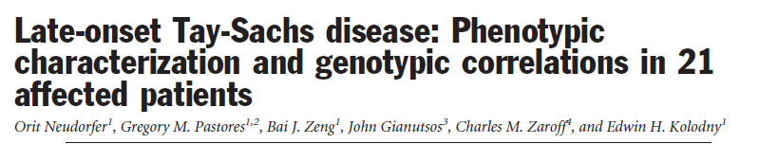
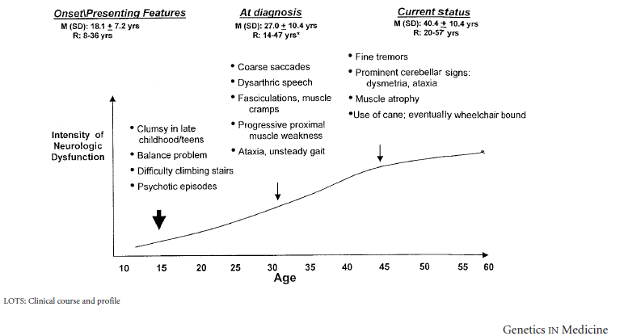

Slide 52
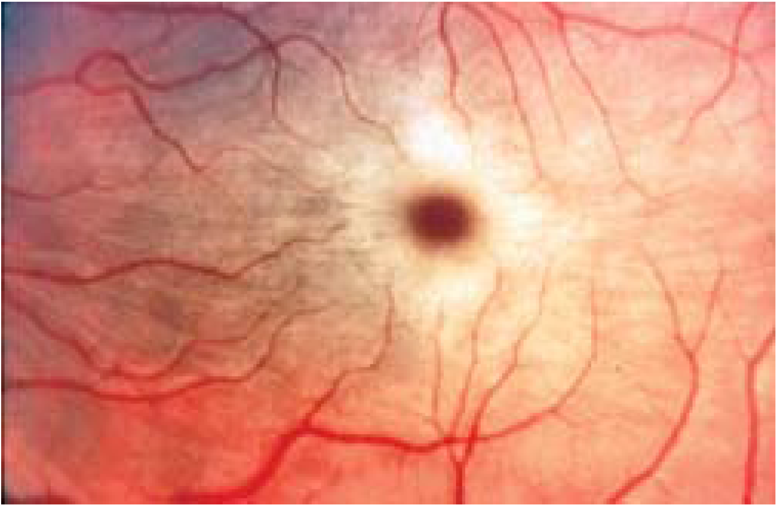
Macular cherry red spot in Tay Sach’s diseas Rare in late onset variety

Slide 53
Diagnosis is established by demonstrating decreased
Hexosaminidase A activity in serum, leukocytes or skin
fibroblasts.

Slide 54
Cerebrotendinous Xanthomatosis
Mutations in the CYP27A1 gene.
Defeciency of sterol 27-hydroxylase which is important for the
synthesis of bile acid from cholesterol.
Cholestanol and cholesterol level accumulates in brain and
other tissues leading on to progressive neurodegeneration .

Slide 55
Clinical features
Progressive cerebellar ataxia onset after puberty
Dementia.
Tendon xanthomas
Juvenile cataracts
Early atherosclerosis

Slide 56
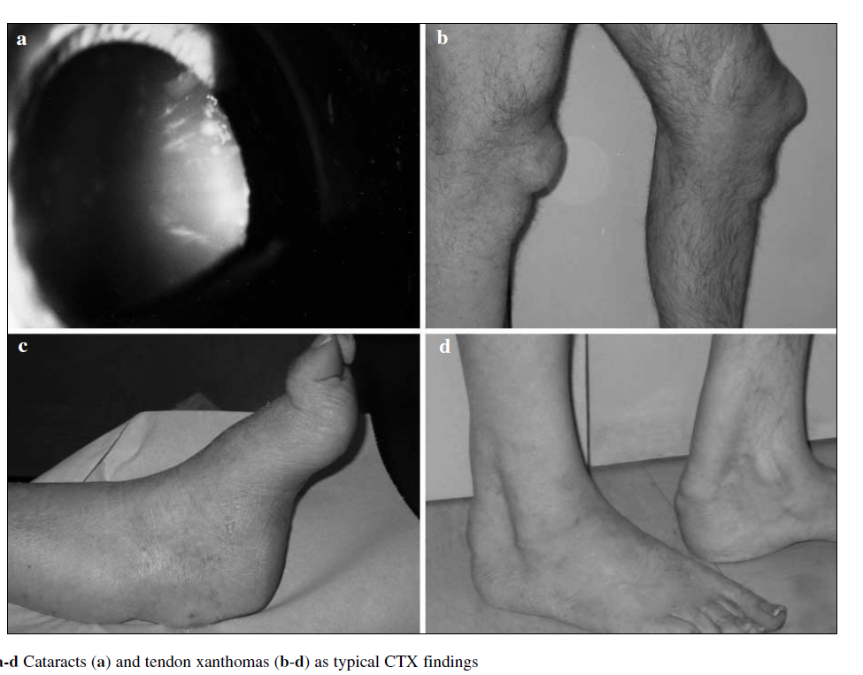

Slide 57
Investigations
Elevated plasma cholestanol concentrations
Plasma cholesterol often normal.
MRI Shows Bilateral hyperintensity of the dentate nuclei
generalised cerebral and cerebellar atrophy and diffuse
white matter hyperintensity

Slide 58
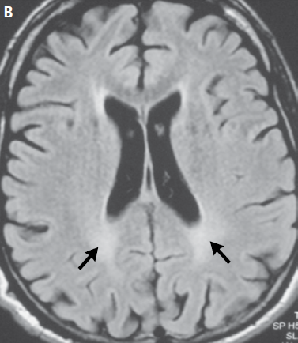
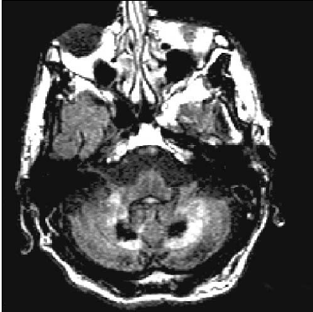

Slide 59
Early diagnosis is important because the disease is treatable by
bile-acid replacement therapy with chenodeoxycholic acid

Slide 60
Mitochondrial recessive ataxia syndrome
[ MIRAS]
Mutations in polymerase γ (POLG) gene
POLG is located on chromosome 15q and the product is the
only DNA polymerase found in Mitochondria
Functions in both the replication and repair of the
mitochondrial genome

Slide 61
Clinical features
Progressive cerebellar ataxia & sensorimotor peripheral
neuropathy with involvement of the dorsal columns
Epilepsy was common and was the presenting symptom in
many cases clinically distinguishing this disorder from other
Friedreich’s ataxia phenotypes.
About half of all patients had various combinations of
Dementia , psychiatric Features, myoclonus and dystonia .

Slide 62
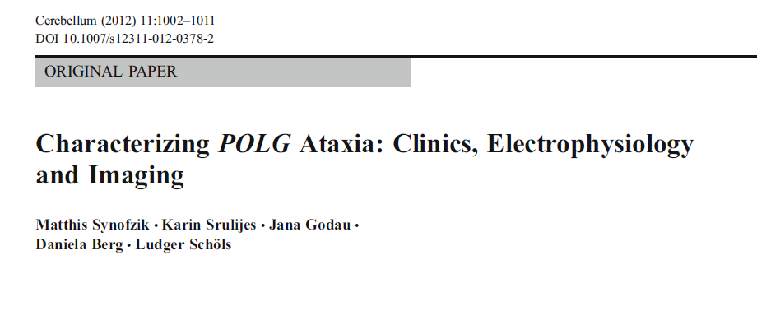

Slide 63
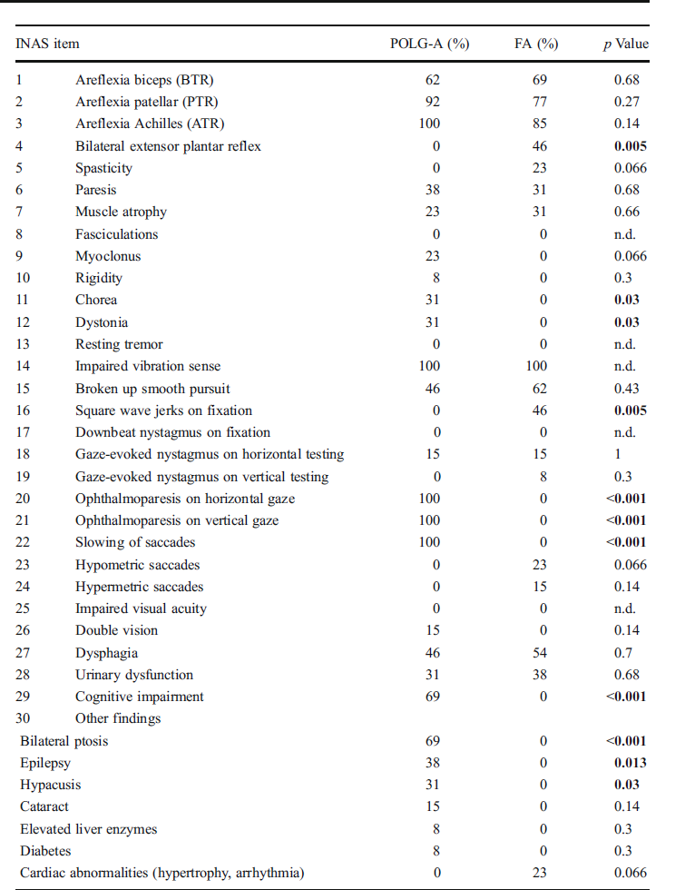

Slide 64
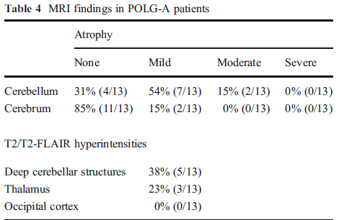

Slide 65
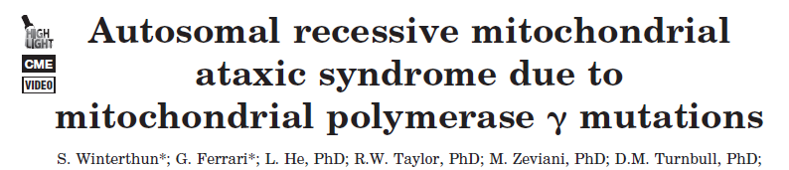
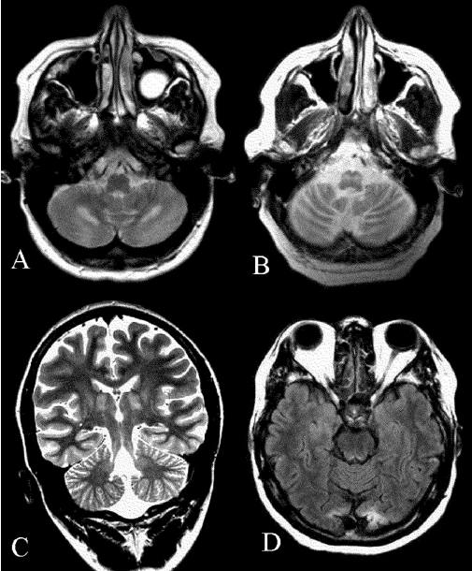
MRI. Representative pictures showing high signal lesions in (A) the central cerebellum in the region of the dentate nucleus; (B) symmetrically in the medulla oblongata in the region of the inferior olivary nuclei; (C) symmetrically in the thalamus. The high signal
lesions were present on T2, fluid attenuated inversion recovery, and proton weighted sequences. (D) Occipital changes seen

Slide 66
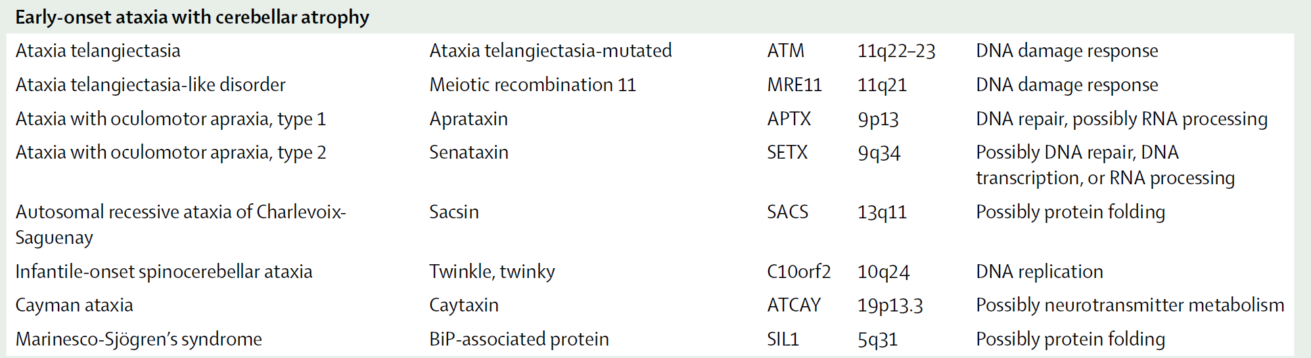

Slide 67
Ataxia-telangiectasia
ATM is causative gene - 11q23
The protein is a serine/threonine protein kinase involved
in the DNA damage response pathway

Slide 68
Clinical features
Progressive cerebellar ataxia → 2 to 4 yrs
Oculomotor apraxia → 2 to 8 yrs
Oculocutaneous teleangiectasia
Choreoathetosis

Slide 69
Recurrent sinopulmonary infections
Variable immunodeficiency
High risk of malignancy
Enhanced sensitivity to ionizing radioactivity
Wheelchair by the age of 10, Lifespan is ↓

Slide 70
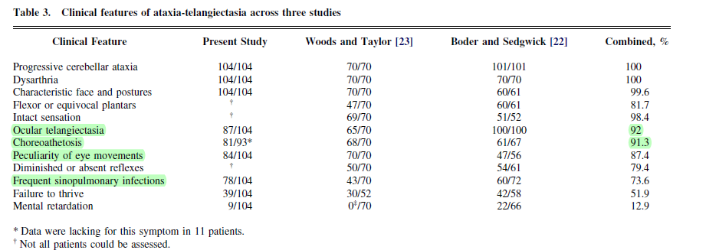

Slide 71
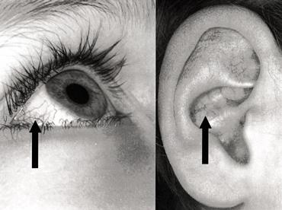
Ocular and cuteaneous telangiectasias

Slide 72
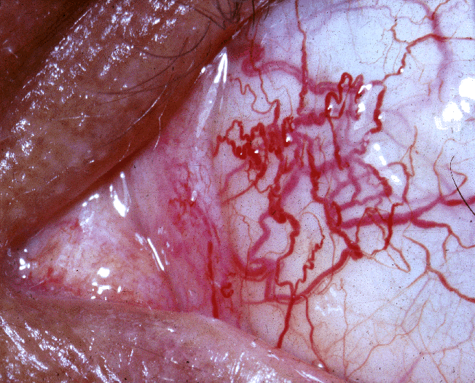
Ocular telangiectasia – subpapillary venous plexus

Slide 73
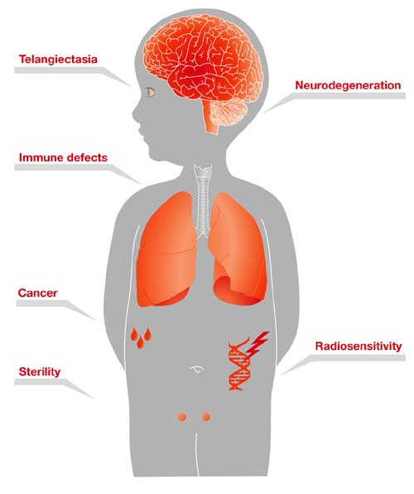

Slide 74
Atypical clinical manifestations
Mild phenotype
Later onset of the first symptoms
Slower progression
Longer lifespan
Investigations
MRI examination shows cerebellar atrophy.
Serum alpha-fetoprotein is > 10 ng/ml – 90%

Slide 75
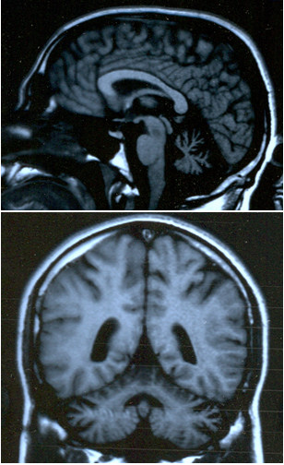

Slide 76
ATLD
ATLD is caused by mutation in the meiotic recombination
gene, MRE11
Clinically ATLD is very similar to ataxia telangiectasia but has
later onset with slower progression patients lack
telangiectasias and do not have raised concentrations of serum
alpha fetoprotein

Slide 77
Ataxia with oculomotor apraxia 1
Mutation in aprataxin gene, APTX, on chromosome 9p13
involved in DNA repair
Clinical features
  Onset of gait ataxia → 5 - 7 years of age
  Slow progression.
  Oculomotor apraxia
  Sensory motor axonal polyneuropathy

Slide 78
  Some patients show
    Dystonia
    Masked facies
    Mental retardation.
Laboratory studies
  Motor & sensory axonal neuropathy
  MRI - cerebellar and brainstem atrophy
  hypoalbuminemia
  Hypercholesterolemia
Normal serum α fetoprotein

Slide 79
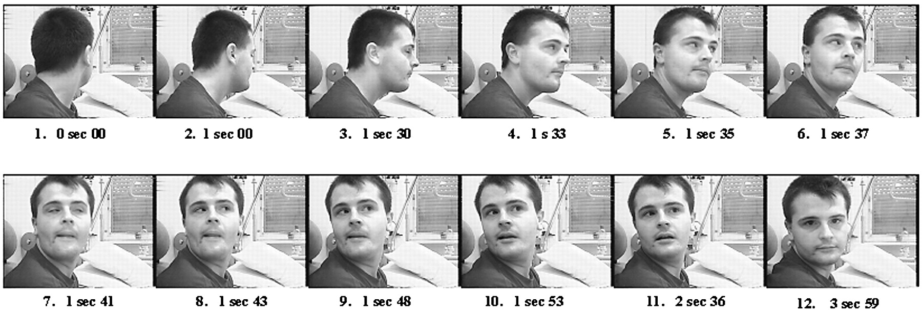

Slide 80
Ataxia with oculomotor apraxia type 2 AOA 2
Mutation in the gene for senataxin, SETX, on chromosome
9q 34
Clinical features
  Onset between 11 and 22 years
  Phenotype similar to AOA 1

Slide 81
Investigations
Contrast to type 1, laboratory studies show normal
albumin and high serum α fetoprotein concentrations
MRI shows cerebellar, particularly vermian, atrophy

Slide 82
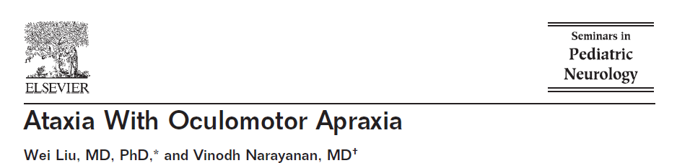
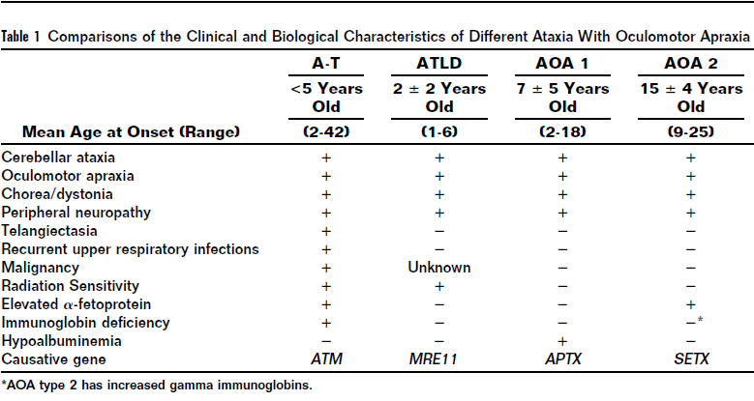

Slide 83
Autosomal recessive spastic ataxia of Charlevoix Saguenay (ARSACS)
Mutation in SACS gene
Clinical features
Progressive cerebellar dysfunction
pyramidal signs
peripheral sensorimotor neuropathy with amyotrophy
Retinal hypermyelinated fibers is a peculiar feature

Slide 84
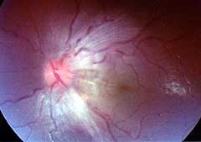
Retinal hypermyelinated fibers

Slide 85
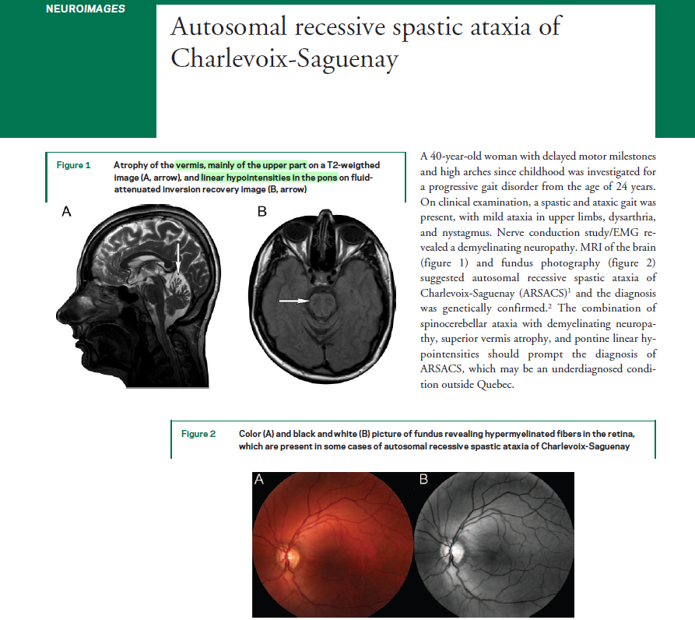

Slide 86
Marinesco-Sjögren syndrome (MSS)
The causative gene is SIL1, chromosome 5q31
Encodes a nucleotide exchange factor for heat-shock protein 70
family member HSPA5.
HSPA5 functions as a molecular chaperone during nascent
protein folding

Slide 87
Clinical features
Onset occurs in infancy.
Cerebellar ataxia, dysarthria, nystagmus
Congenital cataracts
Retarded mental development
Muscle weakness, hypotonia, demyelinating peripheral
neuropathy.
Hypergonadotropic hypogonadism

Slide 88
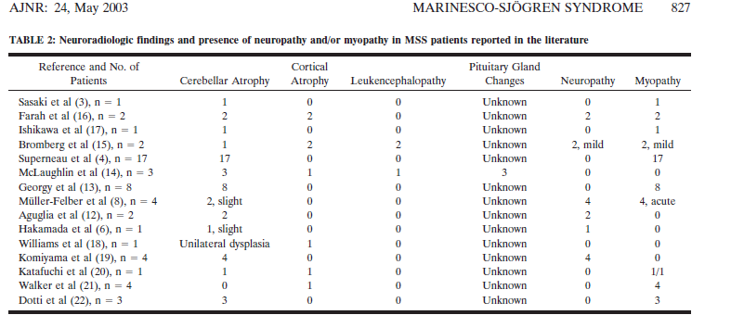

Slide 89
Infantile-onset spinocerebellar ataxia
Seen only in Finland.
Severe ataxic syndrome with onset before age 2 years.
Progressive ataxic neuropathy with optic atrophy
ophthalmoplegia and epilepsy

Slide 90
ARCA
Cerebellar ataxia without neuropathy
Type 1 is pure cerebellar ataxia
Mutation in SYNE1 (Spectrin repeats-nuclear envelope)
Late onset mean 32 range, 17–46
MRI Cerebellar atrophy

Slide 91
ARCA Type 2 characterised by mental retardation
myoclonus, epilepsy, pyramidal signs , strokelike episodes
Mutation in ADCK3
ARCA 2 shows reduced coenzyme Q10 level in the muscle
biopsy and the disease stabilizes with the supplementation of
coenzyme Q10. Variable elevation of serum lactic acid level
MRI Cerebellar atrophy, variable strokelike cerebral
lesions

Slide 92
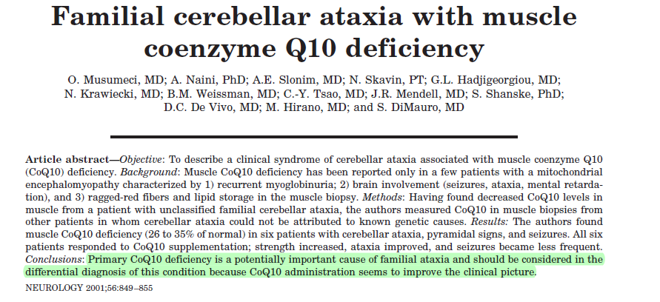

Slide 93

April (1 of 2) 2001 NEUROLOGY 56 851

Slide 94


Slide 95
Primary coenzyme Q10 (CoQ10) deficiency is a mitochondrial
encephalomyopathy with heterogeneous clinical presentation.
A predominantly myopathic form triad of exercise intolerance,
recurrent myoglobinuria and CNS involvement.
A more frequent ataxic form dominated by cerebellar ataxia
developmental delay, seizures, and pyramidal signs (arca2)
A third presentation with fatal infantile encephalomyopathy
All patients appeared to benefit from oral CoQ10
administration.

Slide 96


Slide 97
Congenital ataxias
Non progressive disorders - impaired development of the
cerebellum and its connections
Anomalies such as dysgenesis or agenesis of the
  Vermis
  Cerebellar hemispheres
  Parts of the brainstem

Slide 98


Slide 99
Joubert syndrome
  Absence of cerebellar vermis
  Presence of "molar tooth sign”
Clinical manifestations
  Infantile onset of cerebellar ataxia, nystagmus
  Vertical gaze paresis, ptosis, retinopathy
  Mental retardation
  Episodic hypernea or apnea of the newborn.

Slide 100

Molar tooth sign – triad : deep interpeduncular fossa, thick & straight superior cerebellar peduncles, hypoplastic vermis

Slide 101


Slide 102


Slide 103
Summary of clinical manifestations of ARCA

Slide 104


Slide 105


Slide 106


Slide 107


Slide 108


Slide 109


Slide 110


Slide 111



Slide 112


Slide 113



Slide 114
Autosomal Recessive Cerebellar Ataxias for which Treatment Is Available
Once the diagnoses of Friedreich’s ataxia and ataxia
telangiectasia have been eliminated, the workup should focus
on autosomal recessive cerebellar ataxias for which treatment
is available

Slide 115
AVED,ABL : 1500 mg of alpha-tocopherol in two daily doses.
Refsum’s disease : Phytanic acid–free diet and plasmapheresis.
CTX :750 mg of chenodeoxycholic acid per day in three daily
doses.
ARCA type 2: Coenzyme Q10, 6 mg per kilogram per day

Slide 116
Thank You

Slide 117
References
1 Clinical features and molecular genetics of autosomal
recessive cerebellar ataxia Lancet Neurol 2007; 6: 245–57
2 Milestones in Ataxia Movement Disorders, Vol. 26, No. 6, 2011
3 The Autosomal Recessive Cerebellar Ataxias n engl j med 366;7 february 16, 2012

Slide 118
The frataxin gene is found on chromosome
A 9q
B 8q
C 4q
D 10p

Slide 119
Early onset ataxic syndrome with cataract is seen in
A FDRA
B AVED
C MSS
D ARSACS

Slide 120
Which of the following will have both albumin and
alpha fetoprotein in the normal range.
A AT
B ATLD
C A OA 1
D A OA 2

Slide 121
Which of the following is not associated with neuropathy
A FRDA
B AT
C LOTS
D ARCA 1

