Slide 1

Approach to ataxia in children
Faculty : Dr. Sanjay Prakash

Slide 2
Ataxia – ( Gk- ataktos : lacking order ) refers to lack or loss of movement coordination
Damage or dysfunction of cerebellum or its afferent and efferent projections
In children it is especially debilitating as they are still developing and learning motor competency

Slide 3
Genetic
Acquired
Mixed
Congenital
Hereditary
Sporadic
Acute
Episodic
Chronic - Progressive / Non progressive

Slide 4
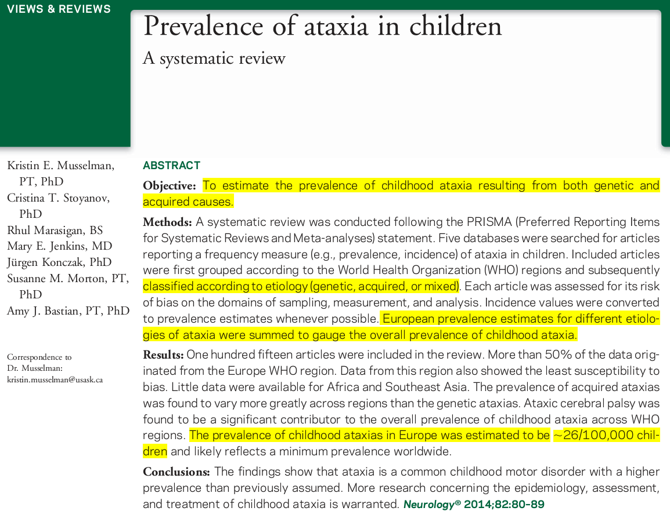

Slide 5
Prevalence of acquired ataxias was found to vary more greatly across regions than genetic ataxias
Ataxic cerebral palsy was found to be a significant contributor to overall prevalence
Prevalence in Europe – 26/100,000

Slide 6
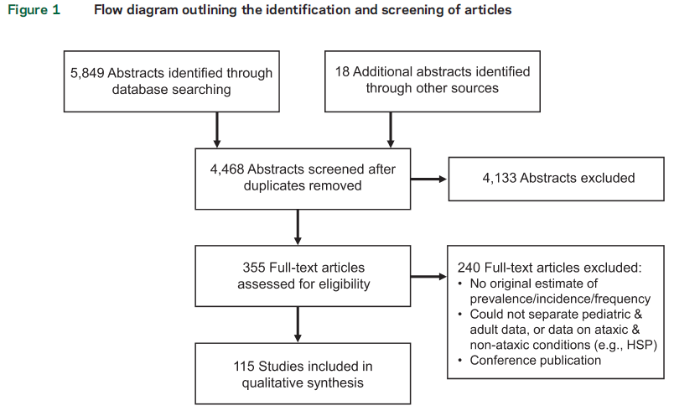

Slide 7
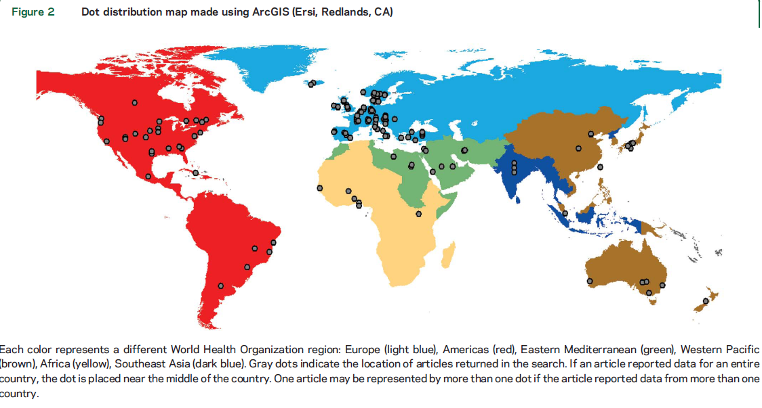

Slide 8
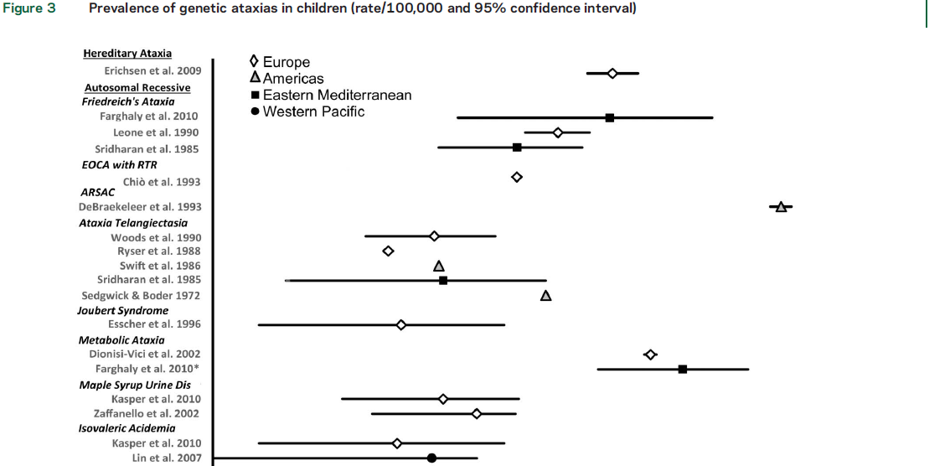

Slide 9
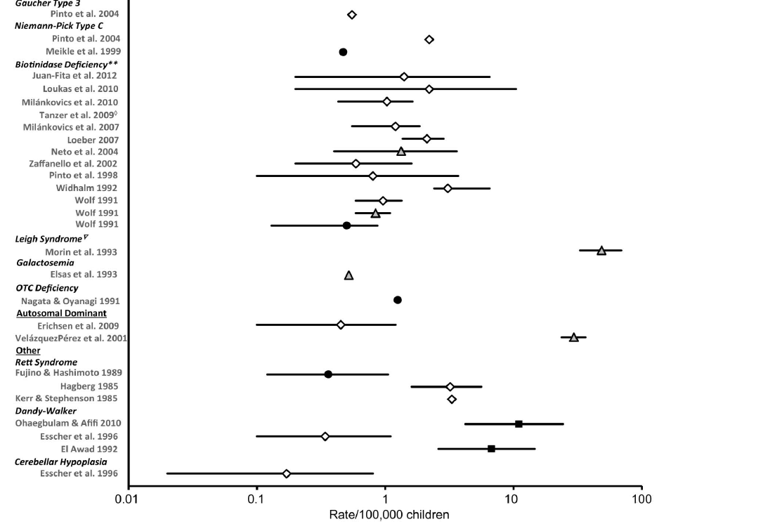


Slide 10
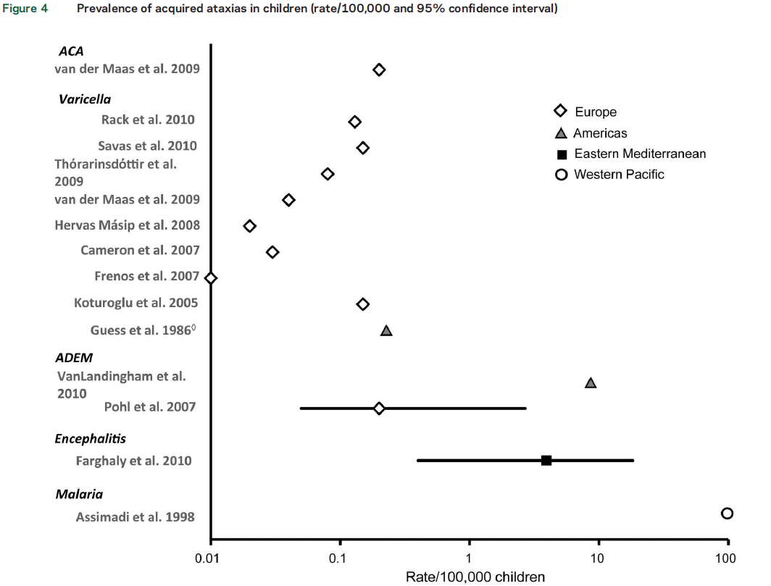

Slide 11
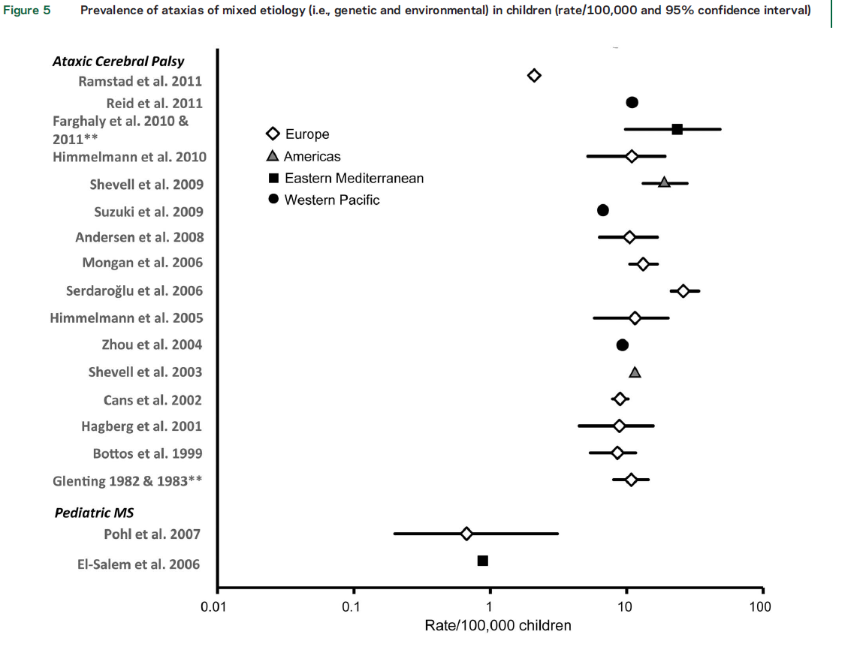

Slide 12
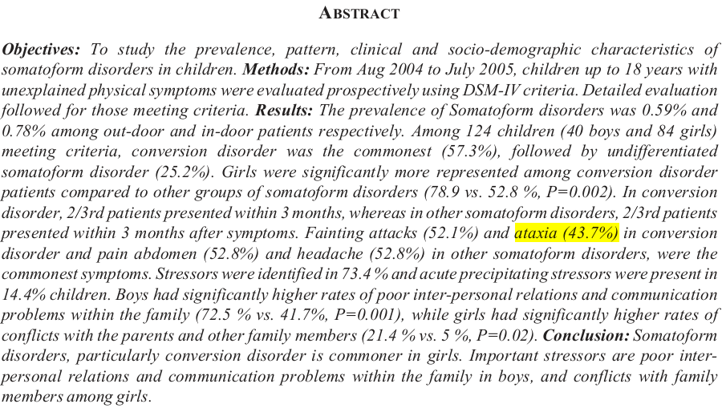

Slide 13
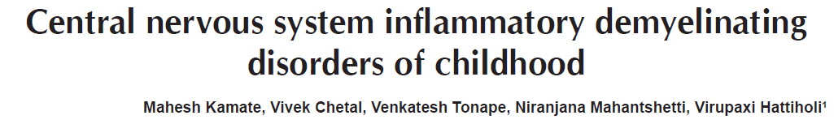
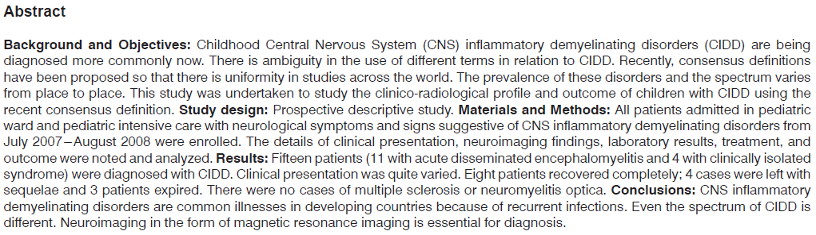
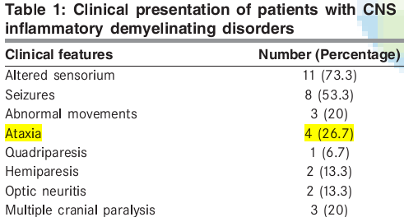

Slide 14
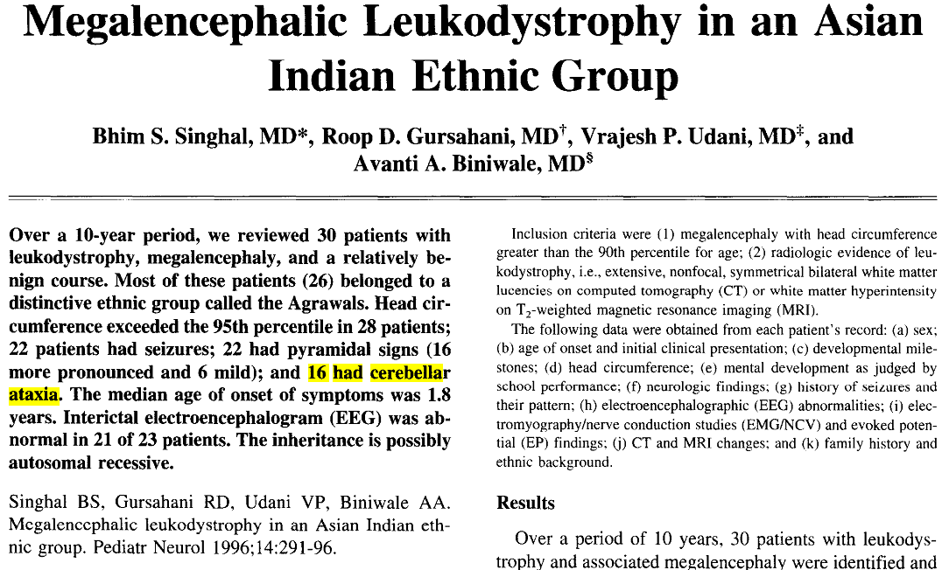

Slide 15
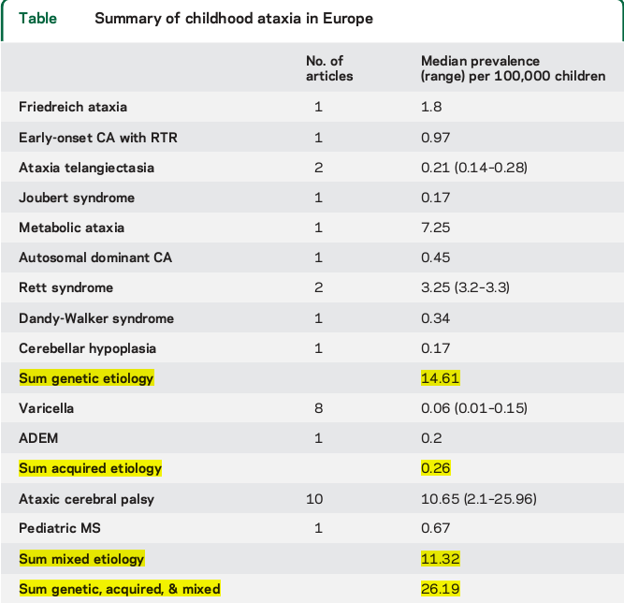

Slide 16
Approach to ataxia in children
Approach to acute ataxia
Approach to chronic ataxia
Investigations
Management

Slide 17
History
Age at onset
  Infancy
  Childhood

Slide 18
Infant (age <1 yr)
Ataxic cerebral palsy.
Developmental malformations.
Marinesco Sjogren Syndrome.
Infantile onset spino-cerebellar ataxia.
Inborn error of metabolism.
- Congenital disorder of glycolation type 1A.
- Aminoacidopathies.
- Urea cycle defect.

Slide 19
Child 1-10 yrs age
Ataxia Telangiectasia.
Ataxia with oculomotor apraxia type 1.
AR spastic ataxia of Charlevoix-Saguenay (ARSACS).
Abetalipoproteinemia.
AR cerebellar ataxia type 2

Slide 20
10-20 years
FRDA
AVED
AOA 1 & 2
Refsum’s disease
Cerebrotendinous xanthomatosis
AR cerebellar ataxia type 1

Slide 21
Congenital Ataxia
Non progressive disorders - impaired development of the cerebellum and its connections.
Cerebellar aplasia
Cerebellar hypoplasia
Vermian aplasia
Dandy-Walker malformation
Joubert syndrome
Associated with developmental delay, mental retardation, spasticity, seizures

Slide 22
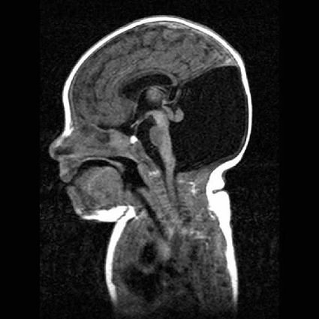
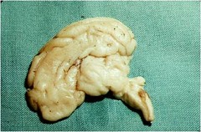
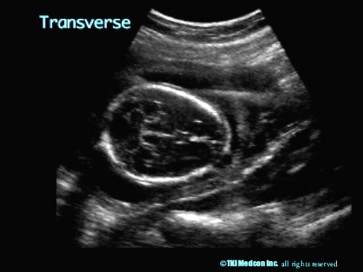
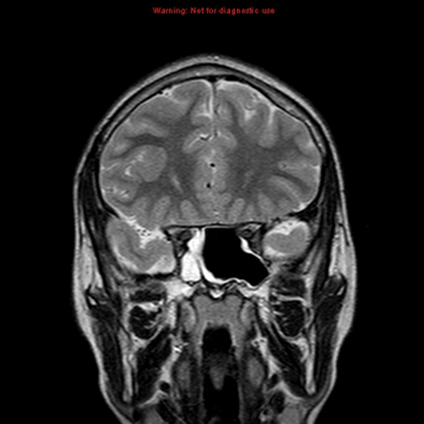
Notes:
CEREBELLAR APLASIA, CAN BE DETECTED PRENATALLY, OCCASIONALLY IT CAN BE UNILATERAL.

Slide 23
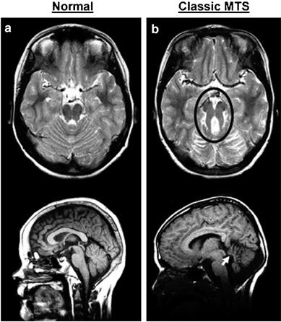
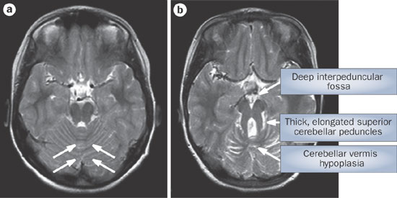
Joubert syndrome: Vermian hypoplasia with Molar tooth sign

Slide 24
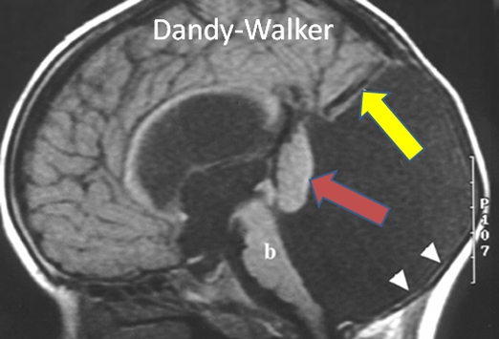
- A large posterior fossa cyst.
- Elevation of torcula and straight sinus. (yellow arrow)
- Hypoplastic vermis everted over the posterior fossa cyst. (red arrow).
- Cerebellar hemispheres and brainstem (b) are hypoplastic.
- Thinned occipital (arrowheads)

Slide 25
History
Time course
  Acute (vascular, toxic, infectious, inflammatory, traumatic)
  Subacute (metabolic/toxic, infectious, inflammatory, paraneoplastic, tumor)
  Chronic (more likely genetic, degenerative, paraneoplastic)

Slide 26
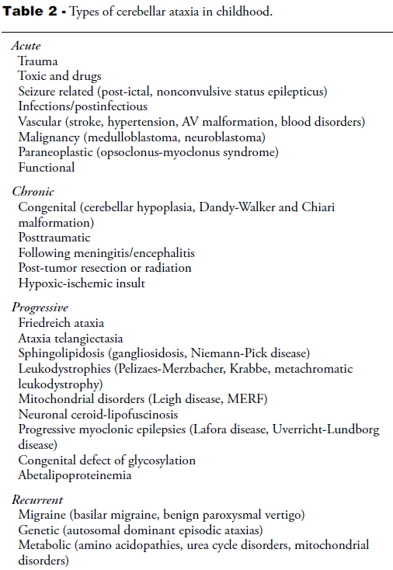

Slide 27
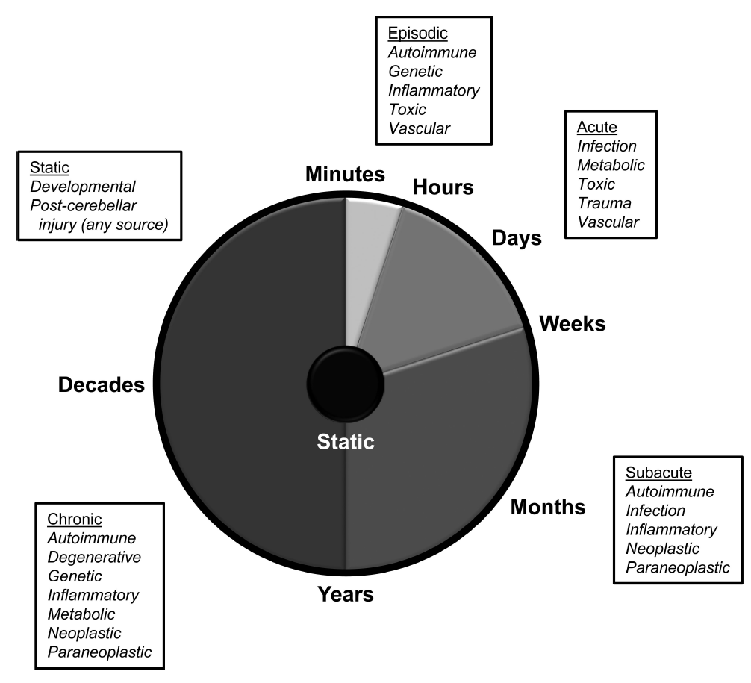

Slide 28
Acute ataxia - < 72 hours duration in a previously well child
History :
Antecedent respiratory or gastrointestinal infection, fever, EBV or Varicella infection
Recent vaccination
Exposure to toxins, alcohol, drugs or chemicals
Similar or recurrent symptoms in family
Recent head or neck trauma

Slide 29
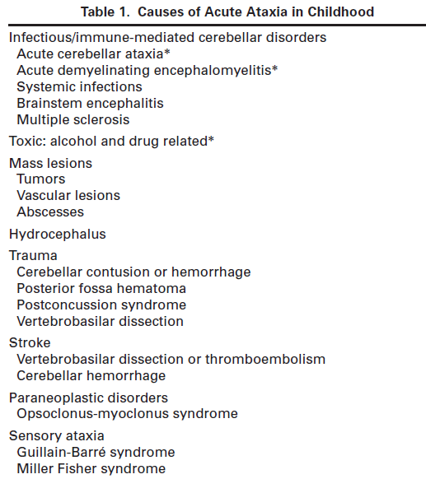

Slide 30
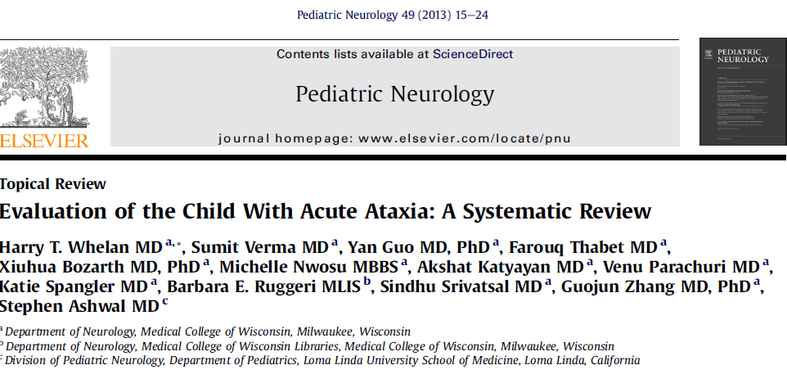
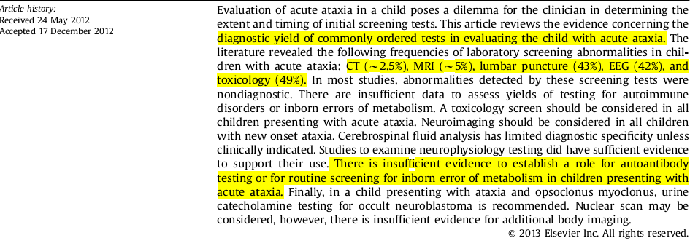

Slide 31
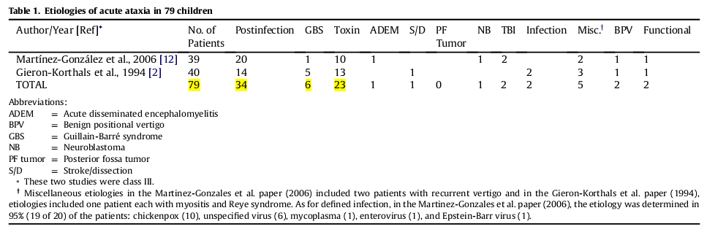

Slide 32
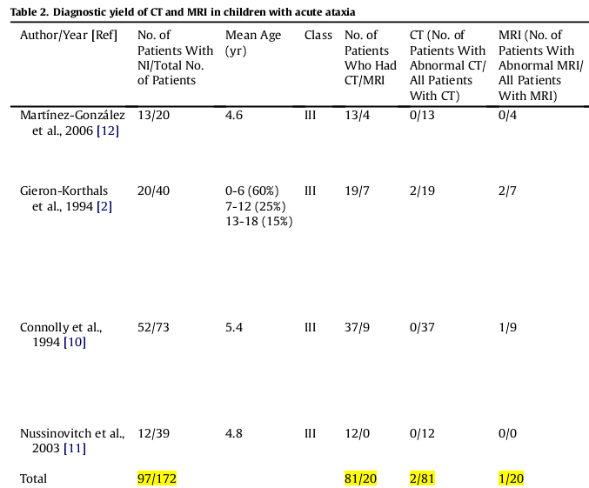

Slide 33
Neuroimaging
Although the diagnostic screening yield of CT and MRI is low , 5% (4 of 79) ;
a specific diagnosis such as tumor, stroke, or ADEM which can only be made with neuroimaging.

Slide 34
Neuroimaging
It is common practice for clinicians to perform an imaging study early in the diagnostic evaluation
to exclude one of these conditions
the risk of post lumbar puncture herniation in children

Slide 35
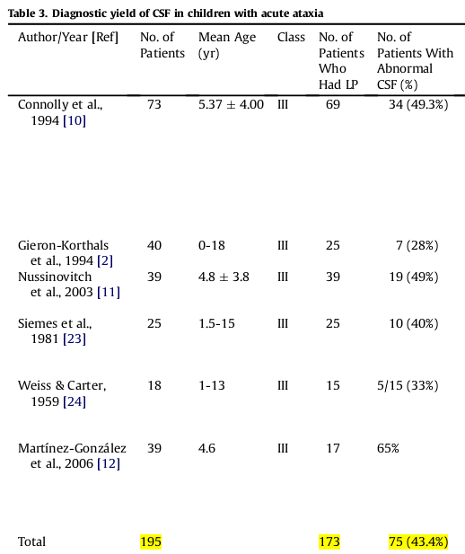
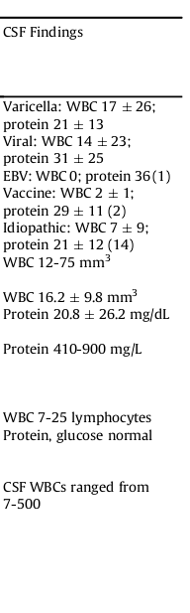

Slide 36
CSF findings suggest very limited diagnostic specificity.
Recent data suggesting that there are an increasing number of children being diagnosed with antineuronal antibody encephalitides raise the question whether such testing on CSF might be worth

Slide 37
Diagnostic yield of neurophysiologic studies in children with acute ataxia
In study by Nussinovitch et al. , 12 / 39 had EEG .
abnormal in six children (50%),
four had diffuse slowing and two with epileptiform abnormalities .
No correlation with acute clinical laboratory data or long-term outcome was made.

Slide 38
Weiss and Carter - 12 / 18 children had
EEGs ; four showed diffuse slowing and eight were normal.
There was no correlation with the occurrence of epilepsy or severity of the ataxia .
Those children who remained symptomatic for > 6 months were more likely to have had an abnormal EEG.

Slide 39
Acute ataxia may be present during the ictal
or postictal phase of seizure .
Non convulsive epileptiform states have also been referred to as pseudoataxia and may present as ataxia with or without alteration of consciousness
Personal or family history of epilepsy or accessibility to anticonvulsants and if there is possibility of toxin exposure

Slide 40
A single study using ENMG studies on 18 patients with acute onset polyneuropathy (suspected Guillain-Barré syndrome) of < 4 days duration was included (Albertí MA et al )
Electrodiagnostic studies found 33% of the cohort fulfilled neurophysiologic criteria for AIDP or axonal Guillain-Barré syndrome.

Slide 41
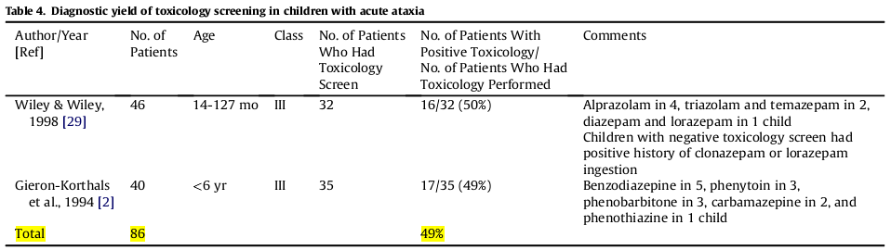

Slide 42
Opsoclonus myoclonus ataxia
Acute ataxia is usually the first presenting symptom followed by opsoclonus and myoclonus
Paraneoplastic syndrome of opsoclonus–myoclonus–ataxia occurs in 2% to 3% of all children with neuroblastoma
50% to 80% of children identified with opsoclonus–myoclonus–ataxia are found to have neuroblastoma

Slide 43
Detecting the presence of neuroblastoma requires CT or MRI, bone and MIBG scans, bone marrow testing, urine catecholamine measurements

Slide 44
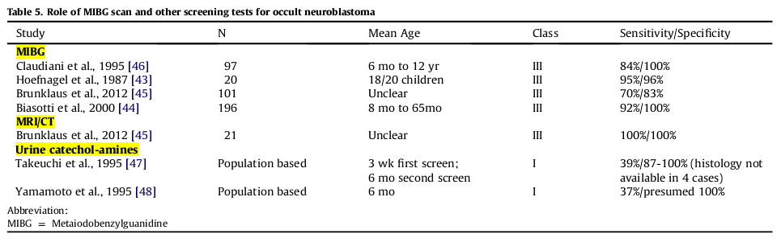

Slide 45
Diagnostic testing for other autoimmune disorders:
ANA - anti-SS-A/Ro and anti-SSB/La
anticardiolipin antibody, antiphospholipid antibodies
antigliadin antibodies
antimyelin-associated glycoprotein , glutamate receptor delta-2 autoantibody
postvaricella anticentrosomal antibodies
Anti – GAD

Slide 46
Toxicologic screen
Imaging: MRI - altered levels of
consciousness, focal neurologic signs, cranial neuropathies, marked asymmetry of ataxia, concern for a mass lesion or trauma
Metabolic evaluation: episodic acute
ataxia
CSF : if there is concern for CNS infection,
demyelination

Slide 47
Electrophysiologic studies: rarely needed
EEG – h/o seizures, altered levels of consciousness or fluctuating clinical signs , clues to etiology or toxic exposure
Evaluation for occult neuroblastoma - in children whose acute ataxia does not begin to resolve within 2 weeks

Slide 48
Treatment of acute ataxias
ACA – No specific therapy
antiviral therapy with acyclovir is often used in immunocompromised patients
immunization against varicella is likely to render varicella-related cerebellar ataxia uncommon.
Treatment of cause

Slide 49
History
Progression
  Stable / non progressive
  progressive
  episodic

Slide 50
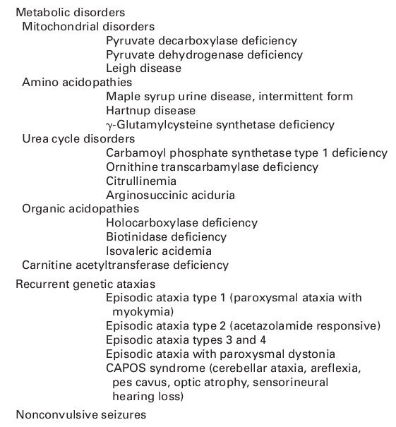

Slide 51
Hereditary ataxias
Classification by inheritance pattern
  Autosomal recessive (AR)
  Degenerative
  DNA repair defects
  Metabolic ataxias
  X-linked
  Autosomal dominant (AD)
  Mitochondrial
Notes:
51
Hereditary ataxias
Traditionally, hereditary ataxias have been classified by inheritance patterns such as autosomal dominant, autosomal recessive, X-linked, or even mitochondrial depending on the family history. Although this method provides a useful classification scheme, we will see that recent advances in the hereditary ataxias have allowed further delineation by pathophysiology and molecular mechanism of disease.

Slide 52

Autosomal recessive cerebellar ataxias (ARCA )
25 identifiable genes
onset < 20 years of age.
slowly progressive, symmetrical cerebellar ataxias
often associated with sensory / sensory-motor polyneuropathy
involve other organ systems

Slide 53
Clinical classification of AR Ataxia
Cerebellar ataxia with
1. Pure sensory neuropathy.
2. Sensory Motor axonal neuropathy.
3. No neuropahty.

Slide 54
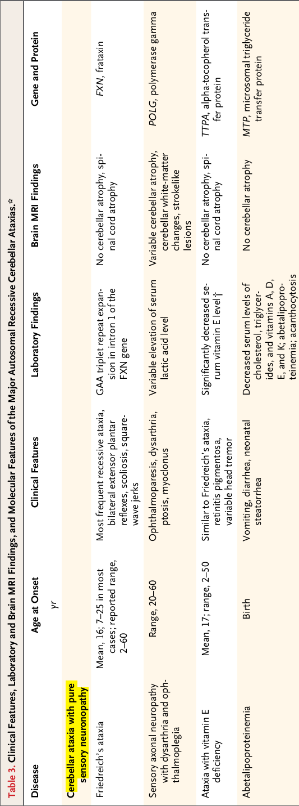

Slide 55
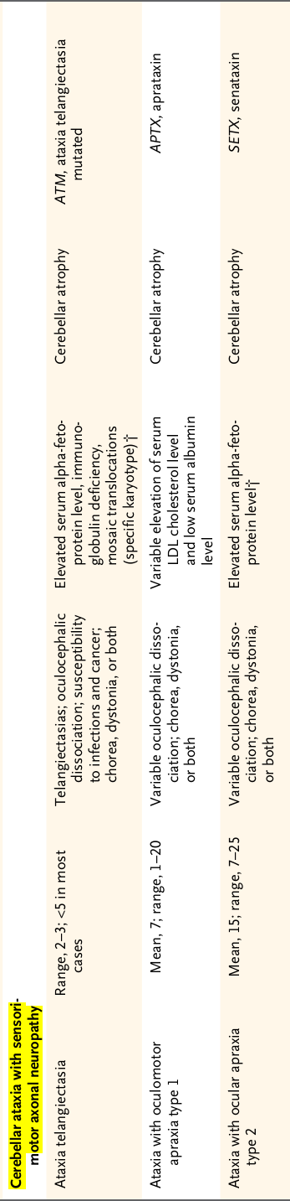

Slide 57
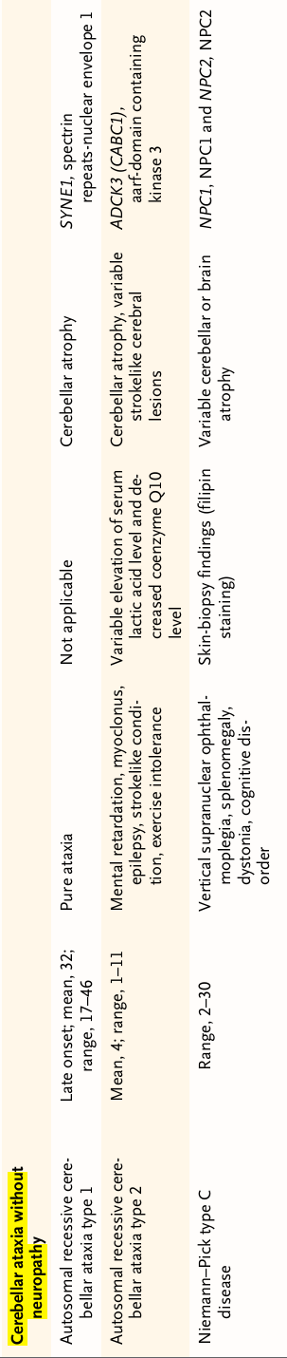

Slide 58
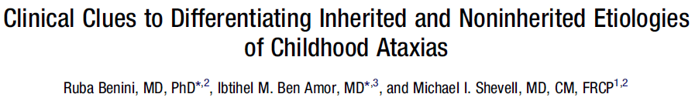
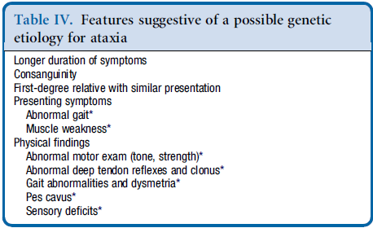

Slide 59
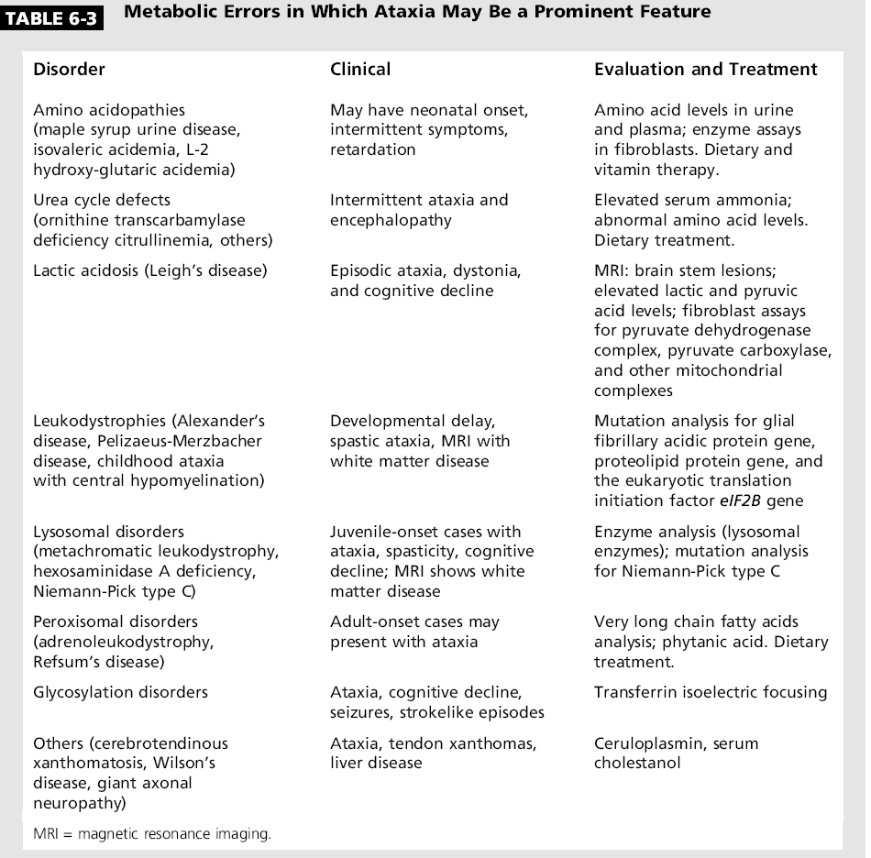
59

Slide 60
DNA repair defects
Ataxia telengiectasia
Xeroderma pigmentosa
Cockayne’s syndrome

Slide 61
AD Ataxias in childhood
Anticipation – DRPLA , SCA 2, and SCA 7
Typical childhood onset - SCA 18, SCA 21, SCA 28, SCA 29

Slide 62
Approach to ataxia
Accompanying symptoms
  Headache , nausea, vomiting in acute cerebellar hemorrhage, increased ICP, posterior fossa tumors
  Systemic – weight loss, GI symptoms, autonomic dysfunction, skin changes
  Neurological – parkinsonism, dystonia, spasticity, neuropathy

Slide 63
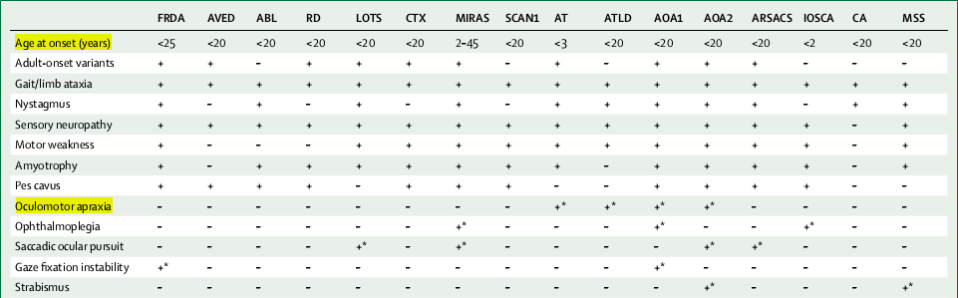

Slide 64
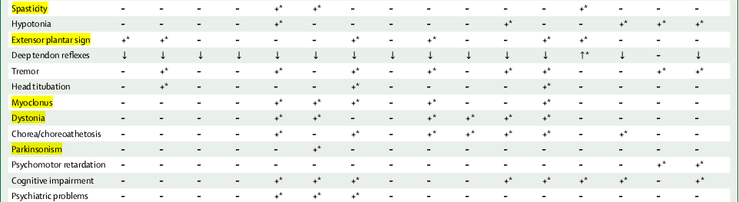

Slide 65
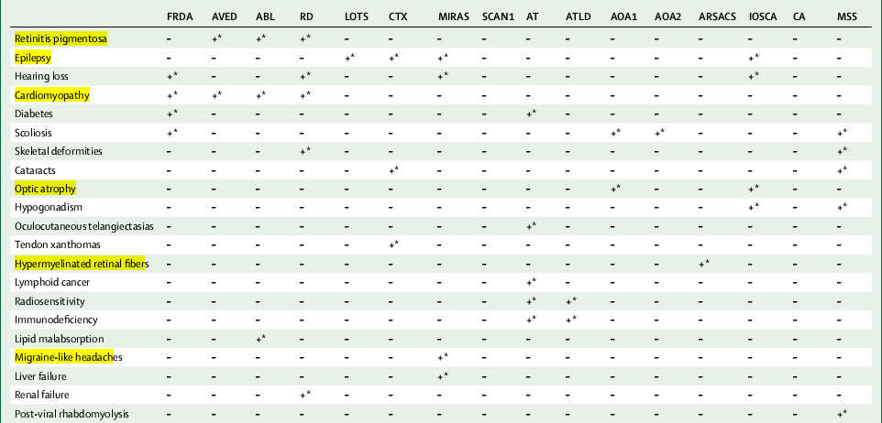

Slide 66
History
Medications
Phenytoin, barbiturates
Lithium
Immunosuppressants (methotrexate, cyclosporine)
Chemotherapy (fluorouracil, cytarabine)

Slide 67
Medical history
  Cancer, infections, HIV, thyroid disease, GI disease (malabsorption, celiac), multiple sclerosis
Social history
  Alcohol and drug use, toxins (heavy metals, solvents, thallium), occupation.
Family history
  Establish at least 3 generations
  Consanguinity
  Ethnicity

Slide 68
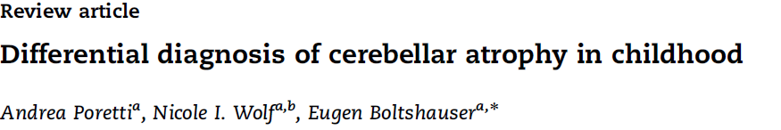
Cerebellar atrophy
CA- cerebellum with normal structures in a posterior fossa
which displays enlarged fissures in comparison to the foliae ; secondary to loss of tissue

Slide 69
Cerebellar hypoplasia
CH – a compact cerebellum with reduced volume, while cerebellar shape is (near) normal
the cerebellar structures are not filling a normally configurated posterior fossa, or a small cerebellum is found within a small posterior fossa

Slide 70
Coronal sections are particularly informative - vermis and hemispheres
signal changes of cerebellar white matter and cortex
Sagittal sections - to assess vermis atrophy, brainstem morphology, the size of the fourth ventricle, and the supravermian cistern
Axial sections - enlarged interfolial spaces of both vermis and hemispheres

Slide 71
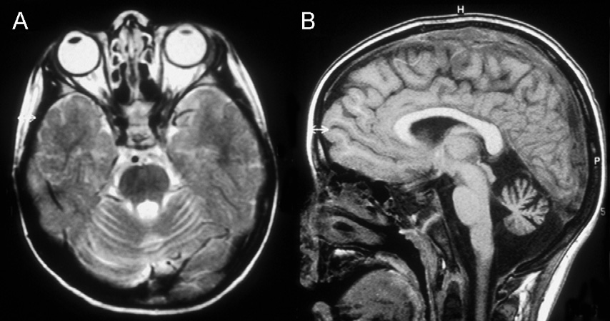

Slide 72
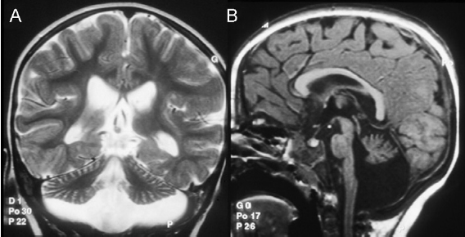

Slide 73
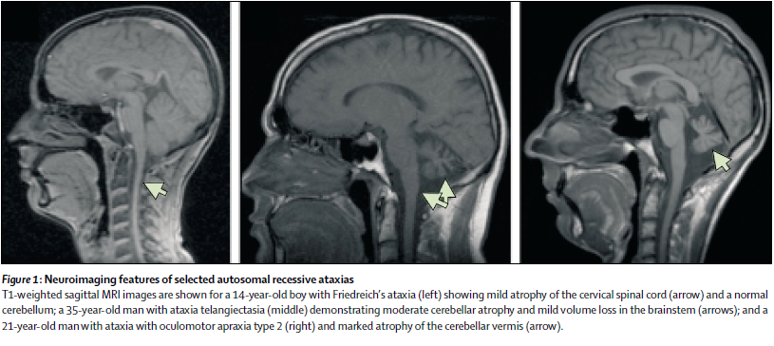

Slide 74
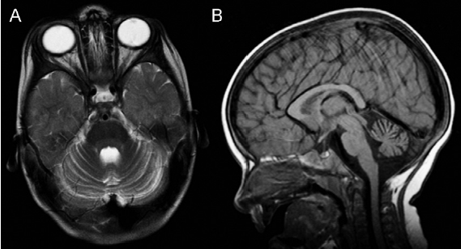

Slide 75
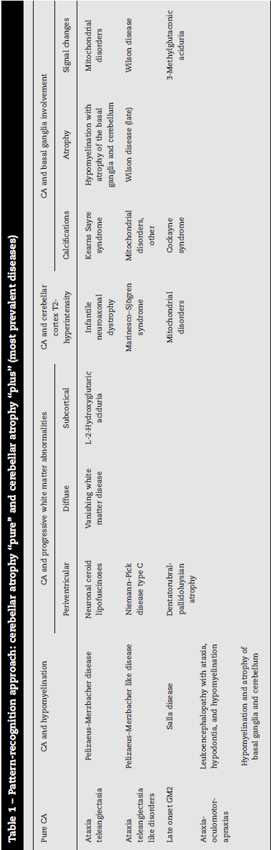

Slide 76
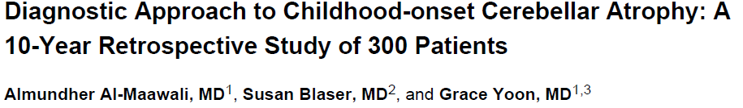
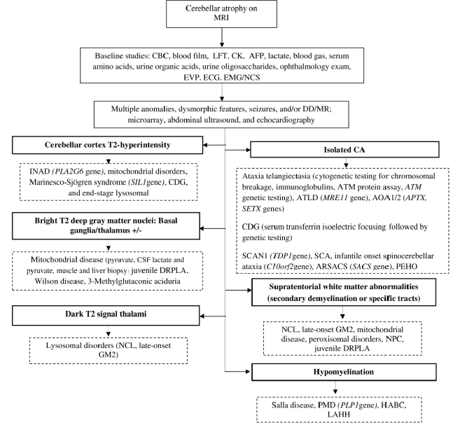

Slide 77
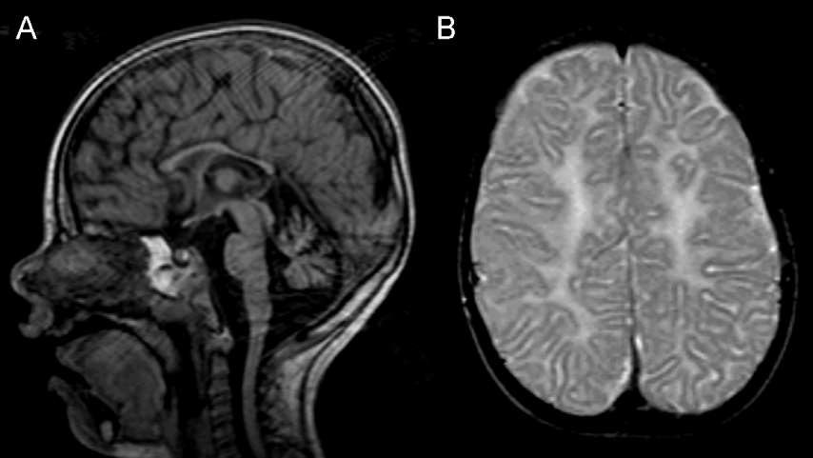

Slide 78


Slide 79


Slide 80


Slide 81

Disappointing results with ARCA
SCA 2 vs SCA 6 – Lactate peak in cerebellar vermis
SCA 6 vs SCA 1 - Decrease in NAA/Cr ratio in cerebellar vermis

Slide 82



Slide 83


Slide 84


Slide 85



Slide 86


Slide 87

Approach to AR ataxia

Slide 89


Slide 90


Slide 91


Slide 92


Slide 93


Slide 94


Management of Ataxias

Slide 95
a neurologist
a cardiologist
an ophthalmologist
a urologist
a physiotherapist
a speech and language therapist
a psychologist
a social worker
an occupational therapist
a specialist neurology nurse

Slide 96


Slide 97


Slide 98



Slide 99



Slide 100


Slide 101
Friedreichs Ataxia therapeutic developments
3 biochemical defects:
decreased frataxin gene
Histone deacetylase inhibitors
Erythropoietin
mitochondrial iron accumulation
oxidative stress
Idebenone, a coenzyme Q10 analogue

Slide 102
Idebenone
Studies of low-dose idebenone, seem to show reduction of cardiac hypertrophy but no improvement in neurological
symptoms.

Slide 103


Slide 104


Slide 105
Friedreich Ataxia Rating Scale Activities of Daily Living
9-Hole Peg Test
Timed 25-Foot Walk
PATA test
International Cooperative Ataxia Rating Scale

Slide 106
Cardiac abnormalities seen in Friedreich’s ataxia include:
• ECG non-specific repolarisation abnormalities
• Echo - 50% usually in the form of concentric ventricular hypertrophy .
Arrhythmia - supraventricular.
Severe or terminal systolic dysfunction with dilation of the ventricle, especially at older ages

Slide 107
Patients to be screened once every two years before any cardiac disease is documented
Annually after detecting cardiac disease
Cardiac screening should include ECG, echocardiography and (depending on the indication) cardiac MRI and Holter .
Anti-arrhythmic and anti-cardiac failure medication

Slide 108
Friedreich’s Ataxia
Scoliosis - major source of morbidity in terms of managing cardiac and respiratory function, as well as posture
Equinovarus deformity can cause significant morbidity - alleviated by physical therapy, splinting, Botox, tendon-lengthening surgery
10% to 30% - diabetes mellitus due to combined insulin deficiency and insulin resistance.

Slide 109
Disease modifying treatments
Gluten-free diet –
gluten ataxia with enteropathy
enteropathy cannot be established, but who have serological evidence of gluten sensitivity
Benefit can only be seen with strict adherence to the diet with evidence of elimination of the antibodies that need to be tested on a six-monthly basis

Slide 110
Any improvement or stabilisation usually manifests within a year on a strict diet
In some patients where there is evidence of cerebellar atrophy the expected benefit will be in the form of stabilisation rather than
improvement.

Slide 111

Ataxia with Vitamin E deficiency
lipid adjusted Vitamin E
leads to cessation of progression of neurological symptoms and mild improvement in certain patients, especially in the early stages of the disease

Slide 112

Ataxia with CoQ10 (ubiquinone) deficiency
Testing of CoQ10 deficiency - skeletal muscle samples or on blood mononuclear cells.

Slide 113
Cerebrotendinous xanthomatosis
Treatment with chenodeoxycholic acid results in at least partial reversal of the neurological symptoms and in cognitive
function in some patients

Slide 114
Hypobetalipoproteinaemia
rare disorder characterized by low levels of fats, beta-lipoproteins and cholesterol.
Patients are deficient in the lipid-soluble vitamins, especially vitamin E
Treatment involves dietary modification and vitamin replacement, which may prevent neurological complications if begun

Slide 115
Refsums disease
Because of impaired branched-chain fatty acid α-oxidation, phytanic acid, accumulates to high levels in body fat
Stressful conditions, such as rapid weight
loss or illness can cause sudden worsening of symptoms or even an acute presentation
Dietary restriction - < 5 mg/day
Plasmapheresis - to rapidly reduce plasma
concentrations of phytanic acid

Slide 116
Structural disorders
surgically treatable tumours can cause ataxia
Hydrocephalus can have similar symptoms and can be due to a wide variety of cause

Slide 117
Episodic ataxias
Acetazolamide is an effective therapy in most patients with EA2 and in half of the patients with EA1.
Phenytoin is an alternative therapy in EA1

Slide 118
Medical management (immunodeficiencies sinopulmonary infections, neurologic dysfunction, and malignancy)
neurorehabilitation (physical, occupational,
and speech/swallowing therapy; adaptive
equipment; and nutritional counseling)
medications that can improve imbalance, incoordination, or dysarthria (such as amantadine, buspiron, and fluoxetine)

Slide 119
Cerebellar tremor - clonazepam, gabapentin, propranolol
Basal ganglia dysfunction - L-dopa compounds, direct dopamine agonists, and anti-cholinergics .

Slide 120

Ataxia – rating scales

Slide 121

Muscle spasms and spasticity
Contractures
Tremors
Eye symptoms
gabapentin - pendular or gaze-evoked jerk nystagmus and downbeat nystagmus. Downbeat nystagmus - 3,4-diaminopyridine
and baclofen .

Slide 122
Neurorehabilatation
symptom-focused (imbalance/incoordination/ dysarthria )
measures of performance (ie, timing of gait,
single-limb balance, hand and foot tapping, completion of a spiral maze or pegboard, reading of a standard paragraph)

Slide 123
Management of communication
Motor Speech Disorders
Lee Silverman Voice Treatment
Augmentative means of communication (AAC) when speech intelligibility levels fall below 50%
Pen and paper
Lightwriter with a choice of written and/or voice output.
Switch activated communication aid systems

Slide 124

Swallowing problems (dysphagia)
videofluoroscopy (radiographic procedure) and/or a fibreoptic endoscopic evaluation of swallowing (FEES)

Slide 125
Specific interventions for gait
Treadmill training
Visually guided stepping
Balance and mobility aids
Manipulation of visual information

Slide 126


Slide 127



Slide 128
Thank you

