Slide 1
PRACTICE PARAMETER
NEWER ORAL ANTICOAGULANTS
Faculty : Dr. C.Rathore

Slide 2
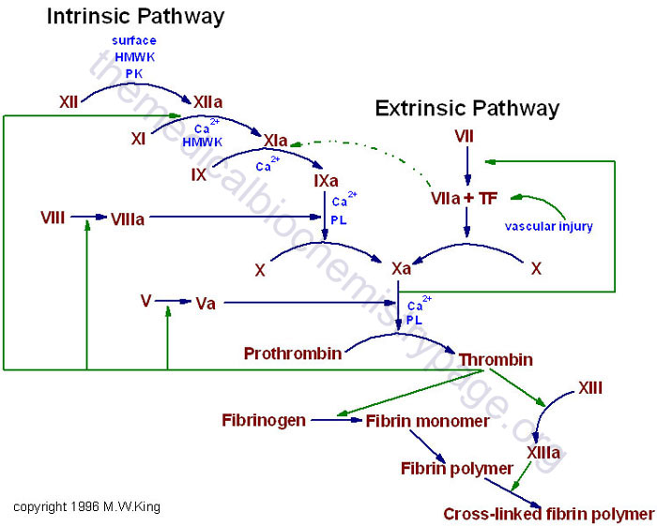

Slide 3
The ‘ideal’ oral anticoagulant
Oral, preferably once daily
Rapid onset and offset of action
Predictable PK and PD
Low propensity for food and drug interactions
Fixed doses
Wide therapeutic window
⇒ Easy to use with no need for monitoring

Slide 4
ORAL ANTICOAGULATION IN STROKE
ATRIAL FIBRILLATION

Slide 5
Persistent AF and paroxysmal AF are potent predictors of first and recurrent stroke.
More than 75 000 cases of stroke per year are attributed to AF.
Patients with AF have a stroke risk of 4.5% per year
Risk stratification may help in identifying which patients with AF benefit most from anticoagulation

Slide 6
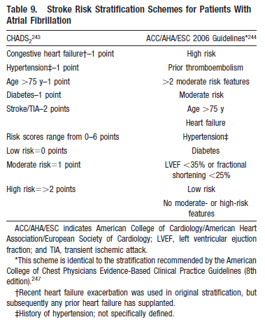

Slide 7
6 independent cohorts of patients with atrial fibrillation, with a score of
0 points indicating low risk (0.5% to 1.7%);
1 point, moderate risk (1.2% to 2.2% per year);
2 points, high risk (1.9% to 7.6% per year).

Slide 8
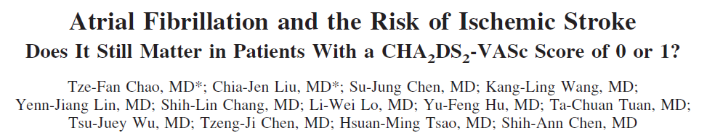

Slide 9
Antiplatelet therapy with aspirin is recommended for low-risk and some moderate-risk patients with atrial fibrillation, based on patient preference, estimated bleeding risk if anticoagulated, and access to high-quality anticoagulation monitoring
(Class I;Level of Evidence A).

Slide 10
Adjusted-dose warfarin (target INR, 2.0 to 3.0) is recommended for all patients with nonvalvular atrial fibrillation deemed to be at high risk and many deemed to be at moderate risk for stroke who can receive it safely
(Class I; Level of Evidence A).

Slide 11
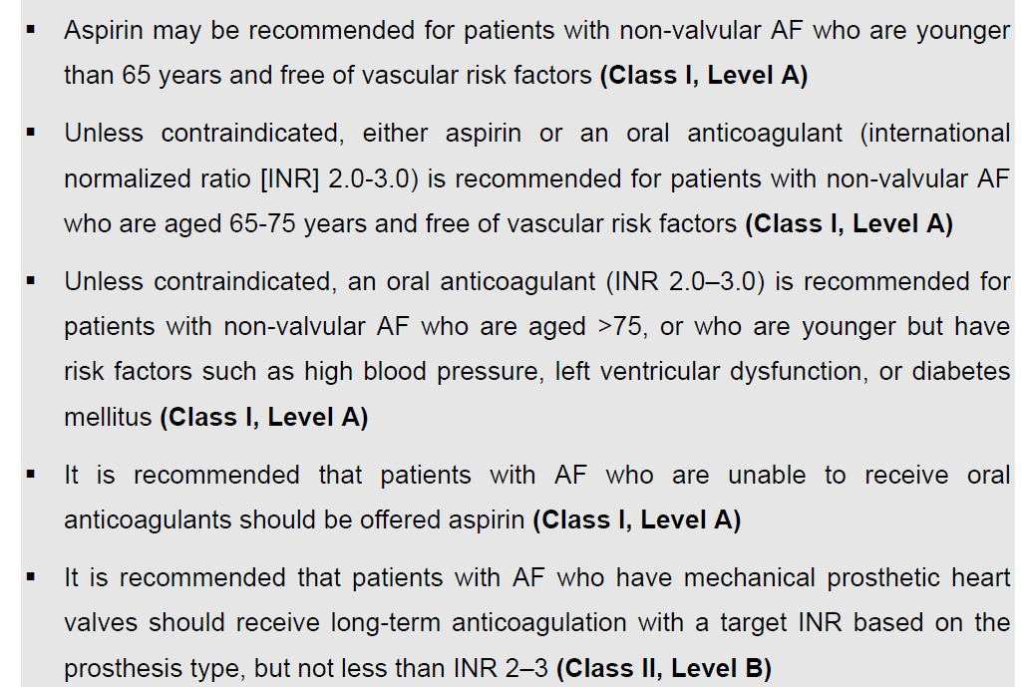

Slide 12
Warfarin
Advantage
  Low cost
  Effective (if done the “right” way)
Disadvantage
  Narrow therapeutic index, requiring frequent blood draws and monitoring
  Multiple drug and/or food interactions
  Variability in dose response
  Slow onset

Slide 13
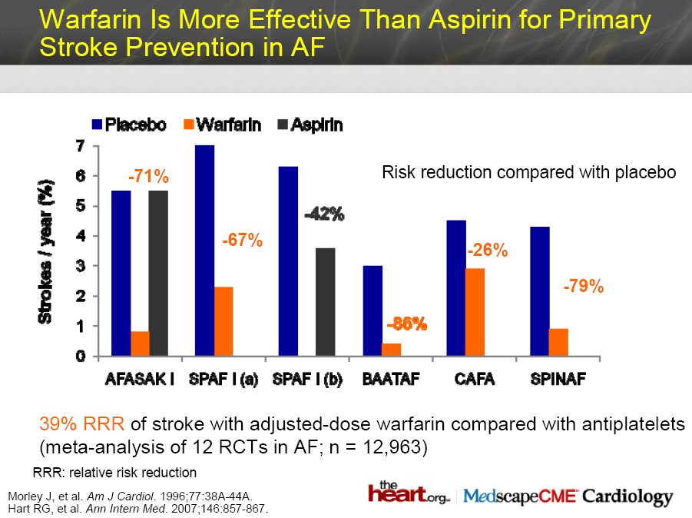

Slide 14
Problems with Warfarin
Narrow Therapeutic Index
Monitoring related problems
TTR
Lab errors
Drug interactions

Slide 15
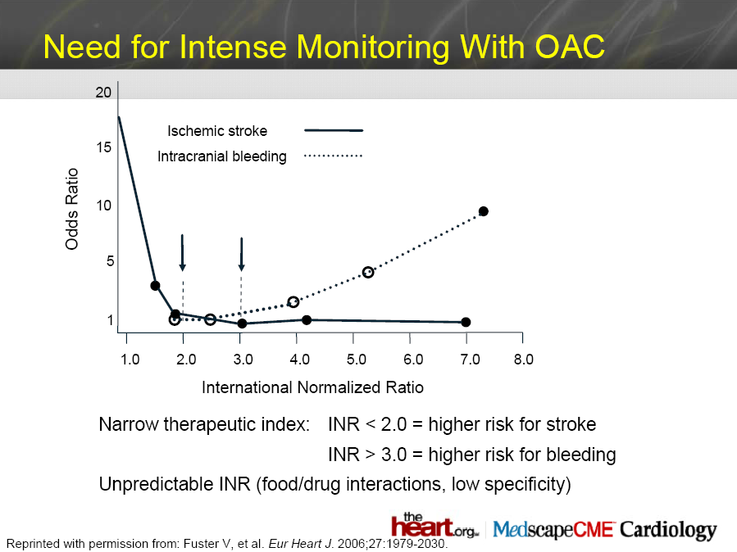

Slide 16
Time in therapeutic range (TTR) of patients taking warfarin
The time in which the patient spends in this INR range as a percentage of the total time the patient had been on warfarin is known as the time in therapeutic range, or TTR

Slide 17
Patients who are within their therapeutic INR range over 70% of the time show good survival . Once the TTR falls below 70 % the survival falls dramatically. If the TTR is less than 40% the patient has a higher risk of stroke than in patients who aren’t receiving warfarin at all
Morgan CL et al. Warfarin treatment in patients with atrial fibrillation: Observing outcomes associated with varying levels of INR control. Thromb Res. 2009;124:37–41.

Slide 18
Concomitant medication that interacted with warfarin,
Poor compliance
Complex pharmacogenomics of warfarin metabolism.

Slide 19
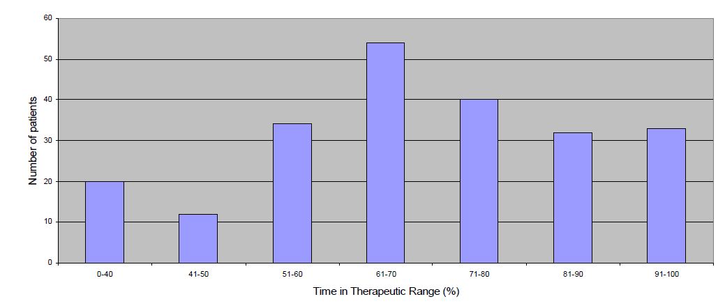

Slide 20
Drug interactions
Decreased metabolism due to CYP2C9 inhibition by
Amiodarone,
Loop diuretics
Azole antifungals, isoniazid, metronidazole,
Cotrimoxazole,
Clopidogrel,
Fluoxetine,
Valproate

Slide 21
New Anticoagulants
ORAL
PARENTERAL
TF/VIIa
TFPI (tifacogin)
TTP889
X
IX
Rivaroxaban
Apixaban
LY517717
YM150
DU-176b
Betrixaban
TAK 442
IXa
APC (drotrecogin alfa)
sTM (ART-123)
VIIIa
Va
Xa
AT
Fondaparinux
Idraparinux
II
DX-9065a
Dabigatran
IIa
Fibrinogen
Fibrin
Adapted from Weitz & Bates, J Thromb Haemost 2007
Notes:
There are many targets for novel anticoagulants in the coagulation pathway:
Tissue factor pathway inhibitor (TFPI) bound to Factor Xa inactivates the tissue factor (TF)–Factor VIIa complex, preventing initiation of coagulation
Activated protein C (APC) degrades Factors Va and VIIIa, and thrombomodulin (soluble; sTM) converts thrombin (Factor IIa) from a procoagulant to a potent activator of protein C
Fondaparinux and idraparinux indirectly inhibit Factor Xa, requiring antithrombin (AT) as a cofactor
Direct (AT-independent) inhibitors of Factor Xa include rivaroxaban (BAY 59­7939), LY517717, YM150 and DU-176b (all orally available), and DX-9065a (intravenous)
Oral, direct thrombin inhibitors include ximelagatran (now withdrawn) and dabigatran
Weitz JI & Bates SM. New anticoagulants. J Thromb Haemost 2005;3:1843–1853

Slide 22
Direct Thrombin inhibition
XIIa
Tissue factor
XIa
VIIa
IXa
Xa
II
×
Factor IIa
(thrombin)
Dabigatran

Slide 23
Direct Factor Xa inhibition
XIIa
Tissue factor
XIa
×
VIIa
IXa
Xa
Rivaroxaban
Apixaban
YM150
DU-176b
LY517717
Betrixaban
TAK 442
Factor II
(prothrombin)
Fibrinogen
Fibrin clot

Slide 24
Agent | Status, phase
Direct thrombin inhibitors
Dabigatran etexilate | 3
AZD 0837 | 2
MCC 977 | 2
Direct factor Xa inhibitors
Rivaroxaban | 3
Apixaban | 3
Edoxaban (DU-176b) | 3
Betrixaban | 2
Indirect factor Xa inhibitor
Idraparinux* | 3
Idrabiotaparinux* | 3
Novel VKA
ATI-5923 | 2b
Garcia D et al. Blood. 2010;115:15-20.

Slide 25
New and old anticoagulants
Features | Warfarin | New agents
Onset | Slow | Rapid
Dosing | Variable | Fixed
Food/drug interactions | Many | None or very few
Monitoring | Yes | No
Half life | Long | Short
Antidote | Yes | No

Slide 26
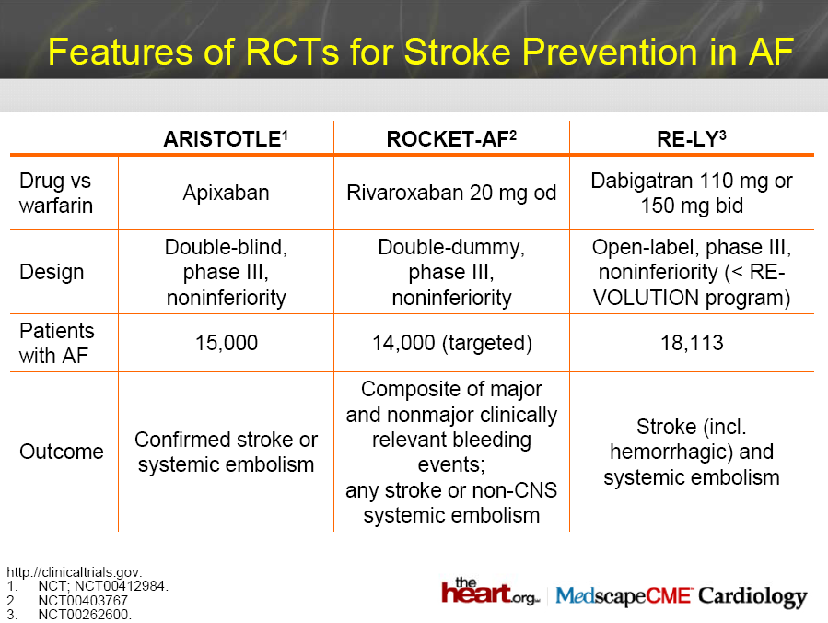

Slide 27
Comparison of the New anticoagulants
 | Dabigatran | Rivaroxaban | Apixaban
Mechanism of action | direct thrombin inhibitor (both free and clot-bound) | direct factor Xa inhibitor | direct factor Xa inhibitor
Bioavailability | 7.2% | >80% | >50%
Peak concentration | 1.5hrs | 3hrs | 3-4hrs
Half life | 14-17hrs | 4-9hrs (up to 12hrs in patients >75yo) | 10-14hrs
Metabolism | activated by liver up to 80% excreted by kidney | 66% excreted by kidney | Partially by CYP3A4 25% excreted by kidney
Interaction | quinine/quinidine, verapamil | very few | very few (does not inhibit or induce CYP enzymes)
Garcia D et al. Blood. 2010;115:15-20.
Notes:
Dabigatran etexilate is a prodrug, activated by liver to become dabigatran, clinical trials excluded patients with kidney failure
Rivaroxaban is contraindicated in patients with crcl <30

Slide 28
Direct Thrombin inhibition
XIIa
Tissue factor
XIa
VIIa
IXa
Xa
II
×
Factor IIa
(thrombin)
Dabigatran

Slide 29
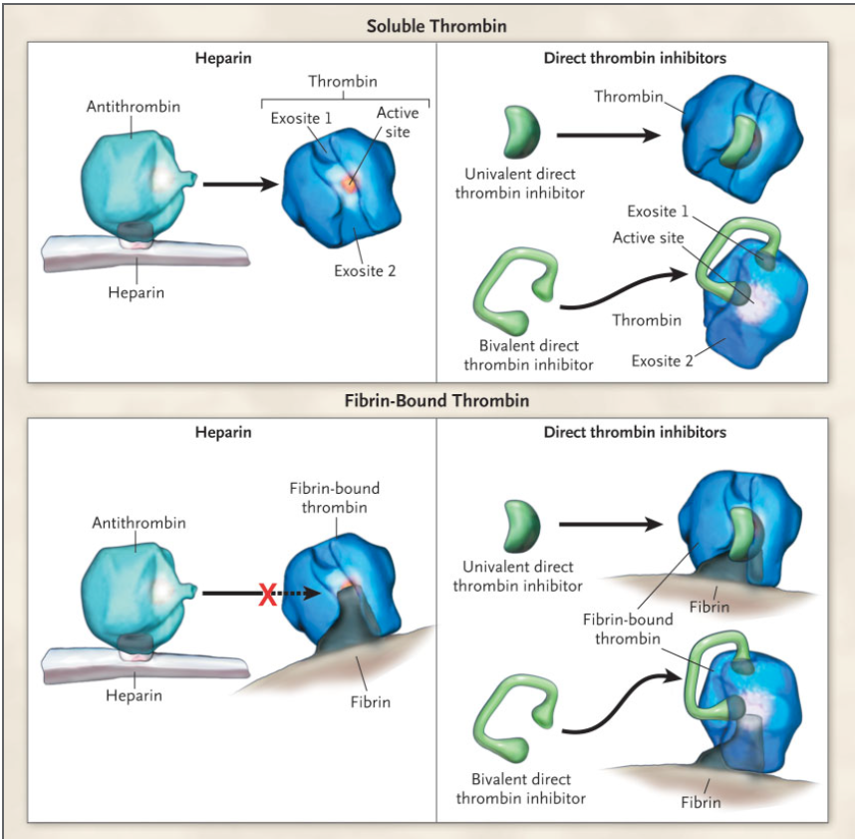

Slide 30
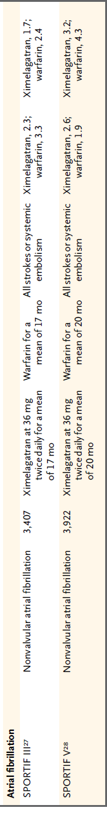

Slide 31
Data on longer-term use of ximelagatran and melagatran indicate that alanine aminotransferase levels can become elevated after one to six months in 6 to 10 percent of patients.
Although increases that have been reported so far are usually asymptomatic and reversible, even if the medication is continued, the few cases of fatal hepatotoxicity observed with prolonged administration of ximelagatran have led the FDA to deny approval of ximelagatran in the United States, and only short-term use of ximelagatran has been approved in Europe

Slide 32
Dabigatran (Pradaxa®)
Direct thrombin inhibitor
Approved by FDA on 20/10/2010
The first and only new oral anticoagulant that is currently approved in the US
The only FDA approved indication – prevention of stroke in atrial fibrillation (RE-LY trial)
Several large phase III trials are either completed or ongoing for dabigatran in DVT prophylaxis and acute VTE treatments

Slide 33
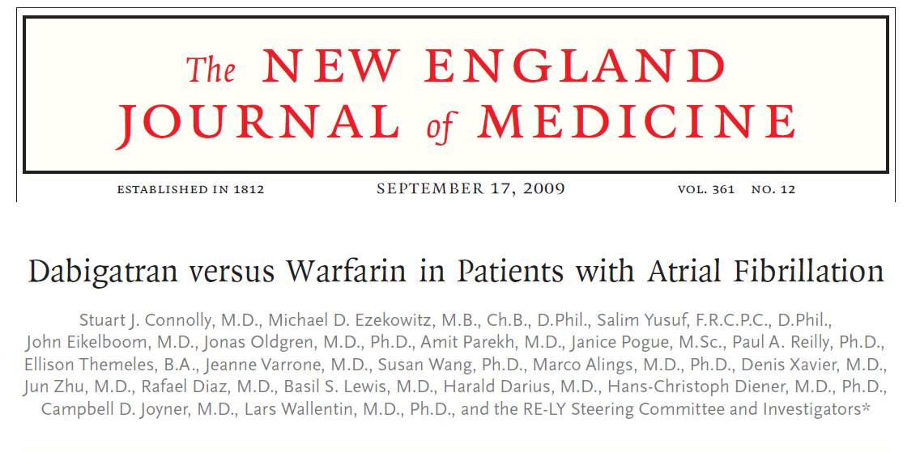

Slide 34
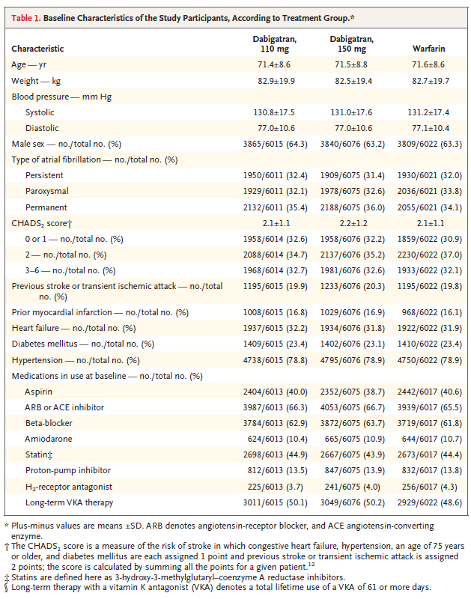

Slide 35
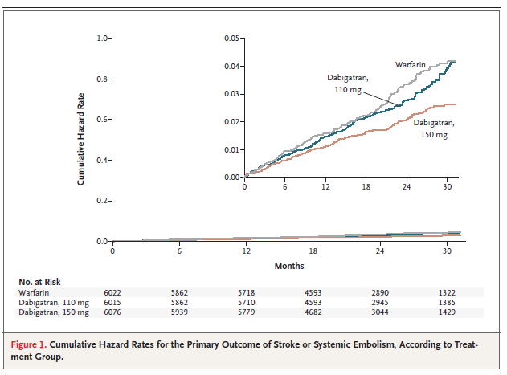

Slide 36
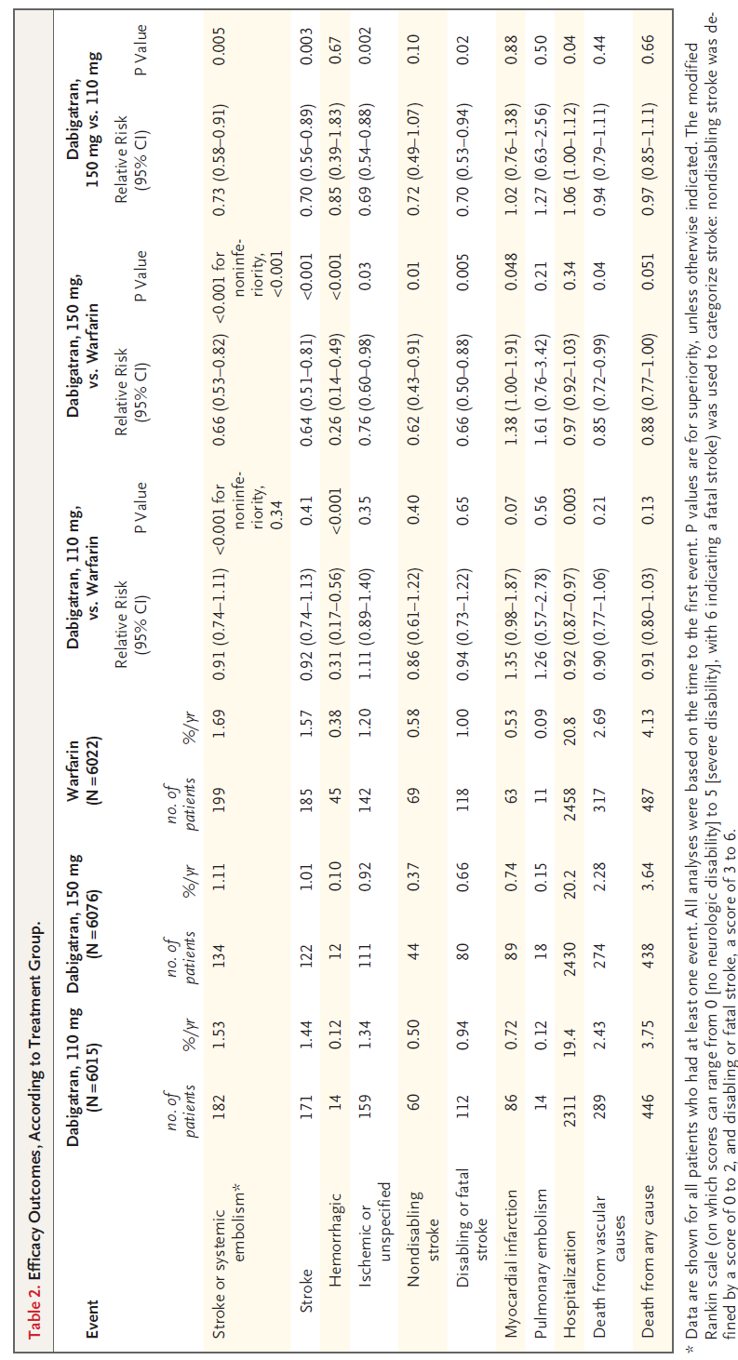

Slide 37
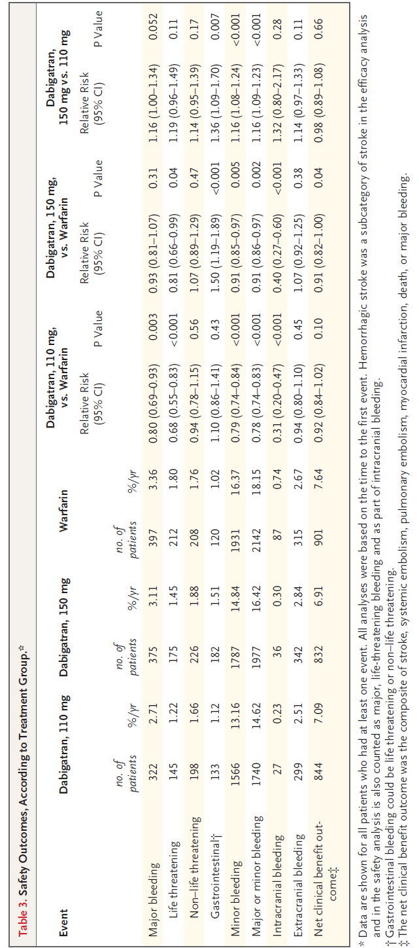

Slide 38
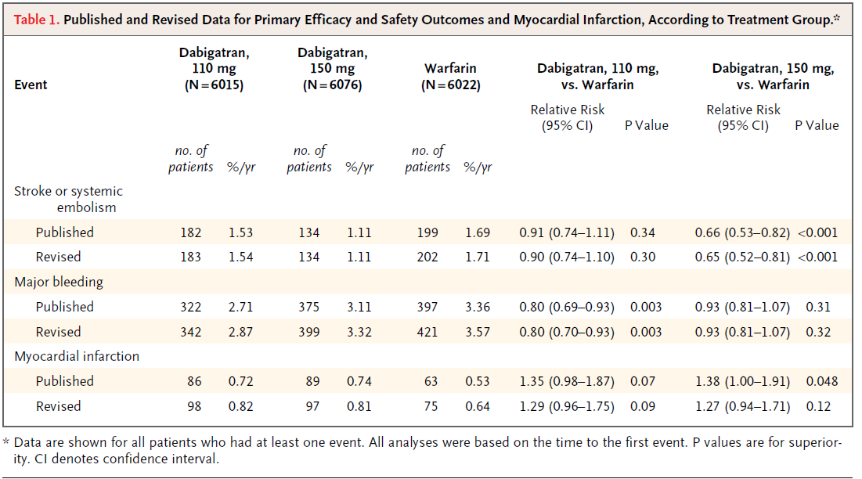

Slide 39
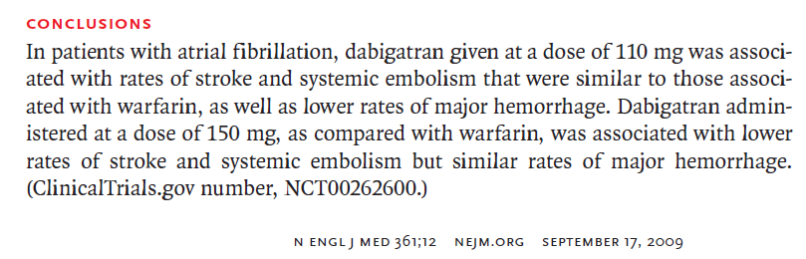

Slide 40
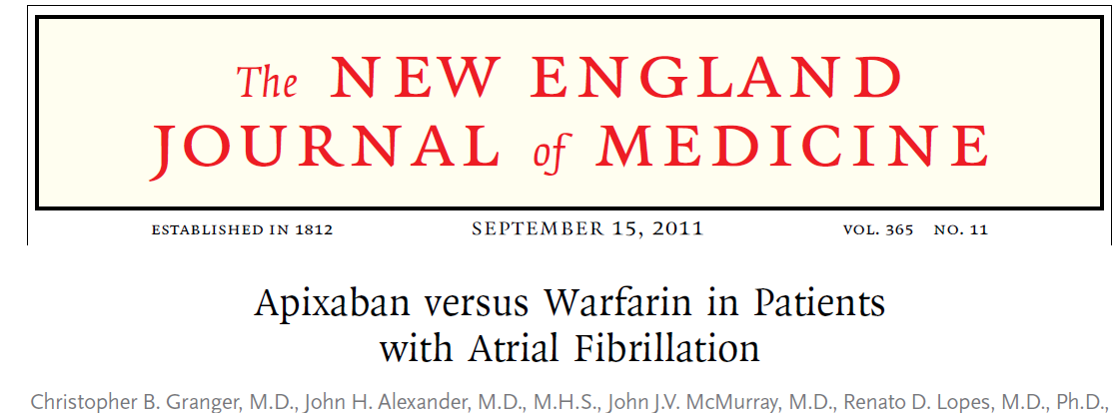

Slide 41
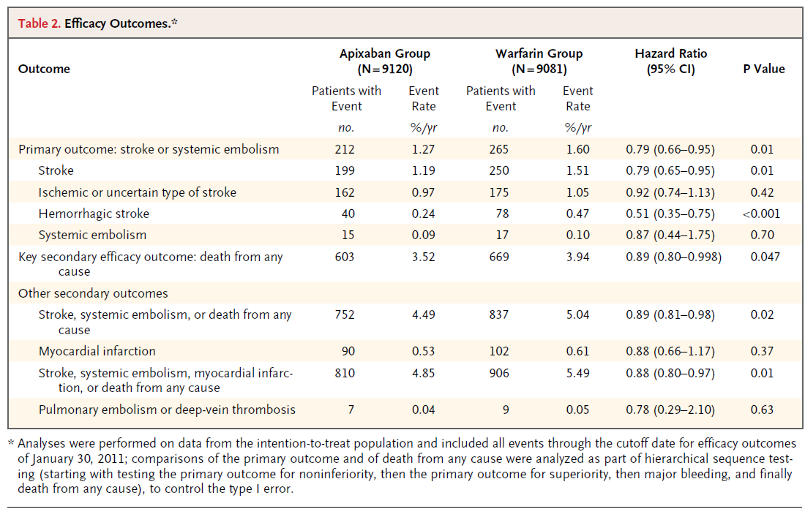

Slide 42
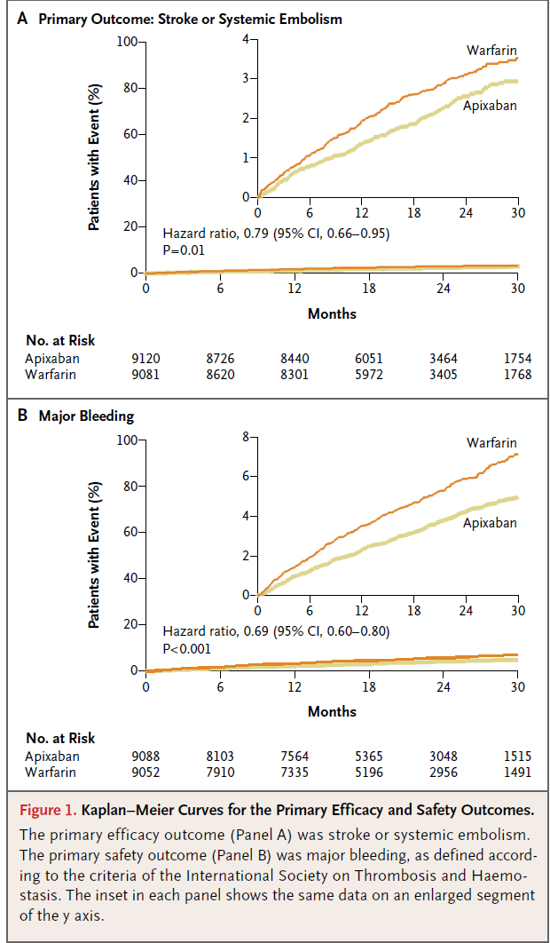

Slide 43
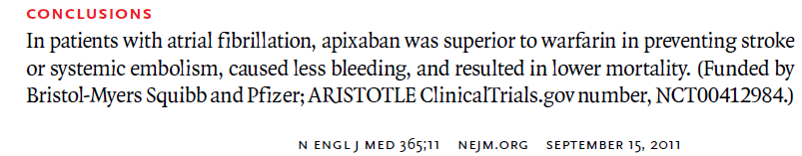

Slide 44
ACUTE VENOUS THROMBOEMBOLISM
PROPHYLAXIS

Slide 45
Dabigatran: Summary of VTE prophylaxis trials
 | Hip trials |  | Knee trials
 | RENOVATE | RENOVATE II | REMODEL | REMOBILIZE
Dabigatran Dosing | 150mg po daily 220mg po daily | 220mg po daily | 150mg po daily 220mg po daily | 150mg po daily 220mg po daily
Comparator dosing | Enoxaparin 40mg SC daily | Enoxaparin 40mg SC daily | Enoxaparin 40mg SC daily | Enoxaparin 30mg SC bid
Duration | 28-35 days | 28-35 days | 6-10 days | 12-15 days
N | 3494 | 2013 | 2010 | 2615
Note: First dose of dabigatran to start 1-4 hours post op, at half dose x1 day
Enoxaparin 40 daily to start pre op, enoxaparin 30 bid to start post op
Eriksson BI, et al. “Journal of Thrombosis and Haemostasis. 2007;5:2178-85.
The RE-MOBILIZE writing committee. The Journal of Arthroplasty. 2009;24(1):1-9.
Eriksson BI, et al. Lancet 2007;370:949-56.

Slide 46
Dabigatran: Summary of VTE prophylaxis trials
*REMOBILIZE is the only trial which did not show non-inferiority
No difference in bleeding amongst agents in all trials

Slide 47
RE-COVER Trial
Design: randomized, double-blinded, non-inferiority
Dabigatran 150 bid vs warfarin
228 centers in 29 countries
N=2539 (1273 in Dabigatran, 1266 in warfarin)
Primary end points: 6-month incidence of recurrent symptomatic, objectively confirmed venous thromboembolism and related death.
Safety end points:
  Bleeding events
  Acute coronary syndromes
  Other adverse events, liver function tests

Slide 48

Schulman S, et al. N Eng J Med. 2009;361:2342-2352.
http://www.boehringeringelheim.com/content/dam/internet/opu/com_EN/protected/document/01_news/02_Press_and_Informationpacks/backgrounder_RE-COVER_FINAL_changes%20marked_up.pdf

Slide 49
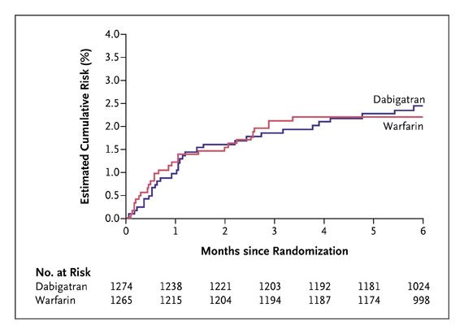

Cumulative Risk of Recurrent Venous Thromboembolism or Related Death during 6 Months of Treatment among Patients Randomly Assigned to Dabigatran or Warfarin.
Dabigatran: 2.4%
Warfarin: 2.1%
HR 1.10 (0.65-1.84), p<0.001 for non-inferiority criteria
Schulman S et al. N Engl J Med 2009;361:2342-2352.
Notes:
Figure 1. Cumulative Risk of Recurrent Venous Thromboembolism or Related Death during 6 Months of Treatment among Patients Randomly Assigned to Dabigatran or Warfarin.

Slide 50
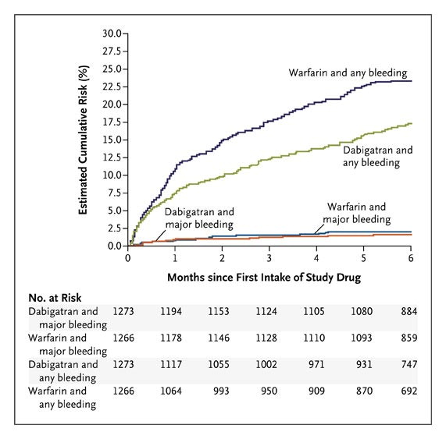
Cumulative Risks of a First Event of Major Bleeding and of Any Bleeding among Patients Randomly Assigned to Dabigatran or Warfarin.
Dabigatran: 1.6%
Warfarin: 1.9%
HR 0.82(0.45-1.48)
Dabigatran: 16.9%
Warfarin: 21.9%
HR 0.71(0.59-0.85)
Schulman S et al. N Engl J Med 2009;361:2342-2352.
Notes:
Figure 2. Cumulative Risks of a First Event of Major Bleeding and of Any Bleeding among Patients Randomly Assigned to Dabigatran or Warfarin. The hazard ratio with dabigatran for major bleeding at 6 months was 0.82 (95% CI, 0.45 to 1.48; P=0.38), and the hazard ratio with dabigatran for any bleeding at 6 months was 0.71 (95% CI, 0.59 to 0.85; P<0.001)

Slide 51
RE-COVER Trial
PE accounts for 30% of the study population
Mean age 55 yo, 95% white, >90% with CrCl >50
Only ~5% of patients have cancer
First dose of dabigatran was only given after median of 9 days after parenteral anticoagulation, giving rise to the question of the effectiveness of dabigatran monotherapy in acute setting
Dabigatran group has more dyspepsia(2.9% vs 0.6%) and discontinuation of drugs (9% vs 6.8%)
Schulman S et al. N Engl J Med 2009;361:2342-2352.

Slide 52
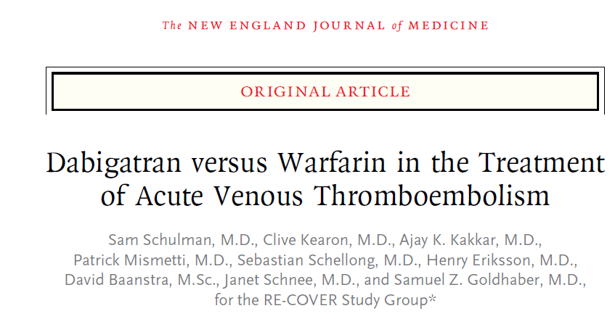
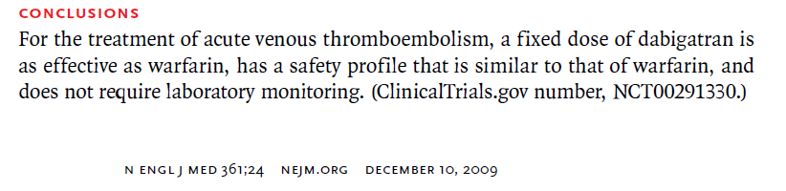

Slide 53
Rivaroxaban (Xarelto®)
A direct factor Xa inhibitor
Approved in Canada and Europe for DVT prophylaxis for after total knee and hip replacement, based on RECORD trial 1-4
Not yet approved in the US.
  In May 2009, FDA is concerned that rivaroxaban “could lead to bleeding events in significantly more patients than enoxaparin”, and requested more safety data before approval.

Slide 54
Rivaroxaban: Summary of the RECORD trials
 | Hip trials |  | Knee trials
 | RECORD 1 | RECORD 2 | RECORD 3 | RECORD 4
Rivaroxaban dosing | 10mg po daily | 10mg po daily | 10mg po daily | 10mg po daily
Comparator dosing | Enoxaparin 40mg SC daily | Enoxaparin 40mg SC daily | Enoxaparin 40mg SC daily | Enoxaparin 30mg SC bid
Duration | Riva:35 days Enox: 35 days | Riva:35 days Enox: 14 days | 14 days | 14 days
N | 4541 | 2509 | 2531 | 3148
Eriksson BI, et al. N Engl J Med. 2008;358:2765-75.
Kakkar AK, et al. Lancet 2008;372:31-39.
Lassen MR, et al. N Engl J Med. 2008;358:2776-86.
Turpie AGG, et al. Lancet 2009;373:1673-80.

Slide 55
Rivaroxaban: Summary of the RECORD trials
Not statistically significant in all trials
Notes:
Major bleeding: clinically overt bleeding that was fatal, in a critical organ, such as intracranial, intraspinal, retroperitoneal, nessitated operation, fall in hgb of 2 or needing transfuse of >2 units
Clinically relevant non-major bleeding- multiple source bleeding, unexpected hematoma (>25cm), excessive wound hematoma, nose or gingival bleeding >5min, macroscopic hematuria, rectal bleeding, cough or vomiting blood, vaginal bleeding, intra-auricular bleeding with trauma, or surgical site bleeding.

Slide 56
EINSTEIN-DVT Trial
Design: open-label, randomized, non-inferiority
Population: patients with acute symptomatic DVT
Rivaroxaban 15mg po bid x3 weeks then 20mg po daily v.s. enoxaparin followed by vitamin K antagonist
Primary endpoint: recurrent venous thromboembolism
Principal safety outcome: major bleeding or clinically relevant non-major bleeding
The EINSTEIN Investigators. N Engl J Med 2010;363:2499-2510.

Slide 57
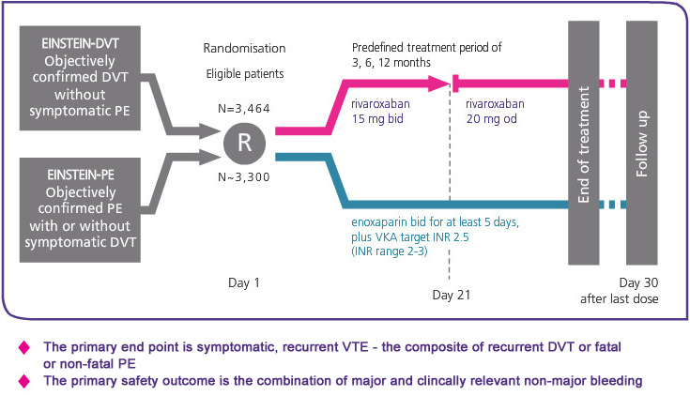
EINSTEIN-DVT and EINSTEIN-PE Schema
N=1731
N=1718
The EINSTEIN Investigators. N Engl J Med 2010;363:2499-2510.
Notes:
Lovenox d/c after at least 2 days of INR >2 and total >5days, coumadin started within 48 hours of randomization

Slide 58
EINSTEIN Extension Trial
Design: double-blind, randomized, event-driven superiority study
Patient population: patients with confirmed DVT or PE s/p full anticoagulation for 6-12 mo
Rivaroxaban 20mg po daily v.s. placebo
Primary endpoint: recurrent venous thromboembolism
Principal safety outcome: major bleeding
The EINSTEIN Investigators. N Engl J Med 2010;363:2499-2510.

Slide 59
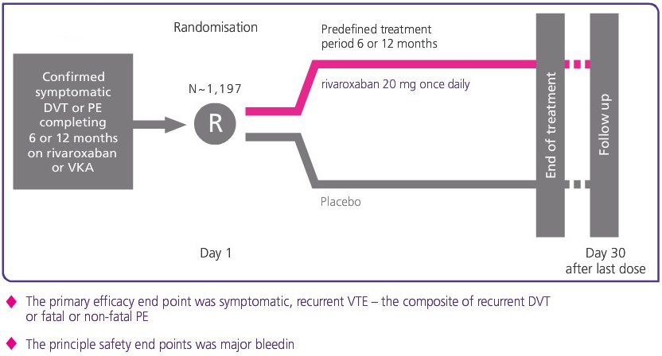
EINSTEIN Extension Trial
N=602
N=594
The EINSTEIN Investigators. N Engl J Med 2010;363:2499-2510.

Slide 60
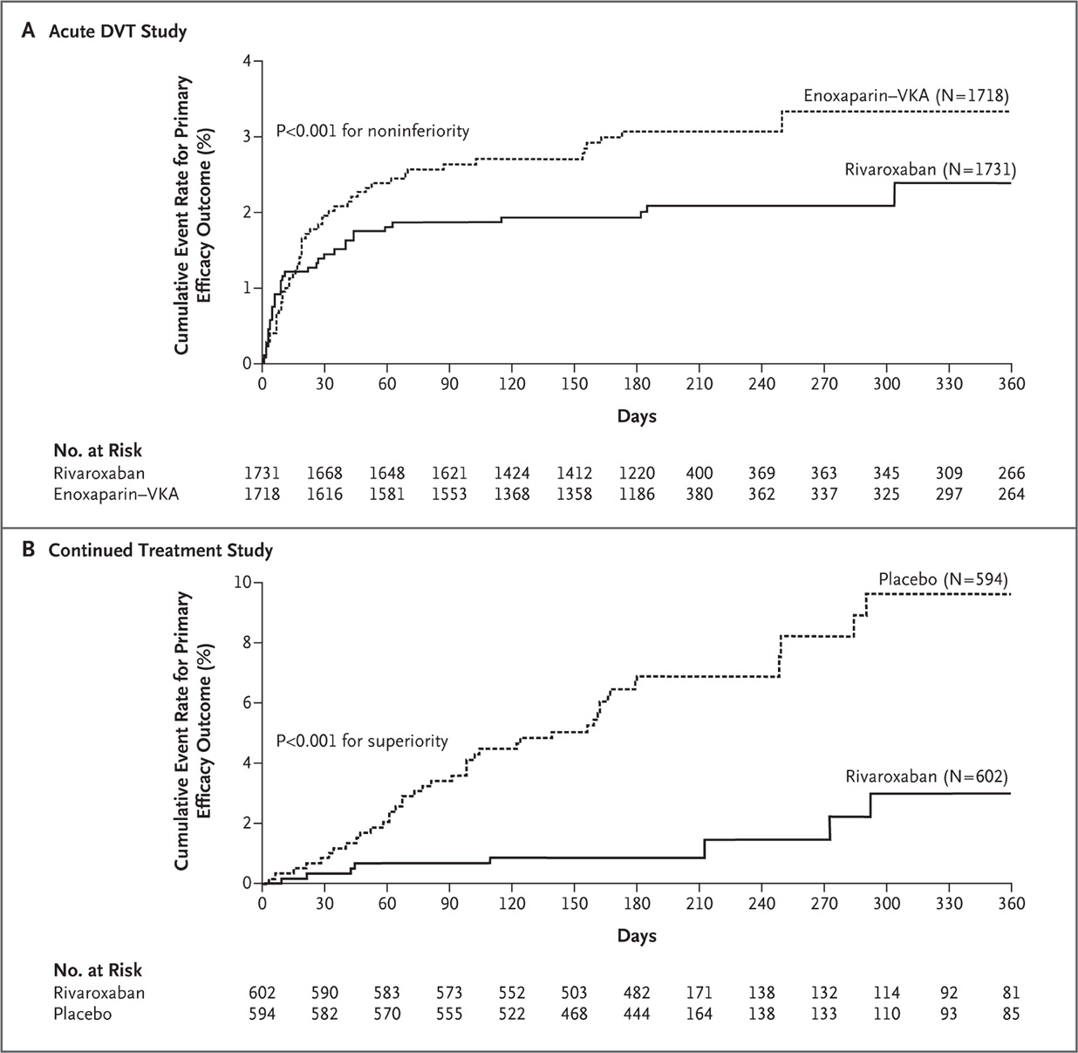
Kaplan–Meier Cumulative Event Rates for the Primary Efficacy Outcome in the Two Studies.
3.0%
2.1%
(HR 0.68, CI 0.44-1.04 p<0.001)
7.1%
1.3%
(HR 0.18, CI 0.09-0.39, p<0.001)
The EINSTEIN Investigators. N Engl J Med 2010;363:2499-2510.
Notes:
Figure 2. Kaplan–Meier Cumulative Event Rates for the Primary Efficacy Outcome in the Two Studies. VKA denotes vitamin K antagonist.
P<0.01 for noninf with a one-sided test, p=0.08 for sup with a two sided test

Slide 61
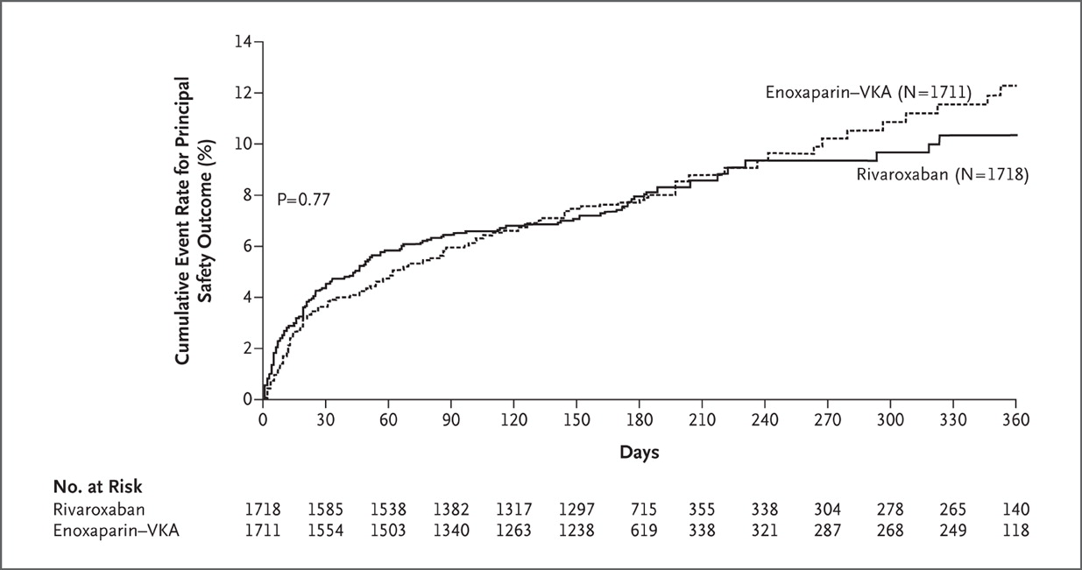
Kaplan–Meier Cumulative Event Rates for the Principal Safety Outcome in the Acute DVT Study.
The EINSTEIN Investigators. N Engl J Med 2010;363:2499-2510.
Notes:
Figure 3. Kaplan–Meier Cumulative Event Rates for the Principal Safety Outcome in the Acute DVT Study. VKA denotes vitamin K antagonist.

Slide 62
Apixaban
Direct factor Xa inhibitor
Not yet approved in Canada, Europe, or the US
ADVANCE Trials demonstrating non-inferiority of Apixaban to enoxaparin in DVT prophylaxis
AMPLIFY Trial – acute DVT treatment

Slide 63
Apixaban: Summary of ADVANCE trials
 | Knee trials |  | Hip trial
 | ADVANCE 1 | ADVANCE2 | ADVANCE 3
Apixaban dosing | 2.5mg po bid | 2.5mg po bid | 2.5mg po bid
Comparator dosing | Enoxaparin 30mg SC bid | Enoxaparin 40mg SC daily | Enoxaparin 40mg SC daily
Duration | 10-14 days | 10-14 days | 35 days
N | 3195 | 3057 | 5407
Lassen MR, et al. N Engl J Med. 2009;361:594-604.
Lassen MR, et al. Lancet 2010;375:807-15.
Lassen MR, et al. N Engl J Med. 2010;363:2487-98.

Slide 64
Apixaban: Summary of ADVANCE trials
Notes:
Advance 1 noninf, all others superior

Slide 65
Apixaban for Prevention of VTE After Major Orthopaedic Surgery
Apixaban od and bid (total daily doses 5-20mg) were assessed relative to enoxaparin and warfarin, in 1,217 patients
Total VTE and All-Cause Mortality (%)
Major Bleeding (%)
Percent
Percent
5mg
10mg
20mg
Warfarin
(INR
1.8-3.0)
Enoxaparin
(30mg bid)
5mg
10mg
20mg
Warfarin
(INR
1.8-3.0)
Enoxaparin
(30mg bid)
Apixaban
(Total Daily Dose)
Apixaban
(Total Daily Dose)
Lassen et al. Blood 2006

Slide 66
AMPLIFY Trial
double-blind, active controlled, non-inferiority study
Enoxaparin + warfarin
N~2408
End of treatment and 30 day follow up
Confirmed symptomatic DVT/PE
R
6 month
N~2408
Apixaban 10mg bidx7d, then 5 bid
Notes:
Amplify ext- after 6-12 month of tx for DVT/PE, rand, then apixabann 2.5 bid vs 5 bid vs placebo for up to 12 months

Slide 67
Apixaban for the Treatment of DVT:
The Botticelli-DVT Study
Apixaban bid (5 and 10mg) and od (20mg) were assessed relative to low molecular weight heparin (LMWH) or fondaparinux followed by VKA, in 520 patients
Composite of Symptomatic Recurrent VTE and Deterioration of Thrombotic Burden (%)
Major Bleeding (%)
Percent
Percent
5mg
bid
10mg
bid
20mg
bid
LMWH/
fondaparinux
+ VKA
5mg
bid
10mg
bid
20mg
bid
LMWH/
fondaparinux
+ VKA
Apixaban
Apixaban
Büller, Eur Heart J 2006

Slide 68
CEREBRAL VENOUS THROMBOEMBOLISM

Slide 69
Treatment with heparin as soon as the diagnosis is confirmed, even in the presence of hemorrhagic infarcts.
No studies have compared the effect of fractionated heparin with that of unfractionated heparin.

Slide 70
After three to four days of heparin therapy or after the patient has shown steady improvement, warfarin is started at minimally effective doses, both are overlapped for two days and then heparin is withdrawn.
But the optimal duration of oral anticoagulant after the acute phase is decided by the individual patient profile.
Usually oral anticoagulants are given for six months after a first episode of venous sinus thrombosis, or longer when there is persistence of the predisposing factors.

Slide 71
STROKE OTHER CAUSES

Slide 72
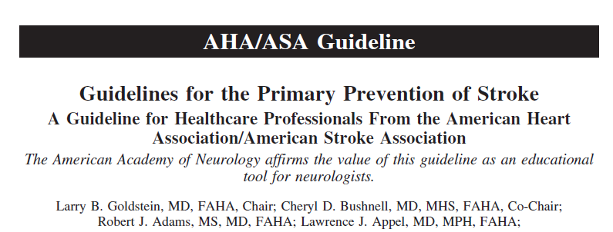
Stroke. 2011;42:517–584.

Slide 73
ACC/AHA practice guidelines providing strategies to reduce the risk of stroke in patients with a variety of cardiac conditions, including valvular heart disease,unstable angina, chronic stable angina, and acute MI are emdorsed.

Slide 74
It is reasonable to prescribe warfarin to post–STsegment elevation MI patients with left ventricular mural thrombi or an akinetic left ventricular segment to prevent stroke
(Class IIa; Level of EvidenceA).

Slide 75
HYPERCOAGULABLE STATE

Slide 76
Those stroke patients (primarily young women) who have a history of thrombotic events and meet the laboratory criteria for aPL syndrome might benefit from primary prevention strategies such as moderate intensity warfarin (INR, 2.0 to 3.0).
This is currently being tested in a primary prevention trial of warfarin therapy (INR,
2.0 to 2.5) to decrease thromboembolic events in patientswith lupus and aPL.

Slide 77
The usefulness of specific treatments for primary stroke prevention in asymptomatic patients with hereditary or acquired thrombophilia is not well established
(Class IIb; Level of Evidence C).

Slide 78
Anticoagulation after myocardial infarction.
Three randomized, double-blind clinical trials have evaluated warfarin treatment versus placebo for prevention of thromboembolic events after MI:
The Sixty Plus trial, the Warfarin Re-Infarction Study(WARIS),and the Anticoagulants in the SecondaryPrevention of Events in Coronary Thrombosis(ASPECT) trial.

Slide 79
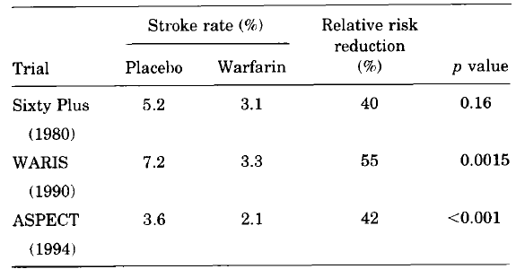
NEUROLOGY 1998;51(S~pp3 ):SZO-SZZ

Slide 80
In all three trials, anticoagulant-treated patients had a lower incidence of thromboembolic events, including
stroke .
A lower stroke risk was especially
apparent in patients with anterior transmural MI and in those with echocardiographic evidence of an intracardiac thrombus.

Slide 81
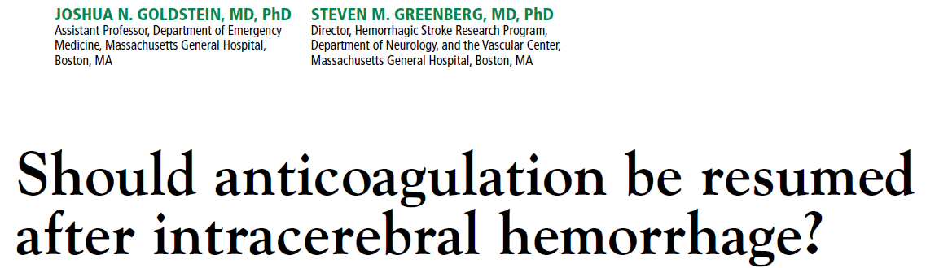

Slide 82
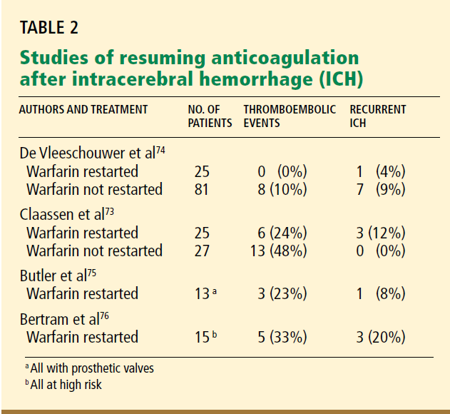

Slide 83
Etiology
Valvular Heart disease
Mechanical heart valve
Atrial fibrillation - High CHADS2 score
Hypercoagulable states
Imaging
Microbleeds in MRI
Type of bleed
Lobar vs Subcortical
Uncontrolled Hypertension
Secondary prevention

Slide 84
The European Stroke Initiative
history of embolic stroke with atrial fibrillation, should be restarted on warfarin after 10 to 14 days, depending on the risk of thromboembolism and ICH recurrence.
The American Heart Association
in patients with a very high risk of
thromboembolism for whom restarting warfarin
is considered, warfarin may be restarted 7
to 10 days after ICH onset.

Slide 85
Alternative anticoagulants to warfarin can be considered especially in Atrial fibrillation but studies are in various stages of development.

Slide 86
Issues related to new anticoagulants

Slide 87
Lab Monitoring
Coagulation tests in patients on dabigatran should be interpreted with caution and peak effect generally occurs within 2-4 hours after administration.

Slide 88
Clinical scenarios may occur where laboratory assessment is necessary:
Urgent/Emergent surgery or invasive procedures
Suspected drug failure (i.e. thrombotic event in patient on dabigatran)
Major or life threatening bleeding complication

Slide 89
Test results are mostly helpful as a
Qualitative assessment (i.e. determining if anticoagulation effect is present or absent).
They are less helpful in quantitative assessment

Slide 90
Activated Partial Thromboplastin Time (aPTT) can be used, but is relatively insensitive to the effects of direct thrombin inhibitors.
The expected median peak aPTT level is approximately 2x control values and median trough aPTT is approximately 1.5x control values.

Slide 91
Normal aPTT suggests little anticoagulant activity is present
Mildly elevated aPTT can be associated with clinically important levels of dabigatran and aPTT becomes increasingly insensitive at higher dabigatran levels as in an overdose.

Slide 92
Thrombin Time for Direct Thrombin Inhibitors (TTDTI)
Qualitatively assess anticoagulation status of patients taking direct thrombin inhibitors.
Sensitive to the effects of therapeutic dabigatran levels
Normal TTDTI excludes the presence of significant dabigatran levels.

Slide 93
Drug overdose/excess anticoagulation, the TTDTI is less useful.
The TTDTI is best used as a sensitive test to ensure no presence of dabigatran

Slide 94
Ecarin Clotting Time (ECT)
There is a strong linear relationship between dabigatran levels and ECT and a normal ECT generally excludes the presence of significant dabigatran levels.
The ECT is not influenced by the concomitant administration of other anticoagulants.

Slide 95
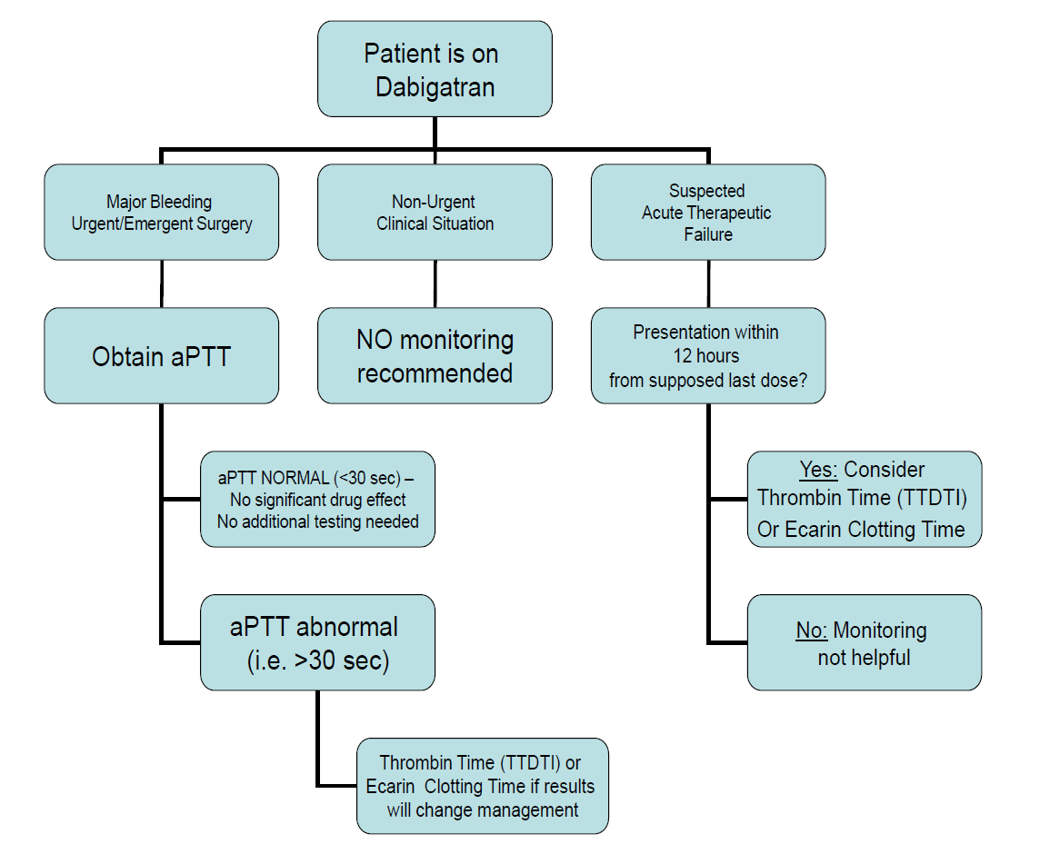

Slide 96
In patients undergoing elective surgery
Surgical interventions may require the temporary discontinuation of dabigatran etexilate.
Dabigatran etexilate should be discontinued at least 24 h prior to elective surgery

Slide 97
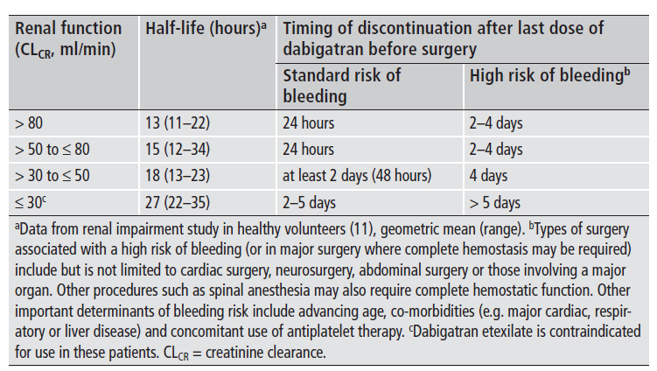

Slide 98
Warfarin to Dabigatran
INR < 2.0
No overlap treatment required

Slide 99
110 mg vs 150 mg Dabigatran
Age > 70 years
Creatinine clearance 30- 50 ml/min
Patient on antiplatelets

Slide 100
tPA administration in therapeutic failure
Last dose given 24 hrs before
aPTT less than 1.5 times the normal

Slide 101
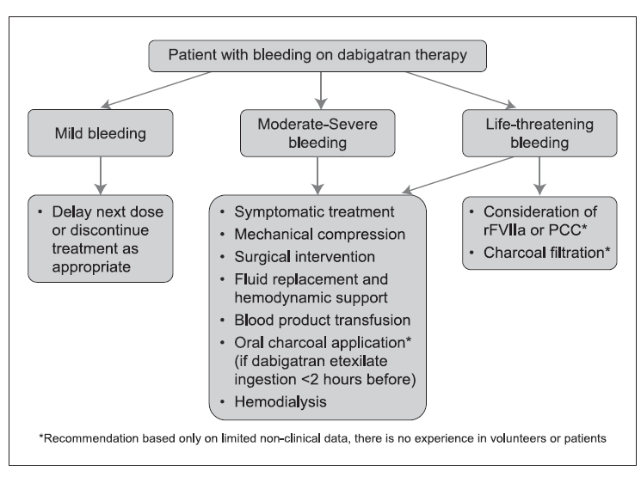

Slide 102
Potential Concerns of Novel Anticoagulants
No antidotes
No methods assessing compliance
No close clinical surveillance
Reduced awareness of the therapy
Cost
Notes:
Patient may self adjust the doses

Slide 103
Cost Comparison of Anticoagulants
Agents | (Indian pharmaceutical.com)
Warfarin | Rs 69 for 30 tablets
Enoxaparin | 6300 Rs for monthly inj
Dabigatran | 4500 Rs for monthly
Rivaroxaban | N/A
Apixaban | N/A

Slide 104
THANK YOU

