Slide 1
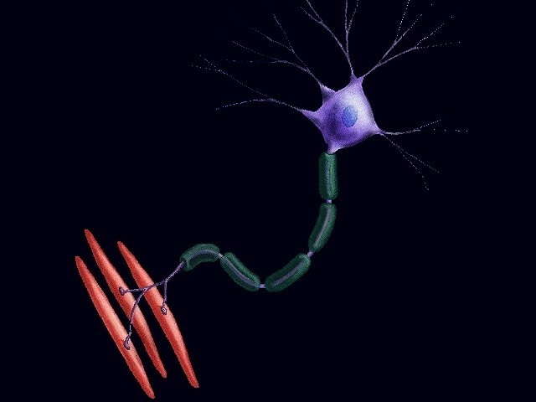
Amyotrophic Lateral Sclerosis
Faculty : Dr. C. Rathore

Slide 2
Scheme of presentation
Introduction
Etio-pathogenesis
Clinical features
Management

Slide 3
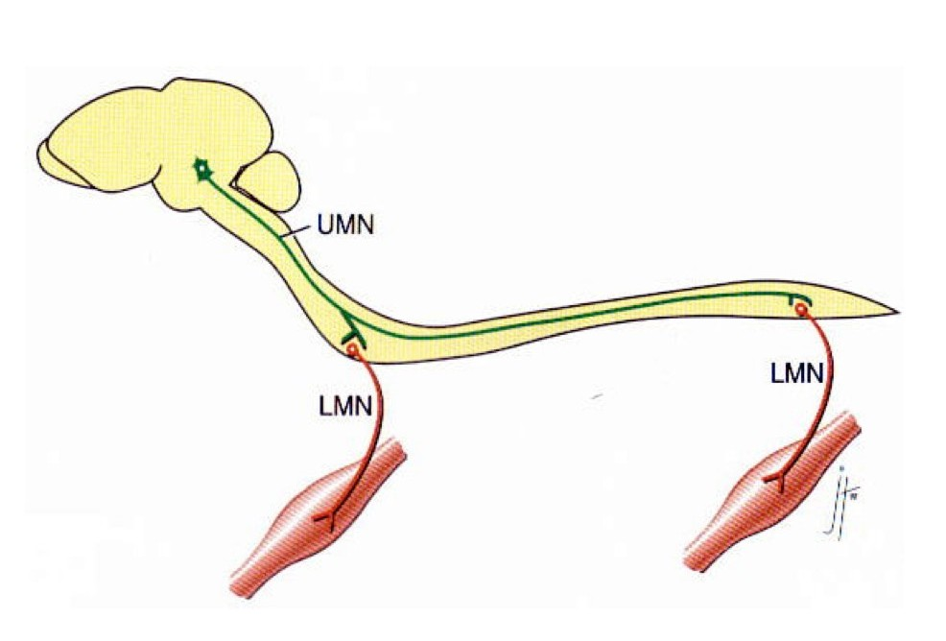
Amyotrophic lateral sclerosis (ALS)
progressive neurodegenerative disease
characterized by loss of motor neurons in
  motor cortex
  brain stem
  spinal cord
dramatically reduces life expectancy

Slide 4
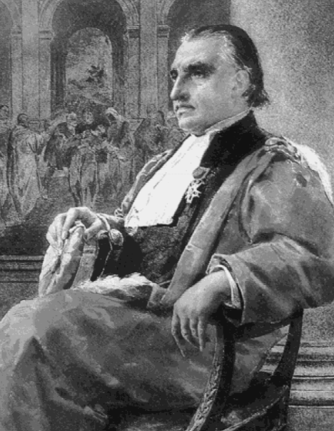
Jean-Martin Charcot
first described ALS in scientific literature.
1869
SLA (sclérose latérale amyotrophique),
  term is preferred in France
Jean-Martin Charcot
Notes:
The methodology available to Charcot was primitive by contemporary standards, but his approach was so insightful that his original descriptions
are considered accurate today

Slide 5
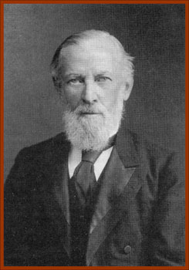

“ALS”O known as…..
Sir William Gowers
United Kingdom
Believed that ALS patients have pathology of both UMNs and LMNs
MND instead of ALS
Lou Gehrig’s disease
United States - 1939
Notes:
Sir William Gowers and Lord Russell Brain made major contributions in the United Kingdom, using the label MND instead of ALS because they believed that all patients have pathology of both UMNs and LMNs, either during life or at autopsy.

Slide 6
Epidemiology
Most frequent adult-onset motor neuron disorder.
Onset - 5th or 6th decade
More frequent in men than women (1.6 : 1)

Slide 7
Prevalence
  3-5/100 000.
Incidence
  2 per 100 000 per year.
  In younger patients - 1-3/500 000 / year.

Slide 8
Pockets of high incidence (50 times more)
  Gaum
  New guinea
  Kii peninsula in Japan.

Slide 9

Sporadic > Inherited
ALS
Sporadic
90 – 95 %
Familial
5 – 10 %
Clinically, FALS and SALS are similar.
Notes:
90-95% - Sporadic ALS (SALS)
the disease occurs randomly, with no clearly associated risk factors
5-10% are inherited - familial ALS (FALS).
most common inheritance - autosomal dominant.
20% of FALS inherited gene mutation encoding the superoxide dismutase 1 (SOD1) enzyme.

Slide 10

Etiopathogenesis

Slide 11
Etiopathogenesis
Unknown
Multifactorial
Large spectrum of etiological factors
Pathogenic mechanisms – largely unclear and many.

Slide 12
ALS
Oxidative stress
Glial cell pathology
Aberrant DNA and RNA metabolism
Heavy metal toxicity
Viral infections
Mitochondrial damage
Defective axonal transport
Genetic
Environmental factors
Glutamate toxicity
Autoimmune
ETIO PATHOGENSIS
Notes:
genetics, autoimmune responses, environmental factors, oxidative stress, glutamate
excitotoxicity, mitochondrial damage, defective axo -nal transport, glial cell pathology, aberrant DNA and
RNA metabolism, toxic effect of heavy metals, viral
infection, paraneoplastic syndromes, lymphomas,
paraproteinaemias

Slide 13

Genetic factors
Genetic factors
Identification of genes causing FALS has been instrumental in understanding the pathogenesis of ALS.
Discovery of SOD1 gene mutation in FALS - 1993
  Important step toward finding the causes of ALS

Slide 14
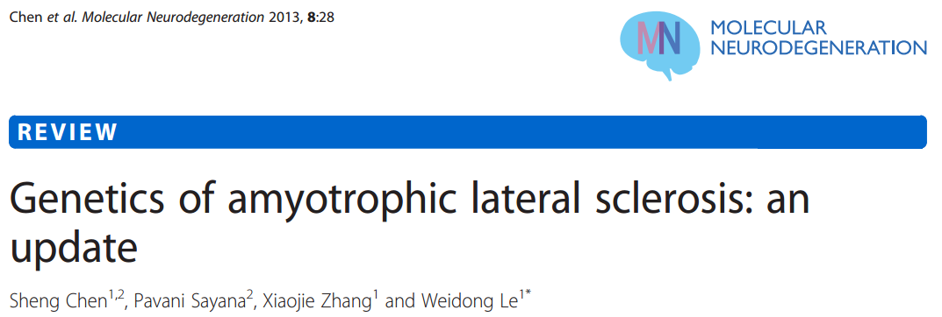
Causative genes have been identified in almost 5-10% of all fALS cases
> 30 % - C9ORF72 mutations
20% - SOD1 gene
4-5% - TARDBP and FUS genes
Rest
  Alsin, Senataxin (SETX), Spatacsin, VAPB, Angiogenin (ANG)
  Factor induced gene 4 (FIG 4), Optineurin
Perhaps other unknown genes

Slide 15
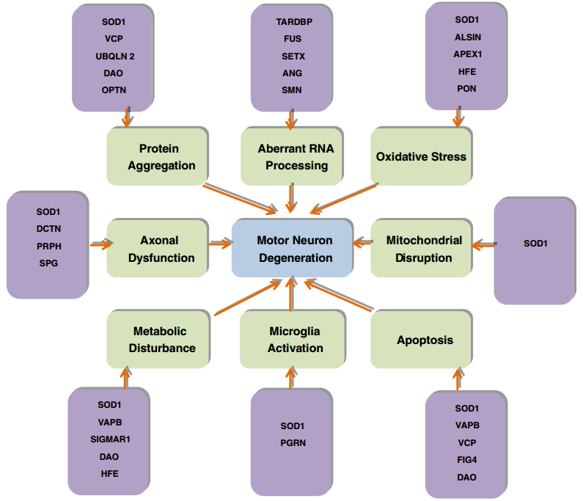
Genes implicated in pathogenesis
Notes:
Figure provides Genetic defects in als and the underlying mechanisms for cause and pathogenesis of disease.
Microglial cells activate an inflammatory cascade via secretion of cytokines. Astrocytes lead to
motor neuron injury through release of inflammatory mediators such as nitric oxide and prostaglandin E2. Accumulation of superoxide radicals
and oxidative stress, aberrant RNA processing, protein misfolding and insoluble proteins may cause motor neuron degeneration in ALS. Protein
aggregation may lead to endoplasmic reticulum stress along with defective endosomal trafficking and mitochondrial damage, which may cause
organelle disruption and activates autophagy and apoptotic pathways. Axonal transport abnormalities lead to energy deficiency in the axon
along with the defective axonal growth and axonal dysfunction. Axonal dysfunction, defective angiogenesis and metabolic disturbance may
contribute to motor neuron degeneration in ALS

Slide 16
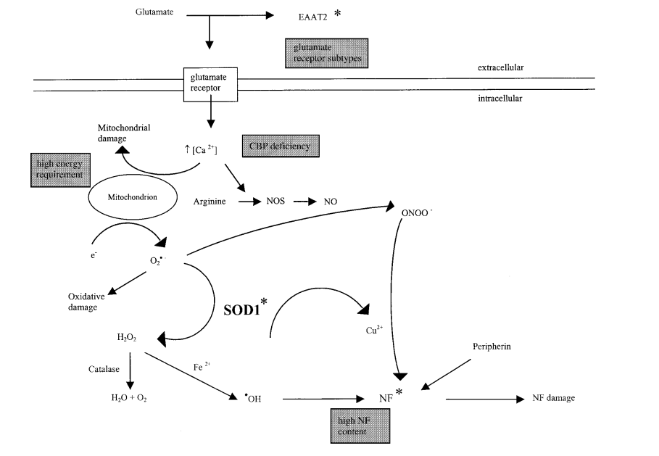
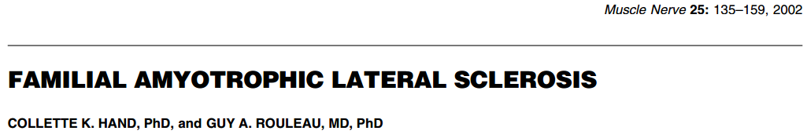
Pathways implicated in motor neuron cell death in ALS
Notes:
Pathways implicated in motor neuron cell death in ALS. Asterisk denotes molecules with mutations associated with ALS.
Shaded boxes indicate factors that may contribute to the selectivity of death of motor neurons. Glutamate released from the presynaptic terminal activates the glutamate receptor on the postsynaptic cell membrane and is then cleared from the synaptic cleft by specific glutamate transporters such as EAAT2. Alterations in this protein may interfere with normal clearance, allowing the glutamate to remain in the environment and continue to activate the receptor. Once activated, the receptors cause a Ca 2+ influx, which the cell does not have the capacity to buffer efficiently due to deficiency in calcium-binding proteins (CBPs). This results in disturbances in mitochondrial metabolism and also the activation of a number of enzymes such as NOS. Neurons have high energy requirements and thus contain many mitochondria that generate O2 − through normal metabolism. It is a function of SOD1 to detoxify this free radical to H2O2, which is then reduced to H2O and O2by catalase. Thus, mutations in SOD1 may lead to increased oxidative damage. The NO produced by NOS reacts spontaneously with O2 − to generate peroxynitrite, which nitrosylates proteins leading to damage. Excess NO may also cause an increase in O2 − production by inhibition of mitochondrial electron flow, resulting in further generation of ONOO − . The nitrosylation reaction is copper-dependent and the source of free copper may be mutant SOD1, which cannot accept the ion from CCS. The target proteins for nitrosylation include the neurofilament subunits, which may result in abnormal NF accumulation and subsequent disruption of the neurofilament network and axonal transport. The high NF content of motor neurons may contribute to the effects of this damage. The reaction is enhanced in the presence of increased peripherin. Mutant SOD1 has increased copper-dependent peroxidase activity, which leads to formation of hydroxyl radical that can also alter the NF network. It is reasonable to assume that disturbances of any of the molecules at any point of this complicated, and as yet incomplete, pathway may contribute to the cell death observed in ALS

Slide 17
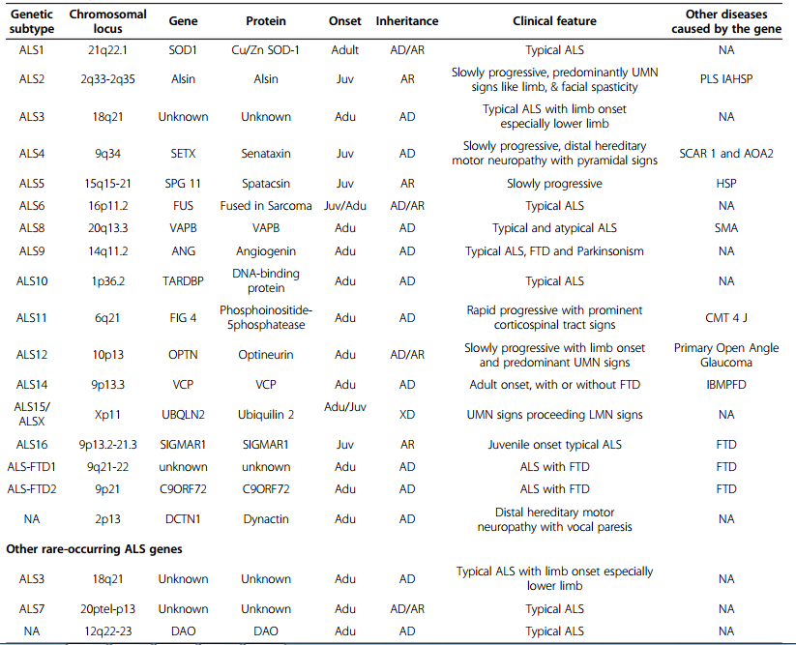
Genetics of ALS

Slide 18
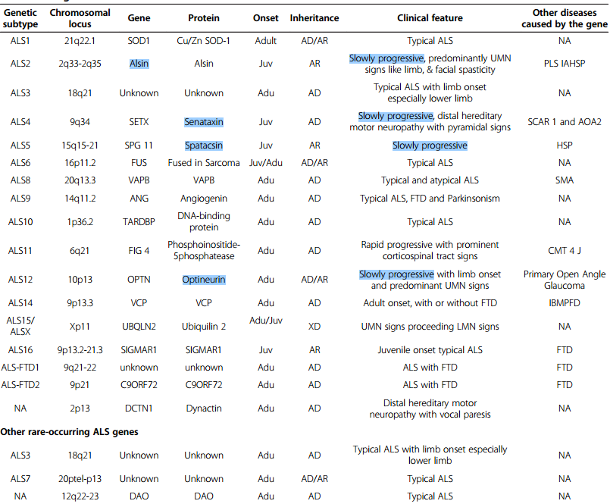
Genetics of slowly progressive ALS

Slide 19
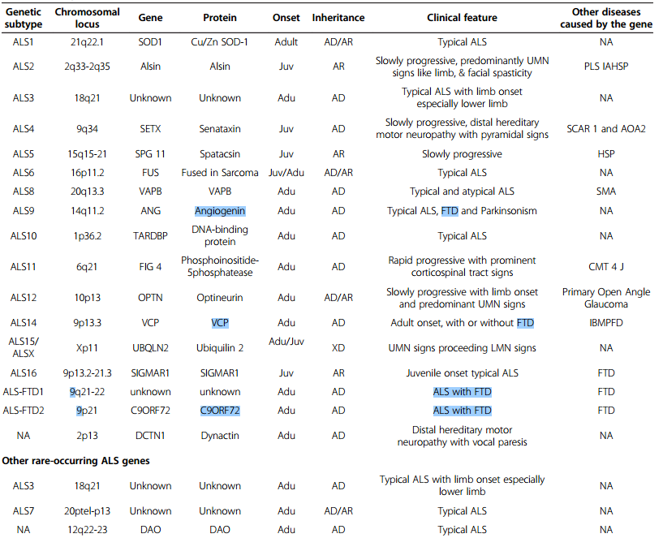
Genetics of ALS with FTD

Slide 20
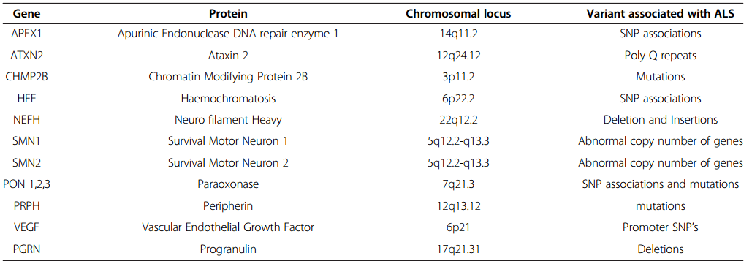
Genetics of sALS
Notes:
With the advanced genetics technology, we can expect that the number of genes involved in fALS as well
as sALS will continue to increase.
Strategic approach based on new ALS genes and drug trials on animal models should enable us to uncover new treatment modalities.

Slide 21

Excitotoxicity
One of the most accepted pathogenetic mechanisms of neuronal pathology in ALS.

Slide 22
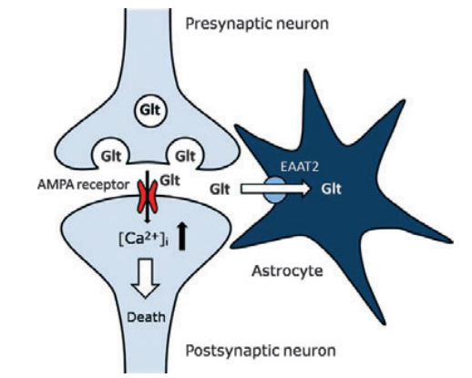
Excitotoxicity
Glutamate-induced excitotoxicity
  Acute neurological conditions and chronic neurodegeneration.
  ALS - higher levels of glutamate in the serum and CSF.
  High glutamate-induced calcium influx in combination with a low calcium buffering capacity.
Excitotoxicity indicates the disrupted role of surrounding nonneuronal cells in ALS
Notes:
One of the most accepted pathogenetic mechanisms of neuronal pathology in ALS.
Glutamate-induced excitotoxicity is responsible for neuronal death in acute neurological conditions as well as in chronic neurodegeneration and probably plays a role in motor neuron disorders.
ALS patients exhibit higher levels of glutamate in the serum and spinal fluid.
Laboratory studies have demonstrated that neurons begin to die when they are exposed over along period to excessive amounts of glutamate.
The motor neuron death seems to be related to a high glutamate-induced calcium influx in combination with alow calcium buffering capacity.
Excitotoxicity indicates the disrupted role of surrounding nonneuronal cells in ALS

Slide 23

Environmental
Exposure to toxic agents
Beta-n-MethylAmino-l-Alanine (BMAA)
  Cyanobacterial neurotoxin,
  one of the dietary compounds found in the seed of the cycad
  Guamanian ALS
Notes:
exposure to toxic or infectious agents
Guamanian ALS, the cyanobacterial neurotoxin beta-N-methylamino-l-alanine (BMAA), one of the dietary compounds found in the
seed of the cycad Cycas cirinalis, atropical plant, was
thought to be arisk factor of the disease. BMAA was
used to make flour and it was amajor dietary component during the 1950s and the early 1960s, when
this type of ALS had an exceptionally high incidence
[6,49]. Some other environmental factors were also
suspected, e.g. smoking. Active smokers face appro -ximately double risk of developing ALS compared to
people who never smoked, whereas former smokers
face an intermediate risk [24]. Furthermore, even an
established risk factor is not automatically acause
Flying foxes were seen as a delicacy on Guam and were eaten whole in a coconut soup. The locals had a voracious appetite for them, describing them as "like nothing you've ever tasted". This may have been since BMAA is an excitatory compound and can likely give people a "buzz"

Slide 24
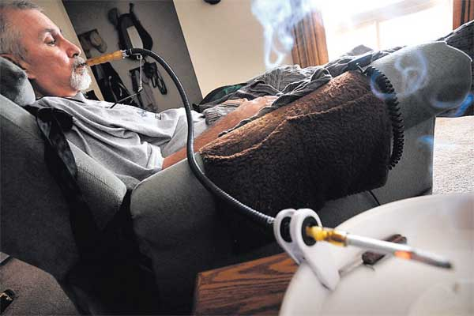
Environmental
Smoking
  Active smokers face approximately double risk of developing ALS compared to people who never smoked.
  Former smokers face an intermediate risk.

Slide 25
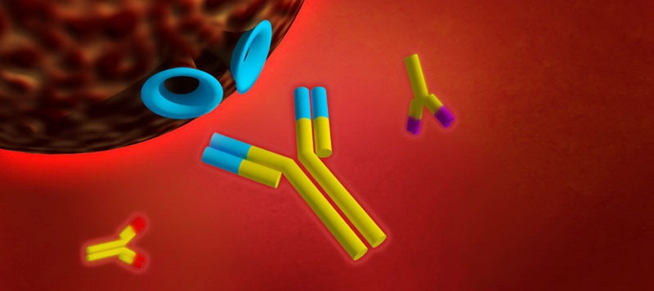
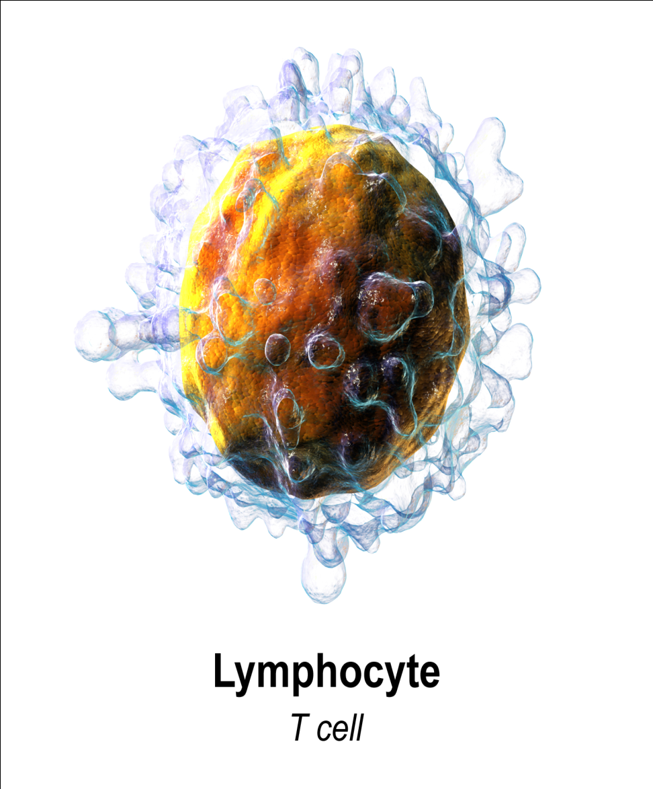
Autoimmune mechanisms

Slide 26
Autoimmune mechanisms
Favouring
Refuting
Auto-antibodies against cellular proteins of the spinal cord has been found in CSF of ALS patients.
  Eg:-Against High mobility group box 1 protein
Modest T-cell infiltration in affected areas.
An autoimmune model of ALS has been produced by the inoculation of guinea pigs with purified bovine motor neurons or spinal cord homogenate.
Trials that have tested autoimmune therapies have not had any effect on the progression of typical ALS.
direct evidence of specific antibodies or T-cell clones attacking motor neurons has not been found
This lack of direct evidence weakens the autoimmune hypothesis
Notes:
Trials that have tested autoimmune therapies, including high-dose intravenous immunoglobulin, plasma exchange, steroids, azathioprine, cyclosporine, high-dose intravenous cyclophosphamide, and total lymphoid irradiation, have not had any
effect on the progression of typical ALS.
89
Moreover,
direct evidence of specific antibodies or T-cell clones
attacking motor neurons has not been found.
12,33,89
This lack of direct evidence weakens the autoimmune hypothesis

Slide 27
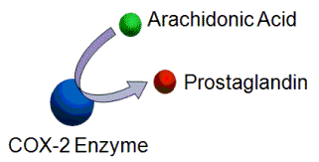
Inflammation

Slide 28
Inflammation
Produces reactive oxygen species in enormous quantities – oxidative sress.
ROS – causes protein dysfuntion impairing axonal transport.
4-Hydroxynonenal – byproduct of lipid peroxidation
  Bind to a glial glutamate transporter and to impair glutamate transport
  Impairs mitochondrial function

Slide 29

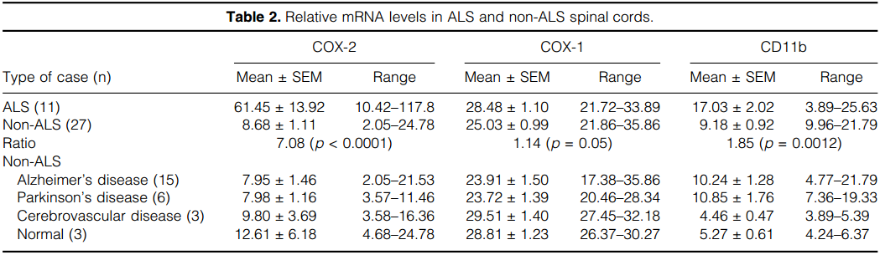
Inflammation
High COX-2 levels in ALS spinal cords were not observed in unaffected areas of ALS brain or in peripheral organs, indicating a restriction to pathologically affected tissue
Notes:
One key biochemical finding consistent with a significant inflammatory response in ALS is a marked increase in spinal cord COX-2 levels.
high COX-2 levels in ALS spinal cords were not observed in unaffected areas of ALS brain or in peripheral organs, indicating a restriction to pathologically affected tissue.
CD11b - this marker on antigen-specific CD8(+) T cells signifies recent activation.

Slide 30
Inflammation
Most practical target for anti-inflammatory therapy is COX-2.

Slide 31
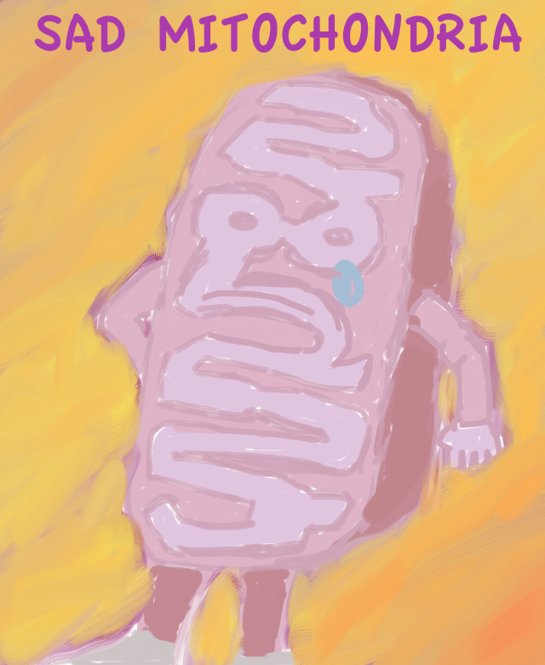
Mitochondria - ALS
Involved in the pathogenesis of ALS, principally through
Mitochondrial dysfunction
  Energy failure
  Generation of ROS
  Impaired calcium handling
Altered mitochondrial morphology
  defective axonal transport of mitochondria in ALS

Slide 32
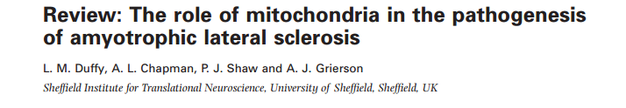
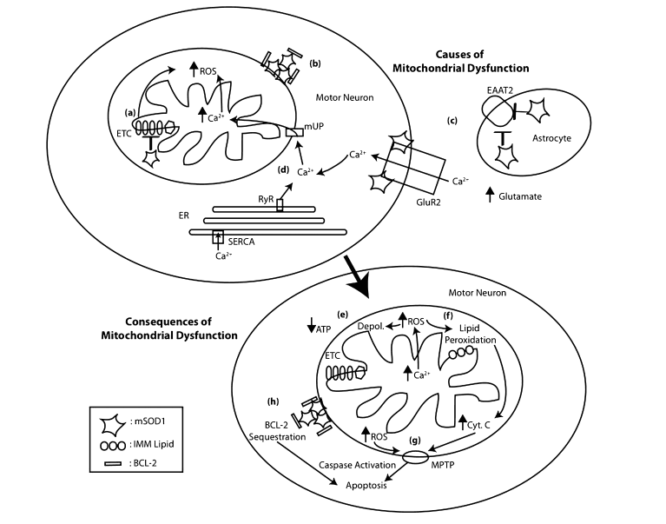

Slide 33
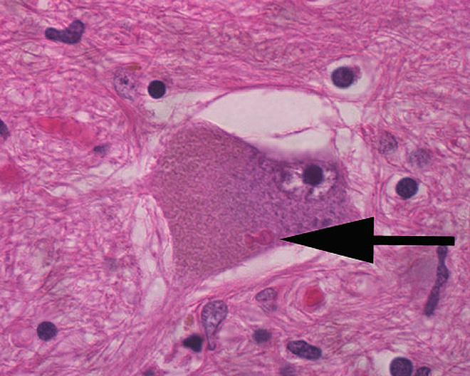
Histopathology – Bunina Bodies
Pathognomonic feature of ALS
Tat’yana Bunina, a neuropathologist from the USSR.
She initially believed that they were a virus.

Slide 34
Histopathology
Golgi complex is implicated in the formation of BBs
May be related to nucleic acid dysmetabolism at the rER.

Slide 35
Histopathology
Identified in the cytoplasm and dendrites, but not within the axoplasm
With H&E staining, appear as bright pink, oval eosinophilic inclusions, occasionally showing clear areas in the centre and forming clusters
most commonly found in the motor neurons of the spinal cord and in the brainstem nuclei

Slide 36
Clinical features
Clinical picture of ALS is a stereotypical one, resulting from combination of signs, secondary to dysfunction of both UMN and LMN.
Objective sensory findings are incompatible with a diagnosis of amyotrophic lateral sclerosis.
Inexorably progressive
  50% of patients dying within 3 years of onset.
Notes:
unless they can be accounted for by neurological comorbidity.

Slide 37
Clinical features
LMN Features
UMN Features
Weakness
Wasting and atrophy of muscles
Fasciculations
Cramping
Bulbar symptoms
  Slurring Dysarthria
  Dysphagia
  Chewing difficulty
Spasticity > weakness
Pseudobulbar affect
Exaggerated DTR
Spastic dysarthria

Slide 38
Clinical heterogenicity
Recognized feature of the disease
Due to
Age of onset
Variable mix of UMN and LMN signs
Site of onset
Survival
Association with other conditions

Slide 39
Clinical heterogenicity
Age of onset
Mean age of disease onset is about 65 years.
Young-onset ALS
  onset in the third to fourth decade
  predominant UMN signs
  male prevalence
  Less common bulbar onset
  more prolonged survival

Slide 40
Clinical heterogenicity
Age of onset
Juvenile ALS
  Rare
  Onset - first two decades
  Relatively benign course
  familial in majority of cases

Slide 41
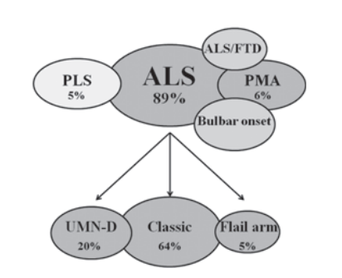
Clinical heterogenicity
Variable mix of UMN and LMN signs
major contributor to phenotypical heterogeneity of ALS

Slide 42
Clinical heterogenicity
Classic ALS (Charcot type)
most frequent form
predominant LMN signs combined with slight to moderate pyramidal signs.
Upper motor neuron-dominant (UMN-D) ALS
dominated by pyramidal signs, consisting mainly of severe spino-bulbar spasticity, associated with slight LMN signs.

Slide 43
Clinical heterogenicity
Progressive muscular atrophy (PMA)
Pure LMN signs without any accompanying clinical or electrophysiological UMN signs.
primary lateral sclerosis (PLS)
About 2–5% of patients with motor neuron disease
exclusive involvement of UMNs with predominant spino-bulbar spasticity

Slide 44
Clinical heterogenicity
Site of onset
consistent feature of ALS is that it starts as a focal process involving variable regions in the neuraxis and then spreads through all the motor system

Slide 45
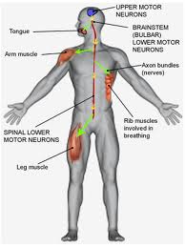
Clinical heterogenicity
Site of onset
Bulbar onset ALS.
Spinal onset ALS.
Pseudoneuritic form.
Flail arm syndrome.
Mill’s hemiparetic type.

Slide 46
Clinical heterogenicity
Bulbar onset ALS.
present with dysarthria and dysphagia
limbs symptoms occur simultaneously with bulbar symptoms or can occur within 1–2 years.
Frequent in females
Worse prognosis with respect to the spinal onset form

Slide 47
Clinical heterogenicity
Flail arm form
symmetric, predominantly proximal,wasting and weakness of both arms
Relative sparing of lower limbs.
Males
> 40 years of age
better clinical course with respect to classic ALS

Slide 48
Clinical heterogenicity
Survival
Median survival of ALS is approximately 3 years after the onset.
Varies widely ranging from few months to over 10 years.
Disease duration depends on the timing of involvement of respiratory muscles.
Major negative prognostic factors
older age
bulbar onset
The UMN-D phenotype appears to be a strong independent predictor of long survival

Slide 49
Clinical heterogenicity
Association with other conditions
ALS/FTD
Cognitive abnormalities ranges from impaired frontal executive dysfunction to overt fronto-temporal dementia.
Both ALS and FTD
show neuronal inclusions positive for the TDP-43
share many gene defects
  C9ORF72
  TARDBP
  FUS
  VCP

Slide 50
Clinical heterogenicity
Association with other conditions
Association of ALS with Parkinson disease.
  Share gene defects
    TARDBP
    ATXN2
    C9ORF72
    ANG

Slide 51
Differential diagnosis
‘Mimic syndromes’
  absence of disease progression
  the presence of an atypical history
  Presence of unusual symptoms
two conditions most commonly mistaken for ALS
  Multifocal motor neuropathy with conduction block
  Cervical spondylotic myelopathy
Notes:
absence of disease
progression, the presence of an atypical history, or the
presence of unusual symptoms should trigger a search
for ‘mimic syndromes’

Slide 52
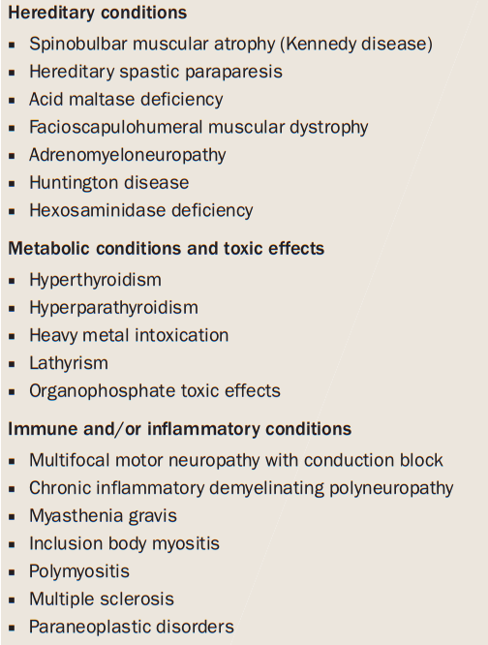
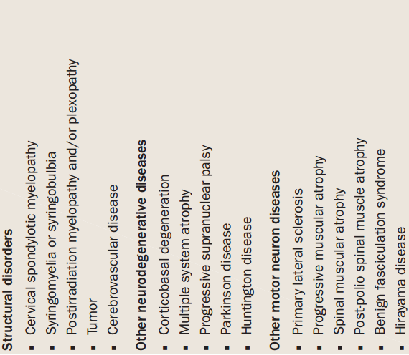

Slide 53
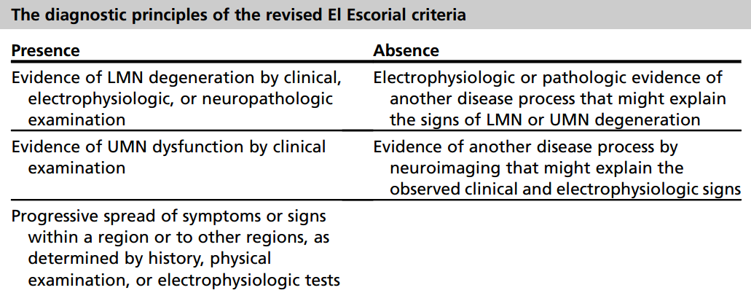
Diagnostic criteria

Slide 54
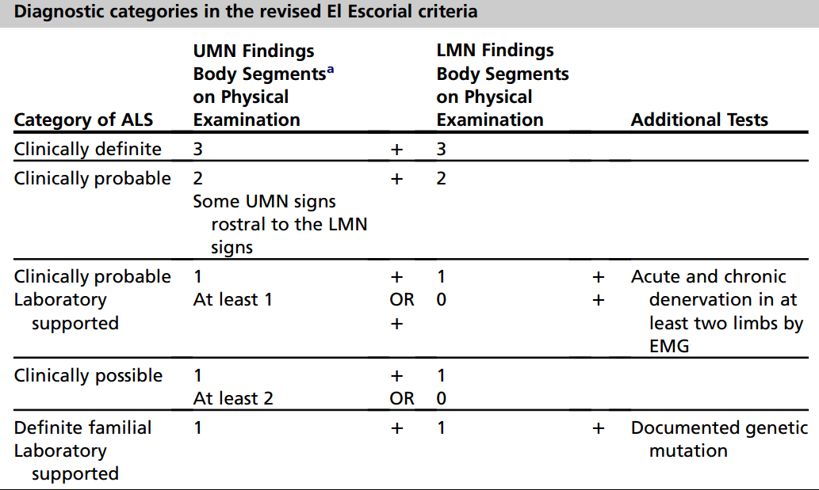
Revised El Escorial Criteria

Slide 55
Revised El Escorial Criteria (EEC)
Gold standard of ALS diagnosis.
Very specific
Insensitive and not suitable for early diagnosis.
Therefore the Awaji Criteria have been developed
  more emphasis on EMG findings, especially on fasciculation potentials.
  Regard fasciculation potentials as sign of active denervation in an otherwise typical clinical context of ALS.
Recent publications confirm that the Awaji Criteria have a higher sensitivity than the EEC in the diagnosis of ALS without increasing the rate of false positive diagnoses

Slide 56
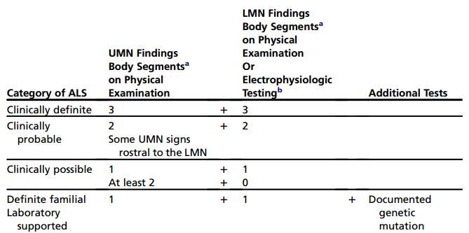
Revised El Escorial Criteria (EEC)
Awaji modification of EEC

Slide 57
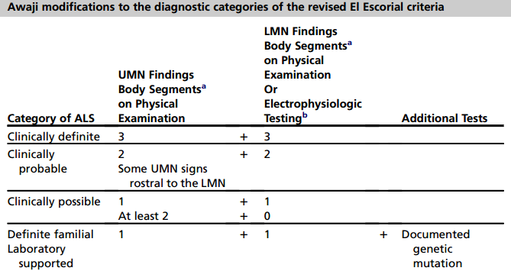
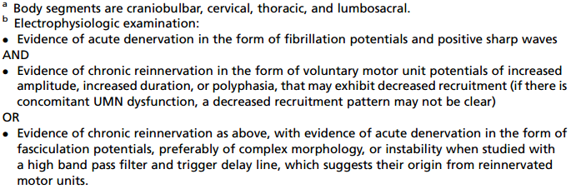
Awaji criteria

Slide 58
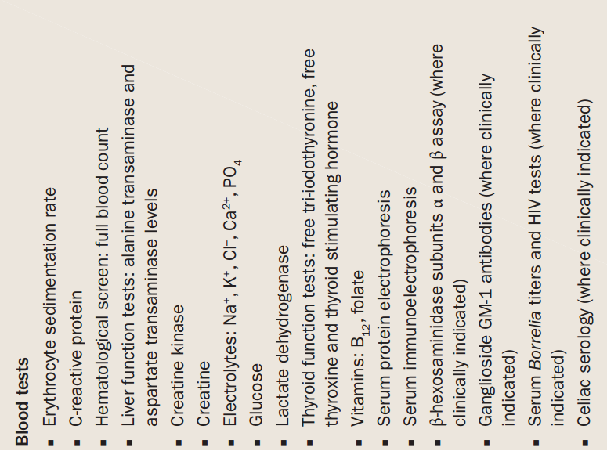
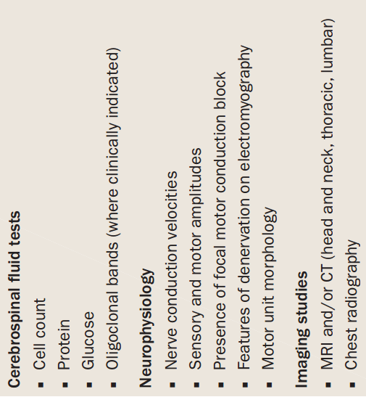

Slide 59
Electrodiagnostic studies
Nerve conduction studies.
  Motor and sensory studies.
  To rule out mimic syndromes
  Normal in ALS.

Slide 60
Electrodiagnostic studies
Electromyography
  Most critical ancillary tool in the investigation of ALS.
  identify loss of lower motor neurons, the hallmark of ALS
  useful in clinically unaffected regions

Slide 61
Electrodiagnostic studies
Electromyography
  Most frequently recognized abnormalities
    spontaneous denervation discharges (fibrillation potentials and positive sharp waves) indicative of ongoing motor neuron loss,
    Fasciculation.
    Polyphasic units indicative of reinnervation.

Slide 62
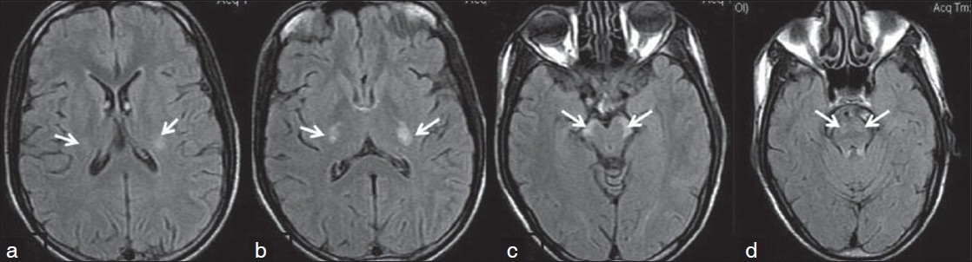
Neuroimaging studies
MRI of the brain and spinal cord
  most useful neuroimaging technique in ALS
  exclude syndromes that mimic ALS.
T2W, FLAIR - Rounded foci of hyperintensity along the corticospinal
  not specific for ALS
  correlate poorly with both disease severity and the presence of upper motor neuron signs

Slide 63
Genetic testing
Little clinical utility.
  Known mutations have limited penetrance
  Risk of disease development in an asymptomatic carrier cannot be determined .

Slide 64
Functional disability
Quality of life
ALS Functional Rating Scale
Amyotrophic Lateral Sclerosis Assessment Questionnaire (ALSAQ-40)
Used to monitor functional change in a patient over time.
Measures:
  Speech
  Salivation
  Swallowing
  Handwriting
  Cutting food and handling utensils
  Dressing and hygiene
  Turning in bed and adjusting bed clothes
  Walking
  Climbing stairs
  Breathing
Dependent on factors other than physical functioning.
  Psychological factors
  Existential factors (perception of purpose, meaning in life, capacity for personal growth)
  Support factors
Does not necessarily deteriorate, despite progressing disability (as assessed by ALS functional rating scale)

Slide 65
Management
No cure yet for ALS.
While research continues, the objective of clinical care is to maintain quality of life and prolonging life as much as possible.

Slide 66
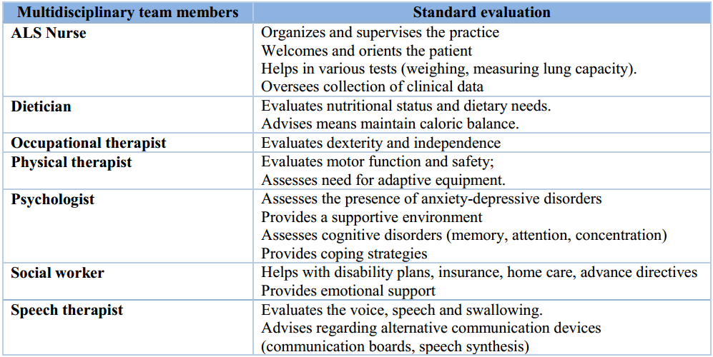
Treatment
Multidisciplinary team approach

Slide 67
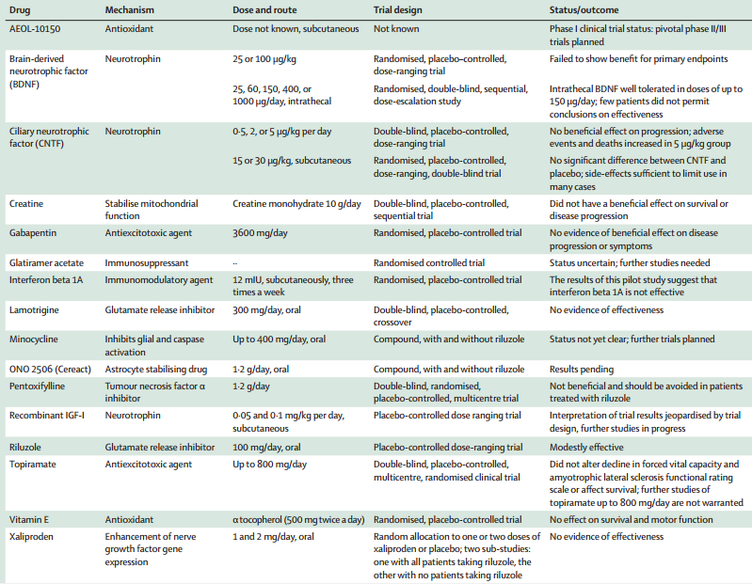
Putative disease-modifying treatments

Slide 68
Riluzole
Despite over 30 phase II and phase III clinical trials of promising agents , riluzole remains the only evidence-based disease-modifying drug for ALS.

Slide 69

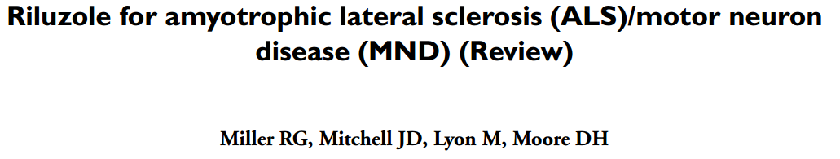

Slide 70
Riluzole 100 mg daily
Probably prolongs median survival 2 – 3 months in patients with probable and definite ALS with
  symptoms less than five years
  age less than 75 years
  forced vital capacity greater than 60%
More studies are needed, especially to determine whether patients treated earlier or older, more advanced patients with longstanding disease derive the same benefit.
The most frequent side effects are nausea and asthenia.
Liver function becomes altered and requires monitoring.

Slide 71
Supportive and Symptomatic treatment
Respiratory function
Handling secretions
Nutrition
Fasciculations, cramps and fatigue
Psychiatric disorders
Physical rehabilitative measures

Slide 72
Respiratory function
Respiratory failure
  Major (60 %) cause of death in patients with ALS
  Respiratory muscle weakness - independent predictor of quality of life.
Early symptoms of respiratory dysfunction should be actively sought at each clinic visit

Slide 73
Symptoms of respiratory dysfunction
Dyspnea
Orthopnea
Sleep fragmentation
Daytime fatigue
Morning headaches
Forceless cough

Slide 74
Assessment of respiratory function
History & Physical examination
Overnight pulse oximetry
Vital capacity
Maximal inspiratory and expiratory pressures (MIP and MEP)
  correlate with respiratory muscle weakness
  MIP of <60 cm H2O is a predictor of reduced survival
Sniff nasal inspiratory pressure (SNIP)
  noninvasive measure of inspiratory force
  estimates intrathoracic pressure
  sensitive to respiratory muscle weakness
  Declines predictably over time predicts survival

Slide 75
Criteria for initiation of respiratory support in ALS patients
symptoms related to respiratory failure associated with one of the following objective criteria
PaCO2 greater than 45 mm Hg and / or
Vital capacity less than 50% of normal and / or
Nasal inspiratory pressure and maximum pressure sniff below 60% of normal and /or
Nocturnal desaturation below 90% PaO2 more than 5% of the time

Slide 76
Respiratory support in ALS patients
Noninvasive positive pressure ventilation (NIPPV)
  extends survival, particularly in patients who are able to use it for 5 h or more per day, and those without severe bulbar dysfunction.
  Improves patients’ quality of life without increasing caregiver burden or stress.
  Overnight pulse oximetry reviewed at regular intervals to ensure that pressure settings are optimized.
Diaphragm Pacing

Slide 77
Handling the secretions
Tenacious secretions
  Adequate hydration
  Mucolytics
  Acetylcysteine
  Saline or bronchodilators nebulisation
Excessive secretions
  Amitriptyline
  Hyoscine
  Scopolamine
  Botulinum toxin
  Salivary gland irridiation

Slide 78
Nutrition and gastrostomy
Weight loss
  The end result of
    Accentuated muscle turnover
      Reduced lean body mass
      Less physical activity.
    Negative calorie balance
      Bulbar muscle weakness and dysphagia,
      Arm weakness that limits the ability to lift the arm to carry food to the mouth
      Hypermetabolism
  accelerated clinical deterioration
  The rate of weight loss may be a more important predictor of disease progression
  Monitoring weight in the clinic is the simplest way to assess caloric balance
Notes:
Reduced lean body mass and
less physical activity accentuate muscle turnover. The end
result is weight loss, which can be rapid and lead to
accelerated clinical deterioration [83]. The rate of weight
loss may be a more important predictor of disease
progression than being under or overweight at diagnosis
[82].
Monitoring weight in the clinic is the simplest way to
assess caloric balance

Slide 79
Nutrition and gastrostomy
Recommendations vary according to symptom severity:
Mild dysphagia
  Adaptations in food texture
  Postural changes - the chin tuck.
Positive caloric balance , no longer possible orally
  gastrostomy is indicated

Slide 80
Nutrition and gastrostomy
Safer while the vital capacity is above 50% of predicted
improves nutrition.
Notes:
improved nutrition, although evidence to support a substantial effect on survival remains
to be firmly established.
93,95
Use of radiological imaging
during insertion of the gastrostomy tube has been shown
to be superior to endoscopic gastrostomy in patients with
pronounced bulbar symptoms or respiratory compromise.112,113
In patients with evidence of respiratory insufficiency, noninvasive ventilation should be in troduced
before gastrostomy

Slide 81
Adjuvant treatment
Fasciculations
and muscle cramps
Fatigue
Mild
  Magnesium 5 mmol up to three times a day
  Vitamin E 400 IE twice a day
Severe
  Quinine sulphate 200 mg twice a day
  Carbamazepine 200 mg twice a day
  Phenytoin 100 mg up to three times a day
Amantadine
Bupropion
Fluoxetine
Pemoline
Pyridostigmine
Venlafaxine

Slide 82
Spasticity
Cramps
Baclofen 10–80 mg
Tizanidine 6–24 mg
Tetrazepam 100–200 mg
Diazepam 2-10 mg tid
Phenytoin 100-300 mg qhs
Vitamin E 400 IU tid

Slide 83
Psychiatric disorders
Depression
Anxiety
Mirtazapine 15-30 mg qhs
SSRI antidepressants 20-100 mg qd
Tricyclic antidepressants 12.5-150 mg qhs
Venlafaxine 37.5-75 mg qd
Amitriptyline 12.5-125 mg qhs
Mirtazapine 15-30 mg qhs
Buspirone 10 mg tid
Diazepam 2-10 mg tid
Lorazepam 0.5-2 mg tid
Mirtazapine 15-30 mg qhs

Slide 84
Pathological laughing or crying
Amitriptyline
Fluvoxamine
Lithium carbonate
Levodopa
Dextromethorphan/quinidine

Slide 85
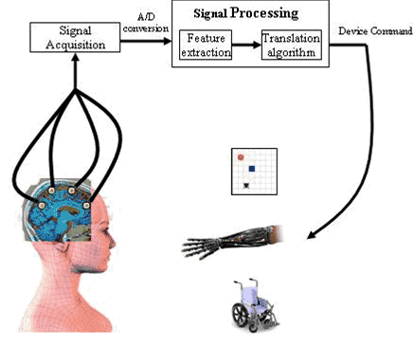
Brain Computer Interface
Useful when some patients become completely locked in, unable to move any voluntary muscle.
  anarthria
  motor function of limbs is lost.
  eye movement is no longer possible.

Slide 86
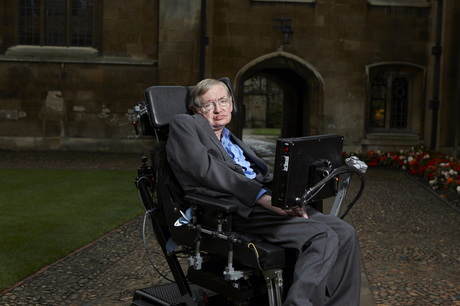
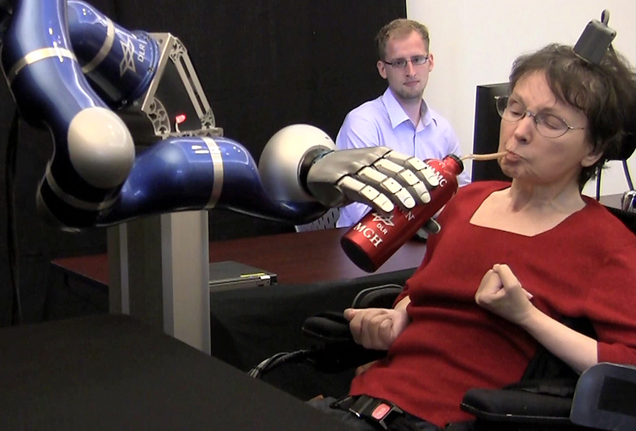
Brain Computer Interface
provide patients with a device that does not rely on muscle activity.
Patients can learn to spell using a virtual keyboard and to move virtual limbs.

Slide 87
To conclude………..
Although there has been substantial progress in our understanding of the disorder in the past 25 years, we are still some distance from fulfilling the aim of the Motor Neurone Disease Association to achieve a “World Free of ALS”.

Slide 88
To quote words of Winston Churchill:
“This is not the end. It is not even the beginning of the end. But it is, perhaps, the end of the beginning.”

Slide 89
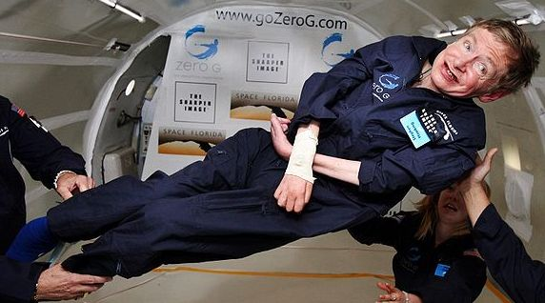
Thank you!!

Slide 90
References
Ewa Naganska, Ewa Matyja, Amyotrophic lateral sclerosis–looking for pathogenesis and effectivetherapy; Folia Neuropathol 2011; 49 (1): 1-13
Christopher g. Goetz, Amyotrophic lateral sclerosis: early contributions of Jean-Martin charcot; Muscle Nerve23:336–343, 2000.
Cedarbaum JM Stambler N. Performance of the Amyotrophic Lateral Sclerosis Functional Rating Scale (ALSFRS) in multicenter clinical trials. J Neurological Sciences. 1997; 152 (Suppl 1): S1 – S9.

Slide 91
J D Mitchell, G D Borasio ,Amyotrophic lateral sclerosis; Seminar, www.thelancet.com Vol 369 June 16, 2007.
Crispin Jenkinson et.al,The amyotrophic lateral sclerosis assessment questionnaire (ALSAQ-40):tests of data quality, score reliability and response rate in a survey of patients; Jour Neur Sci 180 (2000) 94–100.
S.T.Y. Ugradar et. al.Bunina bodies; Grand Rounds Vol 10 pages L6–L9

Slide 92
Peter M. Andersen et.al :Clinical genetics of amyotrophic lateral sclerosis: what do we really know?; Nat. Rev. Neurol. 7, 603–615 (2011)
Orla Hardiman et. al:Clinical diagnosis and management of amyotrophic lateral sclerosis; Nat. Rev. Neurol. 7, 639–649 (2011)
Anuradha Duleep,MD et.al. Electrodiagnosis of Motor Neuron Disease; Phys Med Rehabil Clin N Am 24 (2013) 139–151

Slide 93
Collette k. Hand et.al:Familial amyotrophic lateral sclerosis; Muscle Nerve25:135–159, 2002.
J.C. Schymick et.al: Genetics of sporadic amyotrophic lateral sclerosis; Human Molecular Genetics, 2007, Vol. 16, Review Issue 2
Sheng Chen et.al:Genetics of amyotrophic lateral sclerosis: an update; Molecular Neurodegeneration 2013,8:28

Slide 94
P. L. Mcgeer et.al: Inflammatory processes in amyotrophic lateral sclerosis; Muscle Nerve 26:459–470, 2002.
L. M. Duffy et.al:Review: The role of mitochondria in the pathogenesis of amyotrophic lateral sclerosis; Neuropath and Applied Neurobiology(2011),37, 336–352.
Paul H. Gordon et.al:Amyotrophic Lateral Sclerosis: An update for 2013 Clinical Features, Pathophysiology, Management and Therapeutic Trials; Aging and Disease • Volume 4, Number 5, October 2013

Slide 95
Miller RG, Mitchell JD et.al: Riluzole for amyotrophic lateral sclerosis (ALS)/motor neurondisease (MND) (Review); Cochr Data. of Syst Rev 2007, Issue 1.

Slide 96


Slide 97
Which of the following gene mutation is associated with rapidly progressive FALS ?
Ubiquilin 2
SOD1
TDP 43
FIG 4

Slide 98
Which of the following is the only gene associated with X-linked dominant inheritance in FALS?
Ubiquilin 2
SOD1
TDP 43
FIG 4

Slide 99
Which of the following factors are responsible for the selective motor neuron degeneration in ALS?
Calcium binding protein deficiency
High energy requirement
High neurofilament content
All of the above

