Slide 1


Diseases of Bones & Joints

Slide 2
Osteogenesis Imperfecta
A heterogeneous group of heritable disorders characterized by impairment of collagen maturation.
Mutation of COL1A1 (chromosome 17) or COL1A2 (chromosome7).
Most common type of heritable bone disease (1/8000).

Slide 3
Pathogenesis of Osteogenesis Imperfecta:- COL1A1 ON 17q21 & COL1 A2 ON 7q22.1 Encode α-1 & α-2 chains of type I collagen mutation in the genes qualitative & quantitative deficiency of collagen fibrils Osteogenesis imperfecta

Slide 4
Osteogenesis Imperfecta
Main features are:
Bone fragility, blue sclera, altered teeth, hypoacusis, long bone and spine deformity
Oral findings include
Maxillary hypoplasia with class III malocclusion and
Radiographic lesions similar to florid cemento-osseous dysplasia.

Slide 5
ORAL MANIFESTATIONS:
Large forehead
Anterior & posterior crossbite
Maxillary hypoplasia
Large number of impactions
Ectopic teeth
Unerupted permanent first & second molars

Slide 6
Osteogenesis Imperfecta
Type I:
Most common and mildest form,
10% congenital fracture;
blue sclera;
hyper extensibility
Type II:
Most severe form
blue sclera; opalescent teeth may be present.

Slide 7
Osteogenesis Imperfecta
Type III:
Moderate to severe bone fragility;
Blue sclera fades over time;
Hyperextensibility and hearing loss common;
Type IV:
Mild to moderate bone fragility-50% congenital fractures with frequency decreasing with time;
Opalescent dentin variable.

Slide 8
Radiographic features:
Osteopaenia
Bowing
Angulation & deformity of long bones
Multiple fractures &
Wormian bones are seen.

Slide 9
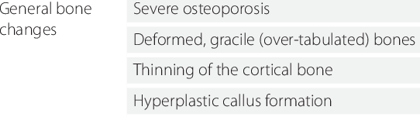

Slide 10
Histopathology:
It exhibits thin cortices with immature spongy bone.
Trabeculae of bone are delicate and show micro fractures.
Fracture of fetal collagen to transform into mature collagen

Slide 11
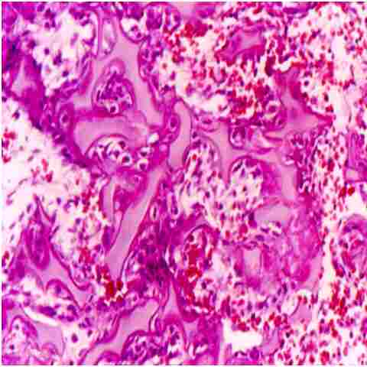
Notes:
Bony spicules in the metaphysis exhibit poor ossification, a characteristic histologic finding in osteogenesis imperfecta Type II.

Slide 12
Differential diagnosis:
Achondrogenesis
During late childhood & adolescence, idiopathic juvenile osteoporosis.
Prognosis and predictive factors:
Treatment is directed towards preventing or controlling the symptoms.
Maximizing independent mobility

Slide 13
Osteopetrosis (Marble Bone Disease; Albers-Schönberg Disease)
A group of rare hereditary skeletal defects of increased bone density resulting from defective remodeling due to failure in osteoclast function.
Endochondral, endosteal and periosteal growth without concomitant resorption results in thickening of bone.

Slide 14
Osteopetrosis (Albers-Schönberg Disease)
Infantile (malignant form):
Growth retardation & failure to survive
Nasal stuffiness due to mastoid or paranasal sinus malformation
Fracture and cranial nerve compression Delayed tooth eruption;
Extraction osteomyelitis .

Slide 15
Intermediate osteopetrosis:
Brittle bones with increased density.
Less severe than the infantile form but more severe than adult form.
Nerve compression, hepatosplenomegaly and pancytopenia.

Slide 16
Adult (benign form):
Limited mostly to axial skeleton;
bone pain is common but nearly 40% are asymptomatic; marrow failure rare.
Treatment of infantile with Bone Marrow Transplant for cure; interferon, calcitriol, steroids, erythropoietin.
Supportive measures; transfusion, antibiotics, surgery & hyperbaric oxygen.

Slide 17
Oral manifestations:
Reduction of medullary spaces
Fracture of jaws during extraction due to bone fragility
Enamel hypoplasia,
Dentinal defects & arrested root development

Slide 18
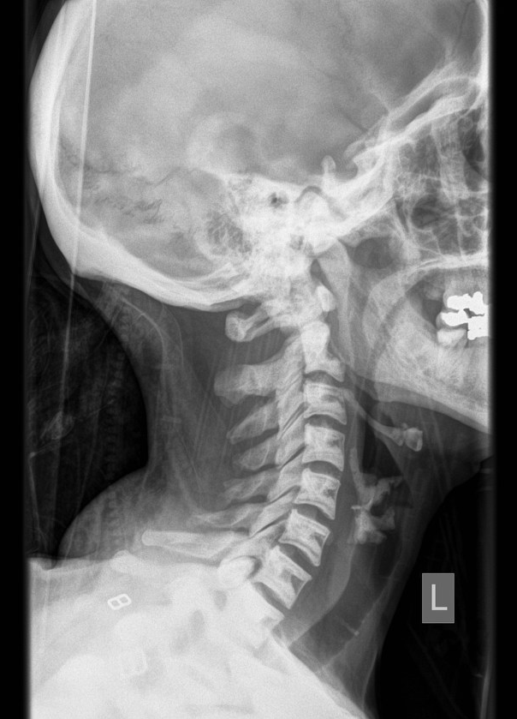

Slide 19
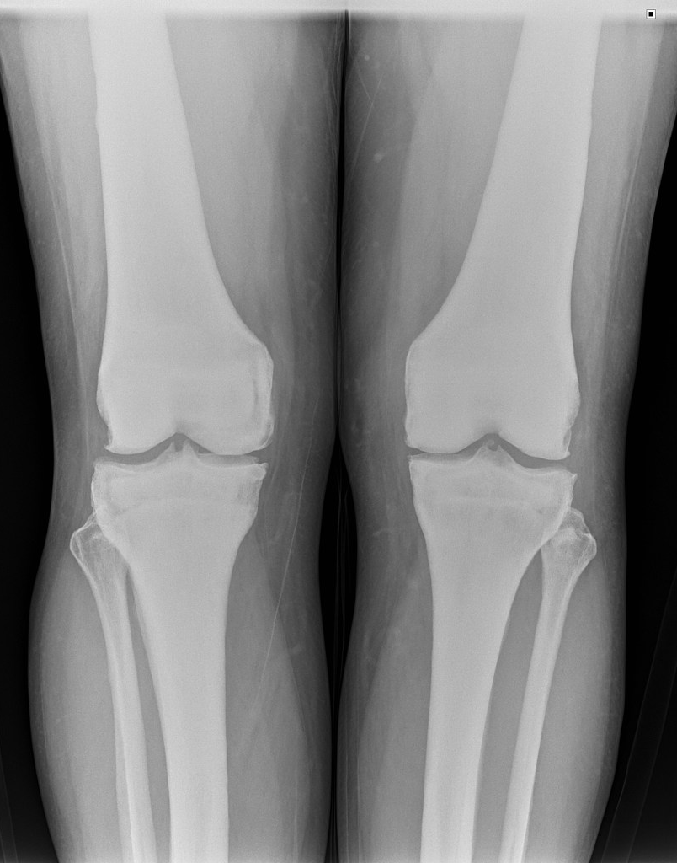

Slide 20
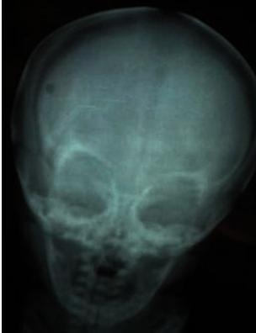

Slide 21
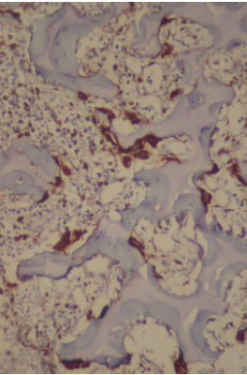
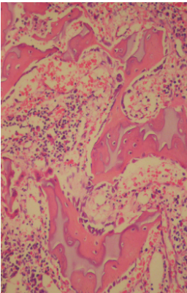

Slide 22
Prognosis and Predictive factors:
Gamma interferon therapy
Corticosteroids
Bone marrow transplantation in cases of infantile osteopetrosis
Adult-no treatment.

Slide 23
Cleidocranial Dysplasia Marie and Sainton’s disease; Cleidocranial dysostosis
Defect in Core Binding Factor alpha 1 gene (6p21); AD with 40% sporadic cases;
Defect in osteoblastic differentiation and bone formation.
Clavicles show hypoplasia or malformation; about 10% one/both clavicles are absent.

Slide 24
Short stature,
large head with frontal & parietal bossing,
hypertelorism,
broad nose, depressed nasal bridge.
Persistent open fontanels and cranial sutures.

Slide 25
Cleidocranial Dysplasia
Dental & gnathic manifestations include
prolonged retention of deciduous teeth,
delayed eruption of permanent teeth,
Narrow ramus, pointed coronoid processes,
Acute gonial angle, prognathism.

Slide 26
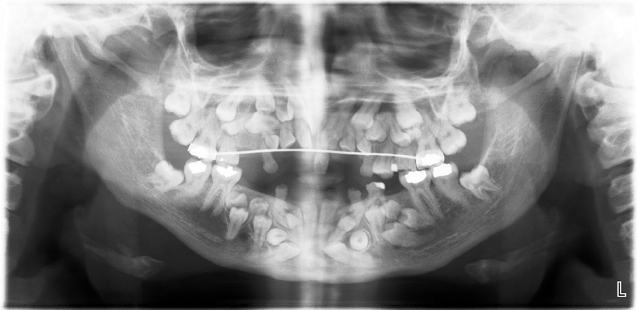

Slide 27
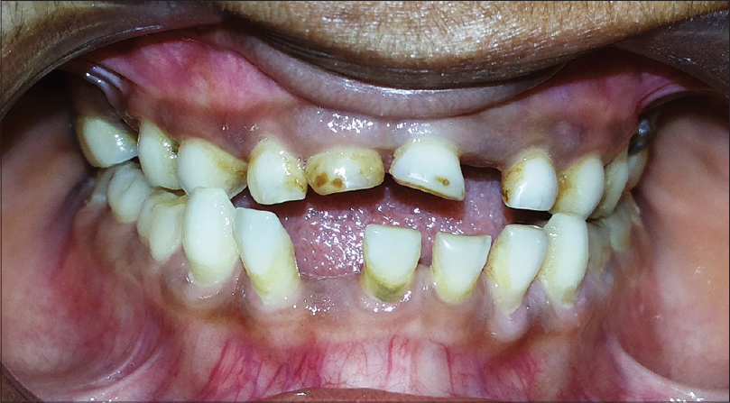
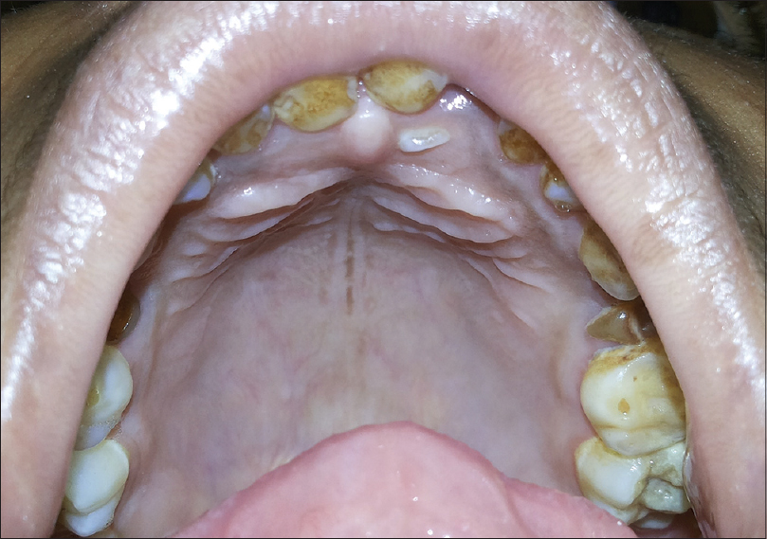

Slide 28
Prognosis and Predictive factors:
Dental problems – most significant complications.
Removal of primary or supernumerary teeth does not promote eruption of unerupted teeth.
Difficulty in extraction due to malformed roots.

Slide 29
thank you!

