Slide 1
Treatment of Alzheimer’s Disease
Practice Parameter & Review of literature
Faculty : Dr. C.Rathore

Slide 2
Scheme of presentation
Introduction
Classification of AD
Recommended treatment
Treatment guidelines
Disease mechanisms & current targeted treatment approaches
Summary

Slide 3
Introduction
Alzheimer’s disease is the largest unmet medical need in neurology.
Without advances in therapy, the number of symptomatic cases in the United States is predicted to rise to 13.2 million by 2050.
The cost of caring for patients with Alzheimer’s disease is extraordinary; annual expenditures total > $ 100 billion.
These figures underscore the urgency of seeking more effective therapeutic interventions for patients with Alzheimer’s disease.

Slide 4
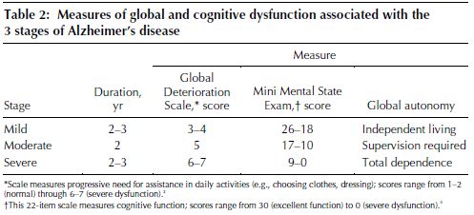
Stages of AD

Slide 5
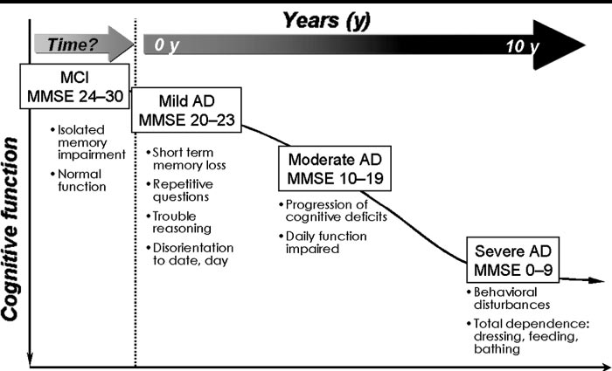

Slide 6
Treatment of Alzheimer’s disease
Five major components:
Neuroprotective strategies
Cholinesterase inhibitors
Psychopharmacologic agents to reduce behavioral disturbances
Health maintenance activities
Alliance between clinicians & caregivers

Slide 7
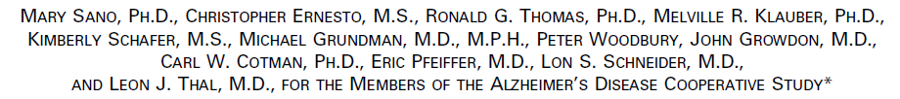
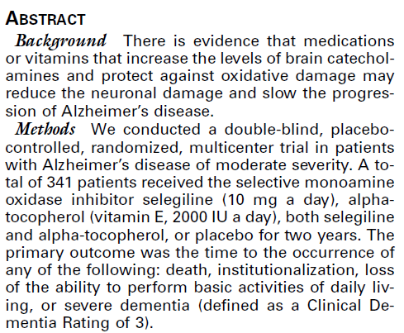
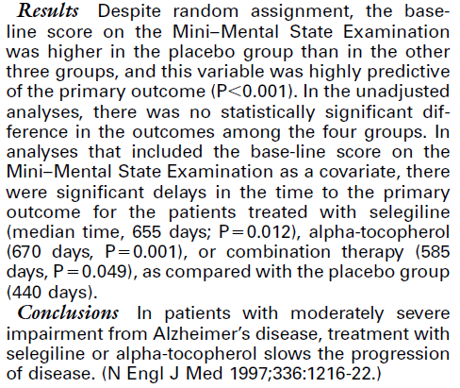

Slide 8
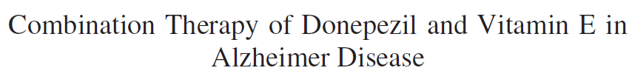

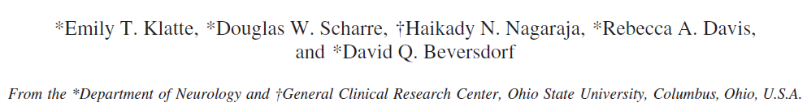
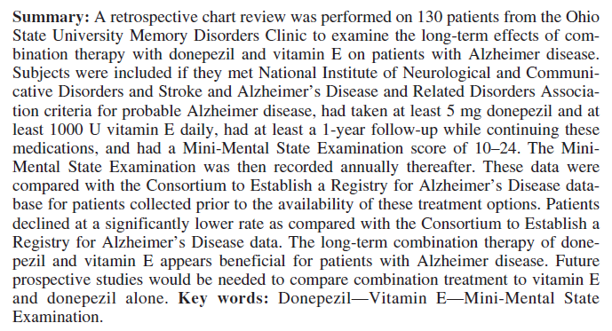

Slide 9
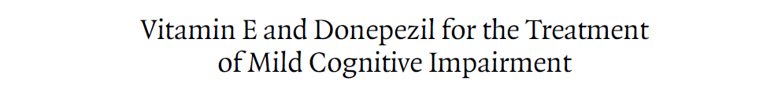
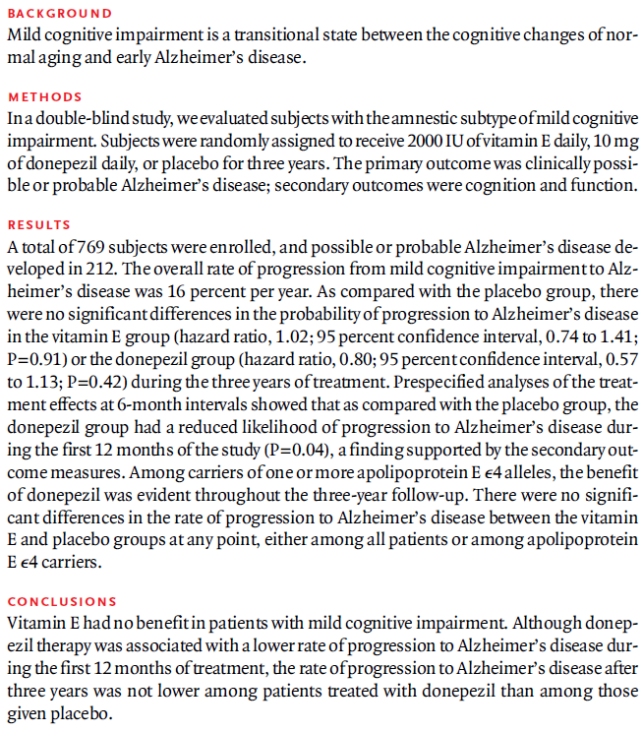

Slide 10
Cholinesterase inhibitors
Since before 1915 Scopolamine, an anticholinergic agent, was used to induce amnesia in women during labor & delivery.
In the 1970s, research explored the specific cognitive effects of acetylcholine
Later research was done in AD pts. using iv/oral Physostigmine (Davis and Mohs and Mohs et al 1982, 1985).
In 1983, the first acetyl cholinesterase inhibitor was approved Tacrine (Cognex).
It was hampered by 4 times per day dosing, reversible hepatocellular injury in up to 50% of patients, and very poor tolerability due to significant cholinergic side effects of nausea, vomiting & diarrhea.

Slide 11
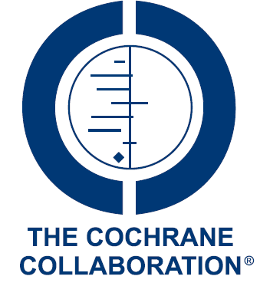
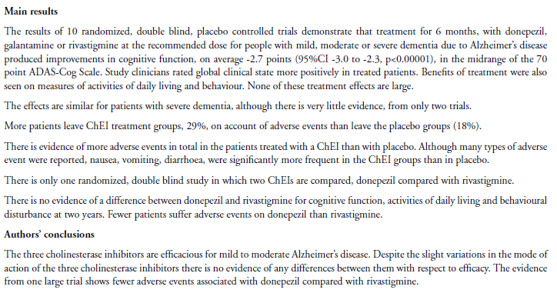
2009 Cochrane review for ChEI in AD

Slide 12
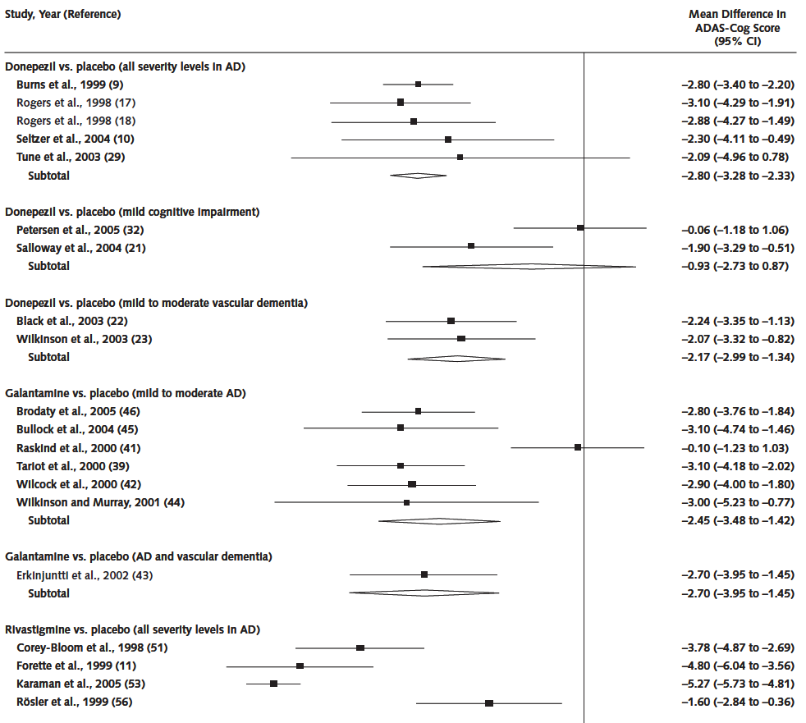

Summary estimates for the change in AD Assessment Scale(ADAS-cog) scores.

Slide 13
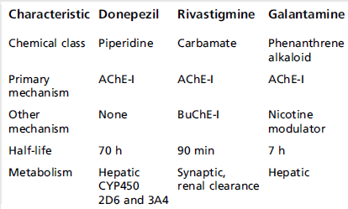
Not many head-to-head studies have compared the efficacy of the cholinesterase inhibitors, and their main differences are their side effect profiles and administration regimens

Slide 14
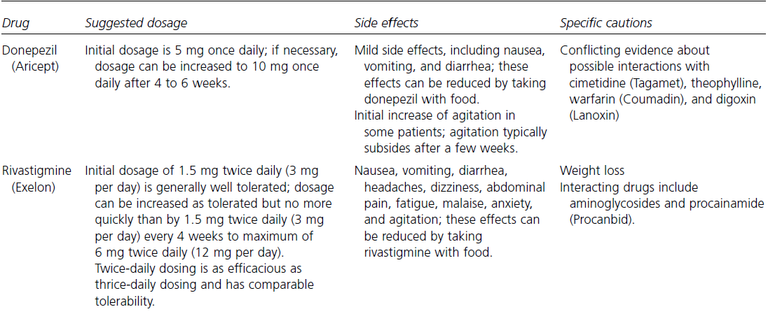

Slide 15
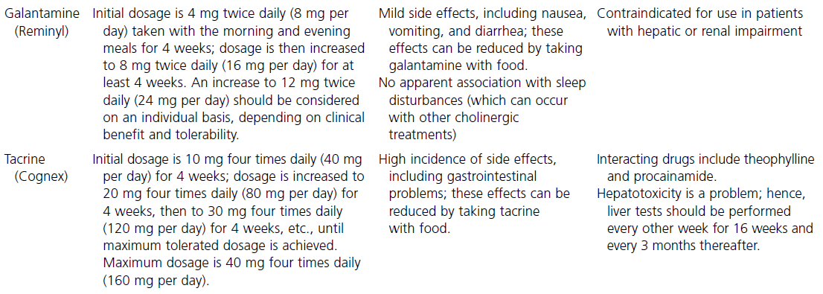

Slide 16
Memantine: NMDA antagonist
First synthesized by Lily & Company in 1968.
FDA approval for Rx of moderate to severe AD in 2003
Most useful aspect of memantine appears to be a delay in emergence of agitation/agressivity and possibly other neuropsychiatric symptoms or alleviation of such symptoms when present (Cummings et al.,2006).
This may translate into a “neuroleptic sparing effect” where atypical neuroleptics would not be required at all or lower doses would be sufficient.

Slide 17
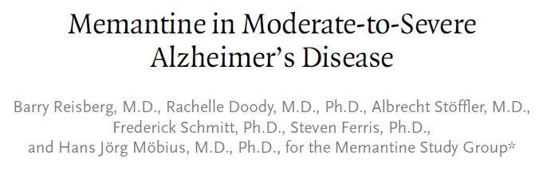
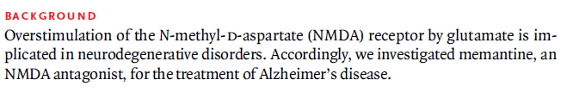

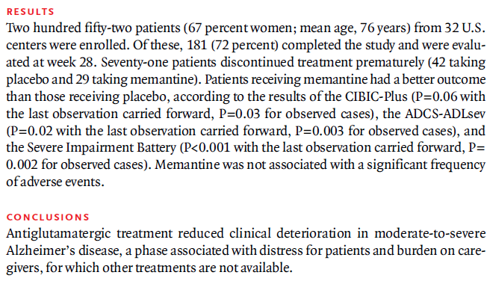

Slide 18
Memantine in combination
When Memantine was administered to pts with moderate-to-severe AD who were receiving stable doses of a cholinesterase inhibitor, there was cognitive improvement, reduced decline in ADL, and a reduced freq of new behavioral symptoms as compared with those receiving placebo.

Slide 19
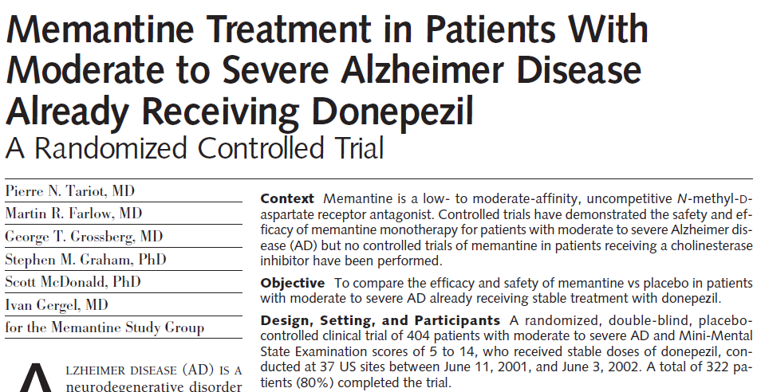
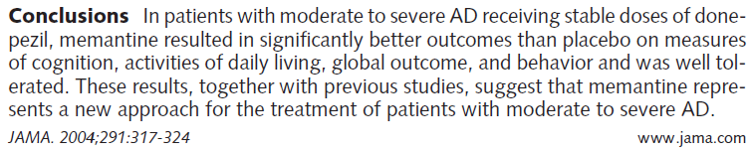

Slide 20
Psychopharmacologic agents
Upto 80% of AD patients report neuropsychiatric symptoms.
Early phase: mood changes & apathy, depression
Middle & later phase: Psychosis & Agitation
Subtypes of agitation: Delirium, Depression, Psychosis, Insomnia, Anxiety, Sundowning, Osteoarthritic pain, Anger
Wandering becomes common as AD progresses
The Three Rs approach: Repeat, Reassure, Redirect
With this approach, the caregiver repeats an instruction or answer to a question as needed and redirects the patient to another activity to divert attention from a problematic situation.

Slide 21

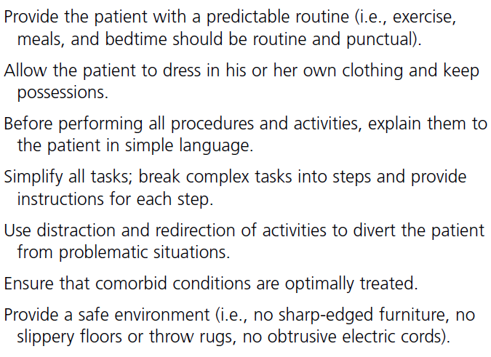
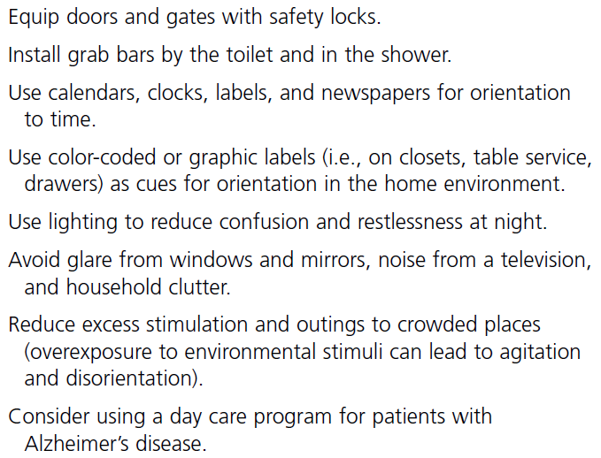

Slide 22
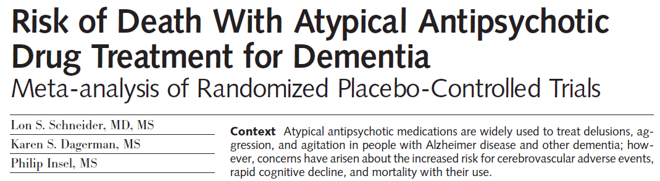

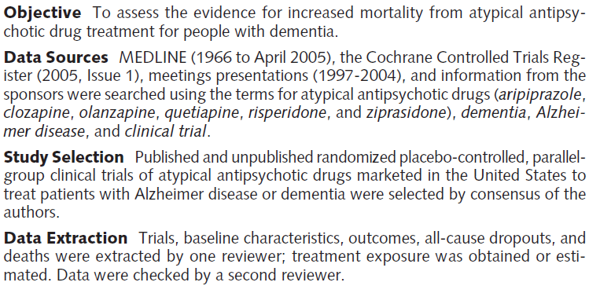
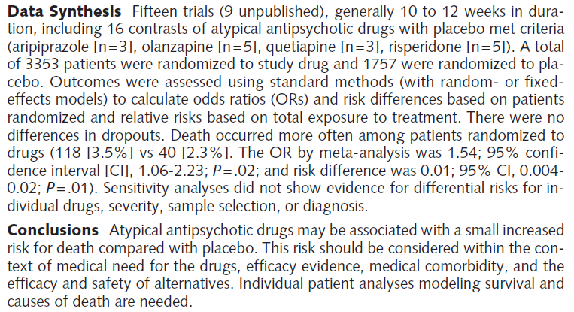

Slide 23
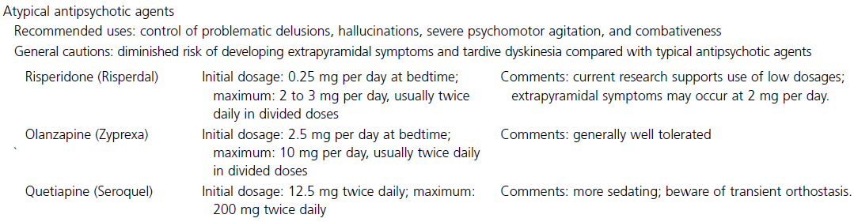
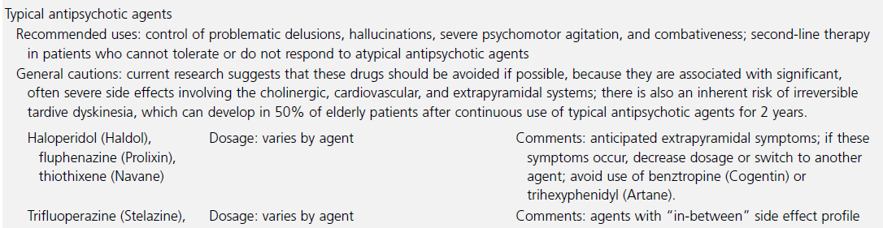
Antipsychotic agents: Atypical & Typical

Slide 24
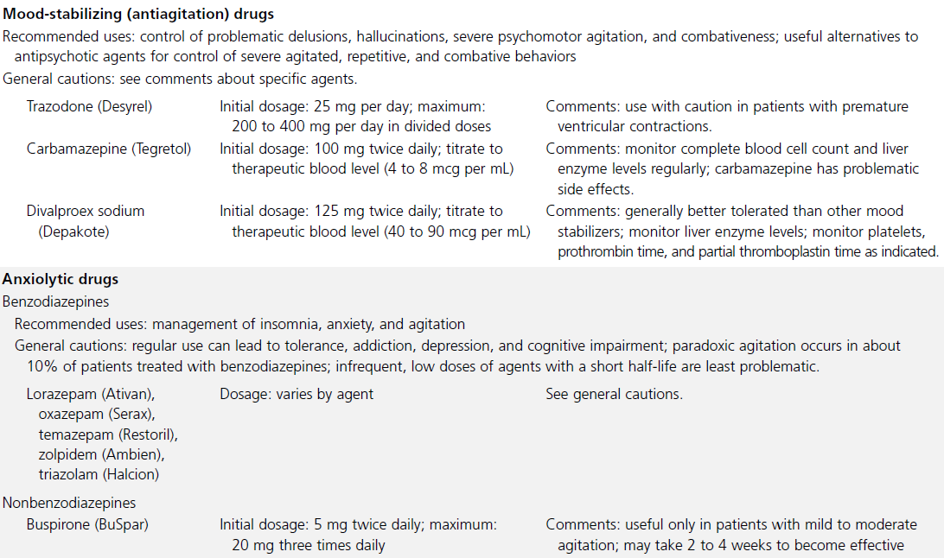

Slide 25
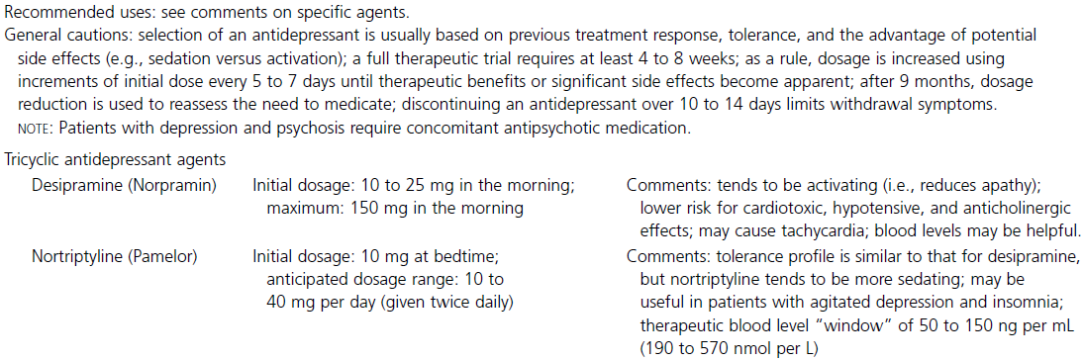
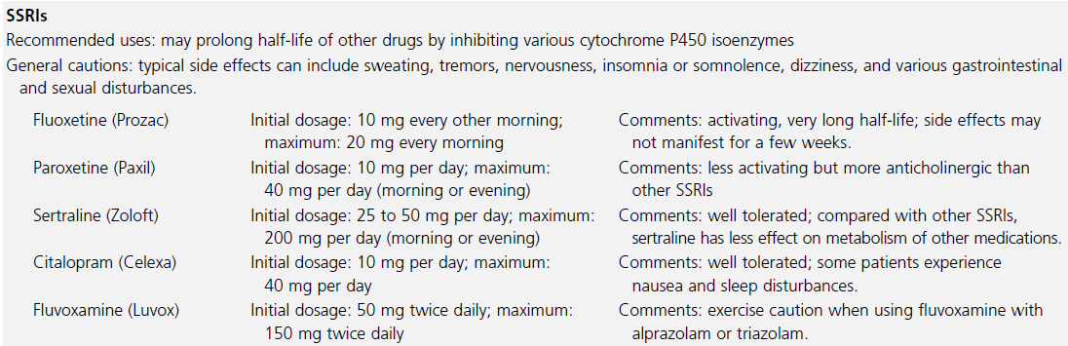
Anti depressant drugs

Slide 26
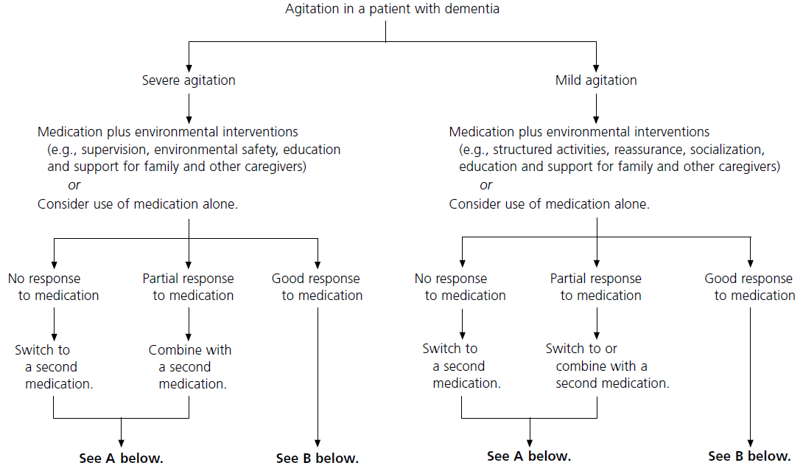
Management of Agitation in Dementia

Slide 27
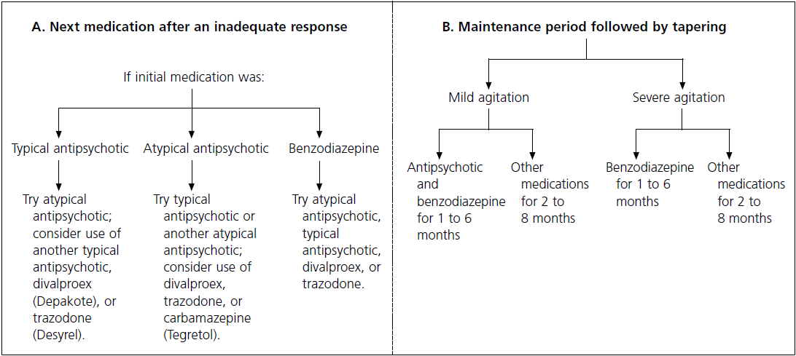
The Expert Consensus Panel for Agitation in Dementia. Postgrad Med 1998 Apr;1-88.

Slide 28
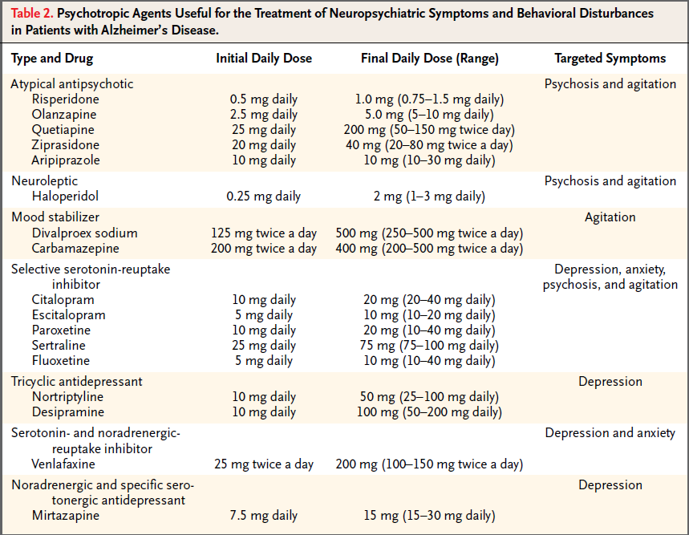

Slide 29
Alzheimer’s association
Safe Return Program
Alzheimer’s Association Safe Return is a 24-hr nationwide emergency response service for individuals with AD or a related dementia that wander or who have a medical emergency.
If an individual with AD wanders and becomes lost, caregivers can call the 24-hr emergency response line to report it.
A community support network will be activated, including local Alzheimer’s Association chapters and law enforcement agencies, to help reunite the caregiver with the person.
The enrollment fee is $49.95 with an annual renewal fee of $25.

Slide 30
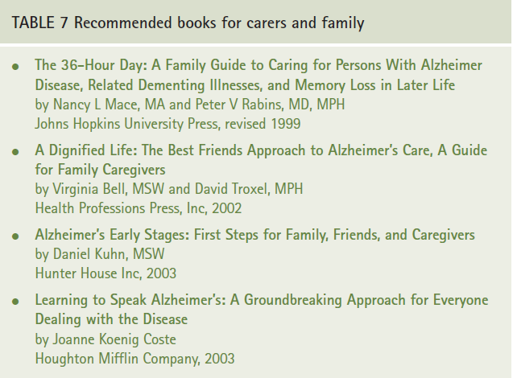
Alliance with care givers

Slide 31
There are only 5 medications approved by the FDA to treat AD.
These medications ameliorate the symptoms and can improve the functioning of patients with AD, but they are not curative, nor do they significantly change the course of the illness.
Because the benefits of these drugs is small, their cost effectiveness has been questioned.

Slide 32
Treatment Guidelines

Slide 33
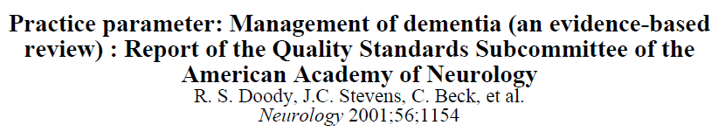
The authors searched the literature for four clinical questions:
1) Does pharmacotherapy for cognitive symptoms improve outcomes in patients with dementia?
2) Does pharmacotherapy for noncognitive symptoms improve outcomes in patients with dementia?
3) Do educational interventions improve outcomes in patients and/or caregivers?
4) Do other nonpharmacologic interventions improve outcomes in patients and/or caregivers?

Slide 34
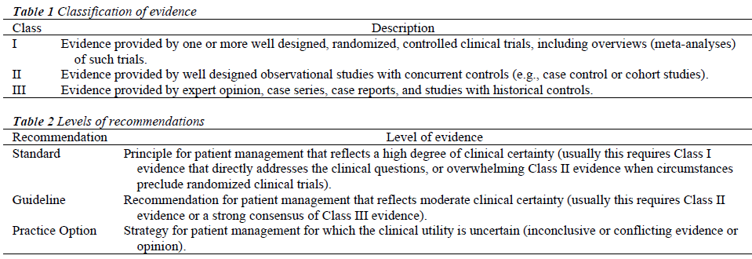

Slide 35
Practice recommendations (2001)
Pharmacologic treatment of AD:
ChEIs :should be considered in patients with mild- moderate AD (Standard), although studies suggest a small average degree of benefit.
Vit E (1000 IU bd): should be considered in an attempt to slow progression of AD (Guideline).
Selegiline (5 mg bd) is supported by one study, but has a less favorable risk–benefit ratio (Practice Option).
There is insufficient evidence to support the use of other antioxidants, anti-inflammatories, or other putative disease-modifying agents specifically to treat AD because of the risk of significant side effects in the absence of demonstrated benefits (Practice Option).
Estrogen should not be prescribed to treat AD (Standard).

Slide 36
Rx of non cognitive symptoms
Practice recommendations.
Antipsychotics should be used to treat agitation or psychosis in patients with dementia where environmental manipulation fails (Standard).
Atypical agents may be better tolerated compared with traditional agents (Guideline).
Selected tricyclics, MAO-B inhibitors, and SSRI should be considered in the treatment of depression in individuals with dementia with side effect profiles guiding the choice of agent (Guideline).

Slide 37
Educational interventions for patient & caregiver
Practice recommendations.
• Short-term programs directed toward educating family caregivers about AD should be offered to improve caregiver satisfaction (Guideline).
• Intensive long-term education and support services should be offered to caregivers of patients with AD to delay time to nursing home placement (Guideline).
• Staff of long-term care facilities should receive education about AD to reduce the use of unnecessary antipsychotics (Guideline).

Slide 38
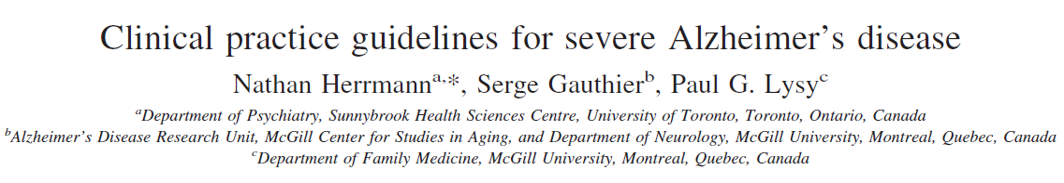

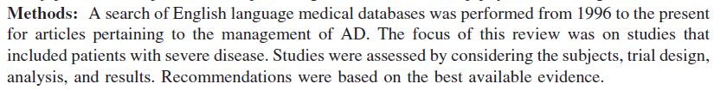

Slide 39
Level of evidence for therapeutic interventions
Level I: High qualityRCT with statistically significant difference or no statistically significant difference but narrow CI, Systematic Review of Level I RCTs
Level II: Lesser quality RCT (e.g. < 80% follow-up, no blinding, or improper randomization), Prospective comparative study, Systematic review of Level II studies or Level I studies with inconsistent results
Level III:Case control study, Retrospective comparative study Systematic review of Level III studies
Level IV: Case series
Level V: Expert opinion

Slide 40
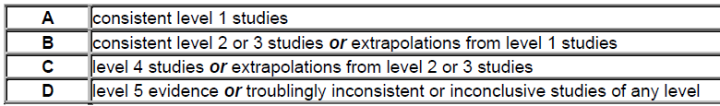
Grades of recommendation

Slide 41
Recommendations for the management of severe Alzheimer’s Disease
Severe AD can be defined as the stage in which the patient becomes totally dependent on a caregiver for survival.
This will typically correspond to MMSE 10. (Grade B, Level 2).
Patients with severe AD should be assessed at least every 4 months or if treated with pharmacotherapy at least every 3 months (Grade C, Level 3).
The goals for management are to improve the quality of life for patient and caregivers maintain optimal function and provide maximum comfort (Grade B, Level 3).

Slide 42
Medical Mx includes Rx of intercurrent medical conditions (infections, parkinsonian symptoms, seizures, pressure ulcers), ameliorating pain, improving nutritional status and optimizing sensory function (Grade B, Level 3).
Patients with severe AD can be treated with ChEIs, Memantine or the combination.
Expected benefits would include modest improvements or slower decline in cognition and behavior (Grade A, Level 1).

Slide 43
Treatment with ChEIs and/or memantine should persist until clinical benefit can no longer be demonstrated.
Treatment should not be discontinued simply because of institutionalization (Grade C, Level 3).

Slide 44
Clinical Practice Guidelines: Management of Behavioral &
Psychiatric symptoms in dementia
The management of BPSD should begin with appropriate assessments diagnosis of target symptoms
Nonpharmacologic Rx should be initiated first.
Approaches that might be useful for severe AD include behavioral management for depression and caregivers/staff education programs (Grade B, Level 1).
Pharmacologic Rx should be initiated concurrently with nonpharmacologic approaches in the presence of severe depression, psychosis or aggression that puts the patient or others at risk of harm (Grade B, Level 3).

Slide 45
Management of BPSD
Pharmacologic Rx for BPSD should be initiated at the lowest doses titrated slowly and monitored for effectiveness and safety (Grade B, Level 3).
Attempts to taper and withdraw medications for BPSD after a period of 3 months of behavioral stability should occur in a standardized fashion (Grade A, Level 1).
Risperidone and Olanzapine can be used for severe agitation & psychosis. The potential benefit of all antipsychotics must be weighed against the potential risks such as cerebrovascular events & mortality (Grade A, Level 1).

Slide 46
Management of BPSD
Benzodiazepines should be used only for short periods as (Grade B, Level 1).
Selective serotonin reuptake inhibitors can be used for the treatment of severe depression (Grade B, Level 3).

Slide 47
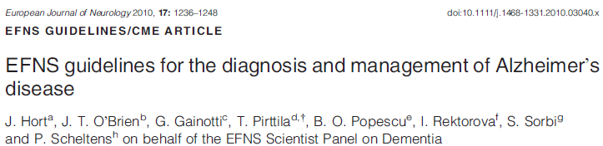
Disclosure of diagnosis is not harmful, and actually decreases depression & anxiety in patients and their care-givers (Class II).
Differences among ethnic, cultural, and religious groups may influence how and what disclosure occurs.
The provision of a standard education & support package to caregivers has been shown in RCT to decrease psychiatric symptoms in caregivers and lead to delays in institutionalisation for patient (Class I).
Carpenter BD et al. Reaction to a dementia diagnosis in individuals with AD & MCI. J Am Geriatr Soc 2008; 56: 405–412.
Mittelman MS. Improving caregiver well-being delays nursing home placement of pts with AD . Neurology 2006

Slide 48
EFNS Guidelines:Primary prevention of AD
Non modifiable risk factors: Age, Genotpye
Potentially modifiable RFs established through several epidemiological studies include- vascular RFs (HTN, smoking, DM, AF & obesity) and head injury.
Protective factors: use of antihypertensives, NSAIDs, statins and HRT, high education, diet, physical activity and engagement in social & intellectual activities.

Slide 49
EFNS Guidelines:Primary prevention of AD
A meta-analysis concluded that there is no good evidence to recommend Statins for reducing the risk of AD.
Results of the large, prospective, placebo-controlled Womens Health Initiative Memory Study showed that the use of estrogen + progestin in post-menopausal women was actually associated with a significantly increased risk of dementia (Class I).
McGuinness B et al. Statins for the prevention of dementia. Cochrane Database Syst Rev 2009.
Shumaker SAet al. Conjugated equine estrogens and incidence of probable dementia and MCI in postmenopausal women: Womens Health Initiative Memory Study. JAMA 2004; 291: 2947–2958.

Slide 50
EFNS Guidelines: Secondary prevention of AD
Prevention of AD in non demented patients with MCI
A meta-analysis included 8 studies involving all three ChEIs, with duration of treatment ranging from 16 wks to 3 yrs . There were no differences in rate of conversion to AD betw active & placebo groups, and most secondary outcomes were also negative (Class I).
Raschetti R et al Cholinesterase inhibitors in MCI: a systematic review of randomised trials.PLoS Med2007

Slide 51
EFNS Guidelines: Secondary prevention of AD
There have also been negative studies of aspirin in primary prevention of cognitive decline and of NSAIDs and vitamin E in MCI (Class I).
A large study showed no effect of Gingko on preventing AD(Class I).
Therefore, no treatments have demonstrated efficacy for preventing or delaying development of AD in MCI subjects until now, while evidence exists that ChEIs, Vitamin E, Gingko Biloba and NSAIDs are not substantively helpful.

Slide 52
Ginkgo Biloba
Products of the maidenhair tree, Ginkgo biloba, have long been used in China as a traditional medicine for various disorders of health.
A standardized extract is widely used in the West for the Rx of a range of conditions including memory & concentration problems, depression, anxiety, dizziness, tinnitus and headache.
The mechanisms of action are thought to reflect the action of several components of the extract and include increasing blood supply by dilating blood vessels, reducing blood viscosity, modification of neurotransmitter systems, and reducing the density of oxygen free radicals.

Slide 53
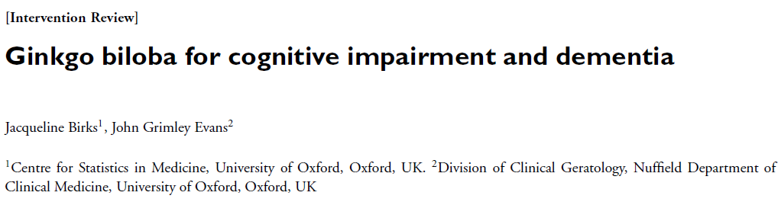
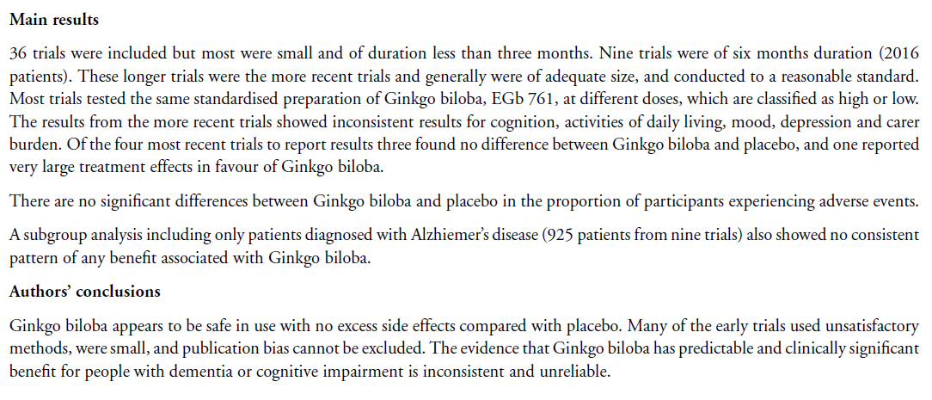

Slide 54
Mechanism-based treatments for AD
Agents currently under evaluation
A new era in therapy for AD has begun, with several clinical trials putatively targeting the mechanisms fundamental to the disease process.
At this point, however, there is still controversy as to which of the targeted processes truly are critical to disease progression, and how best to inhibit these.

Slide 55
Strategies of disease modifying therapy
Interventions targeting Amyloid:
- Inhibiting Amyloid formation- secretase inhibitors
- Inhibiting Amyloid aggregation
- Increasing clearance of Beta amyloid with immunotherapy
Therapies targeting Tau/NFT formation
Therapies for mitochondrial stabilization

Slide 56
Familial AD (25%)
Early onset AD (5%)
Late onset AD (95%)
Amyloid precursor protein (APP)
Chr 21
Apolipoprotein ε (APOE) gene
Chr 19
presenilin 1 (PS1/ PSEN1)
Chr 14
PS2/PSEN2
Chr 1

Slide 57
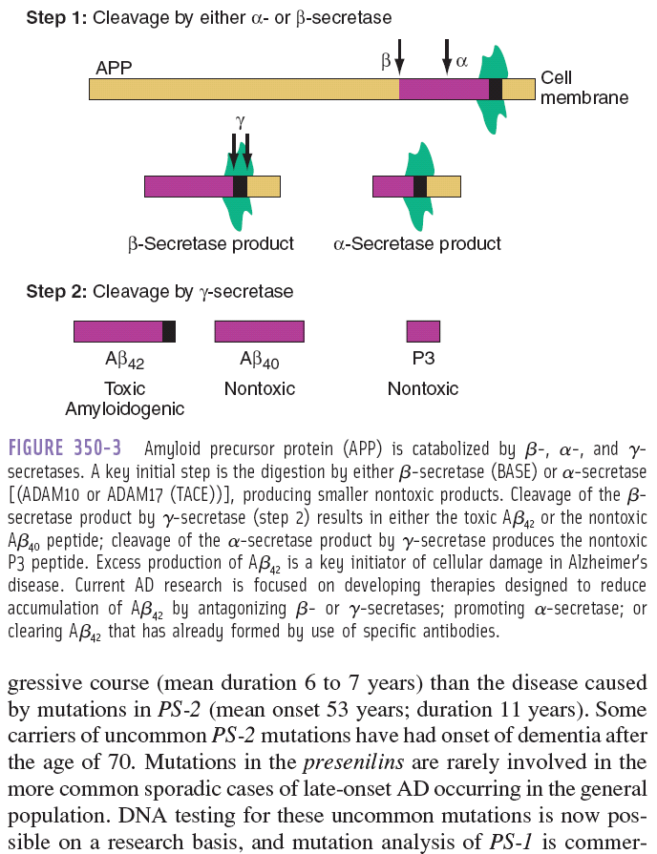

Slide 58
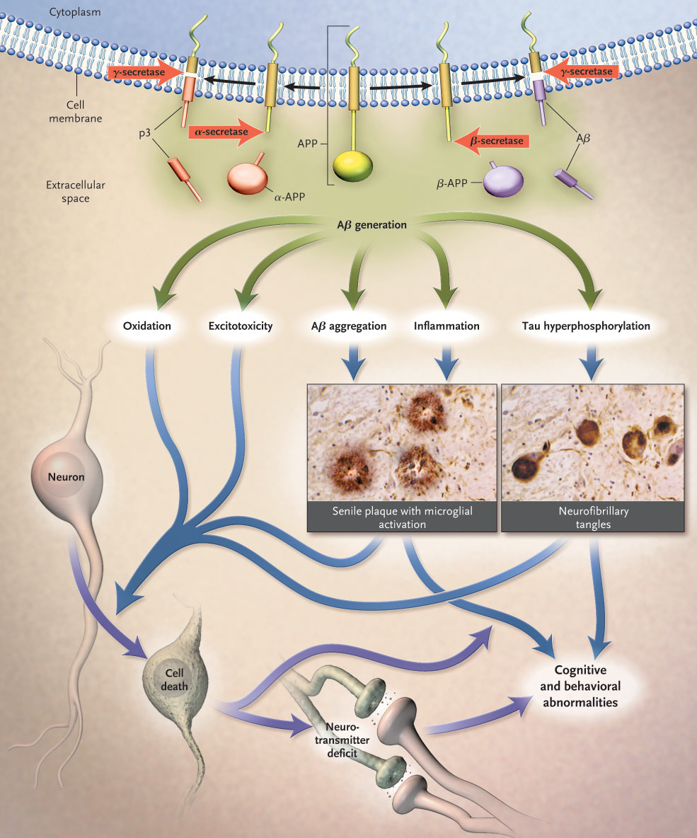
Amyloid cascade hypothesis
This hypothesis of the amyloid cascade, which progresses from the generation of the β-amyloid peptide from the APP, through multiple secondary steps, to cell death, forms the foundation for current and emerging options for the treatment of AD.

Slide 59
Rationale of therapies targeting Amyloid
If the overproduction or accumulation of Aβ is in fact the crucial event in the cascade that leads to AD, then decreasing its production by the inhibition of β-site amyloid precursor protein-cleaving enzyme (BACE) or γ-secretase
or the enhancement of α-secretase should decrease the pathology and change the course of the illness.
One such agent, a γ-secretase inhibitor- LY450139 or Semagacestat is undergoing phase 3 trial

Slide 60
Tarenflurbil: γ-secretase modulator
R-enantiomer of the NSAID flurbiprofen was the first γ-secretase modulator to reach final stage of clinical development.
A phase II trial had showed beneficial results but a multisite 18 month phase III trial did not show a +ve outcome.
One explanation offered was poor CNS penetration
Green RC et al; the Tarenflurbil Phase 3 Study Group. Eff ect of tarenflurbil on cognitive
decline and ADL in pts with mild AD: a randomized controlled trial. JAMA 2009; 302: 2557–64.

Slide 61
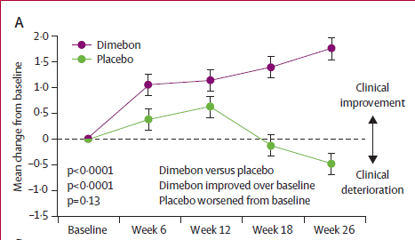
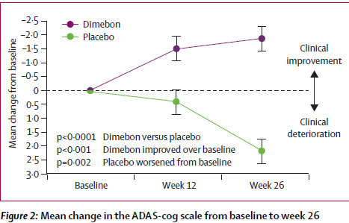
Dimebon/Latrepirdine
Drug used in Russia as an antihistaminic for over 2 decades.
Later found to have ChEI & NMDA inhibitor properties & mitochondrial function stabilizer properties
Phase II trial showed +ve results (Doody S et al, Lancet 2008)
Currently in Phase III trials in USA

Slide 62
Immunotherapy for Beta amyloid clearance
Specific antibodies can bind Aβ and promote its clearance from the central nervous system.
This can be accomplished either by the introduction of Aβ as an antigen so that the body can produce antibodies to it (active immunotherapy)
or by the use of preformed antibodies (passive immunotherapy)

Slide 63
In 2002, the first phase 2 active immunity trial (AN-1792) was halted because of meningoencephalitis in 6% of the pts who received the vaccine.
Despite the halting of the trial, the researchers followed the pts who received the vaccine. ~ 20% of those who received the active vaccine achieved the targeted immune response & there was a marked effect on amyloid in the brain, although the other neuropathological hallmarks of AD were unchanged in comparison with controls
Unfortunately, there was little evidence of any cognitive benefit
Bayer AJ et al. Evaluation of the safety and immunogenicity of synthetic Aβ42 (AN1792) in patients with AD. Neurology 2005; 64: 94–101.

Slide 64
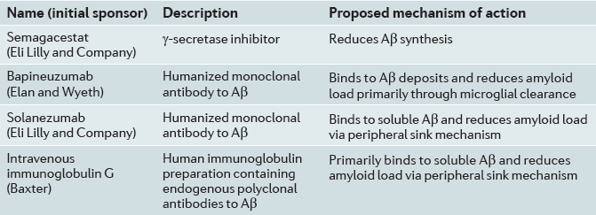
Proposed mechanisms of action of compounds in trials for AD

Slide 65
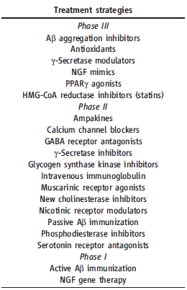
Phase I: Screening for safety, establish dose range
Phase II: Establishing the testing protocol. These trials usually represent the most rigorous demonstration of a medicine’s efficacy.
Synonym: pivotal trials
Phase III: Final testing. Multicenter studies, ≥ 1000-3000 subjects
Phase IV: 'Post-approval' studies

Slide 66
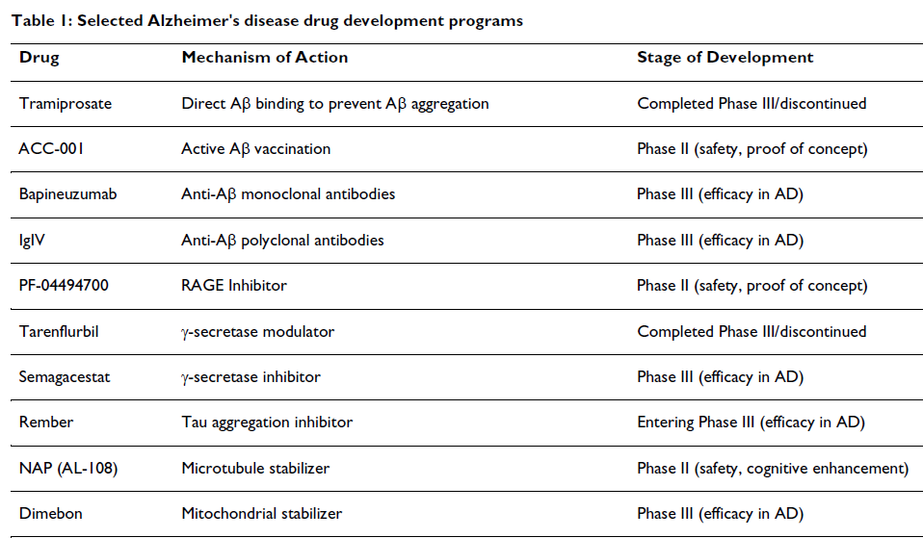

Slide 67

Drugs being investigated for AD, reported according to the most advanced phase of study and main
therapeutic properties. . Aβ=amyloid β. BBS1=anti-β-site antibodies. EGCg=epigallocatechin-3-gallate.
LMT=leuco-methylthioninium. MTC=methylthioninium chloride. NGXsc=NGX series compounds.
GSM=γ-secretase modulator. *RCTs in AD not ongoing. †Drugs approved for the treatment of AD.

Slide 68

Bruno Vellas et al Lancet Neurol 2007

Slide 69
Summary of Recommendations
Patients and caregivers should be provided with education and support (Level A).
There is insufficient evidence to support the use of any drugs purely for the primary prevention of dementia.
In patients with AD, treatment with ChEIs should be considered at the time of diagnosis, taking into account expected therapeutic benefits and potential safety issues (Level A).
In patients with moderate to severe AD, Rx with Memantine should be considered taking into account expected therapeutic benefits and potential safety issues (Level A).

Slide 70
Summary of Recommendations
Aspirin should not be used as a treatment for AD (Level A)
Cognitive stimulation or rehabilitation may be considered in patients with mild to moderate AD (good practice point).
Occupational therapy can improve patients functioning and reduce need for informal care (Level B).
Whenever possible, initial treatment of BPSD should be non-pharmacological (Level C).

Slide 71

Thank You

Slide 72
Referrences
Alzheimer’s disease: strategies for disease modification Martin Citron; Nature Reviews Drug Discovery 2010
Michael S Rafii and Paul S Aisen ; Recent developments in Alzheimer's disease therapeutics; BMC Medicine 2009
Alzheimer Disease: Mechanistic Understanding Predicts Novel Therapies Review 20 April 2004 Annals of Internal Medicine Volume 140 • Number 8 635

Slide 73
Handbook of Clinical Neurology, Vol. 89 (3rd series) Dementias C. Duyckaerts, I. Litvan, Editors 2008 Elsevier
Peter Davies, PhD Jeremy Koppel, MD; Mechanism-based treatments for Alzheimer's disease Dialogues Clin Neurosci. 2009 ; 11(2): 159–169.
Veld BA, Ruitenberg A, et al. Nonsteroidal antiinflammatory drugs and the risk of Alzheimer’s disease.N Engl J Med. 2001;345:1515-21. [PMID: 11794217]
Mayeux R, Sano M. Treatment of Alzheimer’s disease. N Engl J Med. 1999;341:1670-9.

Slide 74


