Slide 1
ADEM
Faculty : Dr. C. Rathore

Slide 2
Scheme
Introduction
Epidemiology
Etiology, Pathogenesis
Clinical features
Investigations
Treatment

Slide 3
Introduction
Acute disseminated encephalomyelitis
Immune-mediated disorder of CNS
Postinfectious, Parainfectious, Postexanthematous, or Postvaccinal encephalomyelitis

Slide 4
History
Post-measles neurological dysfunction - Lucas in 1790
Small-pox/ Rabies vaccine-induced encephalomyelitis

Slide 5
History
Experimental autoimmune encephalomyelitis – by injecting homogenates of normal rabbit brains into monkeys (1930s)
Introduction of rabies vaccines devoid of myelin components

Slide 6
Diagnostic criteria
Not well established
International Paediatric Multiple Sclerosis Study Group

Slide 7
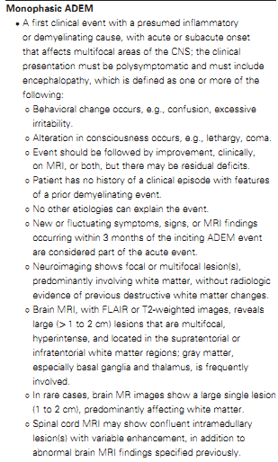

Slide 8
Diagnostic criteria
Sensitivity of 80% and speciﬁcity of 91%
Young et al. Perivenous demyelination: association with clinically deﬁned
acute disseminated encephalomyelitis and comparison with pathologi-
cally-conﬁrmed multiple sclerosis. Brain 2010: 133; 317–319

Slide 9
Epidemiology
Incidence: 0.4 to 0.8 per 100,000 of population
More common in children
Median age of onset: 4.5 to 7.5 in pediatric pts, 33.5 in adults
Slight male predominence
Seasonal peak in winter

Slide 10
Epidemiology
Canadian Pediatric Surveillance Program (<18 yrs)
Acq demyelinating disorders
ADEM 22%
Transverse myelitis 22%
Optic neuritis 23%
ADEM children more likely to be <10 yrs
Banwell B et al. Incidence of acquired demyelination of the CNS in Canadian children. Neurology. Jan 20 2009;72(3):232-9.

Slide 11
Etiology
Viral inf MC
Measles, varicella, rubella, mumps, and inﬂuenza
1 to 2 per 1000 measles infections, more common in children > 5 years of age
Mortality rate 10-40%

Slide 12
Etiology
Post-vaccine (~5%)
Difficult to prove (upto 3 m interval)
Immune reconstitution inﬂammatory syndrome
Stem cell transplantation

Slide 13
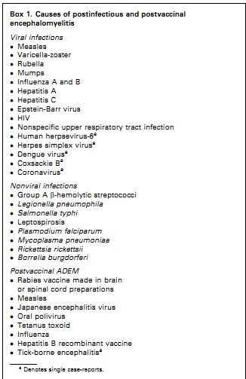

Slide 14
Etiology
Measles vaccine: 10 to 20 per 100 000
Measles infection: 100 per 100 000

Slide 15
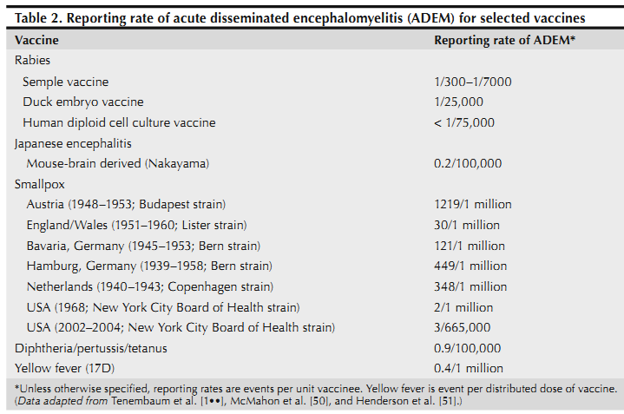

Slide 16
Pathogenesis
Nonimmune mechanisms
  Myelin damage by viral products
Immune-mediated mechanisms
  Molecular mimicry
  Pathogen-derived antigens → dev of Ab, activation of T cells → cross react with CNS

Slide 17
Pathogenesis
Immune-mediated mechanisms
  Disturbing the immunoregulatory mechanisms → activation of self-reactive lymphocytes
  Direct CNS inf → Impair BBB → Leak of CNS confined autoantigens → T cell response

Slide 18
Pathogenesis
Myelin injury from
  activated macrophages which target myelin Ag
  Ab binding to oligodendrocyte → complement fixation → injury
  direct damage by virus/ vaccine asso product
  release of myelin Ag into circulation → autoAb

Slide 19
Pathogenesis
High CSF concentrations of chemokines that recruit or activate neutrophils, monocytes & Helper T cells
? Role as biomarker
Ishizu T, Minohara M, Ichiyama T, et al. CSF cytokine and chemokine profiles in acute disseminated encephalomyelitis. J Neuroimmunol. Jun 2006;175(1-2):52-8.

Slide 20
Pathogenesis
Genetic susceptibility for ADEM was significantly associated with HLA DQB1*0602, DRB1*1501 and DRB1*1503 alleles (<0.05) in monophasic ADEM
Same have been shown to be asso with MS
Alves-Leon et al. Acute Disseminated Encephalomyelitis Clinical features, HLA DRB1*1501, HLA DRB1*1503, HLA DQA1*0102, HLA DQB1*0602 and HLA DPA1*0301 allelic association study. Arq Neuropsiquiatr 2009;67(3-A):643-651

Slide 21
Pathology
WM
Cortical gray, BG
~Experimental Allergic Encephalomyelitis

Slide 22
Pathology
Inﬁltration of T cells & macrophages
Perivenous areas of demyelination (confluent in MS)
Axons relatively preserved

Slide 23
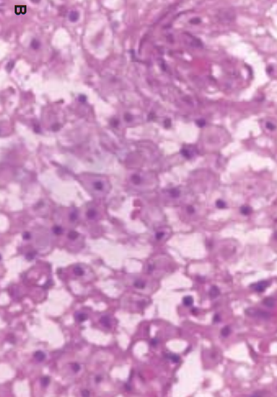
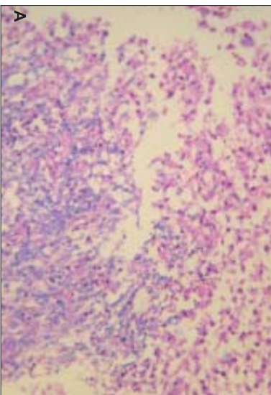
Macrophage infiltration – H&E
Demyelination – Luxol fast blue

Slide 24
Pathology
In MS: Infl not seen, Demyel is confluent
Cytotoxic necrosis & gliosis seen with inf

Slide 25
Clinical features

Slide 26
Clinical features
Abrupt onset of neurologic symptoms 2 to 30 days after a preceding infection or vaccination
Commonly 4 to 14 days
No preceding H/o in ~1/3 adol and ~1/2 adults
But only 7-15% children have neg H/o

Slide 27
Clinical features
Systemic symptoms in ~1/2: fever returns, headache, malaise, myalgia
More common in children
Altered mental status (75-90%)
  Irritability
  Lethargy

Slide 28
Clinical features
Motor weakness (50-70%)
Ataxia (40-50%)
CN palsies (30%)
Sensory deficits (15-20%)
Meningismus (20-30%)
Spinal cord involt (20-25%)
Seizures (10-25%)

Slide 29
Clinical features
Sz more common in children
CN palsies more common in children
Motor & Sensory deﬁcits more common in adults
PNS involt - acute polyradiculoneuropathy – reported in adults
Optic neuritis in 10-20%, often b/l

Slide 30
Clinical features
Evolution from onset to clinical nadir occurring within days (mean 4.5 days)

Slide 31
Acute hemorrhagic leukoencephalitis
Hyperacute form of ADEM
Rapidly progressive hemorrhagic demyelination
Usually in children (2% of ADEM)
Systemic symptoms more common
Most patients die in 1st week of illness (brain edema)

Slide 32
Post-infectious transverse myelitis
Subtype of ADEM
Initial pain in the distribution of the involved segments (~1/3)
Sensory/ Motor / Bladder symptoms
Symmetric, Central (as against MS)
Longitudinally extensive
Abnormal CSF IgG index can be seen in both

Slide 33
Post-infectious transverse myelitis
~1/3 recover completely, 1/3 partial recovery, 1/3 severe disability
Poor prognostic indicators
  Initial severity of weakness
  Evidence of denervation on EMG

Slide 34
Relapsing ADEM
At least 3 m after initial event, at least 1 m after completing steroids
At least 24 h duration
~10% of pts
Often during steroid taper (~5%)

Slide 35
Relapsing ADEM
Recurrent ADEM
  Common
  Same site
  DD: SOL
Multiphasic DEM
  Cannot be distinguished from MS

Slide 36
Relapsing ADEM
Tends to occur early
Mostly in 1st yr (Median first interattack interval 3.1 years in childhood MS)
Suggested – avoid immunization for 6 m in child who had ADEM

Slide 37
Relapsing ADEM
Most children have only 1 recurrence (Biphasic DEM)
Clinical & radiological resolution is the norm

Slide 38
investigations

Slide 39
Investigations
MRI
  T2, FLAIR
  Multiple, large, ill defined lesions
  Often asymmetric
  Vasogenic edema
  CE in uniform fashion (similar stg)
  CE more common in children (~90%), can be dense

Slide 40
Investigations
MRI
  WM - cerebral hemispheres, cerebellum, brainstem & spinal cord; Blurry margins
  Gray-white jxn
  BG, Thalamus (30-40%)
  Brainstem (40-50%)
  Cerebellum (30-40%)

Slide 41
Investigations
4 patterns on MRI
  small (< 5 mm) lesions
  large conluent lesions with edema and mass effect
  symmetric bilateral thalamic involvement
  acute hemorrhagic encephalomyelitis
Tenembaum S et al Acute disseminated encephalomyelitis: a long-term follow-up study of 84 pediatric patients. Neurology 2002, 59: 1224–1231

Slide 42
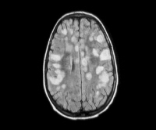
Grey-white, Not well defined, Not perpendicular to ventricles

Slide 43
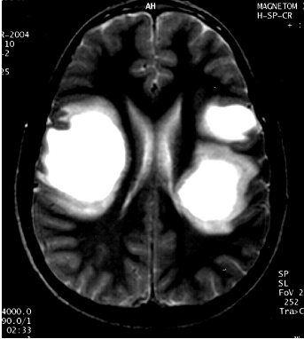

Slide 44
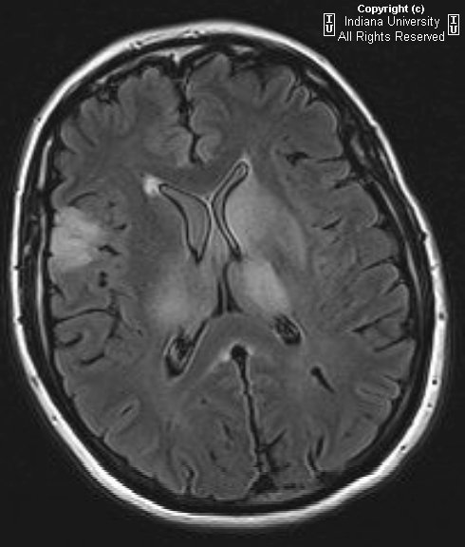

Slide 45
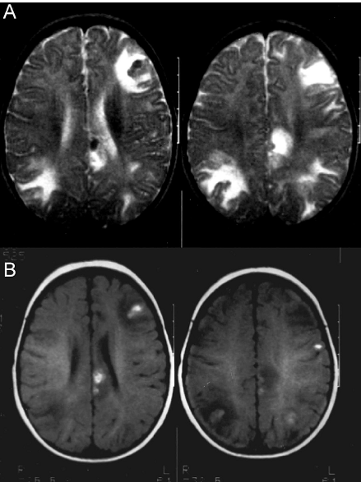
5 m old boy with acute hgic encephalomyelitis

Slide 46
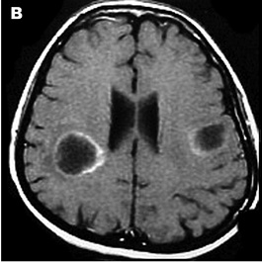
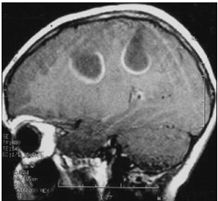
Ring like CE

Slide 47
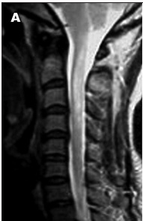
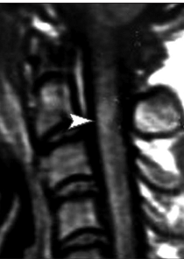
T2
T1+C

Slide 48
MRI
Any 2 of the following criteria distinguish 1st attack of MS in children from ADEM(sensitivity 75%, specificity 95%)
  (1) absence of diffuse bilateral lesion pattern
  (2) presence of black holes
  (3) presence of 2 or more periventricular lesions
Callen DJ et al. Role of MRI in the differentiation of ADEM from MS in children. Neurology. Mar 17 2009;72(11):968-73

Slide 49
MRI
Corpus callosum long axis perpendicular lesions
Sole presence of well-deﬁned lesions
Highly specific for conversion to MS, but low sensitivity
Mikaeloff et al. MRI prognostic factors for relapse after acute CNS
inﬂammatory demyelination in childhood. Brain (2004), 127, 1942–1947

Slide 50
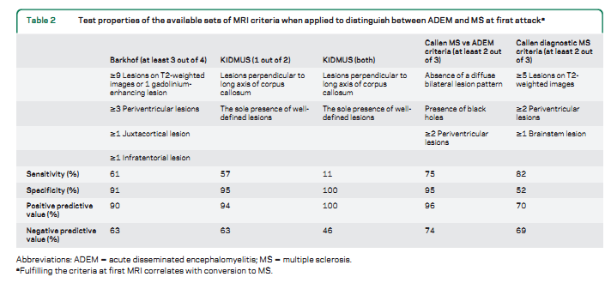
Ketelslegers et al. A comparison of MRI criteria for diagnosing pediatric ADEM and MS. Neurology 2010;74:1412–1415

Slide 51
MRI
In adult pts, MRI less useful in distinguishing ADEM from 1st attack of MS
Schwarz et al. Acute disseminated encephalomyelitis. A follow-up study of 40 adult patients. Neurology 2001;56:1313–1318

Slide 52
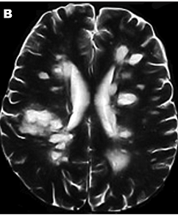
49 yr old pt with ADEM

Slide 53
MRI
MRS
  Low NAA
  Elev lactate

Slide 54
MRI
Follow up MRI – should be after at least 6 months
Persistence of lesions – does not indicate poor prognosis

Slide 55
Investigations
CSF
  Pleocytosis, Elevated protein
  OCB – transient, only in ~10% of children, ~45% adults

Slide 56
Investigations
EEG:
Focal or generalized slowing
Sharp waves/spikes
Not common in MS

Slide 57
Investigations
PET: decreased global and b/l cerebral metabolism (prognostic)
SPECT: more extensive & longer-lasting lesions compared with MRI
Bx – if CNS malignancy is a DD

Slide 58
differential diagnosis

Slide 59
Differential diagnosis
MS
Acute viral encephalitis
Post viral cerebellitis
Toxic encephalopathies

Slide 60
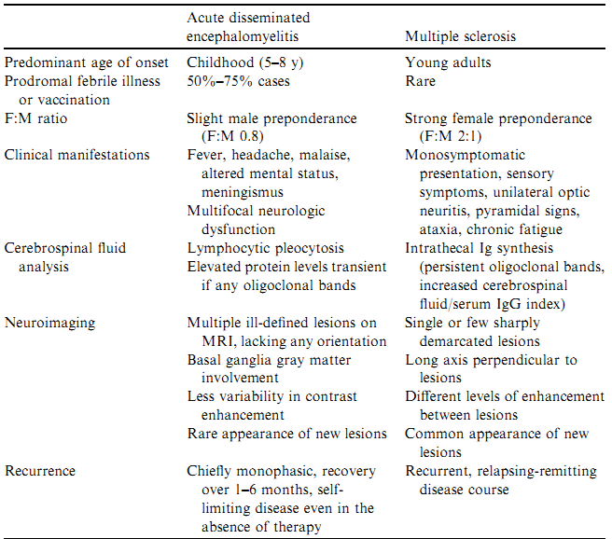

Slide 61
DD – Multiple sclerosis
Brainstem involt more common with MS
SC involt more common with ADEM
Sz in ~20% of ADEM, ~5% of MS

Slide 62
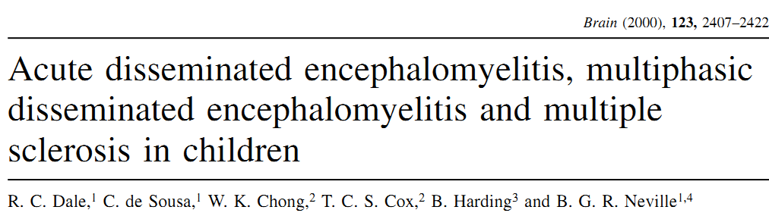
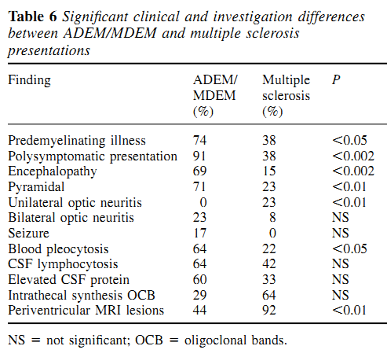

Slide 63
All the features described for MS may also be present in ADEM

Slide 64
DD – Acute viral encephalitis
Distinction difficult
Points favoring ADEM
  h/o prodromal infection or vaccination
  at least 1 fever-free day before onset of neuro symptoms
  absence of markers of acute inf
  focal neurologic signs including visual loss
  spinal cord symptoms
  involvement of peripheral nerves

Slide 65
DD – Acute viral encephalitis
Blood leukocytosis in ~50% of children with ADEM
Elev ESR in ~40%

Slide 66
DD – Acute viral encephalitis
CSF - Similar in both
Lymphocytic pleocytosis, elevated protein levels, normal glucose
TC usually <50 in ADEM
Viral culture or PCR

Slide 67
DD – Postinfectious cerebellar ataxia
Usually follows VZ
In PiCA ataxia is typically gait/ trunk, appendicular in ADEM
MRI usually normal

Slide 68
DD
Vasculitis, Behcet
Malignancy
Paraneoplastic
Sarcoidosis
HIV, PML
MELAS
ALD

Slide 69
treatment

Slide 70
Treatment
IV-MP (20–30 mg/kg/d) or dexamethasone (1 mg/kg) for 3 to 5 days
F/b oral steroids tapering over 4 to 6 weeks
No RCT
Improvement usually takes days

Slide 71
Treatment
Taper-related recurrence occurs in 3-5% of cases
Usually responds to prolongation of taper
A small subset are steroid dependent

Slide 72
Treatment
? IV-IG: consider if there is no response to steroids
? PLEX (case reports)
Shahar E, Andraus J, Savitzki D, et al. Outcome of severe encephalomyelitis in children: eﬀect of high-dose methylprednisolone and immunoglobulins. J Child Neurol 2002; 17(11):810–4

Slide 73
Treatment
Cyclophosphamide
Mitoxantrone
If steroids CI
Severe cases with no response to steroids

Slide 74
Treatment
? DMT for pts with
  recurrences
  steroid dependence

Slide 75
prognosis

Slide 76
Prognosis
Mortality rate 2-5% (upto 10-30%)
Measles vaccine, Steroid rx
Risk factors
Acute hemorrhagic leukoencephalitis
Cervical transverse myelitis
<2 yrs age

Slide 77
Prognosis
Full recovery in 60-80%
In 1-6 months
Poor prognostic factors
  Post-measles
  Sudden onset
  Length of stupor/ coma
  Unresponsiveness to steroids

Slide 78
Prognosis
Morbidity
  visual
  motor
  autonomic
  intellectual deficits
  epilepsy
More likely in younger children

Slide 79
Prognosis
MC sequelae: Motor deficits
Minor neuropsychologic abnormalities – in children with complete radiologic resolution

Slide 80
Prognosis
Long-term (10-y follow-up) risk for development of MS is 25%
~6% in prepubertal pt with single bout
~35% in adults

Slide 81
Prognosis
Inc risk in
  afebrile
  w/o mental status change
  w/o prodromal viral illness or immunization
  w/o generalized EEG slowing
  asso abnormal CSF immune profile
Rust RS (June 2000). "Multiple sclerosis, acute disseminated encephalomyelitis, and related conditions". Semin Pediatr Neurol 7 (2): 66–90

Slide 82
sct experience

Slide 83
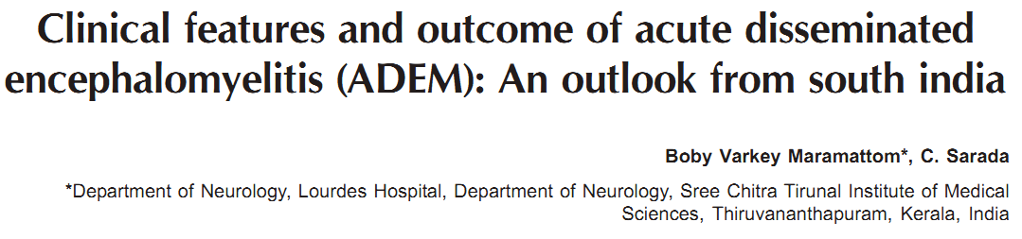
45 patients
Mean F/U 2.5 yrs
85% were adults (mean age 30 yrs)
40% had antecedent infections
Presenting symptoms: Motor weakness 65%, CN symptoms 48%
Annals of Indian Neurology 2006

Slide 84
MRI: Subcortical/ Periventricular WM involt in 50%
Brainstem involt in 29%
SC involt in 20%
Deep gray in 12%
CE in 17%
Annals of Indian Neurology 2006

Slide 85
NCS: Demyelinating neuropathy in 13%, axonal in 8%
CSF: TC <5 in 60%, Normal protein in 72%
Annals of Indian Neurology 2006

Slide 86
Mortality rate 4%
Recurrence in 2 pts: One site-restricted, one MS
Annals of Indian Neurology 2006

Slide 87
Summing up .….
ADEM is more common in children than adults
Suspect in pts with acute polysymptomatic presentation, esp if there is preceding h/o inf or vaccination
Can be difficult to r/o viral encephalitis
Give empirical acyclovir if in doubt

Slide 88
Summing up .….
Differentiating from 1st attack of MS has important therapeutic implications
In adults, it is more difficult
Clinical/ radiological F/U needed
Consider other immunomodulators if there is no response to steroids

Slide 89
Summing up .….
Relapse although not common, should be watched out for during steroid taper
Overall prognosis is good

Slide 90
Thank You!

Slide 91
References
Acute Disseminated Encephalomyelitis: Clinical and Pathogenesis Features. Noorbakhsh et al. Neurol Clin 26 (2008) 759–780
ADEM An update. Menge et al. Arch Neurol . 2005;62:1673-1680
Acute Disseminated Encephalomyelitis. Sejvar JJ. Current Infectious Disease Reports 2008, 10:307–314

Slide 92
References
Acute Disseminated Encephalomyelitis: Current Understanding and Controversies. Young et al. Semin Neurol 2008;28:84–94

Slide 93
MCQ 1
Which of the following features favor a diagnosis of ADEM rather than MS?
A: Monosymptomatic presentation
B: Prominent sensory symptoms
C: Sharply defined lesions on MRI
D: BG lesion on MRI

Slide 94
MCQ 2
Which of the following is more common in adults with ADEM than in children?
A: Seizures
B: PNS involvement
C: CN palsies
D: CE lesion in MRI

Slide 95
MCQ 3
Poor prognostic factor in pt with ADEM?
A: Persistence of MRI lesion at 6 m F/U
B: Age >18 yrs
C: Post-measles
D: Generalized slowing on EEG

