Slide 1
Neuropathology of Alzheimer's Disease
Faculty : Dr. C.Rathore

Slide 2
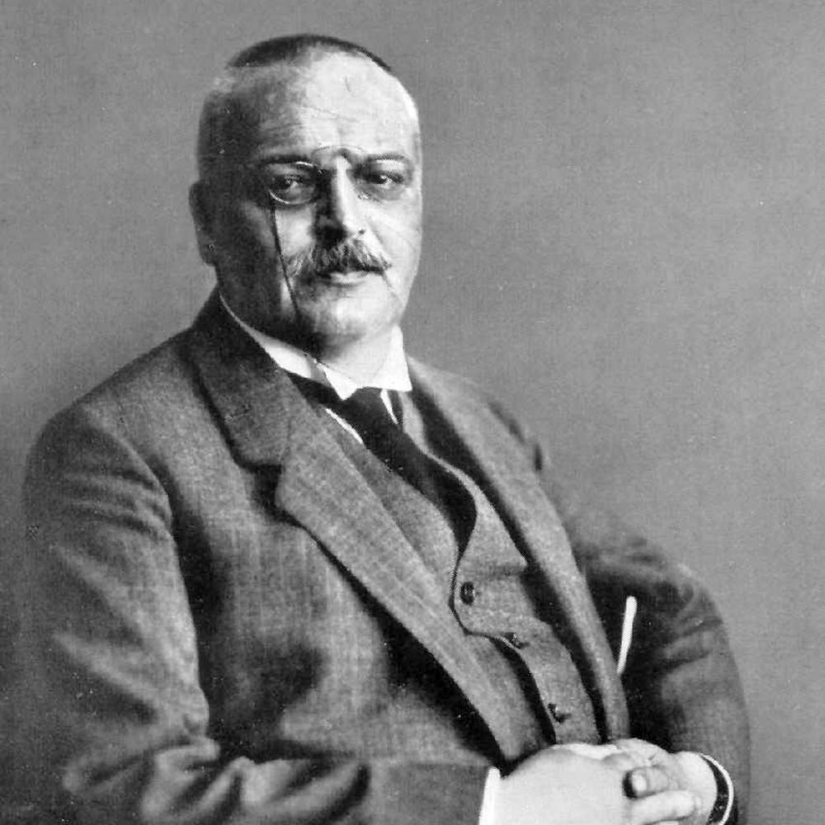

Slide 3
Alois Alzheimer a German psychiatrist and neuropathologist observed a patient at the Frankfurt Asylum named Auguste Deter.
The 51-year-old patient had strange behavioral symptoms, including a loss of short-term memory.

Slide 4
Deter died and Alzheimer had the patient records and the brain brought to Munich where he was working at Kraepelin's lab.
With two Italian physicians, he used the staining techniques to identify amyloid plaques and neurofibrillary tangles.

Slide 5
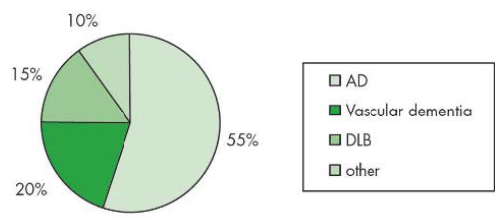
Approximate relative frequencies of the dementias
  2010 Alzheimer’s Disease Facts and Figures

Slide 6
Epidemiology
In 2010, there are 3.7 million Indians with dementia and the total societal costs is about 14,700 crore
While the numbers are expected to double by 2030, costs would increase three times
Prevalence in India
  Pune : 4.1% (>65 yrs)
  Kochi : 3.36% (>65 yrs)
  Kashmir : 6.5% (>60 yrs)
  Alzheimer’s and Related Disorders Society of India (ARDSI)
  Dementia INDIA REPORT 2010
  EXECUTIVE SUMMARY

Slide 7
What is Alzheimer’s Disease ?
Alzheimer's disease , also known as Senile Dementia of the Alzheimer Type (SDAT)
Most common form of dementia.
Alzheimer's disease is a slowly progressive degenerative disease of the brain .

Slide 8
Burden of Alzheimer’s disease
In 2006, there were 26.6 million sufferers worldwide.
Alzheimer’s is predicted to affect 1 in 85 people globally by 2050.

Slide 9
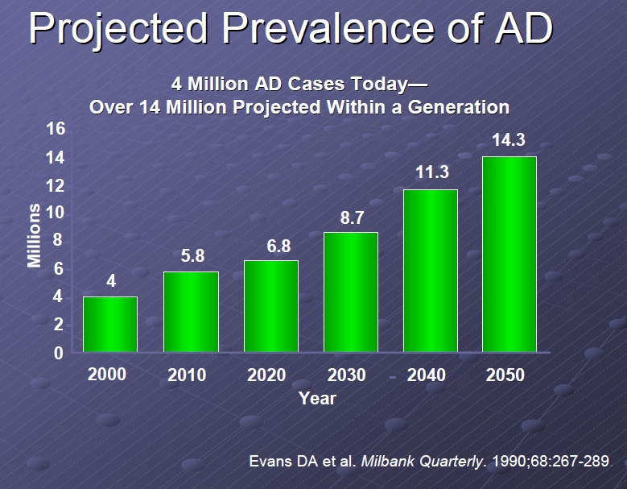

Slide 10
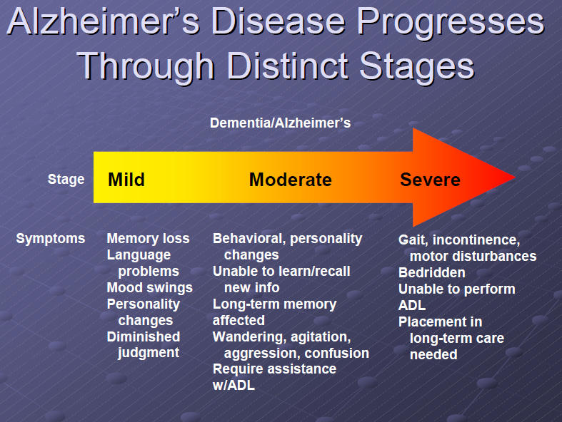

Slide 11
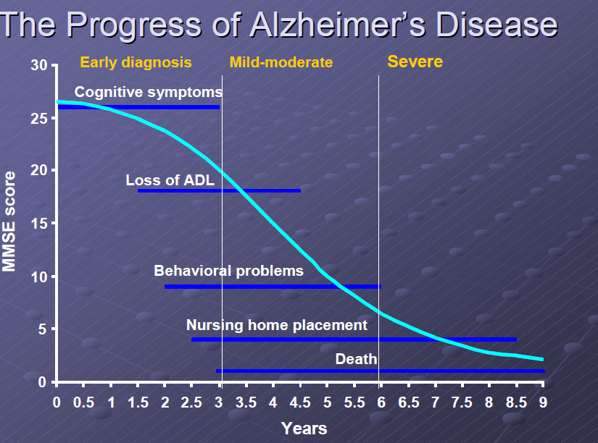

Slide 12
Early Onset Alzheimer’s
Early onset AD - familial autosomal dominant disorders caused by mutations in APP, PS1, and PS2
Mutations that cause the individuals to secrete a higher fraction of A-beta42 and/or A-beta43 peptides

Slide 13
Late Onset Alzheimer’s
Late onset alzheimer’s- no specific gene mutations that are associated with the inheritance of the disease
Specific alleles of apolipoprotein E4 (apoE) and alpha2 macroglobulin are associated with increased risk of alzheimers

Slide 14
Genetic risk factors
Early-onset Alzheimer disease
Only 13% patients clearly exhibit AD transmission
3 known causative gene mutations
  Amyloid precursor protein gene
    The first gene to be identified
    Located on chromosome 21
    Mutations in this gene cause excessive cleavage by the β- and γ-secretase enzymes, instead of normal cleavage by the α-secretase enzyme.

Slide 15
Presenilin-1, located on chromosome 14
Presenilin-2, located on chromosome 1.
  Both of these genes are involved in the γ-secretase complex
  Mutations lead to excessive cleavage by the γ- secretase enzyme
30%– 70% of mutations are in the presenilin-1 gene
10%–15% are in the amyloid precursor protein gene
< 5% are in the presenilin-2 gene

Slide 16
Late-onset alzheimer disease
Risk factor genes
  Apolipoprotein E gene [APOE]
  Sortilin-related receptor 1 gene [SORL1]
APOE is involved in cholesterol transport and β-amyloid formation, but its exact mechanism in promoting Alzheimer disease is unclear
SORL1 is involved in amyloid precursor protein processing

Slide 17
Prevalence of APOE genotypes in Alzheimer’s disease (AD) and controls.
Genotype: | Controls | AD
E2/E2 | 1.3% | 0%
E2/E3 | 12.5% | 3.4%
E2/E4 | 4.9% | 4.3%
E3/E3 | 59.9% | 38.2%
E3/E4 | 20.7% | 41.2%
E4/E4 | 0.7% | 12.9%
Jarvik G, Larson EB, Goddard K, Schellenberg GD, Wijsman EM (1996) Influence of apolipoprotein E genotype on the transmission of Alzheimer disease in a
community-based sample. Am J Hum Genet 58:191-200

Slide 18
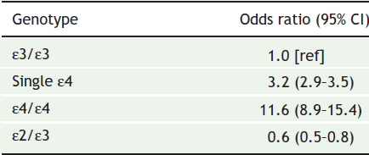
Risk of Alzheimer disease by apolipoprotein E genotype

Slide 19
Association between the APOE ε4 allele and Alzheimer disease
Stronger women > men.
Stronger among people between 55 and 65 years old .

Slide 20
Genetic testing, screening for the apolipoprotein E gene
Not recommended for the purpose of diagnosing Alzheimer disease
Positive and negative predictive values are low
[grade E recommendation, level 2 evidence]

Slide 21
Pathogenesis of Alzheimer disease
Protein misfolding
Oxidative and inflammatory damage
Mitochondrial dysfunction
Synaptic dysfunction

Slide 22
MACROSCOPIC CHANGES
Cerebral cortical atrophy
Tends to spare primary motor, sensory, and visual areas
Comparisons of the brain weight - degree of cerebral cortical atrophy with those of age-matched controls - gross inspection of the brain.

Slide 23
Loss of brain tissue that generally leads to a symmetrical dilation of the lateral ventricles (hydrocephalus ex vacuo)
Significant atrophy of the hippocampus, with an associated selective dilatation of the adjacent temporal horn of the lateral ventricle

Slide 24
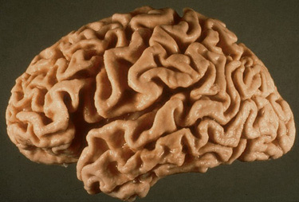

Slide 25
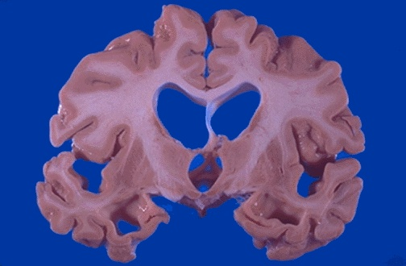

Slide 26
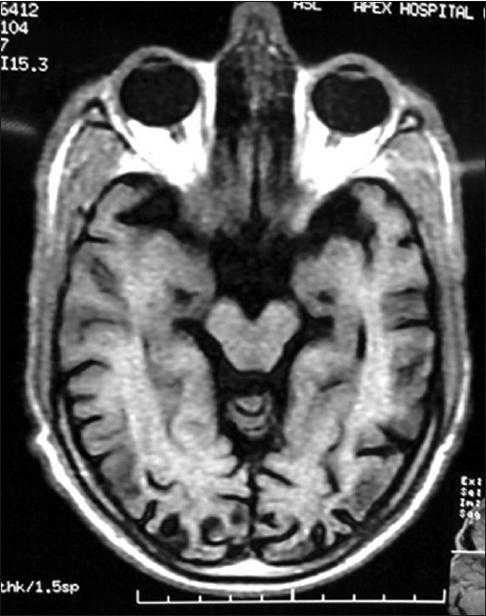
Amit Arora, Chandra M Sharma, BL Kumawat, Dinesh Khandelwal
Department of Neurology, SMS Medical College and Hospital, Jaipur, India

Slide 27
MICROSCOPIC CHANGES
Histological examination of the brain specimen - definitive diagnosis of
Alzheimer's disease can be made.
Diagnosis - series of morphological abnormalities that are distributed in a stereotyped pattern

Slide 28
Neurofibrillary Tangles
Silver impregnation staining techniques Modified Bielschowski
Gallyas technique
Fluorochrome dye thioflavin S
visualize neurofibrillary tangles

Slide 29
Neurofibrillary tangle is composed of abnormal fibrils measuring 10 nm in diameter that
occur in pairs and are wound in a helical fashion with a regular periodicity of 80 nm.
Structures are generally called paired helical filaments.
Primary constituent of the neurofibrillary tangle is the microtubule-associated protein tau

Slide 30
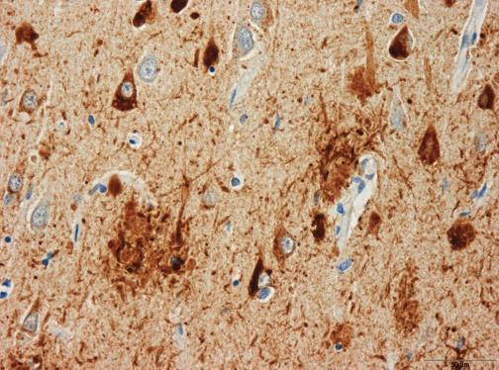

Slide 31
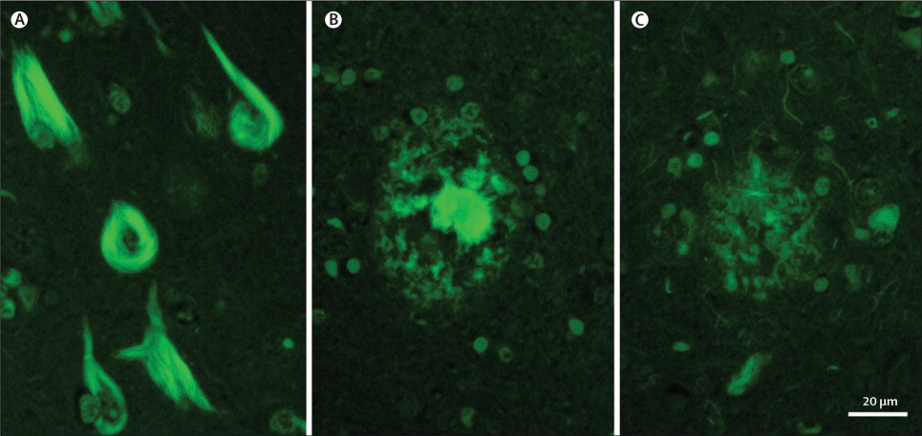

Slide 32
Tau is a microtubule-associated protein that regulates cytoskeleton structure.
When highly phosphorylated, tau is sequestered into PHF, and causes disruption of microtubules, that ultimately leads to cell death.

Slide 33
Phosphorylation of tau by protein kinases
neuron-specific cyclin dependent kinase 5 (cdk5)
precedes the formation of PHF that cause neurodegeneration.
PHF and NFT - hallmark in AD and other neurodegenerative diseases - Taupathies.

Slide 34
Other protein constituents associated with the neurofibrillary tangle
Ubiquitin , cholinesterases, and beta-amyloid
Tau is considered to be the critical constituent of these structures.

Slide 35
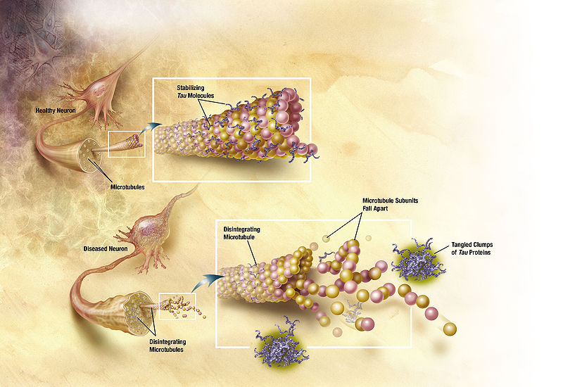

Slide 36
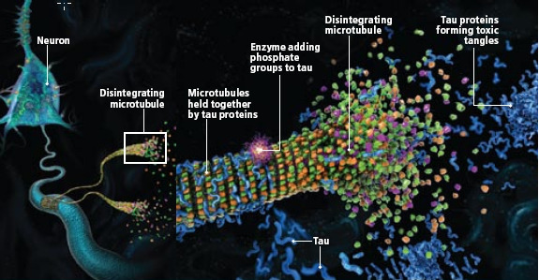

Slide 37
Cornu ammonis 1 (CA1) sector of the hippocampus
Layer V neurons in areas of the association cortex
neurofibrillary tangles appear as parallel, thickened fibrils that surround the nucleus and extend toward the apical dendrite

Slide 38
When the neurofibrillary tangle occurs within a neuron with a more rounded configuration
Neurons within the substantia nigra and locus ceruleus
it is called a globoid neurofibrillary tangle.

Slide 39
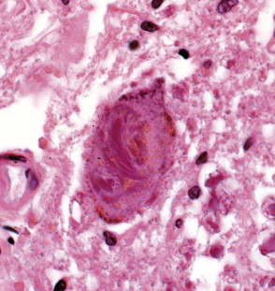

Slide 40
Severe involvement is seen in the
Layer II neurons of the entorhinal cortex
The CA1 and subicular regions of the hippocampus
The amygdala
Deeper layers (layers III, V, and superficial VI) of the neocortex.
The extent and distribution of neurofibrillary tangles - correlate with both the degree of dementia and the duration of illness

Slide 41
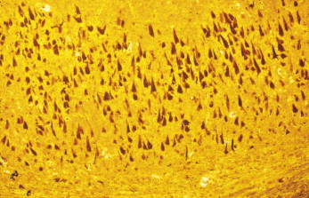

Slide 42
Three subtypes of Alzheimer’s disease
On the basis of the distribution of neurofibrillary tangles:
Typical AD, hippocampal-sparing AD, and limbic-predominant AD
Jennifer L Whitwell, Dennis W Dickson, Melissa E Murray
Lancet Neurol 2012; 11: 868–77

Slide 43
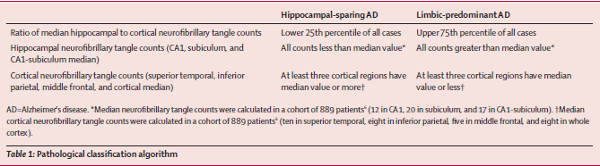
Jennifer L Whitwell, Dennis W Dickson, Melissa E Murray
Lancet Neurol 2012; 11: 868–77

Slide 44
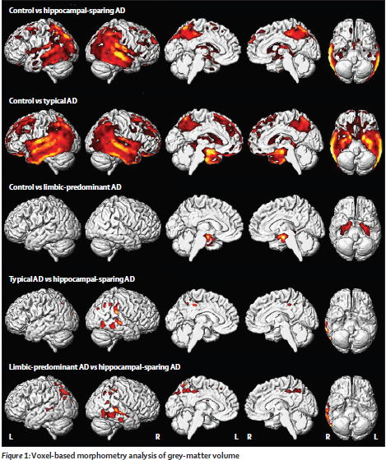

Slide 45
May also be encountered in association with many other disease states.
Postencephalitic parkinsonism,
Posttraumatic dementia or dementia pugilistica
Type C Niemann-Pick disease
Amyotrophic lateral sclerosis/parkinsonism dementia complex of Guam

Slide 46
Senile Plaques
Senile or neuritic plaque
Central core -accumulation of a 4-kD protein with a beta-pleated sheet configuration - βA42
Ability to bind the planar dye Congo red and produce birefringence when illuminated by polarized light- conforms to the physical definition of an amyloid.

Slide 47
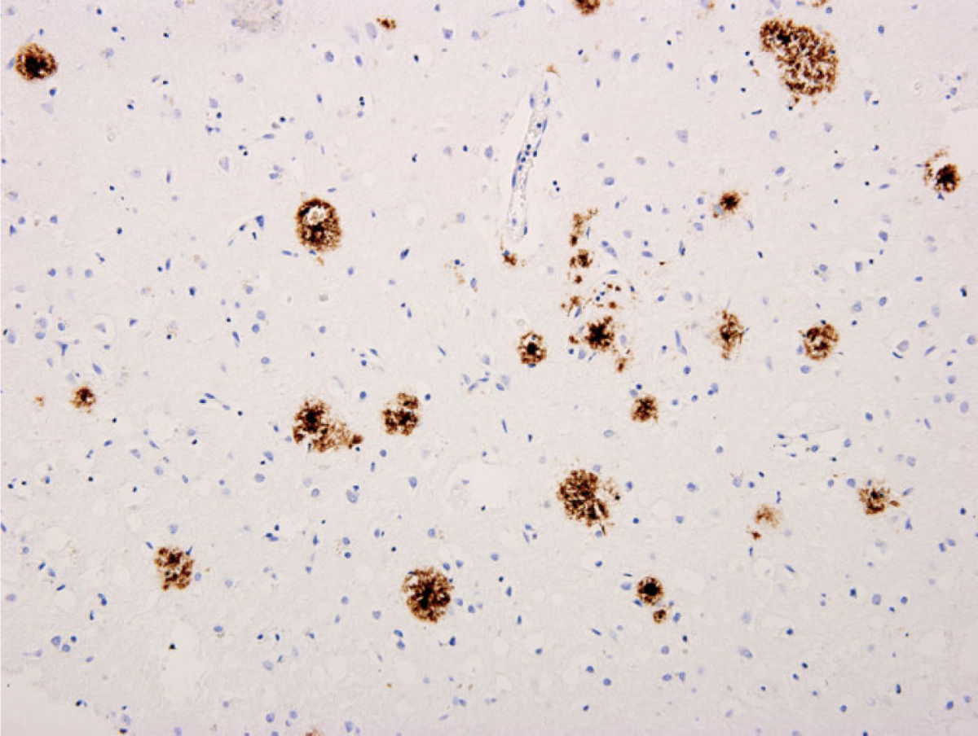

Slide 48
Amyloid Plaque Formation
APP is a membrane associated glycoprotein of 110-135 kDa - cell surface signaling molecule
A-beta peptides are generated in the endosomal compartment and in the endoplasmic reticulum or golgi complex by endoproteolytic cleavage of APP by Beta, alpha, and gamma secretases

Slide 49
Amyloid Plaque formation
About 90% of the secreted A-beta peptides formed from processing of APP are A-beta40, a soluble form of the peptide
About 10% of secreted A-beta peptides are A-beta42 and A-beta43
A-beta42 and A-beta43 are highly fibrillogenic, readily aggregated, and neurotoxic

Slide 50
Amyloid Plaque formation
A-beta42 and A-beta43 - form networks of salt linkages and strong hydrogen bonds between ionized side chains of opposite charge

Slide 51
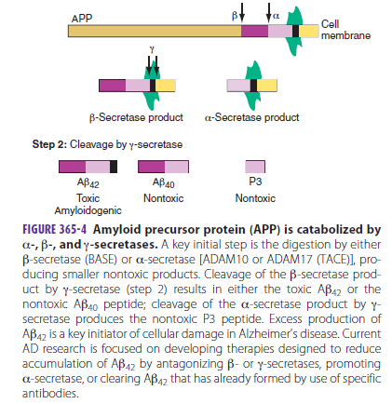

Slide 52
The b-amyloid peptide is insoluble in water.
When released from the precursor protein it assumes a b-sheet conformation that makes it hydrophobic.
b-amyloid peptides forms oligomers that may affect neurotransmitter release and synaptic plasticity.
Oligomers further aggregates in larger structures called fibrils- form the core of the b-amyloid plaque, depositing in the extracellular matrix.

Slide 53
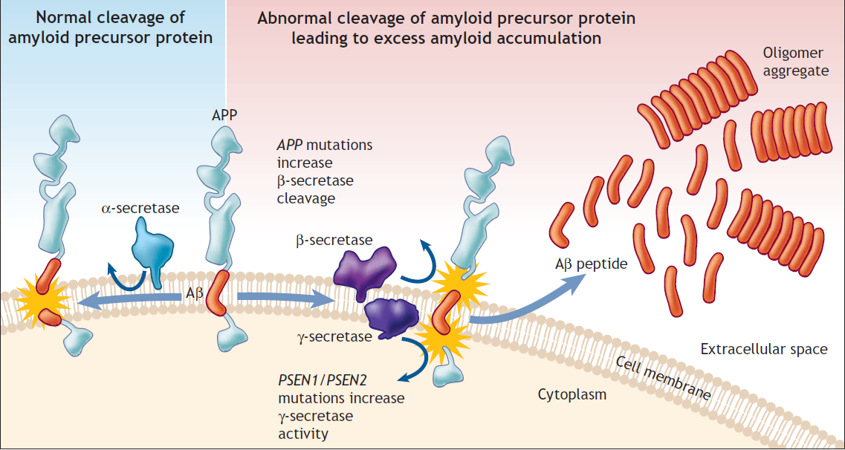
Pathogenesis

Slide 54
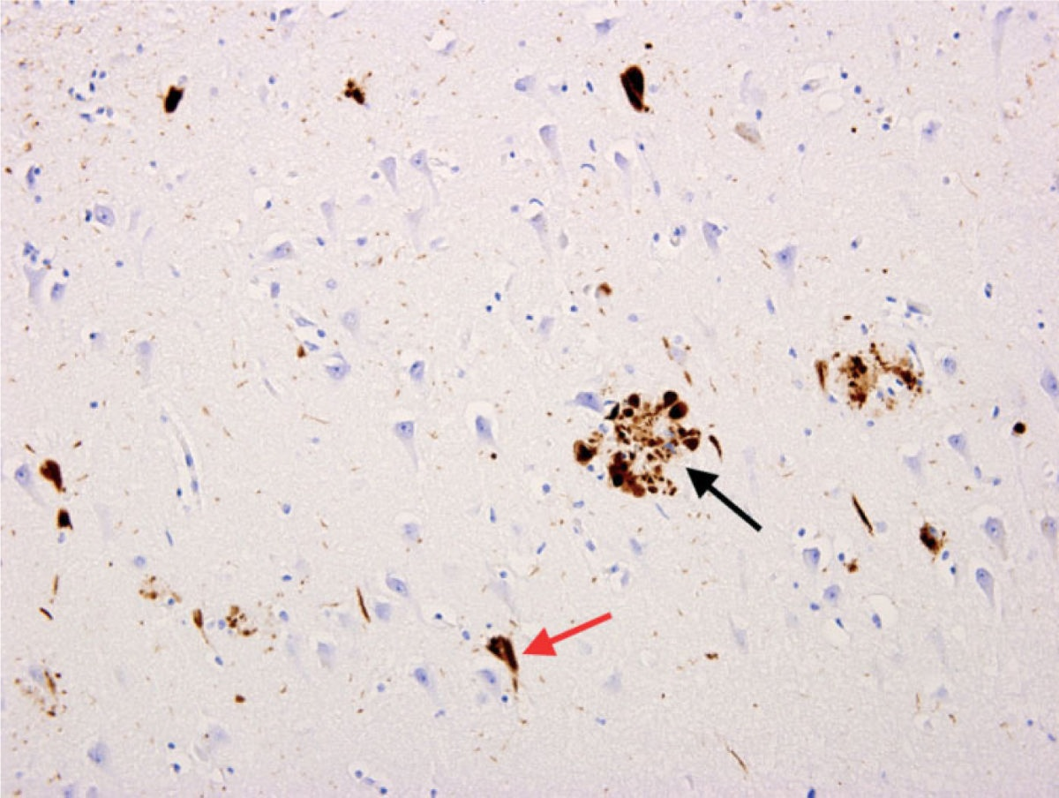

Slide 55
Mechanism
The amyloid hypothesis
accumulation of beta amyloid peptides as the central event triggering neuron degeneration.
Accumulation of aggregated amyloid fibrils disrupts the cell's calcium ion homeostasis, induces programmed cell death (apoptosis).

Slide 56
Aβ affects mitochondria -inhibits enzyme functions and utilization of glucose by neurons.
Inflammatory processes and cytokines - role in the pathology .
Inflammation - secondary to tissue damage in AD or a marker of an immunological response.

Slide 57
The size of the plaque will increase following the progression of the disease.
Plaques formation are associated to neuronal death.
Inherited forms of AD lead to substantial increase of A Beta production.

Slide 58
The senile or neuritic plaque
central core of βA42 protein arranged in a radial fashion and is surrounded by a corona of abnormally formed neurites or neuronal processes- dendrites or axons.
Dystrophic neurites stain with silver impregnation stains .

Slide 59
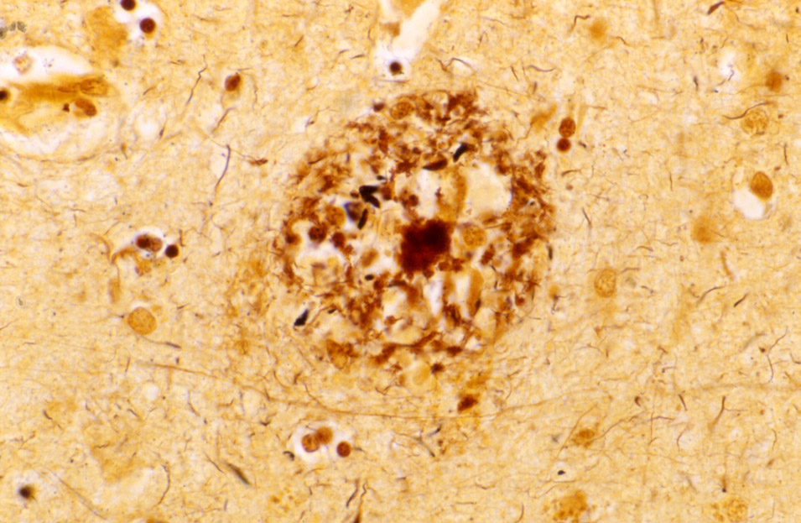

Slide 60
Ultra structurally - contain dense bodies, membranous profiles, and packets of paired helical filaments.
In the periphery of the neuritic plaque, several microglial cells and reactive astrocytes can be seen.

Slide 61
Focal diffuse deposits of amyloid protein may occur in the cerebral cortex in the absence of accompanying dystrophic neurites.
Such deposits of βA42 will stain with the silver-based stains - Hedreen, Tago, and Campbell-Switzer methods
They are called diffuse plaques

Slide 62
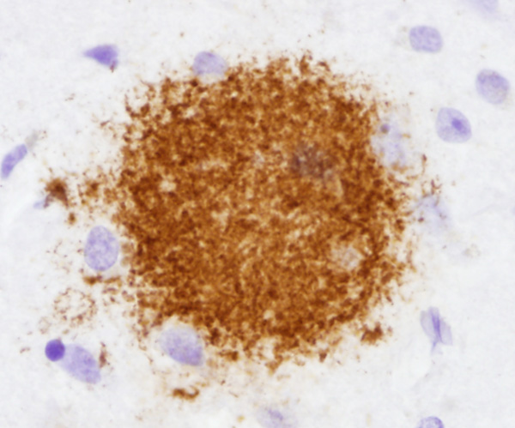

Slide 63
Brains of elderly individuals and can be seen in the absence of any associated evidence of cognitive impairment

Slide 64
Plaques consisting of a dense core of βA42 that does not show any accompanying dystrophic neurites
Burned-out plaques and end-stage plaques
Considered to be the remnants of neuritic plaques.

Slide 65
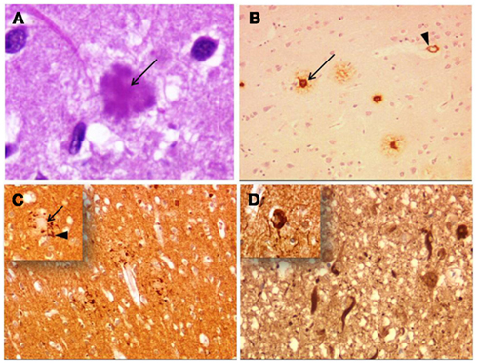

Slide 66
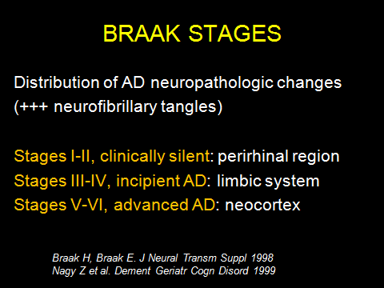

Slide 67
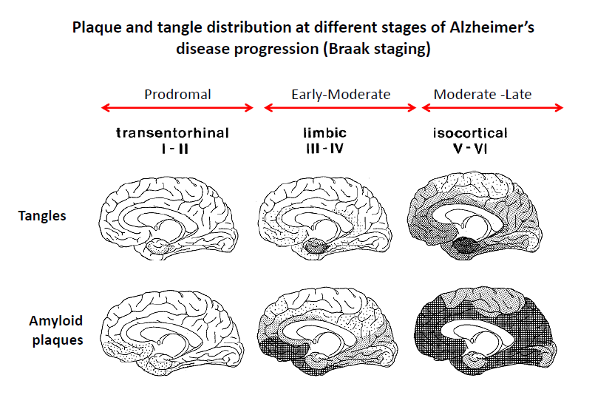

Slide 68
Granulovacuolar Degeneration
Simchowitz first identified granulovacuolar degeneration in 1911
Intraneuronal cluster of small vacuoles measuring 2 to 4 μm in diameter, each containing a small, dense basophilic granule that typically measures approximately 1 μm in diameter.

Slide 69
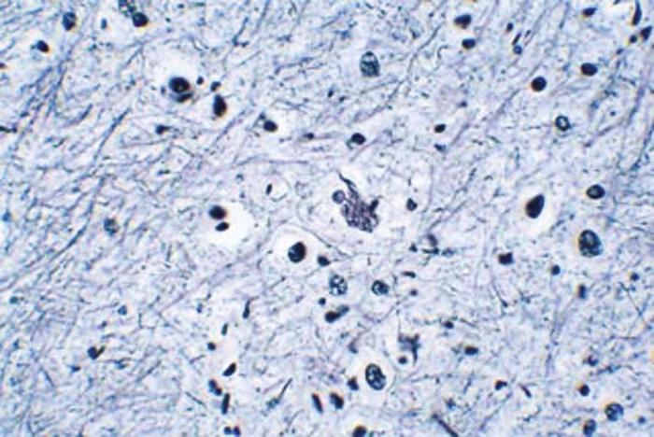

Slide 70
Membrane-bound structures with a clear vacuolar matrix containing an electron-dense central granule.
The central granules stain intensely with silver impregnation stains and with antibodies directed against phosphorylated neurofilaments, tubulin, tau, and ubiquitin.

Slide 71
Perikaryal cytoplasm of pyramidal neurons of the hippocampus
neurons that form the junction between the cornu ammonis 2 (CA2) and CA1 sectors of Ammon's horn.
Lesser numbers in the neurons of the CA1 hippocampal region.

Slide 72
Eosinophilic Rodlike Inclusions (Hirano Bodies)
Eosinophilic perineuronal lesions
CA1 region of the hippocampus.
First identified by Asao Hirano in his studies of amyotrophic lateral sclerosis /parkinsonism dementia complex of Guam.

Slide 73
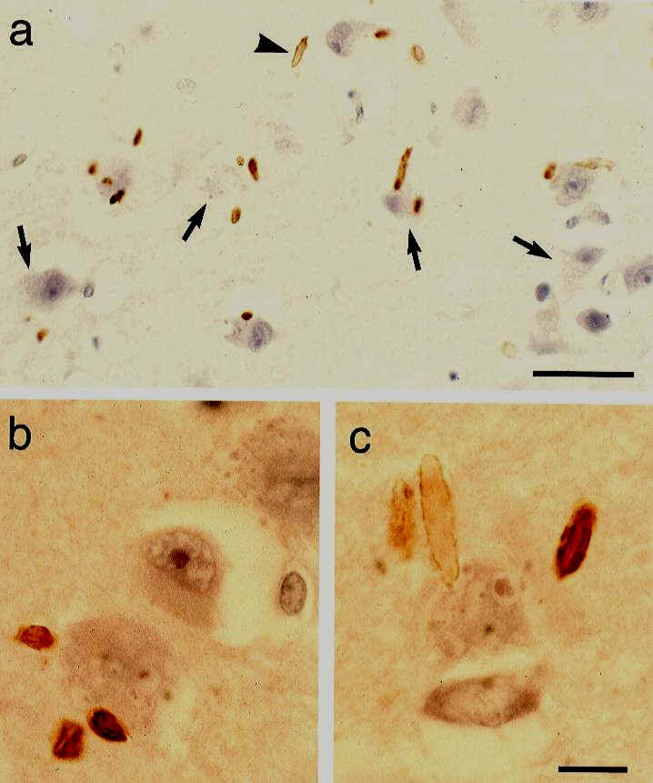

Slide 74
Hirano bodies - consisting of parallel fibers that interweave in a very regular crossing pattern - appearance of a tweed fabric.
Immunohistochemical - indicate the
presence of actin, tropomyosin, and vinculin within these bodies.
The Hirano body is currently considered to be a nonspecific lesion of unknown significance.

Slide 75
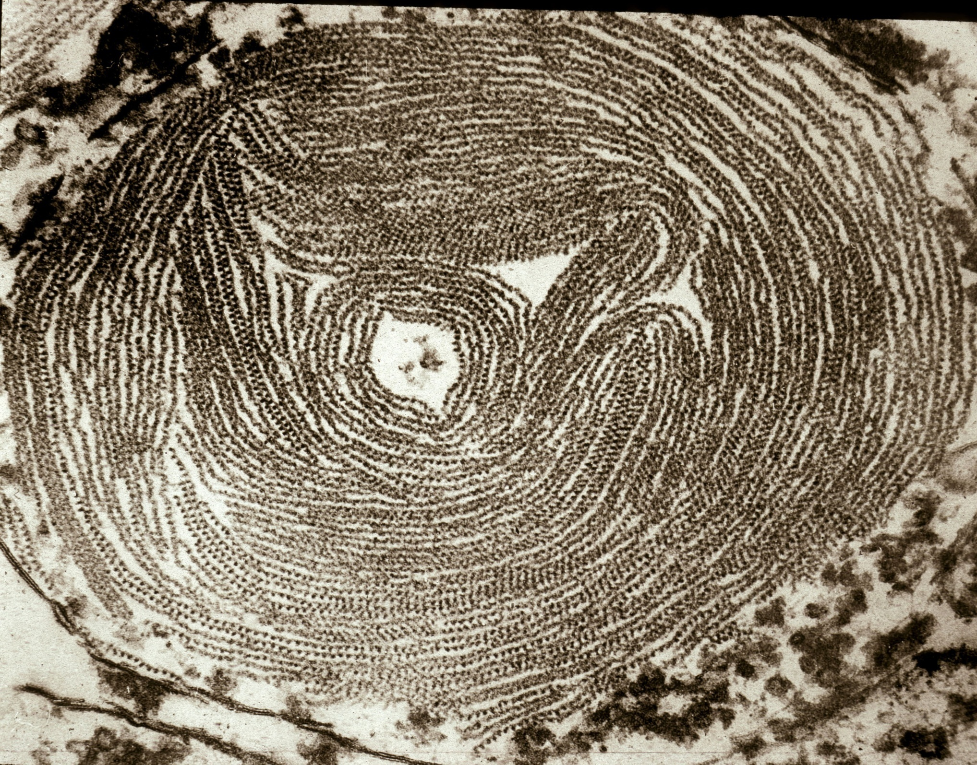

Slide 76
Synaptic Loss
Loss in synaptic profiles occurs in the brains of patients with Alzheimer‘s disease.
Investigated by the quantification of immunohistochemical markers directed against synaptic proteins, such as synaptophysin, and by quantitative electron microscopy.

Slide 77
Studies shown a 45% loss of staining of presynaptic boutons in cases of Alzheimer's disease.
Masliah et al Immunostudy in dementia for synaptic function Neurology 2005 736 – 747
Major morphological counterpart to cognitive loss in Alzheimer's disease.
Loss correlates strongly with the degree of functional impairment.

Slide 78
Synapses are the initial target of AD pathogenesis and progressive synaptic dysfunction is associated with cognitive deterioration in AD
Brain-derived neurotrophic factor (BDNF) Key regulators of synaptic plasticity and memory.

Slide 79
Recent studies have identified miRNAs in the brain that regulate BACE1/b-secretase expression or nuclear factor k B (NF-kB)-induced inflammation
miR-29a/b-1
miR-107
miR-146a
miR-298 and miR-328.
miRNAs help clarify the pathogenesis of
AD and may be useful as biomarkers
Soon-Tae Lee, MD, PhD, Kon Chu, MD, PhD ANN NEUROL 2012;72:269–277

Slide 80
miR-206 regulates BDNF
AM206, the antagomir inhibiting miR-206, enhances BDNF levels, synaptogenesis, and neurogenesis.
miRNA-dependent dysregulation of BDNF participates in the pathogenesis of AD
AM206 may be therapeutically effective.
Soon-Tae Lee, MD, PhD, Kon Chu, MD, PhD ANN NEUROL 2012;72:269–277

Slide 81
Presenilins
Presenilin 1 (PS1) and presenilin 2 (PS2)
43-50 kD proteins with eight transmembrane domains
Presenilin’s - cleave APP
Mutations in presenilins cause the production of A-beta42 and A-beta43 peptides by gamma secretase.

Slide 82
Plasmin
Plasminogen and its proteolytic fragment are abundant in the hippocampus
It has been hypothesized that brains of patients with AD may have lower levels of plasmin
The higher production of amyloid peptide together with less efficient degradation would lead to A-beta accumulation and aggregation

Slide 83
Amyloid Hypothesis
The trigger for alzheimer’s disease is the A-beta peptide and plaques - initiating molecular event
The plaques trigger an inflammatory response, neuronal cell death, and gradual cognitive decline
The rest of the disease process-
an imbalance between A-beta production and A-beta clearance

Slide 84
The sequence of pathogenic events leading to AD proposed by the amyloid hypothesis

Slide 85
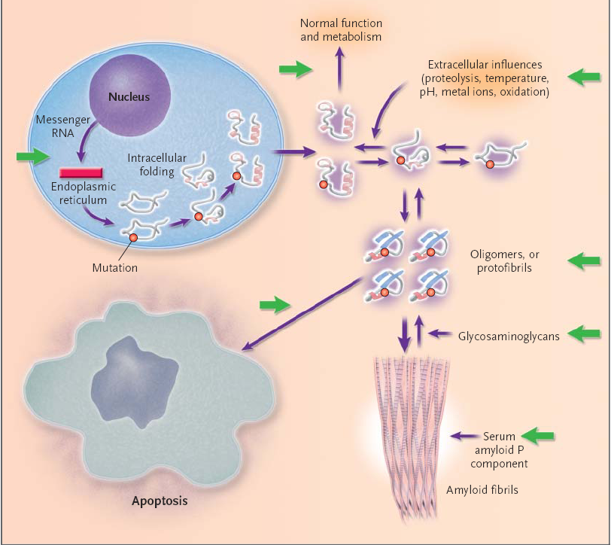

Slide 86
Support for the Amyloid Hypothesis
The A-beta peptide is the primary component of the necrotic brain tissue
Mutations in the gene encoding the tau proteins - frontotemporal dementia with parkinsonism
Parkinsonism is characterized by severe deposition of tau in neurofibril tangles in the brain, but there is no deposition of amyloid

Slide 87
Support for the Amyloid Hypothesis
Growing evidence indicates that genetic variability in A-beta catabolism and clearance may contribute to the risk of late onset of AD

Slide 88
Problems with the amyloid hypothesis
Amyloid deposits in the brain do not correlate well with the degree of cognitive impairment
Asymptomatic- cortical A-beta deposits.
diffuse amyloid plaques - not associated with surrounding necrotic and glial pathology
The amyloid hypothesis remains controversial because a specific neurotoxic species of A-beta and its effects on neuronal function have not been defined in vivo

Slide 89
Problems with the amyloid hypothesis
AD causing mutations in APP, PS1, or PS2 increase A-beta deposition
degree to which a particular mutation affects A-beta production in cell culture
The degree of dementia appears to correlate with soluble A-beta species.
soluble oligomers of A-beta, instead of monomers or insoluble amyloid fibrils, responsible for synaptic dysfunction in the brains

Slide 90
Calcium Hypothesis
Calcium modulates synaptic plasticity and apoptosis
Dysregulation of intracellular calcium
Increased intracellular calcium - accumulation of amyloid-beta, the hyperphosphorylation of TAU and neuronal death
Gene -increase susceptibility to Alzheimer’s disease modulates some aspect of calcium signaling

Slide 91
Calcium Hypothesis
The disruption of calcium homeostasis principal mechanisms by which A-beta manifests its neurotoxicity
A-beta destabilize neuronal calcium homeostasis - increase in cytosolic calcium trigger neuronal apoptosis

Slide 92
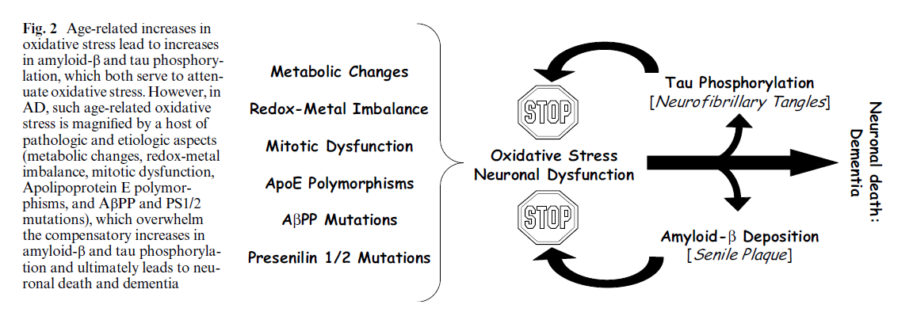

Slide 93
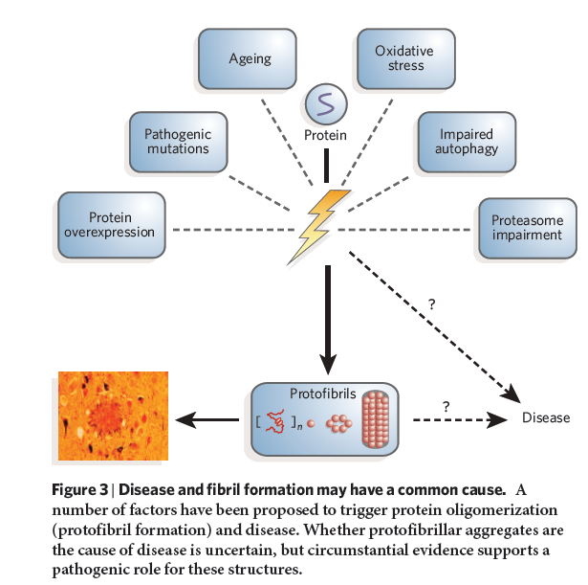

Slide 94
Immunological and Anti-Chaperone Therapeutic Approaches for Alzheimer Disease
Vaccination was the first treatment approach which has been shown to have genuine impact on the disease process.(Animal model)
Inhibition of A beta 42 formation
Inh of gamma secretase
Inh of beta secretase
Antiinflammatory medication
Brain Pathol 2005;15:72-77

Slide 95
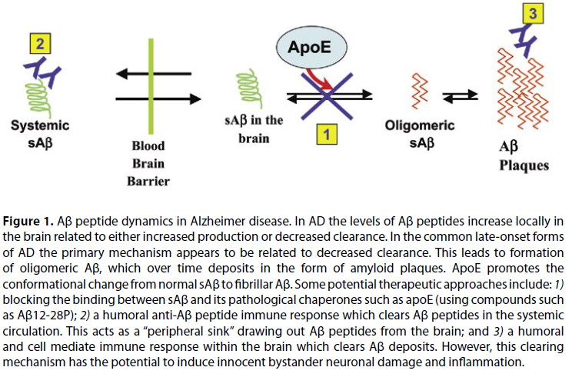

Slide 96
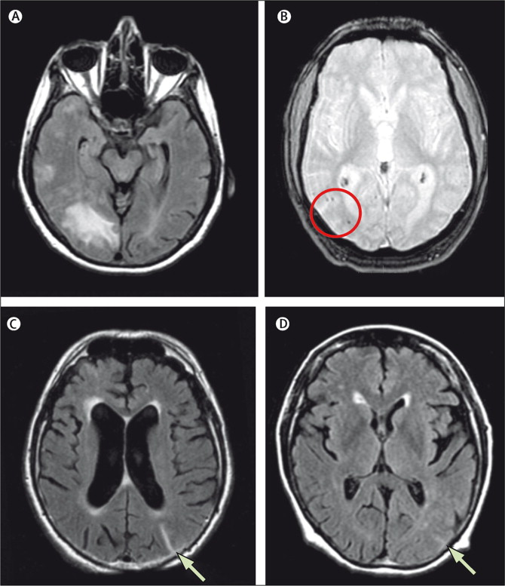
ARIA - Bapineuzumab

Slide 97
SUMMARY
Increased levels of tau in CSF
release from damaged and dying neurons that harbor dystrophic tau neurites and tangles
Reduced CSF levels of Abeta42
large-scale accumulation of this least soluble in the AD brain.

Slide 98
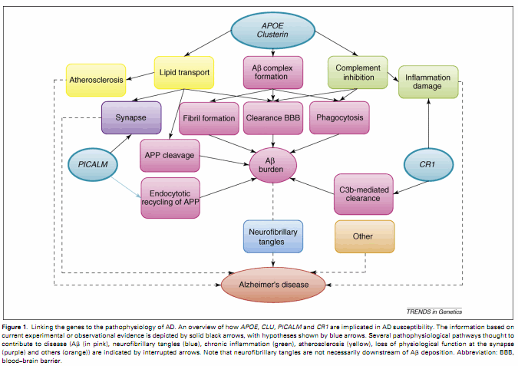
From Sleegers et al. (2010) Trends in Genetics, 26, 84-94, p. 87

Slide 99
THANK YOU

Slide 100
References
Daniel P. Perl, MD, Neuropathology of Alzheimer's Disease
Mt Sinai J Med. 2010 ; 77(1): 32–42.
Rudy J. Castellani · Hyoung-Gon Lee · Xiongwei ZhuActa Neuropathol (2006) 111: 503–509
Chang KA, Suh YH (2005) Pathophysiological roles of
amyloidogenic carboxy-terminal fragments of the beta-amyloid precursor protein in Alzheimer’s disease.
J Pharmacol Sci 97:461–471
Price, D.L., Sisodia, S.S., and Borchelt, D.R. (1998). Genetic Neurodegenerative Diseases: The Human Illness and Transgenic Models. Science 282, 1079-1093

Slide 101
Vassar, R., and Bennet, B.D. (1998) Beta-secretase cleavage of alzheimer’s amyloid precursor protein by the transmembrane aspartic protease BACE. Science 286, 5440-5464
LaFerla, F.M. (2002) Calcium dyshomeostasis and intracellular signalling in alzheimer’s disease. Nature Reviews Neuroscience 3, 862-872
Gregersen, N., Bross, P., and Andresen, B.S. (2001) The role of chaperone-assisted folding and quality control in inborn errors of metabolism: Protein folding disorders. Journal of Inherited Metabolic Disorders 24, 189-212

Slide 102
Protein constituents associated with the neurofibrillary tangle other than Tau
1.Ubiquitin
2.Cholinesterases
3.Beta-amyloid
4.All of the above

Slide 103
Hirano bodies consist of all except
1.Actin
2.Myosin
3.Tropomyosin
4.Vinculin

