Slide 1
ASYMMETRIC CORTICAL DEGENERATION SYNDROMES
Faculty : Dr. C . Rathore

Slide 2
Scheme of presentation
Introduction
History
Definition
Types of ACDS
  Imaging
  Pathology
Treatment

Slide 3
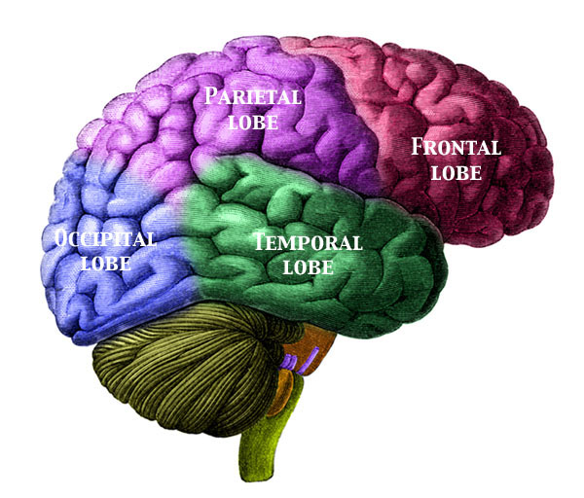
Introduction
The term asymmetric cortical degenerative syndromes designate any brain affliction that results in selective atrophy, particularly with an asymmetric pattern

Slide 4
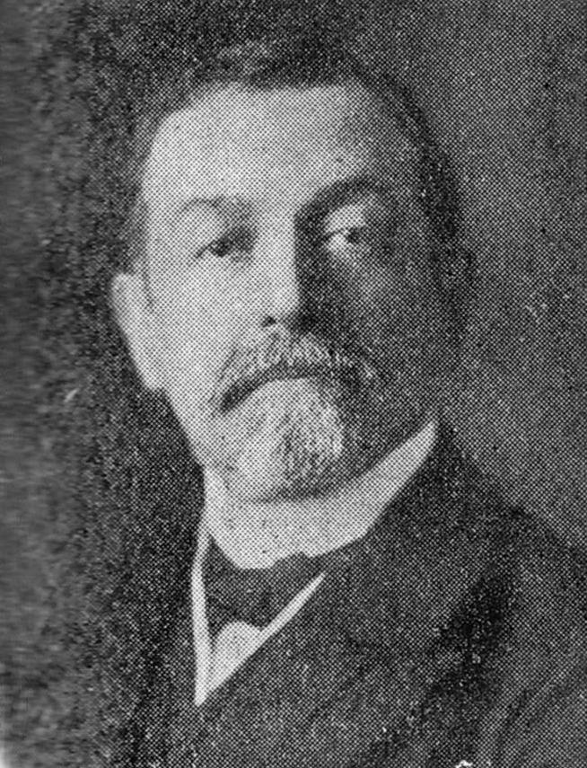
History
Current understanding of various lobar functions has been revolutionarised by the clinico radiological correlation studies of asymmetric degeneration syndromes
Frontotemporal degeneration (FTD) →Arnold Pick in 1892

Slide 5
History
Posterior Cortical Atrophy→ first described by Benson et al in 1988
Progressive degeneration of the right temporal lobe was described by Tyrrell et al in 1990
Till the advent of molecular genetics the progressive disorders without Pick’s or AD pathology on HPE were designated as non specific disorders→now most of those fall into category of taupathy or ubiquitinopathy
Tauopathy that was first described by Rebeiz et al

Slide 6
History
The term asymmetric corticl degeneration suggested by Caselli et al in 1992 , after a long term longitudinal follow up of 26 patients with various curious manifestations selectively pertaining to various lobes

Slide 7
Definition
ACDS was defined as a condition that is slowly progressive (a period of years) and encompasses a focal neurologic deficit that is not due to a radiologically (MRI) defined lesion such as tumor, infarction, hemorrhage,vascular malformation, demyelination, trauma, or infection

Slide 8
Initial studies on ACD
Caselli et al (1992)
long term longitudinal follow up
n=26 patients
  Progresssive apahasic syndromes
  Progresssive perceptuomotor syndromes
  Progresssive neuropsychiatric syndrome

Slide 9
  Progressive Aphasia:N=12
  Fluent and non fluent
  No evidence of sensorimotor disorders ideomotor apraxia
  pseudobulbar affect
  perseverative tendencies
The patients were limited only by their difficulty communicating
continued to function relatively normally in their daily routines—maintaining their home, farming, driving, and traveling

Slide 10
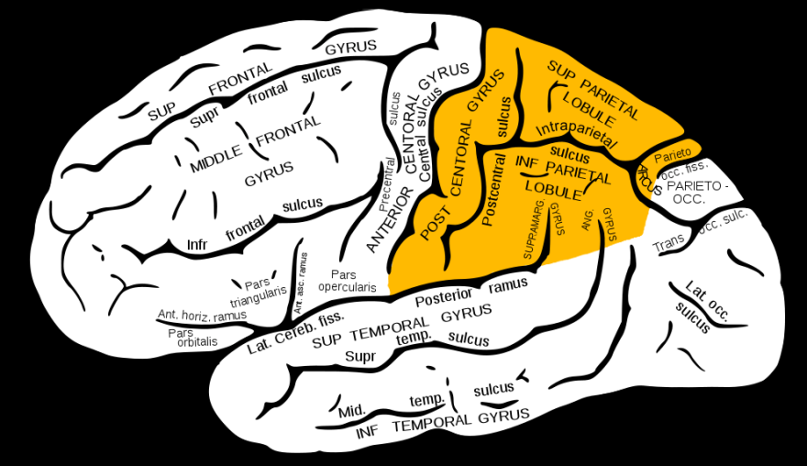
Progressive parietal syndromes perceptuomotor disorders
Lateralized somatic deficits
  hemiparesis or hemispasticity
  hemisensory deficits
  unilateral myoclonic arm
  homonymous visual field defects
various forms of apraxia
  Constructional apraxia
  apraxic agraphia
  ideational or ideomotor apraxia
  dressing apraxia
fluent aphasia with L>R parietal involvement
N=9

Slide 11
  Neuropsychiatric symptoms N=5
2 patterns of frontal degeneration
  a neuropsychiatric syndrome consisting of abulia,perseverative behavior, pseudobulbar affect, and inappropriate behaviour
  Prominent,generalized spasticity and similar neuropsychiatric symptoms

Slide 12
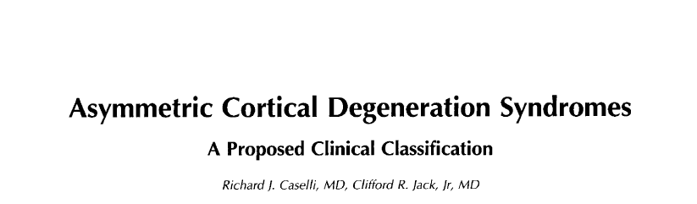
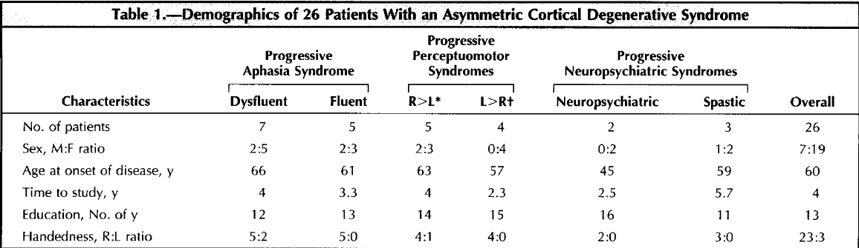

Slide 13
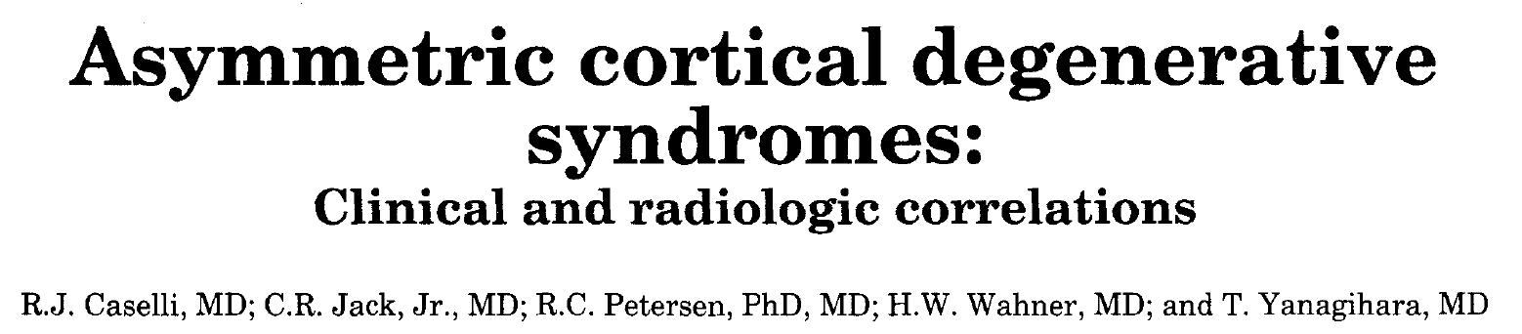

3 different clinical permutations of ACDS identified:
  progressive nonfluent aphasia
  Progressive perceptual-motor impairment
  Progressive frontal lobe syndrome
Planar MRI and SPECT
  to ascertain whether there were focal or asymmetric structural (atrophy) and physiologic (hypoperfusion) abnormalities that corresponded to the predominant clinical deficits

Slide 14
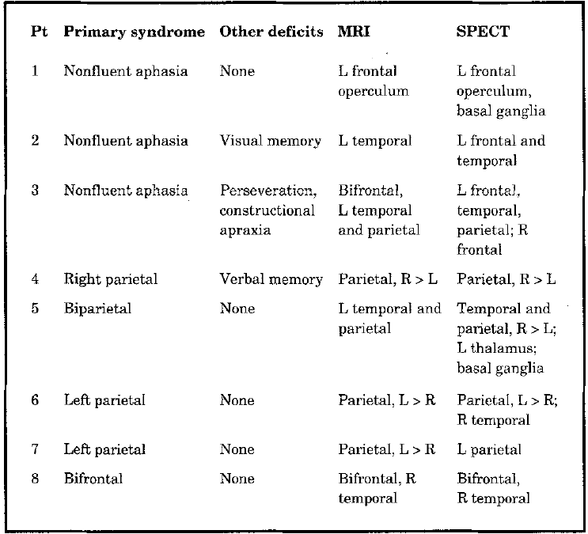

Slide 15


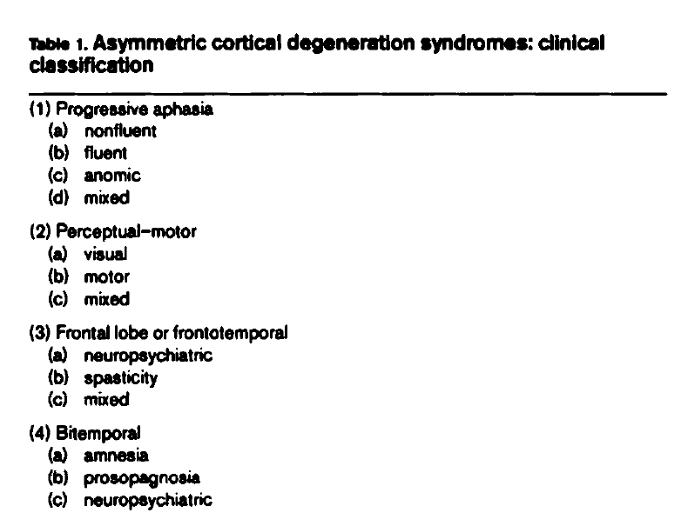

Slide 16
Caselli et al ……
Different clinical disorders do not appear to have distinctive histopathologic features
clinical symptoms may be determined solely by the neuroanatomic location of the degenerative process

Slide 17
Current terminologies,
pathogenesis and syndromes

Slide 18
Frontal lobar degenerations
  Frontal variants
  Temporal variants
  Primary progressive aphasias
Cortical basal degeneration
Posterior cortical atrophy

Slide 19
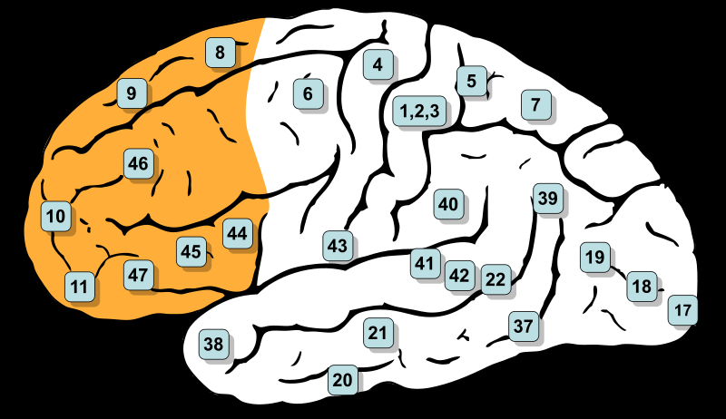
Frontal lobar degeneration
focal cortical atrophy that involves the frontal and/or temporal lobes

Slide 20
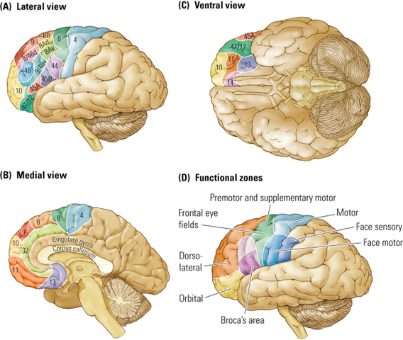
Functional Frontal Lobe Anatomy
Prefrontal cortex
  Dorsolateral-9,10,46
  Medial-9,10
  Orbitofrontal-11,12,47
Paralimbic cortex
  anterior cingulate
  sub callosal areas
Motor cortex
  Primary -4
  Premotor-6
  Supplementary- mesial 6
  Frontal eye field-8
  Broca’s speech area-44/45

Slide 21
3 disctinct syndromic variants
  frontal lobe variant of FTD
  Progressive nonfluent aphasia
  semantic dementia
  The degerative process relatively spares motor areas

Slide 22
Dorsolateral prefrontal cortex
Functions
Dysfunction
working memory
attention
abstract thinking
creativity intelligence
Planning
problem solving
executive function- temporal sequencing of information and of motor planning
Executive dysfunction
Memory problems:
    -Defective working memory
    -Defective retrieval
Impaired attention span
Lack of initiative & spontaneity
Impaired abstract thinking
Impaired problem solving, creativity

Slide 23
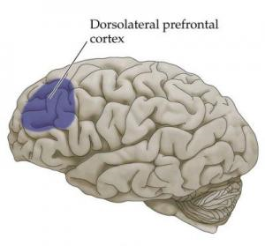
Bedside tests
DLPFC
-Digit span, days of the week or months of the year backwards
category generation
Luria’s test of alternating sequences/ fist-edge-palm test
Formal neuropsych tests :
-Wisconsin Card Sorting Test
Notes:
The tests are not absolute. It gives a suggestion that it is the probable area of involvemnet

Slide 24
Orbitofrontal cortex
Disinhibition
antisocial behavior
flat affect, blunted emotional response.
Lack of self awareness
Separation of action from knowledge
Euphoria, hypomania
Obsessive-compulsive behavior
Imitation and utilization behavior
‘pseudopsychopathic’
Neocortical representation of limbic system
closely connected with the limbic system and autonomic, visceral, and emotional processes

Slide 25
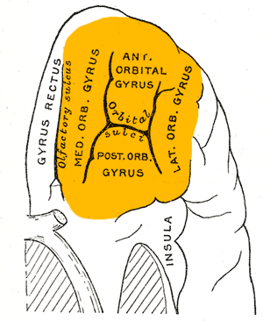
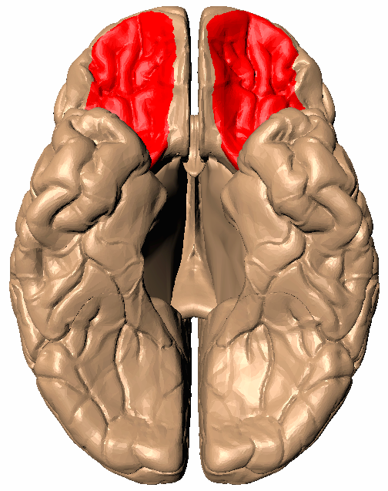
Bedside tests for OFC
- Test sense of smell- coffee, cloves etc
- Go/no-go Test
neuropsychological tests- The Stroop Test (Stroop 1935); examines the ability of the patient to inhibit automatic responses
Card sorting tasks normal in pt.s with orbitofrontal $

Slide 26
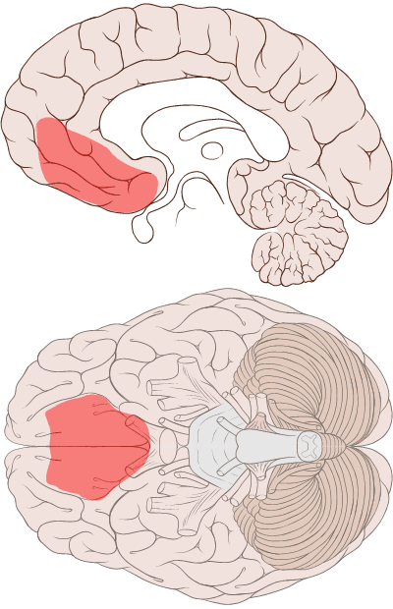
Medial frontal
Medial part of the superior frontal gyrus, cingulate gyrus

Slide 27
Medial prefrontal
Social Cognition
movements of the hand,eye and mouth
behavioural responses
processing of risk, fear
decision making
Akinetic mutism/syndrome
  profound apathy
  indifference to pain, thirst & hunger
  absence of motor & psychic initiative.
  -Manifested by lack of spontaneous movement, absent verbalization and failure to respond to questions & commands
Notes:
Meeting of minds: the medial frontal
cortex and social cognition
David M. Amodio* and Chris D. Frith‡

Slide 28
Frontal Lobe Variant of Frontotemporal Degeneration
There is a marked heterogeneity as a result of the differential involvement of selected brain regions
Some patients are
  disinhibited, fatuous, purposelessly overactive,
  easily distracted, socially inappropriate, and display a lack of concern
whereas others are
  apathetic, inert, display a lack of volition,
  mentally rigid, and perseverate
Notes:
clinical and imaging findings show predominant involvement (symmetric or not) of the frontal lobes

Slide 29
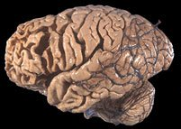
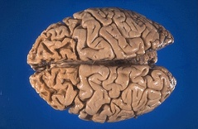
Pathology & imaging
The macroscopic inspection of the brain and the conventional MR images show cortical atrophy with a “knife-blade” pattern involving the frontal lobes, and less severely, the temporal lobes

Slide 30
MR →HI signal on the long repetition time sequences in the frontal cortex and adjacent WM, esp in advanced stages (extensive gliosis and demyelination)
NM studies → hypoperfusion of the frontal lobes and show a positive correlation with the severity of cortical atrophy that is depicted by MR
  Progression of the atrophy by prospective MR studies can also be correlated with the severity of clinical features and NM findings

Slide 31
Progressive Non fluent Aphasia
Expressive language disorder
problems in word retrieval occur
Patients present with changes in fluency, pronunciation, or difficulty in word location.
Phonologic errors are usually obvious in conversation.
Behavioral changes are uncommon until later in the disease

Slide 32
MRI in aphasic variants
MRI → typical widening of the left Sylvian fissure with atrophy of the insula, inferior frontal lobe, and superior temporal lobe
The medial temporal structures are spared
NM studies show decreased blood flow and hypometabolism in the involved structures before the development of the atrophy in both fluent and nonfluent subtypes of PPA

Slide 33
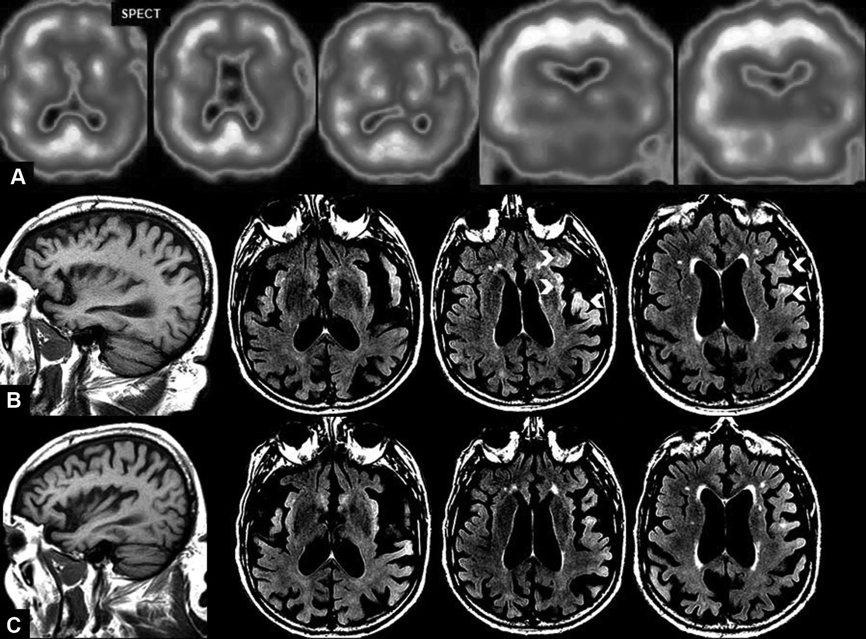
Notes:
Seventy-two-year-old man, PNFA, 1-year post-onset with rapid deterioration. The patient, an immigrant, regained
his native tongue. A, Axial and coronal SPECT images showing hypoperfusion in the left temporal perisylvian regions. B, Sagittal
T1 and axial FLAIR images showing an asymmetric cortical atrophy of the perisylvian gyri, markedly on the left side. FLAIR
images show hyperintensity with loss of the gray/white matter distinction (arrowheads). C, Follow-up examination (1 yr).
Note the progressive atrophy, mainly in the left insular and perisylvian cortex

Slide 34
Temporal Lobe Variants
There is consistent implication of right temporal lobe atrophy with psychiatric syndromes, behavioral disturbances, and visuospatial compromise (facial recognition)
Left temporal lobe atrophy is generally related to language and speech disturbances
Notes:
Alzheimer disease is the most common neurodegenerative disorder
that involves the temporal lobes. Temporal lobe variants have
some distinct features from Alzheimer disease, including their imaging
patterns of atrophy. Different regions in the temporal lobes may be
responsible for particularities in the clinical presentation, which can also
be confirmed by pathologic and imaging analysis. Usually, the disease
is bilateral and may

Slide 35
Left Temporal Lobe Variant
Semantic Dementia
often begins with a difficulty in naming and comprehending single nouns, with progressive loss of word meaning
Although patients maintain good articulation and syntax, they tend to use substitute phrases and stereotypical questions

Slide 36
Some show deficits on nonverbal tasks that use visual, auditory, and other modalities
  →key impairment in SD is a breakdown in conceptual knowledge rather than a specific problem with language
Left temporal lobe degeneration have a normal behavioral and psychiatric status

Slide 37
Imaging in left temporal variant
Particular pattern of left temporal lobe atrophy, especially in the anterior and lateral portions
  The entorhinal, parahippocampal, and fusiform gyri are often affected
  The R TL can be involved to a less severe degree
FLAIR and T2-W images → high signal intensity in the corresponding subcortical white matter, which is related to gliosis and demyelination

Slide 38
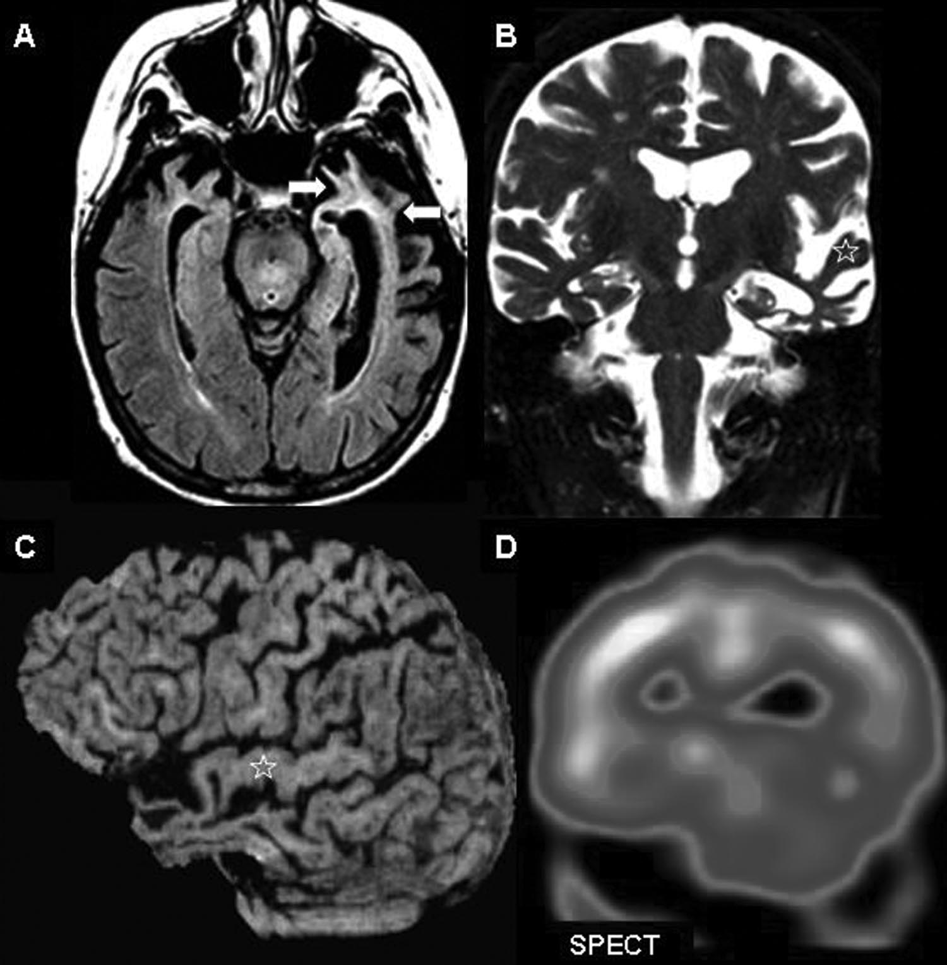
Notes:
cognitive deficit and speech disturbance (anomia). A, Axial FLAIR image showing marked atrophy of the left temporal which extends to the mesial structures
hyperintensity of the underlying subcortical white matter. There is also a lesser involvement of the right temporal pole. B,Coronal T2-weighted image demonstrating the relative preservation of the superior temporal gyrus (star). C, Coronal SPECT image displaying bilateral temporal hypoperfusion, with clear predominance on the left hemisphere, which establishes a good correlation with the MR findings

Slide 39
Right Temporal Lobe Variant
“Behavior Variant”
Asymetric, right-sided, temporal atrophy
memory impairment of episodic memory
disorders of behavior
prosopagnosia reported in 60% of patients
Other additional symptoms include
  visual hallucinations, involving visions of snakes and headless figures
  abnormal responses to somatic and sensory stimuli

Slide 40
“Behavior Variant”
clear dominance of psychiatric manifestations and behavioral disturbances,which are rather different from those that are involved in fvFTD
  irritability
  Impulsiveness
  Eccentricity
  limited and fixed ideas
  Hyper religiosity
  decreased facial expression
Notes:
, which suggests that the right hemisphere may
be the primary controller of social conduct.1

Slide 41
Behaviour variant
MRI → marked atrophy of R TL with hyperintensity on T2& FLAIR sequences in the underlying subcortical WM,esp. in the anterior and medial regions
These correlate well with NM studies→hypoperfusion/hypometabolism in these regions

Slide 42
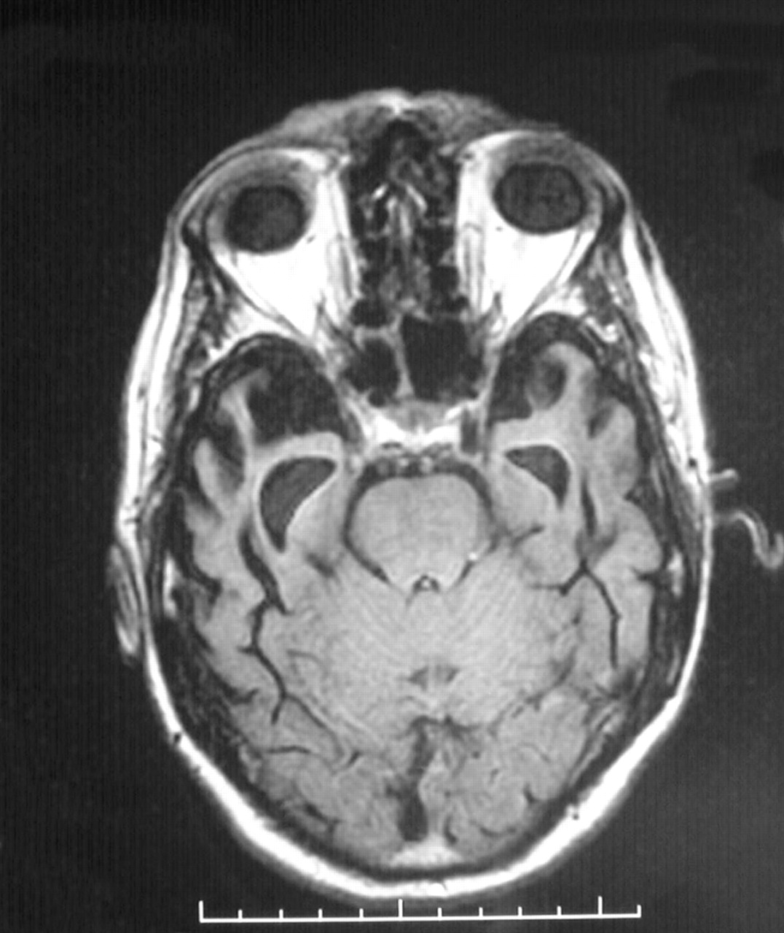

Slide 43
Progressive Prosopagnosia
represents a specific subtype of right temporal degeneration with more selective involvement and distinct symptoms
progressive inability to recognize familiar faces in the absence of severe intellectual and cognitive impairments
recognition of people is accomplished by their voice or gait
Occasionally, even the identification of the patient’s own face is impaired
Some consider PP to be a right hemisphere variant of SD

Slide 44
Imaging
MRI → atrophy in the medial and inferior nondominant occipital and temporal lobes
The coronal FLAIR →demonstrate the underlying subcortical WM gliosis
As the involvement is predominant in a small area (fusiform gyrus), the NM techniques has spatial limitations in this setting

Slide 45
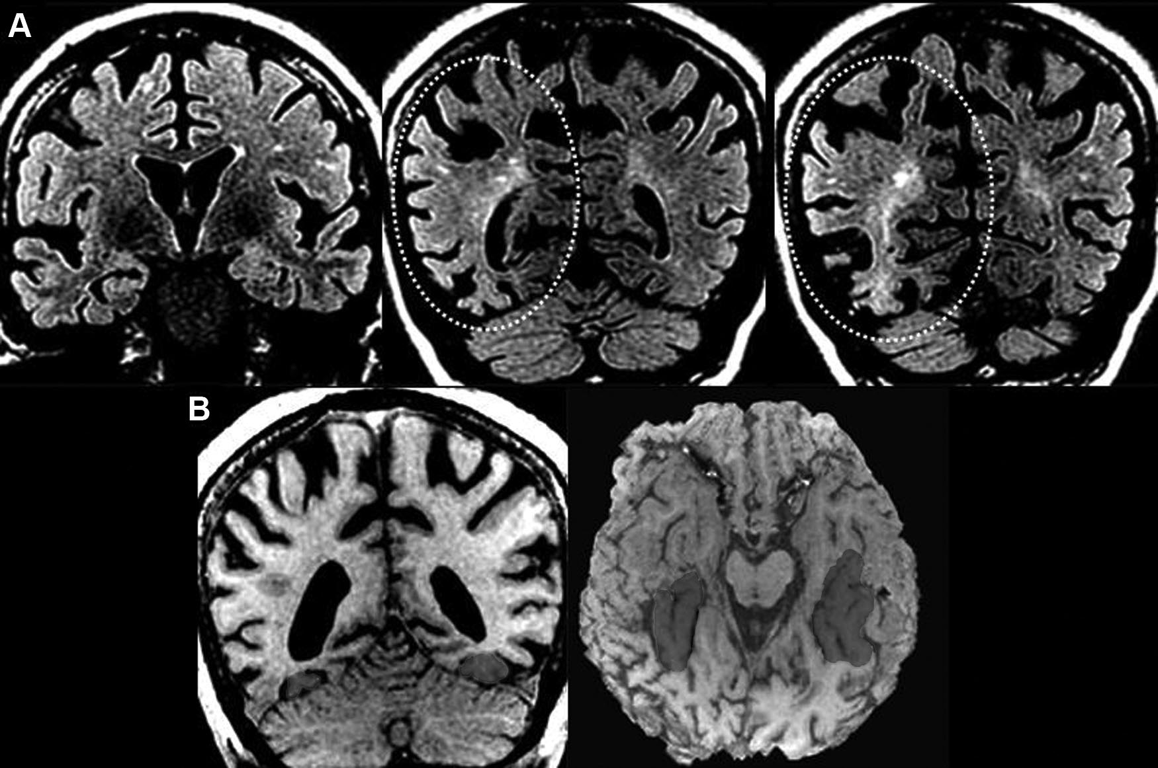

Slide 46
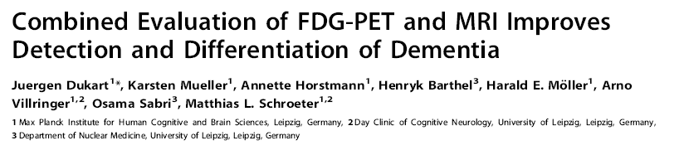
single-modality whole-brain and ROI information FDG-PET provided higher accuracy rates for both,detection and differentiation of AD and FTLD compared to structural information from MRI
The ROI-based multimodal classification, combining FDG-PET and MRI information, was highly superior to the unimodal approach
With this method, accuracy rate was 94% for the differentiation of AD and FTLD patients

Slide 47
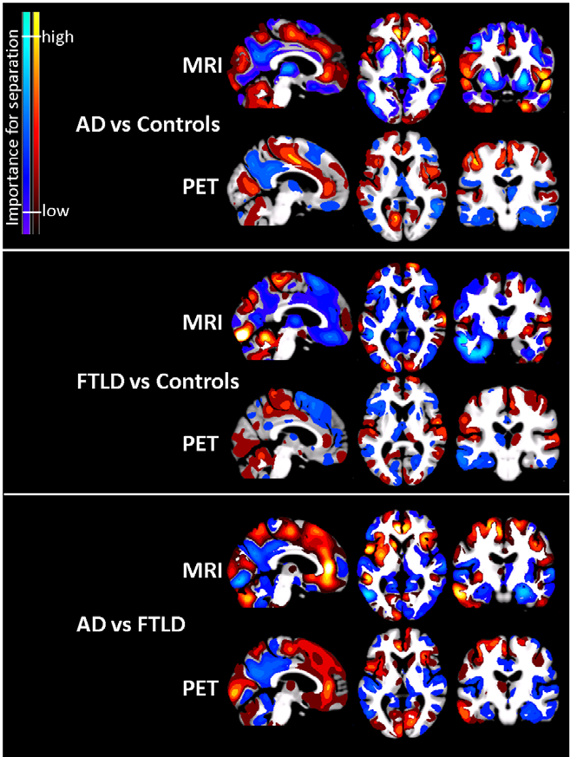

Slide 48
Why there are so many types/variants for FTD??

Slide 49
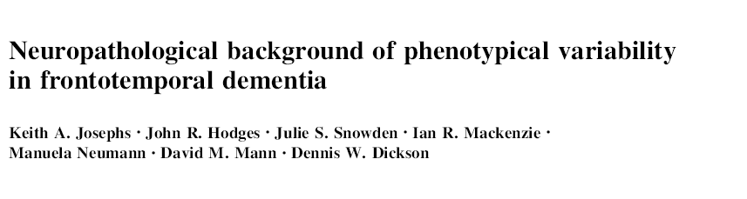
Three major proteins have been identified as leading players in the mechanism of neurodegeneration of the FTLDs
  microtubule associated protein, tau (MAPT)
  transactive response DNA binding protein of 43 kD (TDP-43)
  Tumor associated protein fused in sarcoma (FUS)

Slide 50
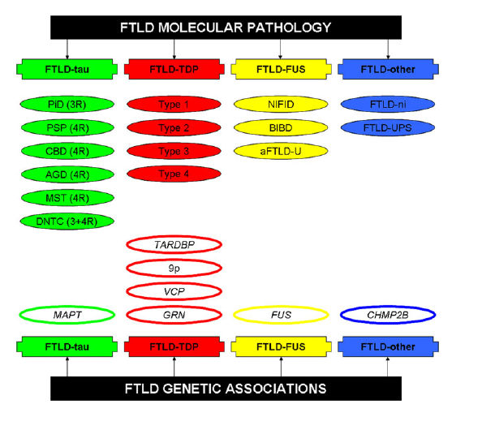

Slide 51
Rohrer et al. suggested that MAPΤ mutations are more often associated with symmetric atrophy on MRI than proganulin mutations
Notes:
type 1 Sampathu
(type 2 Mackenzie) is associated with long, TDP-43 immunoreactive,
dystrophic neurites but few neuronal cytoplasmic inclusions;
type 2 Sampathu (type 3 Mackenzie) is associated with
predominantly granular or stippled neuronal cytoplasmic inclusions
in superficial and deep layers; and type 3 Sampathu (type 1
Mackenzie) is associated with crescentic or compact neuronal
cytoplasmic inclusions, abundant short angulated neuropil
threads, and, more variably, neuronal intranuclear inclusions

Slide 52
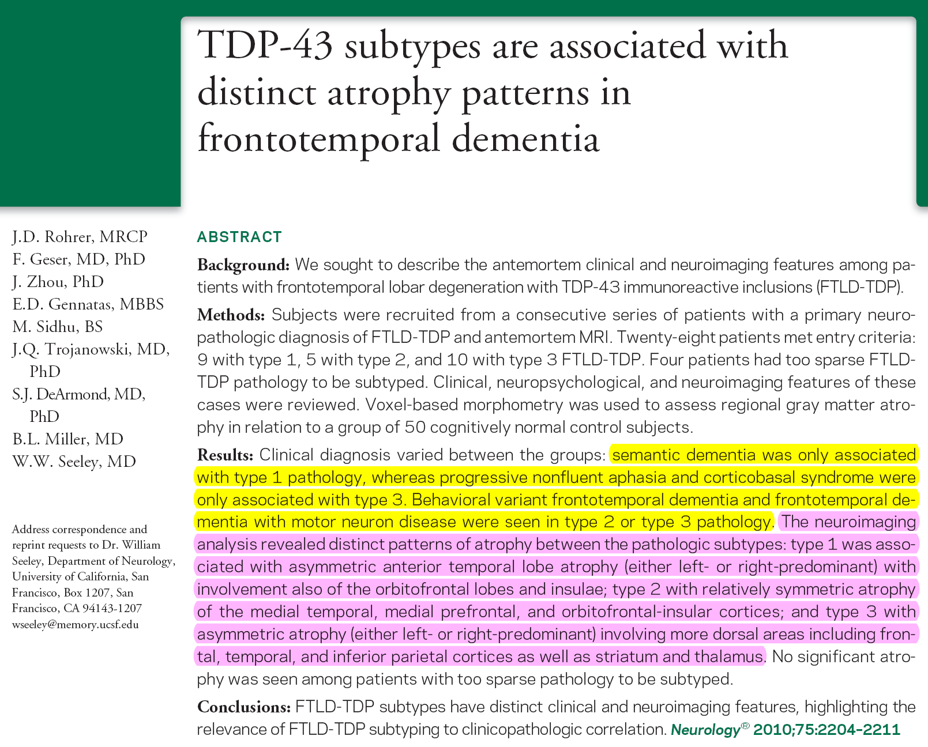

Slide 53
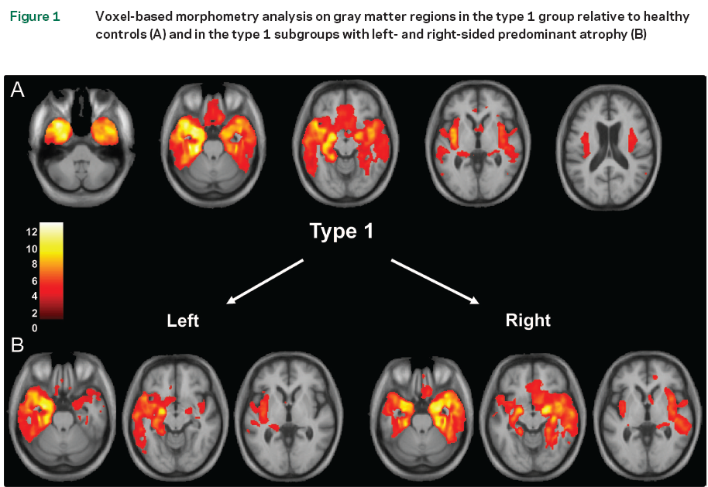

Slide 54
Current concept
Semantic dementia is associated with FTLD-TDP(83% FTLD-TDP pathology)
PNFA is associated predominantly with FTLD-tau (70%)
bvFTD syndrome shows almost equal proportions of FTLD-tau and FTLD-TDP.

Slide 55
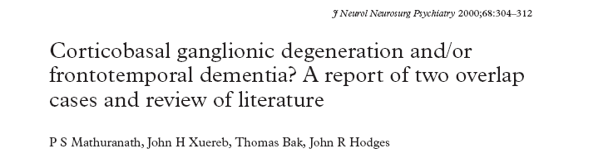
evidence is emerging to suggest that the clear distinction drawn between FTD and CBD by the existing viewpoint, needs revision

Slide 56
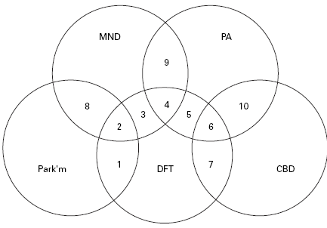

Slide 57
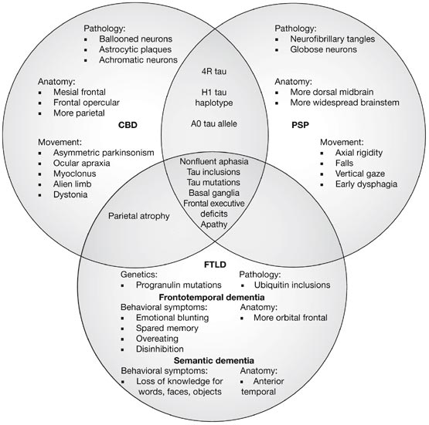

Slide 58
Histology
Variable histologic patterns
various degrees of neuronal loss , swollen neurons and gliosis
Pick cells and Pick bodies(argentophilic inclusions) in some
TDP-43 positive intracytoplasmic inclusions
TDP-43 positive neurites in the frontal cortex

Slide 59
Pick’s cells: arygrophilic intracytoplasmic inclusions are seen in neurons of the dentate gyrus

Slide 60
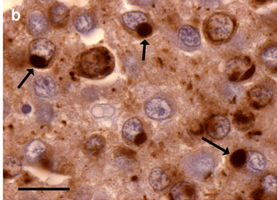
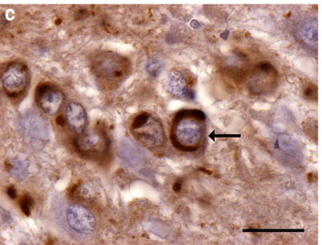
‘‘mini-Pick bodies”
nuclear rim of positivity

Slide 61
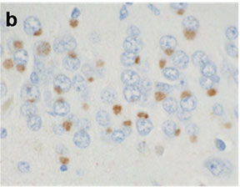
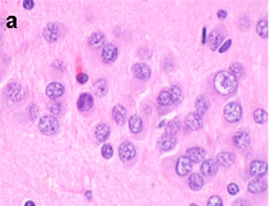
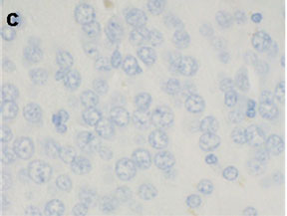
Positive for 3R tau
but negative for 4R tau
globose Pick bodies in dentate fascia with H&E

Slide 62
TDP-43 positive intracytoplasmic inclusions in the dentate gyrus withe loss of normal nuclear staining in inclusion bearing neurons
Normal nuclear staining of TDP-43

Slide 63
TDP-43 positive neuritis in the frontal cortex
Normal nu staining of TDP-43

Slide 64
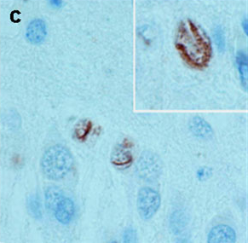
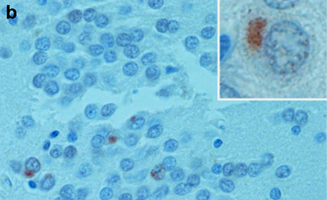
FTLD -FUS
vermiform neuronal intranuclear
inclusions
neuronal
cytoplasmic inclusions

Slide 65
CORTICOBASAL DEGENERATION
One invariable pathologic abnormality is asymmetric frontoparietal cortical degeneration.
both motor and cognitive dysfunction
asymmetric clinical presentation
Dementia
ideomotor apraxia
Dystonia
alien limb phenomenon (most commonly affecting the arm)
postural instability
akinetic-rigid syndrome
poor response to levodopa treatment

Slide 66
CBGD
occurs in late adulthood (more than 60 years)
Significant overlap of clinical features
Over time, some patients develop features of FTD, PPA, or PCD
Some patients present with a focal cortical degeneration syndrome, such as FTD, PPA, or posterior cortical atrophy, and subsequently develop CBD findings
4R Tau, A9D Progranulin Mutations are commonly implicated

Slide 67
Imaging
MR imaging typically shows frontoparietal atrophy
Asymmetric perirolandic cortical atrophy, contralateral to the clinically affected side and extending to the supplementary motor areas
As the cortical atrophy becomes more prominent, abnormal T2 and FLAIR hyperintensities are seen in the underlying subcortical white matter
Asymmetric hypoperfusion of the frontoparietal involved areas and the basal ganglia can be seen in NM studies

Slide 68
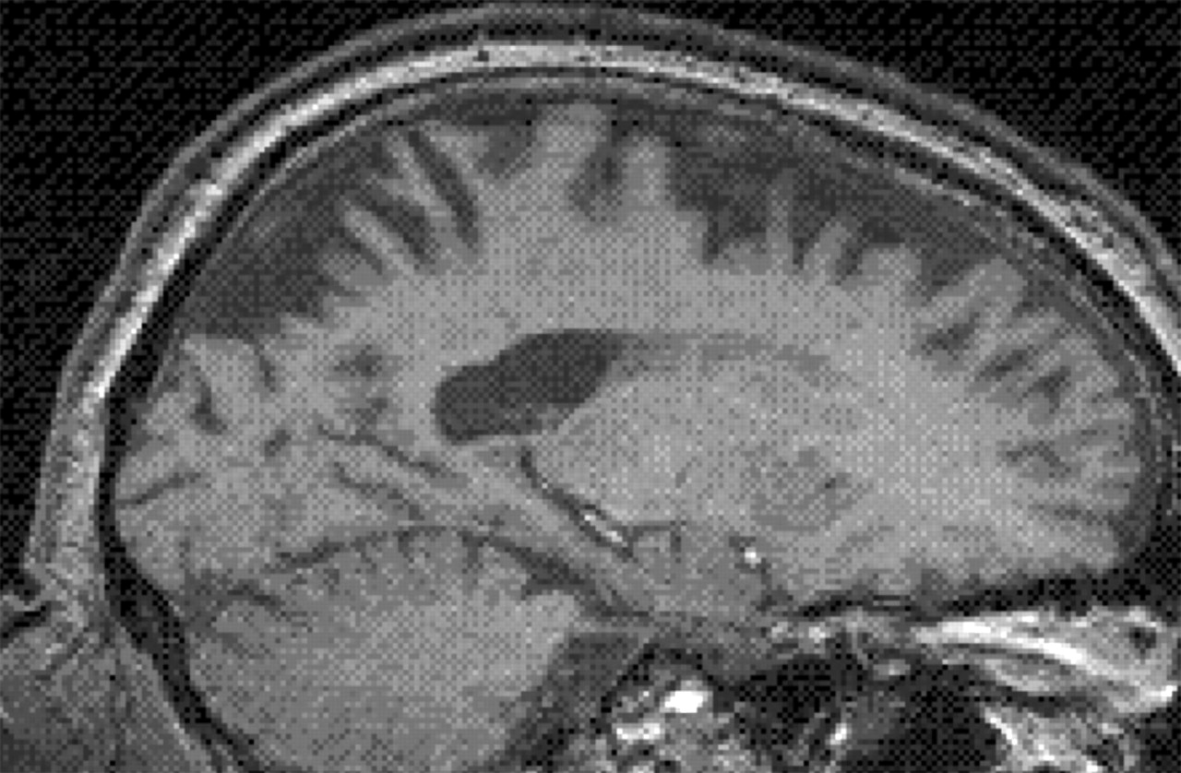
Sagittal MRI of CBD illustrating striking frontoparietal atrophy, but with sparing of primary sensorimotor cortex.
Greene J D W J Neurol Neurosurg Psychiatry 2005;76:v25-v34
©2005 by BMJ Publishing Group Ltd
Notes:
Sagittal MRI of corticobasal degeneration illustrating striking frontoparietal atrophy, but with sparing of primary sensorimotor cortex.

Slide 69
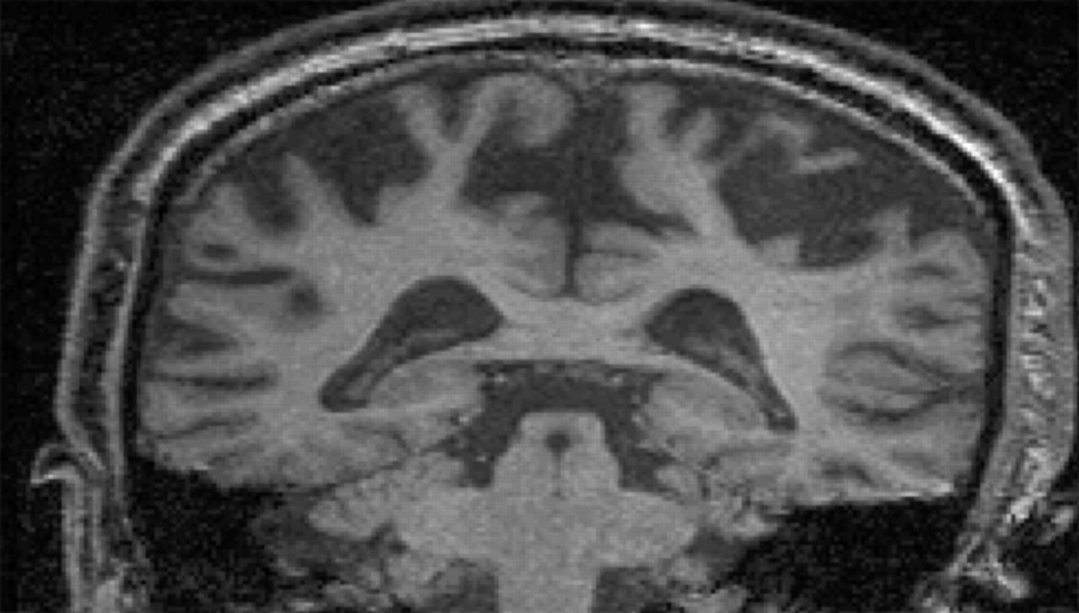
Coronal MRI of corticobasal degeneration showing striking gyral atrophy.
Greene J D W J Neurol Neurosurg Psychiatry 2005;76:v25-v34
©2005 by BMJ Publishing Group Ltd
Notes:
Coronal MRI of corticobasal degeneration showing striking gyral atrophy.

Slide 70
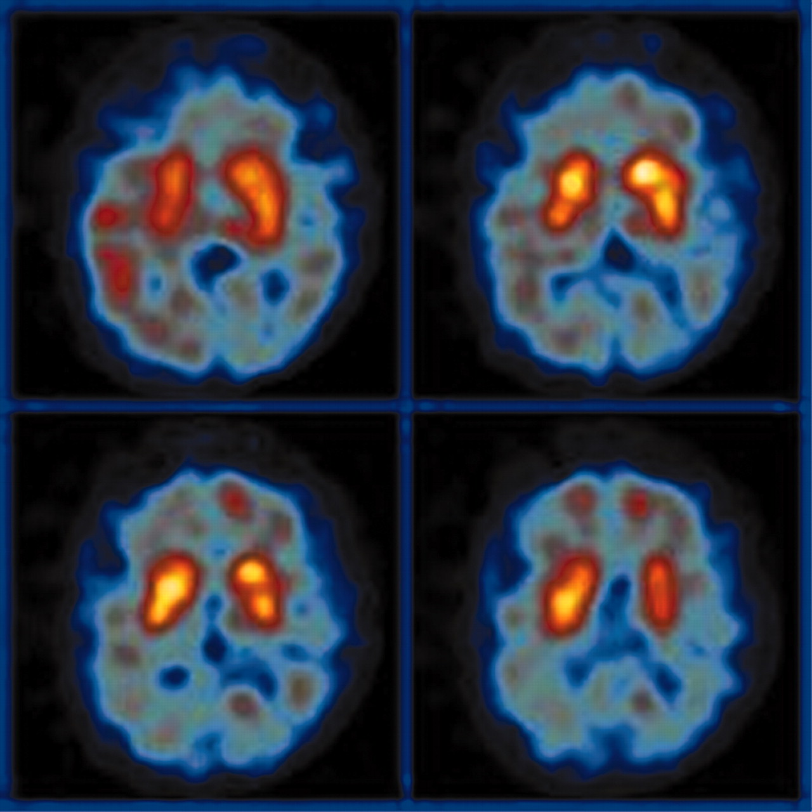
D2 SPECT scan illustrating reduced post-synaptic dopamine receptors in CBD
©2005 by BMJ Publishing Group Ltd
Notes:
D2-single photon emission computed tomography (SPECT) scan illustrating reduced post-synaptic dopamine receptors as occurs in Parkinson-plus syndromes, as in corticobasal degeneration here.

Slide 71
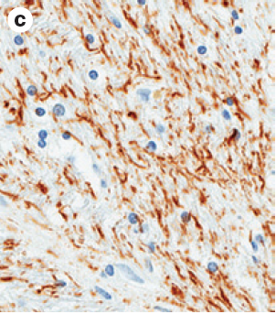
HISTOLOGY IN CBD
Numerous neuropil threads in the internal capsule
The astrocytic plaque is a hallmark of CBD.
Numerous neuropil threads in the internal capsule
Ballooned neurons and achromatasia lacks sensitivity

Slide 72
Astrocytic plaque in CBD stained for hyperphosphorylated tau
Coiled body in the white matter of CBD stained for hyperphosphorylated tau

Slide 73
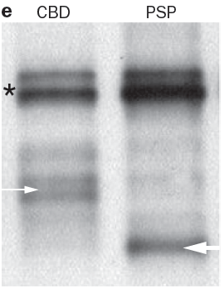
Cleaved tau fragments from a patient with CBD migrate as two bands at approximately 37 kDa whereas cleaved fragments from a patient with PSP migrate as a single band at 33 kDa

Slide 74

In cases with midbrain tegmentum atrophy and signal-intensity changes in the subthalamic nuclei, white matter lesions and asymmetric atrophy differentiates CBD from PSP
Asymmetric frontoparietal atrophy is more sensitive & specific for CBD

Slide 75
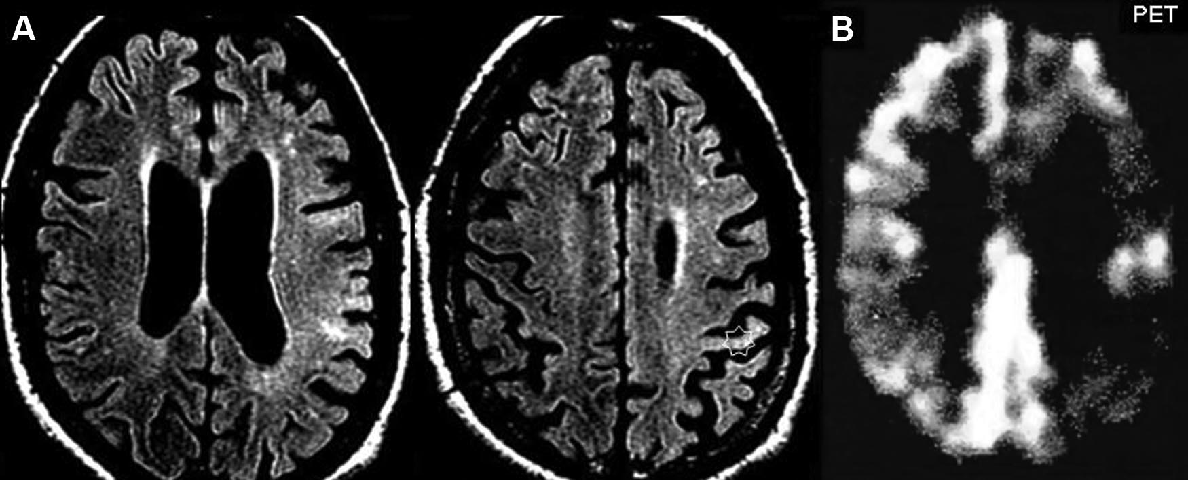
Asymmetric frontoparietal atrophy

Slide 76
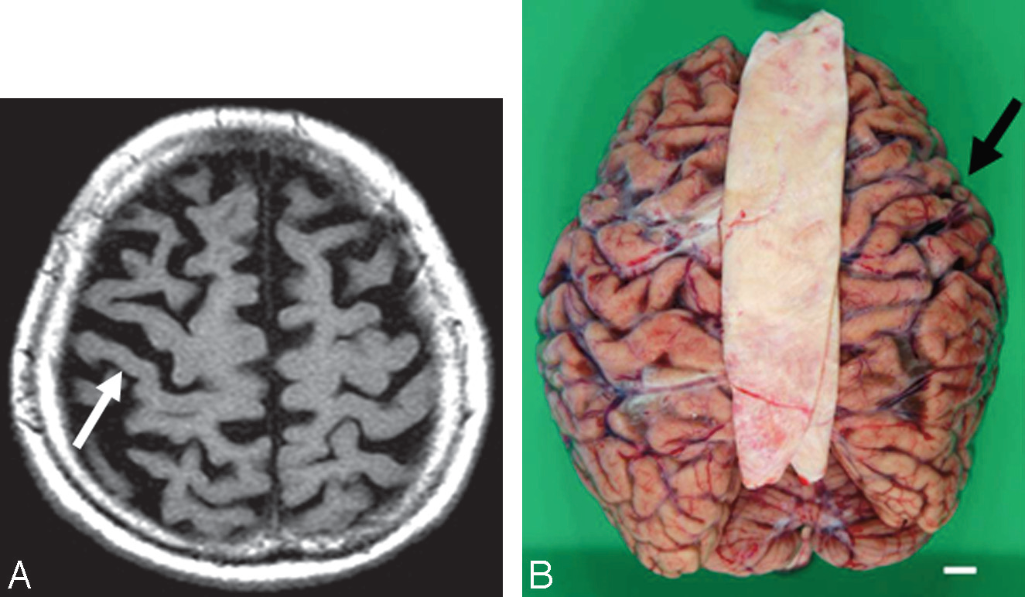
right-side-dominant atrophy including the central sulcus
Macrospecimen shows right-frontal-dominant atrophy

Slide 77
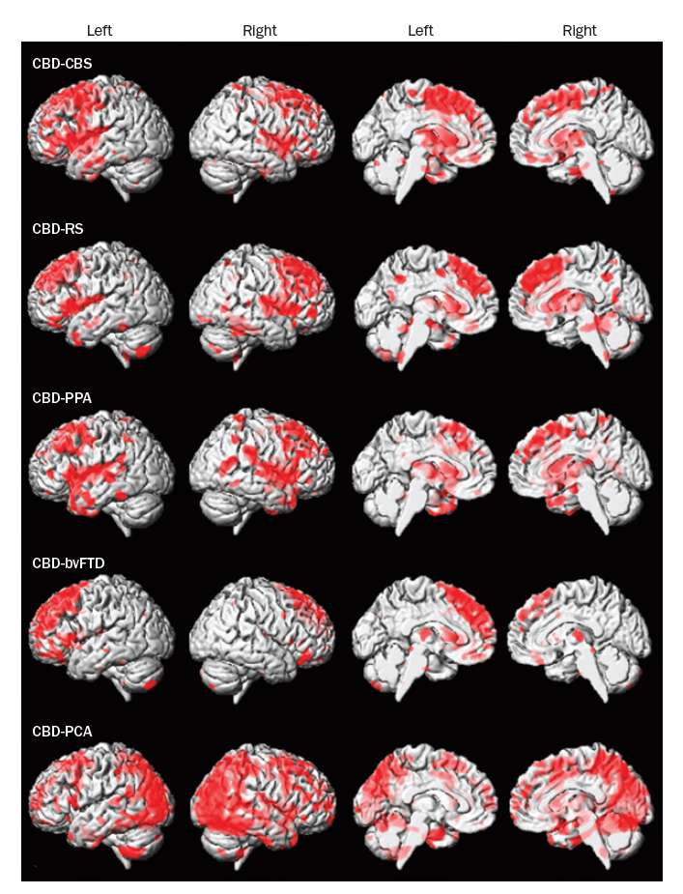

Slide 78
POSTERIOR CORTICAL DEGENERATION
characterized by signs and symptoms of higher visuospatial dysfunction
Patients develop features of
  Balint syndrome (ocular apraxia,optic ataxia, and simultanagnosia)
  Gerstmann syndrome (acalculia,agraphia, finger agnosia, and left-right disorientation), environmental agnosia, and transcortical sensory aphasia.
Neuropsychologic symptoms, such as memory loss and changes in social behavior, are mild until late in the disease course

Slide 79
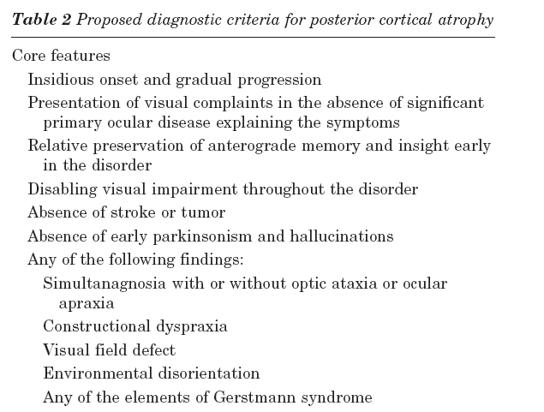

Slide 80
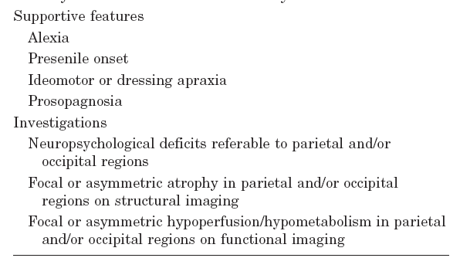

Slide 81
Imaging in PCD
MRI → selective and bilateral parietooccipital atrophy
The disproportionate visuospatial deficits of PCD are due to the involvement of the dominant angular gyrus in Gerstmann syndrome,the bilateral parietooccipital areas in Balint syndrome, and the nondominant parietal lobe in motor apraxias
There is a good correlation of MR atrophy with hypoperfusion on NM studies

Slide 82
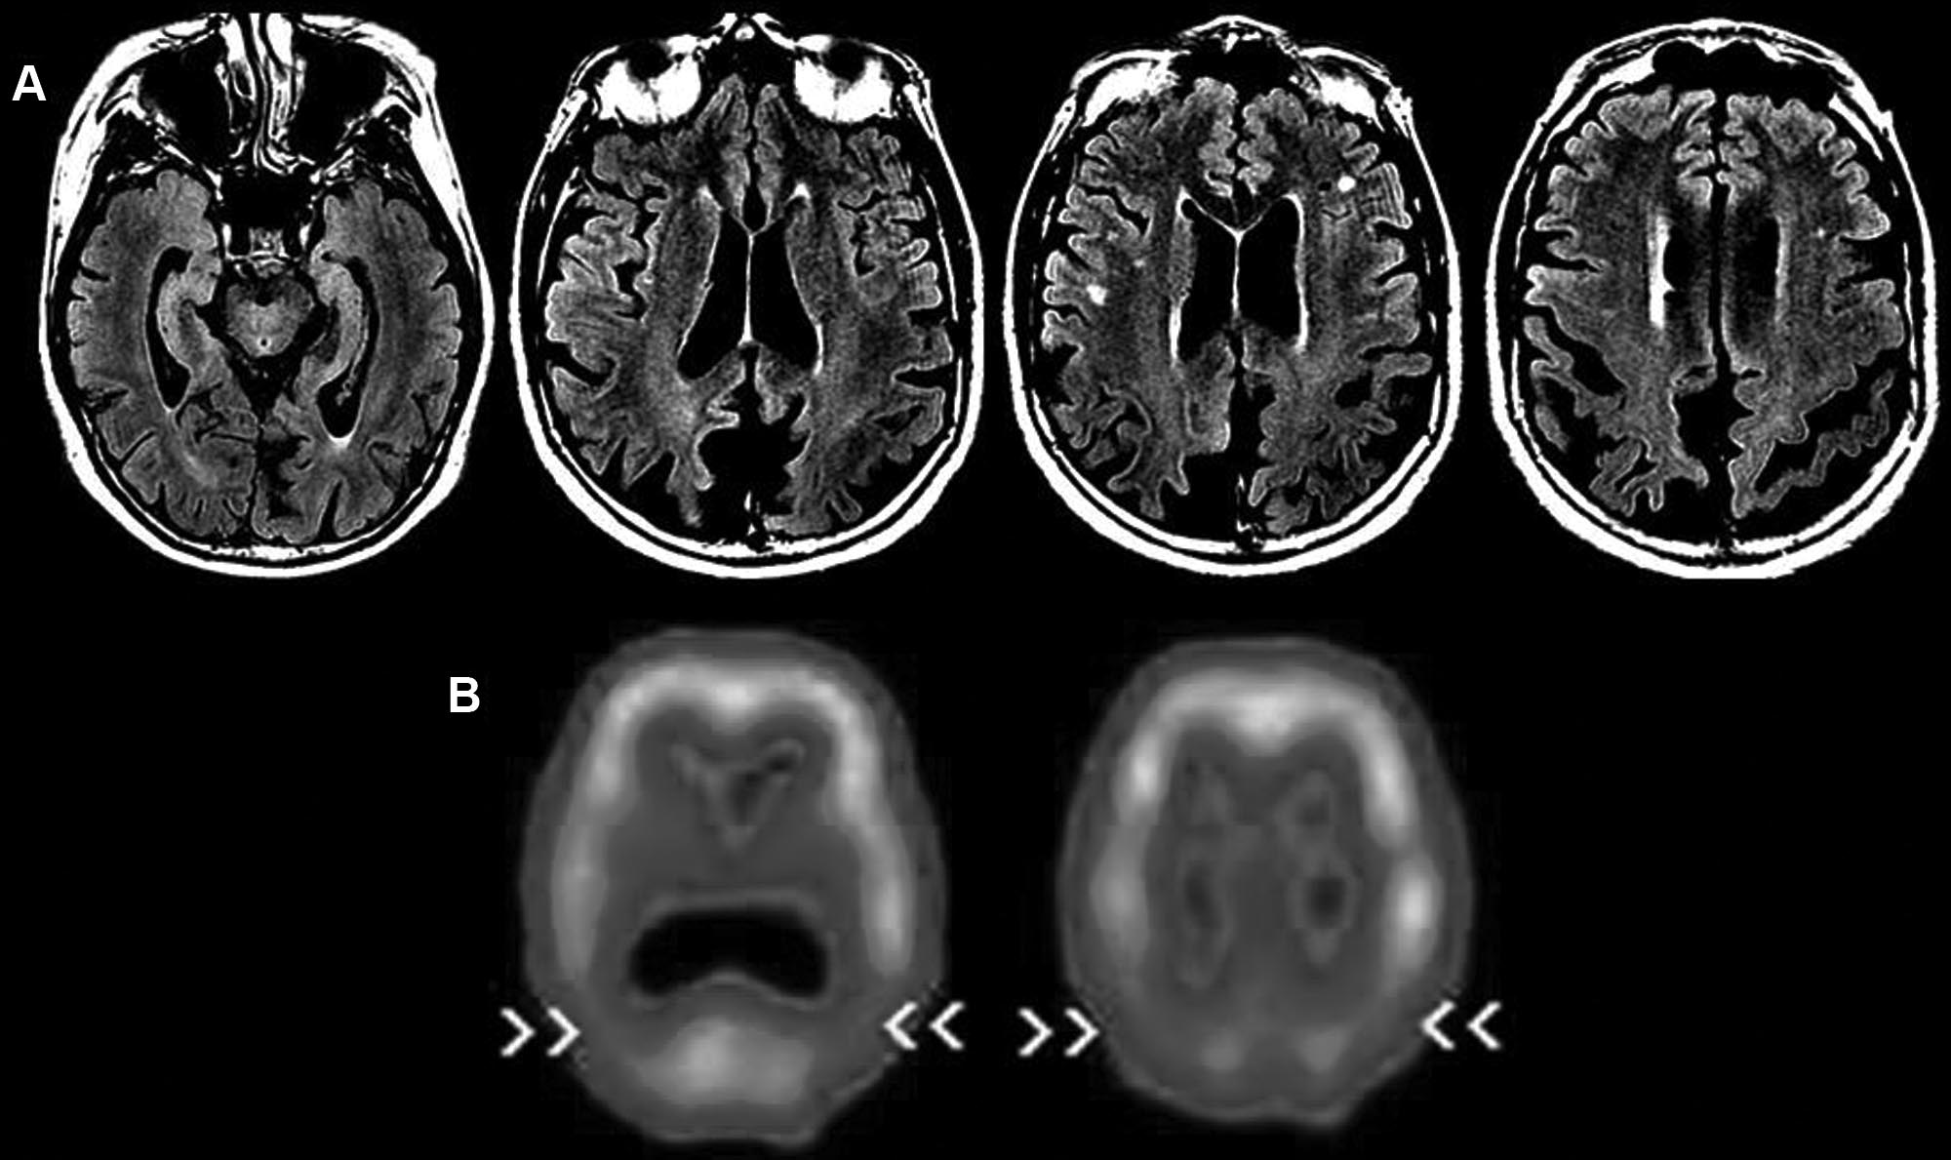

Slide 83
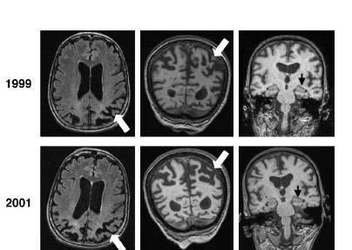

Slide 84
Logopenic progressive aphasia
LPA is a clinical variant of primary progressive aphasia characterized by slow speech with frequent word-finding pauses, and deficits in sentence repetition
LPA is associated with left-hemisphere predominant atrophy in posterior temporal cortex and inferior parietal areas

Slide 85
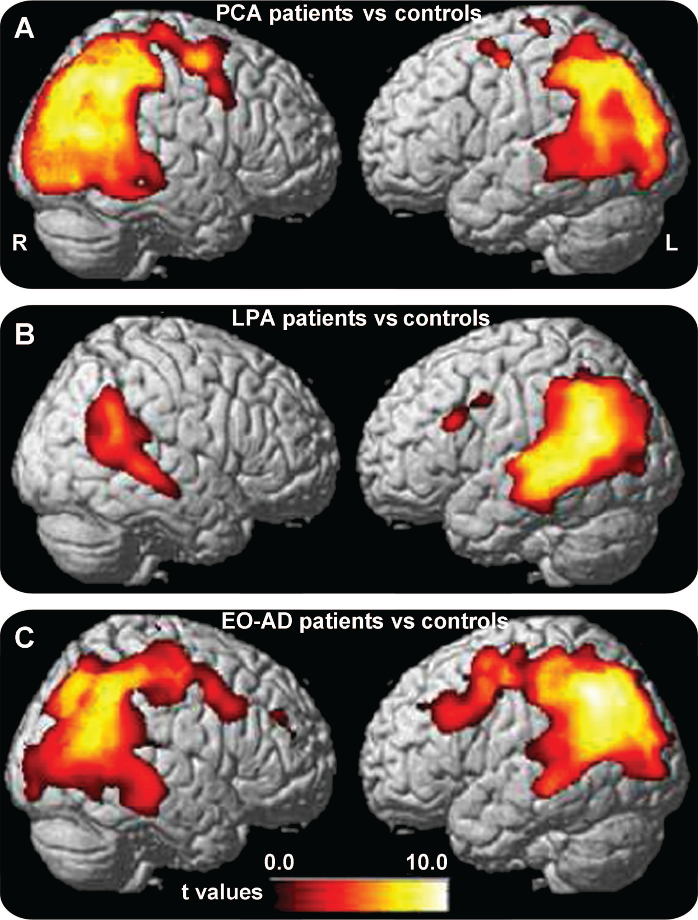
(A) Posterior cortical atrophy (PCA)
(B) phonological progressive aphasia
(C) early age at onset AD (EO-AD).

Slide 86
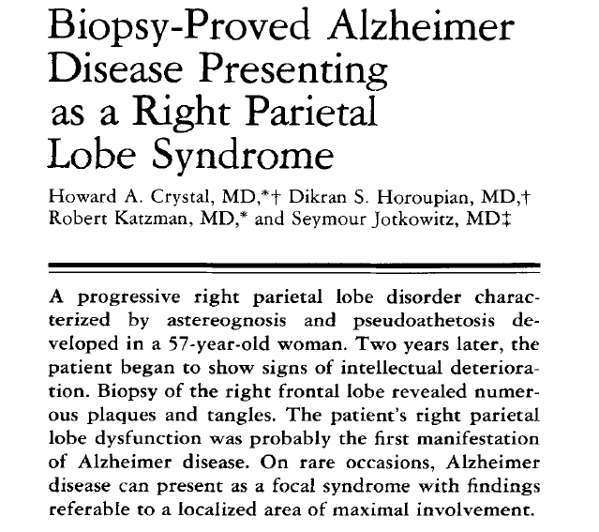

Slide 87

PCA is a distinctive dementia syndrome in which the most pronounced pathologic involvement is in the occipitoparietal regions independent of the specific underlying pathology
AD was the most common pathologic cause, but its regional distribution differed from typical AD

Slide 88



PCD=14, LPA=10
Migliaccio et alio

Slide 89
treatment

Slide 90
Treatment of FTD and PPA
Anticholinesterase agents in have not proved beneficial in FTD
Treatment of depression →SSRI
  sertraline
  paroxetine
  escitalopram
Trazodone may be helpful for sleep
Social interventions
  counseling, and speech/language/cognitive therapy
Stimulant drugs such as amphetamines may benefit patients with frontal lobe syndromes

Slide 91
Treatment for pca
Anticholinesterases for AD variants
Largely symptomatic
  Anti psychotics
Supportive therapy

Slide 92
Summary
asymmetric cortical degenerative syndromes designate any brain affliction that results in selective atrophy, particularly with an asymmetric pattern
It indicates an early focal manifestation of a more diffuse pathology
Phenotypic variability is due to different pathogenetic mechanisms of the same disease type

Slide 93
Summary
Imaging study and neuropsychological evaluation have good correlation with each other and helps finding out the disease process early
Early diagnosis warranted for treatment, prognostication and rehabilitation
Once the abnormal gene products are better understood, specific medical treatments may emerge

Slide 94
Thank you

Slide 95
Akinetic mutism is extreme form of affection of
Medial frontal cortex
Orbitofrontal cortex
Dorsolateral prefrontal cortex
Broca’s area

Slide 96
Most common pathogenetic abnormality associated with posterior cortical degeneration is
ApoE4
3R Tau
TDP 43
Pick’s bodies

Slide 97
ACD S are associated with
Earlier age of onset
Rapid progression
Early onset amnesia
Monogenic inheritance

Slide 98
Diagnostic accuracy for ACDS is best with
MRI + volumetry
MRI + FDG PET
Long relaxation MRI sequences
SPECT

Slide 99
references
Richard J caselli.Asymmetric cortical Degeration Syndromes; Current Opinion in Neurology 1996
Caselli,Jack, Petersen:Asymmetric cortical degenerative Syndromes:Clinical and radiologic correlations. Neurology 1992;42:146
Antoˆnio Jose´ da Rocha, MD,Fla´vio Tu´lio Braga, MD, Carlos Jorge da Silva; Asymmetric Cortical Degenerative Syndromes An Integrated Approach to Clinical and Imaging Review, The Neurologist 2010;16: 298–305

Slide 100
references
Danielle Seilhean , Isabelle Le Ber. Fronto-temporal lobar degeneration: neuropathology in 60 cases; J Neural Transm (2011) 118:753–764
J.D. Rohrer, F. Geser,J. Zhou; TDP-43 subtypes are associated withdistinct atrophy patterns in frontotemporal dementia; Neurology 2010;75:2204–2211
Colin l. Masters, Jillian J. Kril*, Glenda M. Halliday;Overview and recent advances in neuropathology.Part 2: Neurodegeneration. Pathology (February 2011) 43(2), pp. 93–102

Slide 101
references
A.M. Tokumaru,Y. Saito,S. Murayama: Imaging-Pathologic Correlation in Corticobasal Degeneration; AJNR 30 Nov-Dec 2009.
Naomi Kouri, Jennifer L; Whitwell.Corticobasal degeneration: a pathologically distinct 4R tauopathy. Nat. Rev. Neurol. 7, 263–272 (2011)
Arne Ittner, Yazi D. Ke, Janet van Eersel:Brief Update on Different Roles of Tau in Neurodegeneration; Life, 63(7): 495–502, July 2011

Slide 102
references
D.F. Tang-Wai, N.R. Graff-Radford;Clinical, genetic, and neuropathologic characteristics of posterior cortical atrophy. Neurology 2004;63:1168–1174
R. Migliaccio, F. Agosta, MD,K. Rascovsky;Clinical syndromes associated with posterior atrophy. Neurology®2009;73:1571–1578

