Slide 1

Management Of Ludwig Angina
Dr. Navin Shah (Prof. & H.O.D)
Dept. Of Oral & Maxillofacial Surgery

Slide 2
Treatment:
Primary goal:
  Preserve the oropharyngeal airway.
Secondary goal:
  Antibiotic agent or incision and drainage.
Hshs L. jan 8 2013, ludwigs angina,

Slide 3
Airway maintenance:
The need for immediate artificial airway:
  a) Stridor
  b) Cyanosis
  c) Retractions
  d) difficulty managing secretions.
  e) Rapid progression of edema
  f) Comorbid health problems, DM

Slide 4
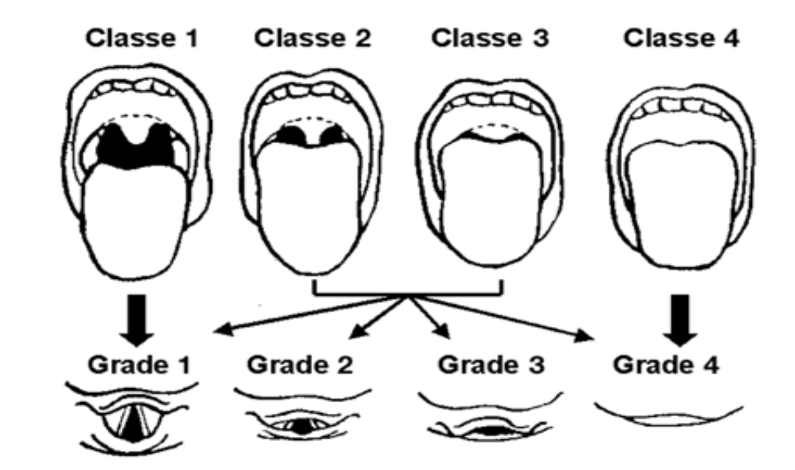
Airway assessment
  Ludwig's Angina causes obstruction of oropharynx and potentially supraglotic area
  Mallampatti score - crowding in Oropharynx

Slide 5
Airway Maintenance
Airway maintenance may be difficult:
  Endotraclear intubation:
Supraglottic edema
Nuchal rigidity
Trismus
  Nasal intubation:
Requires careful awake
Flexible endoscope
Patient in an upright position.
  Last resort:
Cricothyroidotomy
Tracheostomy.

Slide 6
Airway Management:
  Airway management is the most important aspect of immediate care.
  Risk of rapid airway compromise, all patients with Ludwig’s angina should be admitted to the ICU.
  Death is usually the result of hypoxia or asphyxia, not overwhelming sepsis.
  Fiber optic intubation.
  When fiber optic intubation is not possible tracheostomy using local anesthesia recommended
  Tracheostomy using local anesthesia has been considered the gold standard of airway management in patients with deep-neck infections. However, cellulitis of the neck with involvement of the tracheostomy site makes the procedure difficult.
  A recent study on patients with Ludwig’s angina showed that tracheal intubation with a flexible bronchoscope using topical anesthesia provided good airway management.

Slide 7
Antibiotic agent
Early aggressive antibiotic therapy:
Initial antibiotic therapy is targeted at gram-positive organisms and oral cavity anaerobes.
Empiric therapy with IV penicillin G, or metro­nidazole is recommended before culture and sensitivity results are available.
Some experts recommend the addition of gentamicin.
In penicillin-allergic patients, use clindamycin.
IV dexamethasone, given for 48 h, has been beneficial in reducing edema.

Slide 8
Use of Steroids
  a) IV dexamethasone (eg, Dalalone, Decadron, Dexasone), given for 48 hours, can decrease edema and cellulitis and thus help maintain the integrity of the airway and enhance antibiotic penetration.
b) Dexamethasone 10-20 mg IV
  Then 4-6 mg Q6 for 8 doses (Busch)
  “Used routinely when airway compromise suspected”
  (Larawin et al.)

Slide 9
Surgical intervention:
  Decompression
Sublingual and Submandibular & Submental spaces.
  Incision and drainage
  1) Therapy includes early surgical removal of the source of infection (which is often grossly carious dentition) via extraction, aggressive, and vigorous incision and drainage procedures with appropriate placement of drains, along with intense and prolonged antibiotic therapy and maintenance of a patient airway
  2) Surgical drainage is indicated in the presence of clinical
a) fluctuance or crepitus,
b) radiologic evidence of fluid collection or air in the soft tissues. c) a relative indication is the lack of clinical improvement within 24 hours of initiation of antibiotic therapy
Ludwigs angina, JAMA , 1940, 114(60)

Slide 10
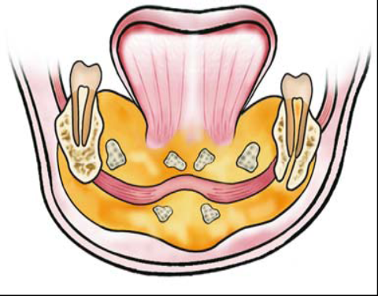
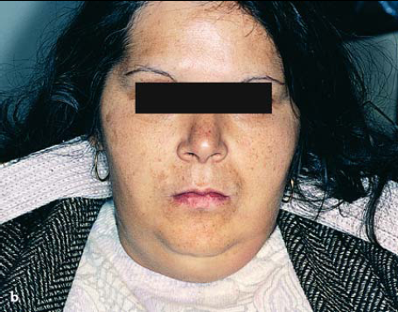
  Ludwig’s angina.
  a) Diagrammatic illustration showing the spread of purulent infection in five fascial spaces of the mandible.
  b) Clinical photograph of extensive extraoral swelling in submental and submandibular spaces

Slide 11
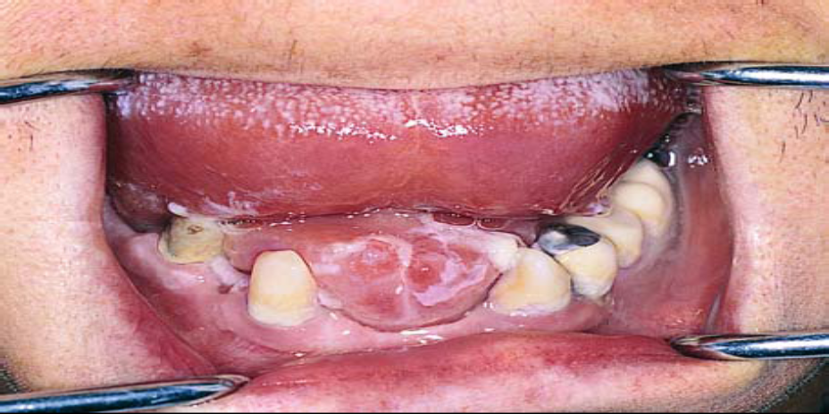
a
  a)Clinical intraoral photograph showing severe edema of the floor of the mouth and elevation of the tongue, due to suppuration of sublingual spaces (risk of asphyxiation).
  b)Intraoral incision, parallel to the ducts of the submandibular glands.

Slide 12
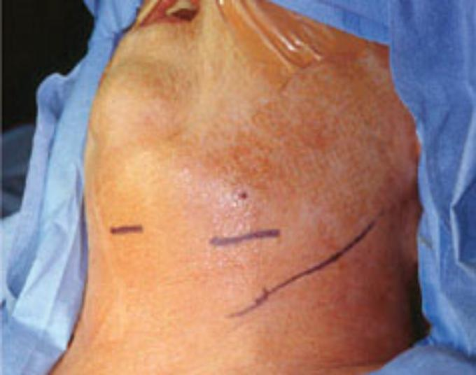
Incisional Planes:

Slide 13
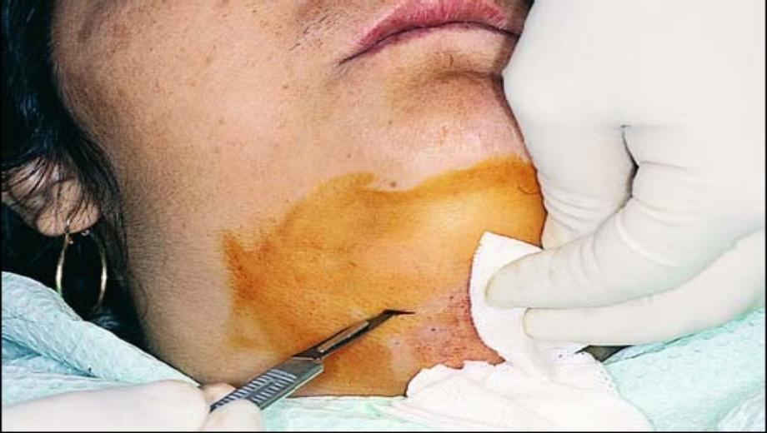
  a)Incision for drainage of inflammation.
  b)The incisions must be bilateral, extraoral, parallel, and medial to the inferior border of the mandible, at the premolar and molar region.

Slide 14
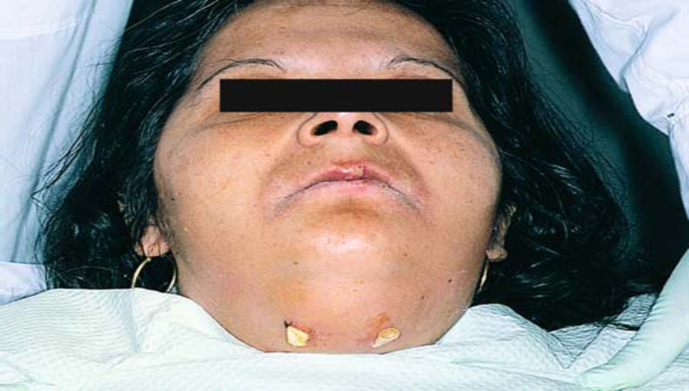
  Placement of rubber drains at the sites of incision

Slide 15
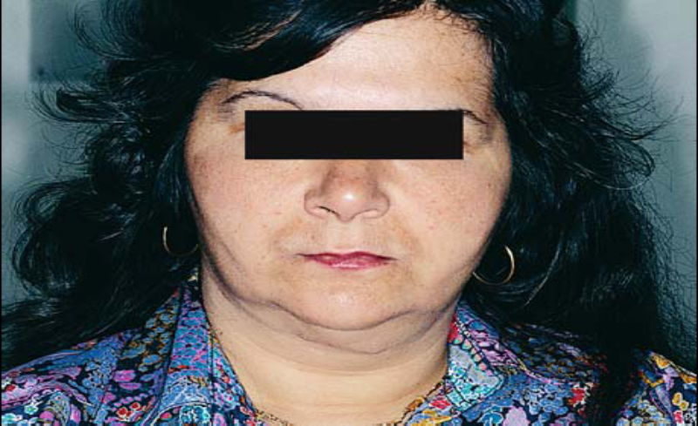
  Postoperative clinical photograph 1 month after
treatment of infection

Slide 16
Ludwig's Angina & Pregnancy
  PREDISPOSING FACTORS:-
  1) Pregnancy is accompanied by many physiological changes which place the mother at a higher risk of infection or of doing worse once infected.
2) Immune response greatly diminished resulting in potential faster progression of an infection.
3) Decreased neutrophil ,chemo taxis, cell mediated immunity, and natural killer cell activity

Slide 17
  4) 50% pregnant women complain of dyspnea by 19 weeks gestation , results in lower oxygen reserve which could increase fetal hypoxia during periods of hypoventilation.
  5) Pregnancy gingivitis :- pregnancy associated hormonal changes begin to affect a woman's gingival tissues plaque accumulates resulting in a constant, low-grade intraoral infection
  6) Dietary habits:- women tend to maintain frequent meals and snacks, which cause further plaque accumulation, as well as an increase in decay or rapid progression of previously present decay can lead to odontogenic infections.
  7) Pt unwilling to give high risk consents for treating minor orodental infection which turns later in facial space infection in due course of pregnancy.

Slide 18
Ludwig's & Pregnancy
  COMPLICATIONS:-
  1) Risks of maternal and fetal morbidity include both septicemia and asphyxia
  2) An infection in itself can infect the placenta, uterus, and possibly the fetus, causing fetal septicemia
  3) Poor oxygenation is compromising to the fetus.
4) Maternal infective process sometimes resulting in preterm labor, premature rupture membranes, and low birth weight.

Slide 19
Management :
  PREVENTION:-
  1) Regular visits to dental clinics during antenatal appointments.
  2) Health care providers should not neglect even minimal complaints of dental pain, timely identification of infection during the early stages & proper elimination of potential problems with extremely aseptic technique is of prime importance.
  3) An appropriate time for dental care from a medical standpoint is the second trimester .

Slide 20
Management Cont…….
  Surgical management of Ludwig's Angina infection in pregnant lady is same but following points should be considered.
  1) Formal consultation to the Departments of Obstetrics and Gynecology (Ob/Gyn) and Anesthesiology.
  Ob/Gyn continued follow up on the patient by frequent monitoring of the fetal heart rate
2) Healthcare provider must consider the risks that the condition and the possible treatments may cause the
mother, her unborn child & perinatal effects of the treatment to new born.

Slide 21
  3) Prolonged intubation and certain intravenous medications can also harm the fetus. During a life threatening infectious situation ,the risk of maternal and fetal morbidity may overshadow potential teratogenic side effects.

Slide 22
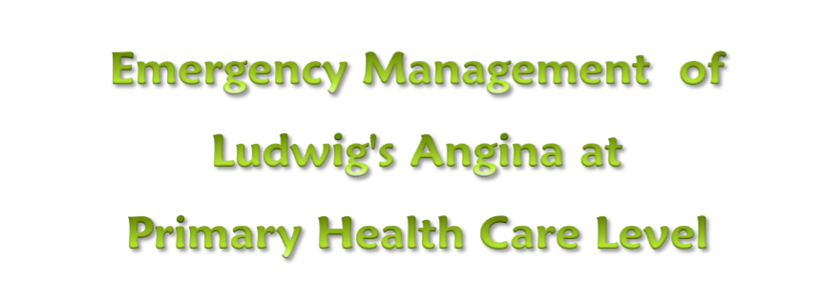

Slide 23
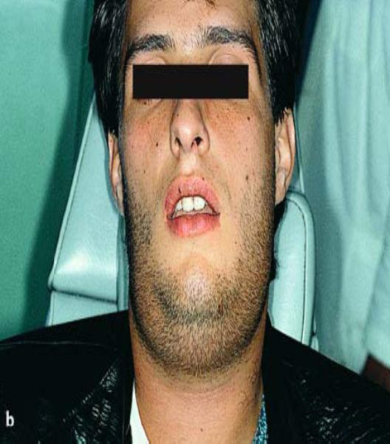
1)Picture showing grade II to progressing grade III Ludwig's angina.
2)Patient is maintaining his airway.
In such case what is the role of primary attending physician
a). Assessment
b). Check airway & SPO₂
c). Start high dose antibiotics
d). IV steroids
e). Arrange for early transfer to higher health care center

Slide 24

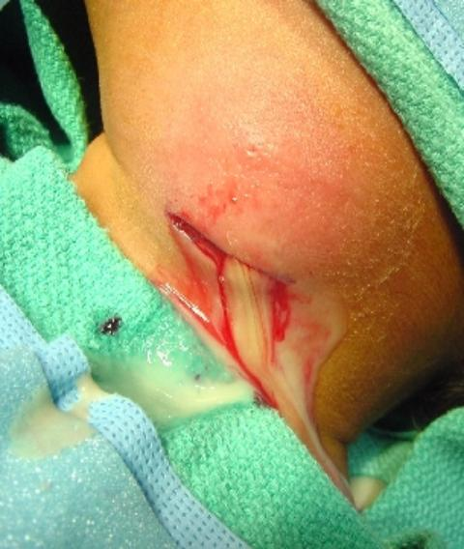
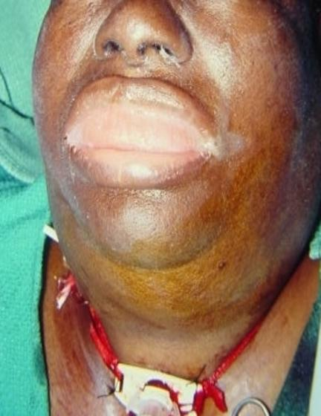

Severe form of ludwig’s angina.
Signs of airway obstruction: -
Stridor, Cyanosis, Retractions,
Rapid progression of edema.
In such cases :-
a). Maintain airway by using
oro-pharyngeal airway
b). Decompression of indurated facial
spaces should be done by
incision under local anesthesia
c). Urgent transfer to higher center .

Slide 25
Complications:
  Deep neck infection.
  Mediastinitis.
  Pericarditis.
  Sepsis.
  Pneumonia.
  Empyema.
  Asphyxia.
  Pneumothorax .

Slide 26
Conclusion:
  The very name angina, meaning spasmodic suffocative pain when not treated.
  Tracheostomy may eliminate the decision-making burden.
  Early aggressive antimicrobial therapy has reduced the need for airway intervention.
  The treatment plan for each patient should be individualized.
  The condition of the patient and comorbid health problems, physician experience, available resources, and manpower are all crucial factors in this decision-making process.

Slide 27
IMPORTANT NOTE:
  Ludwig’s angina usually resolves without complications, but the condition can be fatal. Prompt diagnosis, appropriate airway management, aggressive IV antibiotic therapy, and close monitoring in the ICU promote good outcomes in most patients.

Slide 28
Ludwig’s Angina: A Rare Case Report
S Vijay Parthiban*, R Sathish Muthukumar**, M Alagappan, M Karthi
Ludwig’s Angina: A Rare Case Report
Indian Journal of Multidisciplinary Dentistry, Vol. 2, Issue 3, May-July 2012

Slide 29
Title Citation | Level of evidence | Aims & objectives | Material & method | Conclusion | Remark
S Vijay Parthiban Ludwig’s Angina: A Rare Case Report Indian Journal of Multidisciplinary Dentistry, Vol. 2, Issue 3, May-July 2012 | Level 4 | Proper diagnosis of ludwig’s angina | We present a case of Ludwig’s angina in a 50-year-old man. and review the presentation and management of this disease. | Ludwig’s angina is a life-threatening infection of floor of the mouth and neck In advanced cases, securing the airway, surgical drainage and antibiotics following culture and sensitivity test are important. | .Early diagnosis and immediate treatment is the key for successful management of Ludwig’s angina.

Slide 30
REFERENCES
Nguyen VD, Potter JL, Hersh-Schick MR. Ludwig angina: an uncommon and potentially lethal neck infection. AJNR Am J Neuroradiol 1992;13:215–9
Weiss L, Finkelstein JA, Storrow AB. Fever and neck pain. Ludwig’s angina. Acad Emerg Med 1995;2:835,843–4
Murphy SC. The person behind the eponym: Wilhelm Frederick von Ludwig (1790-1865). J Oral Pathol Med 1996;25(9):513-5.
Kurien M, Mathew J, Job A, Zachariah N. Ludwig’s angina. Clin Otolaryngol Allied Sci 1997;22(3):263-5.
Marple BF. Ludwig angina: a review of current airway management. Arch Otolaryngol Head Neck Surg 1999;125(5):596-9.
Neff SP, Merry AF, Anderson B. Airway management in Ludwig’s angina. Anaesth Intensive Care 1999;27(6): 659-61.
Barakate MS, Jensen MJ, Hemli JM, Graham AR. Ludwig’s angina: report of a case and review of management issues. Ann Otol Rhinol Laryngol 2001;110(5 Pt 1):453-6.
Nguyen VD, Potter JL, Hersh-Schick MR. Ludwig angina: an uncommon and potentially lethal neck infection.AJNR Am J Neuroradiol 1992;13(1):215-9.
Tshiassny K. Ludwig’s angina: an anatomic study of the lower molar teeth in its pathogenesis. Arch Otolaryngol Head Neck Surg 1943;38:485-96.
8. Durand M, Joseph M. Infections of the upper respiratory tract. In: Harrison’s Principles of Internal Medicine. Volume 1. 16th edition, Braunwald E, Fauci AS, Kasper DL, et al (Eds.), McGraw-Hill: New York 2001:p.191.

Slide 31


T H A N K Y O U

Slide 32
QUESTIONS

Slide 33
MCQ
1.Facial Spaces Involved:
A)Submandibular space.
b) Sublingual space.
c) Submental space
D) all of above
1. ludwig’s died bcos of
A) neck swelling
B) Fever
C) HIV
D) Hernia

Slide 34
2. etiology which is true?
  A)Peritonsillar absecess
  B)Parapharyngeal abscesses
C) dentigerous cause
D) all of above
2. differentia diagnosis is
Angioneurotic edema,
2) Lingual carcinoma,
3) Sublingual hematoma, &
4) Peritonsillar abscess
5) all of above

Slide 35
3. primary goal of treatment is
  A) Preserve the oropharyngeal airway.
B) antibiotics
C) analgesics
D) none of above
3. management is
A) I & D
B) antibiotic
C) Steroids
D) all of above

Slide 36
4. gram negative bacteria causing ludwig’s angina is
A)Klebsiella species,
B) Hemophilus influenzae
C)Proteus species &
D) streptococcus
4. Complications are
  A)Deep neck infection.
  B)Mediastinitis.
  C)Pericarditis.
  D)Sepsis
  E) All of above

Slide 37
5. clinical symptoms of ludwig’s angina is
  A)Fever
  B)Dysphagia
  C)Trismus
  D)All of above
5. airway management can be done by
A) endotracheal
B)nasal
C) Oral
D) all of above

Slide 38
6. Complications are
  A)Deep neck infection.
  B)Mediastinitis.
  C)Pericarditis.
  D)Sepsis
  E) All of above
6. clinical symptoms of ludwig’s angina is
  A)Fever
  B)Dysphagia
  C)Trismus
  D)All of above

Slide 39
7. management is
A) I & D
B) antibiotic
C) Steroids
D) all of above
7.gram negative bacteria causing ludwig’s angina is
A)Klebsiella species,
B) Hemophilus influenzae
C)Proteus species &
D) streptococcus

Slide 40
8. airway management can be done by
A) endotracheal
B)nasal
C) Oral
D) all of above
8. primary goal of treatment is
  A) Preserve the oropharyngeal airway.
B) antibiotics
C) analgesics
D) none of above

Slide 41
9. differentia diagnosis is
Angioneurotic edema,
2) Lingual carcinoma,
3) Sublingual hematoma, &
4) Peritonsillar abscess
5) all of above
9. etiology which is true?
  A)Peritonsillar absecess
  B)Parapharyngeal abscesses
C) dentigerous cause
D) all of above

Slide 42
10. ludwig’s died bcos of
A) neck swelling
B) Fever
C) HIV
D) Hernia
10. Facial Spaces Involved:
A)Submandibular space.
b) Sublingual space.
c) Submental space
D) all of above

Slide 43
Ludwig's angina and airway considerations: a case report
Anand H Kulkarni et al
Cases Journal 2008, 1:19
Abstract
Introduction: Patients with deep neck infections present challenging airways for an
anesthesiologist. Patients with Ludwig's angina may die as a result of the inability to effectively
manage the airway.

Slide 44
A Rare Complication of Tooth Abscess —
Ludwig’s Angina and Mediastinitis
© J Can Dent Assoc 2001; 67:324-7
Abstract
Deep neck infections are a rare but potentially fatal complication of pulpal abscess of the teeth. If an infection can
progress rapidly from a toothache to a life-threatening infection, then it is critical that dentists be able to recognize
the danger signs and identify the patients who are at risk. This article reviews a case of a seemingly innocuous
toothache which rapidly progressed to Ludwig’s angina and mediastinitis, and discusses how to recognize.

