Slide 1
Assessment Procedures of Voice Disorders

Slide 2
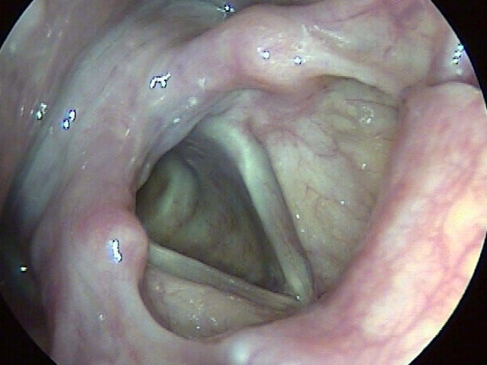
Introduction of Voice

Slide 3
Introduction of Voice
Voice, Articulation, and Language are the major elements of human speech production. When a disorder related to any of these elements is present, the ability to communicate may be impaired.
Voice is the element of speech that provides the speaker with the vibratory signal upon which speech is carried.
Voice serves as the melody of our speech and provides expression, feeling, intent, and mood to our daily-articulated thoughts.

Slide 4
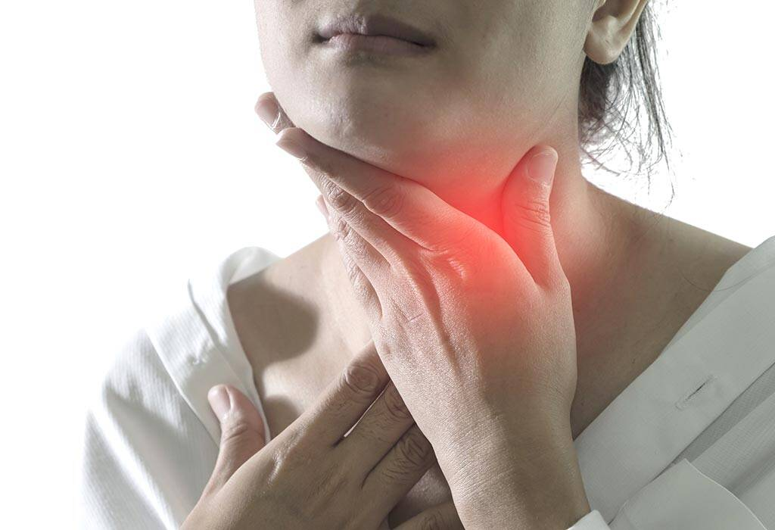
Definition of Voice Disorder

Slide 5
Definition of Voice Disorder
The historical definition states that a voice disorder exists when a person’s quality, pitch and loudness differ from those of similar age, gender, cultural background, and geographical location.
In other words, when the perceptual properties of voice are so deviant that they draw attention to the speaker a voice disorder may be present.

Slide 6

Effect of Voice Disorder

Slide 7
Effect of Voice Disorder
The effects of voice disorder depend on the voicing needs of the individual. Those with a great need for normal voice production, such as professional voice users, may be unusually concerned with the presence of even minor vocal difficulties.
Those with low vocal needs may not be greatly concerned even more severe vocal problems.
Identifying the vocal needs of each patient is extremely important in successfully treating voice disorder.

Slide 8
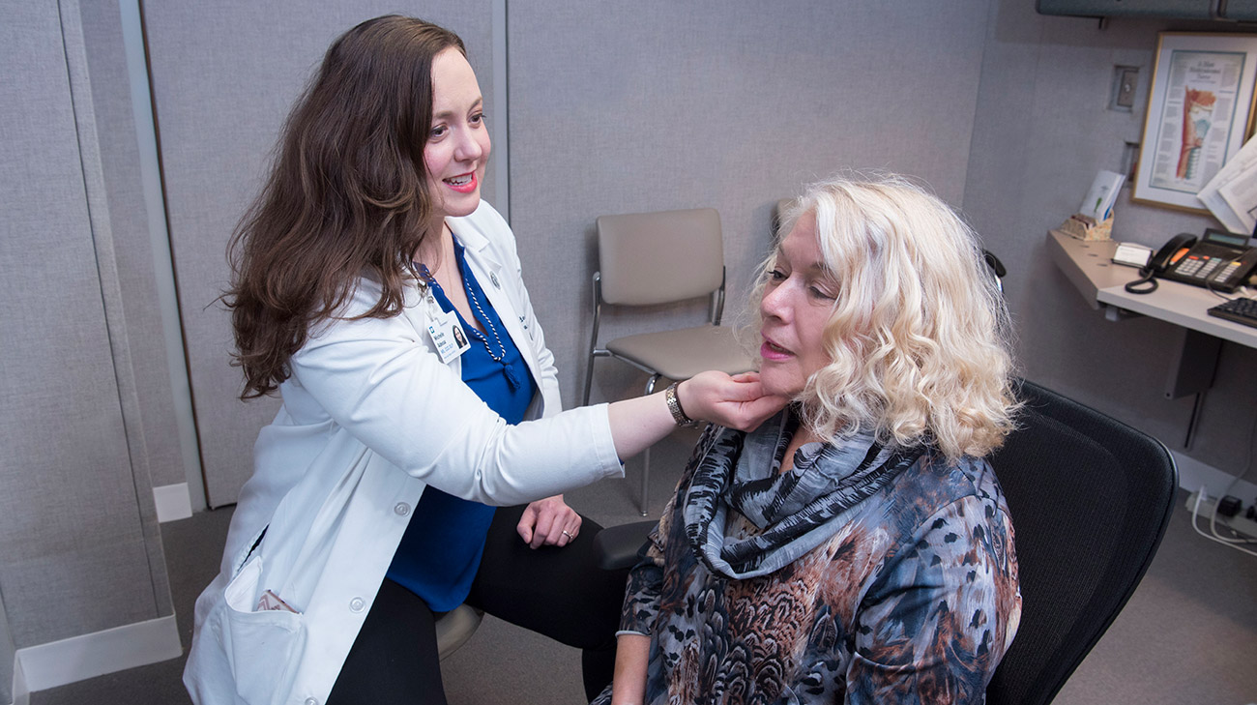
Role of Speech Language Pathologist

Slide 9
Role of Speech Language Pathologist
The Speech Language Pathologist (SLP) plays a major role in the evaluation and management of voice disorders.
This role focuses three major goals:
  Evaluation of laryngeal function using auditory and visual perceptual tasks, acoustic analysis, aerodynamic measures of vocal function, and patient self-assessment.
  Identification and modification or elimination of the functional causes that have led to the development of voice disorder.
  Developing a therapy plan that will remediate the voice disorder and return the voice to improved function.

Slide 10
Cont..
To accomplish aforesaid goals, SLP must have an extensive understanding and knowledge of the normal anatomy and physiology of the laryngeal mechanism, as well as knowledge of common laryngeal pathologies.
They also must understand etiologic factors that lead to the development of voice disorders, as well as appropriate diagnostic techniques and skills for discovering the causes.
They also must understand etiologic factors that lead to the development of voice disorders, as well as appropriate diagnostic techniques and skills for discovering the causes.

Slide 11
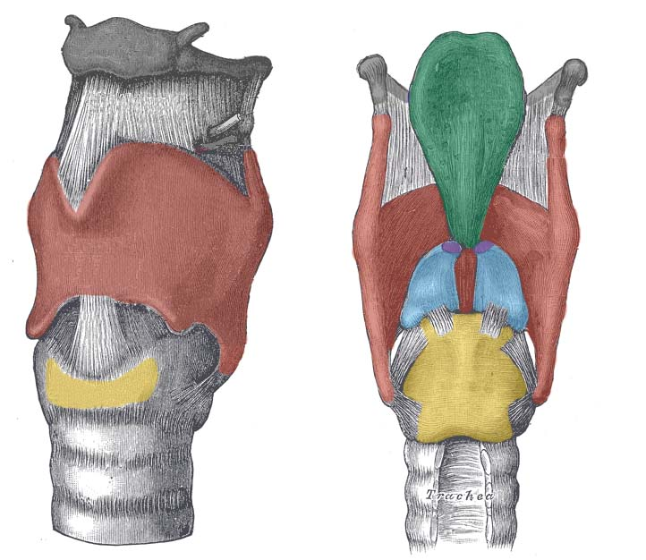
Anatomical Structure of Larynx

Slide 12
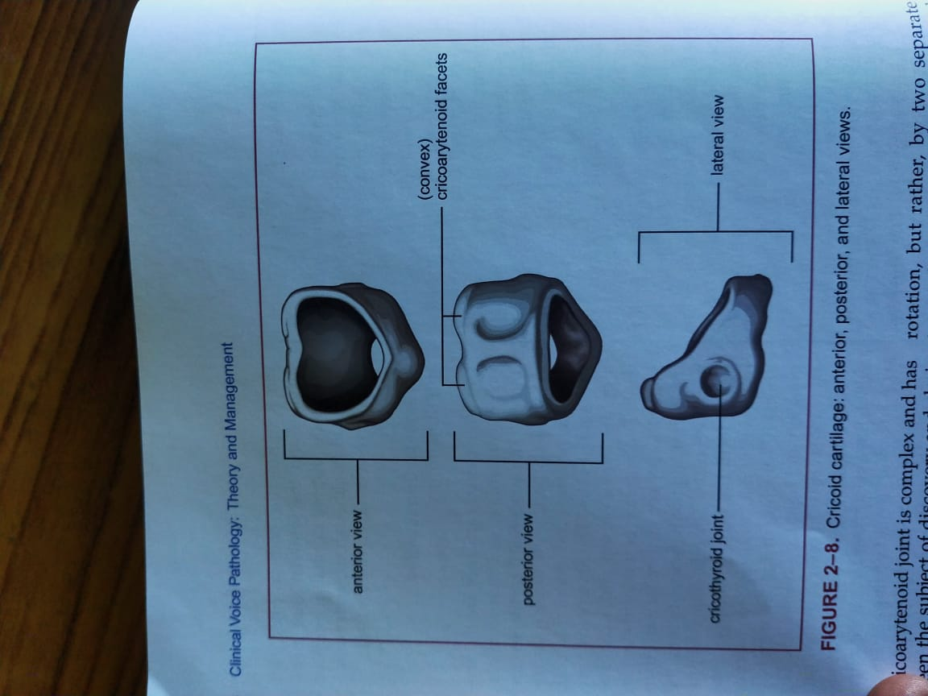
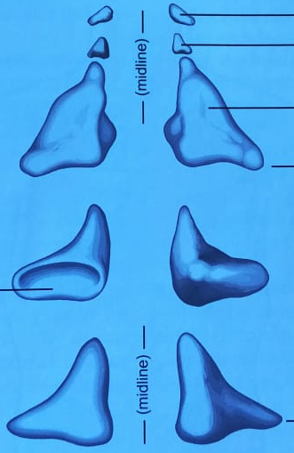
Cartilages of Larynx
Unpaired cartilages
Thyroid
Cricoid
Paired cartilage
Arytenoids
Corniculate
Epiglottis
Cuneiform

Slide 13
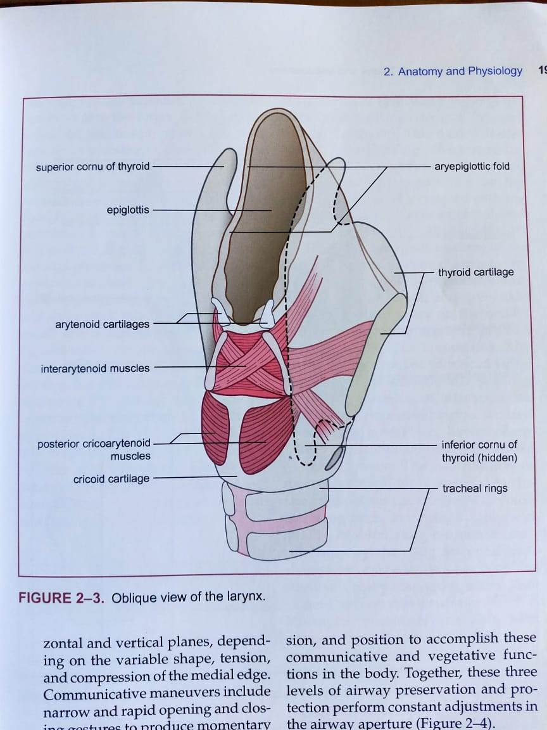
Thyroid Cartilage

Slide 14
Muscles of Larynx
Extrinsic Laryngeal Muscles
Intrinsic laryngeal Muscles

Slide 15
Cont..
Thyroarytenoid Muscle.
Posterior Cricoarytenoid Muscle.
Lateral Cricoarytenoid Muscle.
Arytenoid Muscles.
Cricothyroid Muscle.

Slide 16
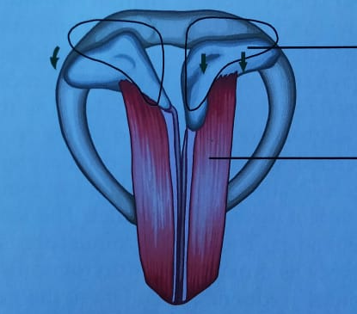

Slide 17
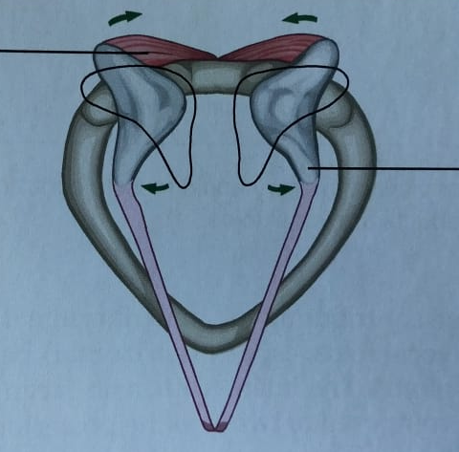

Slide 18
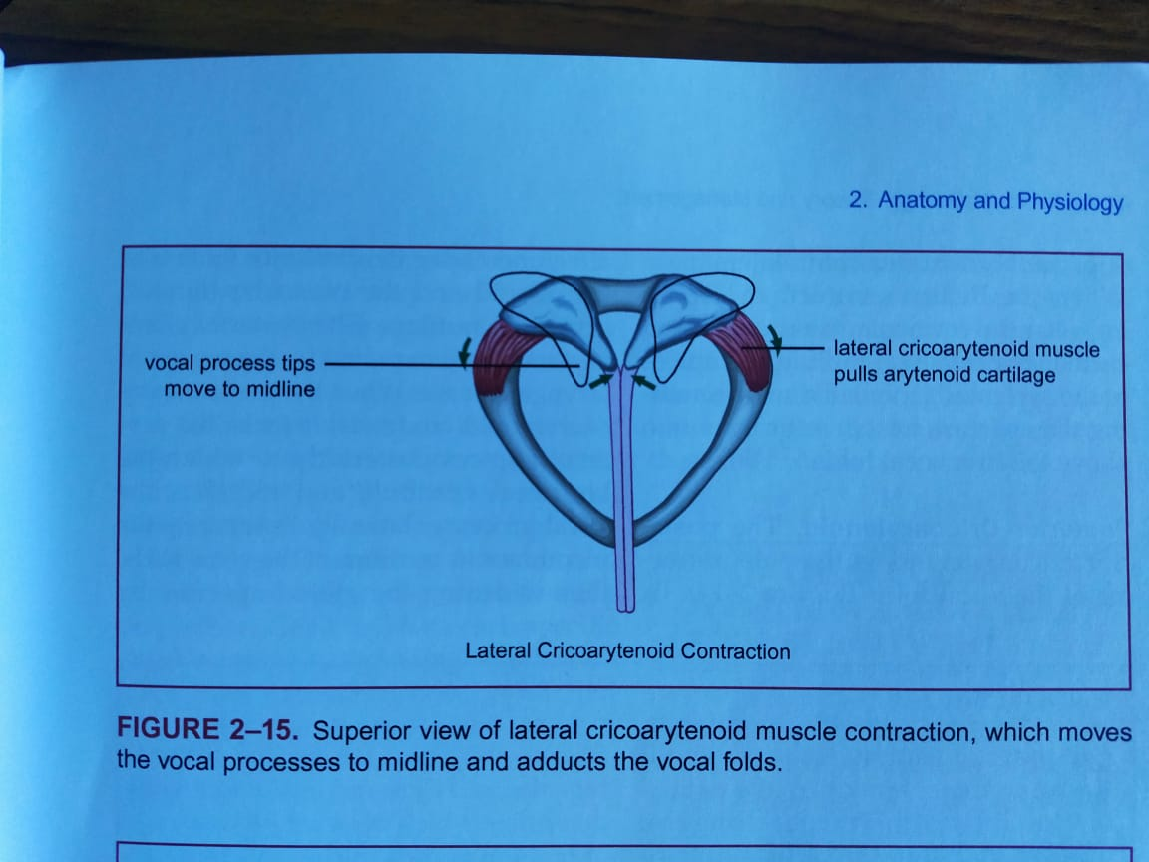

Slide 19
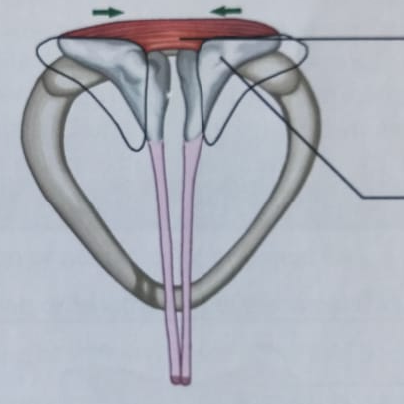

Slide 20
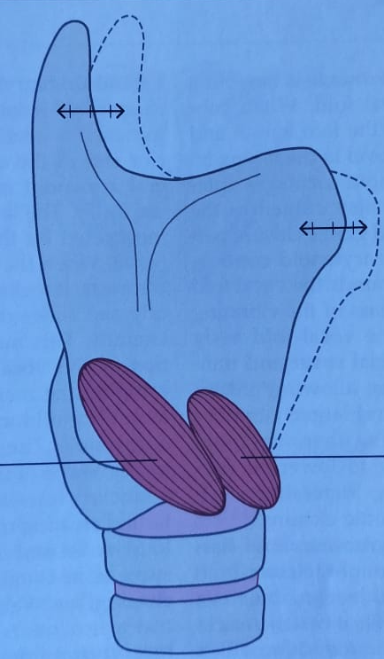

Slide 21
Classification Manual for Voice Disorders

Slide 22
Classification of Voice Disorder
Structural Pathologies
Inflammatory Conditions
Trauma or Injury
Systemic Condition
Aerodigestive Condition
Psychiatric or Psychological Disorder
Neurologic Voice Disorder
Other Disorder of Voice Use

Slide 23
Structural Pathologies
Malignant Epithelial Dysplasia of the Larynx
Benign Epithelial and Lamina Propria Abnormalities of the vocal fold.
  Vocal Nodules
  Vocal Fold Polyp and Cyst.
  Reinke’s Edema.
  Vocal fold Scaring.
Congenital and Maturational Changes affecting voice.
  Congenital webs.
  Laryngomalacia.
  Puberphonia.

Slide 24
Inflammatory Conditions
Cricothyroid and Cricothyroid Arthritis.
Acute Laryngitis.
Laryngoscopy Reflux

Slide 25
Trauma or Injury of the Larynx
Internal Laryngeal Trauma.
External Trauma and Arytenoid Dislocation.

Slide 26
Systemic Conditions affecting Voice
Endocrine Disorder.
  Hypothyroidism and Hyperthyroidism.
Immunologic Disorder.
  Allergies.

Slide 27
Nonlaryngeal Aerodigestive Disorder affecting voice.
Respiratory Disease.
GERD.

Slide 28
Psychiatric or Psychological Disorder affecting voice
Aphonia

Slide 29
Neurologic Voice Disorder
Palsy.

Slide 30
Other Disorder of Voice Use
Vocal Abuse and Misuse.

Slide 31
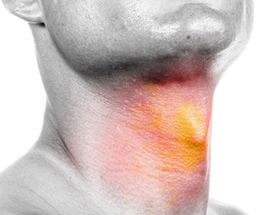
Sign and Symptoms of
Voice Disorder

Slide 32
The generic term dysphonia encompasses the auditory-perceptual symptoms of voice disorders. Dysphonia is characterized by altered vocal quality, pitch, loudness, or vocal effort.
Signs and symptoms of dysphonia include:
  roughness (perception of aberrant vocal fold vibration);
  breathiness (perception of audible air escape in the sound signal or bursts of breathiness);
  strained quality (perception of increased effort; tense or harsh as if talking and lifting at the same time);
  abnormal pitch (too high, too low, pitch breaks, decreased pitch range)
  abnormal loudness/volume (too high, too low, decreased range, unsteady volume);

Slide 33
Aphonia (loss of voice);
phonation breaks;

Slide 34
Assessment of Voice
Case History
Oral-Peripheral Examination
Assessment of Respiration
Auditory-Perceptual Assessment
Instrumental Assessment

Slide 35
Case History
Individual's description of voice problem, including onset and variability of symptoms.
Medical status and history, including surgeries, chronic disorders, and medications.
Previous voice treatment.
Daily habits related to vocal hygiene.

Slide 36
Oral-Peripheral Examination
Assessment of structural or motor-based deficits that may affect communication and voice, including strength, speed, and range of motion of oral musculature.
Assessment of symmetry and movement of structures of the face, oral cavity, head, neck, and respiratory system during rest and purposeful speech tasks.
Testing of mechano-sensation of face and oral cavity
Testing of chemo-sensation (i.e., taste and smell)
Assessment of laryngeal sensations (dryness, tickling, burning, pain, etc.) and palpation of extrinsic laryngeal musculature, as indicated.

Slide 37
Assessment of Respiration
Respiratory pattern (abdominal, thoracic, clavicular)
Coordination of respiration with phonation (breath-holding patterns, habitual use of residual air, length of breath groups)
Maximum phonation time (MPT; Dejonckere, 2010; Speyer et al., 2010)
s/z ratio to assess for glottal insufficiency, which may be indicative of laryngeal pathology (Eckel & Boone, 1981; Stemple et al., 2010)

Slide 38
Auditory-Perceptual Assessment
Voice Quality
  Consensus features assessed during production of sustained vowels, sentences, and running speech
    Roughness—perceived irregularity in voicing source
    Breathiness—audible air escape in voice
    Strain—perception of excessive vocal effort
    Pitch (perceptual correlate of fundamental frequency)—deviations from normal relative to age, gender.
    Loudness (perceptual correlate of sound intensity)—deviations from normal relative to age, gender.

Slide 39
Instrumental Assessment
Laryngeal Imaging
Acoustic Assessment
Aerodynamic Assessment

Slide 40
Laryngeal Imaging
Measures of structure and gross function (using videoendoscopy) and measures of vocal fold vibration during phonation (using videostroboscopy).

Slide 41
Videolaryngoendoscopy
Vocal fold edges—appearance of superior vocal fold edges during abduction.
Vocal fold mobility—movement of vocal folds toward and away from midline at level of cricoarytenoid joint during laryngeal diadochokinetic task.
Supraglottic activity—degree of compression of supraglottic structures during sustained phonation

Slide 42
Videolaryngostroboscopy
Regularity—consistency of successive glottic cycles
Amplitude—lateral movement of the vocal fold medial plane
Mucosal wave—independent lateral movement of mucosa over vocal fold
Left/right phase symmetry—symmetry of vocal folds (opening, closing, maximum lateral–medial excursion) during glottic cycle
Glottal closure pattern—glottal configuration during maximum closure
Glottal closure duration—relative proportion of glottal cycle in which glottis is closed

Slide 43
Acoustic Assessment
Acoustic measures can provide objective and non-invasive analyses of vocal function, if they are recorded and interpreted carefully.
Purpose of Acoustic Assessment:
  Discriminate between normal and disordered voice quality.
  Correlate with auditory-perceptual judgements of voice quality.
  Sufficiently assess change in performance across time.

Slide 44
Cont…
There are mainly five parameters which we include in Acoustic analysis:
  Fundamental Frequency, which is an acoustic measures of the perceptual judgement of pitch.
  Intensity, which is an acoustic measures of the perceptual judgement of loudness.
  Perturbation measures, which assess the cycle-to-cycle variation in the acoustic waveform for either frequency or intensity.
  A ratio of signal to noise, which reflects the relative contribution of periodic and aperiodic (noisy) components of the acoustic signal.
  Spectral features, which represent vocal tract harmonic energy.

Slide 45
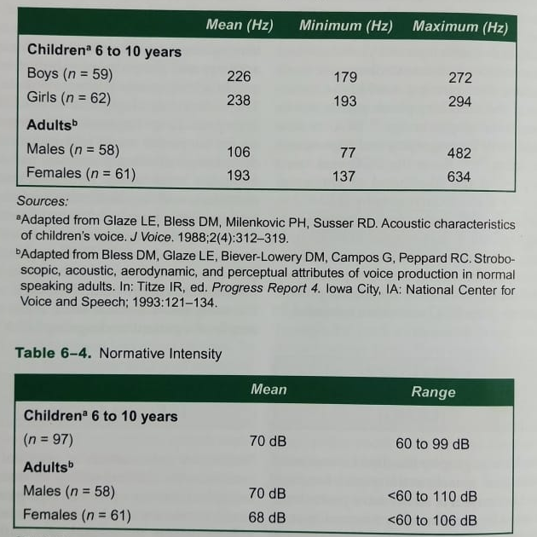

Slide 46
Cont.
Procedure of recording for Acoustic Analysis:
  For acoustic measurement, signal detection begins with a microphone. Vibrating sound waves oscillate against an internal diaphragm or other sensing device that connect electronically to an amplifier and eventually an output device, such a monitor and speaker.
  To ensure reliable speech and voice recordings, microphones should be positioned off centre from the mouth to avoid excessive aspirate noise, at a constant mouth-to-microphone distance of approximately 3 to 8 cm for sustained vowels.

Slide 47
Aerodynamic Assessment
Two Aerodynamic measurements, subglottic pressure and transglottic flow, assess physiologic vocal function indirectly and noninvasively. Both measures reveal information about the laryngeal valving mechanism, based on the integrated change of pressure and flow during vocal fold vibration.
Measures of subglottic pressure and transglottic flow have been used to discriminate normal and disordered vocal function, assess disorder severity, and even indicate the etiology of dysphonia. For example, an excessive average flow rate usually reflects an underlying glottal incompetence, whereas increased subglottic pressure measures are often associated with hyperfunctional voice use patterns.
Subglottic pressure
Transglottic flow

Slide 48
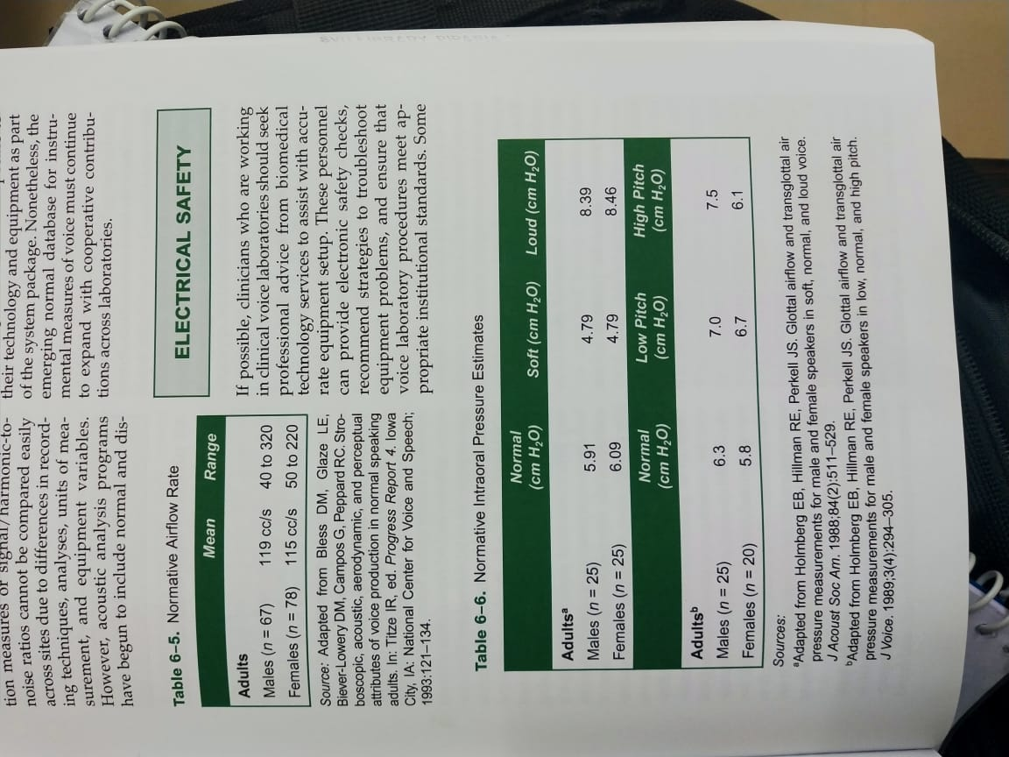

Slide 49
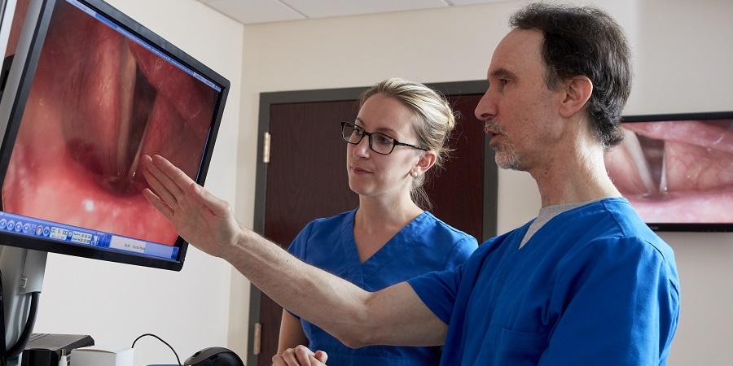
Management Procedure for Voice Disorder

Slide 50
Management of Voice Disorder
Management Team
Voice Therapy Orientations.

Slide 51
Management Team
Laryngologist
Voice Pathologist
Other Medical Professional

Slide 52
Voice Therapy Orientation
Treatment Approaches
Hygienic Voice Therapy
Symptomatic Voice Therapy
Physiologic Voice Therapy
Psychogenic Voice Therapy

Slide 53
Treatment Approaches
Approaches can be direct or indirect.
  Direct approaches focus on manipulating the voice-producing mechanisms (e.g., phonation, respiration, and musculoskeletal function) in order to modify vocal behaviors and establishing healthy voice production (Colton & Casper, 1996; Stemple, 2000).

Slide 54
Cont..
Indirect approaches modify the cognitive, behavioral, psychological, and physical environments in which voicing occurs (Roy, et al., 2001; Thomas & Stemple, 2007). Indirect approaches include the following two components:
  Patient education—discussing normal physiology of voice production and the impact of voice disorders on function; providing information about the impact of vocal misuse and strategies for maintaining vocal health (vocal hygiene)
  Counseling—identifying and implementing strategies such as stress management to modify psychosocial factors that negatively affect vocal health (Van Stan, Roy, Awan, Stemple, & Hillman, 2015)

Slide 55
Hygienic Voice Therapy
Hygienic Voice Therapy often is the first step in many voice therapy programs. Many etiologic factors contribute to the development of voice disorders. Poor vocal hygiene may be a major developmental factor.
Some examples of behaviors that constitute poor vocal hygiene include shouting, talking loudly over noise, screaming, coughing, throat clearing, and poor hydration.
When the inappropriate hygienic behaviors are identified, appropriate treatments can be devised for modifying or eliminating those behaviors. Once modified, voice production has the opportunities to improve or return to normal.

Slide 56
Symptomatic Voice Therapy
The focus of symptomatic voice therapy is on the modification of the deviant vocal symptoms or perceptual voice.
Daniel Boone was the first author to organize and introduce this symptomatic therapy to our profession.
  Chewing exercise.
  Digital manipulation.
  Open mouth exercise.

Slide 57
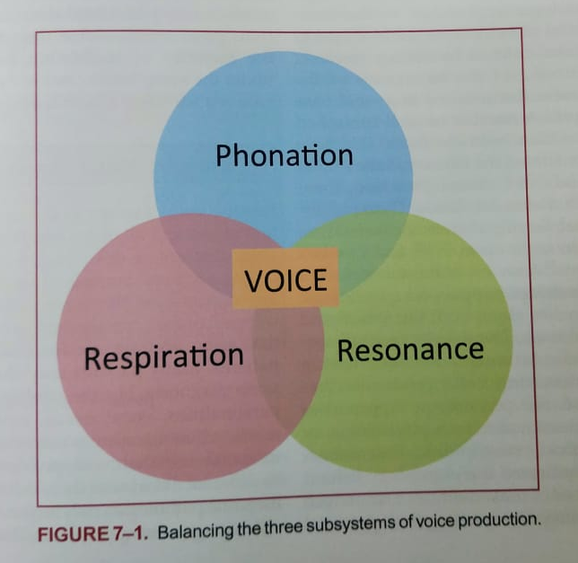
Physiologic Voice Therapy

Slide 58
Psychogenic Voice Therapy

