Slide 1
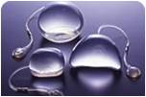
TISSUE EXPANSION
Dr. Sanjay Vaghani
Assistant Professor
Department of Plastic Surgery, SBKSMI & RC

Slide 2
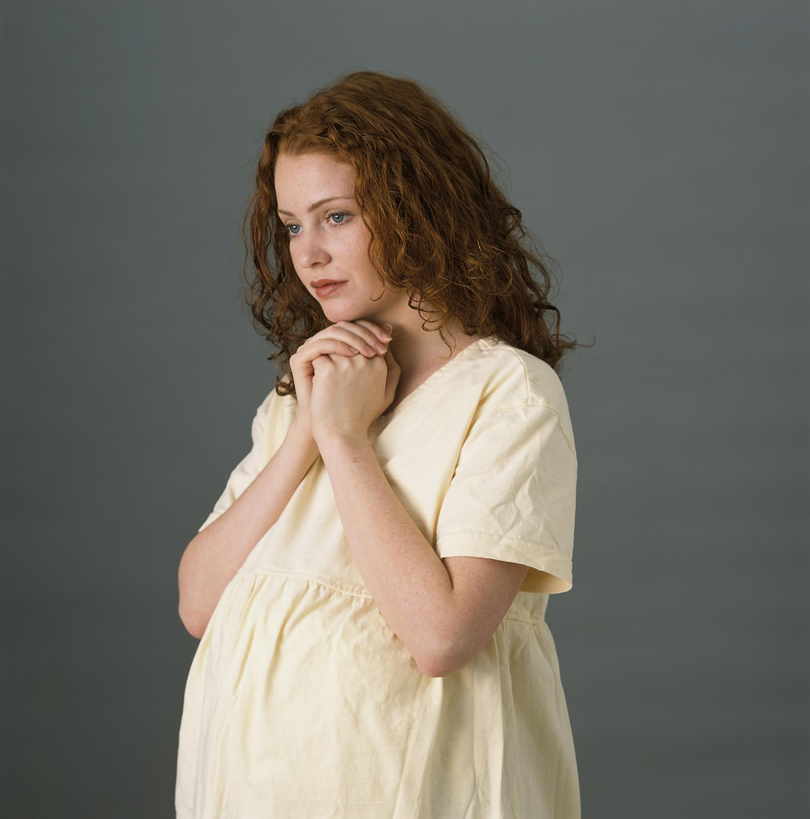
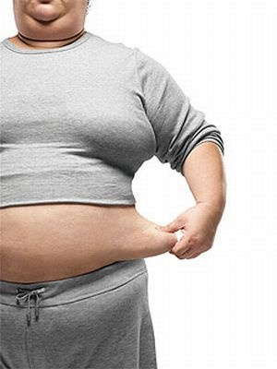
PHYSIOLOGICAL
PREGNANACY
OBESITY

Slide 3
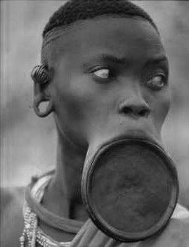


Slide 4
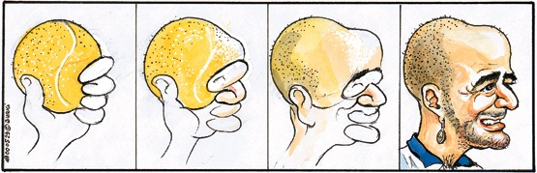
PRINCIPLE
“All living tissues respond in a dynamic fashion to mechanical stresses placed on them”

Slide 5
INHERENT EXTENSIBILITY
SERIAL EXCISION
PER OPERATIVE STRETCHING OF SKIN FLAPS.
CLOSURE OF ABDOMINAL WALL WITH SPECIAL SUTURES

Slide 6
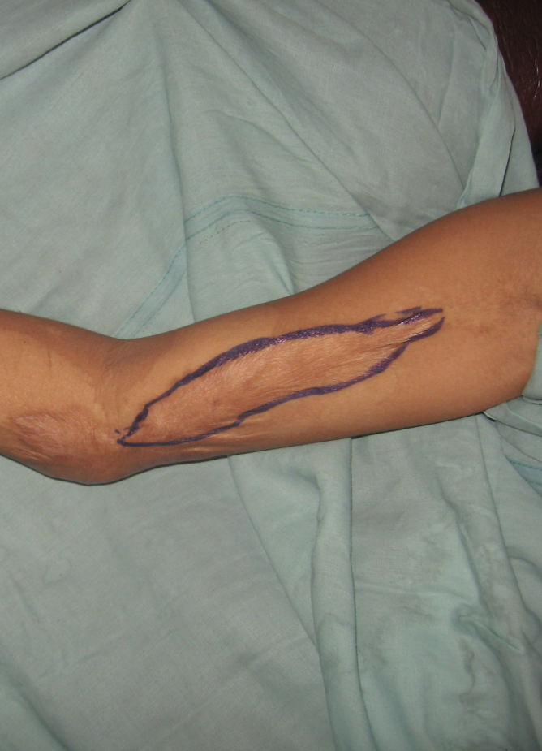
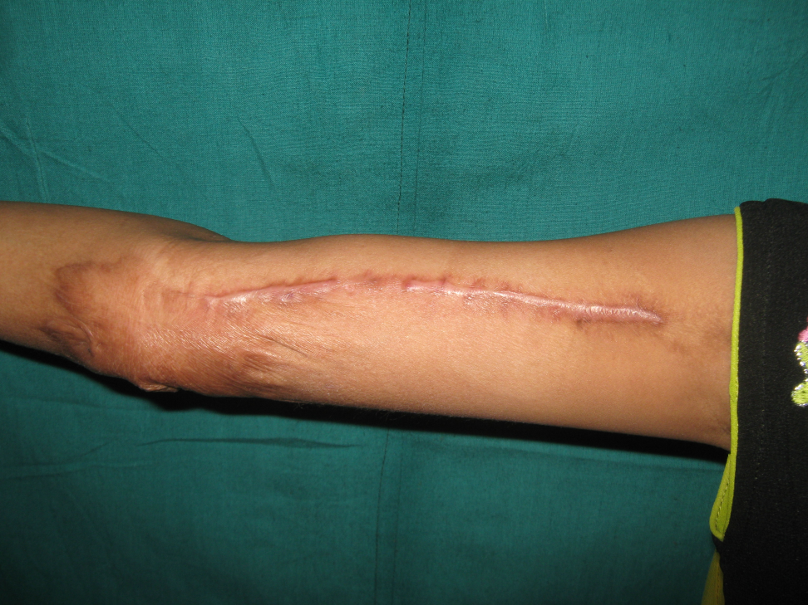
SERIAL EXCISION
BEFORE
AFTER

Slide 7
INTRODUCTION
An important advance in plastic
and reconstructive surgery
Reliable method of providing additional
cutaneous tissue with optimal matching
and to avoid unacceptable donor sites
Forms an important step of the reconstructive ladder
Helps in covering complex defects
Comparable to the ‘delay’ phenomenon

Slide 8
HISTORY
Distraction osteogenesis- Traction on tissues will lead to lengthening .
Putti- Applied this concept from bone to soft tissue. obtained lengthening of tissue by applying constant traction over tissues.
Charles Neumann(1956)- First surgeon to apply tissue expansion in practice.
reconstructed subtoatally avulsed auricle by expanding periauricular skin.
he used air inflated rubber ballon.

Slide 9
HISTORY
Chadomir Radovan(1976)
  Presented his experience with tissue expansion for breast reconstruction
  Designed the Radovan tissue expander which
  had a remote fill-valve connected to the
  inflatable sac by a small tube

Slide 10
HISTORY
  Eric D. Austad (1976)-
  Produced a self-inflating implant that would increase in volume by osmotically attracting extracellular water

Slide 11
Physiology
Constant mechanical stress to the skin
  Mechanical creep
    Cell is stretched
  Biological creep
    Cell proliferation, disruption of gap junctions
    Increased tissue surface area
    Restoration of the resting tension of the stretched tissue to baseline

Slide 12
Histology
Epidermis
  Thickness is increased
  Flattening of cells
  No increase in mitotic activity
The number of epidermal cells per surface unit is same in stretched and unstretched skin
Hence, epidermopoiesis is a said to be a
‘temporary activity with a lasting dividend’

Slide 13
Histology
Dermis
  More sensitive than epidermis
  Thickness is decreased (by about 20%)
  Myofibroblasts appear
  RE-ALIGNMENT OF COLLAGEN FIBERS
  Hyalinization of collagen fibers
  Increased collagen synthesis by fibroblasts

Slide 14
HISTOLOGY
Dermal appendages
  Hair
    Increase in distance between the hair follicles
    Number of hair follicles is constant
  Sebaceous glands
    Relatively insensitive
    Occasional blockage – inactivity / compression
  Sweat glands
    Some signs of blockage
  Arrectores pilorum muscle
    Rather insensitive
    Atrophy / necrosis after extreme expansion

Slide 15
HISTOLOGY
Subcutaneous fat
  Very sensitive
  Decreased thickness (up to 60%)
  Significant decrease in number of fat cells
Muscle
  Sensitive to stretching and pressure
  Atrophy, hyalinization, decreased striations
  No gross functional loss

Slide 16
HISTOLOGY
Capsule
  Initially, primary granulation tissue is formed
  (macrophages, fibroblasts and lymphocytes)
  Within 7 days, forms a double-layered capsule
    Cell-rich inner layer of macrophages
    Outer layer of fibroblasts and lymphocytes
  With time, the outer layer becomes more rich
  in collagen fibers
  Mean thickness : 3-4 mm

Slide 17
HISTOLOGY
Capsule
  Local factors – hematoma, mechanical factors,
  allergic reactions to talcum powder, suture material or
  gauze, local immunologic dysregulation, necrosis of
  overlying fat or muscular tissue
  Capsules around tissue expanders are thicker
  than those around other implants due to
  ‘recurrent tearing forces’ during inflation

Slide 18
HISTOLOGY
Vasularization
  Expanded tissue has a significantly increased
  vascularity (similar to classic delay)
  (Radovan et al, Cherry et al, Sasaki and Pang et al,
  Saxby et al, Leighton et al)
  No increase in vascularity or size of capillary
  bed of the expanded skin ( Van Rappard et al)
    It is the surgical procedure that induces a delay-like
    phenomenon leading to increased survival of
    expanded random pattern flaps

Slide 19
HISTOLOGY
Arteries and veins
  Rapid elongation without reduction in diameter
  or loss of intimal integrity
  Mean successful elongation of vessels
    84 +/- 47 % in six weeks
Nerves
  Tolerant to expansion
  Occasional condensation of perineurium
  Slight atrophy due to pressure
    Thinning of axons, segmental demyelinization, but
    no axonal degeneration

Slide 20
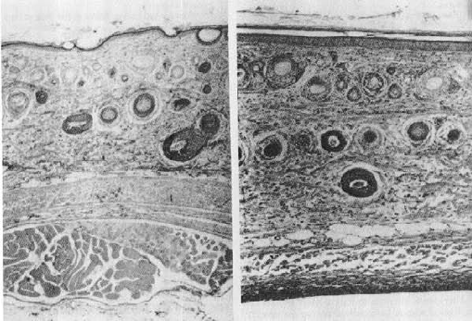
MICROSCOPIC CHANGES IN SKIN
Normal skin
Stretched skin

Slide 21
DYNAMIC PROCESS

Slide 22
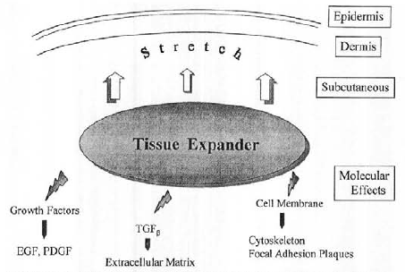
MOLECULAR EFFECTS OF TISSUE EXPANSION

Slide 23
INDICATIONS
Logical alternative when there is
requirement of additional tissue of specific
characteristics
When there is no other efficient or reliable
means

Slide 24
CONTRAINDICATIONS
Patient factors
  Not highly motivated
  Financial costs
Donor / recipient site factors
  Marginal donor site
  Scars, previous radiation (relative)

Slide 25
CONTRAINDICATIONS
Surgeon-related factors
  Labor and time-intensive process
  Experience and comfort level
Social factors

Slide 26
TISSUE EXPANDER SYSTEM
BALLOON
FILLING TUBES
CONNECTORS
VALVES

Slide 27
BALLOONS
Preshaped prosthesis that is filled with fluid through remote or an incorporated valve.
The envelope may posses either smooth or textured surface.
COMPOSITION- It is composed of silicone mainly.
Silicone is a synthetic polymer made by vulcanization of carbon oxygen and silica. The final product is in gel state. Rigid standards are set for its use as medical appliance.

Slide 28
BALLONS
TYPES-
STANDARD
DIFFERENTIAL
CUSTOM
ANATOMIC

Slide 29
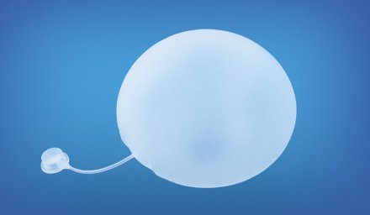
ROUND

Slide 30
STANDARD
ROUND EXPANDER- THESE COME IN VARIOUS CAPACITIES RANGING FROM 100 TO 2000CC.
PRODUCE HEMISPHERIC FLAP AFTER EXPANSION.
SKIN GAIN IS HALF THE BASE’S DIAMETER. LARGER THE BASE LARGER FLAP IS AVAILABLE DURING ADVANCEMENT.
USEFUL IN ROUND LESIONS AND IN HEAD AND NECK LESIONS.

Slide 31
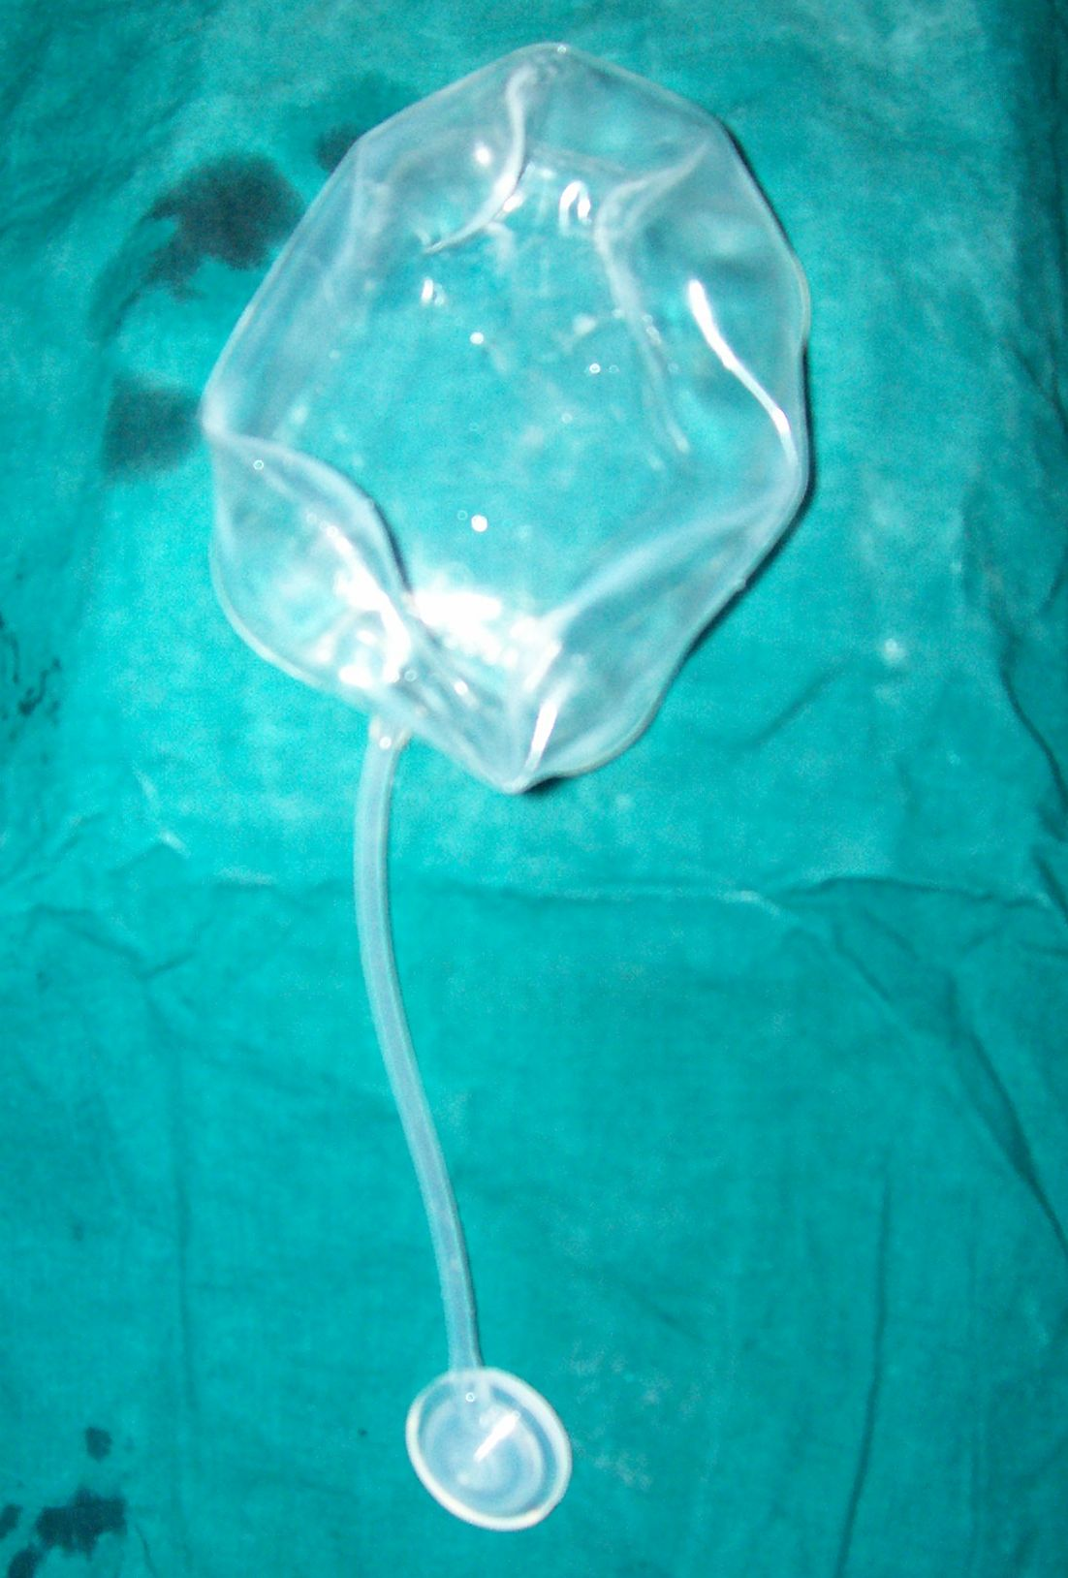
RECTANGULAR

Slide 32
STANDARD
RECTANGULAR- AVAILABLE IN VOLUMES OF 100 TO 1000 CC.
ON EXPANSION IT PRODUCES SAUSAGE SHAPED FLAP.
TISSUE GAIN IS HALF THE DOME’S WIDTH.
USEFUL IN SCALP, TRUNK AND EXTREMITY EXPANSIONS.

Slide 33
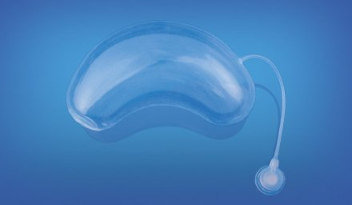
CRESCENT

Slide 34
STANDARD
CRESCENT SHAPED-RANGES FROM 100 TO 1000CC.
EXPANSION IS MORE AT CENTRE THAN AT PERIPHERY.
FOR ROUND SHAPED DEFECTS MINIMIZING DOG EAR .
TISSUE GAIN IS COMPARATIVELY LESS AS COMPARED TO OTHER SHAPED EXPANDERS.

Slide 35
DIFFERENTIAL
THESE WERE DESIGNED TO EXPAND IN MORE THAN ONE SITE WITH THE SAME EXPANDER.
THIS EFFECT IS OBTAINED BY ALTERING THE DUROMETER OF THE SILICONE ENVELOPE.
THESE ARE RARELY USED TODAY.

Slide 36
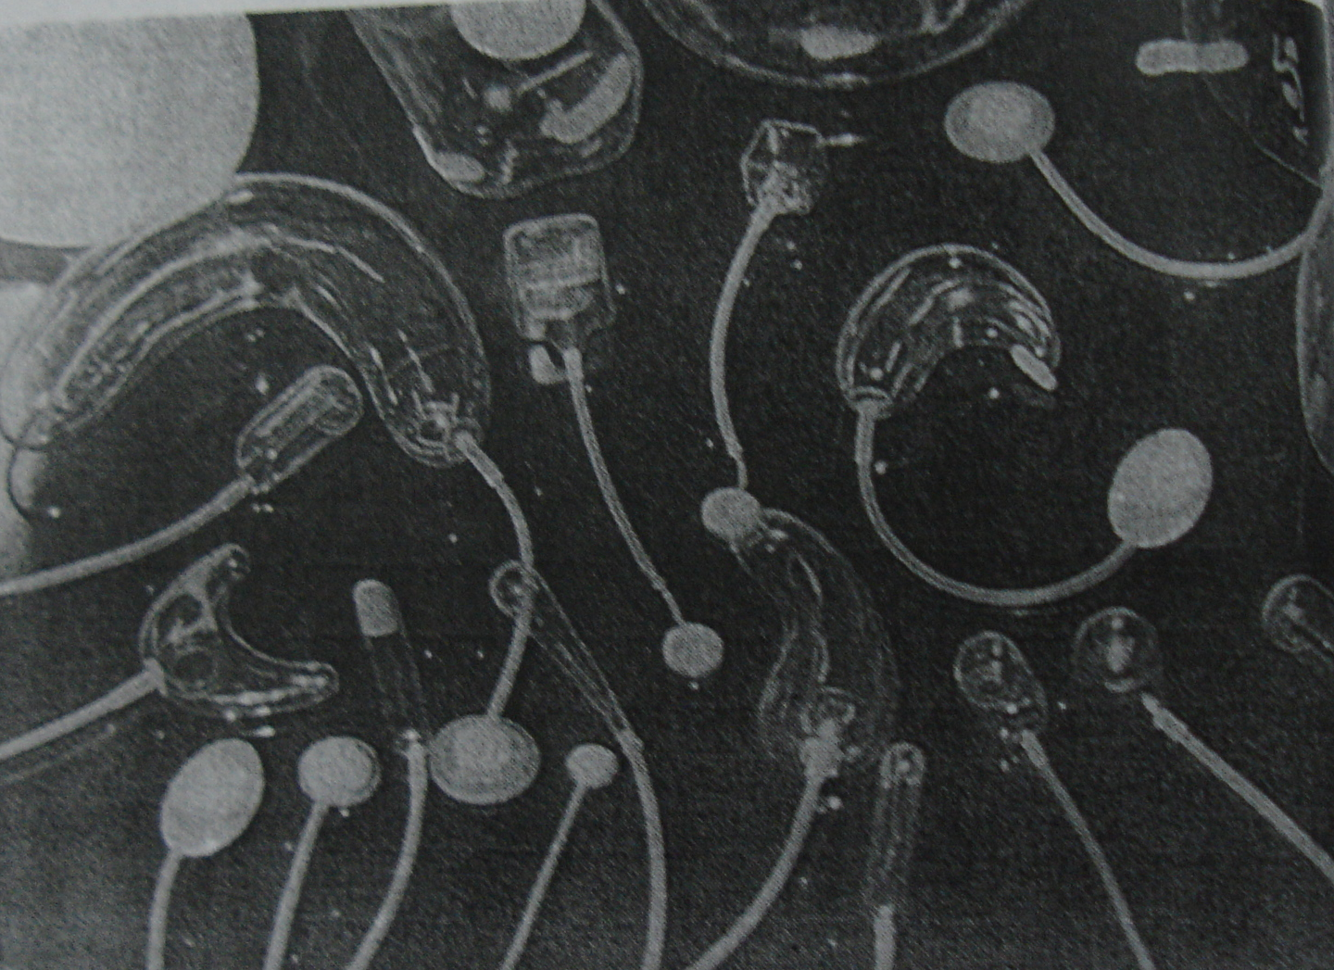
CUSTOM

Slide 37
CUSTOM
THESE ARE SPECIALLY MADE ACCORDING TO VOLUME LENGTH WIDTH AND PROJECTION REQUIRED.
PROVIDES GOOD OPTION FOR COMPLEX LESIONS.

Slide 38
ANATOMIC EXPANDERS
THESE ARE DESIGNED TO MIMIC PROJECTION AND SHAPE OF BREAST.
EXPANDER PERMANENT IMPLANT- IT IS VARIATION OF ANATOMICAL EXPANDER WITH IMPLANT.

Slide 39
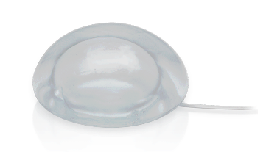
IMPLANT AND EXPANDER

Slide 40
FILLING TUBE
FILLING TUBE CONNECTS VALVE TO EXPANDER UNIT.
ENTERS EXPANDER AT LOWER THIRD, AT THE EDGE OF THE BASE, THE CENTER OF THE BASE.
IT OFFERS VERSATILITY IN PLACEMENT OF SYSTEM.

Slide 41
VALVES
VALVES PERMIT SALINE INJECTION INTO EXPANDER WITHOUT BACKPRESSURE LEAKAGE.
TYPES-
INCORPORATED
INTERNAL REMOTE
EXTERNAL

Slide 42
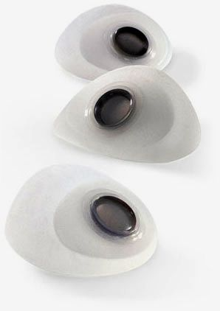
INCORPORATED

Slide 43
INCORPORATED
May require sonographic guidance to locate the port.
Repeated trauma to the expanding skin flap through needle sticks may injure the flap and even lead to expander exposure.
commonly used for breast and permanent expanders.

Slide 44
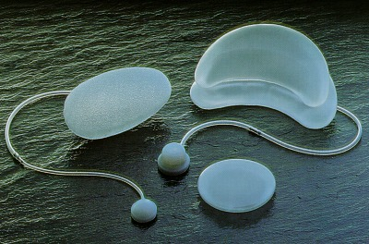
Distal inflation port type

Slide 45
Self expanding tissue expanders (SETE)
A sealed outer envelope, constructed of Silicone rubber permeable to extra cellular body fluids.
A material which establishes a high osmotic pressure is placed within the envelope.
This induces the passage of extra cellular body fluid into the envelope.

Slide 46
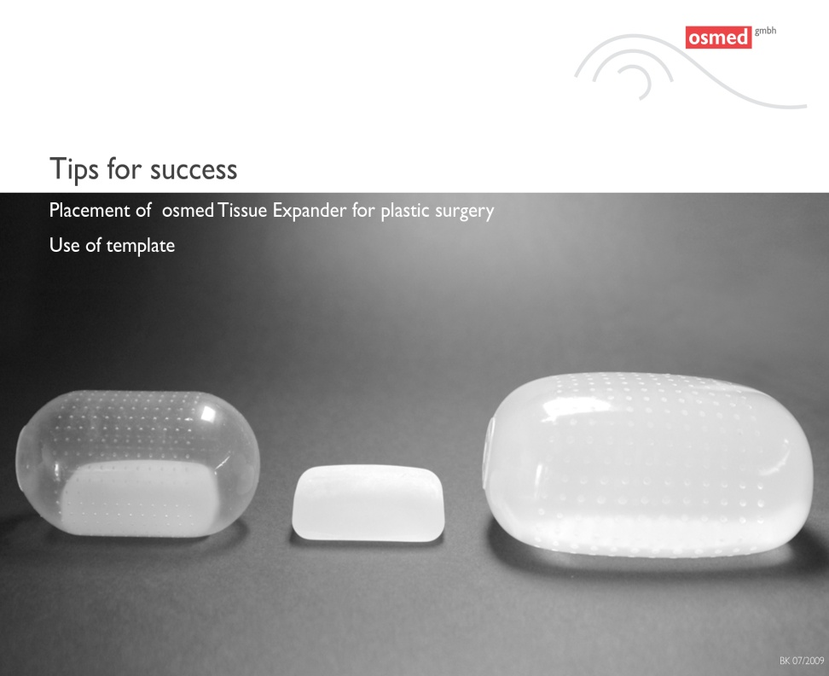
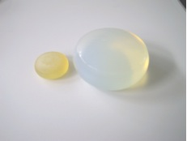
S.E.T.E.

Slide 47
Advantages (SETE - specific)
The size is about 10% of its final volume ~ requires a smaller incision.
No need for external fillings ~ minimal infection, fewer follow-ups, no painful inflations, good for kids and pain intolerants.
Minimizes patient discomfort with no periodic large volume filling.
Small size ~ less tissue trauma ~ decreased incidence of seroma, hematoma.

Slide 48
DISADVANTAGES
IRREGULAR EXPANSION
DIFFICULT TO ASSES PREOPERATIVELY AMOUNT OF EXPANSION.

Slide 49
Geometric planning
Place of the expander
Shape
Size
Projection
Number
Incisions for insertion
Planning of flaps
Amount of yield

Slide 50
PLANNING
Place of expander
  Close and parallel to the longest side(s) of the
  lesion to be removed
  Most nonmobile area available
Shape of expander
  Depends on the initial size and shape of the
  implant, thickness and tension of the overlying
  tissue, shape of the underlying base
  Choice of initial shape depends on the shape and size of the defect and the flaps planned to use

Slide 51
PLANNING
  Hemispheric expander on flat surface
    Rotation flaps with relaxing incisions at base
  Hemispheric expander on convex surface
    Advancement flaps
  Rectangular expander
    Advancement flaps with relaxing incisions
  Spindle-shaped expander on convex surface
    Advancement flaps without extra relaxing incisions
  Crescent-shaped expander
    Good for round lesions

Slide 52
Size of expander
Same size (Morgan and Edgerton et al, Radovan et al)
2.5 to 3 times the defect
(Gibney and van Rappard et al)
  Tissue expanders are 3-D objects
  Hence, the volume needs to be converted
  surface area to select the proper size
  Preoperative selection is often erroneous
  It is wise to use the largest possible expander
  depending on the anatomy of the donor area

Slide 53
  Mechanical creep – stretch-back phenomenon
  Significant decrease in the surface area gained
  Over-expansion upto 1.5 times the stated nominal capacity is perfectly safe
  Not to excise the area to be reconstructed before trial advance of the expanded tissue is performed

Slide 54
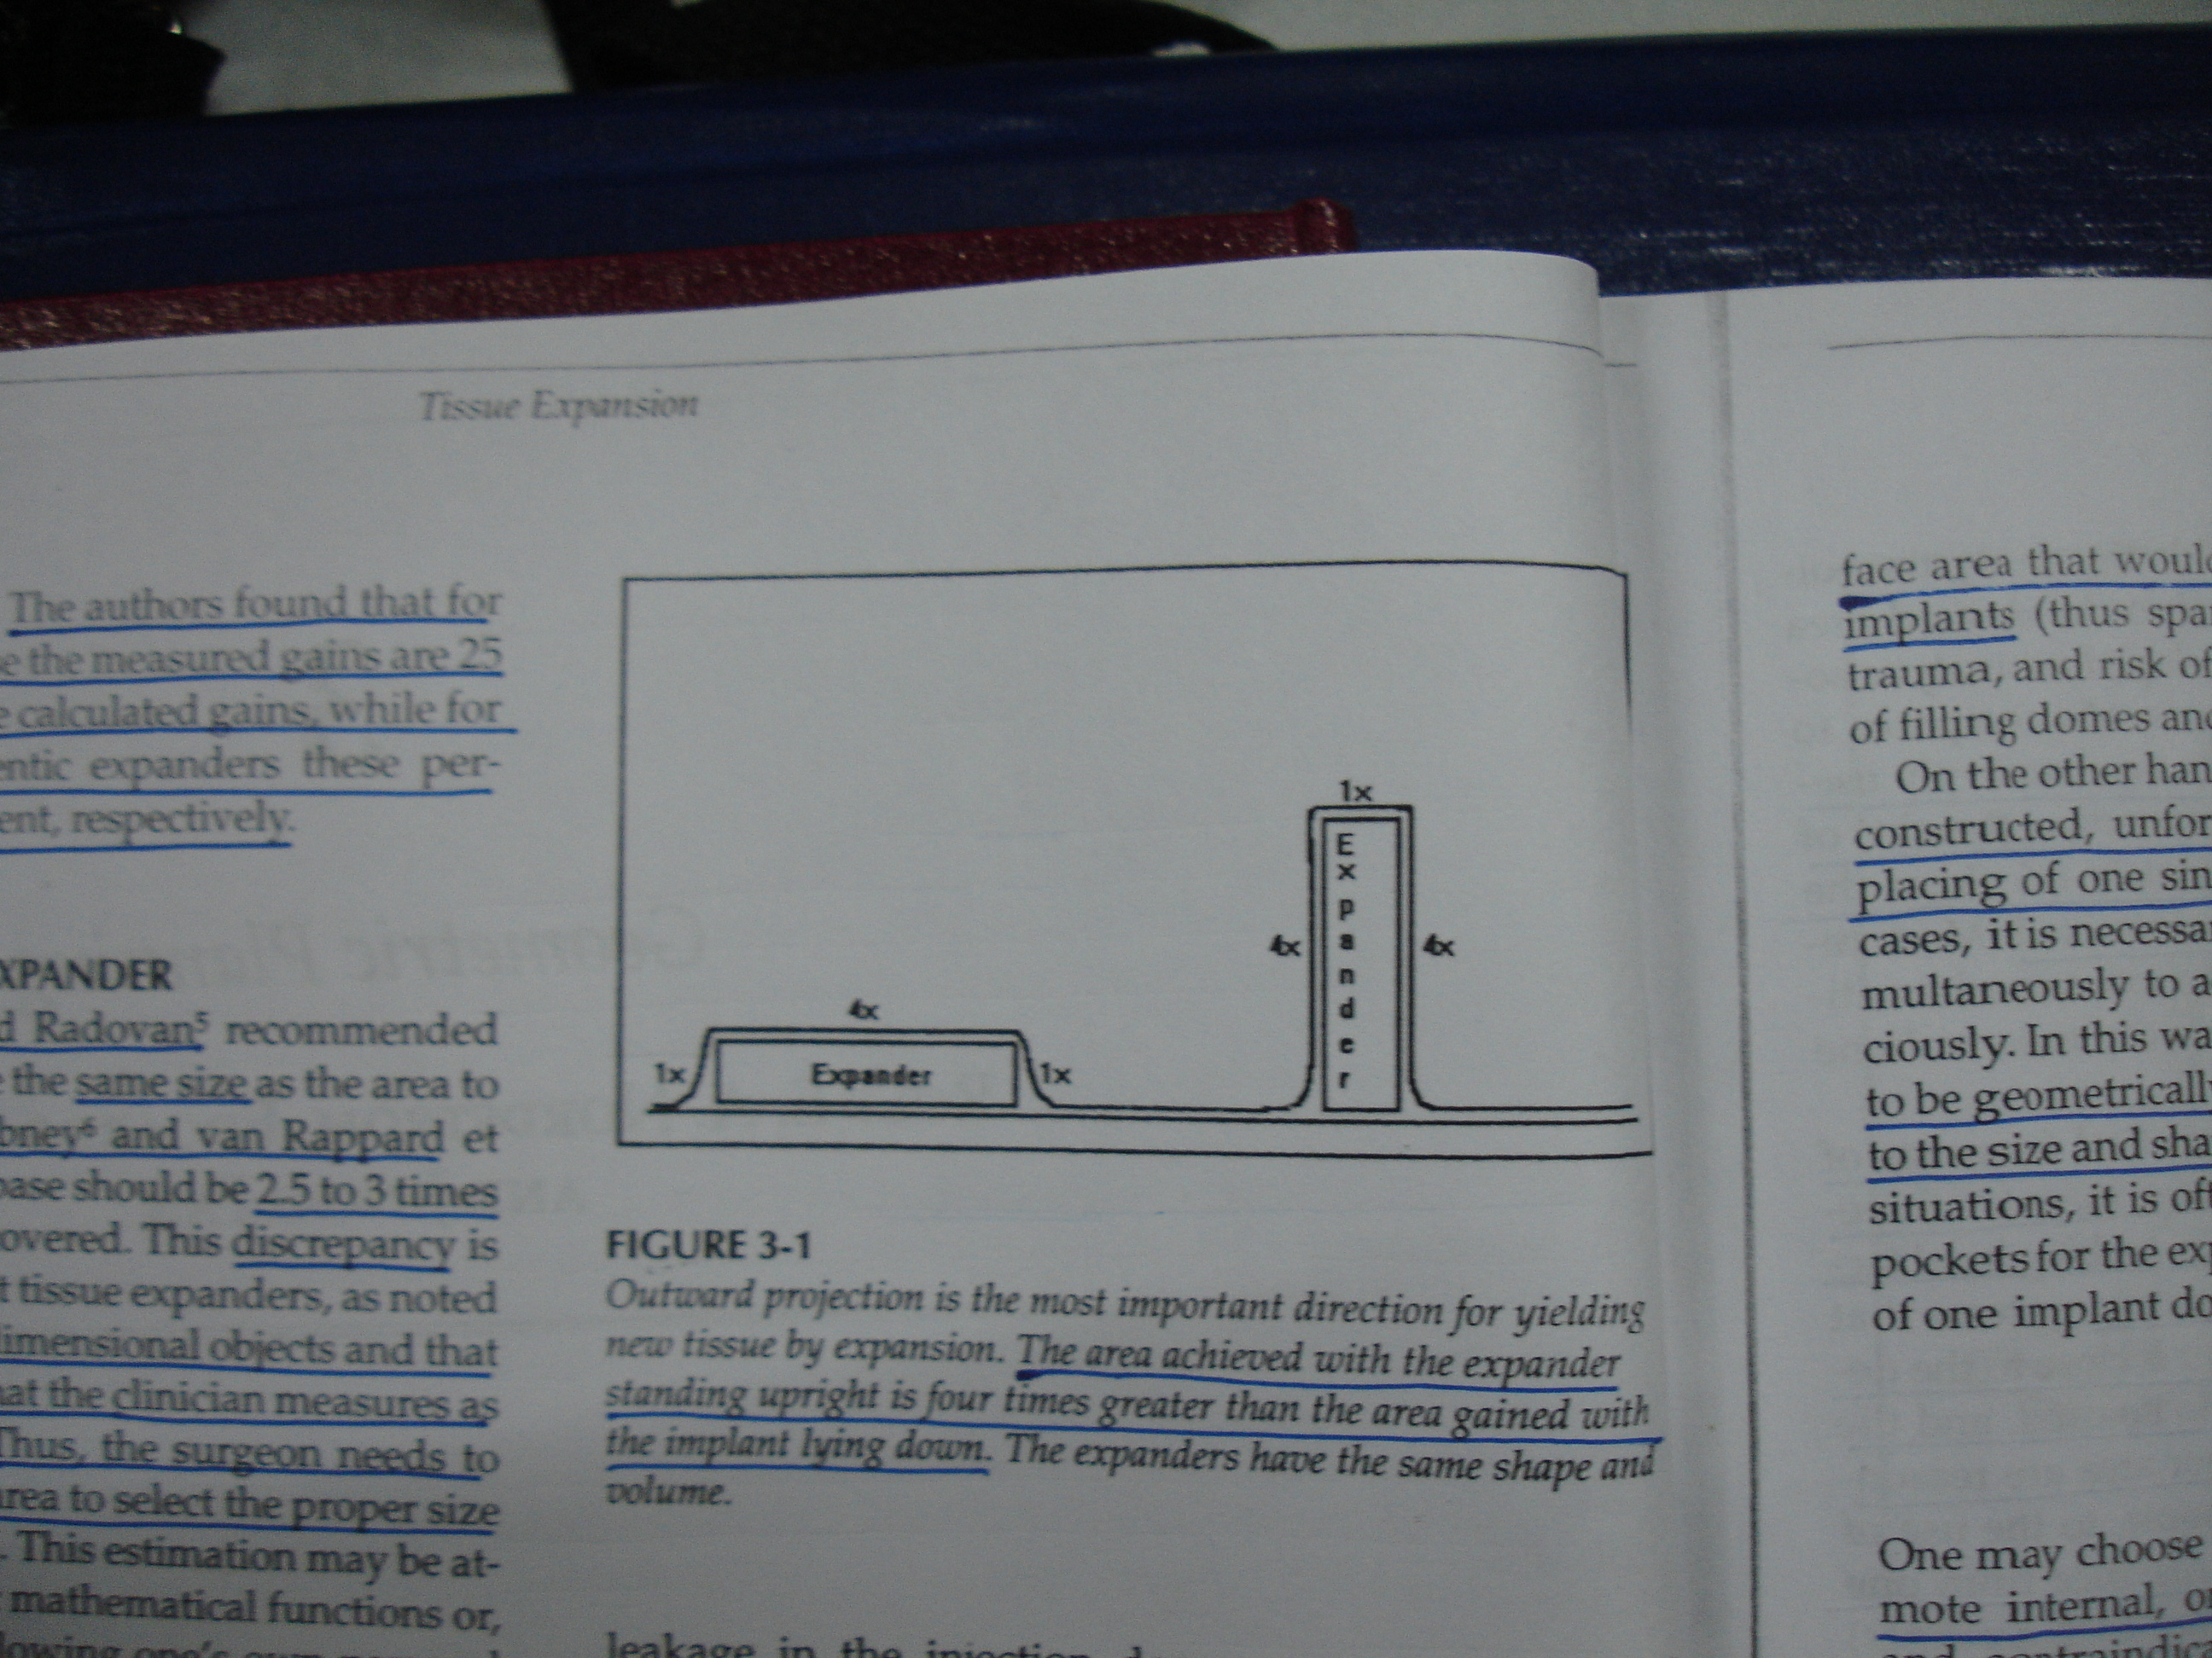
PROJECTION OF EXPANDER
It is the most important direction of expansion to gain the maximum amount of tissue
Flat expansion produces minimum tissue
  Expander and fill are same
  Area achieved with higher projection is greater

Slide 55
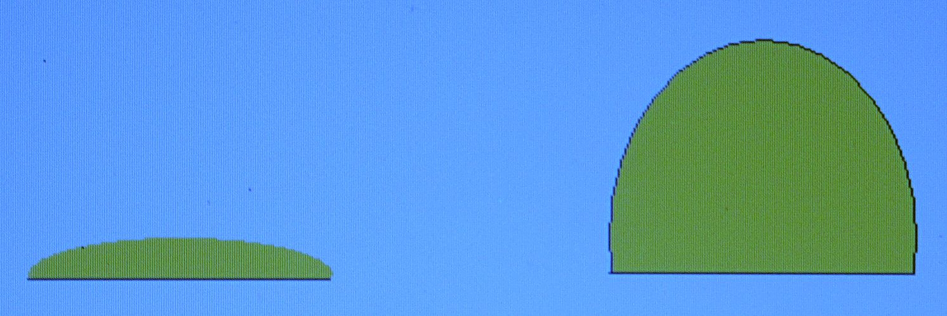
VOLUME AND SIZE
X !
Y !
X
Y
X Y – Tissue expander base
X! Y! – Circumference of expanded tissue
( X! Y! ) – (X Y) = Net tissue gain
Net tissue gain > the area to be covered

Slide 56
VOLUME AND SIZE
A _{c} = A _{d} +πr² + area of rotation
V = 1/6 √A _{d} / π (A _{d} + 3πr²)
h = √A _{d} / π ≈ 0.6√A _{d}
A _{c} - surface area of a convex surface of a sphere
A _{d} - A _{d} is the surface area of the recipient defect
r - radius of the base
V - volume
h - height of the spherical tissue expander

Slide 57
VOLUME AND SIZE
The area gained in a spherical tissue expander is related to its height and has no correlation with its radius/diameter.(Duits et al)
Area gained in a spherical expander = πh²
Volume of a spherical expander = 1/8 πd² h + 1/6 πh³

Slide 58
VOLUME AND SIZE
Surface gain in various expanders
Spherical-25%
Rectangular-38%
Crescent-32%
They concluded that mathematical calculations can only guide the choice of an expander. The dimensions calculated need to be multiplied by an appropriate factor for round (6), rectangular (3.75) and crescent-shaped (4.5) expanders

Slide 59
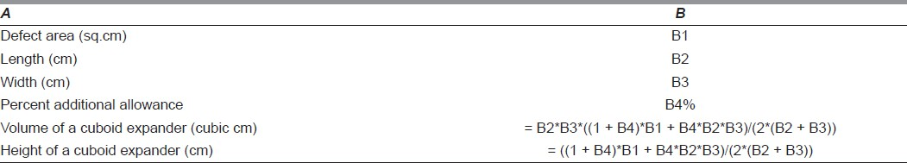
For rectangular expanders

Slide 60
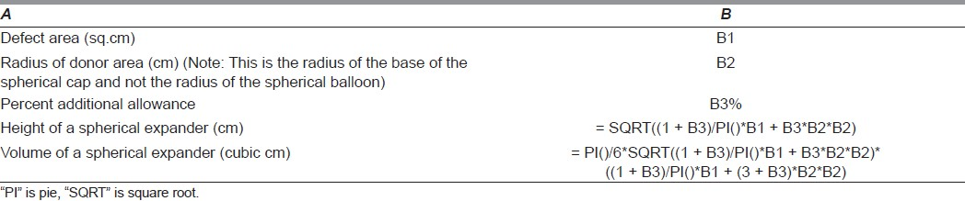
Spherical expander

Slide 61
Volume and size
Computer aided determination
3d photogrammetry
It requires a sound clinical judgement to finally decide the shape and size of the expander.

Slide 62
NUMBER OF EXPANDERS
  For irregular defects, two or more expanders
  may be used simultaneously
  The defect has to be geometrically split into
  various figures according to the size and shape
  of the expanders inserted
  A larger custom-fitted implant is more efficient than several small expanders

Slide 63
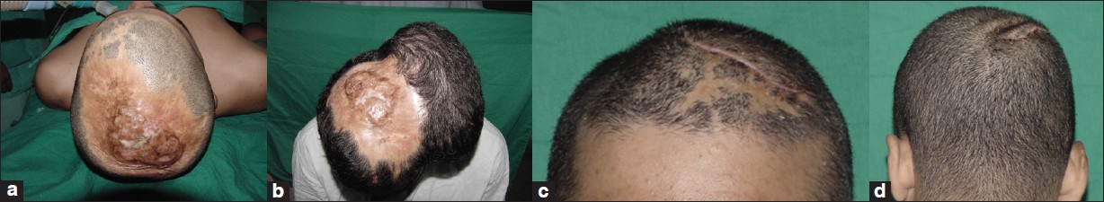
SINGLE LARGE IMPLANT

Slide 64
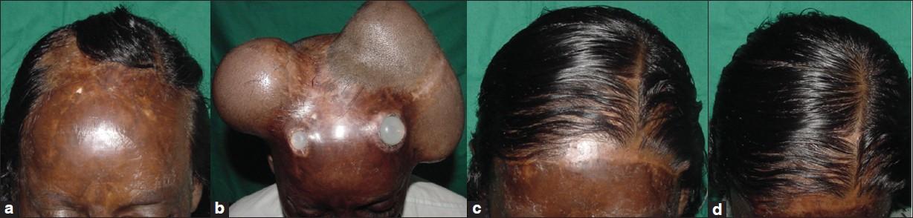
TWO IMPLANTS

Slide 65
NUMBER OF EXPANDERS
  Less time, pressure and volume are needed in a large expander to gain the same surface area that would be attained from several smaller implants.

Slide 66
INCISIONS
  Are of considerable importance
  Have an impact on the start of the expansion
  and also the rate of complications
  Should be incorporated into the projected
  incision ultimately left by implant removal and
  flap rotation or advancement
  Should not compromise the blood supply of the
  expanded tissue
  Should not compromise the possible
  alternative flaps

Slide 67
INCISIONS
INTRALESIONAL
PARALESIONAL
REMOTE

Slide 68
PLANNING OF FLAPS
Most crucial for optimum use of expansion
  Very often an advancement flap is used
    No additional scars are created
  In triangular lesions or when transposition
is required, the expander should be placed
parallel to the longest side of the lesion
  Single and double back-cut flaps
  (Zide and Karp et al)
  The width of the implant base helps determine
  the position of the back-cut (usually the
  middle of the expander)

Slide 69
FILLING POLICY
Outpatient procedure
Normal saline is used
Air or other gases are not used
  Uncontrolled volume
  Unstable intraluminal pressure
  Risk of air embolism
A normal syringe with 23-25 gauge needle
Filling kit – for multiple expanders

Slide 70
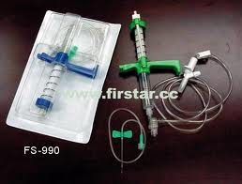
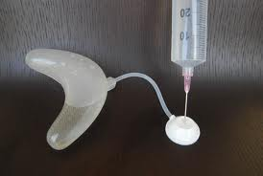
FILLING OF IMPLANT

Slide 71
FILLING POLICY
First filling
  In the operating room
  Obliterates the dead space
  Decreases risk of hematoma, seroma, and
  infection
  Checks for leaks, kinking of the tube
  10% of the expander nominal volume
Subsequent fillings
  10-20% of the expander nominal volume
  Intervals ranging ½ to 2 weeks

Slide 72
FILLING POLICY
Under strict aseptic conditions
In children, EMLA may be used
The needle penetrates the skin at 90
degree angle
Communicate with the patient regarding pain and discomfort
Filling is continued till
  Patient complains of pain
  Blanching of skin
Withdrawal of small amount of saline

Slide 73
MONITORING
Major parameters
  Intraluminal pressure
  Circulation of the expanded tissue
Subjective evaluation
  Pain
  Skin blanching
  Implant pressure by palpation
  Capillary refill

Slide 74
MONITORING
Objective evaluation
  Intraluminal pressure monitoring
    Hand-held pressure monitor system
    Sterile, disposable tissue expander monitor set
  Skin tensionmetry
  Transcutaneous pO2 measurement
  Laser doppler flowmetry

Slide 75
OTHER TECHNIQUES
Rapid tissue expansion (Marks et al)
  Maximal tolerable volume each day for 7-10 days
  May cause loss of skin sensitivity
Overfilling technique
  Pressure increase to a point at which the dermal capillary flow is zero or patient experiences severe discomfort
  Average volume gain of 59%

Slide 76
OTHER TECHNIQUES
Continuous tissue expansion
  Filling pressure is maintained slightly less than capillary filling pressure for few days
  Using controlled continuous tissue expansion pump system
Cycled hyperinflation
  Cyclical hyperinflation and deflation at each filling session

Slide 77
INTRAOPERATIVE TISSUE EXPANSION
Sasaki, 1987
Intraoperative sustained limited expansion (ISLE)
  Cyclic loading of temporary expanders
  Filling till tissue tolerance, maintained for 2-3 minutes
Some value in harnessing the visco-elastic properties of the skin
Abramo et al – used in cleft palate repair

Slide 78
MAJOR COMPLICATIONS
During placement
  Skin damage during undermining
During filling
  Anaphylactic foreign body reaction
  Infection, unbearable pain
  Exposure through incision / necrosis of skin
  Invincible capsule
  Psychological problems
  Prosthesis related problems – disconnection, leakage
During or after removal
  Necrosis of expanded flap
  Inadequate expansion
  Venous air embolism

Slide 79
MINOR COMPLICATIONS
During placement
  Apparent injury of the implant
  Excessive bleeding
During filling
  Hematoma, seroma
  Pain
  Valve problems – displacement, leakage, exposure
  Organ compression – bone, rib, skull, nerves, vessels
  Alopecia (temporary)
  Striae
During or after removal
  Hematoma, seroma, ulceration, rupture of suture lines
  Dog-ears, spreading of scars
  Numbness of expanded skin

Slide 80
CLINICAL APPLICATIONS

Slide 81
TOLERANCE OF TISSUES
Scalp (tolerant)
Breast
Trunk
Face
Neck
Back
Upper leg
Upper arm
Fore-arm
Lower leg (intolerant)

Slide 82
SCALP RECONSTRUCTION
Second most frequent expanded region
Common indications
  Large congenital naevi
  Scars
  Skin graft alopecia
  Adjunct to craniofacial reconstruction
Subgaleal plane with port in preauricular region
Temporary cranial molding occurs, self-corrects within 3-4 months

Slide 83
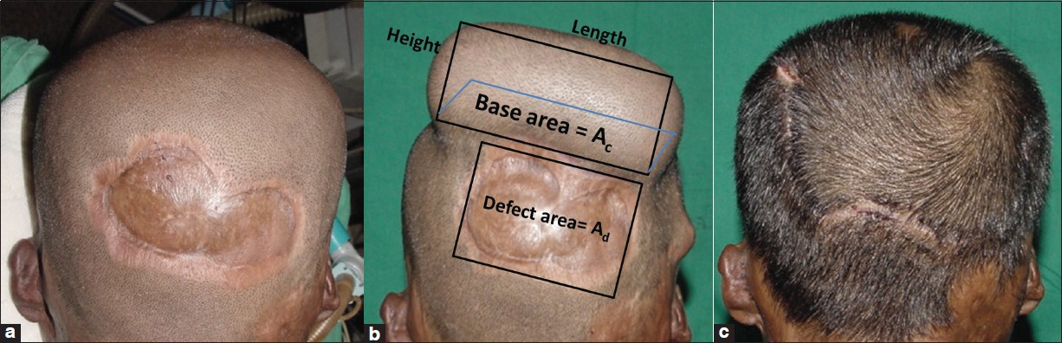

Slide 84
FACE AND NECK
Facial and neck skin is of 3 distinct types
(Argenta and Austad et al,1990)
  Forehead and nose – thick skin, few hair follicles,
  numerous sebaceous glands
  Periorbital region – thin and pliable skin,
  few sebaceous glands
  Cheeks, upper lip, neck – thin skin, numerous hair
  follicles, few sebaceous glands
For optimum aesthetic and functional result
  Adherence to ‘subunit principle’
  Tissue expander and flap incisions so that final scars are hidden in natural creases

Slide 85
FACE AND NECK
Most of the defects are amenable to
  primary closure
  Sasaki’s method (ISLE)
Forehead
  Convex surface is receptive to advancement or
  rotation of hemispherical flaps
  Unusually severe pain is more frequent
  Complication rate is high
    Brow asymmetry, brow ptosis,
    Altered hair direction, anterior hairline asymmetry

Slide 86
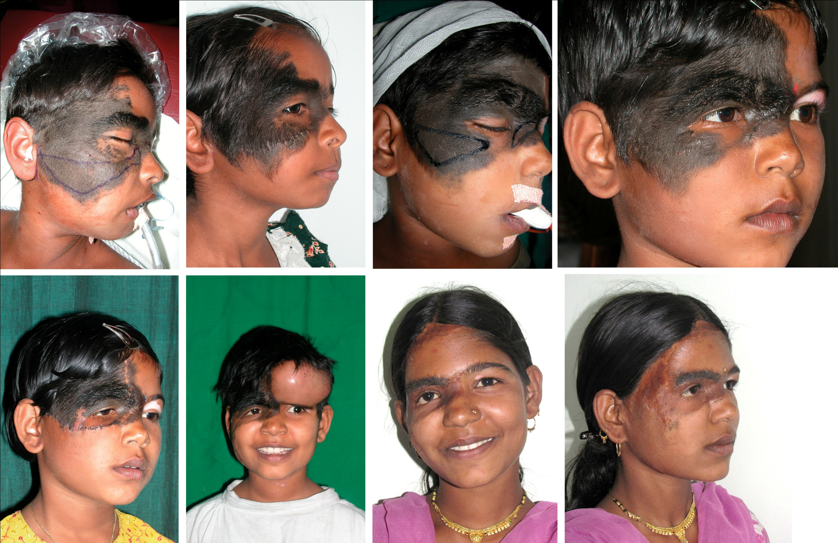

Slide 87
NOSE
Requires thin, hairless skin that will not conceal the contour of the underlying structures
Reconstructive options
  Forehead flap – ideal skin texture, thickness, color
  match, and vascularity
  Others – scalp flaps
  brachial flaps (Tagliacotian or Italian technique)
  cervical flaps
  acromiopectoral flaps
  deltopectoral flaps

Slide 88
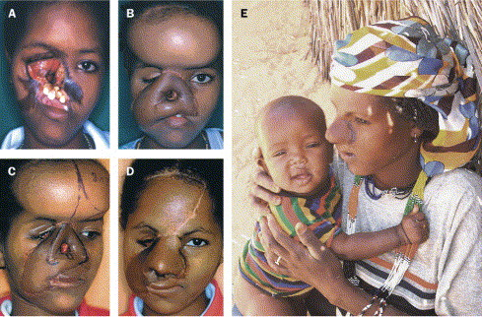

Slide 89
AURICLE
Ear reconstruction
  Microtia
  Post traumatic ear loss
Problem –
  lack of adequate amount of pliable, well vascularized,
  and hairless skin to cover the reconstructed framework
  Cosmetic results
Tissue expansion has helped immensely
by providing the desired skin cover

Slide 90
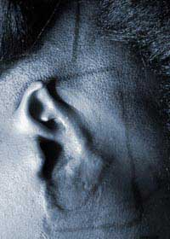
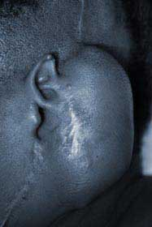

Slide 91
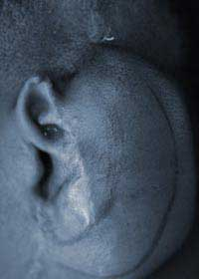
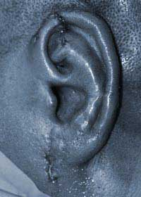

Slide 92
TRUNK
Indications (apart from breast reconstruction)
  Giant naevi
  Vascular malformations
  Contour defects
Lower abdomen is perhaps the most easily
expanded site
Uses – excision of adjacent lesions,
donor tissue for expanded free tissue transfer,
donor site for large, expanded, full-thickness grafts
Lower back expansion – for buttocks
Lower abdomen expansion – for anterior thigh

Slide 93
BREAST
Expanders and expandable implants
  Post mastectomy reconstruction
  Congenital anomalies
Have been used as ‘spacers’ during delayed primary breast reconstruction

Slide 94
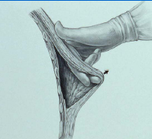
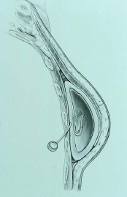
BREAST AUGMENTATION

Slide 95
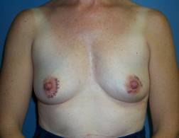
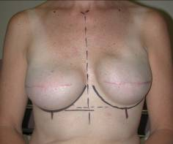
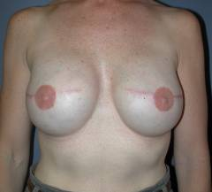
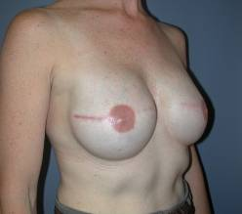
(Top) Preoperative and post-expansion, with full expanders in place.
(Bottom) Permanent textured, shaped silicone gel implants in place.

Slide 96
BREAST
Congenital anomalies
  Poland syndrome
  Idiopathic unilateral breast hypoplasia
  Iatrogenic asymmetry (juvenile breast bud
  damage)
Early reconstruction is now demanded by
today’s adolescent female
Expander can be placed as early as the opposite breast begins to develop and expanded over time
Later it can be replaced by a permanent implant and balancing procedures may be done

Slide 97
EXTREMITIES
Unfavorable donor site for expanded flaps
Complication rate is significantly high
Unstable, infected wounds are relative contraindications

Slide 98
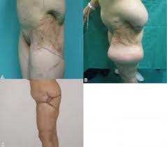

Slide 99
BURNS
USE OF TISSUE EXPANSION IN BURNS ESPECIALLY SCALP AND FACE HAS REVOLUTIONIZED TREATMENT.
THERE IS ALMOST ALWAYS PAUCITY OF TISSUE AFTER BURNS.
RECONSTRUCTION TO BE CARRIED OUT ONLY AFTER SCARS HAVE BEEN COMPLETELY MATURED.
FLAPS ARE PLANNED IN SUCH A WAY THAT SUTURE LINES ARE NOT PARALLEL TP PREVIOUS SCARS.
MULTIPLE PROSTHESES PREFERRED OVER SINGLE LARGE ONE.
GOOD ANTIBIOTIC COVER REQUIRED.

Slide 100
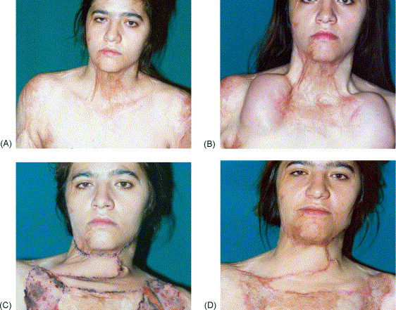

Slide 101
CHILDREN
SKIN AND SOFT TISSUES ARE THINNER IN CHILDREN.
THEY ARE BETTER VASCULARIZED BUT LESS RESISTANT TO TRAUMA.
COMPLICATION RATES ARE HIGHER IN CHILDREN.
SCALP EXPANSION MAY LEAD TO EROSION OF SKULL. IT IS USUALLY DONE AFTER 1 YR OF AGE.
TOLERANCE TO PAIN IS ALSO PROBLEM IN CHILDREN.
EXTERNAL VALVE PREFERRED IN CHILDREN TO AVOID PAIN DURING EVERY EXPANSION.

Slide 102
FULL THICKNESS GRAFT
THE LIMITED AREAS FROM WHICH FULL THICKNESS GRAFT CAN BE HARVESTED WITHOUT DONOR SITE DEFECT MAKES THEIR USE LIMITED.
VERY USEFUL IN FACE AND HAND RECONSTRUCTION.
TISSUE EXPANDERS CAN INCREASE THE SIZE OF FULL THICKNESS GRAFT WITHOUT DONOR SITE MORBIDITY.

Slide 103
FULL THICKNESS GRAFT
EXPANDED FULL THICKNESS GRAFTS ARE VERY RSILIENT AND HAVE BEEN SHOWN TO GROW OVER TIME IN CHILDREN.
RATE OF CONTRACTURE IS SIGNIFICANTLY LESS.
GRAFT HARVESTED MUST BE 10-15%LARGER THAN THE RECIPIENT AREA.
EXPANDED GRAFT REQUIRES STRICT IMMOBILIZATION( BOLSTER DRESSING/V.A.C.)

Slide 104

EXTERNAL TISSUE EXPANDERS
Not implants, rather distracters in true sense.
Fixed to the margins of the wound with application of constant opposition force
Extra tissue gain occurs from a larger area.

Slide 105
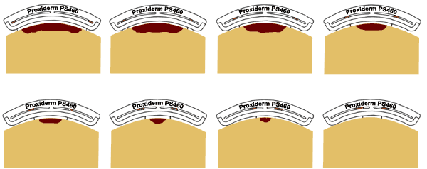
EXTERNAL TISSUE EXPANDERS

Slide 106
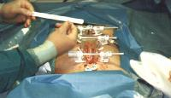
EXTERNAL TISSUE EXPANDERS

Slide 107
CONCLUSION
Attractive in its simplicity and encouraging in its clinical applications, tissue expansion may be viewed as a judicious manipulation of normal physiologic process.
BIOLOGICAL DIVIDEND

Slide 108

Thank you

