Slide 1
POST LEPROTIC HAND RECONSTRUCTION
Dr. Sanjay Vaghani
Assistant Professor
Department of Plastic Surgery, SBKSMI & RC

Slide 2
SCOPE OF THE TOPIC
Functions of hand
Anatomy of hand
Pathophysiology and Mechanism of clawing
Clinical signs
Examination
Surgical management
Other deformities of hand in leprosy

Slide 3
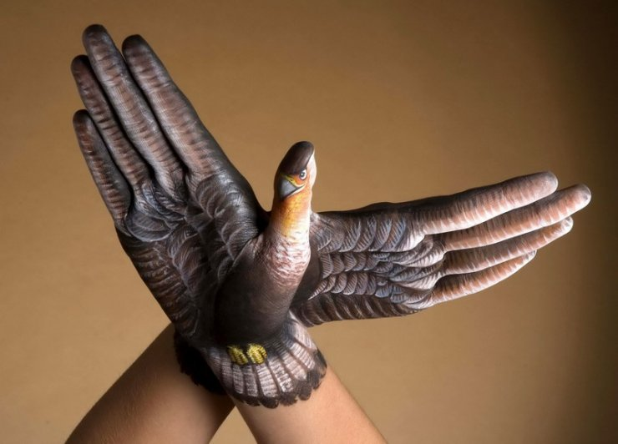
Notes:
Hands are the main organs of execution. Most of the skilled unskilled or power works are carried out by the hands,

Slide 4
Humans have evolved out as best species to survive because of the brain they possess.
From brain maximum cortical representation goes to hand.
Hands which can perform various sensory & motor functions are the major factor of human superiority.

Slide 5
Ideal organ to identify a person; as everyone is born with unique finger prints & palm impression.
Most of the persons show dexterity, with > 90% are Rt. Dominated. A few are ambidextrous.

Slide 6
Functions of hand
Sensory function of touch & the function of apprehension.
Gesture through positions of hands.
Visceral function in carrying food to mouth.
Functions relating to body care.
Thermoregulatory function.

Slide 7
Functions of hand
The passive functions:
Hand remains immobile, work & movement is carried out at proximal part of limb i.e. carrying, scooping, pointing and pushing.
The percussive function:
Motion starts from MP joint, wrist or proximally i.e. pointing fingers, clapping hands.
The active functions:
Requiring great deal of mobility of the hand at the digital level.

Slide 8
Anatomy
- Anatomy of Intrinsic muscles of hand
Thenar muscles
Hypothenar muscles
Lumbricals
Palmar interossei
Dorsal interossei
- Anatomy of dorsal digital expansion

Slide 9
Thenar muscles
Abductor pollicis brevis
Flexor pollicis brevis
Opponens pollicis
Adductor pollicis

Slide 10
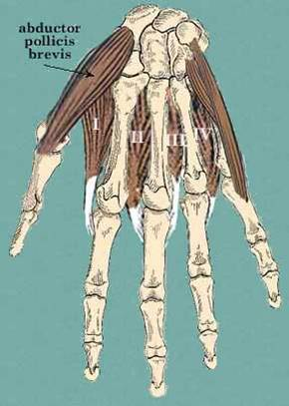
Abductor pollicis brevis
Origin: tubercle of scaphoid,crest of trepezium, flexor retinaculum
Insertion: lateral side of base of proximal phalynx of thumb
Nerve supply: median nerve
Action: abduction of thumb at MCP & CMC Jt

Slide 11
Flexor pollicis brevis
Origin:
a. superficial head- crest of trepezium , flexor retinaculum
b. deep head – trapezoid and capitate bone
Insertion: lateral side of base of proximal phalynx
Nerve supply : median nerve (* deep head may be supplied by deep branch of ulnar nerve)
Action: flexion of thumb

Slide 12
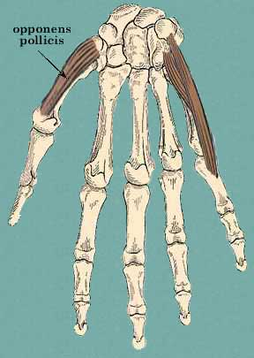
Opponens pollicis
Origin: crest of trepezium, flexor retinaculum
Insertion: lateral head of palmar surface of first metacarpal bone
Nerve supply : median nerve
Action: opposition (flexion+medial rotation)

Slide 13
Adductor pollicis
Origin: two heads – oblique and transverse
a. Oblique head : capitate bone, base of 2nd & 3rd MC bone
b. Transverse head: palmar aspect of 3rd MC
Insertion: medial side of base of proximal phalynx
Nerve supply: ulnar nerve(65%),median nerve(35%)
Action: adducts the thumb, flexes MP Jt

Slide 14
Hypothenar muscles
Palmaris brevis
Abductor digiti minimi
Flexor digiti minimi
Opponens digiti minimi

Slide 15
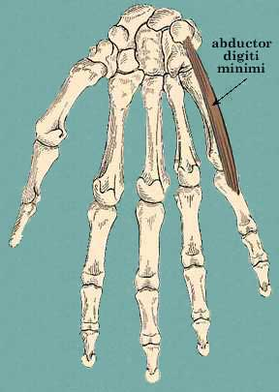
Abductor digiti minimi
Origin: pisiform bone
Insertion:ulnar side of base of proximal phalynx
Nerve supply: ulnar nerve
Action: abduction of LF at MCP Jt

Slide 16
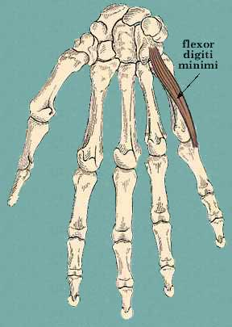
Flexor digiti minimi
Origin: hook of hamate and flexor retinaculum
Insertion: ulnar side of base of proximal phalynx
Nerve supply: ulnar nerve
Action: flexion at MCP Jt

Slide 17
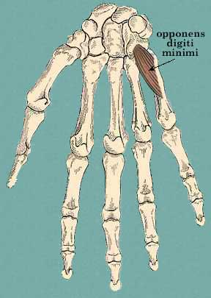
Opponens digiti minimi
Origin: Hook of hamate, flexor retinaculum
Insertion: Medial Surface of shaft of 5th MC
Nerve supply: ulnar nerve
Action: flexion and lateral rotation of 5th MC

Slide 18
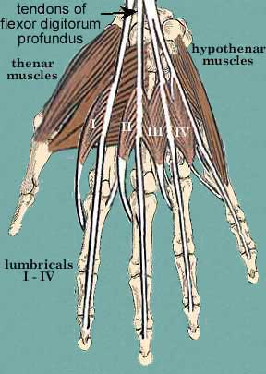
Lumbricals
Arise from tendons of FDP
Numbered from lateral to medial side
1st and 2nd lumbricals arises from radial side of respected tendon
3rd and 4th arises from contiguous sides of the respected tendons

Slide 19
Insertion: dorsal digital expansion of respected digits
Nerve supply: radial two by median nerve, ulnar two by ulnar nerve
Action: flexion at MCP Jt and extension at IP Jt

Slide 20
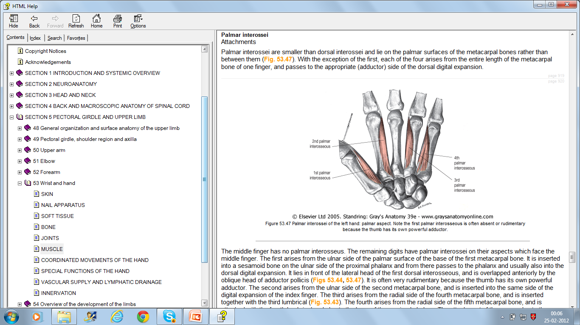
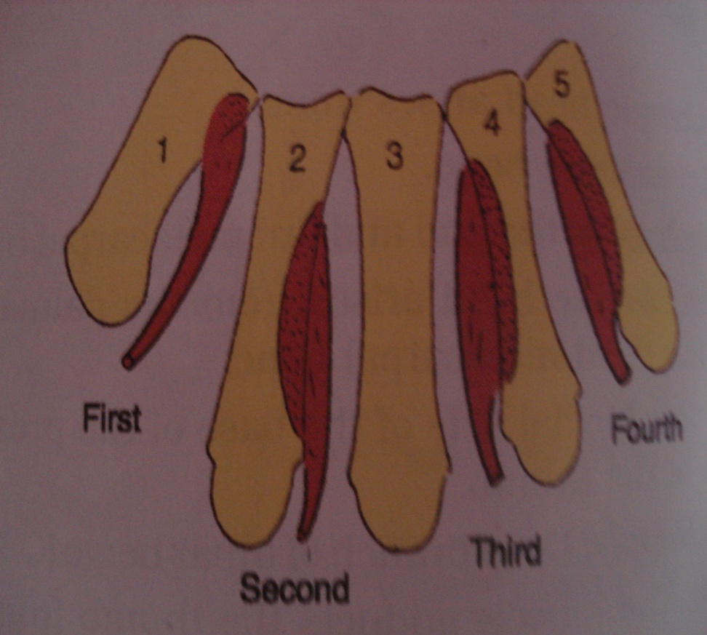
Palmar interossei
Origin:1st- medial side of base of 1st MC, 2nd- medial side of shaft of 2nd MC, 3rd- lateral aspect of shaft of 4th MC, 4th- lateral aspect of shaft of 5th MC
MF no palmar interossei

Slide 21
Insertion: dorsal digital expansion
1st PI- medial side of thumb
2nd PI- medial side of index finger
3rd PI- lateral side of ring finger
4th PI- lateral side of little finger
Nerve supply- ulnar nerve
Action- adduction , flexion at MCP, extension at IP

Slide 22
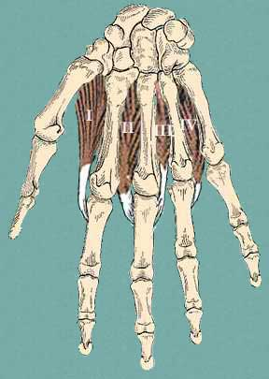
Dorsal interossei
Origin : contiguous sides of MC
Thumb and LF doesn’t have DI
MF has two DI
Insertion: dorsal digital expansion , base of proximal phalanx of that digit

Slide 23
Nerve supply: ulnar nerve
Action: abduction of digits, flexion at MCP Jt, extension at IP Jt.

Slide 24
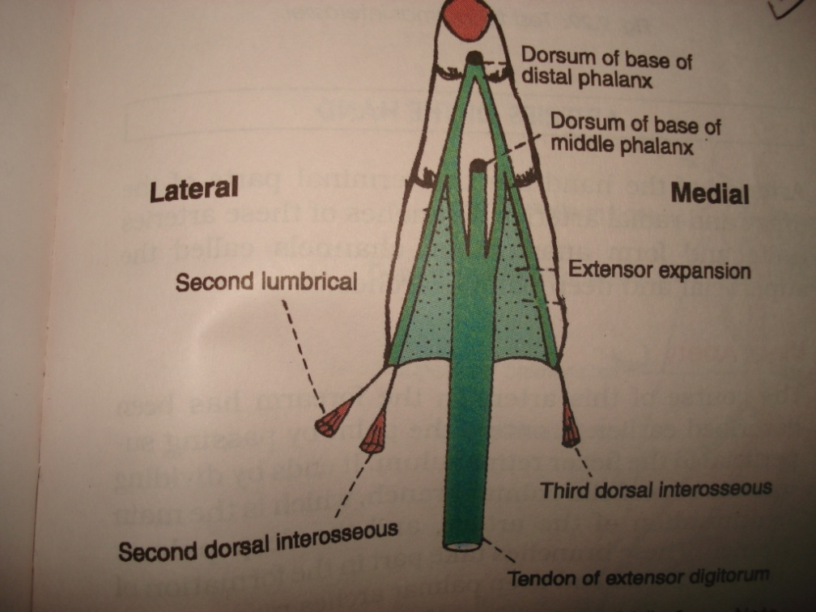
Anatomy of dorsal digital expansion
EDC deep part inserts into dorsum of proximal phalanx
As it continues distally divides into three slips
A central slip inserts into dorsum of proximal end of middle phalanx
Two lateral tendinous slip unite with tendon of lumbrical and interosseus muscles and inserts on dorsum of terminal phalanx

Slide 25
Anatomy of dorsal digital expansion

Slide 26
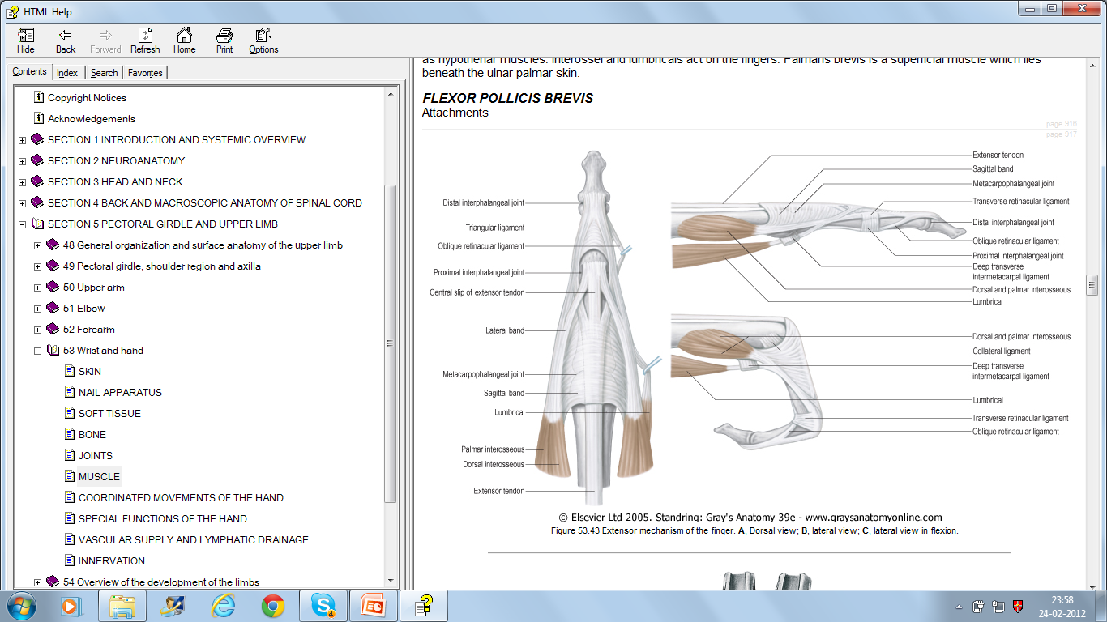

Slide 27
Nerve supply
Ulnar nerve supplies all intrinsic muscles of hand excluding thenar muscles and 1st and 2nd lumbricals. Adductor pollicis & FPB is also supplied by ulnar nerve.
It also supplies FCU , FDP LF & MF

Slide 28
Median nerve supplies all FDS,FDP IF & MF, FPL, FCR, PL, pronator quadratus in forearm
In hand- 1st and 2nd lumbrical, three thenar muscles- AbPB,OP,FPB

Slide 29
Pathophysiology
M leprae involves the ulnar nerve most commonly above the ulnar groove, followed by the region just proximal to guyon’s canal
The ulnar nerve lesion above the cubital groove is the earliest lesion followed by median nerve deficit
Claw without ulnar nerve involvment is rarely seen

Slide 30
Bacillus infiltrates the ulnar nerve
intranueral edema
local compression with in normal anatomic boundaries of cubital tunnel and guyon’s canal
compression of perinueral blood vessels
secondary local ischemia

Slide 31
Schwan cells and axons are destroyed by granulomatous process
postinflammatory fibrosis
irreversible nerve damage

Slide 32
Bi -articular model of digital mechanics
Bi- articular system consists of
MCP and PIP joints, with the PPX forming the inter-calated bone
Movement of MCP and IP joints are independent
Movement of the two IP joints are coordinated.
  On DIP joint flexion Dorsal digital expansion drawn distally loosening tension on the central slip
  DIP joint Flexion tenses the oblique retinacular ligament which slides volarly imparting a flexion to PIP joint.

Slide 33
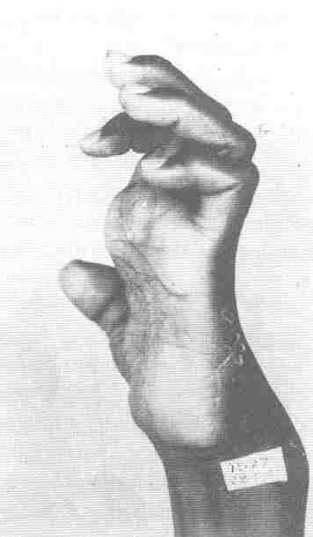
PRIMARY HAND DEFORMITIES
Ulnar nerve paralysis
Clawed little & ring fingers
Adductor weakness of thumb
Combined ulnar & median nerve paralysis
Clawing of all fingers
Loss of opposition of thumb
Triple nerve paralysis
Wrist drop

Slide 34
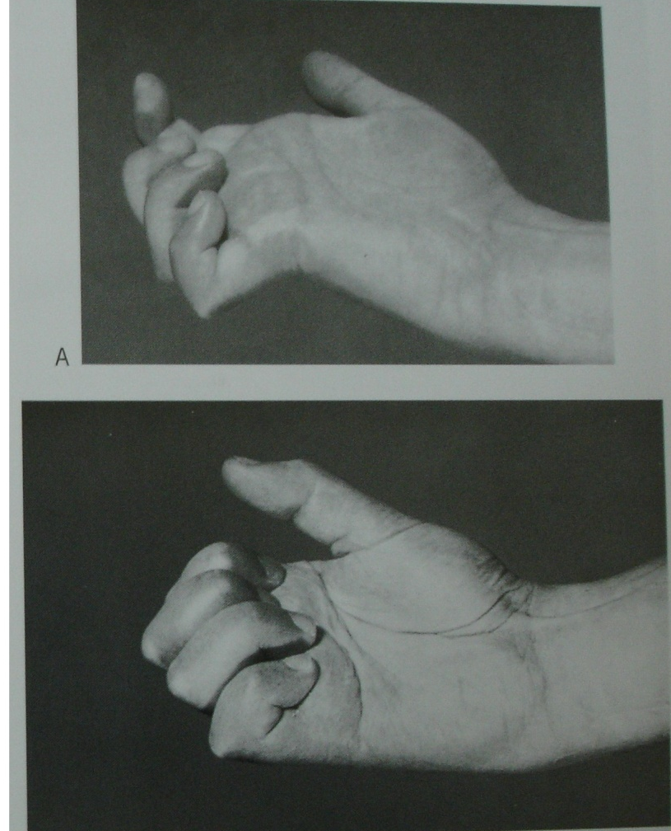
CLAW HAND
Deformity of the hand arising due to the paralysis of the intrinsic muscles of the hand resulting in hyper-extension of the MCP joint and flexion of the PIP joint.

Slide 35
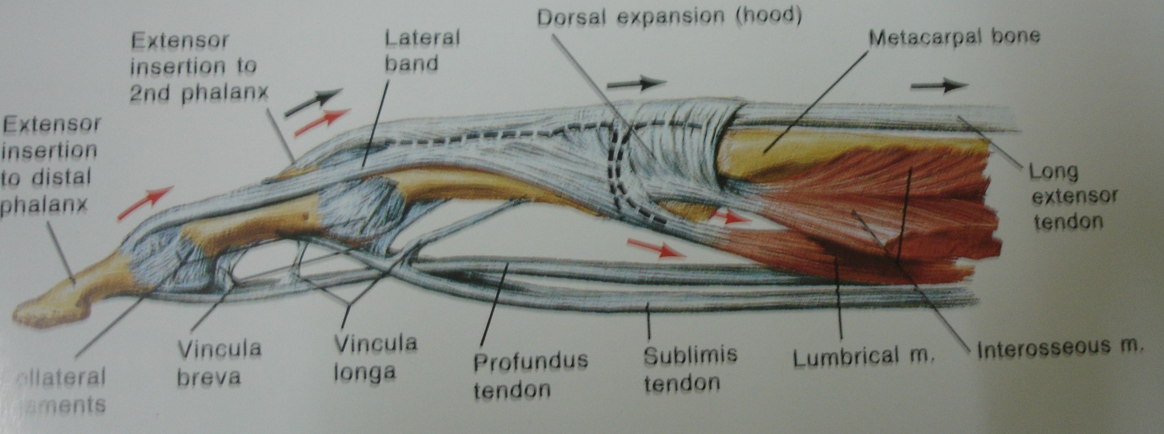
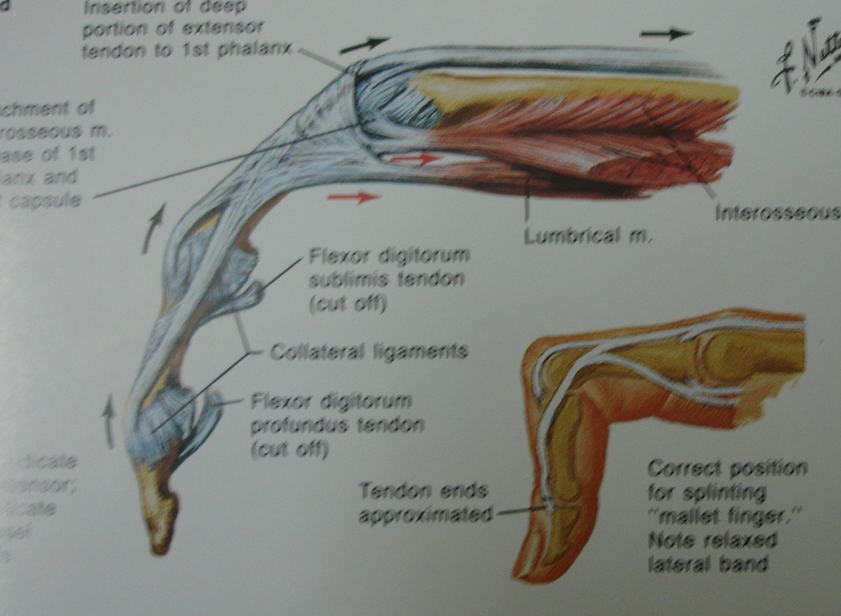

Slide 36

Pathomechanics
Normal situation :
  MCP joint neutral: extensor tension is transmitted distally to extend the IP joint
  Normal cascade of digital extension & flexion

Slide 37
Pathomechanics
Paralytic finger:
  Long extensor function is blocked at MCP joint.
  Tension diverted to sagittal band – hyperextension.
  Extensors unable to extend IP joints.
  Finger cascade disturbed.
Deformity :
  Clawing
Disability :
  Loss of independence of IP & MCP joints

Slide 38
Mechanism of claw finger in intrinsic palsy
MCP hyperextension occurs because of the inability of the nonfunctioning intrinsics to stabilize the MCP joint against traction of long extensor tendons
Flexion of the phalanges is produced by elastic action of functionally shortened long flexor tendons of the fingers causing digital claw hand.

Slide 39
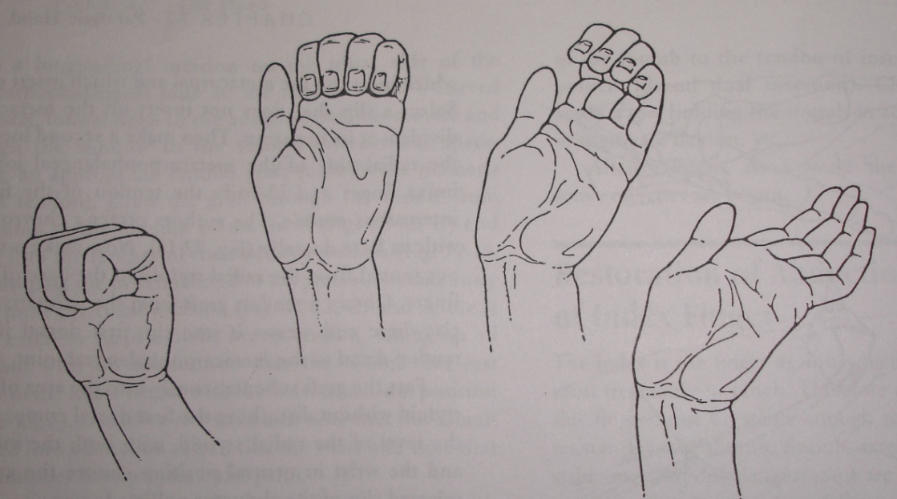
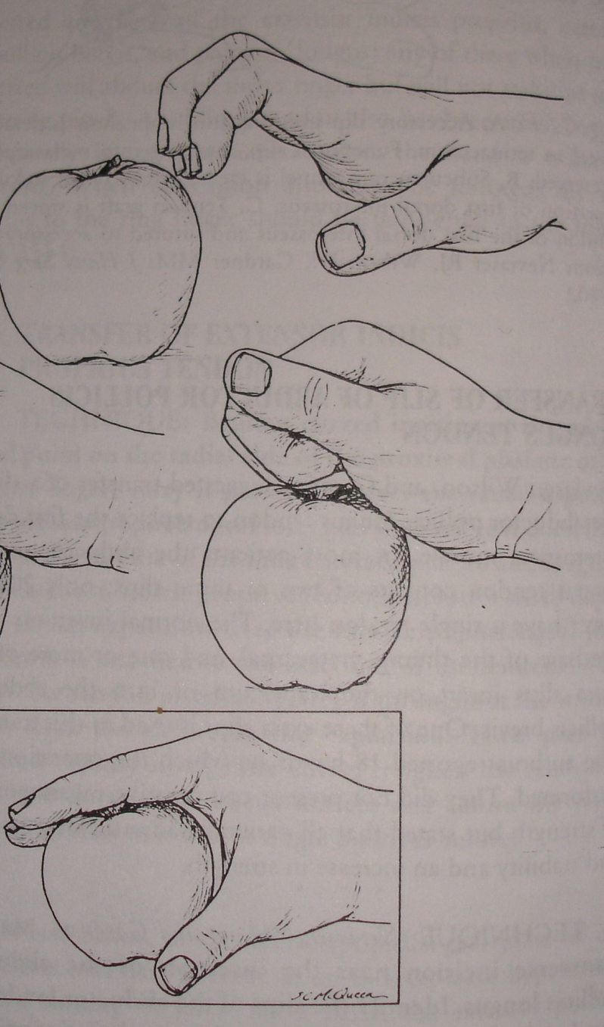
In the absence of functioning intrinsic system the biarticular system becomes unstable and
Cascade of movement
is disturbed

Slide 40
Digital extension from full complete flexion
Digital skeleton shortens - 58% corresponds to MCP Jt,25% at PIP Jt, 17% at DIP Jt
extensor tendons also shorten by proximal gliding

Slide 41
83% of bony shortening is absorbed by long extensor proximal gliding
the skeletal shortening depending on the extension of distal phalynx is absorbed by lateral extensor tendons(17%)
Thus intrinsics prevent proximal phalangeal hyperextension & produces equal shortening between dorsal surface of skelton and extensor appratus

Slide 42
In intrinsic palsies , due to absence of intrinsic stabilization of proximal phalanx, it hyperextends
Bouvier first noticed the capacity of intrinsics to stabilize the proximal phalanx
He also clearly showed that in an intrinsic claw the long extensor tendons may extend the IP joints by itself if hyperextension of MCP joint is prevented.
“claw hand deformity is the expression of the inability of the extensor tendon to extend, by itself the interphalangeal joints if metacarpophalangeal joints hyperextended”

Slide 43
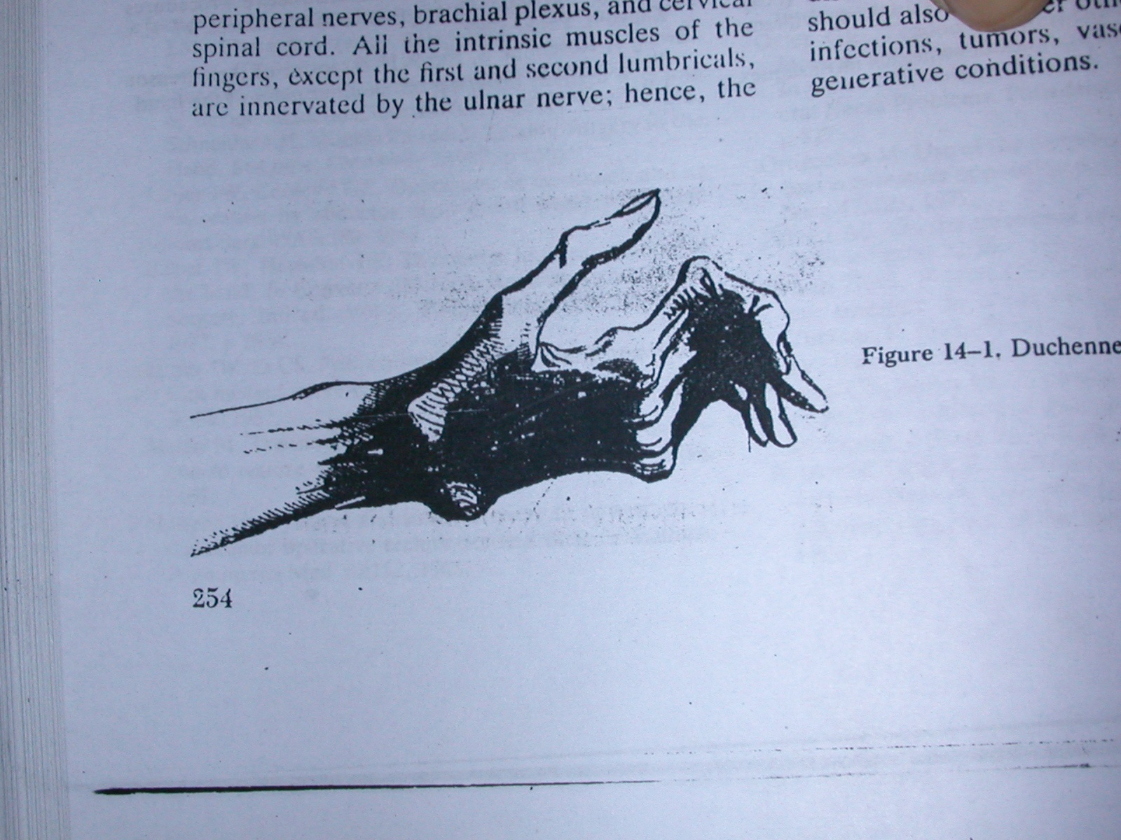
Clinical signs
1. Duchenne sign,1867:
If extrinsic muscle function is intact the the ring and little finger will claw, with hyperextention of MP Jt and flexion of IP.

Slide 44
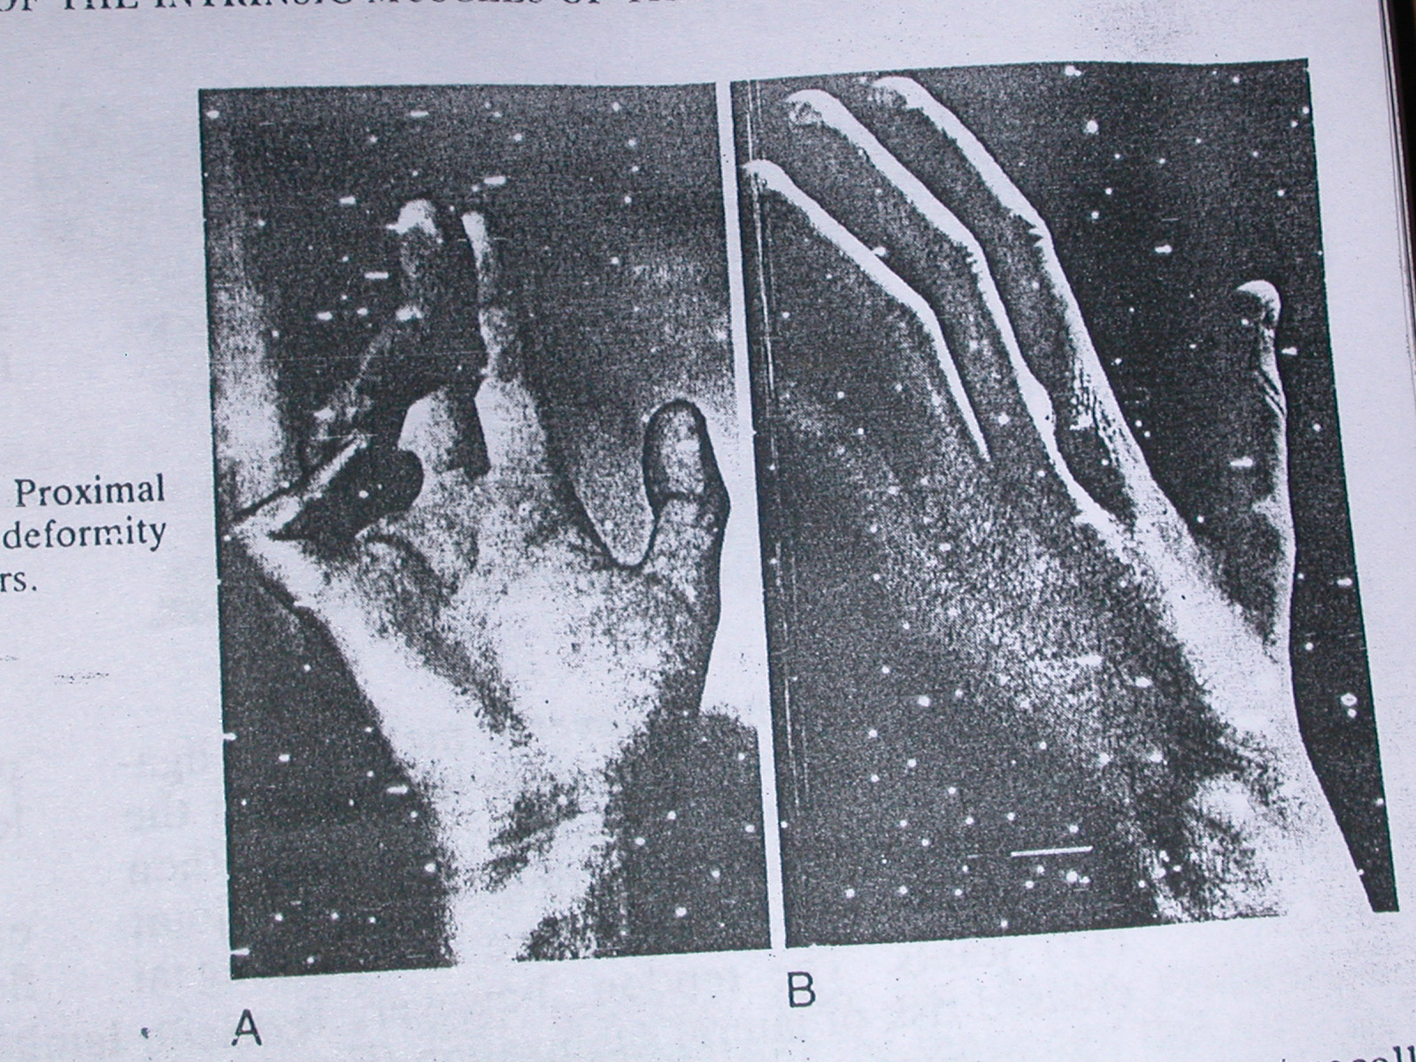
Pr0ximal u n
palsy
lack of
deformity
Distal u n
palsy
-deformity

Slide 45
2. Bouviers maneuver, 1851 ;
If hyper extension is passively prevented by dorsal pressure, the extensor digitorum can extend the distal and middle phalanx.

Slide 46
3. Andre thomas sign 1917:
Increase in claw deformity when patient makes an effort to extend the fingers by flexing the wrist
This is due to to tenodesis effect of the long extensor tendons.

Slide 47
4. Cross your finger test (1980- Earle valstou):
Inability to cross the long finger dorsally over the index finger
or index over the long finger when palm and fingers are
placed on a flat surface - tests 1st volar interosseous and 2nd
dorsal interosseous muscle.

Slide 48
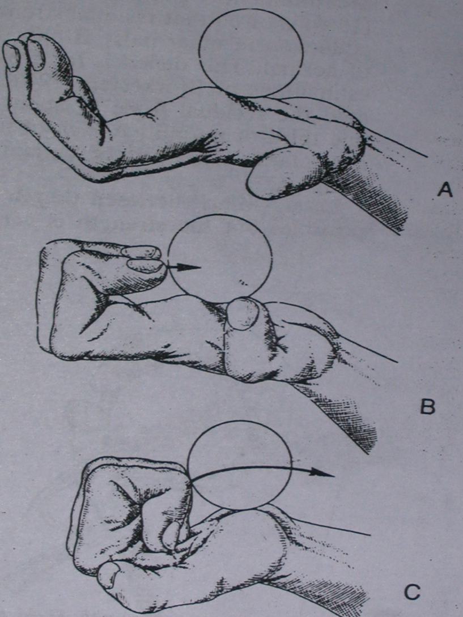
5. Loss of integration of MP and IP joints flexion because of paralysis of lumbrical muscles to Rf and LF.
In intrinsic paralysis,MP joint doesn’t flex untill IP joints have flexed completely.the fingers curls or rolls in palm and the objects pushed away instead of grasped.(flat-1961)

Slide 49
6. Masse’s sign:
Flattened metacarpal (palmar) arch and loss of hypothenar eminence
7. Pitrese testut sign(1925):
Loss of active adduction and abduction of fingers due to paralysis of interossei and hypothenar muscles.
Because there is also paralysis of Adductor Pollicis tips of extended digits can not brought into cone.
The resulting effect is impairment of precision grip

Slide 50
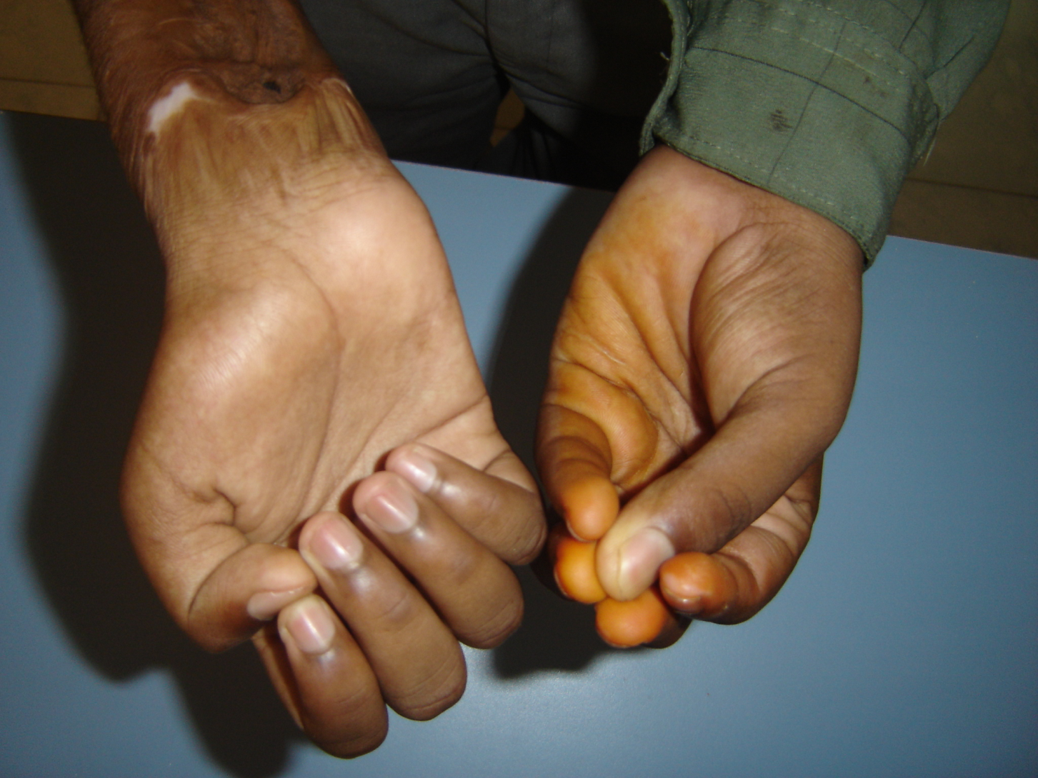
Impairment of precision grip:
Pitre-Testut’sign(1925):

Slide 51
9. Wartenberg’s sign(1930):
There is inability to adduct extended Lf to RF.
It is charactrestic of isolated deep motor branch involvement, in which the functioning extensor digiti minimi is unopposed by paralysed palmar interossei.

Slide 52
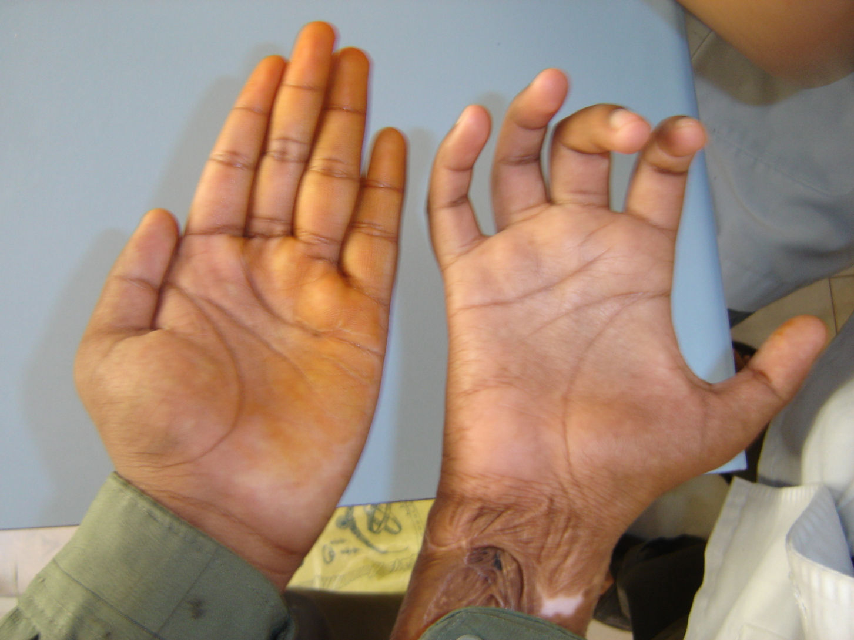
Wartenberg’s sign

Slide 53
The Thumb
1. Jeannes sign(1915)
There is loss of lateral or key pinch of thumb, because of paralysis of Adductor Pollicis .

Slide 54
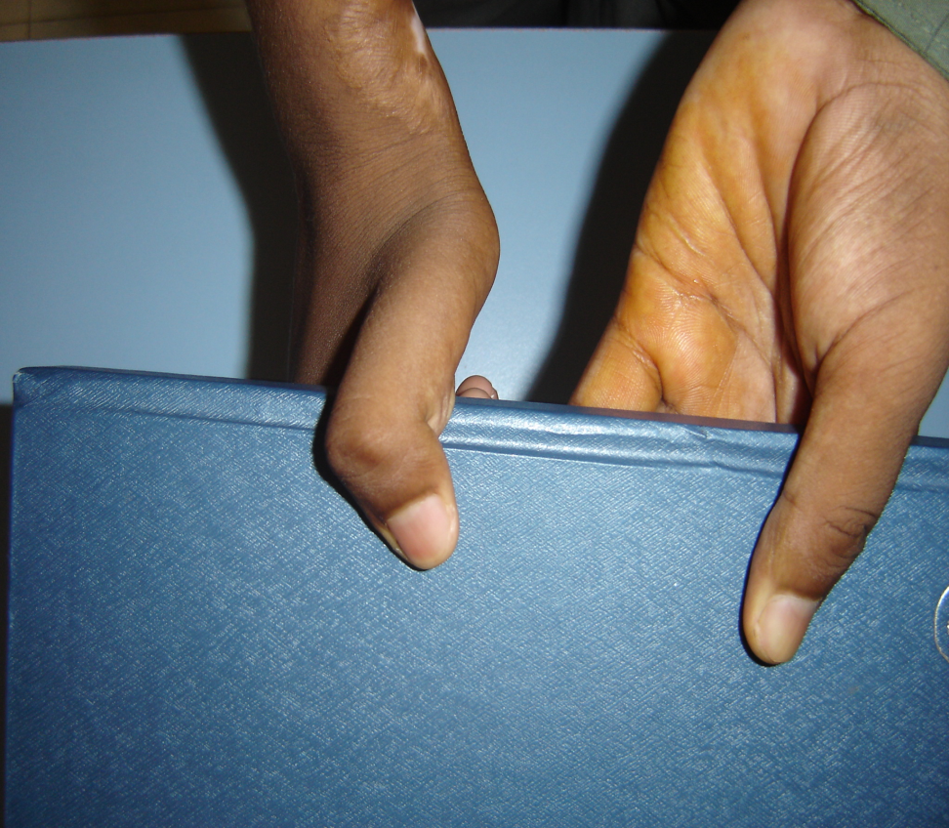
2. Froment’s sign:
Hyperflexion of IP Jt of thumb may occur while attempting to perform a lateral pinch.
Due to exccesive use of FPL

Slide 55
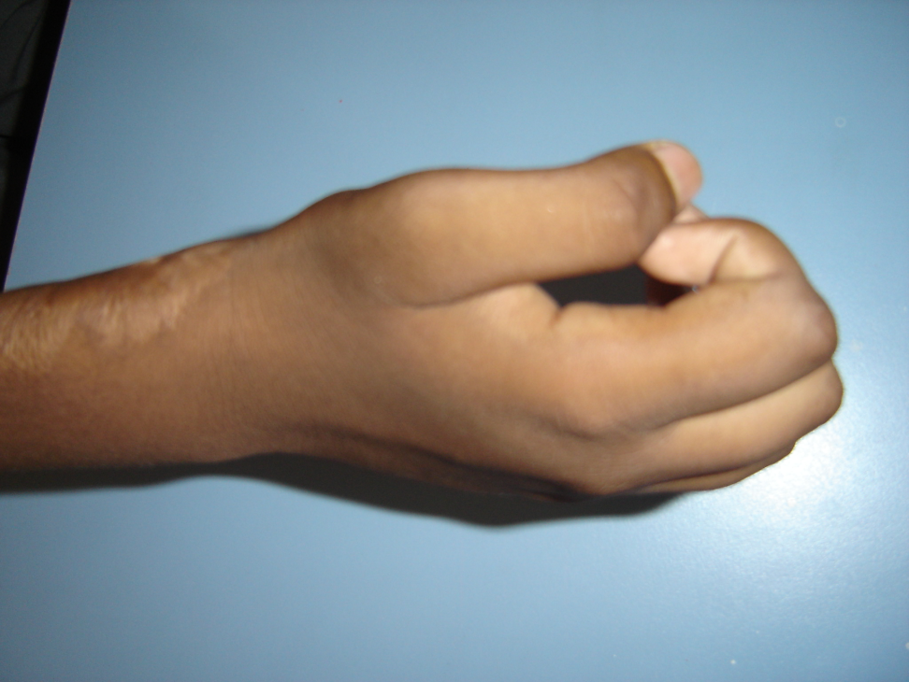
3. Bunnel’s O sign (1956):
When patient makes a pulp to pulp pinch with thumb and index finger ,there is combined hyper flexion at IP Joint and hyperextension at MP joint which makes a circle instead of a spindle which occurs in a normal person.

Slide 56
The extrinsic muscles
1. Pollock’s sign(1919): Loss of extrinsic power to ulnar nerve innervated portion of FDP,with inability to flex DP of RF and LF.
2. Bowden & Napier(1961): Partial loss of wrist flexion because of paralysis of FCU.

Slide 57
Loss of sensibility function lost in ulnar nerve palsy over volar aspect of LF and ulnar aspect of volar side of RF.
In high / proximal ulnar nerve palsy, additional sensibility loss over –dorso ulnar aspect of palm and dorsal aspect of LF.

Slide 58
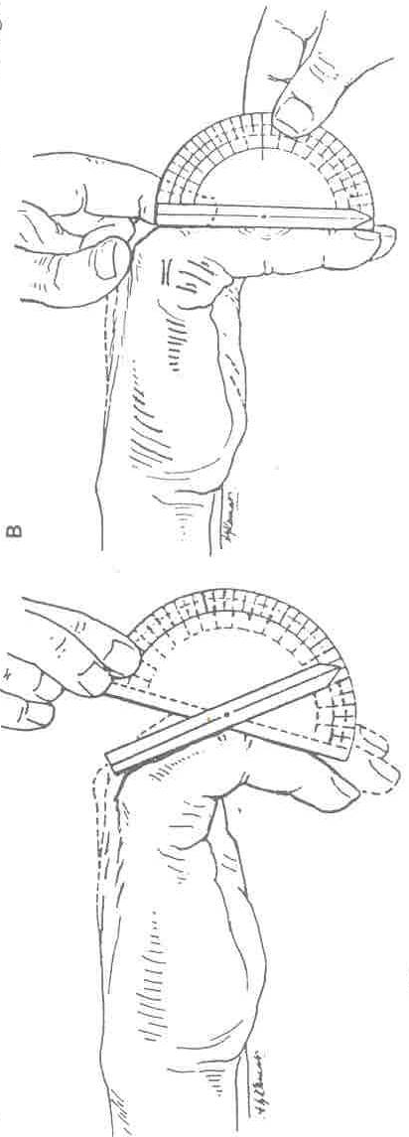
CLAW HAND
ASSESSMENT
Neurological status: Ulnar
Median
Radial
Joint mobility : Unassisted angle
esp. at PIP Assisted angle
Contracture angle
Skin

Slide 59
CLAW HAND
ASSESSMENT
Capsule & other ligamentous structures
Musculotendinous assembly esp. integrity of extensor expansion, status of finger tendons
Hyper mobile joints
Mechanical defects: Intrinsic plus deformity
Hooding deformity
Ankylosis of joint
Intelligence of patient & occupation
Extent of disability

Slide 60
Assesment of angles
1. Unassisted angle:
Pt is asked to maintain lumbrical position , examiner measures the extension deficit at PIP Jt.
More the deficit – less likelihood of complete correction
2. Assisted angle:
The examiner supports the fingers to maintain MP flexion and instruct the patient to extend IP Jt. In absence of contracture this angle should become 0 .
Can be used as a prognostic indicator
It reveals defect in line of tendon forces.
Long extensors not able to extend IP joint

Slide 61
3. Contracture angle:
It is the angle by which the finger falls short of full extension at the PIP joint even when passively extended by the examiner.
Can be due to skin contracture or volar plate or capsular contraction.

Slide 62
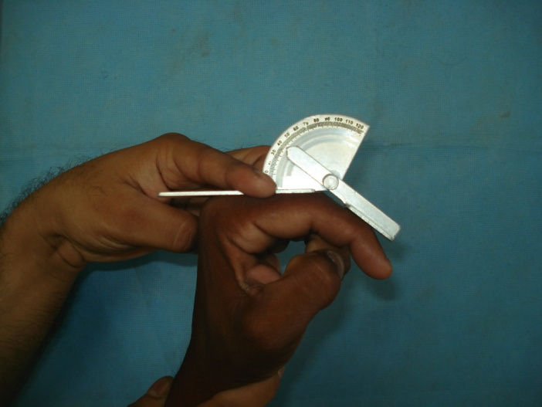
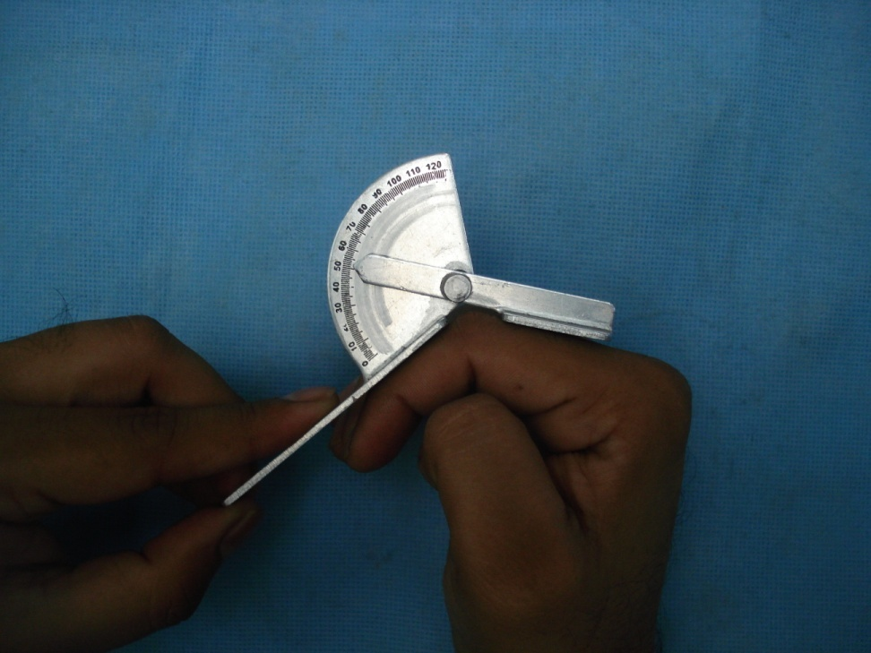
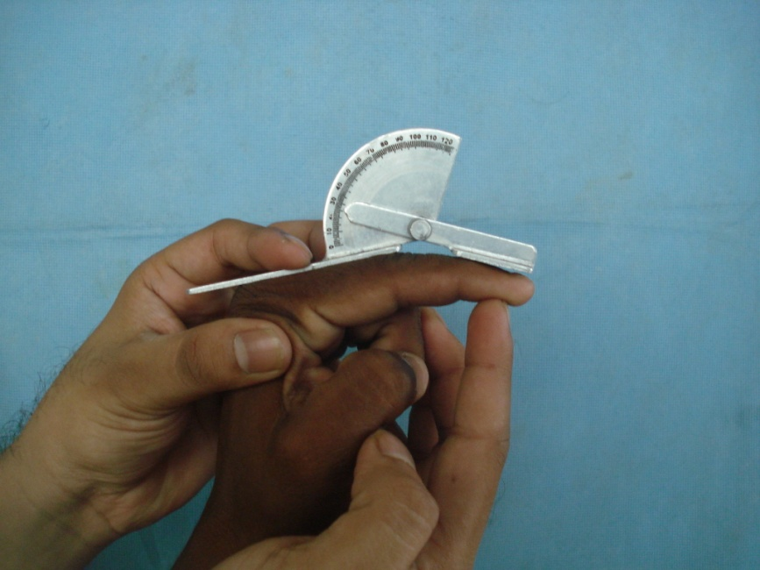
Photograph of angle measurement
Assisted angle
UNASSISTED ANGLE
Contracture angle

Slide 63
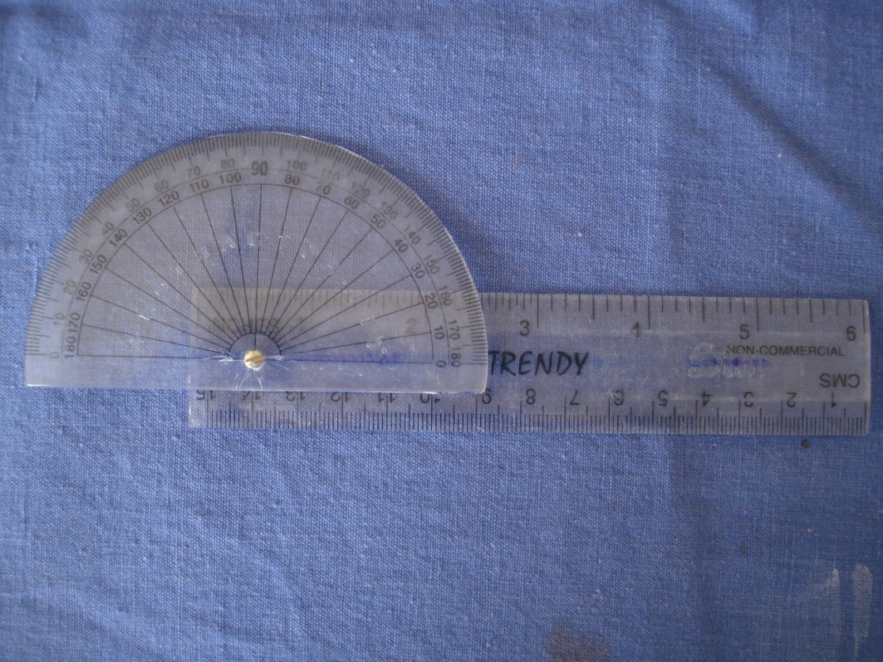
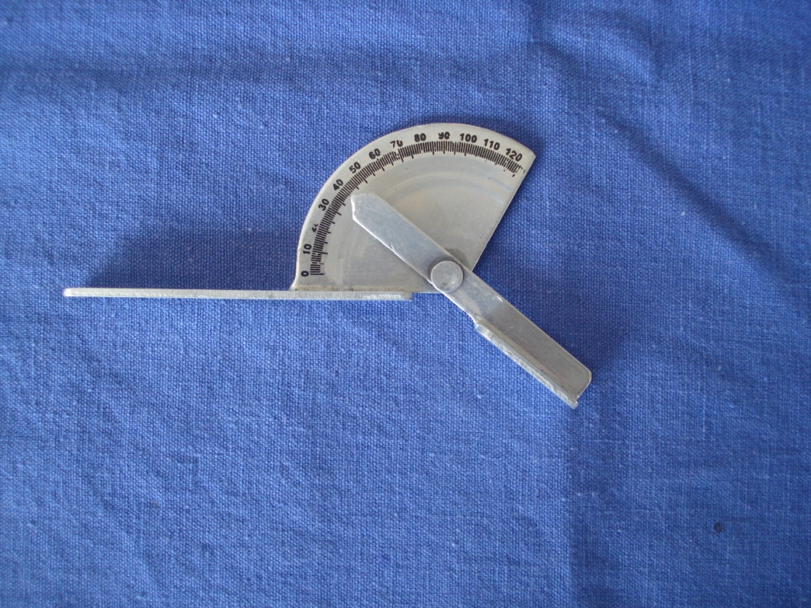
Goniometer

Slide 64
Severity of deformity

Slide 65
Classification according to joint status(Anderson)

Slide 66
 | Open hand asssesment | Close fist analysis | Mechanism of closing
Excellent | No residual flexion contracture at PIP Jt | Fully tight fist | Pt can complete the MP flexion before the IP Jt begin to flex
Good | 150 unassisted extension at PIP Jt and no flexion at DIP Jt | Fingers closes fully but not tightly enough to hold a needle | IP jt flexion begins just before MP flexion is completed
Fair | 120 unassisted extension at PIP Jt and no flexion at DIP Jt | A visible gap between the base of the finger and the tip | IP Jt begins and continues along with MP flexion
Poor | Any hand that does not score fair | Any hand that does not score fair | MP flexion delayed behind IP flexion

Slide 67
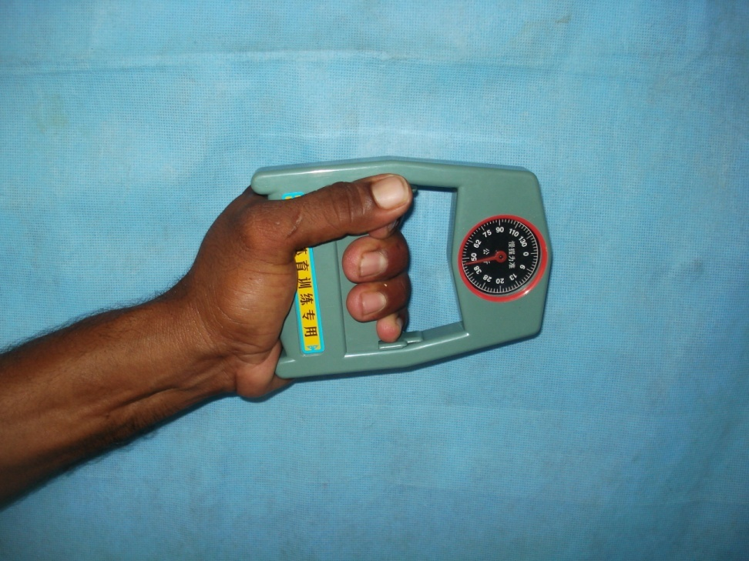
Grip Strength Measurement
Grip strength measured in percentage(%) , compared to contra lateral side and preoperative value
Operated side/contra lateral side x 100
Post op/pre op x 100

Slide 68
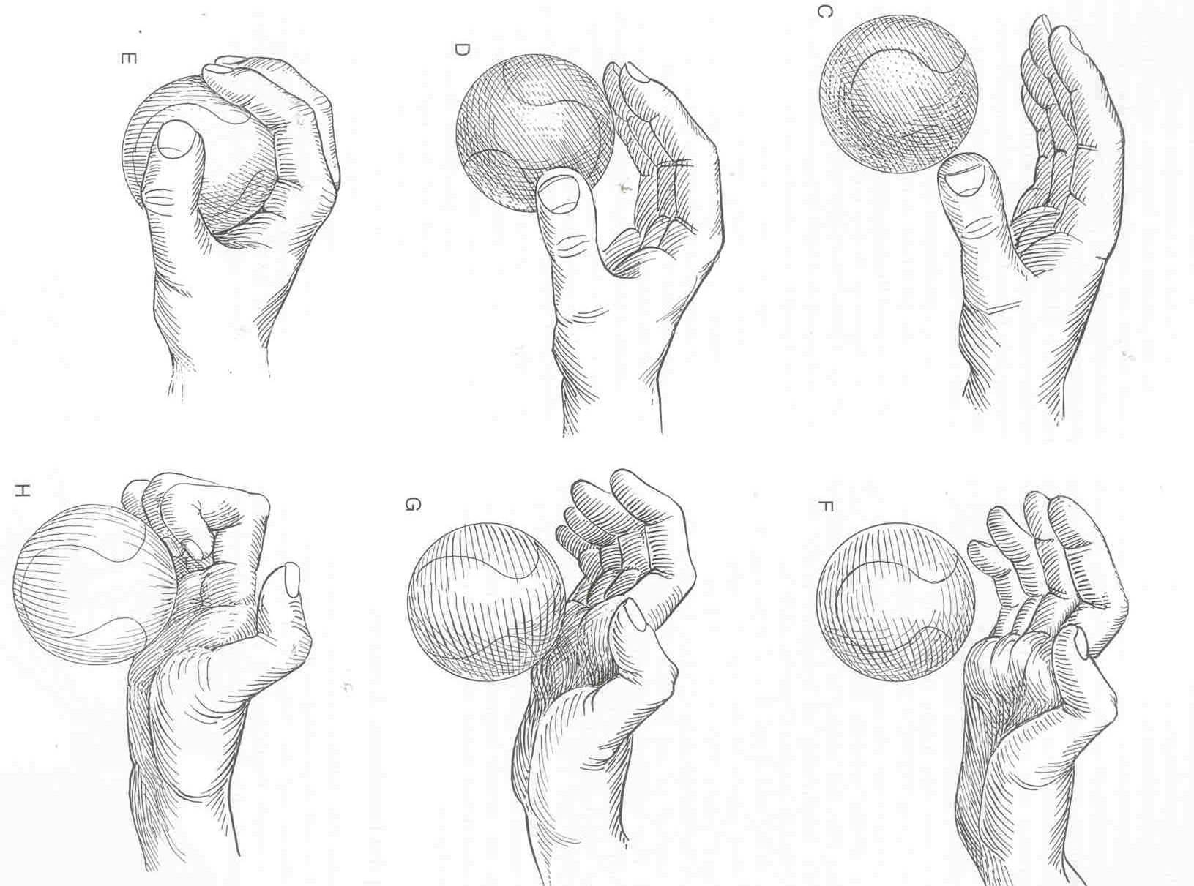
CLAW HAND
Patient unable to pinch & grasp.

Slide 69
Surgical management
Why Correct Such Deformities????
» These Deformities Stigmatize Affected Persons As Leprosy Patients.
» As They Involve The Hands-Persons Experience Certain Disabilities In The Use Of Their Hands Rendering Useful Postures & Movements Impossible For These Digits.

Slide 70
AIMS
Restore The Balance Of Forces And Thereby
Correcting The Deformity And Disability.
» Action Of Muscles Of Relocated Tendons Should Be In Proper Sequence And In Co-Ordination With Other Muscles.

Slide 71
CLAW HAND
PRINCIPLES
Restoration of grasp (thumb and fingers)
Restoration of pinch (thumb)

Slide 72
CLAW HAND
PRINCIPLES
Restoration of grasp
Inability to grasp large objects
Can grasp smaller objects but excessive stress
Restoration is by substituting an active muscle for the paralysed lumbrical muscle.
Restoration of pinch

Slide 73
CLAW HAND
PRINCIPLES
Restoration of grasp
Restoration of pinch
Provision of an abductor rotator for the thumb. Requisites include adequate thumb web >40°.
Mobile MCP jt. without hyperextension.

Slide 74
SELECTION OF PATIENTS
Well Motivated Patient.
» Good IQ Of The Patient:
•To State Precise Functions To Be Restored.
•Deformity Correction Pt. Considers Most Important.
•What Is Expected Of The Pt.[Physiotherapy Regimen,No Undue Expectations]
•Understanding &Execution Of The Pre &Post Operative Training Instructions[Re-education].

Slide 75
SELECTION OF PATIENTS
Younger Patients [15-45 Yrs]
» Recent Deformity[<3Yrs]
»NoStiffness,SoftTissueContractures[SuppleJoints].
» No /Minimal [<10degree]Hyperextension
At PIP Joints.
» No Weakness Of Fore Arm Muscles.

Slide 76
TIMING OF SURGERY
Good Clinical Response To Anti-Leprosy
Treatment.
» Should Not Have Had Any Attack Of reaction/Neuritis In Last Six Months.
» Disease Activity should be Quiescent For At Least 1Yr.
» Free Of Corticosteroid Treatment For Several Months.
» Should Have Had The Deformity For At Least 1 Yr.

Slide 77
PRE-OPERATIVE ASSESSMENT
Extent Of Claw Deformity.
» Extent Of Disability [d/t Intrinsic Paralysis].
» Integrity Of Extensor Expansion.
» Status Of PIP Jts.
» Status Of Digital Flexors &Extensor Muscles.
» Sensory Charting,Testing Of All Muscles Below Elbow Jt ,Palpation Of Nerve Trunks.
» Radiographic Assessment.

Slide 78
PRE-OPERATIVE PHYSIOTHERAPY
» Dynamic Procedures-Pre-Op Assisted Angle O Degrees.
» Hot Wax Bath,OilMassage,Exercises,Splinting.
» BoutonniereDeformity – Dynamic Splintage With Exercises 6-8 Wks Prior To Surgery.
» PIP Jt Contractures >45Degrees- Serial Static Splintage.

Slide 79
PROCEDURES OF CLAW CORRECTION
» Broadly Grouped Into:
•Dynamic Procedures:
Transfer Of Dispensable Normally Functioning Motor Unit To Pre-Determined Location In Digit.
•Static Procedures:
Maintains MP Jts. In Some Degree Of Flexion.

Slide 80
Dynamic tendon transfer
Superficialis tendon transfer technique
Four primary sites of transfer were used
  Lateral band ( Bunnel, Littler, Brand, Fritschi )
  Phalangeal ( Burkhalter )
  Pulley (Riordan,Zancolli, )
  Interosseous (Zancolli, Palande, Anderson)

Slide 81
Dynamic tendon transfer
Finger level Extensor motor
Extensor indicis and Extensor digiti Minimi transfer ( Fowler, Riordan ).
Wrist level motors
Dorsal route transfer of ECRB ( Brand )
Flexor carpi radialis transfer (Riordan)
Flexor route transfer of ECRL ( Brand )
Palmaris longus Transfer (Lennox –Fritschi )

Slide 82
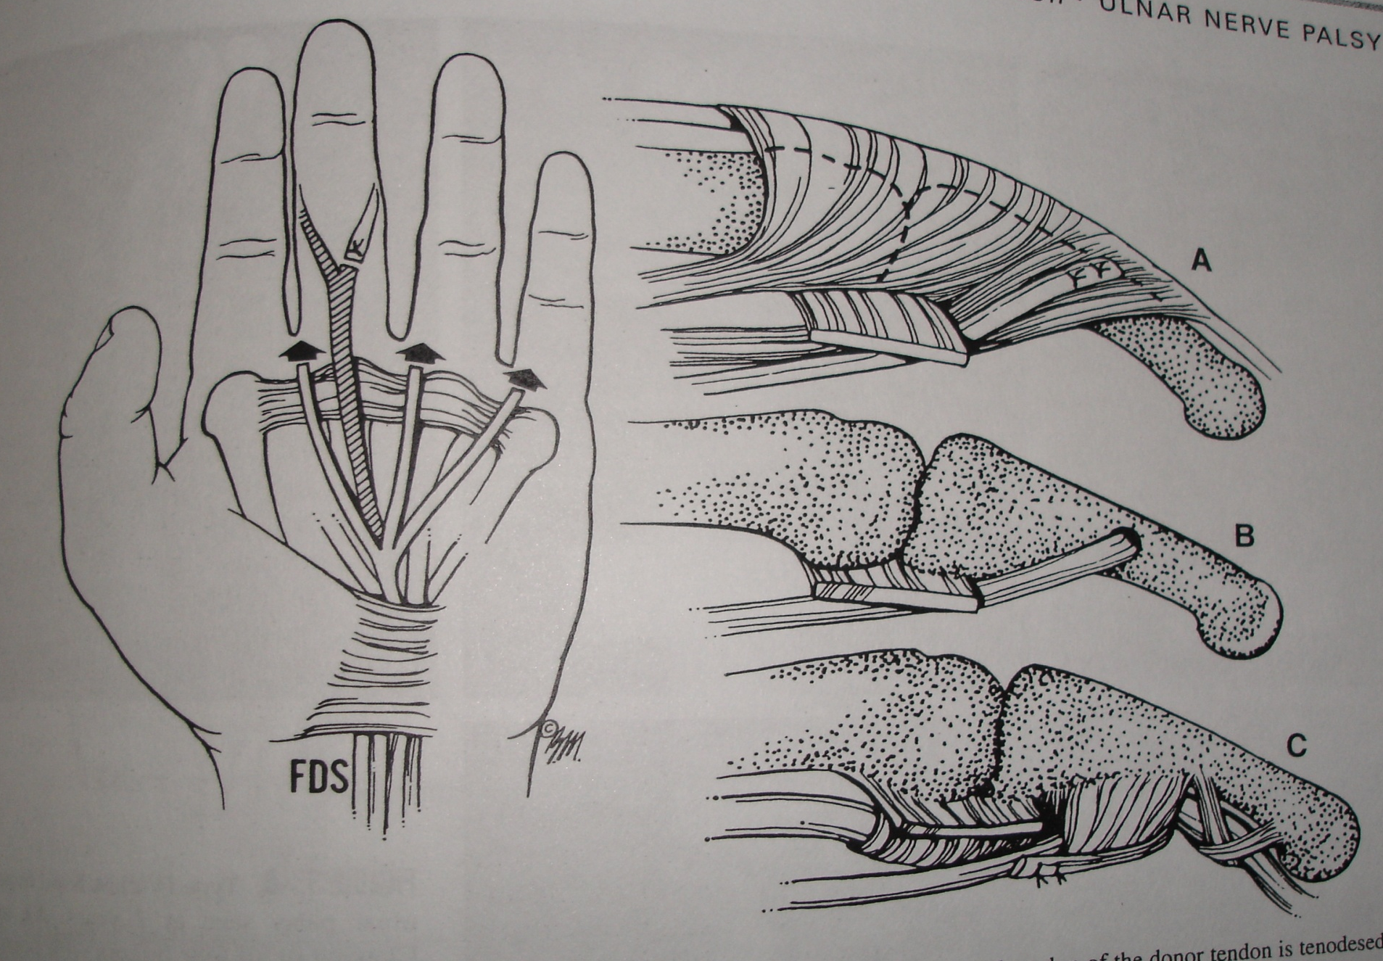
FDS transfer

Slide 83
LASSO PROCEDURE
TRANSFER OF FDS –MF TO FLEXOR PULLEYS OF FINGERS
PROCEDURE:
-Detach & Deliver FDS –MF Into Palm.
-Exposure Of The Pulleys.
-Fixing Tendon Slips To Pulleys A1,A2[Partial].

Slide 84
TENSION ADJUSTMENTS AT MCP JOINTS:
IF 30Degrees
MF 35Degrees
RF 40Degrees
LF 50Degrees
IMMOBILISATION :
IN POP CAST UPTO PIP Jts,MCP Jts In 70 Degree.

Slide 85
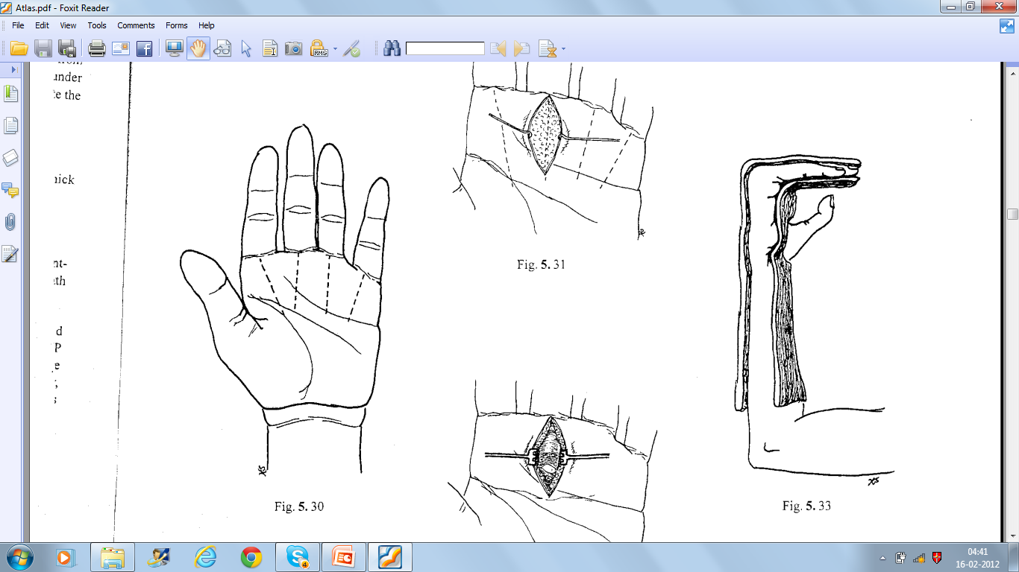
Post op regime
Plaster slab immobilisation for 3weeks
Staged mobilisation of IP and MCP Joint
  1st week exercises to maintain lumbrical plus
  position
  IP joint flexion is begun after 7-10 days
  Assisted MCP joint extension keeping the IP joint in Neutral position
  Light functional activity at 8th week onwards

Slide 86
CLAW HAND
LASSO PROCEDURE
Indications : Claw hand with mobile IP jts.
Assisted angle -0
Advantages : Re- education is easy.
Easy to perform.

Slide 87
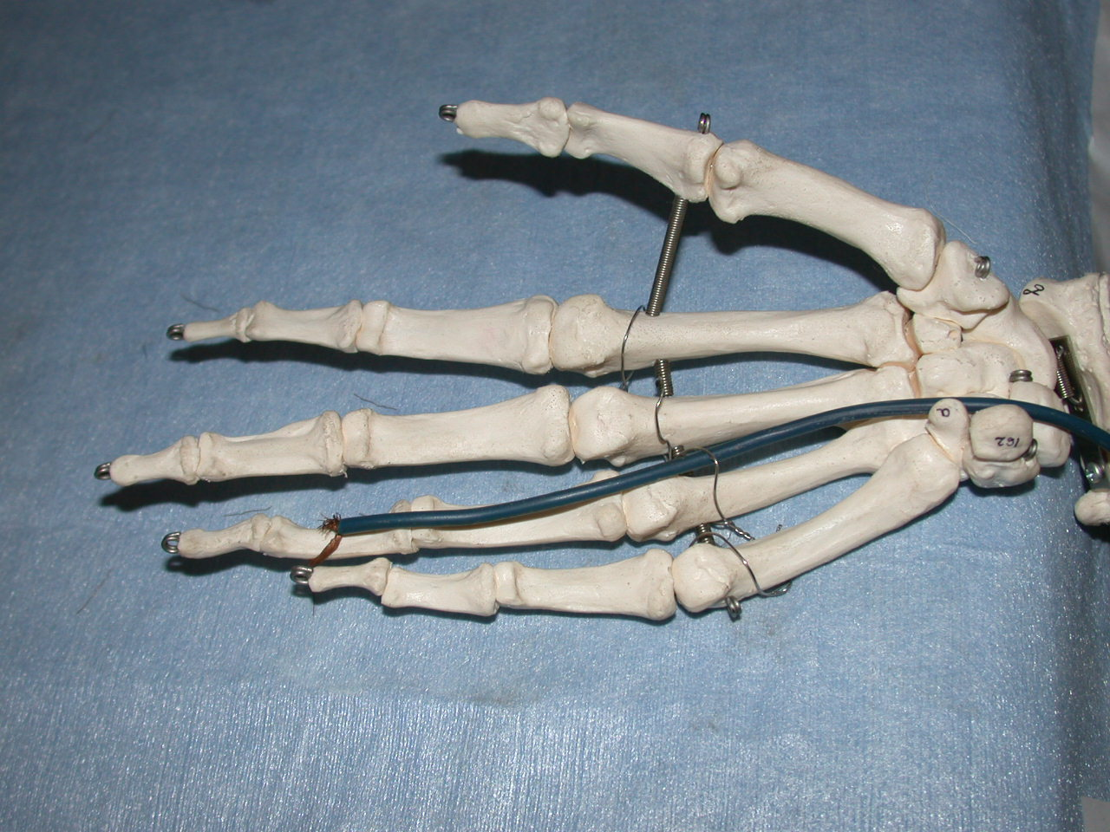
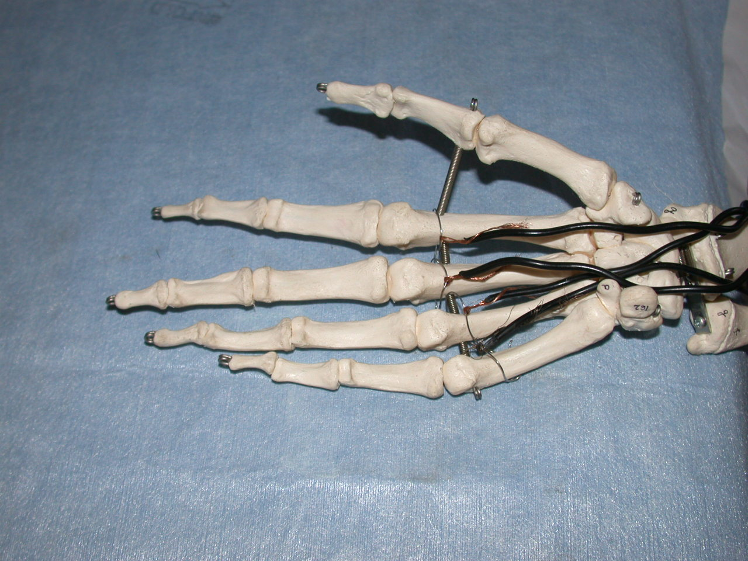
CLAW HAND
LASSO PROCEDURE

Slide 88
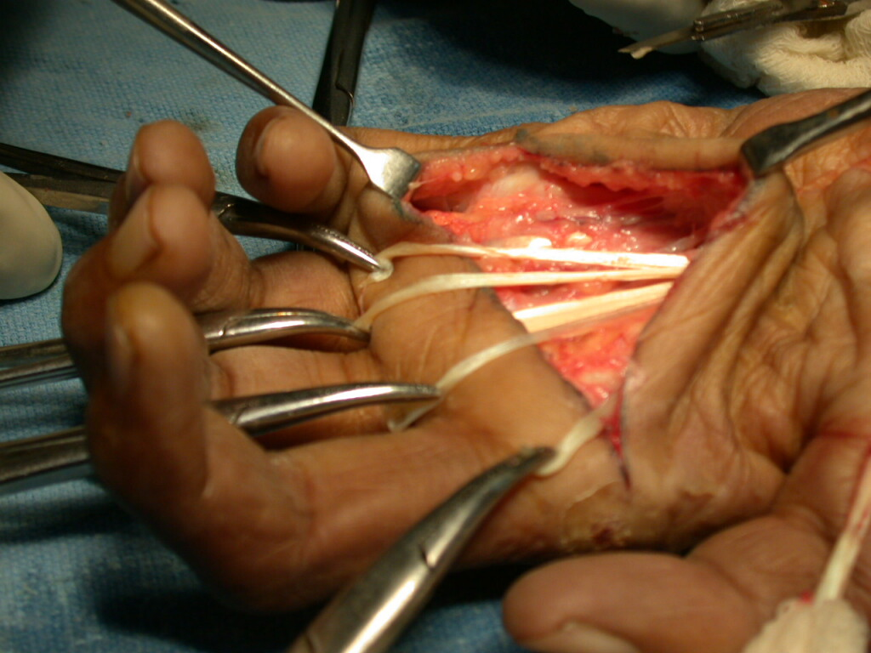
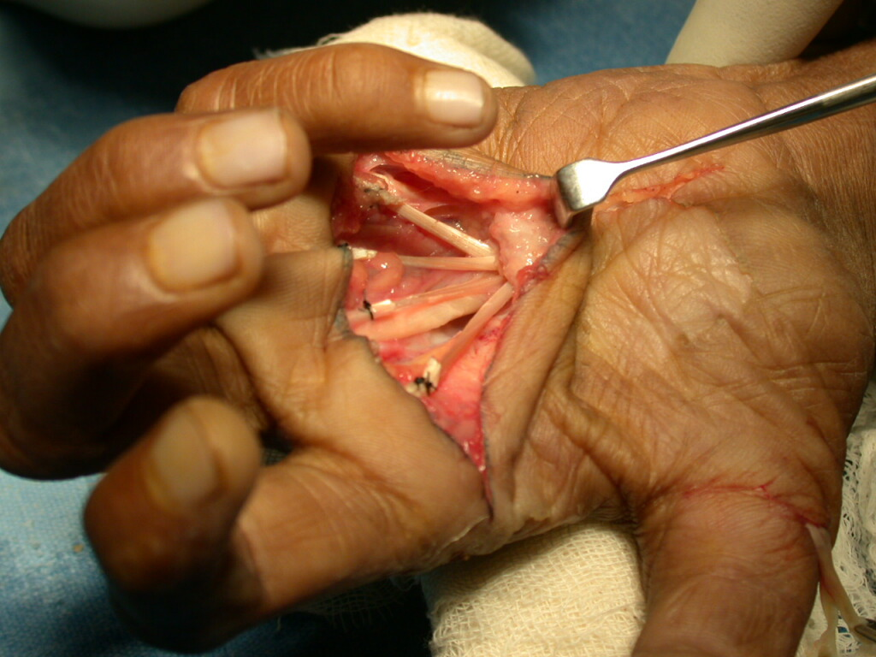
CLAW HAND
LASSO PROCEDURE

Slide 89
INDIRECT LASSO PROCEDURES
Term indirect is used when motor other than FDS is used
Insertion is same, around the A1 pulleys
Two motors can be used
ECRL
PALMARIS LONGUS ( LENNOX PROCEDURE )
Both will require lengthening by tendon graft.
Both are passed through the carpal tunnel.

Slide 90
INTRINSIC SUBSTITUTION PROCEDURES
Tendon of a normal muscle is re-routed such that it new course mimics to that of lumbrical- interosseous muscles (volar to MCP joint and dorsal to PIP joint)
Distally it is attached to lateral band of extensor expansion of the finger.
Motors used are
FDS ( MODIFIED STILES BUNNEL )
ECRL AND ECRB ( BRAND )
PALMARIS LONGUS ( ANTIA )

Slide 91
CLAW HAND
EF-4T
EXTENSOR TO FLEXOR FOUR TAILED GRAFT
( BRAND’S WRAPAROUND TECHNIQUE)
Principle :
Motor power provided by the ECRL
Tendon re-routed to the flexor aspect.
Mimics the action of the lumbricals once routed through the lumbrical canal & sutured to the extensor expansion

Slide 92
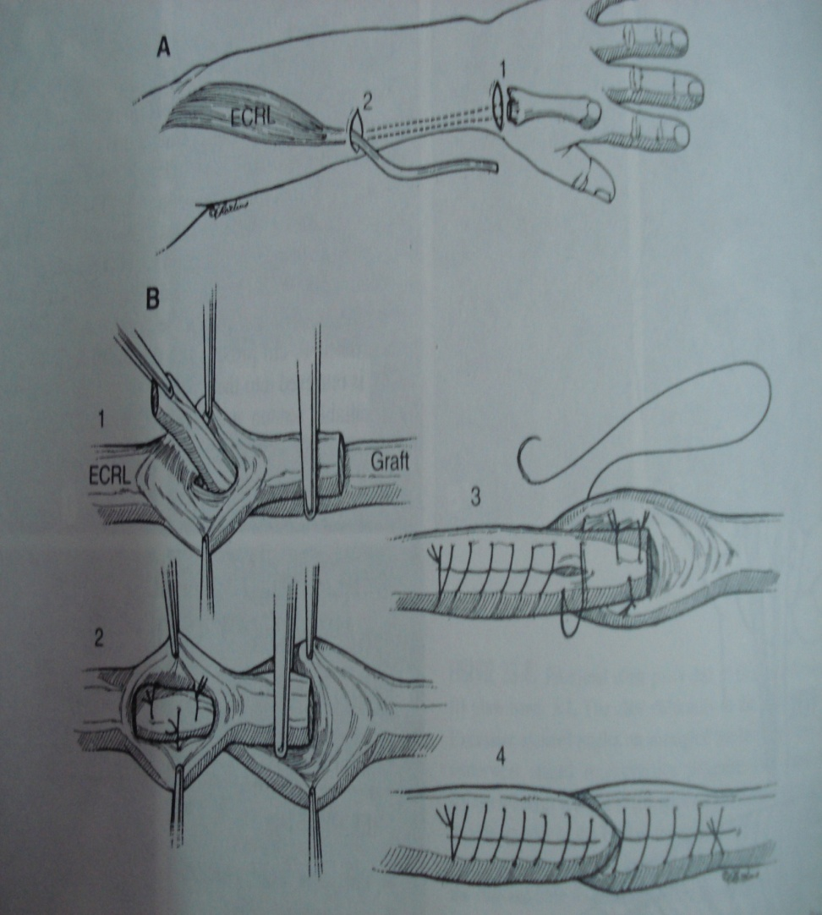
PROCEDURE :
Harvestation Of The Graft- PL,Plantaris Tendon, Fascia Lata as Tendon Graft.
Anastomosis and passage of tendon graft into the palm

Slide 93
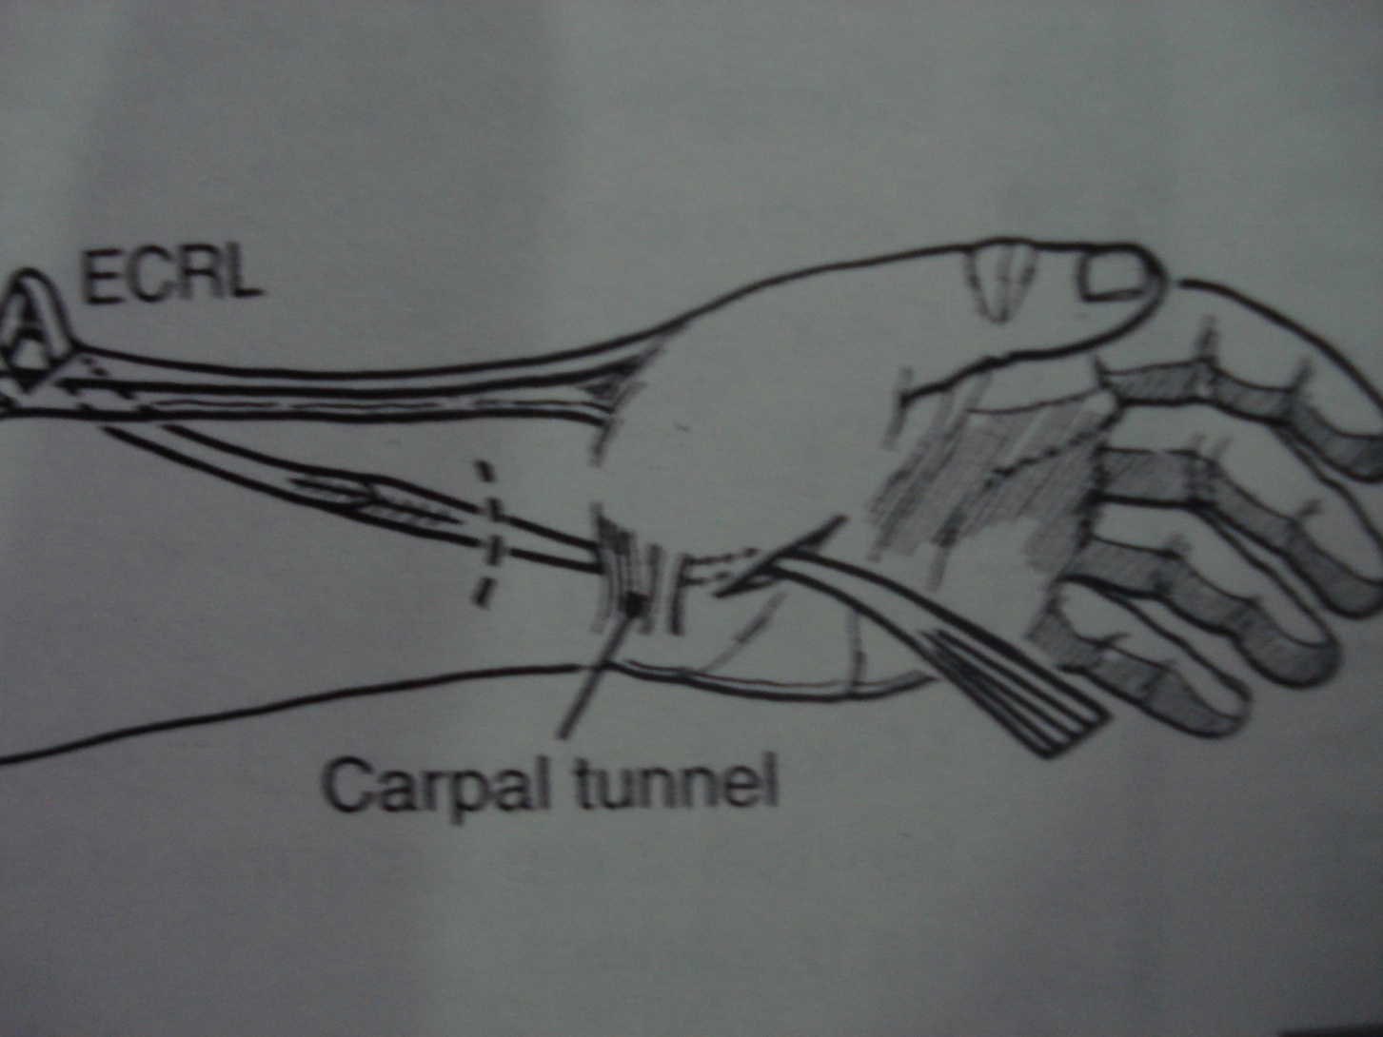

Slide 94
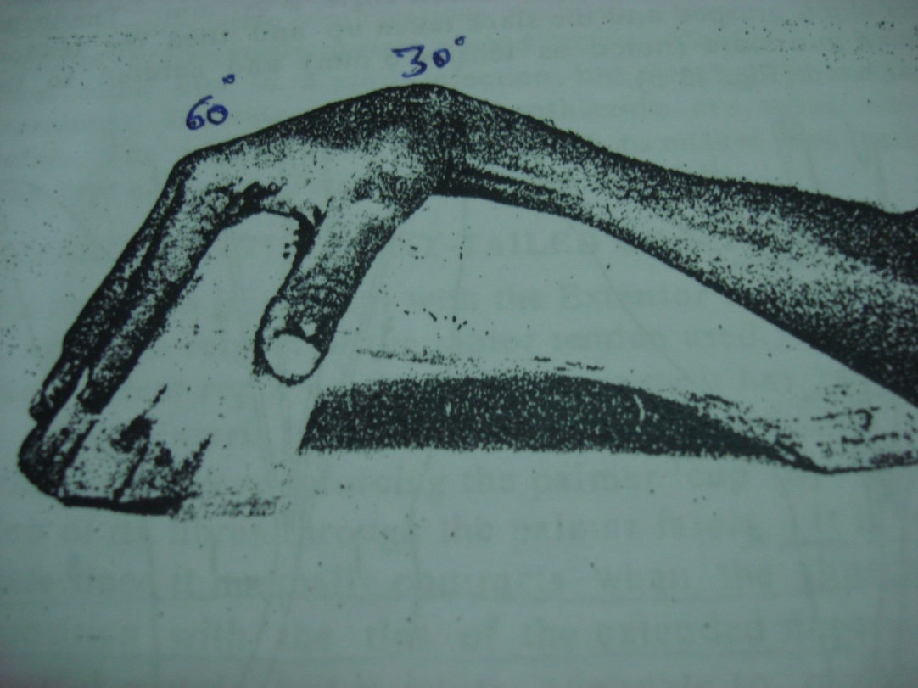
Each tail passed into lumbrical canal
Hand and wrist incision are closed
Each tail sutured to lateral band of dorsal digital expansion while maintaining the position of wrist in 30 degree and MCP in 60 degree flexion

Slide 95
Tensioning the tails of the Motor
1st tension the index to take up the slack and suture to the lateral band
Next tension the small finger to take up thr slack, advance an additional 6mm before suturing
Suture the ring and middle without taking any tension
Maintain IP joint extension

Slide 96
CLAW HAND
EF-4T
Indications : Ulnar claw hand with mobile or hypermobile IP jts.
Pitfalls:
Re- education is difficult
Well motivated patient.
Median nerve compression
Need for a free graft increases operative time
Requires more meticulous dissection to prevent injury

Slide 97
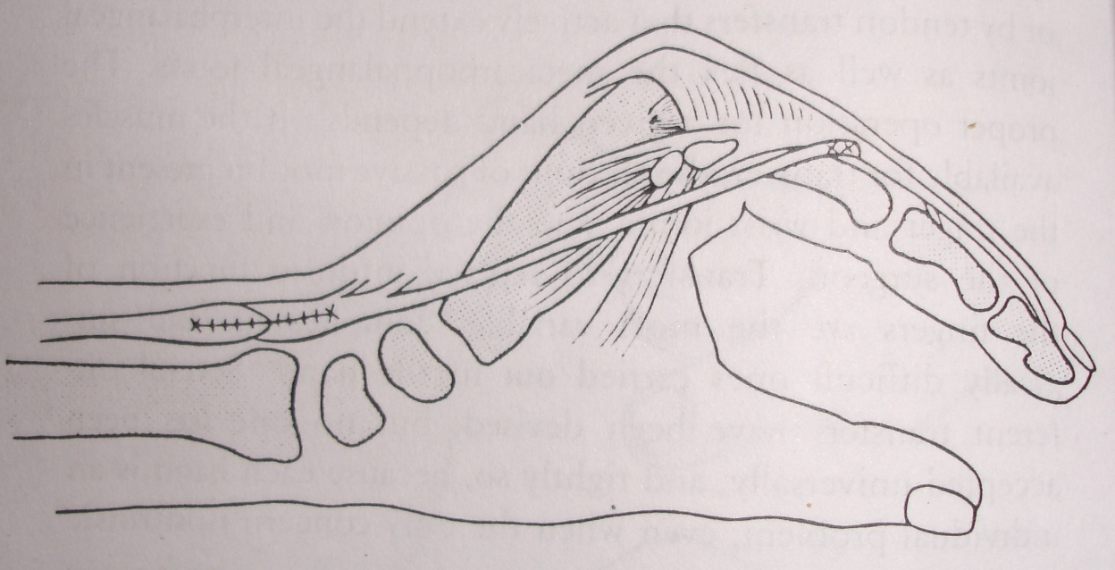
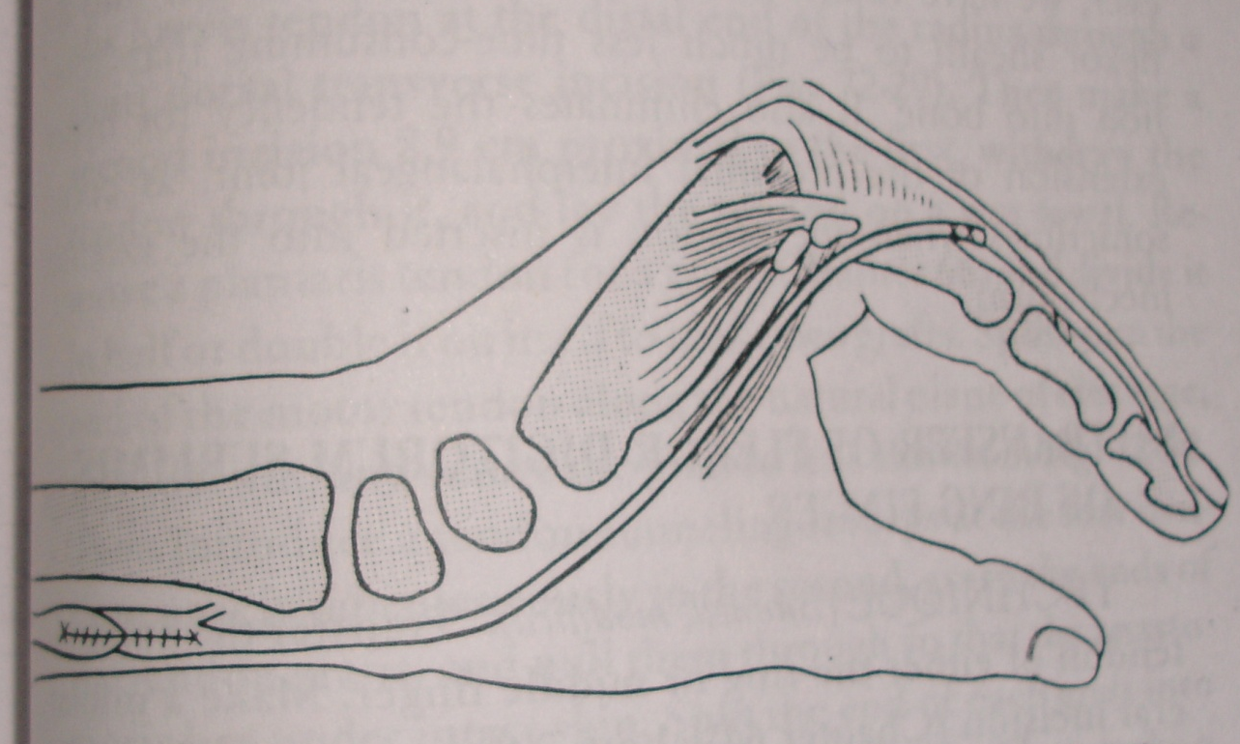
ECRB dorsal route
ECRL volar route

Slide 98
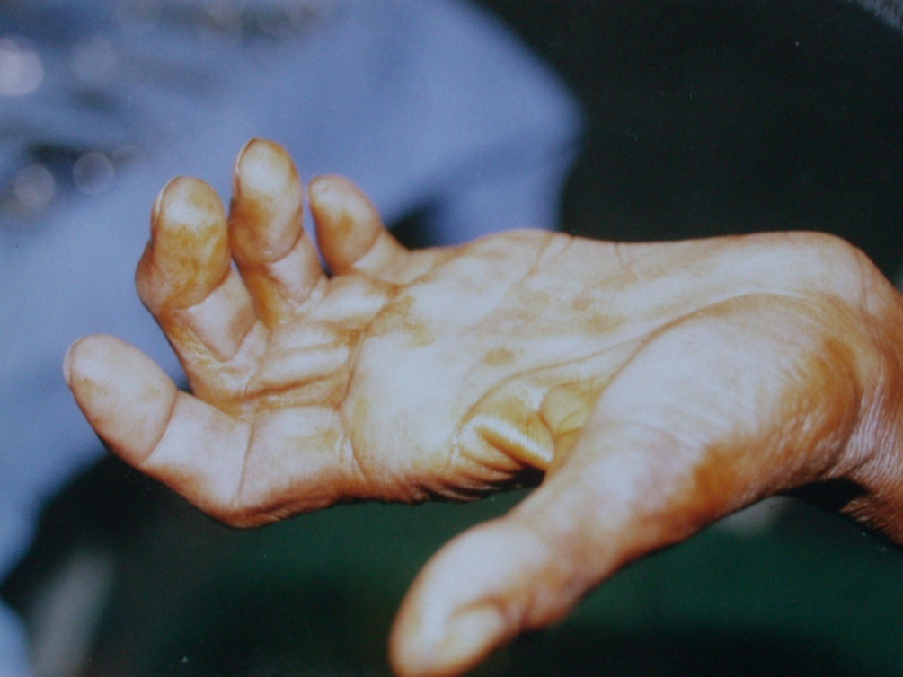
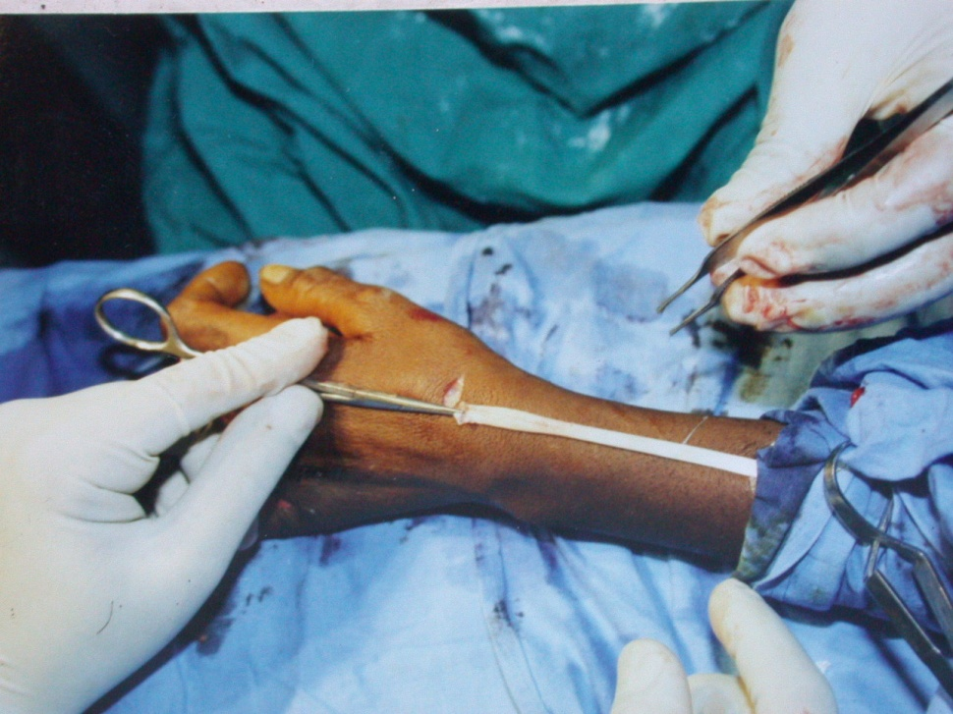
CLAW HAND
EF -4T

Slide 99
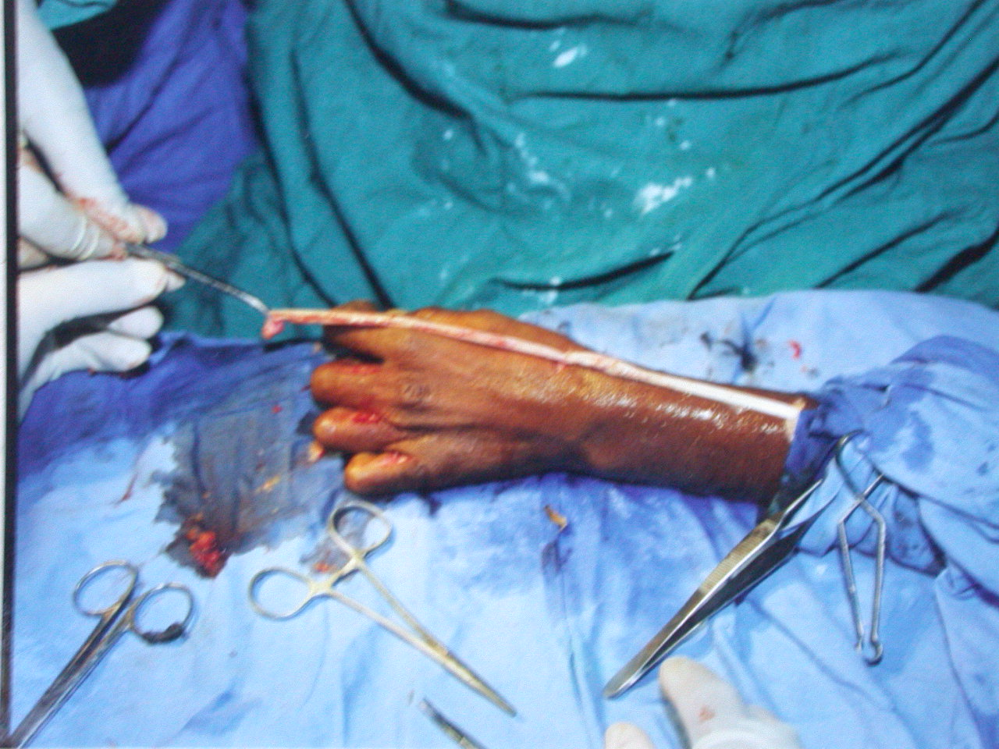
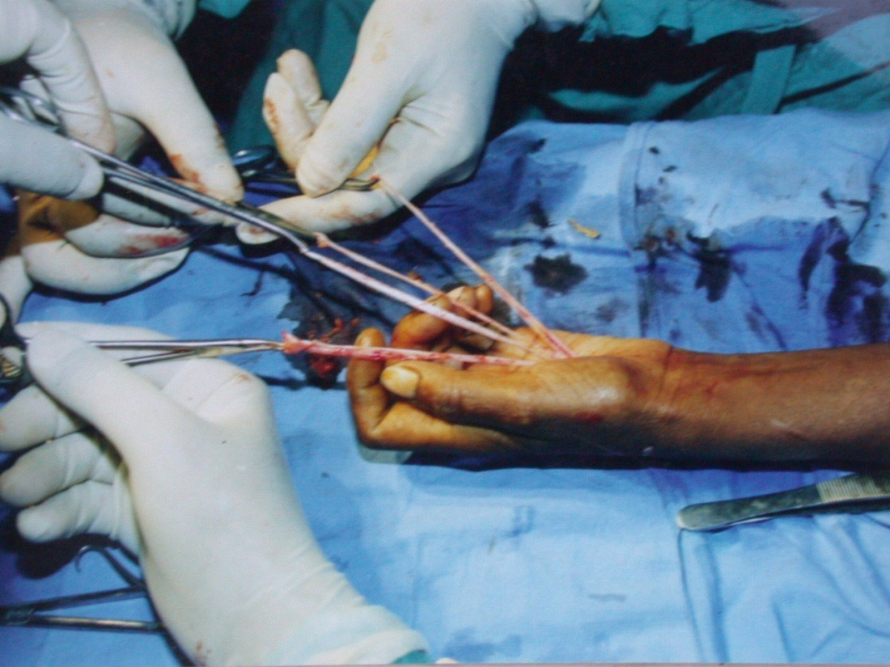
CLAW HAND
EF – 4T

Slide 100
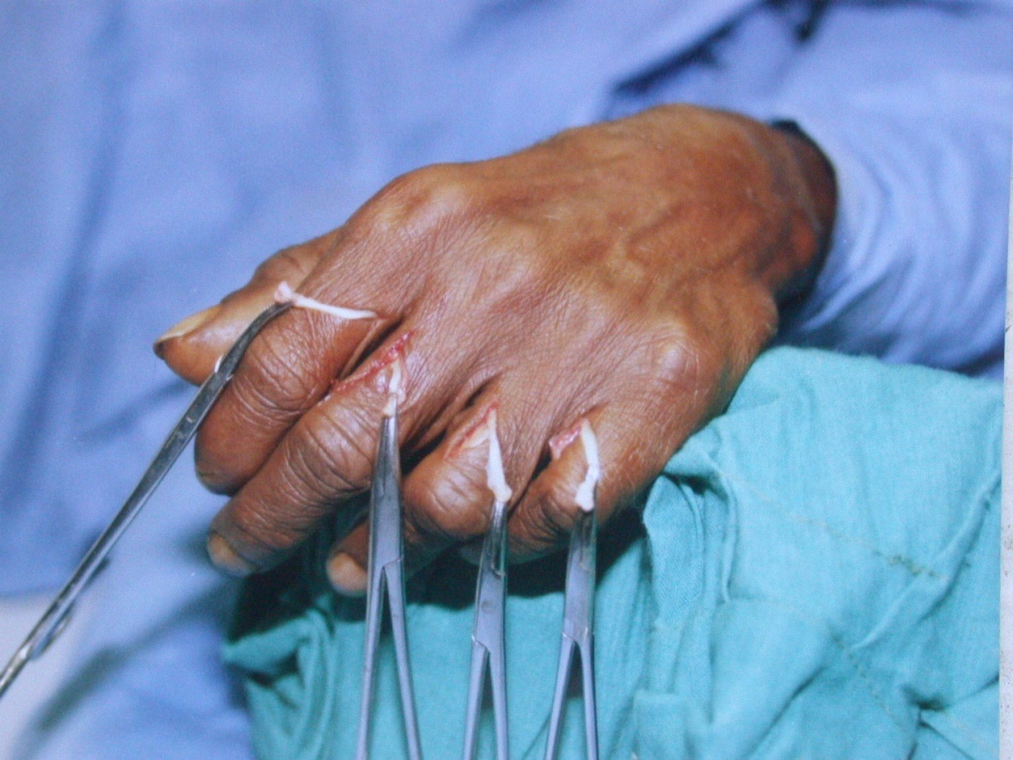
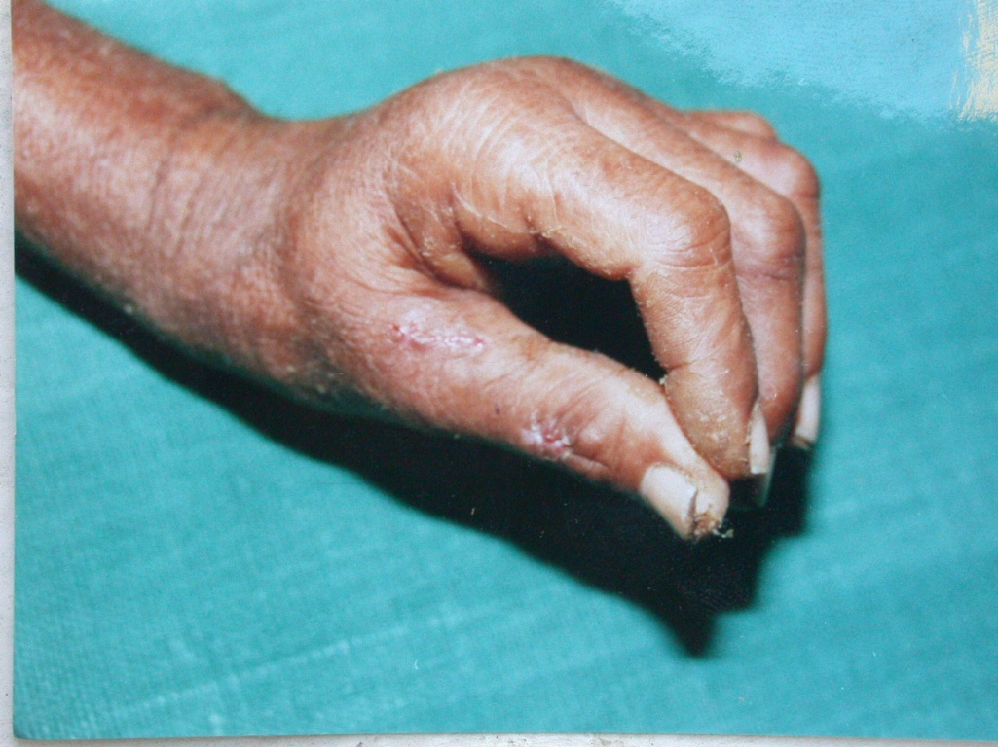
CLAW HAND
EF – 4T

Slide 101
CLAW HAND
Superficialis tendon transfer technique
Sir Harold Stiles and Forrestor Brown reported the first tendon transfer in 1922.
Bunnel popularised this technique in 1942.
Littler modified it in using only the ring finger FDS slip for tendon transfer
Further modified based on Insertion of the donor tendon

Slide 102
MODIFIED STILES - BUNNELS PROCEDURE
PRINCIPLE
Transfer Of FDS Tendon Of MF or RF to radial lateral band of all 4 Fingers.
Mimics the action of the lumbricals once routed
through the lumbrical canal & sutured to the extensor
expansion

Slide 103
MODIFIED STILES - BUNNELS PROCEDURE
PROCEDURE:
HAND INCISIONS.
EXPOSURE OF EXTENSOR EXPANSION
RELEASE OF FLEXOR SUPERFICIALIS TENDON FROM MIDDLE FINGER:
WITHDRAWLAL OF TENDON ,DIVISION INTO 4 SLIPS, TUNNELING INTO FINGERS.

Slide 104

MODIFIED STILES - BUNNELS PROCEDURE
SUTURING TENDON SLIPS TO RADIAL LATERAL BAND OF DORSAL APPRATUS.
WRIST -30
MCP- 80 to 90
IP JOINT IN FULL EXTENSION

Slide 105

CLAW HAND
MODIFIED STILES BUNNELS PROCEDURE

Slide 106
MODIFIED STILES - BUNNELS PROCEDURE
Indications
- Hands Which Are Rather Stiff [↑Assisted Angle, presence of contracture angle]
- Long Physiotherapy Regimen To Overcome Flexion Contracture
- Paralysis Of Wrist Extensors Making Ext. - Flexor Transplant Impossible.
Advantages : Re- education is easy.
Easy to perform.
Pitfalls: Transfer of the sublimis may exaggerate the intrinsic plus deformity in pts with hypermobile jts

Slide 107
INTEROSSEOUS tendon insertion:
First described by zancolli – used 1st and 2nd dorsal interossei as an insertion site of FDS tendon
D D Palande used ECRL with PL graft
Ideal for patients with supple or hypermobile joints

Slide 108


Slide 109
Static procedures
CAPSULOPLASTY AND FLEXOR PULLEY ADVANCEMENT (ZANCOLLI AND LEDDY)
DERMADESIS AND FLEXOR PULLEY ADVANCEMENT (SRINIVASAN)
EXTENSOR DIVERSION GRAFT(SRINIVASAN)

Slide 110
STATIC PROCEDURES FOR CLAW HAND
CAPSULOPLASTY AND FLEXOR PULLEY
ADVANCEMENT
Principle : Each side of proximal pulley system split 1.5 -2.5 cm upto proximal phalanx and anterior capsule is shortened to produce about 25 deg. flexion of the proximal phalanx.
Used to counter extensor dominance at the MCP jt & restore balance.
Leverage of the flexors also enhanced

Slide 111
STATIC PROCEDURES FOR CLAW HAND
CAPSULOPLASTY AND FLEXOR PULLEY ADVANCEMENT
Indications : Claw hand with mobile IP jts with anticipated difficulty in re education
Advantages : Re- education not needed.
Easy to perform.
Good grip strength
Disadvantage : perfect lumbrical position not possible

Slide 112

Capsuloplasty
A1 pulley release with MP joint volar plate advancement.
( Zancolli )

Slide 113
STATIC PROCEDURES FOR CLAW HAND
DERMADESIS AND FLEXOR PULLEY ADVANCEMENT
Principle : 2 cm of palmar skin at MP joint excised,shortening of pretendinous bands of palmar aponeurosis
Used to counter extensor dominance at the MCP jt & restore balance.
Leverage of the flexors also enhanced

Slide 114
STATIC PROCEDURES FOR CLAW HAND
DERMADESIS AND FLEXOR PULLEY ADVANCEMENT
Indications : Claw hand with mobile IP jts with anticipated difficulty in re education
FTSG required for release of contracture
Advantages : Re- education not needed.
Easy to perform.
Disadvantage : high recurrence rate

Slide 115
STATIC PROCEDURES FOR CLAW HAND
EXTENSOR DIVERSION GRAFT
Tendon graft is taken and passed volar to the deep transverse metacarpal ligament
One end sutured to lateral band and other to the extensor tendon on the dorsum of hand for all the 4 fingers.
Acceptable position is MCP flexion to 30 deg.

Slide 116
STATIC PROCEDURES FOR CLAW HAND
Dorsal methods :
  MIKHAIL : bone block on the dorsum of metacarpal head
  HOWARD: elevation of the dorsal wedge of the metacarpal head itself.

Slide 117
STATIC PROCEDURES FOR CLAW HAND
Static tenodesis techniques
  Riordan static tenodesis
  ECRL and ECU slips used
  Parkes Tenodesis
  Free tendon graft used on the volar side connecting flexor retinaculum
  Fowler Wrist tenodesis
  uses active wrist flexion and connected to extensor retinaculum

Slide 118


Parkes procedure

Slide 119

Intrinsic Reactivation
1st DI
2nd PI & 2ND DI
3rd PI and 3rd DI
4th PI & 4th DI
Abductor digiti minimi

Slide 120
DEFOMITIES OF THUMB
Due to dual nerve supply of FPB and functional Adductor Pollicis, thumb abduction and opposition are frequently retained after isolated median nerve involvement as a result of preserved ulnar nerve functions
Opponensplasty is usually indicated in combined palsy .

Slide 121
Thumb in combined ulnar and median nerve palsy
Thumb lies adducted,extended and externally rotated at CMC joint and flexed at IP joint.
Hands frequently devolp thumb web contracture due to persistent adduction posture.
This deformity must be corrected first before doing opponensplasty.

Slide 122
Methods for release of thumb web contracture
1) Limited skin and fascial release(brand)
2)Z plasty of thumb web.
3) Rotation flap

Slide 123
OPPONENSPLASTY BASICS
The tendon is re routed to the thumb,so it needs a pulley/pivot to change its direction
THE PULLEY: Guyon’s canal.flexor retinaculum,FCU
Distally based pulleys are recommended so that the transfer’s line of action passes distal to the pisiform producing more thumb MP flexion
THE INSERTION: should be parallel to APB
The insertion to APB should be at 3/4th tension and it should be sutured first.
The insertion to EPL should be just in tension

Slide 124


CLAW THUMB
TECHNIQUE
OPPONENSPLASTY

Slide 125
Commonly used opponensplasties
FDS opponensplasty:
1)Royle-thompson technique
2)Bunnel technique
3)Brand
EIP - Burkhalter

Slide 126
OPPONENSPLASTY
ROYLE-THOMSON
Donor: RF FDS
PULLEY: FLEXOR RETINACULUM
INSERTION: APB AND EPL

Slide 127
OPPONENSPLASTY
BUNNEL’S
DONOR: RF FDS
PULLEY: SPLITTED FCU 4cm PROXIMAL TO ITS INSERTION
INSERTION: OSSEOUS BY DRILLING ON PROXIMAL PHALYNX BASE IN DORSOULNAR TO RADIOPALMAR DIRECTION

Slide 128
OPPONENSPLASTY
BRAND
Donor: RF FDS
PULLEY: GUYON’S CANAL
INSERTION: APB AND EPL

Slide 129


RF FDS OPPONENSPLASTY
PRE OP

Slide 130


Post op

Slide 131

EIP OPPONENSPLASTY
( BURKHALTER’S)

Slide 132

POP SLAB X 3 WEEKS
FINGERS IN LUMBRICAL POSITION
THUMB IN FULL ABDUCTION AND OPPOSITION

Slide 133
Thumb in ulnar nerve palsy
Paralysis of adductor pollicis causes weakness of precision handling and power grip but no deformity occurs.
Paralysis of FPB ( if supplied by only ulnar nerve), causes MP joint extension and IP joint flexion, which in prolonged cases leads to Z DEFORMITY OR SWAN NECK DEFORMITY of the thumb

Slide 134
Correction of Z deformity of thumb
1) Half FPL transfer to EPL(TSUGE and HASHIZUME)
FPL tendon is split extending proximal to MCP joint and one slip is sutured to EPL . FPL now functions as a flexor of MCP joint
2) Half FDS of index finger transfer to thumb(SRINIVASAN)
Radial half of FDS tendon is taken and sutured to
first palmar interossei – for Z deformity
adductor tendon – to improve power of grip

Slide 135
Correction of Z deformity of thumb
3) EPB diversion (BEINE)
Tendon graft is taken and attached proximally to the tendon of EPB, near the base of first metacarpal
It is then taken volar to MCP joint and around the ulnar border of thumb and fixed to EPL tendon close to IP joint.
Diverting the extending force in EPB , hence flexion at MCP joint

Slide 136


CLAW HAND
LASSO+OPPONENSPLASTY

Slide 137



CLAW HAND
LASSO + OPPONENSPLASTY

Slide 138
RADIAL NERVE INVOLVEMENT IN LEPROSY
Not common, however if present leads to very severe disability.
If present , it should be treated first
Wrist-drop, finger-drop or thumb-drop.
Tendon transfers
PRONATOR TERES TO ECRB for wrist drop
FCR TO EDC for finger drop
PL TO EPL for thumb drop

Slide 139
THE INSENSITIVE EXTREMITY
Prevention of trauma and infection
Maintainence of normal tissue equilibrium
Correction of deformities

Slide 140

OTHER DEFORMITIES OF HAND IN LEPROSY
Absorption
Contractures
Shortening
amputations
swan neck deformity
boutonniere deformity

Slide 141
MITTEN HAND
Progressive decrease in length of the fingers
Secondary to trauma and infection
Function can be improved by creating a cleft b/w 1st and 3rd metacarpal bones by excising the 2nd metacarpal bone

Slide 142
SWAN NECK DEFORMITY (INTRINSIC PLUS DEFORMITY)
Flexion at MP and DIP joint and extension at PIP joint.
Due to post inflammatory contracture and fibrosis of interossei.
Resistance is felt on attempt to extend the MCP joint and flex the PIP joint confirming contracture of lateral band of extensor expansion.
If not correced by physiotherapy, then surgery is required, the AIM of which is to reduce the force in the tendon of interossei and restore the volar migration of lateral tendons

Slide 143


SWAN NECK DEFORMITY

Slide 144
SWAN NECK DEFORMITY
Surgical procedure
- lateral tendons are seperated
- lateral band on one side is isolated and RELOCATED ANTERIOR to skin ligaments of Cleland.
- Transverse retinacular ligament on other side is shortened
- Z LENGTHENING of central tendon may also be done.

Slide 145
BOUTONNIERE DEFORMITY
Cental tendon of extensor apparatus is ruptured or damaged due to loss of sensibility.
If there is no rupture or damage , but due to long standing strech as in claw hands- HOODING
Flexion at PIP joint and extension at DIP joint.
If not corrected by physiotherapy, surgery is required,in which AIM is to restore the central tendon, lengthen the lateral tendon and divide the tight oblique and short transverse retinacular ligaments

Slide 146

BOUTONNIERE DEFORMITY

Slide 147
NERVE DECOMPRESSION
Historically nerve decompression was advocated for many
patients but with advent of multidrug therapy it reserved
for rare situations like intraneural abscess, intractable
pain despite vigorous immunosupressive therapy.

Slide 148
NERVE DECOMPRESSION
PRINCIPLES
Gentle dissection
External neurolysis only
Longitudinal epineurotomy procedure of choice
Stripping of thickened epineurium may relieve pain but damages the nerve
Ulnar nerve : add epicondylectomy but not transposition, may need release of the arch of FCU, can also be involved at the wrist
Median nerve : release at carpal tunnel.

Slide 149


Ulnar nerve abscess
Thickened
Ulnar nerve
Nerve abscess

Slide 150


PRE OP
POST OP

Slide 151
COMPLIMENTARY CHANGES
CALCIFICATION
OSTEOARTHRITIS
OSTEOPOROSIS
FRACTURES

Slide 152


PRE OP
POST OP

Slide 153

POST OP GRIP STRENGTH

Slide 154


FUNCTIONAL ASSESMENT

Slide 155


SUMMARY
Classical deformity associated with leprosy is claw hand
Commonly high ulnar paralysis. Deformity more pronounced when median nerve also involved.
Hyperextension at MCP joint with varying flexion at the IP joints.
Associated with wasting of intrinsic muscles.
Patient unable to pinch & grasp.

Slide 156
TAKE HOME POINTS
Patient to be treated with a holistic approach.
Proper assessment essential.
Ensure adequacy of medical treatment.
Best results in patients who have completed MDT.
Choice of procedure to be tailored to the individual patient.

Slide 157
TAKE HOME POINTS
Proper assessment of all tissues: skin ,muscles & ligaments.
Ideal patient : young, well motivated, recent deformity <3 yr, mobile joints,< 10° hyperextension at PIP jt ,no weakness of forearm muscle.
Tension adjustment crucial.
Static procedures useful in multiple nerve injuries
Supple joint essential for optimal results in tendon transfer

Slide 158

thank you

